Slide 1



Vered Shaffer, Ph. D.
RAMP Program Manager
ramp@nrc.gov
Office of Nuclear Regulatory Research
United States Nuclear Regulatory Commission
What’s Been Happening in RAMP?

Slide 2

How is RAMP Membership?
RAMP: ~ 1700
RASCAL: ~ 550
VARSKIN: ~ 550
Domestic: 1200
International: 500

Slide 3












RAMP International Agreements
Our newest RAMP International Agreement… SINGAPORE! Welcome!
And we are renewing with… CANADA, UAE, SPAIN, and TAIWAN!
And our active agreements!

Slide 4

RAMP User Meetings
April 13-17, 2020 - International User Meeting in Kiev, Ukraine – Postponed
June 25, 2020 – International RAMP Webinar
October 2020 RAMP User Meeting – Virtual
  Week long - half day sessions via webinar on variety of topics
  Keep an eye out for a questionnaire

Slide 5
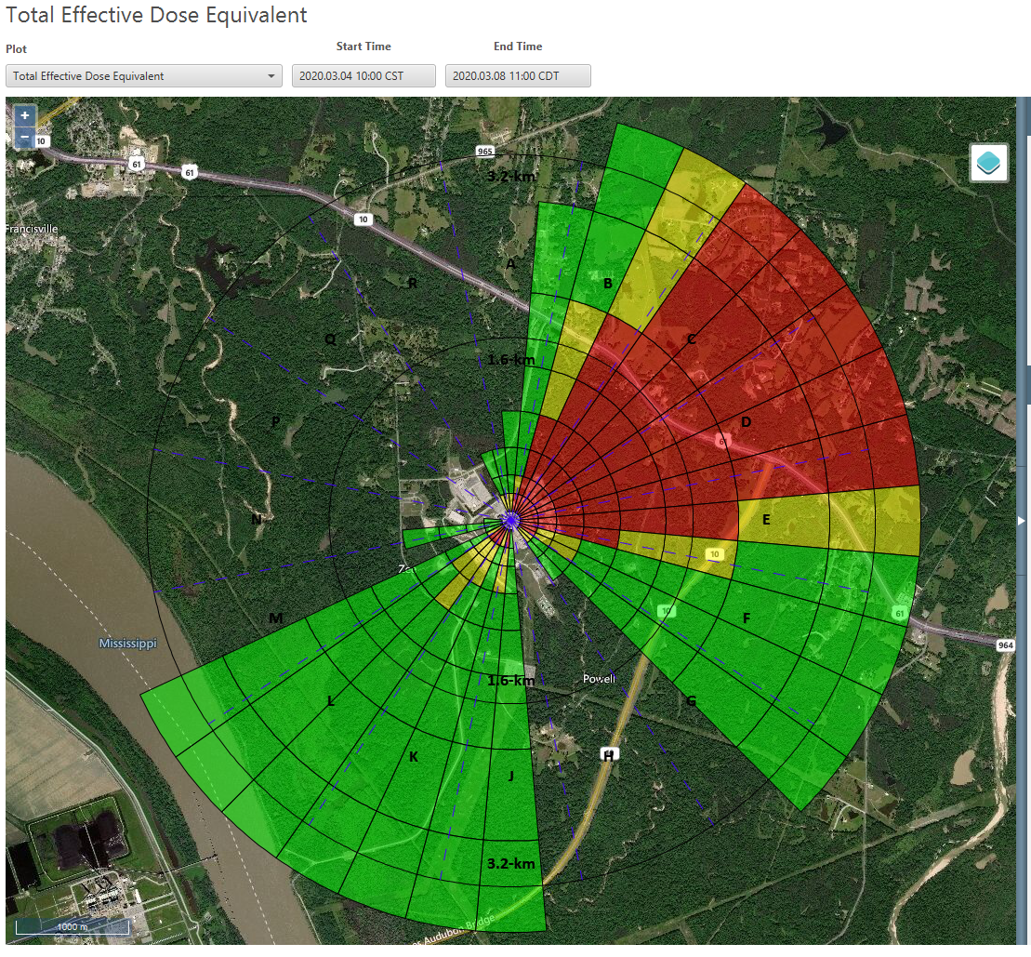
RASCAL 5.0
RASCAL 5.0 continues to be under development. Improvements to the code include:
Updated source term modeling to make use of newer science.
Better integration of tools that were separate in RASCAL 4 including weather data downloading and multi-unit support.
DCFPAK 2015 included as source for all dose coefficients.
Dynamic map background for displaying results including pan and zoom as well as several choices for the map data source.
User interface upgrades to improve usability with a more modern look and feel but retaining the basic workflow structure of RASCAL 4.

Slide 6
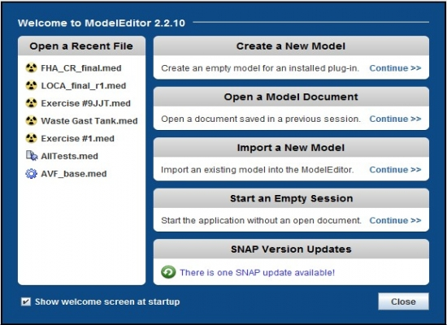
RADTRAD 5.1.0
Release of the RADTRAD-AC v5.0.0, the update the release of SNAP Model Editor v 3.1.0 and Plugin 5.1.0 – available July 3, 2020
NRC developed Java version of the RADTRAD code with additional features and options.
  include additional features and options include the reactor coolant system (RCS) activity calculator
  a larger radionuclide database from ICRP-38 (838 available nuclides)
  the ability for the user to model alternative source term (AST) non-LOCA DBAs described in Regulatory Guide 1.183 (RG 1.183).

Slide 7
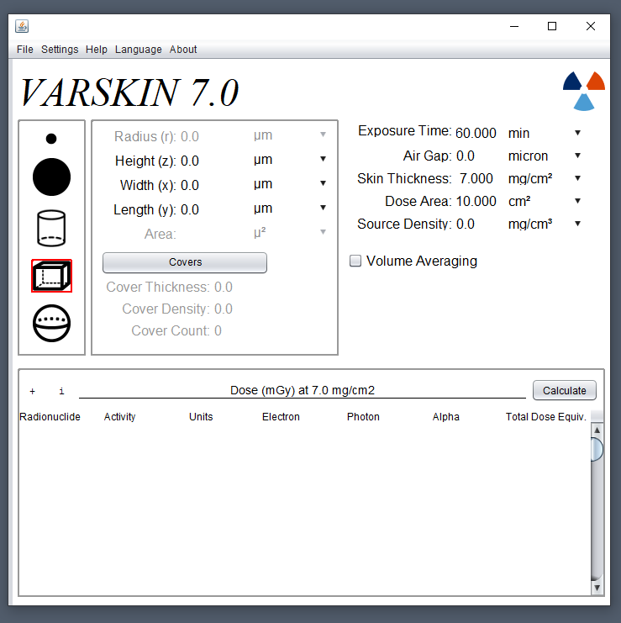
VARSKIN +
VARSKIN’s capability is more than just skin dosimetry
  Our technical meetings have shown that users use VARSKIN for more than just skin dosimetry
VARSKIN + (VARSKIN 7.0) will be released December 2020
  Updated GUI
  Eye dose model
  Neutron dose model
  Alpha dose model
  Would model (NCRP 156)
  Re-instated syringe model

Slide 8
MILDOS 4.2
MILDOS 4.2 is available for download on the RAMP website. Updates for MILDOS 2.0 include:
A population wheel generator based on the 2016 U.S. can generate an 80‐km population distribution for any location within the United States.
Users can specify custom output graphs in a variety of formats (column, scatter, radar, and grid).
Organ dose estimates from Rn‐222 exposure have been removed (zeroed out) in the calculations.
A number of minor user interface issues were resolved.
Population overlay option

Slide 9
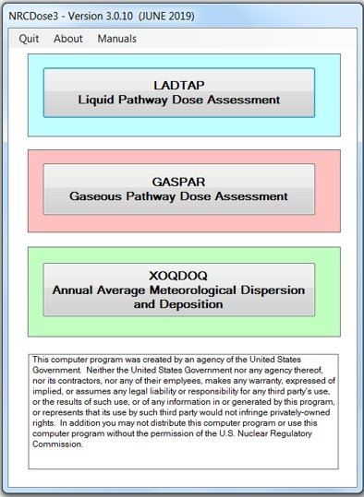
NRC Dose 1.1.2
GUI for the LADTAP II, GASPAR II, and XOQDOQ Fortran codes that implement NRC’s current requirements for As Low As Reasonably Achievable for radioactive effluents from NPP.
Release of NRC Dose 1.1.2 by Summer 2020
  Corrected user found bugs
  Updating NUREG documentation

Slide 10
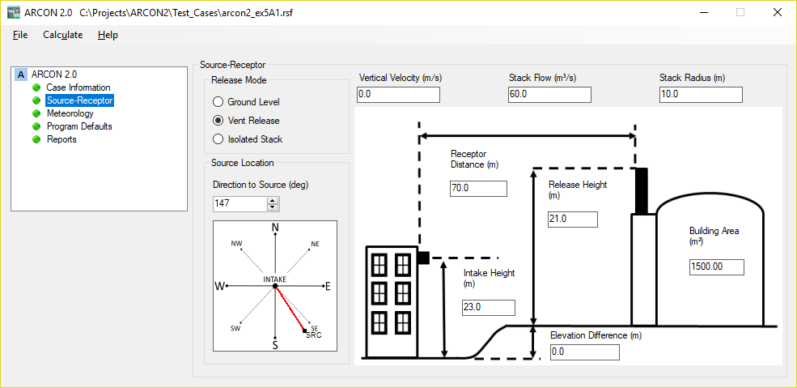
ARCON 2.0
Atmospheric Relative CONcentrations in Building Wakes (ARCON) is a computer code used to calculate atmospheric relative concentrations (X/Q)
ARCON 2.0
  finalized peer-reviewed diffusion coefficients (Ramsdell and Fosmire, 1998)
  New GUI interfaceas well as a user interface. The interface uses a simple “folder” structure to organize user inputs.
  Fall 2020

Slide 11
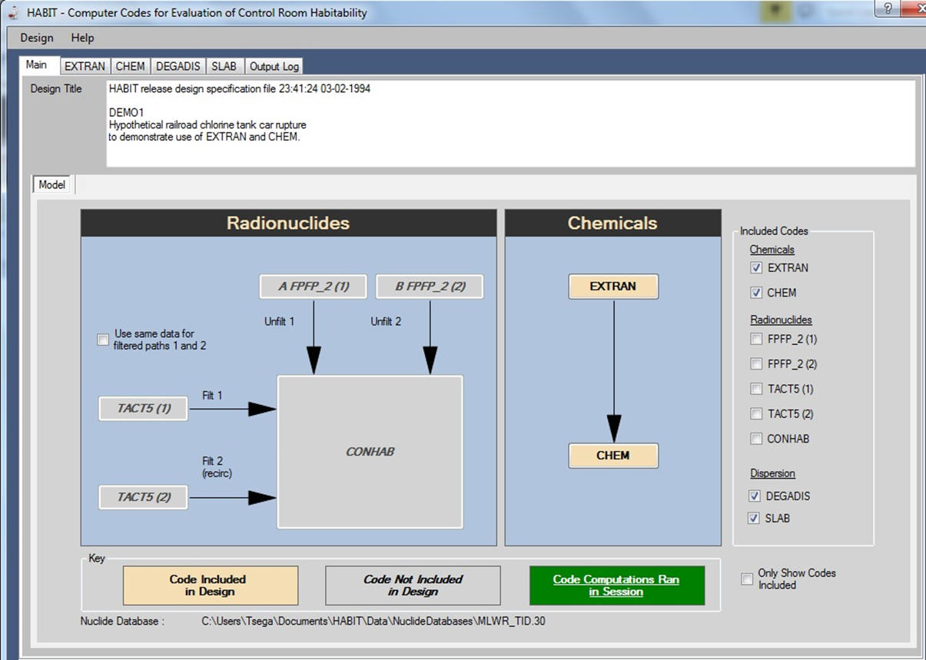
HABIT 2.2
Evaluation of Light-Water Reactor (LWR) control room habitability in the event of accidental spills of toxic chemicals. NRC performs independent confirmatory calculations of control room habitability in the event of accidental spills of toxic chemicals.
HABIT 2.2 will be released Fall 2020
  Calculation of radiation doses for control room habitability in no longer functional. Strictly chemical toxicity for control room habitability.
  GUI updated with easy to read fonts, improved waring and notification messaging and a redesign of the graphing and plotting utilities for all the Fortran codes (i.e., EXTRAN, DEGADIS and SLAB)

Slide 12
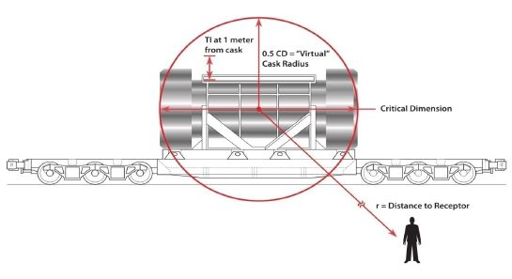
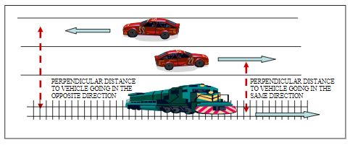
“NRC RADTRAN”
RADioactive Material TRANsport - Environmental impact statement (EIS) for transportation of all types of radioactive material by road, rail, air, and water, 10 CFR Part 51.
NRC is working with a contractor to develop a user-friendly GUI (JAVA)
“NRCRADTRAN” will be available through RAMP – Late Fall 2020
NRCRADTRAN user guide and documentation

Slide 13
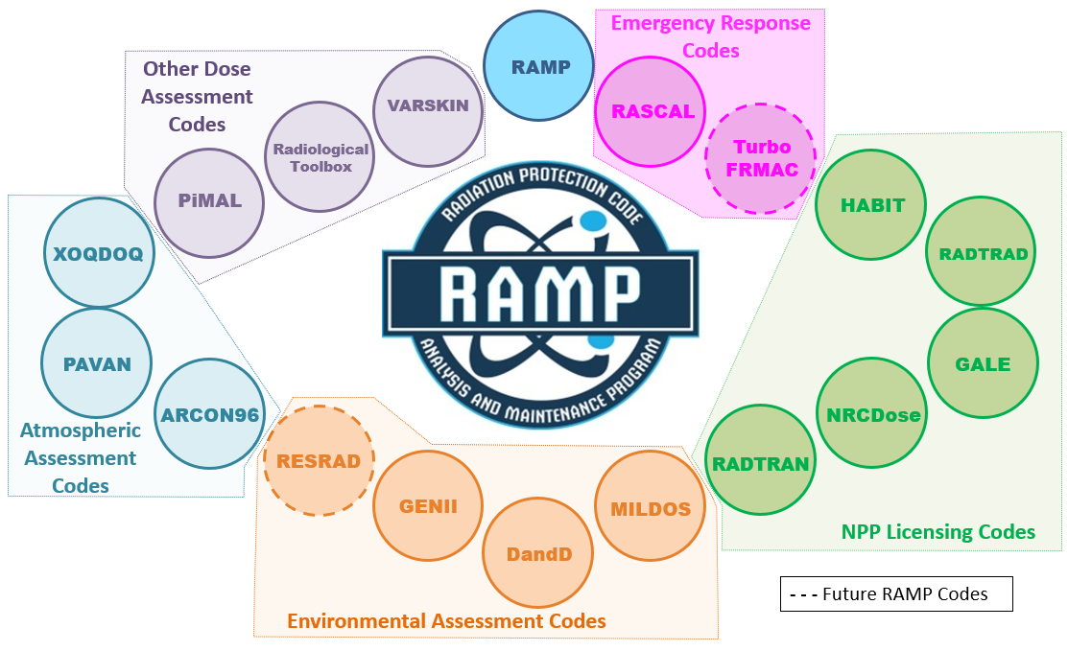
New Additions to RAMP
+ IMBA
+ DCFPAK

Slide 14
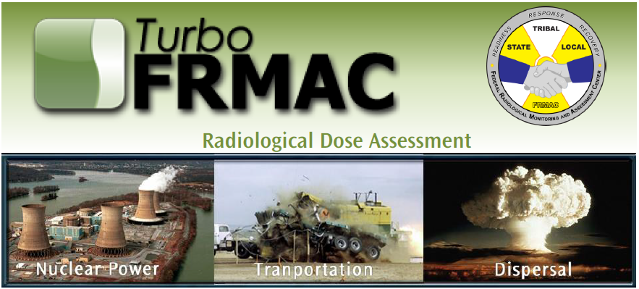
Turbo FRMAC
Turbo FRMAC performs complex calculations to quickly evaluate radiological hazards during an emergency response by assessing impacts to the public, workers, and the food supply.
Wide variety of radiological incidents, such as:
  Radiological Dispersal Devices (RDDs)
  Nuclear Power Plant Emergencies
  Fuel Handling Accidents
  Transportation Accidents
  Nuclear Detonations
Sandia National Laboratory will maintain distribution of Turbo FRMAC but RAMP users will be able to receive code discussions, training, and technical support.

Slide 15
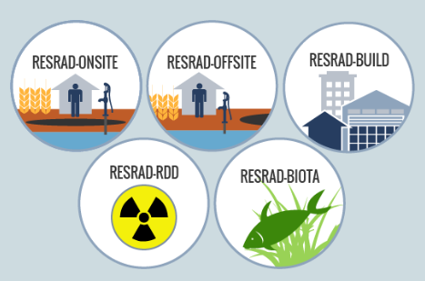
RESRAD
RESidual RADioactive Material - Family of codes used to analyze human and biota radiation exposures from environmental contamination of residual radioactive materials.
The codes are used worldwide by regulatory agencies, the risk assessment community, and universities in more than 100 countries.
Argonne National Laboratory will maintain distribution of RESRAD but RAMP users will be able to receive code discussions, training, and technical support.

Slide 16
IMBA
IMBA® (Integrated Modules for Bioassay Analysis) suite of software modules for internal dosimetry implements all of the biokinetic and dosimetric models recommended by the International Commission on Radiological Protection (ICRP). Users can specify their own parameter values and apply sophisticated data handling techniques to their customized internal dose calculations.
Coming to RAMP December 2020!

Slide 17
DCFPAK 4.0
DCFPAK (Dose Coefficient File Package) provides electronic access to:
  Nuclear decay data
  Dose and risk coefficients for exposure to radionuclides
DCFPAK 4.0 has updated U.S. Environment Protection Agency’s Federal Guidance Report No. 15 (FGR 15), External Exposure to Radionuclides in Air, Water and Soil, tabulates age-specific reference person effective dose rate coefficients for 1,252 radionuclides based on external exposure to radionuclides distributed in air, water or soil.

Slide 18

Again… Reminder…
SAVE THE DATE
VIRTUAL FALL USER MEETING
OCTOBER 2020

Slide 19

Thank you for the virtual applause!

