Slide 1


Welcome to the
2021 Symposium: Transport of Radionuclides in the Environment

Slide 2
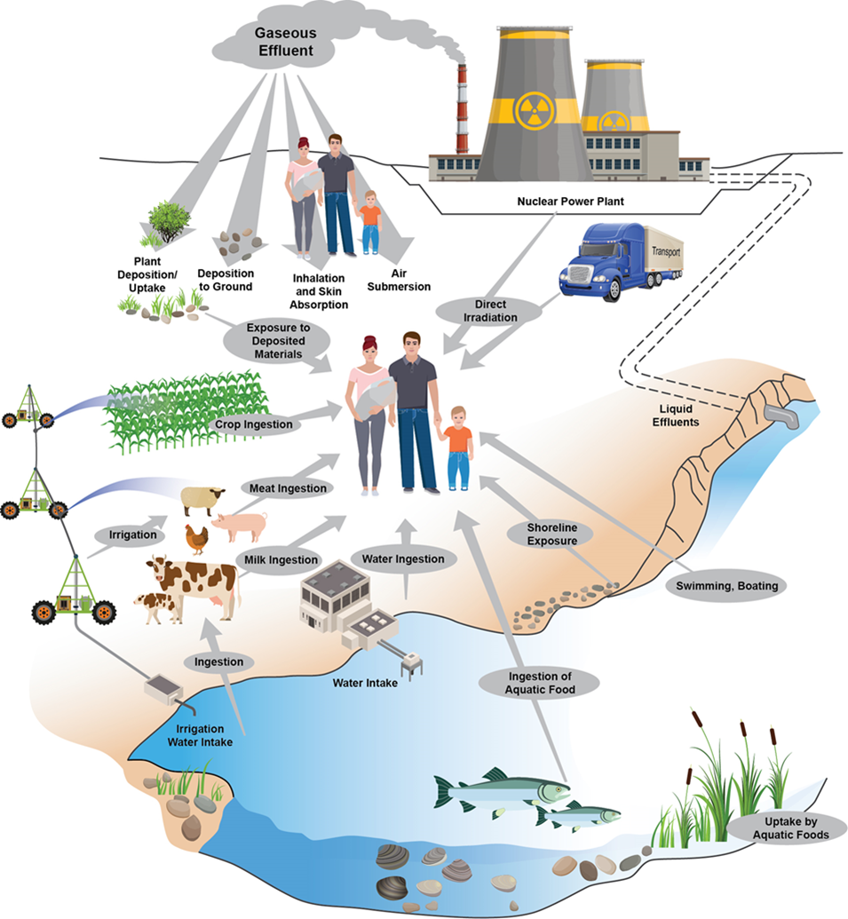
What is RAMP?
The purpose of the Radiation Protection Computer Code Analysis and Maintenance Program (RAMP) is to develop, maintain, improve, distribute, and provide training on NRC-sponsored radiation protection and dose assessment computer codes.

Slide 3
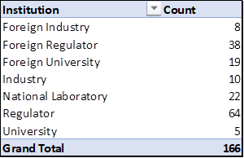
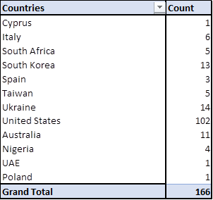
What is RAMP?
Seven
Institutions
Eleven
Countries

Slide 4
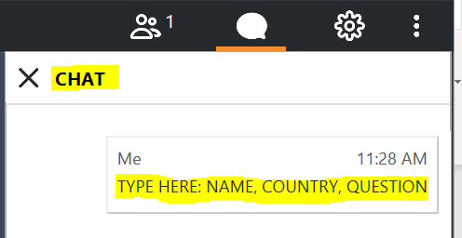
Logistics
Recording – Webinar is being recorded. The recorded webinar and presentations will be uploaded on the RAMP website within 2 weeks.
Audio – All participants will be muted.
Questions –
  Questions will be addressed at the end of the presentations.
  Please type your name, country, the question, and the person the question is directed to in the CHAT (see image below):
  If we don’t get to your question, it will be posted with an answer on the RAMP website.
  If you have questions after the meeting, please email the questions to RAMP.ADMIN@pnnl.gov

Slide 5
Again Welcome!
We are glad you are here!

