Slide 1
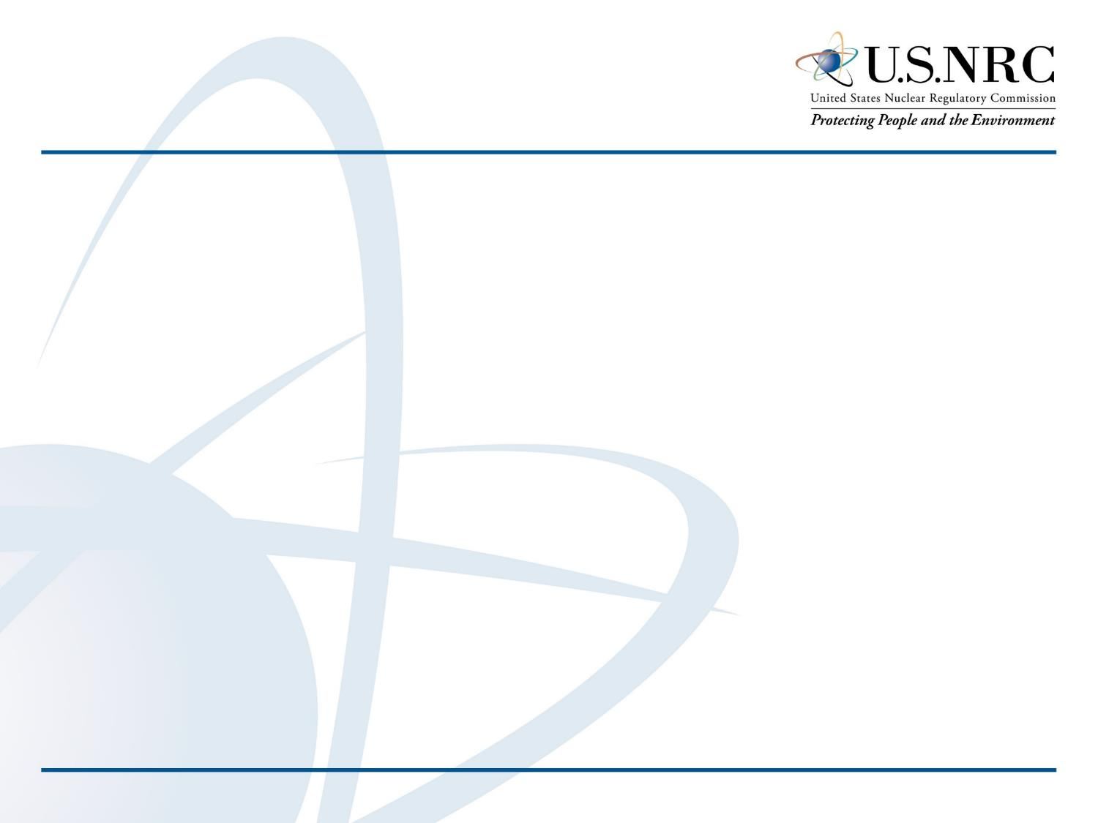
Day in the Life of a (Reactor) Decommissioning Inspector
Rhex A. Edwards
Senior Health Physicist
U.S. NRC Region III

Slide 2
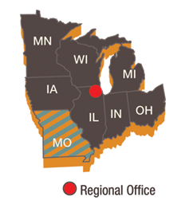
U.S. NRC Region III Decommissioning Reactors
Dresden Unit 1
Morris, IL
Duane Arnold Energy Center
Palo, IA
Fermi Unit 1
Newport, MI
La Crosse Boiling Water Reactor
Genoa, WI
Kewaunee Power Station
Kewaunee, WI
Zion Nuclear Power Station
Zion, IL
Regional Office
Decommissioning Reactor
1

Slide 3
Discussion Topics
  Definition of decommissioning
  Priorities during decommissioning
  NRC’s decommissioning inspection program
  Day in the life inspection examples
  General inspection lessons learned
2

Slide 4
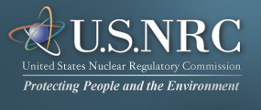
Decommissioning
Decommissioning Definition (10 CFR 20.1003):
Safely remove a facility from service and reduce residual radioactivity to a level that permits:
release of the property for unrestricted use, and terminate the license; or
(b) release of the property under restricted conditions, and terminate the license
3

Slide 5
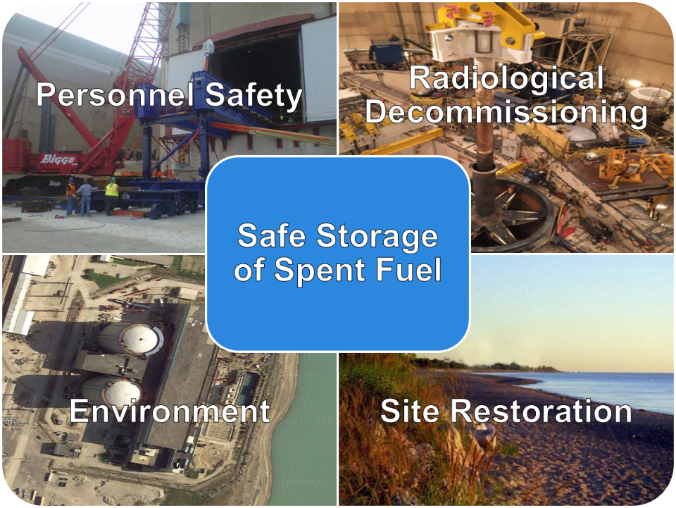
Priorities During Decommissioning
4

Slide 6
Inspection Cycle
Periodic Teleconferences
Preparation for Inspection
Conduct Inspection
Evaluate Performance and Document Inspection Results
Annual Inspection Planning
5

Slide 7
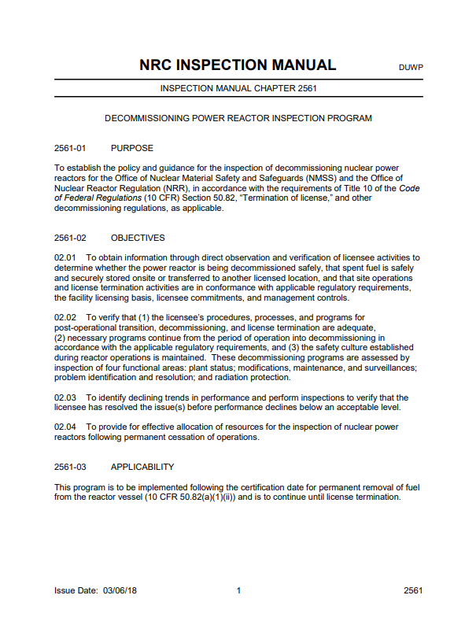
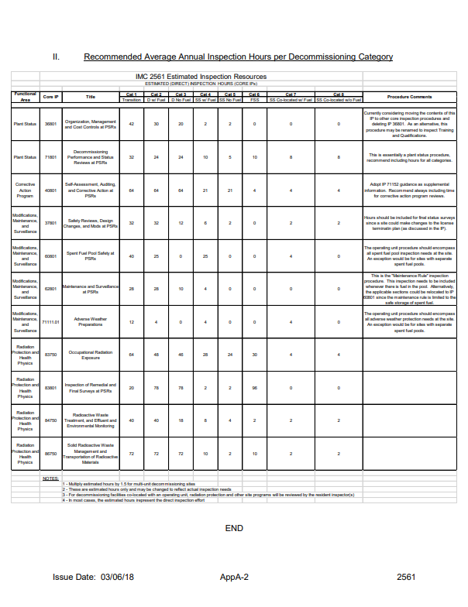
Inspection Manual Chapter (IMC) - 2561
Facility Status
Estimate of time to complete procedure
Inspection Procedure
https://www.nrc.gov/reading-rm/doc-collections/insp-manual/
6

Slide 8
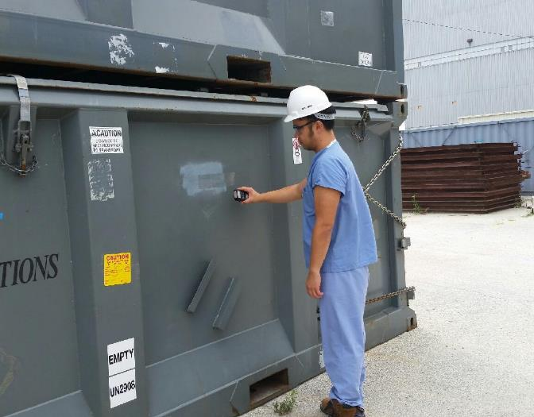
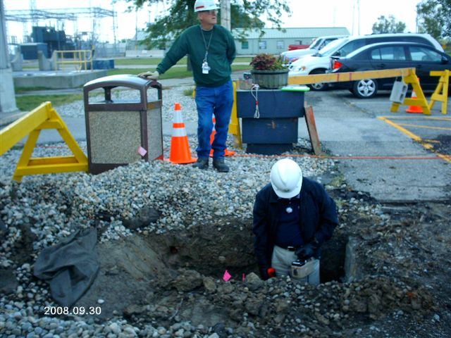
General Decommissioning Inspections

Slide 9
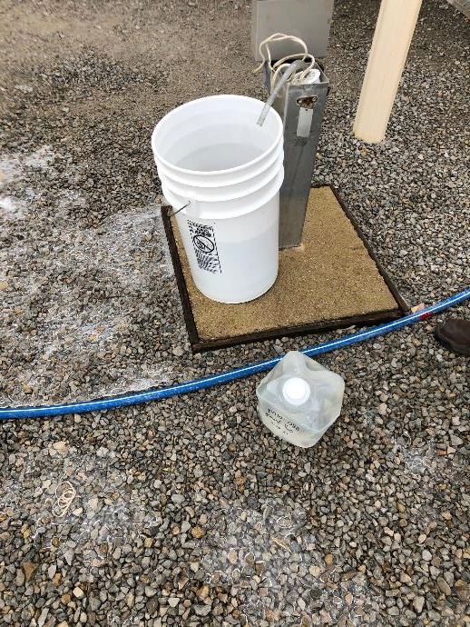
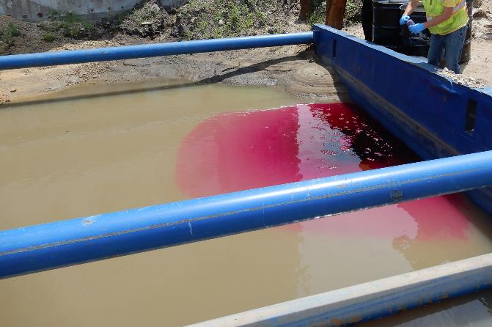
Environmental Monitoring

Slide 10
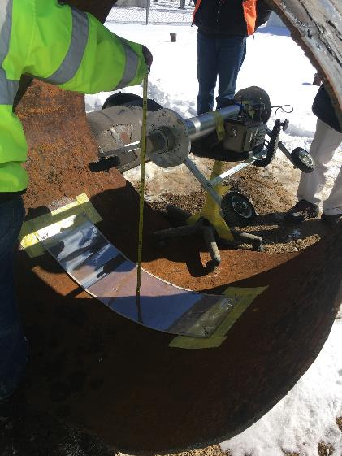
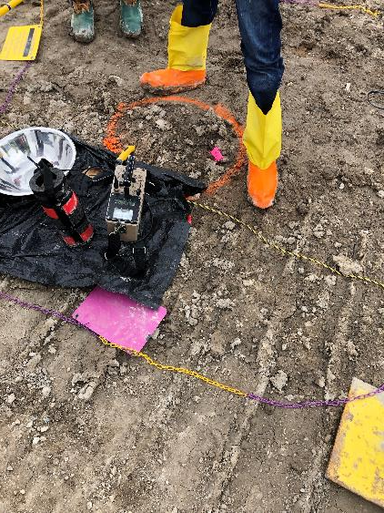
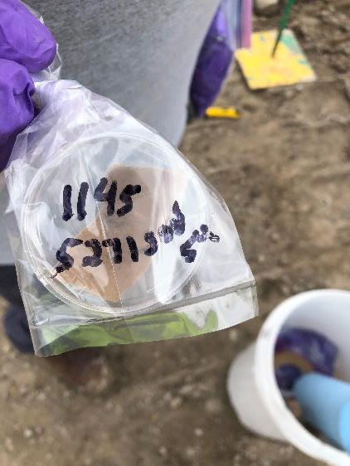
Verification Surveys

Slide 11
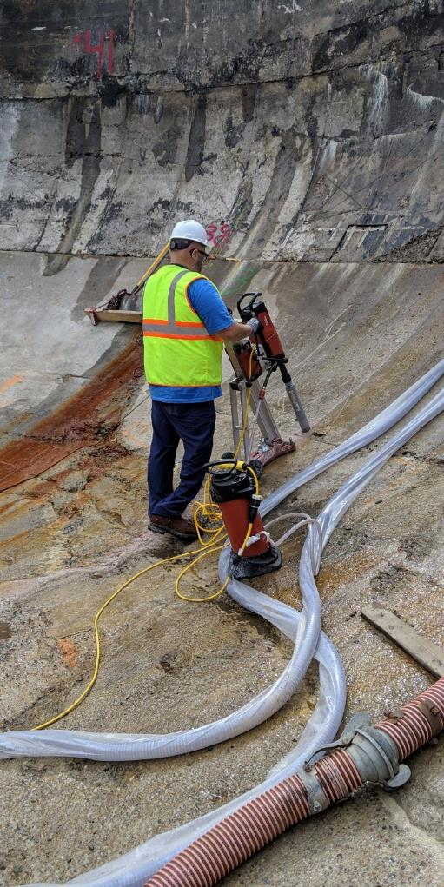
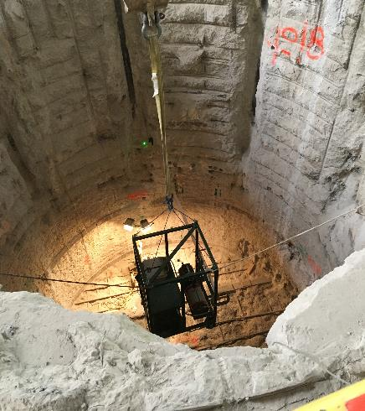
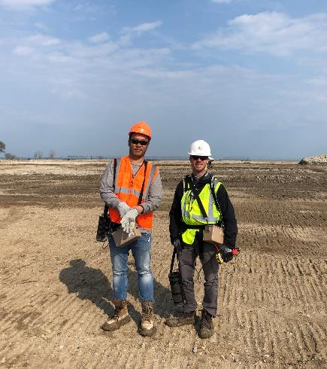
Confirmatory Surveys

Slide 12
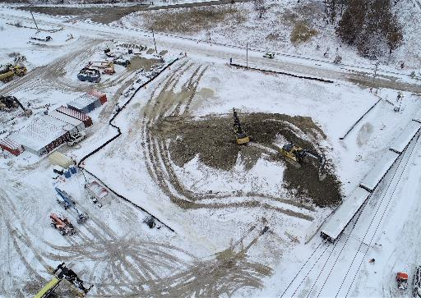
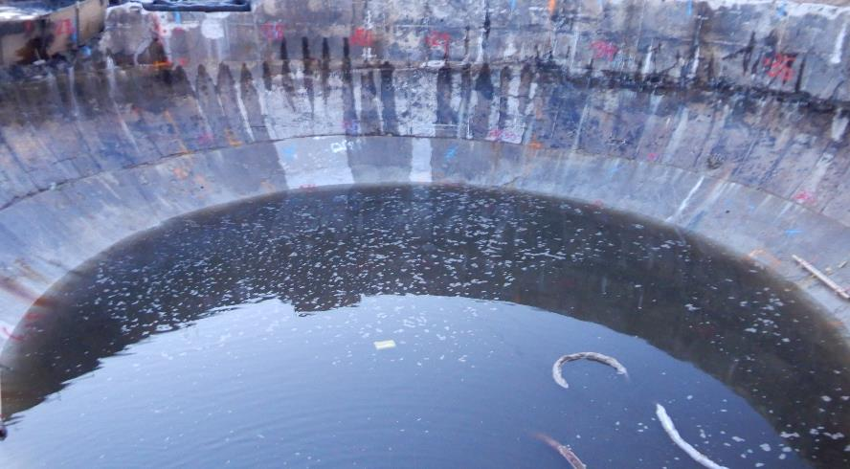
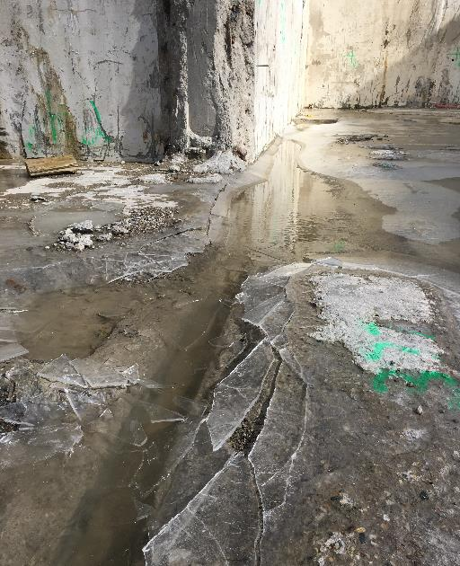
Challenges

Slide 13
Inspection Lessons Learned
Project management
Communications
Regulatory requirements
Procedures and processes
Part 50
Production and Utilization Facilities
Part 37
Physical Protection of RAM
Part 72
ISFSI
Part 73
Physical Protection of Plants
Part 20
Protection Against Radiation
12

Slide 14
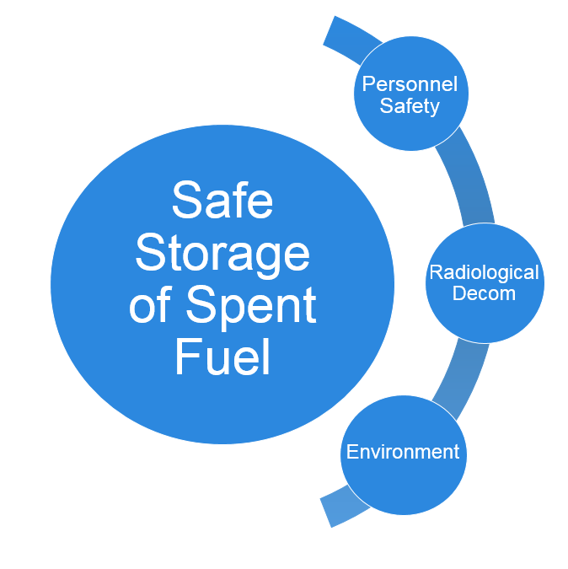
Questions?
13

