Slide 1
Decommissioning-Case Study
Zion Nuclear Power Plant
RAMP Presentation 2021
By: Bill Lin US NRC Region III

Slide 2
Zion Nuclear Power Plant
Objectives:
  Decommissioning Status
  Overview of the Decommissioning Process and how various decommissioning software programs were involved
  Lessons Learned and Emergent Themes

Slide 3
Zion Nuclear Power Plant
Decommissioning Started around 2010
Active Decommissioning activities ended around late 2019 early 2020
Currently NRC HQ has issued additional Request for Additional Information regarding licensee's FSS submittal
License Termination expected sometime during 2021

Slide 4
Zion Nuclear Power Plant
Decommissioning Process
  Two types of inspections during decommissioning
  Safety Significance evolutions during decommissioning
  Inspections that were included in the annual NRC Master Inspection Plan submitted to the licensee annually

Slide 5
Zion Nuclear Power
RESERAD-Will be useful during the License Termination Plan (LTP) review. Typically the RESERAD program will be used as part of the dose modelling to justify site release. The Regional Inspectors does not directly review the Licensee’s LTP however the inspectors need to be familiar with the program in order to discuss the LTP with technical reviewer.

Slide 6
Zion Nuclear Power Plant
VARSKIN-The VARSKIN software potentially plays an important part in the inspector’s arsenal of tools. Depending on the situation, VARSKIN is used to estimate doses to contaminated personal (scenario dependent). In the decommissioning of Zion Nuclear Power Plant, the inspectors had used VARSKIN to calculate doses and also interact with the licensee regarding their calculations.

Slide 7
Lesson Learns and Emergent Theme
Decommissioning is a complex evolution. It is important for the inspectors to communicate with not only the licensee but the rest of the stakeholders such as NRC HQ license reviewers, the State Inspectors, other Federal and State Government Agencies (EPA and OSHA), and various NGOs.
Ensure that licensee had the appropriate personnel during each phase of the decommissioning process (as decommissioning progress, personnel onsite will be reduced and it is vitally important to ensure licensee has the qualified personnel)

Slide 8
Lesson Learns and Emergent Theme
Hot particles-played a big part of the license termination and have to ensure that the questions are asked upfront.
Industrial Safety also played a significant role in the decommissioning timeframe.

Slide 9
Lesson Learns and Emergent Theme
Diamond Chain Saw used to segment various large components
New various methods to surveys and decommission (robotic surveys was tested )

Slide 10
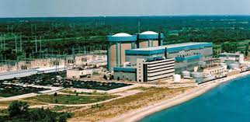
Pictures
Before Decommissioning

Slide 11
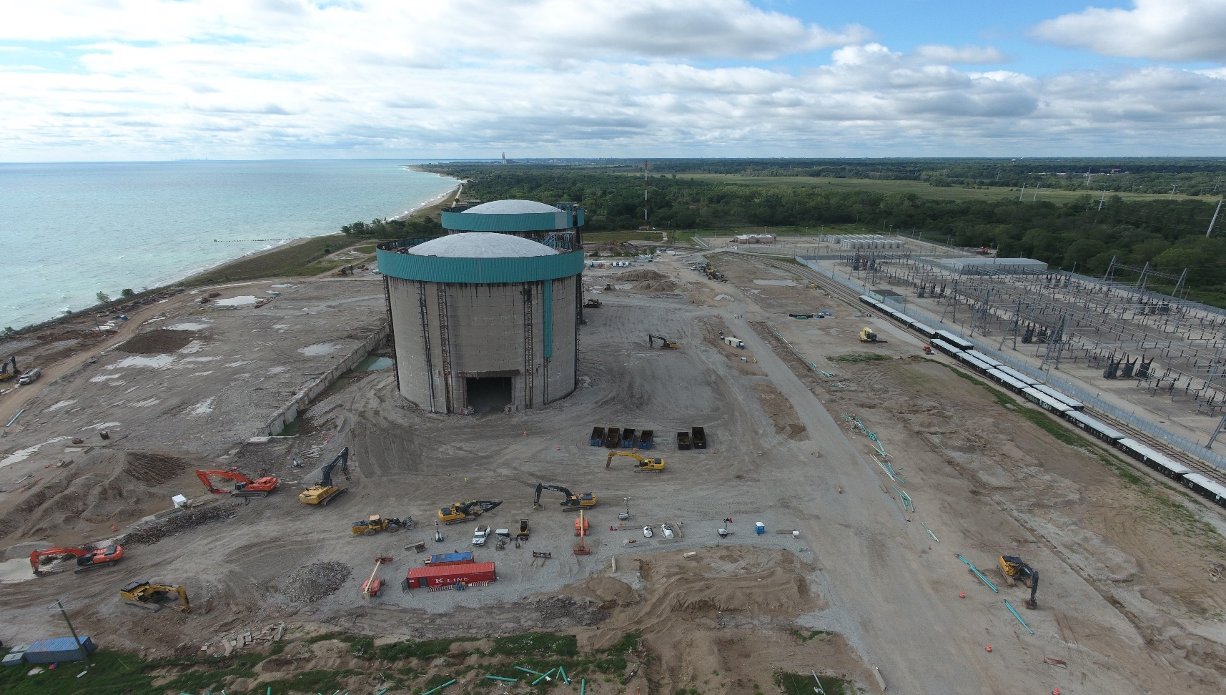
Pictures
During Decommissioning

Slide 12
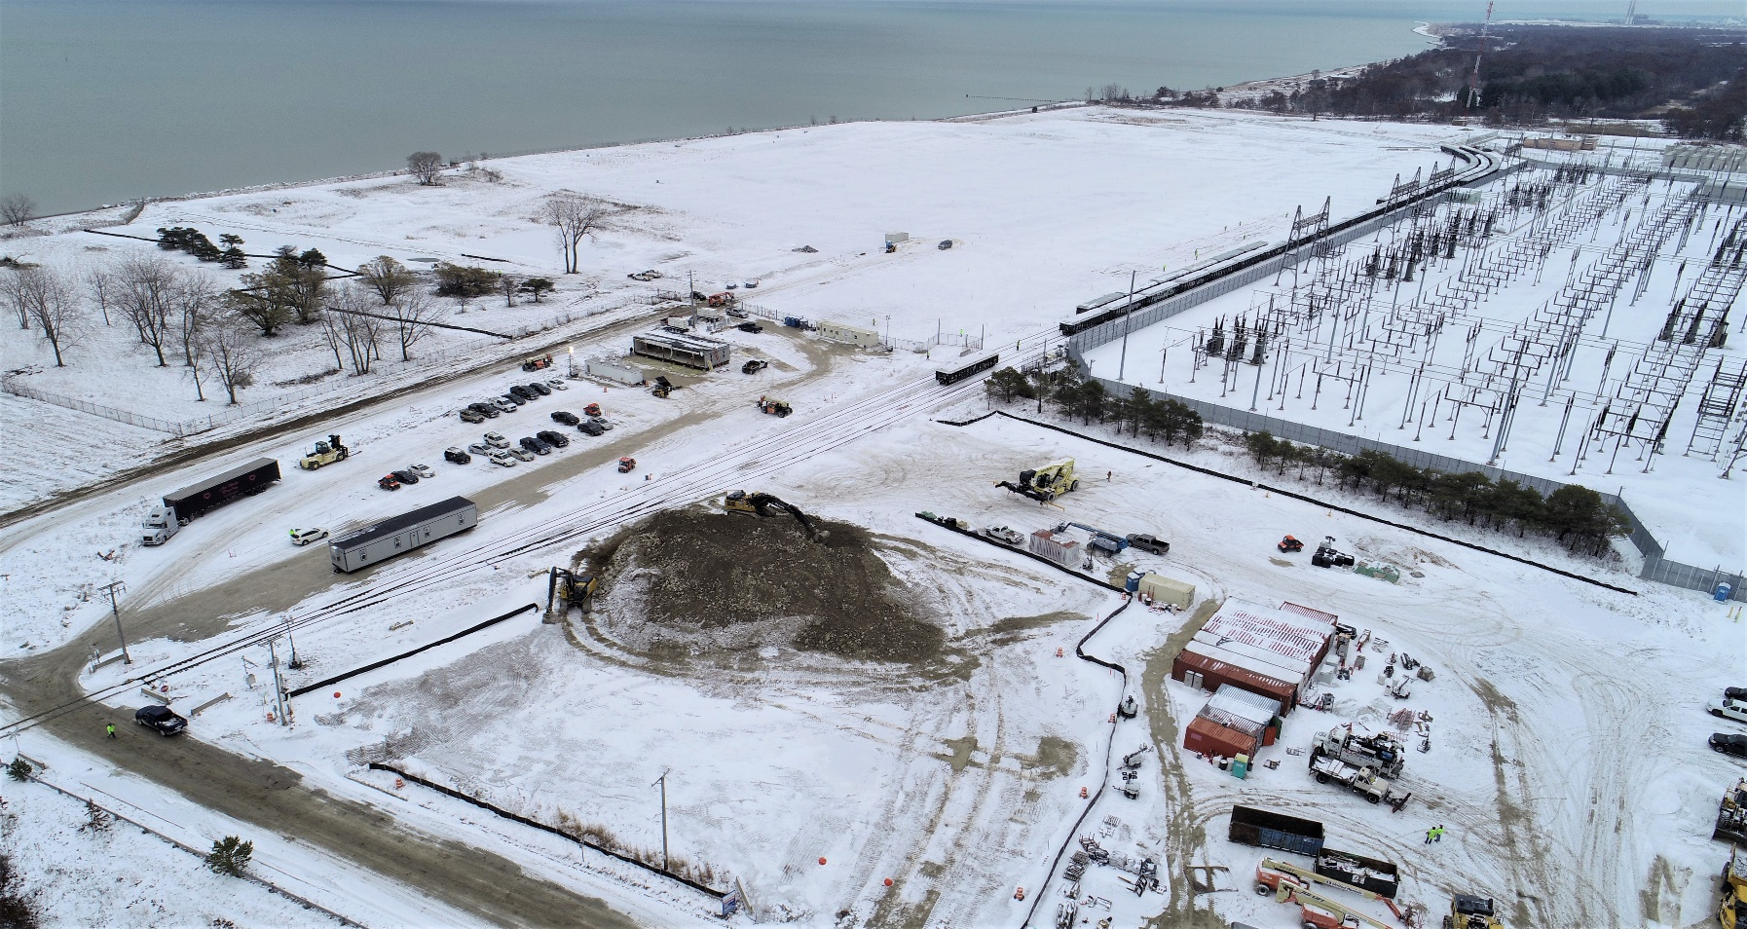
Pictures
Completion of Decommissioning

Slide 13
Questions???

