Slide 1


2021 Spring International
RAMP Users’ Group Virtual Meeting

Slide 2

Meeting Logistics
Audio – All participants will be muted, keep yourself muted.
Questions –
  Questions will be addressed at the end of the presentations.
  Please type your name, country, the question, and the person the question is directed to in the CHAT (see image below):
  If you have questions after the meeting, please email the questions to RAMP@nrc.gov
Closing Session – there will be no closing session
Electronic Certificates – available per request only. Please email RAMP.ADMIN@pnnl.gov or RAMP@nrc.gov
Technical Issues – please email RAMP@nrc.gov

Slide 3



Welcome!
We are glad you are here!

Slide 4
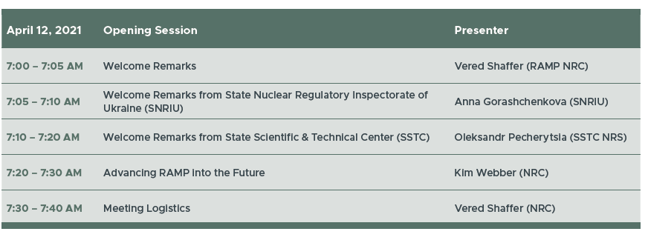
Opening Agenda

Slide 5



Vered Shaffer, Ph. D.
RAMP Program Manager
ramp@nrc.gov
Office of Nuclear Regulatory Research
United States Nuclear Regulatory Commission
RAMP User Meeting Information

Slide 6
Welcome RAMP Partners
Over 2300 registered RAMP Users (up from 1500 this time last year)
Over 160 participants at this RAMP Meeting
  Representatives from 12 Countries
    Ukraine, Cyprus, Italy, South Africa, South Korea, Spain, Taiwan, Ukraine, Australia, Nigeria, United Arab Emirates, Poland
  Federal Agencies, State and Local Governments
  DOE National Labs
  Universities
  Private entities

Slide 7














RAMP International Agreements
Our newest RAMP International Agreements… Mexico and Nigeria! Welcome!

Slide 8

Codes in RAMP
Other Dose Assessment Codes
Emergency Response Codes
IMBA
RAMP
VARSKIN
RASCAL
Radiological
Toolbox
Turbo
FRMAC
PiMAL
HABIT
XOQDOQ
RADTRAD
PAVAN
GALE
Atmospheric Assessment Codes
ARCON96
NRCDose
RESRAD
RADTRAN
GENII
MILDOS
NPP Licensing Codes
DandD
VSP
Environmental Assessment Codes

Slide 9
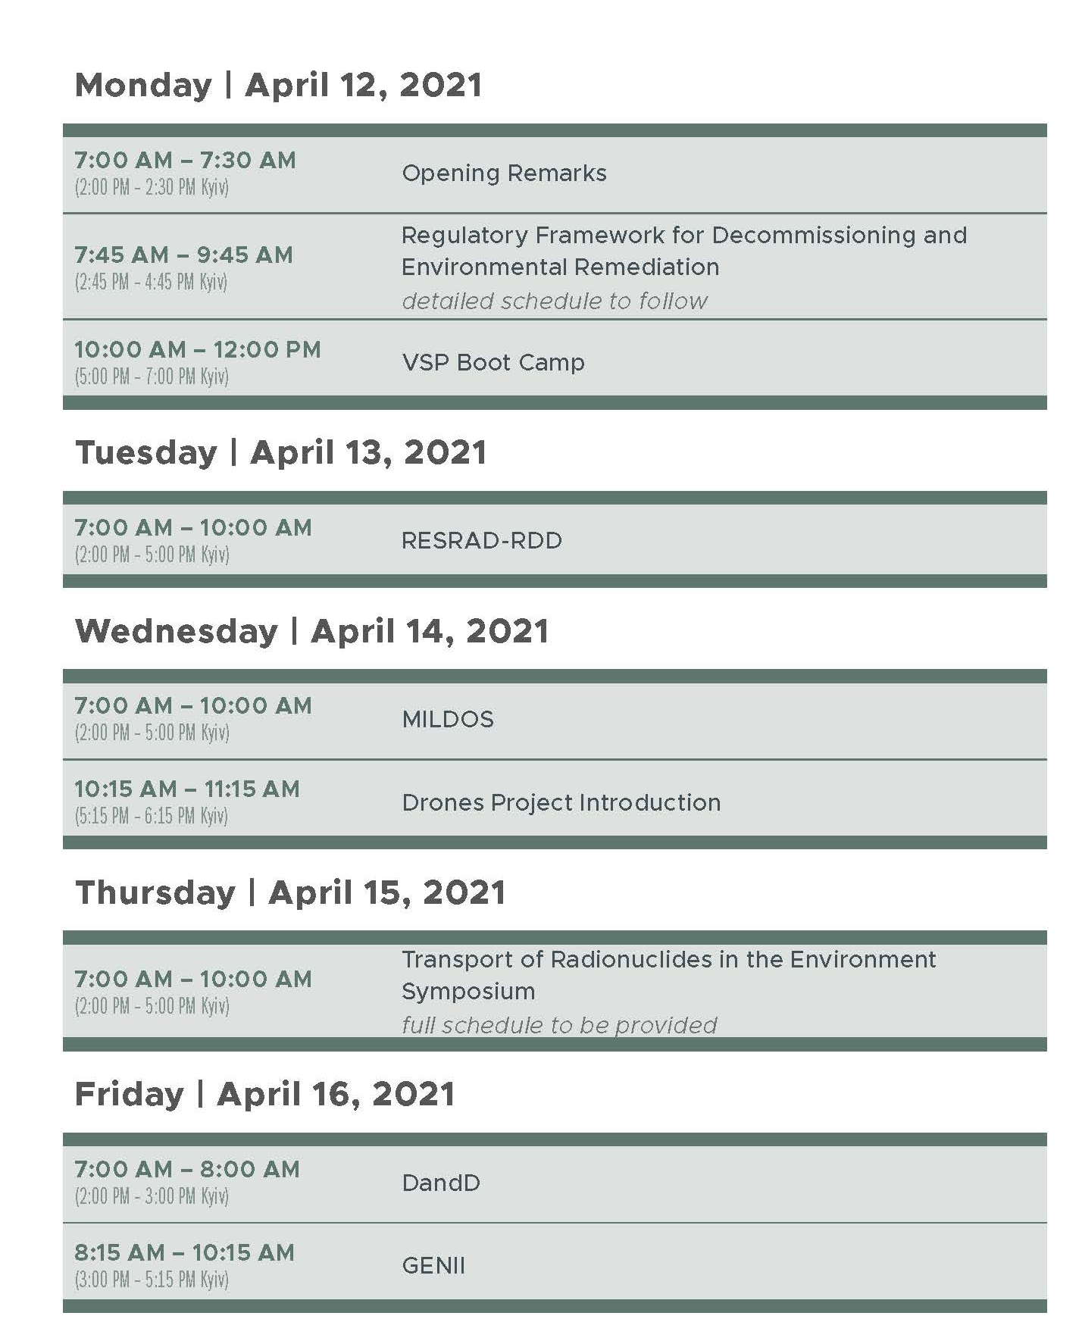

Slide 10
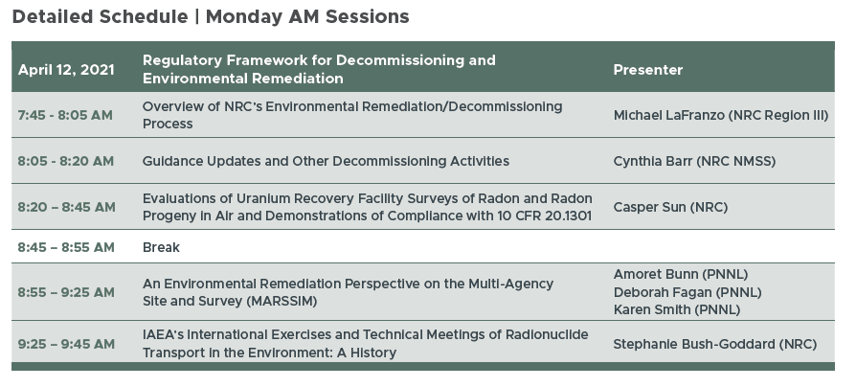

Slide 11
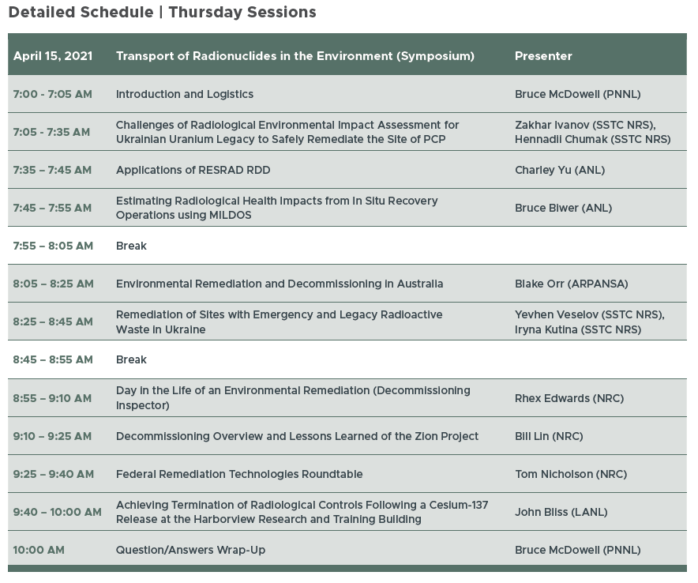

Slide 12

SAVE THE DATE
VIRTUAL FALL USER MEETING
OCTOBER 2021

Slide 13

Thank you for the virtual applause!

