Slide 1
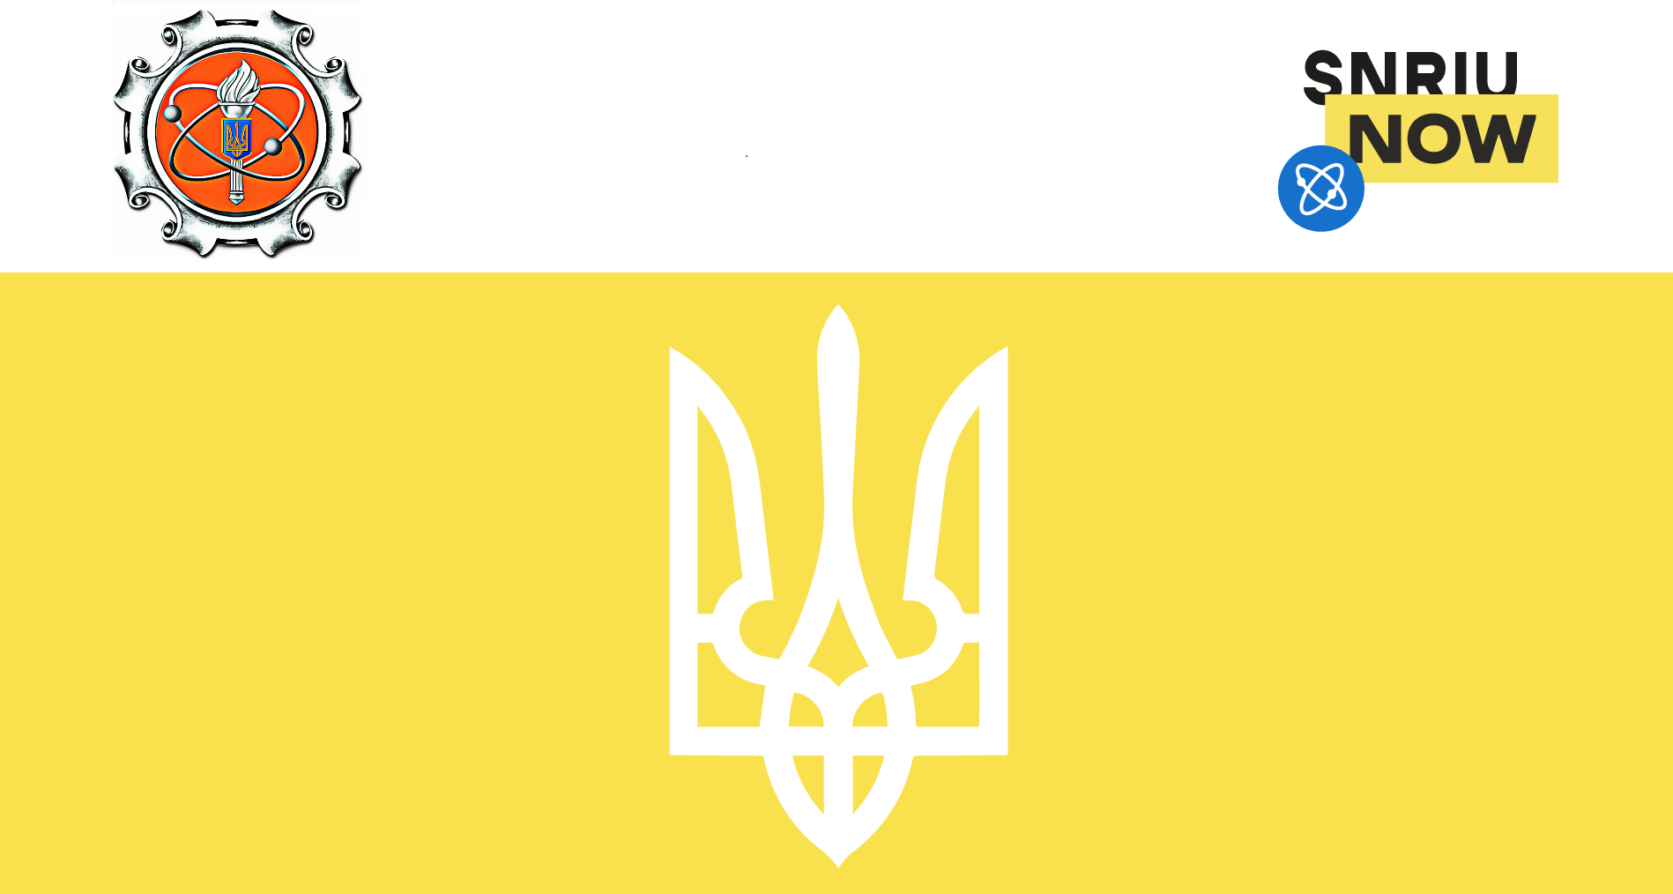
RAMP
2021 Spring Users Group Virtual Meeting
SNRIU
AT-A-GLANCE

Slide 2

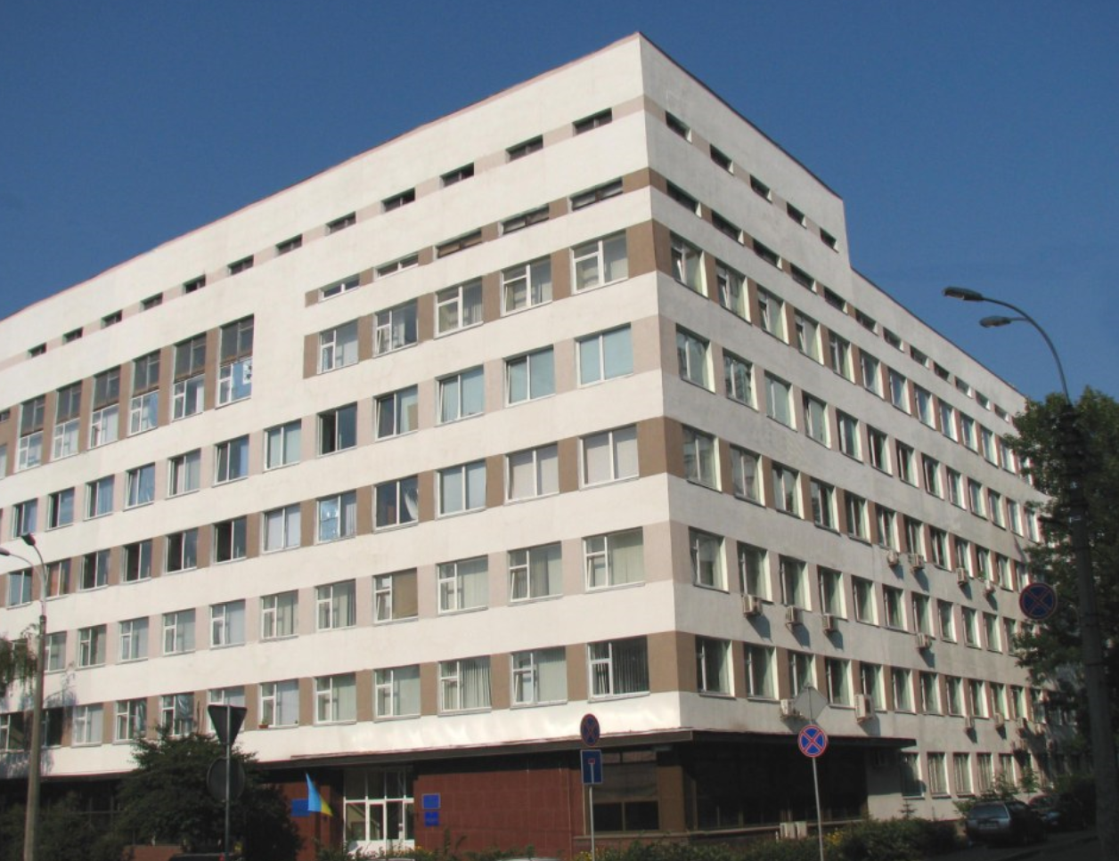
Framework
Independent nuclear regulatory authority of Ukraine was established according to Decree of the President of Ukraine № 1303 of 5 December 2000.
The SNRIU operates under Statute approved by the Resolution of the Cabinet of Ministers of Ukraine № 363 of 20 August 2014.
SNRIU reports directly to the Cabinet of Ministers of Ukraine (Prime-Minister).
SNRIU is independent from the State agencies, establishments and officials whose activity is associated with the use of nuclear energy.

Slide 3
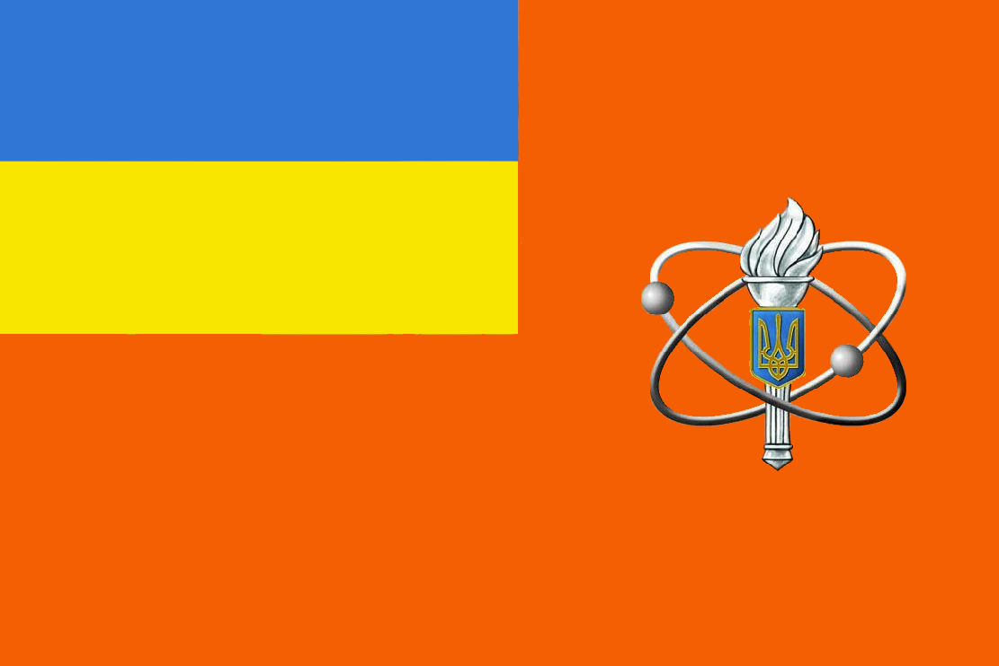
Mission
State regulation of nuclear and radiation safety in Ukraine in compliance with national legislation and international obligations relying on the principles of independence, integrity, competence, responsibility, objectivity and openness, as well as compliance with nuclear security requirements and nuclear weapon non-proliferation safeguards.

Slide 4
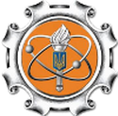
Responsibilities and Functions
RESPONSIBILITIES
To establish and implement state policy in the sphere of safe nuclear energy use.
To perform state regulation of safe nuclear energy use (rule-making, licensing, oversight).
To fulfil the duties of the competent authority on: physical protection of nuclear materials and nuclear facilities; safe transport of radioactive materials; on emergency notification under nuclear emergencies.
Functions
To identify safety criteria, requirements and conditions for the use of nuclear energy (rule-making).
To issue authorizations and licenses for activities in this area after review of the applicant’s submittals to confirm compliance with safety requirements (licensing).
To conduct state supervision over compliance with legislation, regulations and standards on nuclear and radiation safety and apply sanctions established by law in case of violations (oversight).

Slide 5
Organization
Chairman
Chief State Inspector on Nuclear and Radiation Safety of Ukraine
First Deputy Chairman
Deputy Chief State Inspector on Nuclear and Radiation Safety of Ukraine
Deputy Chairman
Deputy Chief State Inspector on Nuclear and Radiation Safety of Ukraine
Section of Organizational Activity, Management Support, and Occupational Safety
Section of Administrative and Service Support
Section of Corruption Prevention and Combating
Radioactive Waste Management Safety Department
Directorate of Nuclear Installation Safety
Radiation Safety Department
Internal Audit Section
Central Inspection Division
Nuclear Safety Inspectorate at Zaporizhzhya NPP (independent division)
Section of Clearance and Restrictions
Northern Nuclear and Radiation Safety Inspectorate (self-managed)
Nuclear Safety Inspectorate at Rivne NPP (independent division)
Division of Document Support, Control and Interaction with Regional Bodies
North-Western Nuclear and Radiation Safety Inspectorate (self-managed)
Nuclear Safety Inspectorate at Khmelnytsky NPP (independent division)
Personnel Division
Division of International Cooperation and European Integration
Western Nuclear and Radiation Safety Inspectorate (self-managed)
Nuclear Safety Inspectorate at South Ukraine NPP (independent division)
Southern Nuclear and Radiation Safety Inspectorate (self-managed)
Department of Information & Analytical Support and Digital Development
Nuclear and Radiation Safety Inspectorate in Exclusion Zone (independent division)
South-Eastern Nuclear and Radiation Safety Inspectorate (self-managed)
Legal Department
Economy, Finance and Accounting Department
Central Nuclear and Radiation Safety Inspectorate (self-managed)
Nuclear Security and Safeguards Department
Eastern Nuclear and Radiation Safety Inspectorate (self-managed)

Slide 6
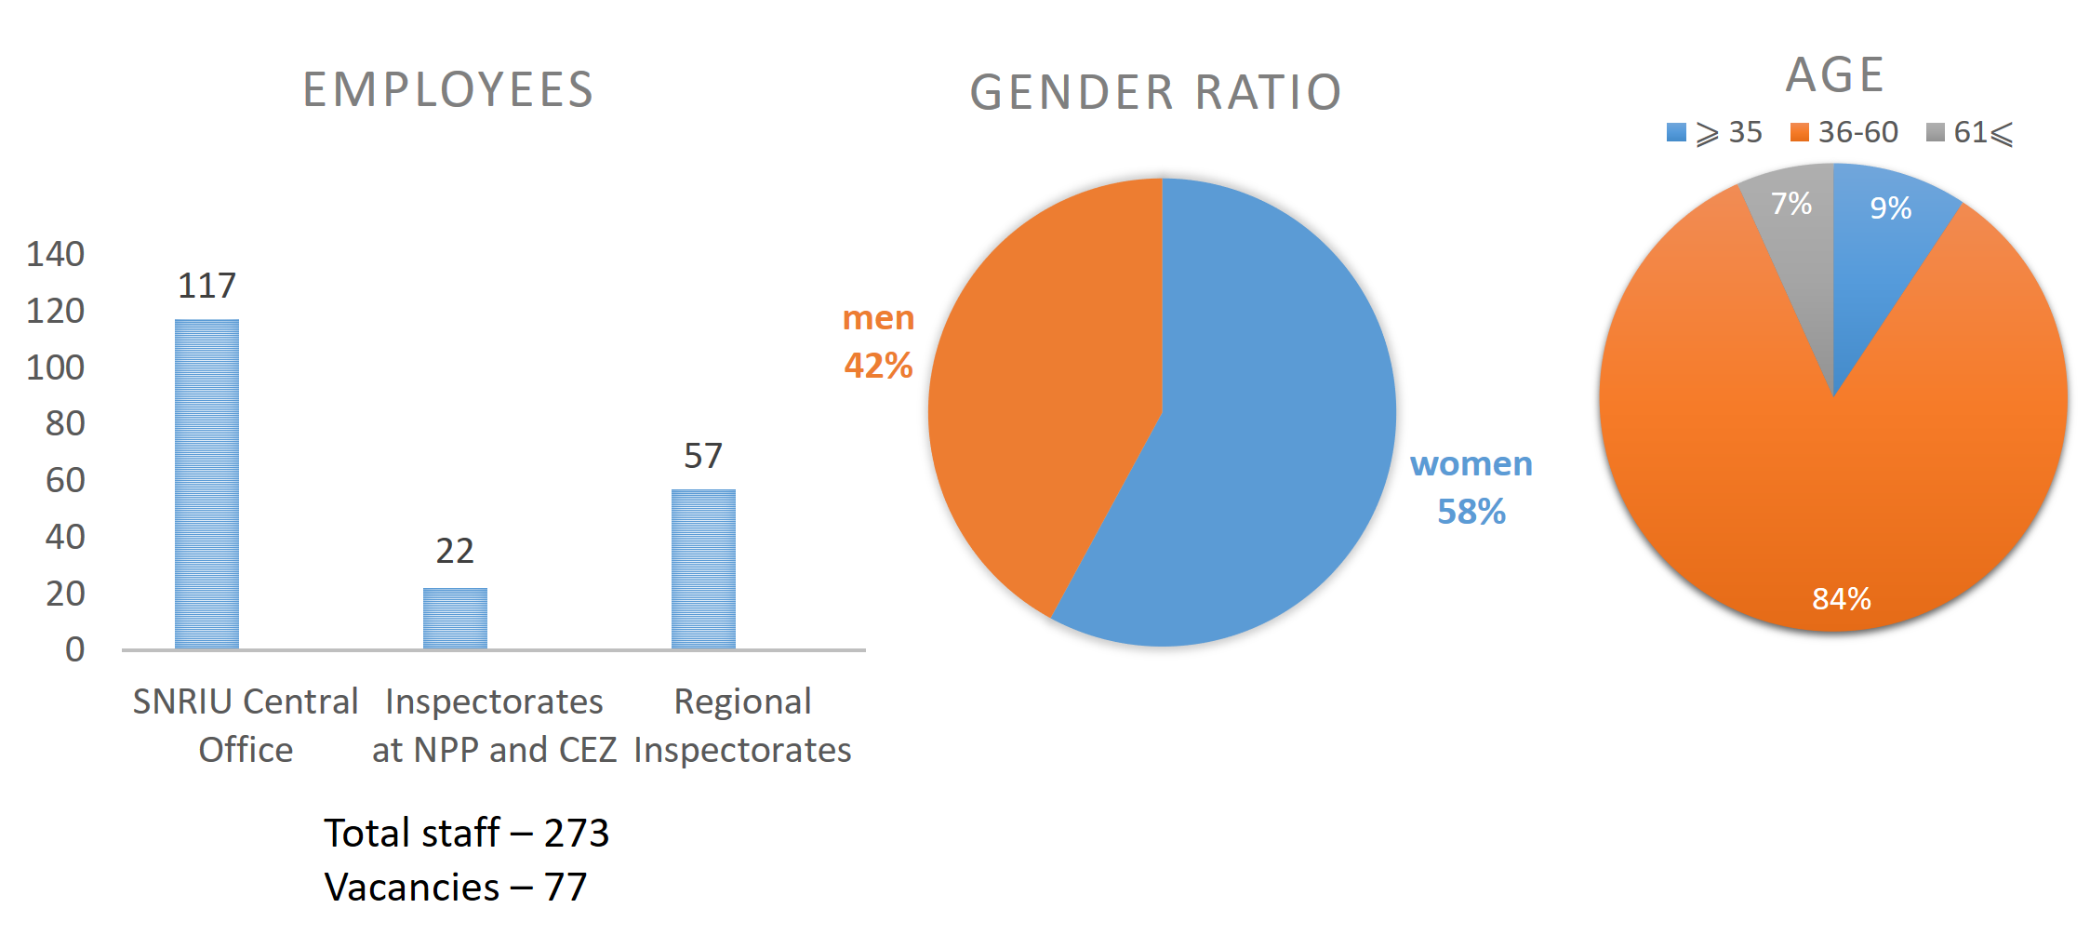
Staff

Slide 7
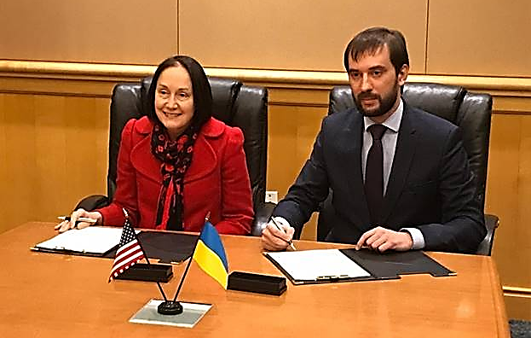
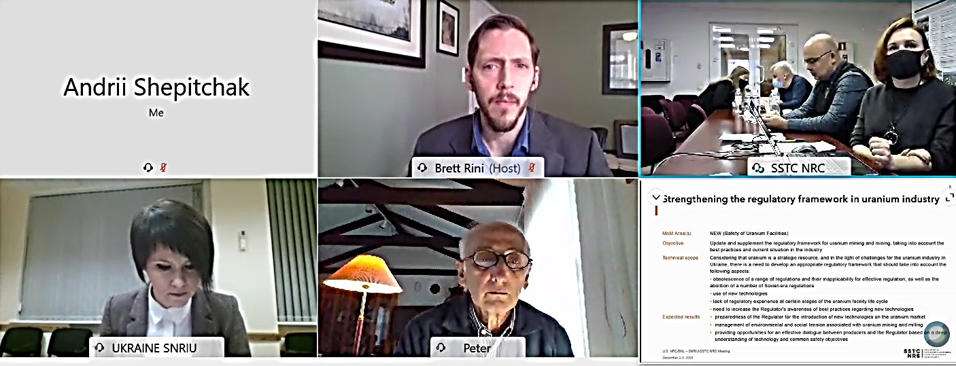
Cooperation with US NRC
Since 2000, cooperation is carried out according to the Memorandums of Meetings between the US NRC and the SNRIU.
MoM define areas and tasks for the certain period of bilateral cooperation. US NRC provide assistance in the following directions:
systematic strengthening in mastering and efficient use of a wide range of state-of-the-art computer codes (under CAMP, CSARP and RAMP Implementing Agreements);
support of the SNRIU in solving comprehensive technical issues;
support and strengthening capacities of SNRIU and its territorial branches to fulfil the assigned functions and develop relevant infrastructure.

Slide 8

SNRIU participation in RAMP
SNRIU joined the Program in June, 2019
Objective of participation:
to use and implement the latest code releases;
to cooperate with code users;
to provide feedback on the codes and participate in their upgrade.

Slide 9
Thank you snriu.gov.ua
Notes:
Последний слайд

