Slide 1




Advancing RAMP into the Future
Kimberly Webber
Director, Division of Systems Analysis
Office of Nuclear Regulatory Research
U.S. Nuclear Regulatory Commission
  RAMP User Meeting April 2021

Slide 2
US NRC:
Nuclear Regulatory Research
Mandated by Congress
~ 150 engineers, scientists, analysts, and support staff
About $40M in research funding
Research technical activities that capture the entire nuclear cycle and materials programs
Strong International Cooperation and Collaboration
  100+ Agreements with 20+ Countries
  Cooperative Research Program (RAMP)

Slide 3
International Collaboration in RAMP
International cooperative research program for development, maintenance and distribution of radiation/dose assessment codes:
Incorporate latest models
Prioritize technical updates
Fiscally responsible by leveraging group dynamics
Leverage NRC expertise in member countries
Knowledge transfer and expertise from international colleagues
Regulator to regulator code discussions
NPP Licensing
Atmospheric
Environmental
Emergency Response
Other Dose Codes

Slide 4





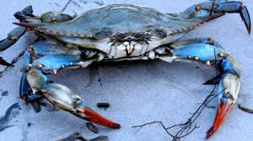



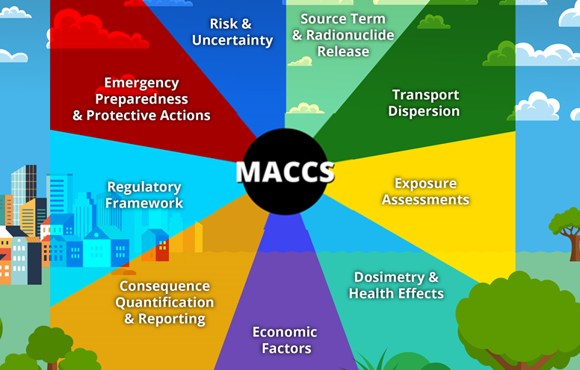





NRC’s “Be Ready” Attitude
Improve mission value while enabling safe operations
  Deliver cost savings
  Develop regulatory tools
  Build staff expertise
  Leverage collaborations
BlueCRAB

Slide 5
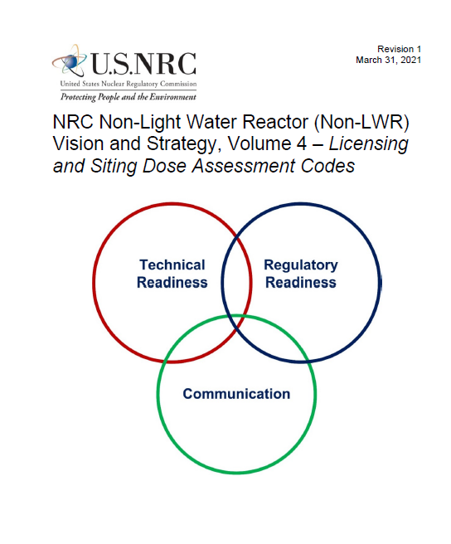
Non-LWR Code Consolidation and Modernization
Discuss RAMP codes as they relate to non-LWR designs and code consolidation
Volume 4: Licensing and Siting Dose Assessment Codes
  Potential for a spectrum of Non-LWR and fuel designs
  Over 10 licensing and siting dose assessment codes
Approach (Tasks)
  Consolidate/Modernize Dose Assessment Codes
  Improve characterization of Source Terms
  Improve Atmospheric Transport & Dispersion Models
  Update Dose Coefficient values
  Develop Environmental Pathway Models
ML21085A482

Slide 6





Early Exploration at the NRC
Artificial Intelligence Solutions
Low-Code No-Code Applications
Robotic Process Automation

Slide 7
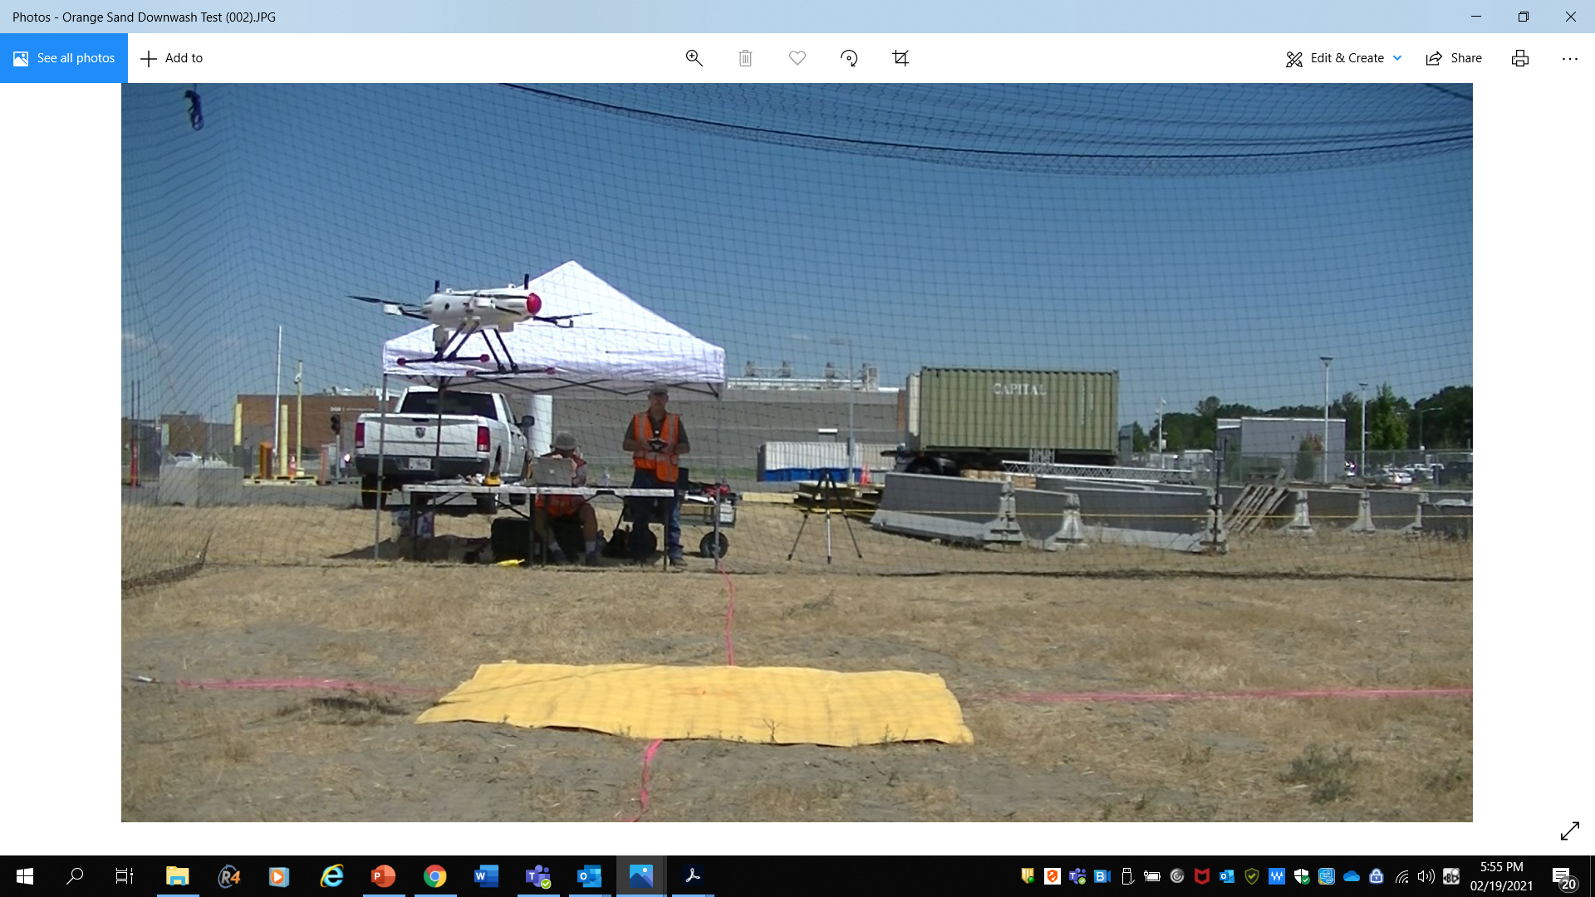

Drones used in Decommissioning
Goal:
  Demonstrate the use of drones for decommissioning activities, improving knowledge of scanning systems, for possible inclusion in Computer Codes such as RAMP’s Visual Sample Plan and RASCAL
How: Outdoor Scenario
  Test and evaluate the survey instruments and drones for factors such as varying height off ground and velocity of drone.

Slide 8

Thank you! The Future is Now!
www.indemnis.com

