Slide 1
Decommissioning Guidance Updates and Other Initiatives
RAMP 2021 Spring User’s Meeting
April 12, 2021

Slide 2
Guidance Updates
NUREG-1757, Consolidated Decommissioning Guidance
  Volume 1, Rev. 3 Decommissioning Process for Materials Licensees
  Volume 2, Rev. 2 Characterization, Survey, and Determination of Radiological Criteria (draft for public comment)
NUREG-1507, Rev. 1, Minimum Detectable Concentrations with Typical Radiation Survey Instruments for Various Contaminants and Field Conditions
NUREG-1575, Rev. 2, Multi-Agency Radiation Survey and Site Investigation Manual (MARSSIM) (to be issued for public comment)

Slide 3
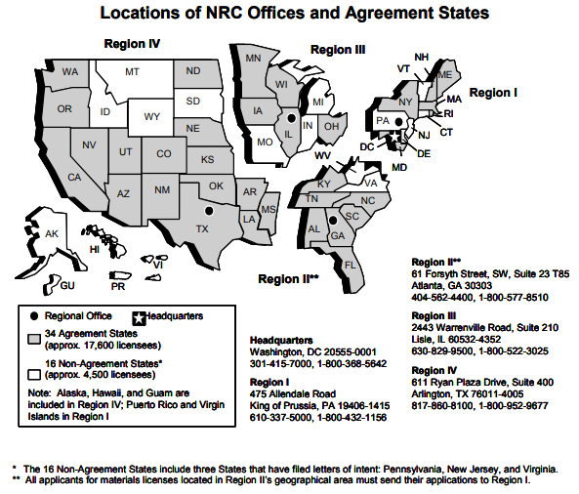
Significant Changes to NUREG-1757, Volume 1
Guidance related to fees incurred during decommissioning found in 10 CFR 170 (10 CFR 171 fees stop when the site enters decommissioning)
Updated status on the Site Decommissioning Management Program
Guidance on the decommissioning planning rule related to minimization of contamination (10 CFR 20.1406 requirements)
Guidance on categorial exclusions (CATXs) for decommissioning

Slide 4
Major Changes to NUREG-1757, Volume 2
Dose modeling: updates on model abstraction & simplification, exposure scenarios for buried radioactivity, and conduct of uncertainty analysis​ (new App Q)
Radiological surveys (App G): updates on surveys of excavations, soil reuse and statistical tests
Surface water and groundwater characterization​ (App F)
“As Low As Is Reasonably Achievable” guidance (App N)
Composite sampling (new App O)

Slide 5
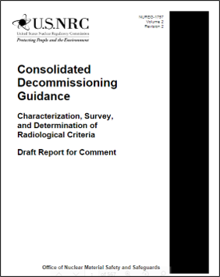
NUREG-1757 Path Forward
NUREG-1757
Vol 1, Revision 3 has been developed and planned publication in 2021
Vol 2, Revision 2 was issued for comment with final publication in mid 2022
  See ADAMS accession number: ML20273A010

Slide 6
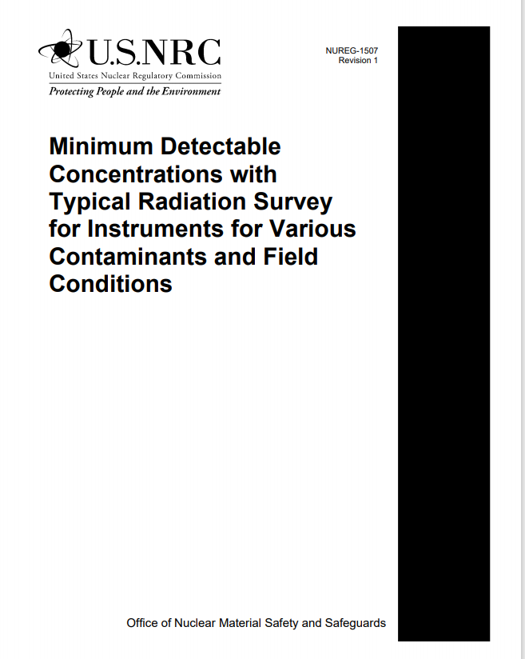
NUREG-1507, Revision 1
Minimum Detectable Concentrations with Typical Radiation Survey Instruments for Various Contaminants and Field Conditions
First published August 2000
Revision 1 published August 2020
Incorporates updates from NRC decommissioning program lessons learned, current survey instruments
Can be found on NRC’s web site:
  ML20233A507
  https://www.nrc.gov/reading-rm/doc-collections/nuregs/staff/sr1507/

Slide 7
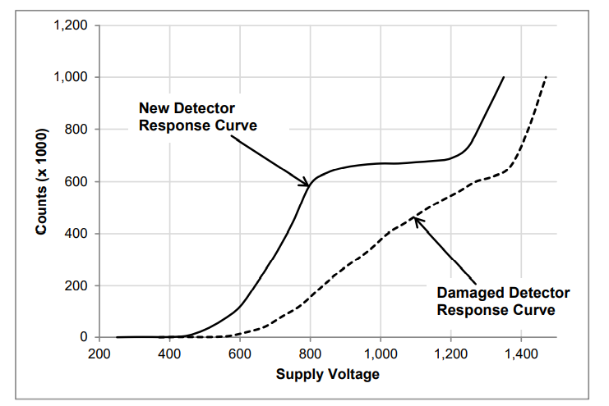
NUREG-1507, Revision 1 Updates
  Updated methods: Data acquisition using global positioning system and geographic information systems tools
  Updated detector types: non-planar detectors, gamma spectroscopy, floor monitors, additional scintillator types
  Updated information on a priori and a posteriori (post-processing) methods for detection decisions
  Appendix A provides case studies with example weighted efficiency, minimum detectable concentration calculations, and calibration methods

Slide 8
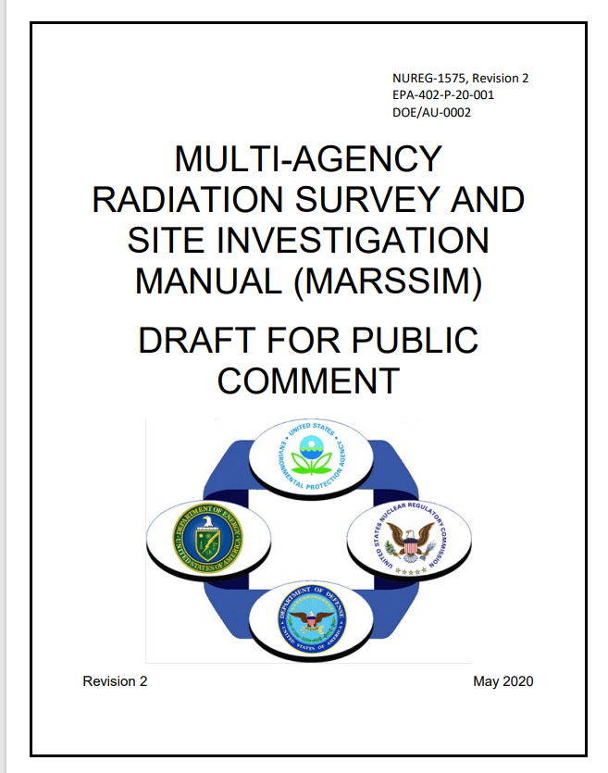
MARSSIM, Revision 2
EPA is the lead agency
Updates include
  Scan-only surveys
  Definition of lower boundary of the gray region (LBGR) for Scenario A
  Alternative Scenario B
  Statistical tests and associated parameters
  Conservatism in unity rule for multiple elevated areas
  Less emphasis on area factors
  Measurement quality objectives
  Field instruments
  Rank set sampling found in Appendix E
Soon to be issued for public comment

Slide 9
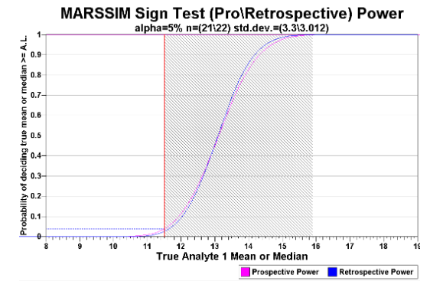
Other Decommissioning Initiatives
Visual Sample Plan computer code improvements
  Alpha scan minimum detectable concentrations
  Total dose tool
  Updated reports
  Prospective and retrospective power curves for Scenario B
  Composite sampling tool
  Data analysis tool
Most of the updates are in current version

Slide 10
Other Decommissioning Initiatives (cont)
Contract with SC&A on subsurface investigations
  A technical letter report is being developed
  A workshop is planned for this summer (tentatively July 14-15)

Slide 11
Conclusions
Several guidance initiatives are completed or well underway to share lessons learned and experience from review of license termination plans, decommissioning plans, and final status surveys
NRC has been working with interested stakeholders including members of the public to improve the guidance in key areas
Improvements to the Visual Sample Plan computer code have been made to facilitate survey design and analysis
New guidance is being developed for subsurface investigations
NRC is interested in continuing to improve its guidance documents and computational tools to increase efficiency in review of licensee submittals related to license termination

Slide 12
Back-up slides

Slide 13
Regional Staff:​
Laurie Kauffman, Region I, Health Physics Inspector​
Michael LaFranzo, Region III, Health Physics Inspector​
NRC Headquarters Staff (Volume 1):​
Ted Carter, Senior Project Manager
Stephen Giebel, Health Physicist
Nadine Aridi, Administrative Assistant
Allen Gross, Risk Analyst
Kenneth Kline, Financial Analyst
Dominick Orlando, Senior Project Manager
NUREG-1757 Team Members
NRC Headquarters Staff (Volume 2):​
Cynthia Barr, Senior Risk Analyst
Greg Chapman, Health Physicist
Sheldon Clark, Office of General Counsel
Tony Huffert, Sr. Health Physicist
Chris McKenney, Branch Chief
Leah Parks, Risk Analyst
Adam Schwartzman, Risk Analyst
Bruce Watson, Branch Chief

Slide 14
NUREG-1757, Volume 1 Contact Information
Stephen J. Giebel
stephen.giebel@nrc.gov
301-415-5526

Slide 15
NUREG-1757, Volume 2 Contact Information
Cynthia Barr
cynthia.barr@nrc.gov
301-415-4015

Slide 16
NUREG-1507
Contact Information
    Tony Huffert
anthony.huffert@nrc.gov
301-415-2468

Slide 17
MARSSIM
Contact Information
    Mark Fuhrmann
mark.fuhrmann@nrc.gov
301-415-0879
    Kathryn Snead
snead.kathryn@epa.gov
202-343-9228

