Slide 1


“Evaluations of Uranium Recovery Facility Surveys of Radon and Radon Progeny in Air and Demonstrations of Compliance with 10 CFR 20.1301”
Presented at RAMP Ukraine Meeting
April 2020
Special thanks to Rob Evans, Ph. D. Region IV

Slide 2

“Evaluations of Uranium Recovery Facility Surveys of Radon and Radon Progeny in Air and Demonstrations of Compliance with 10 CFR 20.1301” (DUWP-ISG-01)
Issued June 11, 2019
  Had been in development since 2011
  Draft document published in Federal Register in 2014 for public comment
Can be found in ADAMS at ML15051A002
  Package that includes public comments can be found in ADAMS at ML14058A010
* Interim Staff Guidance (ISG)

Slide 3
DUWP-ISG-01
Provides methods acceptable to NRC for measuring radon-222 with daughters (progeny), and determining TEDE or WLM to members of the public
Applies to licensed uranium recovery facilities in the USA
Can be used for other types of sites if radon is major effluent

Slide 4
Radon progeny
In this ISG, radon progeny includes decay products with half-lives less than 30 minutes
  Polonium-218
  Lead-214
  Bismuth-214
  Polonium-214
Does not include lead-210 and polonium-210, which may need to be evaluated separately.

Slide 5
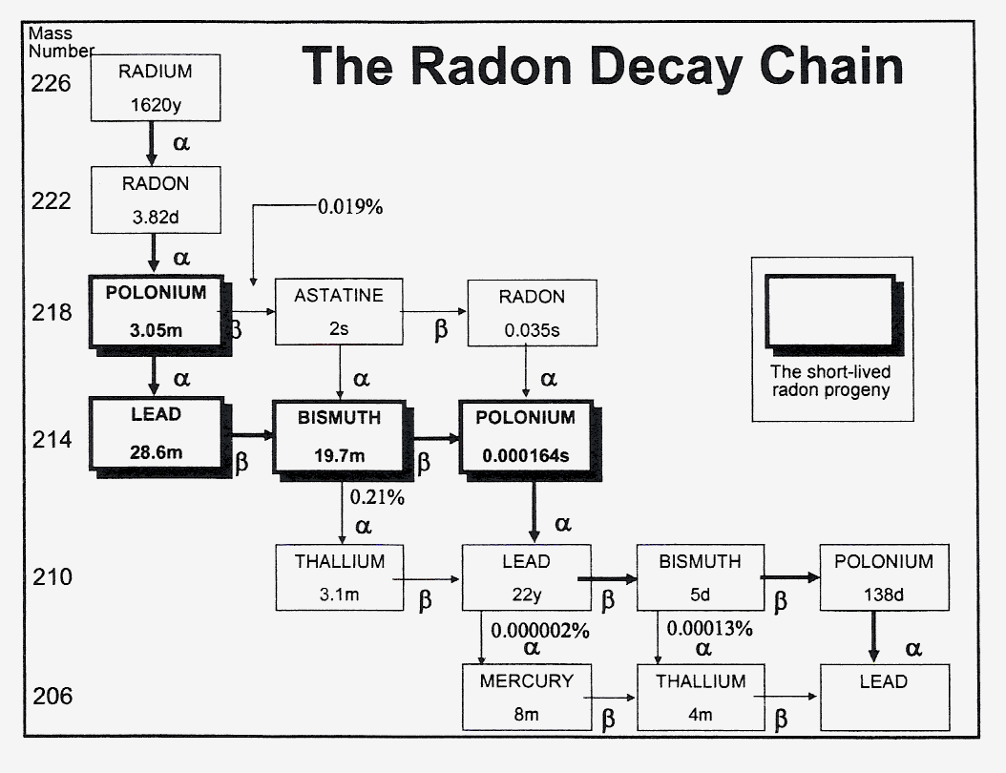


Slide 6
Demonstrating compliance
Demonstration of compliance with 10 CFR 20.1301 limits (100 mrem or 1 mSv per year; 2 mrem (0.02 mSv) in any one hour) is an annual requirement
Inspectors should not rely solely on licensee’s semiannual or ALARA reports (trust but verify)
ISG suggests regulators review trends using several years worth of data
Notes:
Limit should be more appropriate as “action-level”

Slide 7
Overview
ISG provides detailed discussion of two topics
  How to measure or calculate radon and radon progeny releases or concentrations in air
  How to calculate public doses from these measurements
In addition to radon and its progeny, public doses may include inhalation of uranium and its progeny as well as direct gamma exposures
  Dose from water or food ingestion is uncommon
Notes:
EPA has the public dose guidance! Will show you all in the last slide of this presentation!

Slide 8
Four basic ways to obtain radon dose
(1) Measure outdoor radon concentration at unrestricted area boundary or receptor location
  As needed, convert to indoor radon concentration
  The simplest assumption is that indoor = outdoor concentration
  Receptor location may be onsite or offsite, such as onsite man-camps or offsite nearest residence
Notes:
REMI - Reasonable Exposure from Maximum Individual (EPA)

Slide 9
Obtaining radon dose, cont.
(2) Measure operational process parameters to calculate radon release rates, then calculate radon concentrations at unrestricted area boundary or receptor locations
  MILDOS-AREA is one computer code that has been used for this type of calculation
  NRC expects licensee to collect field data for comparison to modelled concentrations

Slide 10
Obtaining radon dose, cont.
(3) Measure radon released at vents, stacks, wellfields, tailings, ore pads, storage areas, etc. using passive or dynamic radon monitors, then calculate doses at unrestricted area boundaries or receptor locations
  Computer code (MILDOS) may be used to simplify calculations, but again, NRC expects licensee to verify calculated values with field samples

Slide 11
Obtaining radon dose, cont.
(4) Measure radon progeny directly at receptor locations, then convert to radon equivalent
  Common examples include man camps and other site locations where visitors are frequently located
  Radon progeny concentrations have to be high enough to be measured directly
  Grab samples may not be representative of long-term averages

Slide 12
Compliance with 20.1301
One way to demonstrate compliance is to compare radon concentrations (annual averages) at unrestricted area boundary against 10 CFR Part 20, Appendix B, Table 2 effluent concentration limit for radon-222 with daughters (progeny) present
  NRC recommended effluent concentration limit (air) is 1 E-10 µCi/ml, which equals 0.1 pCi/L (i.e., 3.7 Bq/m³)
Notes:
It is about x100 in concentration if the progeny removed.

Slide 13
Compliance with 20.1301, cont.
A second way to demonstrate compliance is to perform a dose assessment
This method requires use of dose conversion factor (DCF) and assumptions of radon-radon progeny EEC to obtain equilibrium factor (F)
Notes:
ICRU-88 is the latest and the best reference ….
EEC = equilibrium equivalent activity concentration.

Slide 14
Compliance with 20.1301,cont.
ISG allows licensees to adjust ECL value (1 E-10 µCi/ml) using an equilibrium factor
  Easiest and most conservative option is to use EF of 1; no change to ECL
  An EF of less than 1 results in adjusted ECL that is greater than given in Appendix B, Table 2
  Adjustment of ECL requires prior NRC approval
  Generally acceptable EFs are provided in ISG, 0.7 for outdoors, 0.5 for indoors, or site specific

Slide 15
Dose conversion factor, DCF
Converts radon in units of pCi/L to dose in units of mrem/year
NRC recommends using 50 mrem/yr (Appendix B, Table 2 values equal 50 mrem/yr) divided by 0.1 pCi/L (ECL for radon with daughters), which equals 500 mrem/yr per pCi/L radon at 100% equilibrium
  Note that radon greater than 0.2 pCi/L above background will exceed the 100 mrem/year.

Slide 16
Example given in ISG
Visitor in controlled area for 10 weeks
Assume gross radon progeny calculation of 0.018 Working Levels (WL), i.e., Licensee chooses not to subtract background
Occupancy factor of 0.046 (400 hours per year divided by 8766 hours in year)
NRC’s DCF per WL is 50 rem/y (500 mSv/a) at equilibrium factor is 100%.

Slide 17
Example, cont.
Dose = (radon progeny concentration in WL) x (DCF) x (occupancy factor)
Dose = (0.018 WL) x (5E+4 mrem/WL-y) x (0.046)
Dose = 41 mrem/y (i.e., 0.41 mSv/a)
Assuming that combined dose from direct exposure and inhalation of other radionuclides is less than 59 mrem/y, licensee has demonstrated compliance with 10 CFR 20.1031

Slide 18
Problems noted in ISG
Are your background radon concentrations accurate?
  One solution is to collect multiple background samples at different locations
  Background that is consistently higher than other locations may not represent true background
  Preoperational data may help resolve background discrepancies
Notes:
If the spatial and temporal exposure conditions remain relatively stable, then individual exposures may reasonably be approximated by areal measurements. The objective of area monitoring for radon in dwellings and workplaces is the determination of a long-term average radon activity concentration representative of the exposure of residents and workers. These measurements are preferably carried out over a long-term period to cover daily and seasonal variations.

Slide 19
Problems noted in ISG, cont.
Minimum Detectable Concentrations (MDCs)
  NRC’s preferred effluent concentration limit is roughly equal to some measurement MDCs
  Regulatory Guide 4.14 (issued in 1980) recommends MDC of 0.2 pCi/L, compared to current effluent concentration limit of 0.1 pCi/L
  May have to use more sensitive radon canisters, conduct longer deploy times, or multiple canisters
Notes:
MDC values go to ANSI N13.31 document… Radon gas measurements can be an adequate surrogate for radon progeny and for dose calculations.
However, uncertainty remains unless two factors are well known, the equilibrium factor and the particle size distribution.

Slide 20
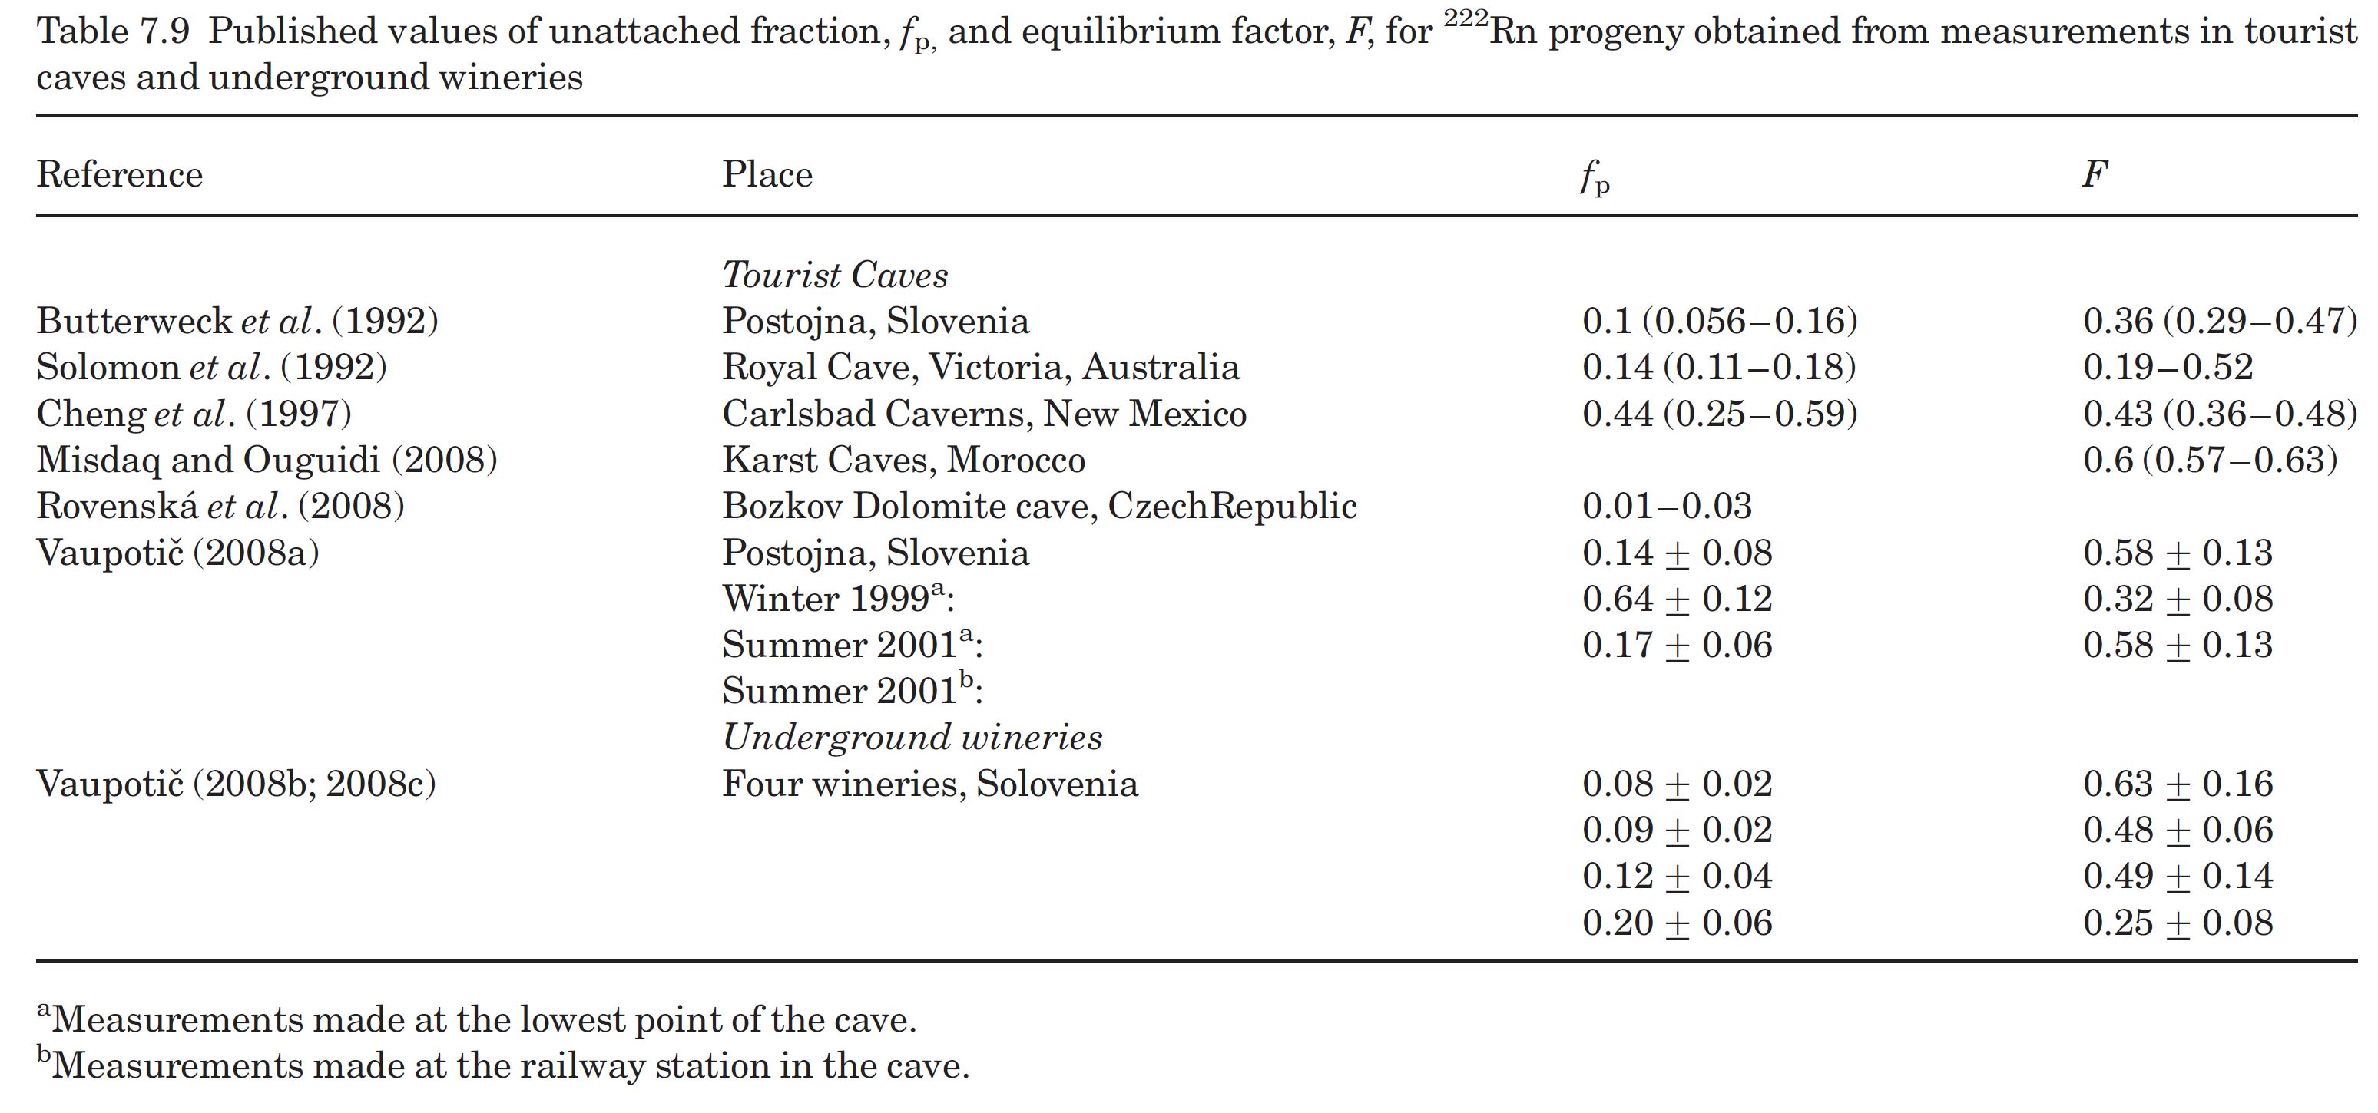
Problems noted in Radon Measurements
Source: ICRU Publication 88 (2012): “Measurement and Reporting of Radon Exposures.”

Slide 21
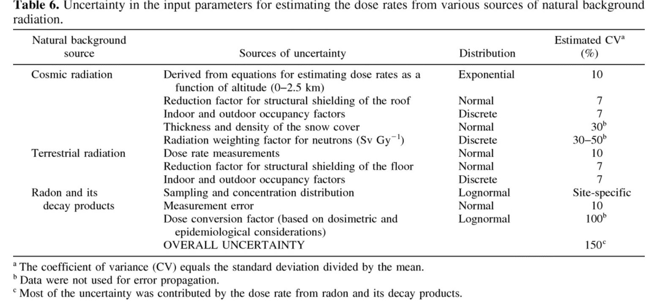
Uncertainty in Natural Background Radiation
COMPARISON OF NATURAL BACKGROUND DOSE RATES FOR RESIDENTS OF THE AMARGOSA VALLEY, NV, TO THOSE IN LEADVILLE, CO, AND THE STATES OF COLORADO AND NEVADA Moeller, Dade W.*; Sun, Lin-Shen C.† Health Physics: October 2006 - Volume 91 - Issue 4 - p 338-353

Slide 22

Thanks for your time
Casper.Sun@NRC.gov

