Slide 1

An Environmental Remediation Perspective on the Multi-Agency Radiation Survey and Site Investigation Manual (MARSSIM)
SPRING 2021 RAMP INT’L USERS GROUP MEETING
April 12-16, 2021
Co-Hosted with Ukraine
Amoret Bunn, Debra Fagan and
Karen Smith
Pacific Northwest National Laboratory,
Richland, Washington, USA
PNNL-SA-161030

Slide 2
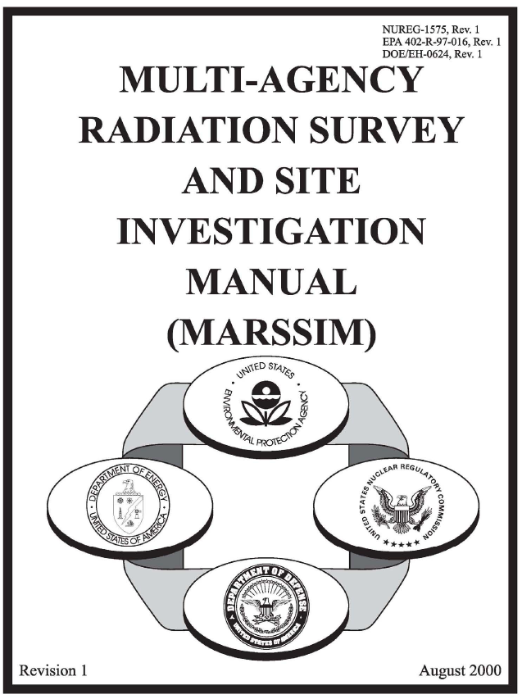
What is Multi-Agency Radiation Survey and Site Investigation (MARSSIM) Manual?
Guidance document that leads site teams through sampling and analysis process for demonstrating site meets release criteria
MARSSIM process flows can be used to guide preliminary survey activities to ensure scientific, statistically rigorous characterization, remediation, and verification process for site.
Reference: https://www.epa.gov/radiation/multi-agency-radiation-survey-and-site-investigation-manual-marssim

Slide 3
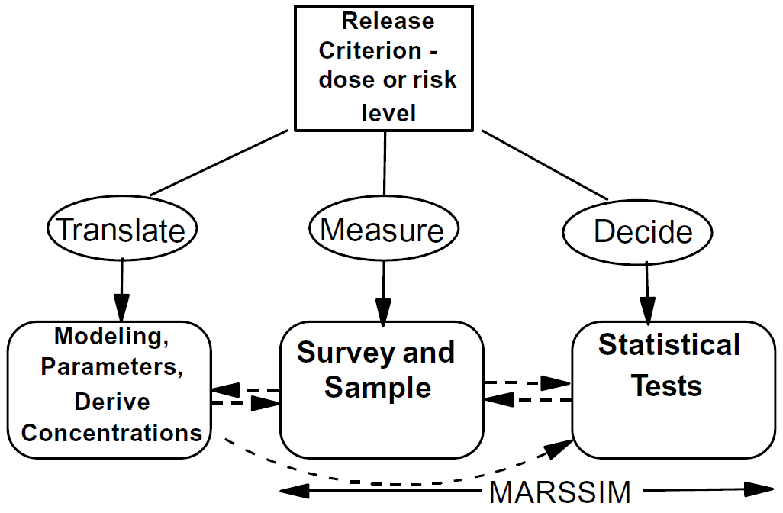
Demonstration of compliance with respect to conducting surveys
Figure 1-1 in MARSSIM, Rev. 2
Reference: https://yosemite.epa.gov/sab/sabproduct.nsf/RSSRecentAdditionsBOARD/E1D35FEB397932FF8525854D00836CFA

Slide 4
Release Criterion
Release Criterion is typically a specific regulatory limit
Limit typically tied to type of the site that is being evaluated:
  Sites have residual radioactive material in excess of natural background.
  Sites range in size of land areas and may have structures:
    Nuclear power plant
    Weapons production facilities
    Mining and milling sites
    Nuclear medicine departments in a hospital
    Radiological incident
Figure 1-1 in MARSSIM, Rev. 2
Notes:
Release criterion is typically a regulatory limit, in most cases [ “most cases” because there may be a participant that is from a country that does not have regulatory limits; in that case, they can use the codes in translate to come up with the best release criterion for their country and site]
For unrestricted use, the release criteria with EPA is risk-based and use a range of 10−4 to 10−6 as an acceptable lifetime excess cancer risk, while the U.S. Department of Energy’s (DOE) release criteria are dose-based and have a dose limit of 0.25 mSv y−1 [25 mrem/yr]

Slide 5
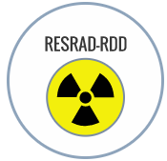
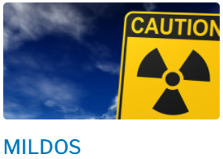

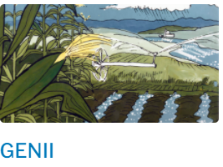
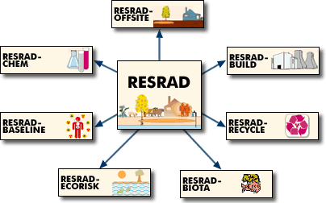
Translate
Figure 1-1 in MARSSIM , Rev. 2
Translating the Release Criterion into corresponding Action Level using environmental pathway modeling:
  Release Criterion is:
    dose (mSv/y, mrem/y) or
    risk (10⁻⁴ to 10⁻⁶ lifetime cancer risk)
  Action Level is an activity in soil (Bq/kg, pCi/g)
  Numerous codes conduct the pathway modeling:
*
*
*RESRAD is a family of codes (https://resrad.evs.anl.gov/).
This week we will present RESRAD-RDD training
Notes:
…we are going to discuss this week RESRAD-RDD, which is “for evaluating human radiation exposures … after a radiological dispersal device (RDD) incident”
That differs from the objectives of these other codes that model and translate the release criterion into an action level
Action Level – using this term as a generic term for the investigation level – whether an interim value or final value. This is the level at which a decision can be made for the property or structure to proceed towards release
Risk-based and dose-based calculators are the same, except risk-based calculators use slope factors (risk coefficients) over a period of exposure to provide concentrations for a target risk level, while dose-based calculators use dose conversion factors for an annual target dose limit.
Slope factors are used to estimate incremental cancer risk for both radionuclides and chemicals. The total incremental lifetime cancer risk is estimated as the sum of the risks from all radionuclides and chemicals in all exposure pathways

Slide 6
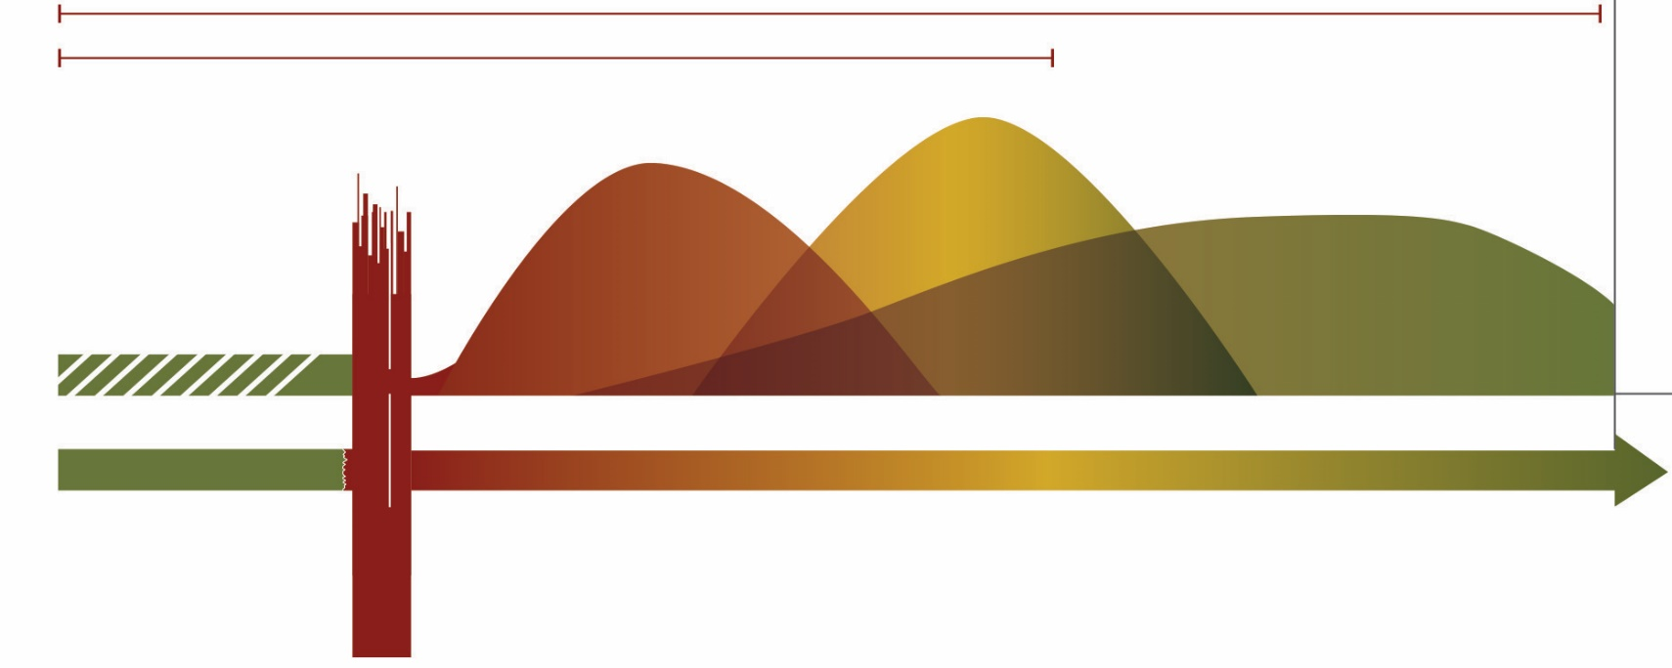
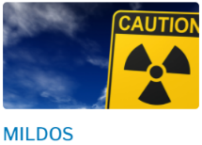

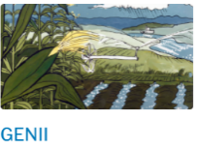
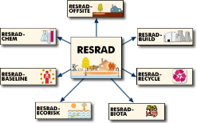
Translate: Action Levels for
Response, Recovery to Release
Recovery
Decommissioning/Remediation
License Termination and Release of Property
Response
Preparedness
RDD Incident
Early Phase
Intermediate Phase
Late Phase
Days
Weeks - Months
Months - Years
Protective Action Guidelines
(PAGs)
Action Level for Recovery
(Remediation and Release)
Notes:
This figure is to help orient the various codes in relation to a radiological

Slide 7
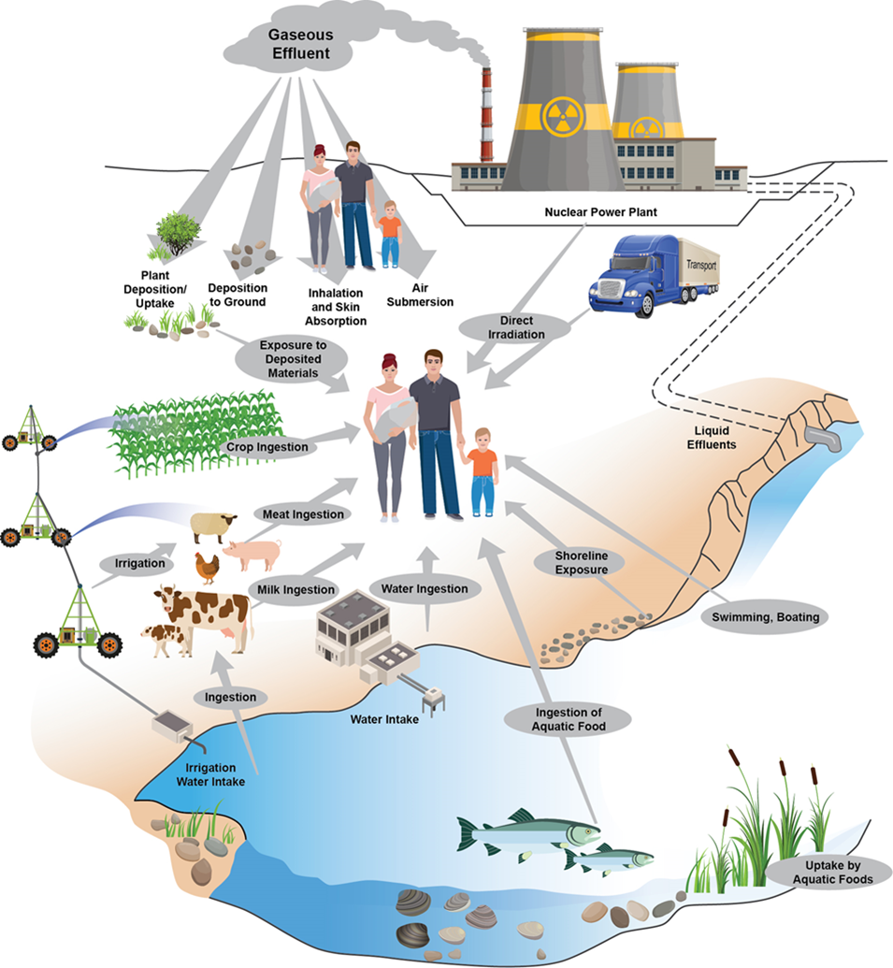
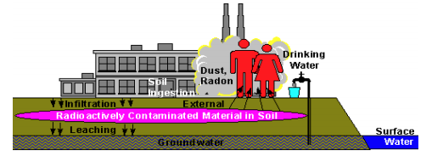
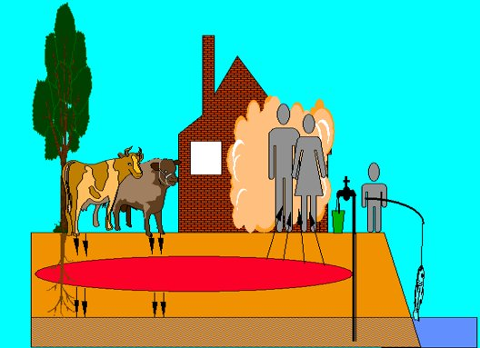
Translate:
Release Criterion to Action Level, cont.
    Action Level = Derived Concentration Guideline Level (DCGLs)
All-Pathway Assessment
End State Scenario (Future Land Use)
Industrial worker scenario
Soldat et. al 1974
Resident farmer scenario
Notes:
In MARSSIM, Action Level = Derived Concentration Guideline Level (DCGLs): radionuclide specific concentration limits used to guide clean-up for decommissioning or remediation and release of a site.
DCGL for each contaminant of concern
DCGLs are calculated based on an all-pathways dose assessment and represent a concentration limit that could potentially lead to a peak dose over a 1000 year compliance period at a specified dose limit (e.g., unrestricted release standard of 0.25 mSv/yr or 25 mrem/yr) to the average member of a group of individuals reasonably expected to receive the highest dose.
When deriving DCGLs, one should consider how residual contamination could move through the environment, and consider how a potential receptor could be exposed through various pathways based on reasonable land use scenarios (e.g., external exposure; ingestion of soil, water, plant, and animal products; and inhalation).
Realistic scenarios and less likely, but plausible scenarios that consider future land use should be considered.
DCGLs are only appropriate for the conditions for which they are derived (e.g., depth, area and thickness of contamination). In some cases, several DCGLs need to be derived to address different types of contaminated media such as building contamination, surficial contamination, subsurface contamination, contaminated groundwater, sediment, surface water.
Reference for pathway figure: Soldat, J.K, N.M Robinson, D.A. Baker. 1974. Models and Computer Codes for Evaluating Environmental Radiation Doses. Battelle, Pacific Northwest Laboratory, Richland, Washington. BNWL-1754.

Slide 8
Translate:
Further information for MARSSIM process
  Knowledge of residual radioactive material
    Evenly distributed
    Small areas of elevated concentrations
  Establish survey units
    Structures
    Land areas
  Classify areas by contamination
  potential
    Graded approach
Degree of final survey effort
High
Emphasis on DCGL – site comparisons
Class I
Class II
Emphasis on background – site comparisons
Low
Class III
Low
High
Potential of residual contamination
Notes:
DCGLs can be developed based on the knowledge of residual radioactive material
Site can be divided into survey units, or areas of structures or land areas that are smaller areas of a site, and can facilitate the survey process and statistical analysis because of the knowledge or the residual radioactive material and the final decision to be made for the site.
Classification assigns the site or survey units into classes according to radiological characteristics that assists further with the planning. Classification of a site or survey unit may change as new information becomes available.
Class 1 Areas have a potential for residual radioactive material to be above the DCGL, even after remedial activities.
Class 2 Areas are thought to be below the DCGL – additional actions (e.g., removal of materials and subsequent sampling) can move a Class 1 site to a Class 2 site
Class 3 Areas are not expected to contain any residual radioactive material, or are expected to be below the DCGL at the time of starting the process.

Slide 9

Demonstration of compliance with respect to conducting surveys
Figure 1-1 in MARSSIM, Rev. 2
Reference: https://www.epa.gov/radiation/multi-agency-radiation-survey-and-site-investigation-manual-marssim

Slide 10
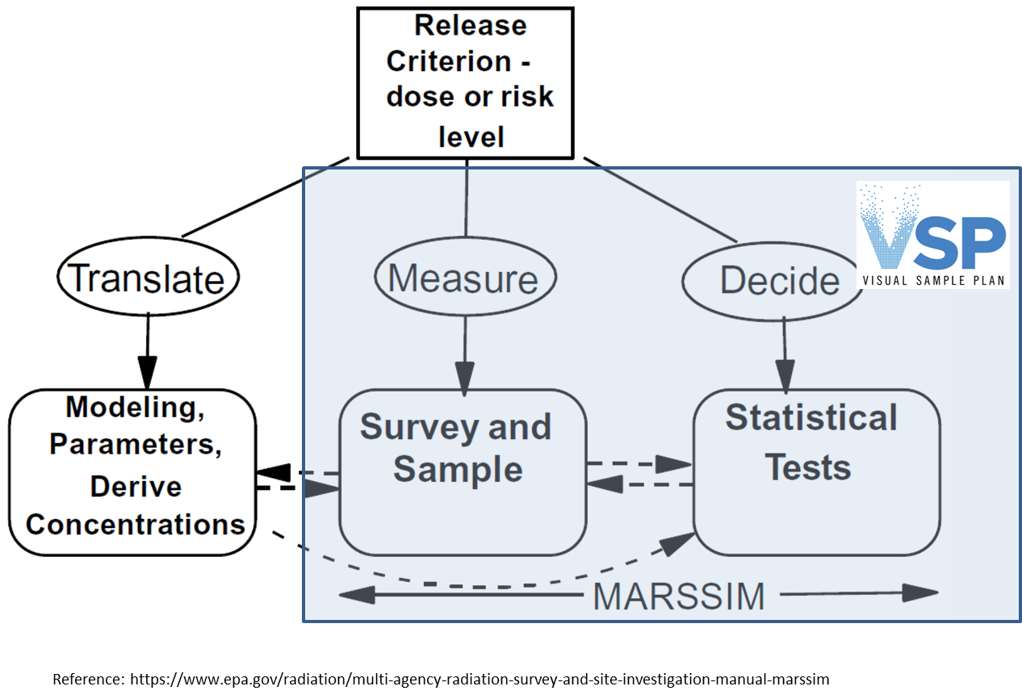
MARSSIM:
Measure and Decide
Planning Phase
Plan for data collection:
Data Quality Objectives (DQO)
Measure
Implementation Phase
Collect data with measurement techniques and quality assurance/quality control additives
Assessment Phase
Evaluate collected data against survey objectives – Data Quality Assessment (DQA)
Decide
Figure 1.1 in MARSSIM, Rev. 2
Decision-Making Phase
Make technically defensible decisions with specified level of confidence
Figure 2.2 in MARSSIM, Rev. 2
Reference: https://www.epa.gov/radiation/multi-agency-radiation-survey-and-site-investigation-manual-marssim

Slide 11
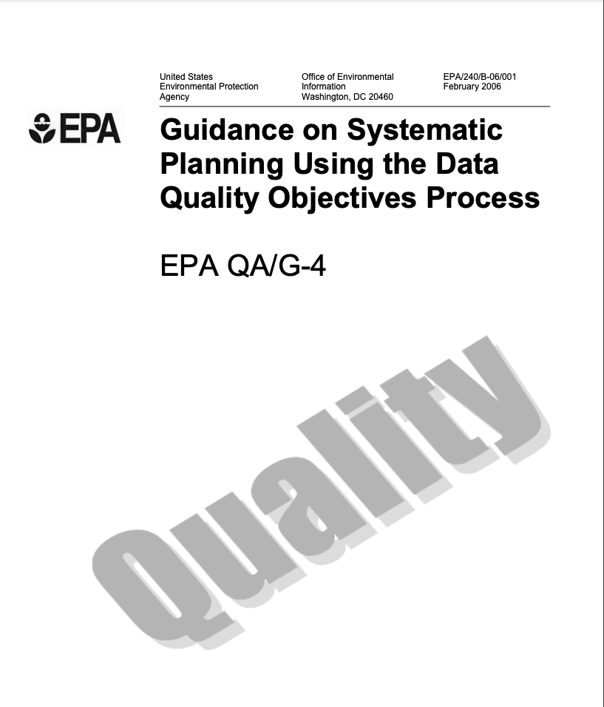
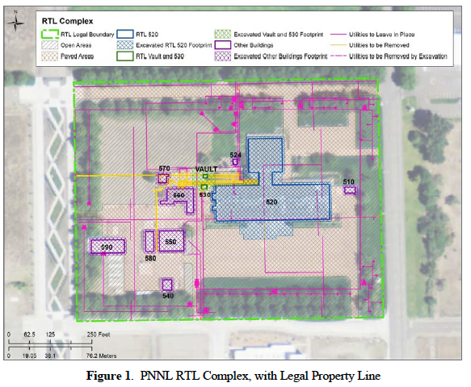
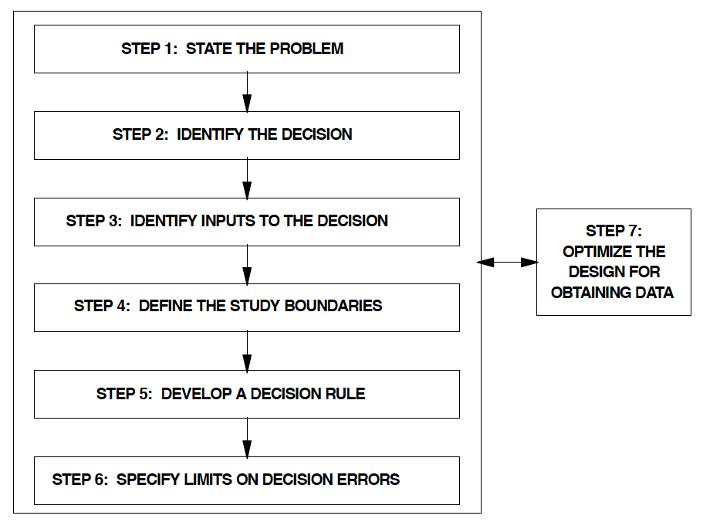
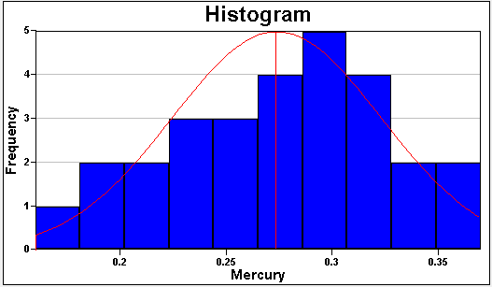
Measure:
Survey Design & DQO process
Planning Phase
Plan for data collection:
Data Quality Objectives (DQO)
DQO Process is a workflow that guides users to statistically defensible sampling plans
DQO Process steps
Contaminant
https://www.epa.gov/sites/production/files/2015-06/documents/g4-final.pdf
Notes:
DQOs involve a 7 step process
Site map and areas on map within which samples are needed
Statistical hypotheses to be tested
Expected total variability of data and expected analytical variability
Expected frequency and/or spatial distribution of data
Tolerable decision error rates
False positive, false negative

Slide 12
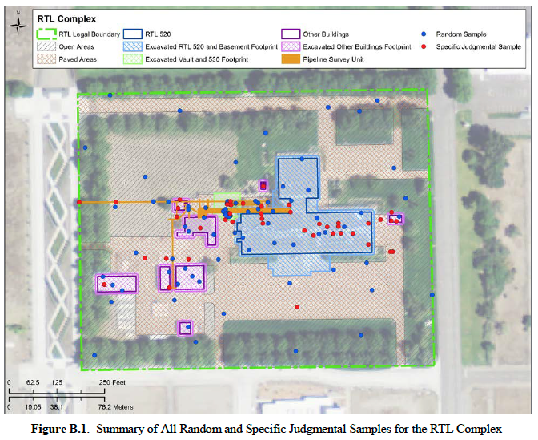
Measure:
Sampling Plan and Implementation
Implementation Phase
Collect data with measurement techniques and quality assurance/quality control additives
Sampling plan
  Sample locations
  Survey transects
  Analytical methods/procedures
  Action limits
VSP output includes documentation
Collect the data
Research Technology Laboratory (RTL) Disposition Program Final Status Survey Report. S740277-RPT-05

Slide 13
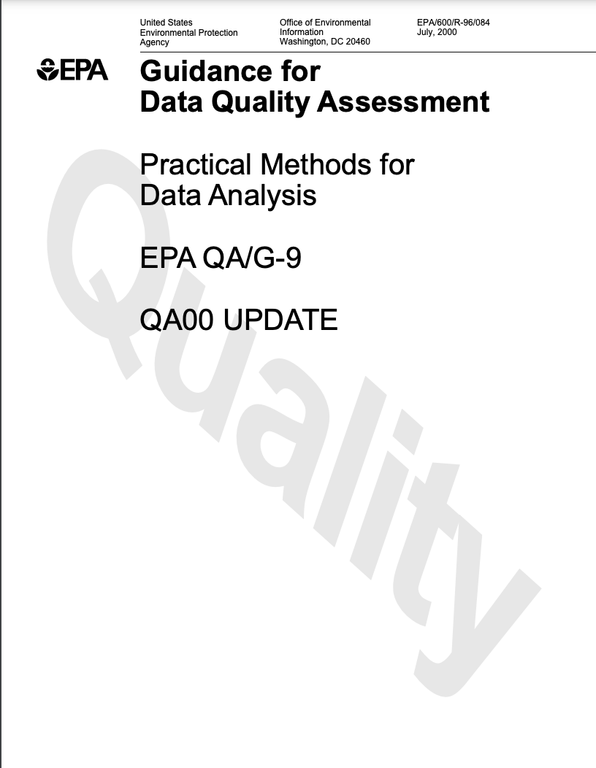
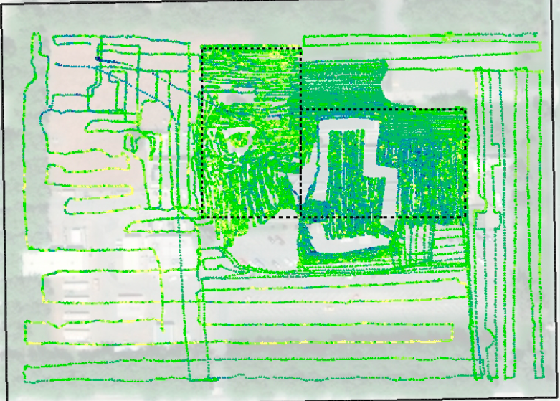
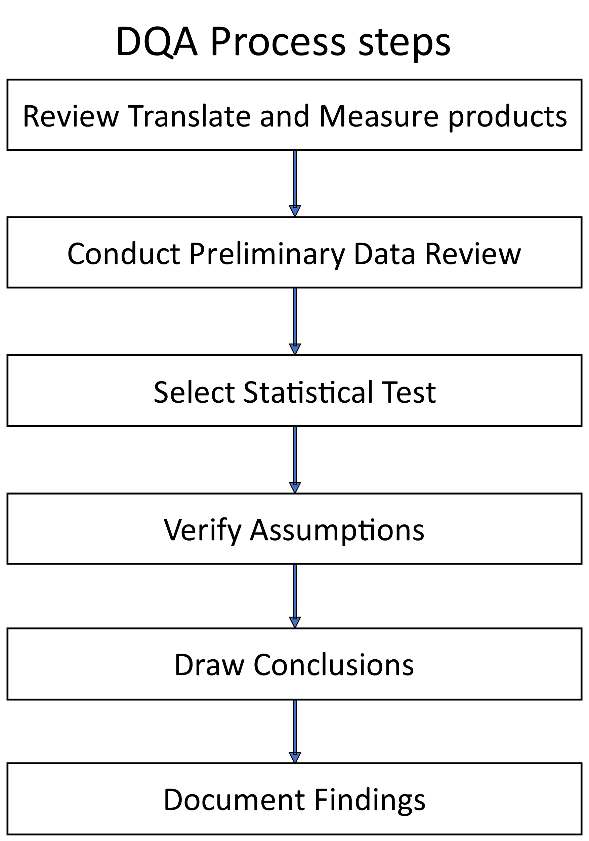
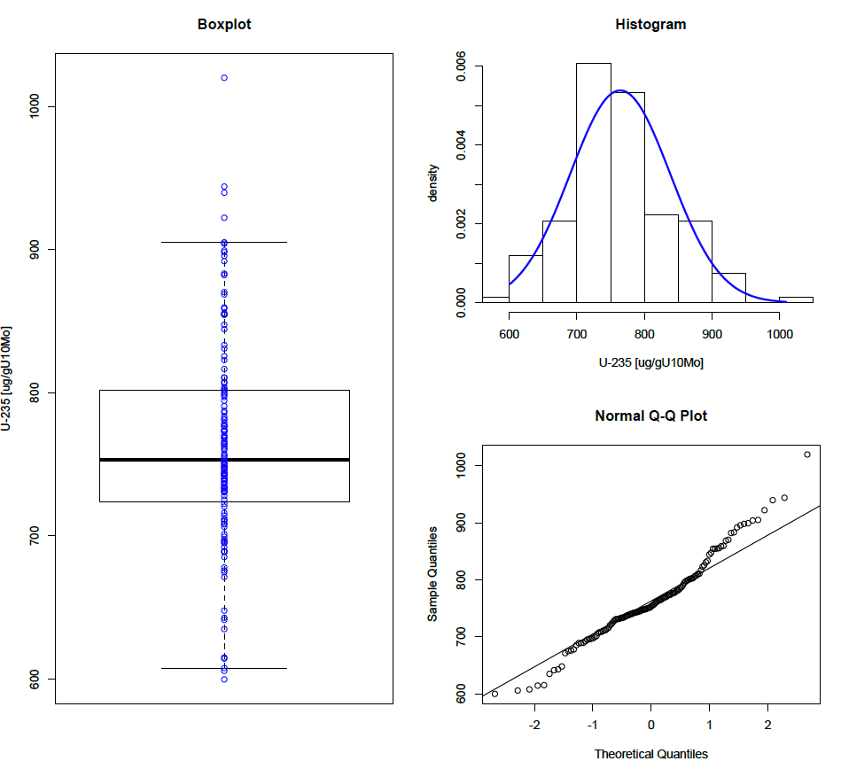
Decide:
Assessment & Statistical Assumptions
Assessment Phase
Evaluate collected data against survey objectives
- Data Quality Assessment (DQA)
https://www.epa.gov/sites/production/files/2015-06/documents/g9-final.pdf
Notes:
What hypothesis test was established in DQOs?
Assumptions must be verified now that data are collected

Slide 14
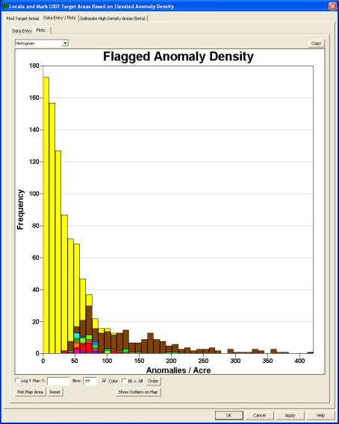
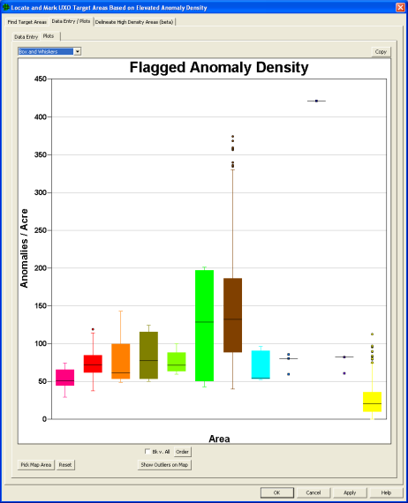
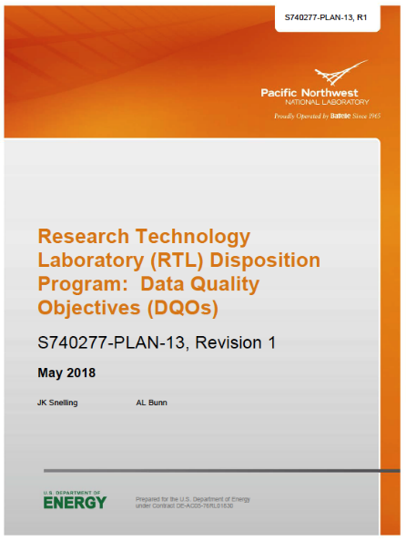
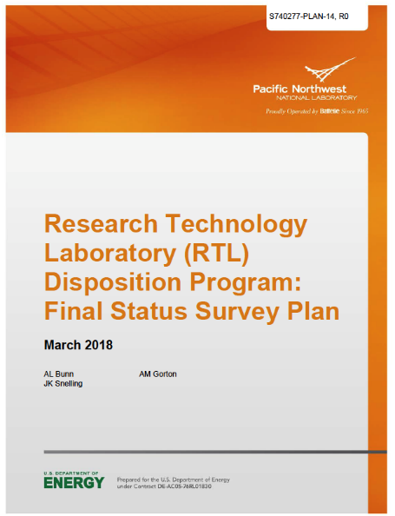
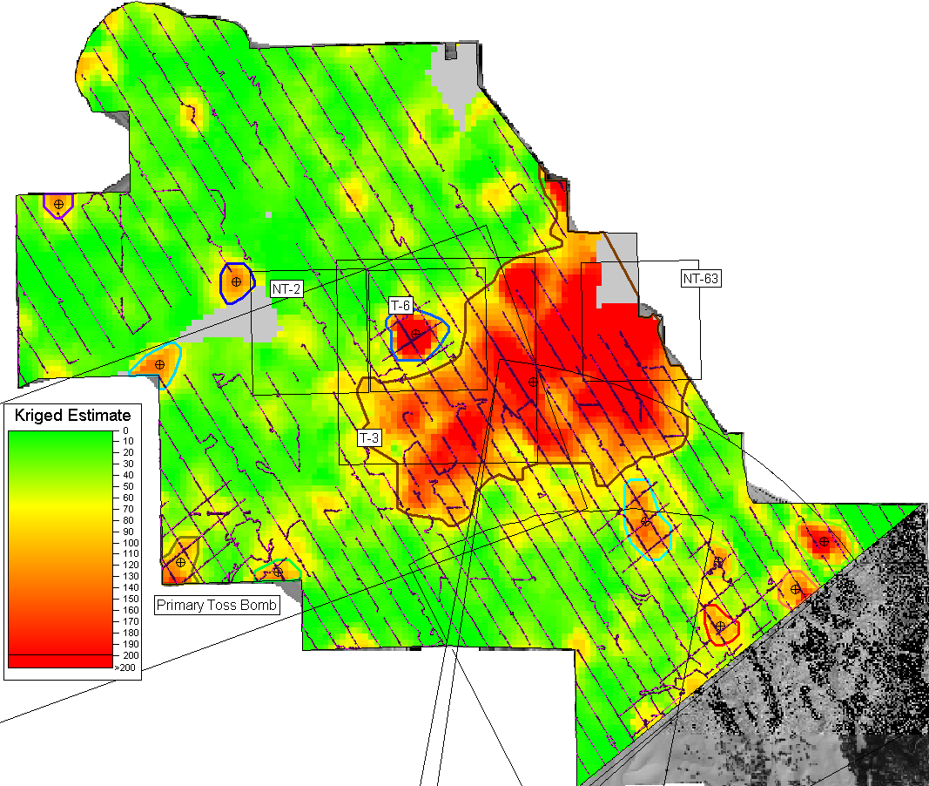
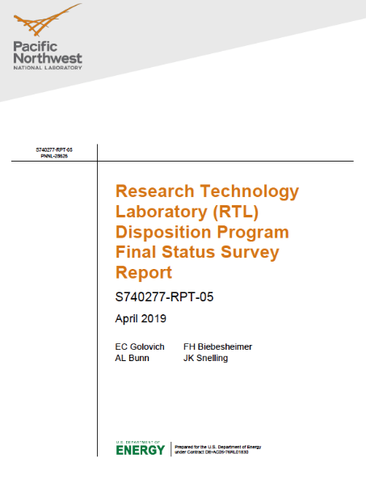
Decide:
Statistical test results & Documentation
Decision-Making Phase
Make technically defensible decisions with specified level of confidence
Notes:
Results include
P-values
Boundary delineations
Hot spot identification

Slide 15
Questions?
Figure 1-1 in MARSSIM, Rev. 2
Reference: https://www.epa.gov/radiation/multi-agency-radiation-survey-and-site-investigation-manual-marssim

