Slide 1

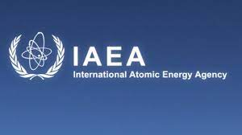
IAEA’s International Exercises and Technical Meetings of Radionuclide Transport in the Environment: A History
Stephanie Bush-Goddard
Senior Researcher
Office of Nuclear Regulatory Research
U.S. Nuclear Regulatory Commission
  RAMP User Meeting April 2021
Notes:
Hello, as Vered said my name is Stephanie Bush-Goddard.
I am a Senior Researcher at the US Nuclear Regulatory Commission in the Office of Nuclear Regulatory Research
This presentation is a history and status of one of the International Atomic Energy Agency's ongoing International Exercises.
This programs overall mission is to tests and validates models used for the transport of radionuclides thru the Environment.
The RAMP team thought it would be fitting to talk about international collaboration, as this is the 35th anniversary month of the Chernobyl event and why this particular exercise was started.
[NEXT SLIDE PLEASE]
45 seconds

Slide 2
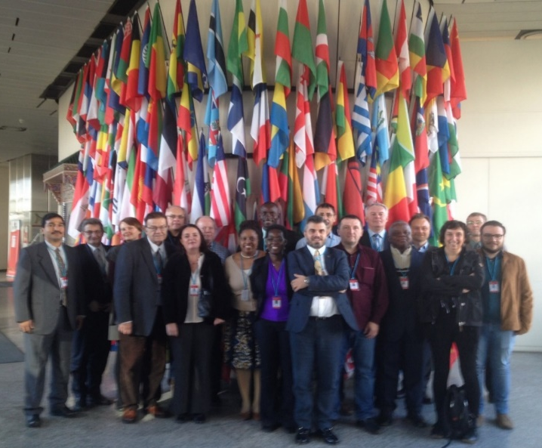
This International Exercise:
Who/What/Why
Recommended by the International Nuclear Safety Advisory Group
Goal: Share Knowledge and Expertise
Countries: ~30-40, Members: ~150
Working groups: 20-30 members
One combined meeting and ~2-3 WG meetings/year
Outcome: IAEA publications, journal articles
IAEA MODAIA II WG 3
Notes:
Following the Chernobyl accident and on the recommendation of the International Nuclear Safety Advisory Group, the IAEA established this Research Program.
These particular meetings started with a group of researchers from various countries with a common goal.: to share knowledge and expertise on the fate and transport of radionuclides in the environment from the Chernobyl accident.
The first technical meetings, called VAMP, which you will hear about shorty consisted of 4 working groups with about 50 people from approximately 15 countries.
Subsequent exercises grew to over 40 countries and over 150 people in numerous working groups.
There are usually one combined meeting at the IAEA headquarters in Austria each year and working group meetings throughout the year.
Each working group produces IAEA publications and journal articles in a hope to contributed to the improvement in models and the capabilities of modelers in IAEA. Member States.
[NEXT SLIDE PLEASE]
One minute

Slide 3
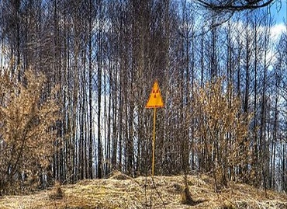
International Exercises:
Timeline
Chernobyl
Event
VAlidation of Model Predictions
BIOMASS
(1996-2003)
BIOsphere Modeling and ASSessment
VAMP
(1988 -1996)
EMRAS I & II
(2003-2007)
(2008-2011)
MODARIA I & II
(2012-2015)
(2016-2019)
Environment Modeling for RAdiation Safety
Modeling and
DAta for Radiological Impact Assessment
1986
1988
1996
2003
2012
Strengthens Collaboration and Advances the Science
Notes:
The Chernobyl accident was in April 1986.
VAMP, which stands for the Validation of Model Predictions, started in 1988 and concluded in 1996. It ran for 8 years.
After VAMP, there was BIOMASS. BIOMASS stands for Bioshere Modleing and Assessment. BIOMASS also ran for 8 years between 1996 and 2003.
After BIOMASS, the IAEA approved EMRAS. EMRAS stands for Environment Modeling for Radiation Safety.
ERMAS only lasted for 4 years from 2003 to 2007, but IAEA started ERMAS II from 2008 to 2011 to follow-up on ERMAS I and studies showed that 8 year exercises where too long.
After ERMAS came MODARIA and it started in 2012. The MODARIA programs was also 4 years, similar to ERMAS and ended in 2019.
Nevertheless, to this date MODARIA participants are trying to get publications and journal articles finished and published.
[NEXT SLIDE PLEASE]
1:15 minutes

Slide 4
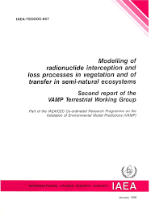
VAMP (1988-1996) VAlidation of Model Predictions:
Four Working Groups
Terrestrial Working Group
  Resuspension, Food Processing losses, Seasonality
Urban Working Group
Aquatic Working Group
  Cs-137 in freshwater (lakes, rivers)
Multiple Pathways Working Group
  Data from Finland and Czech Republic
  Used GENII and RESRAD, among other transport codes
Notes:
So lets dig a little into VAMP. VAMP had four working groups.
The Terrestrial Working Group, the Urban Working Group, the Aquatic Working Group and the Multiple Pathways Assessment Working Groups.
The Terrestrial Working Group researched the resuspension of particles in air, the variation of contaminated crops with the seasons and a number of interception, retention and loss processes from vegetation.
The Urban Working Group modelled radiation exposure of urban populations through the external and inhalation pathways.
The Aquatic Working Group studied the turnover of caesium-137 in freshwater systems. It was divided in two subgroups, one on lake modelling and the other about rivers.
The Multiple Pathways Assessment Working Group as the name implies modeled data in the environment to humans via all pathways using Chernobyl fallout data from the Czech Republic and Finland
The researchers compared several codes and models including GENII and RESRAD. In fact, the developers, Bruce Napier from Pacific Northwest National Lab and Charley Yu from Argonne National Lab participated in this working group are participating in the RAMP meeting this week, so there’s a lot of history here.
The VAMP program produced numerous documents and this picture a publication of the Terrestrial working group’s work.
[NEXT SLIDE PLEASE]
1.5 minutes

Slide 5
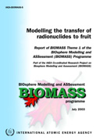
BIOMASS (1996- 2003)
BIOsphere Modeling and ASSessment:
Themes
VAMP was mainly from Chernobyl Release
BIOMASS
  Chernobyl scenarios with others
  Environmental Cleanup
  Methodology for long term waste disposal
Theme 1: Radioactive Waste Disposal
Theme 2: Environmental Releases
Theme 3: Biosphere Processes
Notes:
Moving on to BIOMASS.
While VAMP concentrated on Chernobyl Releases, BIOMASS continued with Chernobyl but included other sites.
The exercises, now 10 years after Chernobyl, also included topics such as environmental cleanup and the methodology for long term waste disposal.
As such, BIOMASS developed three over all themes.
Theme 1 was Radioactive Waste Disposal
Theme 2 was Environmental Releases
Theme 3 was Biosphere Processes
[NEXT SLIDE PLEASE]
45 seconds

Slide 6
BIOMASS:
Themes
Waste Disposal
Environmental Releases
Working Group 1
Biosphere Process
Working Group 1
TG 1: Principles for the Definition of Critical and Other Exposure Groups
TG 2: Principles for the Application of Data to Assessment Models
TG 3: Consideration of Alternative Assessment Contexts
TG 4: Biosphere System Identification and Justification
TG 5: Biosphere System Descriptions
TG 6: Model Development
Working Group 2
long-term tritium dispersion in the environment
Working Group 2
radionuclide uptake by fruits
Working Group 3
radionuclide migration and accumulation in forest ecosystems
The reconstruction of radiation doses received by people from past releases of radionuclides (I-131) to the environment at the Hanford Site
Testing of environmental transfer models using data from the remediation of a radium extraction site in Belgium
Task Groups
Working Groups
Working Groups
Notes:
The themes had several task groups and working groups under them.
For example, Theme One Radioactive Waste disposal had 6 task group and their mandate was to develop the reference biosphere for long-term safety for radioactive waste. This was a change from VAMP in that it focused on task group that defined, identified and modeled biosphere systems.
Theme 2 had only 2 working group. Working group one reconstructed doses from the Hanford Site and Working Group 2 tested models from data of a radium site in Belgium.
Theme 3 dealt with tritium, which has been carried throughout these technical meetings even until today. Theme 3 also continue research on radionuclide update by fruit and migration and accumulation of radionuclides in forest ecosystems.
[NEXT SLIDE PLEASE]
1 minute

Slide 7
BIOMASS (BIOsphere Modeling and ASSessment): IAEA Publications
Modelling the Migration and Accumulation of Radionuclides in Forest Ecosystems, (IAEA BIOMASS-1) (2002)
Testing of environmental transfer models using data from the atmospheric release of Iodine-131 from the Hanford site, USA, in 1963, (IAEA-BIOMASS-2) (2003)
Modelling the environmental transport of tritium in the vicinity of long term atmospheric and sub-surface sources, (IAEA-BIOMASS-3) (2003)
Testing of environmental transfer models using Chernobyl fallout data from the Iput River catchment area, Bryansk Region, Russian Federation, (IAEA-BIOMASS-4) (2003)
Modelling the transfer of radionuclides to fruit, (IAEA-BIOMASS-5) (2003)
"Reference Biospheres" for Solid Radioactive Waste Disposal, (IAEA-BIOMASS-6) (2003)
Testing of environmental transfer models using data from the remediation of a radium extraction site, (IAEA-BIOMASS-7) (2004)
Notes:
As with VAMP, BIOMASS produced numerous IAEA publications and well as Journal Articles.
On this slide, is a list of IAEA BIOMASS publications to show the depth and breath of these meetings.
BIOMASS-1 was Forest Ecosystems, BIOMASS 2 was the Hanford Site, 3 was transport of tritium,
BIOMASS 4 was Chernobyl fallout data in Russia. 5 was the transfer of radionucluides to Fruit,
BIOMASS – 6 was Reference Biospheres and BIOMASS 7 was the Radium Extraction Site in Belgium.
This is was a move from the Tec Doc series of VAMP. For Example BIOMASS 6 was a document with assessment concepts, societal assumptions and philosophies,
[NEXT SLIDE PLEASE]
1 minute

Slide 8
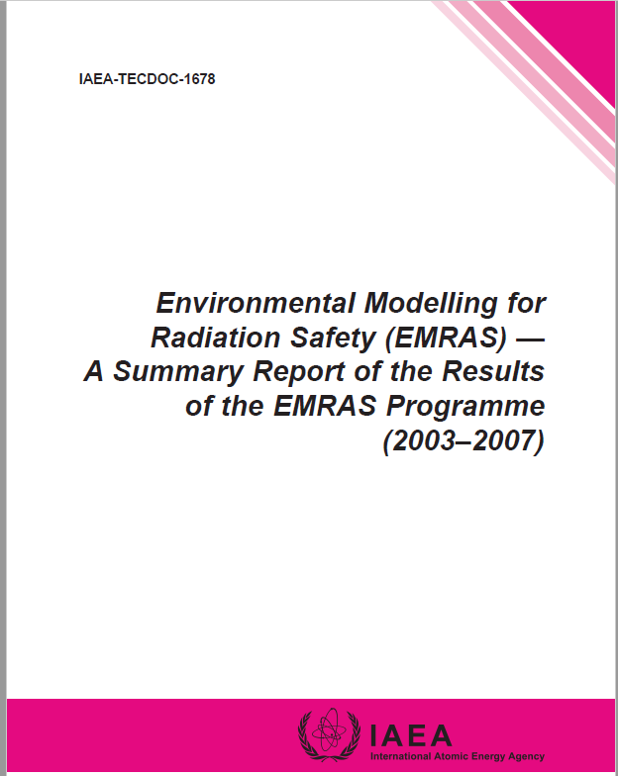
EMRAS (2003-2007):
Environmental Modeling for RAdiation Safety
Theme 1: Radioactive Release Assessment
Theme 2: Remediation of Sites with Radioactive Residues
Theme 3: Protection of the Environment
Notes:
Now moving to EMRAS
EMRAS also had themes.
Theme 1 was Radioactive Release Assessment
Theme 2 was Remediation of Sites with Radioactive Residues
Theme 3 was Protection of the Environment
EMRAS, unlike VAMP and BIOMASS, published a summary report of the entire program, because as you will see on the next few slides, the ERMAS program consisted of technical exercises and revising existing IAEA handbooks and documents.
There was also a paradigm shift to concentrate on direct biota dose as oppose to dose to humans from biota. This was captures in Theme three.
[NEXT SLIDE PLEASE]
1 minute

Slide 9
EMRAS (2003-2007):
Themes
Radioactive Release Assessment
Remediation of Sites with Radioactive Residues
WG 1 (WG 5): Modelling of naturally occurring radioactive materials (NORM) releases and the remediation benefits for sites contaminated by extractive industries (U/Th mining and milling, oil and gas industry, phosphate industry, etc.)
Protection of the Environment
Working Group 1: Revised the IAEA Technical Report Series No. 364 “Handbook of parameter values for the prediction of radionuclide transfer in temperate environments (TRS-364)
Working Group 2: Modelling of tritium and carbon-14 transfer to biota and man
Working Group 3: Chernobyl I-131 release: model validation and assessment of the countermeasure effectiveness
Working Group 4: Model validation for radionuclide transport in the aquatic system “Watershed-River” and in estuaries
WG 2 (WG 6): Remediation assessment for urban areas contaminated with dispersed radionuclides
Used RESRAD RDD
Working Group 1: Model validation for biota dose assessment working group
Modelling Radiation Exposure and Radionuclide Transfer for Non-human Species.
Theme 1
Theme 2
Theme 3
Notes:
Just like BIOMASS the themes had several working groups under them.
For example, a working group under Theme 1 revised the IAEA Handbook on Parameter values, while other working groups dealt with specific radionuclides and scenarios, such as organically bound tritium update in plants, animals and fish.
Theme 2 had 2 working group. One working dealt with NORM because the IAEA had not had any involvement with NORM other than on the regulatory side.
The second working group was called the Urban Remediation Working Group. This working modelled a town in Ukraine and used computer codes including RESRAD RDD that will be highlighted on Wednesday.
Theme 3 was a matrix of Theme 1 and 2, but focused on the protection of the environment.
Computer codes used in this Working group included RESRAD Biota developed in the US and ERICA developed by European partners.
[NEXT SLIDE PLEASE]
1 .15 minute

Slide 10
EMRAS II (2008-2011):
Themes
Reference Approaches Biota
Working Group 1 Reference Methodologies for "Controlling Discharges" of Routine Releases
Working Group 4 – "Biota Modelling"
Working Group 2 – Reference Approaches to Modelling for Management and Remediation at "NORM and Legacy Sites"
Working Group 3 – Reference Models for "Waste Disposal"
Working Group 5 – "Wildlife Transfer Coefficient" Handbook
Working Group 6 – Biota "Dose Effects Modelling
Reference Approaches Human
Notes:
Moving on to EMRAS II
ERMAS II had 3 themes and a total of 9 working groups.
These meetings follow the model of the past programs, but took ideas from surveys, conferences, the IAEA Secretariats and Consultants.
As such, some of the topics they wanted to avoid were topics for “academic only” interest and instead link to practical issues and needs of countries.
As such the goal was to try to reach consensus on modelling philosophies and approaches.
This resulted in the development of referenced approaches, as one theme was references approaches for humans and a separate theme was approaches for biota dose.
As an example, these working groups modeled aquatic releases to the Ottawa River in Canada, mining and milling sites in France and a host of other countries radioactive sites that included reactor, medical and other waste.
[NEXT SLIDE PLEASE]
1:00

Slide 11
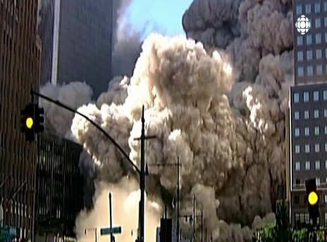
EMRAS II (2008-2011):
Themes
Emergency Situations
Working Group 7 – "Tritium" Accidents
Working Group 8 – "Environmental Sensitivity"
Working Group 9 – "Urban" Areas
Other Influences of ERMAS II
The 2007 ICRP Recommendations
-------
Needs of Developing Countries
-------
Nuclear Renaissance
Effects of Climate Change
Notes:
The last Theme, Emergency Situations was somewhat of a new topic, that pulled from a variety of scientific, social, environmental and sometimes political issues.
Working Group 7 was called tritium accidents. This Working group had several task groups that studied tritium deposition, uptake, retention and movement in soil.
The environmental sensitivity group looked a vulnerable populations and developed a radioecology sensitivities document.
The Urban Areas working group modeled dirty bombs and potential countermeasures and remediation efforts for reducing human exposures.
ERMAS was also influences by the Implications of 2007 ICRP Recommendations, Needs of developing countries, the Nuclear Renaissance and Effects of Climate Change. However these needs would manifest themselves in the next program.
[NEXT SLIDE PLEASE]
1 min

Slide 12
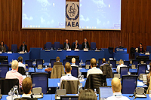
MODARIA (2012- 2015):
Leading Topics
The Fukushima Daiichi nuclear accident in 2011
Member States launching nuclear power programs
Member States need to control residues containing enhanced levels of natural radioactivity that are produced during industrial activities or during mining of metals and uranium.
Notes:
Our final exercise was called MODAIRA I and II
MODRIA was greatly influences by, you guest it, Fukushima.
However, as I said on the previous slide IAEA wanted to capture of needs of Member States launching Nuclear Power program, as a number of States have already launched, or plan to launch these program, it was important to help them have capabilities for assessing radiological impacts.
The last important issues was the need of Member States to control residues containing NORM that are produced during industrial activities or during mining of metals and uranium.
[NEXT SLIDE PLEASE]
:45

Slide 13
MODARIA (2012- 2015):
Themes
Remediation of Contaminated Areas
Uncertainties and Variability
Exposures and Effects on Biota
Marine Modelling
Notes:
As such MODARIA had 4 themes listed here and a total of 10 working group.
The groups work centered around many issues that had been raised in the past programs and over the now 26 years of these exercise, but now with Fukushima’s event.
So I’ll spare you the details for a number of reasons,
Number one is that the numerous sites studied, and the complexity of issues warranted a presentation in itself.
Another is that the programs work is very transparent and easy to access. As such all material developed for MODARIA is now available via the IAEA portal called the Global Nuclear Safety and Security Network
[NEXT SLIDE PLEASE]
:50

Slide 14
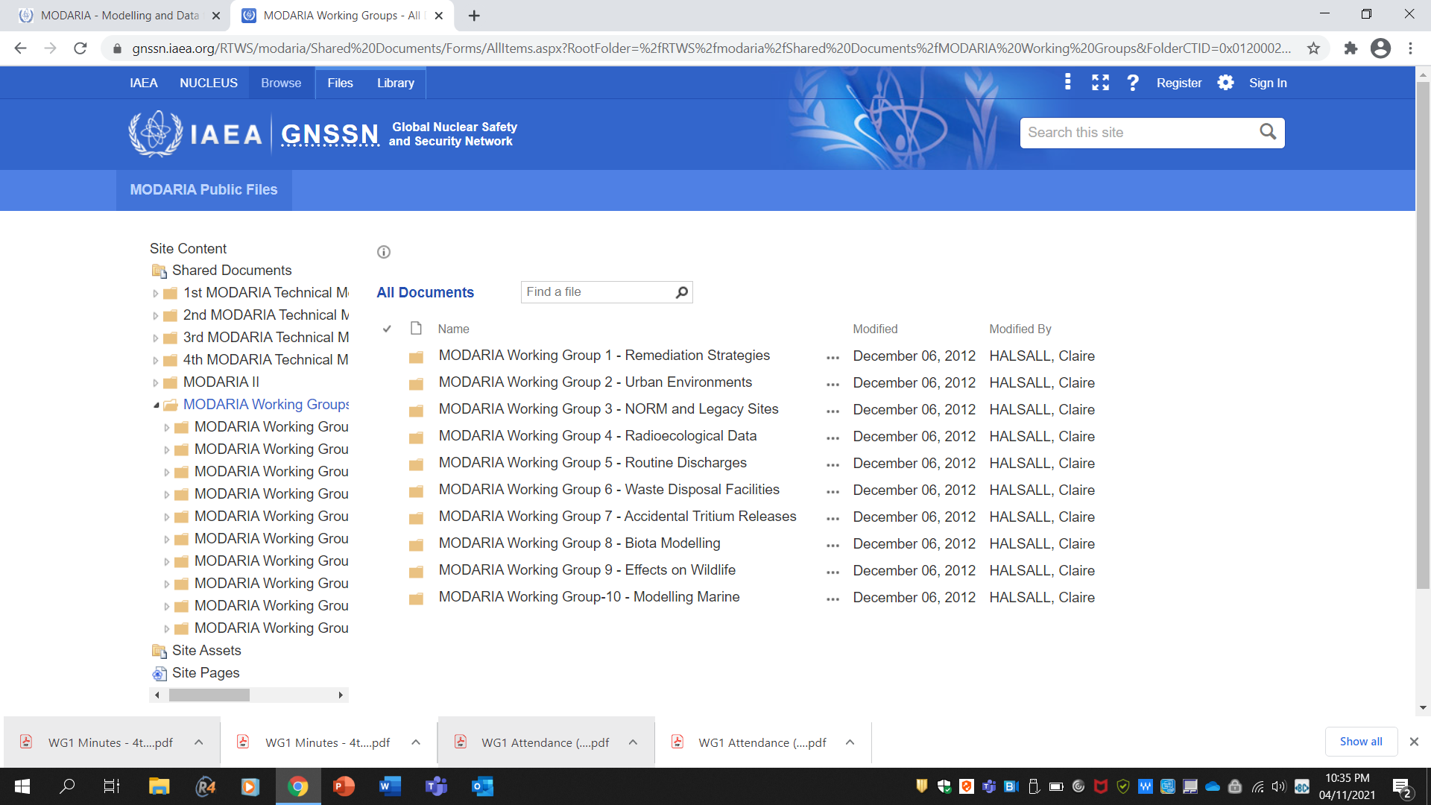
Notes:
The IAEA Global Nuclear Safety and Security Network is a web platform of IAEA information
Shown here are all the MODRIA working Group documents on that platform
These folders contain the agenda, meeting notes, participants list and technical documents of the 10 working group
As such, the portal is the gateway to sharing information and knowledge, facilitating multilateral cooperation and coordination
And lastly, building capacity, which was a need of developing countries and those launching new nuclear power programs.
NEXT SLIDE
:45

Slide 15
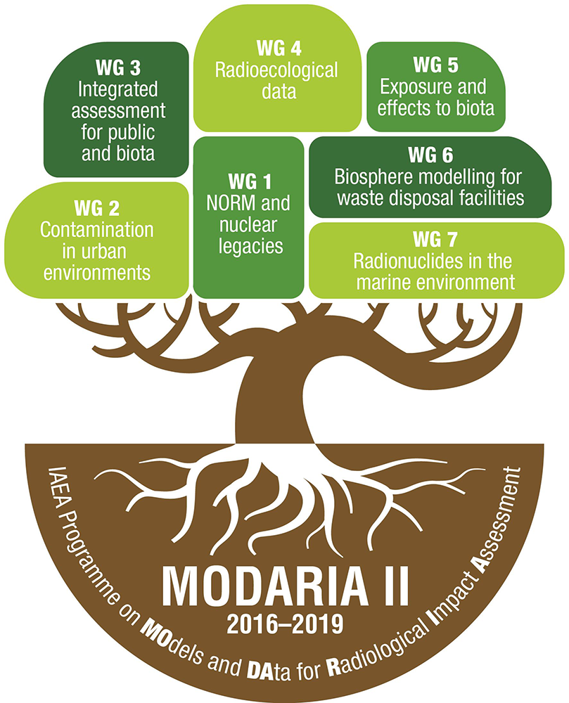
Notes:
This leads to the last and current program, MODARIA II. I say current because there is no new program, and the working group members are still finishing IAEA publications and journal articles for this programs
However, like the past programs, MODAIRA II has 7 working groups and all the information is located in the IAEA Global Nuclear Safety and Security Network platform as shown on the previous page.
Therefore, I’ll end this presentation, not with explaining the subject of each group, but with information on a specific working group:.
It is MODARIA II working group was #3. The working group’s name is “Integrated assessment for public and biota.”
[NEXT SLIDE PLEASE]
:50

Slide 16
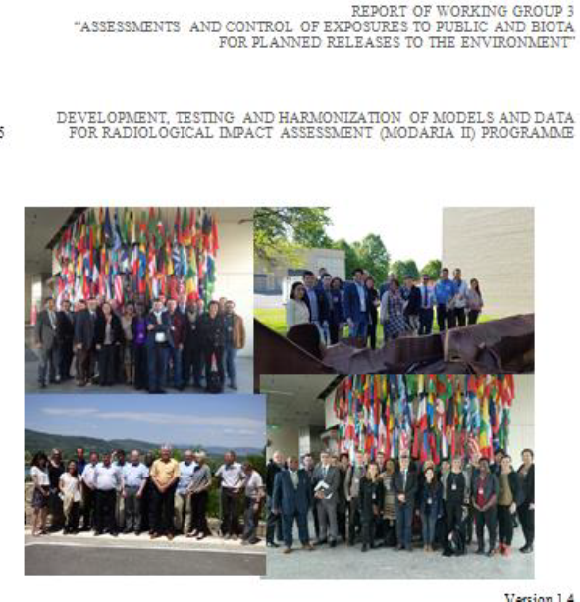
WG3: Integrated assessment for public and biota
Goal: An integrated approach for humans and biota
Activities/Duties
Model routine discharges
Compared computer codes
Developed surveys
Trained
Notes:
Working Group 3, lead by Juan Carlos Mora of Spain was a group of approximately 34 representatives from over 16 countries.
Over the four years, we meet a total of 8 times in difference places and had plenty of homework.
Our overall mandate was to develop an integrated approach to humans and biota from routine discharges from several facilities.
The more experienced modelers used computer codes such as PC Cream from the UK and CROM from Spain to explore cases where an explicit assements was needed, they also includedthe more advanced models for tritium and Carbon 14.
Some of us, from regulatory bodies, lead surveys to ascertain the depth of legislation at the Country level and regulations at the state and local levels that had been developed to include both limits to humans and reference level for animals and plants.
and the newest members did a lot of listening, took training and participated where possible.
There were always side bars of training sessions, discussions of papers to be prepared, proposals for more projects and presentations.
[NEXT SLIDE PLEASE]
1: 15

Slide 17

We achieved some conclusions
Most counties had protection of humans at the lightest level of legislation and regulations but not necessary protection of biota
Several codes do exist ready to prove (rather than assume) integrated dose assessments on human and absorbed dose on biota
Assessments carried out with difference codes resulted in equivalent results and all of them below generic screen reference levels
Notes:
Finally, we did achieve some conclusions.
Most counties had protection of humans at the lightest level of legislation and regulations but not necessary protection of biota.
We proved that several codes did exist ready to perform integrated dose assessments on human and absorbed dose on biota.
Additionally, assessments carried out with difference codes resulted in equivalent results and all of them below generic screen reference levels, which was expected because we were dealing with routine discharges.
As I said before, most documents with all our conclusions, including the IAEA publications and journal articles are still in draft awaiting review.
Next slide please
45 sec

Slide 18


Thank You
Notes:
Thank you for the opportunity to present this long running program.
As with all history, it is “his” story or in my case “her” story.
As such, this presentation is a snap shot of my literature searches and experiences.
There were working groups not mentioned in the various technical meetings.
Therefore, I apologize, if I left out very important details in describing any of these programs, their mission, intent and outcomes.
Finally, there was work within my own working group that I did not participate in.
However, I have noticed that the diversity of these working groups over the years that included researchers, regulatory personnel, professors, private companies, executives and technical staff have lead to a very comprehensive program.
Thank you.
45 sec

