Slide 1


NRC Drones Project:
Drones for Decommissioning
SPRING 2021 RAMP INT’L USERS GROUP MEETING
April 12-16, 2021
Co-Hosted with Ukraine
Amoret Bunn, Ph.D.
Pacific Northwest National Laboratory
PNNL-SA-161377

Slide 2
Agenda
What are Drones?
Why use Drones?
How are Drones being used today?
NRC recognizes the need using Drones
Goal, Project Planning and Outcomes of the Drone project

Slide 3

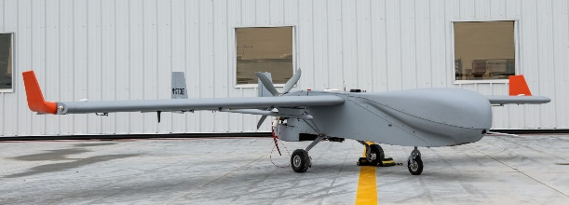
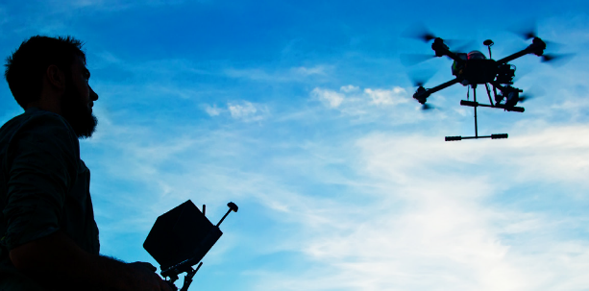
Drones are…
Unmanned Aerial Vehicle (UAV)
  An aircraft without a human pilot on board
  Unmanned Aerial System (UAS) is the
  UAV, ground-based controller and
  communication system
Operate under remote control by a human operator (pilot)…
or with various degrees of autonomy
PNNL’s Fixed-wing drone, Arctic Shark
Multirotor UAV
Notes:
Drone image from FAA: https://faadronezone.faa.gov/#/

Slide 4
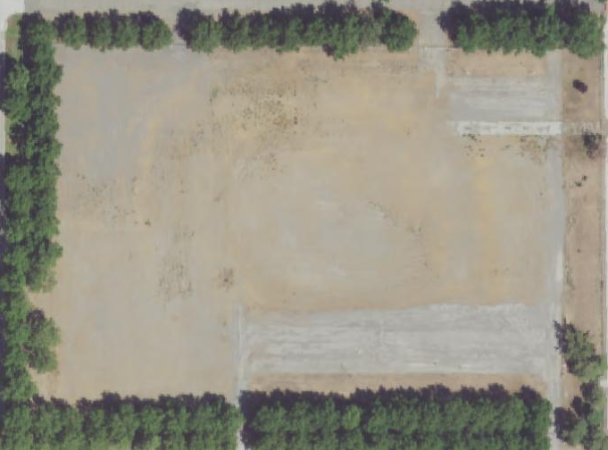

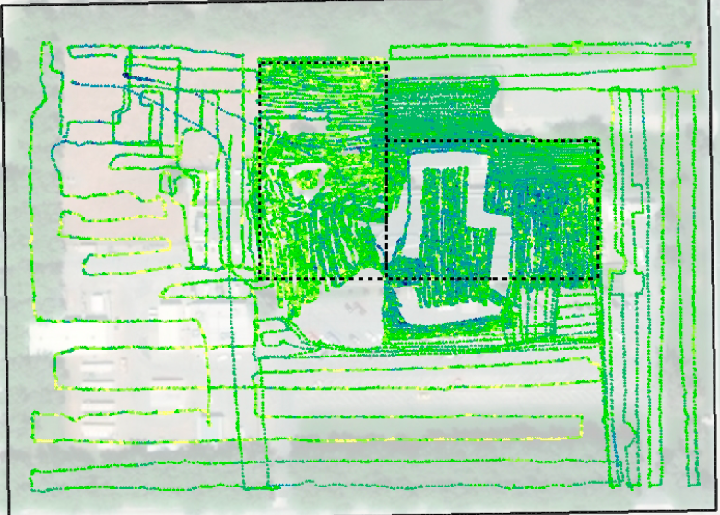
Why use Drones?
Radiological surveys for decommissioning is currently completed by a human collecting scanning data
Minimum Detection Concentration (MDC): DCGL (action level) very low for a final status survey
Time:
Human survey took 5 days, with 2 staff
Survey Area: 0.5 Km²
(5 hectare)
Notes:
ALARA concerns
OSHA concerns (terrain, slopes, etc)

Slide 5


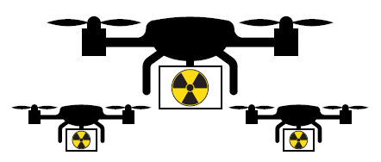

Why use Drones?
Piloted
Autonomous
Unmanned Aerial System
Unmanned Aerial System
Swarming UAVs
ATV-lead
Surveys
Unmanned Crawler
Unmanned Crawler
Human
Surveys
Tandem Systems
Now Near Future

Slide 6
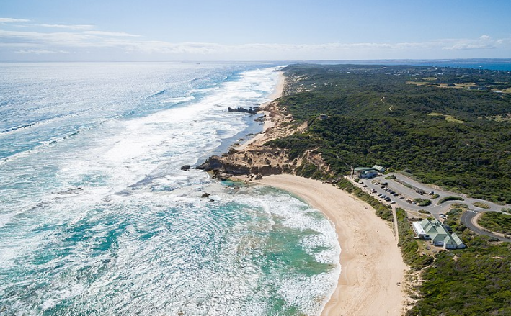
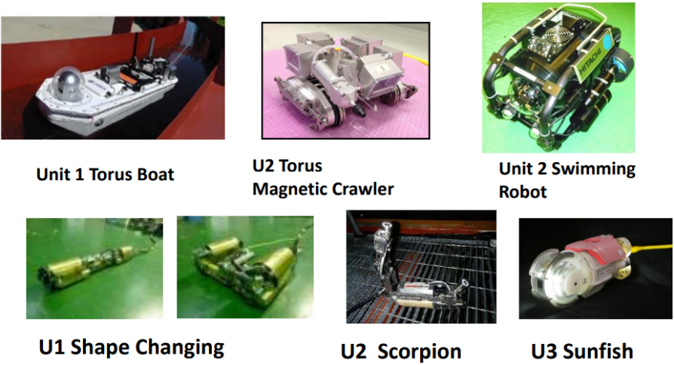
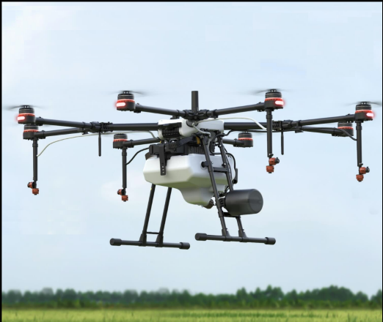
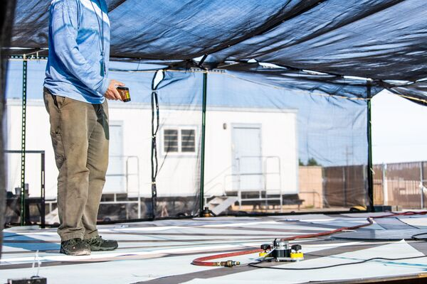
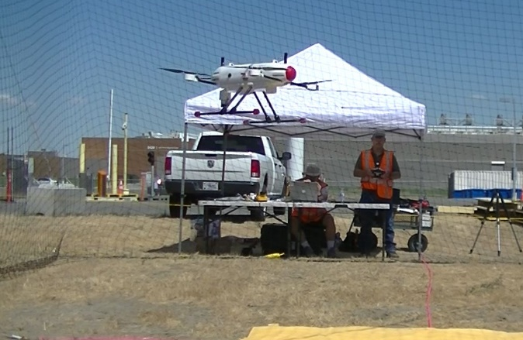
How are Drones being used Today?
Characterization at Fukushima Daiichi
Photography
https://commons.wikimedia.org/wiki/File:DJI_0014Drone_photography.jpg
file:///C:/Users/D3J524/Downloads/fukushima2021-presentation_slides.pdf
Distribution
Characterization of Storage Tanks
Emergency Response
Notes:
Aerial photography – copyright usage – Open with attribution – see https://commons.wikimedia.org/wiki/File:DJI_0014Drone_photography.jpg
Fukushima: ANS presentation, copyright usage with attribution,
available at: file:///C:/Users/D3J524/Downloads/fukushima2021-presentation_slides.pdf
Distribution: Benton County Mosquito Control Board, 2021, copyright usage with attribution, available at: https://www.facebook.com/BentonMosquito/photos/pb.596208727213377.-2207520000../1860085774158993/?type=3&theater
Characterization of Storage Tanks: PNNL photo, available at https://pnnlcreative.getbynder.com/media/
Emergency Response: PNNL photo, available at https://pnnlcreative.getbynder.com/media/

Slide 7
NRC Recognizes the Need for:
Knowledge and awareness of new and advanced technologies for characterization and survey of radiological and hazardous contaminants and remediation and exploring potential application/implications for regulatory compliance.
Demonstrate decommissioning practices with state-of-the-art processes and practices using autonomous systems (drones).
Specifically, to provide guidance to licensees to increase the understanding of factors that affect measurement techniques

Slide 8
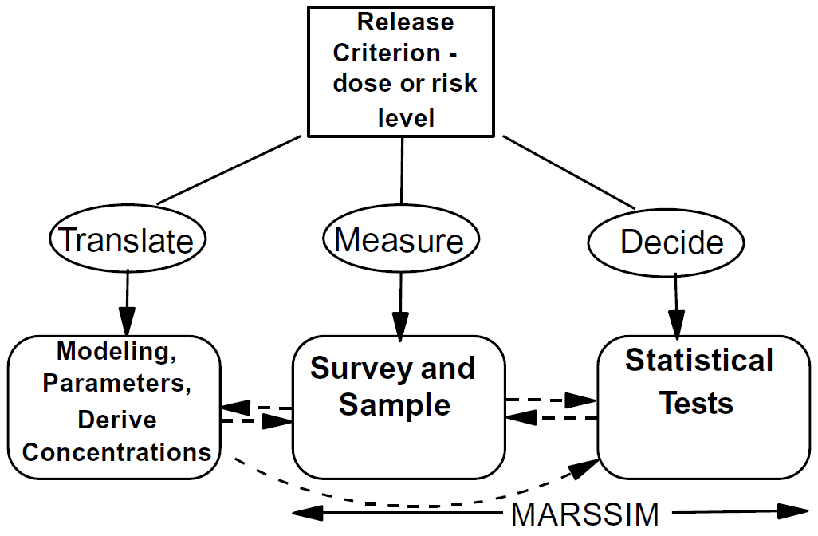




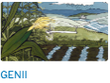
NRC’s Decommissioning
Decommissioning is performed in accordance with 10 CFR 50, as part of termination of license (10 CFR 50.82) and release of the facility or site for unrestricted use (10 CFR 50.83 and 10 CFR Part 20, Subpart E).
Guidance for conducting surveys includes:
  Multi-Agency Radiation Survey and Site Investigation Manual (MARSSIM) NUREG-1575
  Minimum Detectable Concentrations with Typical Radiation Survey Instruments for Various Contaminants and Field Condition (NUREG-1507)
Criteria for Decommissioning (10 CFR 20, Subpart E):
  Site will be considered acceptable for unrestricted use if residual radioactivity that is distinguishable from background radiation results in a TEDE to an average member of the critical group does not exceed 0.25 mSv/year
  (25 mrem/year)

Slide 9
Goal of NRC’s Drone Project
Goal:
Demonstrate the use of autonomous systems (drones) for decommissioning activities, improving knowledge of scanning systems, meeting Action Levels (DCGLs) and for possible inclusion in guidance documents and computer tools (such as VSP)
How: Outdoor Scenario
Test and evaluate radiation detector's ability to meet the Data Quality Objectives (DQOs), varying height off ground and velocity of drone
Notes:
DQOs for a specific scenario(s)?

Slide 10
Project Planning
Drone Payload:
Radiation detector
GPS – navigation system vital to flight performance
Data storage
Sensors to detect ground and surrounding objects
Camera (gimble stabilization)
Tradeoffs:
Weight of payload
Power (flight time, flight distance)
Quality of data (precision, accuracy, representativeness)
Selection of Drone
Notes:
Do detection limits fall under precision or accuracy?

Slide 11
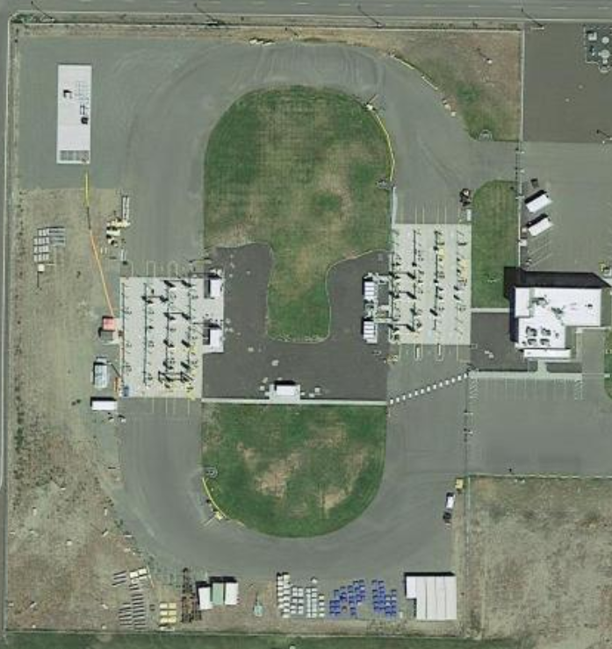
Project Planning
Identify characteristics of decommissioning projects for testing objectives
Radionuclides of interest
Detector parameters
Outdoor challenges
Build project plan based on:
MARSSIM (e.g., DQOs)
Minimum Detection Concentrations
Statistical analysis
Fence line

Slide 12
NRC-PNNL Communication Plan
NRC Actions
NRC Review on the Project Plan
NRC Review Prototypes
NRC Comment on Technical Report
Witness Drone Demonstration at PNNL
MAR
2021
APR
2021
MAY
2021
JUN
2021
JUL
2021
AUG
2021
SEP
2021
OCT
2021
NOV
2021
DEC
2022
JAN
2022
FEB
2022
Develop Project Plan, including Test Bed Plan & DQOs
Develop functional drone/sensor protypes for survey
Demonstration of Drones
Prepare PNNL Technical Report and Journal Article
PNNL Actions

Slide 13
Outcome of the Project
Define the scientific/technical opportunities for the future of drones for decommissioning
Refining radiation detectors – detection limits
Drone flight options:
  Hover, dwell, return
  Swarm and tandem operations

Slide 14
Drones can Team with US
Piloted
Autonomous
Unmanned Aerial System
Unmanned Aerial System
Swarming UAVs
ATV-lead
Surveys
Unmanned Crawler
Unmanned Crawler
Human
Surveys
Tandem Systems
Now Near Future

Slide 15
Outcome of the Project
Define the scientific/technical opportunities for the future of drones for decommissioning
Refining radiation detectors – detection limits
Drone flight options:
  Hover, dwell, return
  Swarm and tandem operations

Slide 16
Welcome Your Ideas!
Please let us know if you have ideas to use drones for decommissioning!
Amoret.Bunn@pnnl.gov
NRC RAMP program managers
Thank you to the NRC Drone Supporters:
Stephanie Bush-Goddard, NRC
Bruce McDowell, PNNL
Deborah Fagan, and many more

