Slide 1

Using the DandD Code to Derive Dose-Based Screening Values for the
U.S. Nuclear Regulatory Commission's Radium Program
Oak Ridge Associated Universities
April 16, 2021
Radiation Protection Computer Code Analysis and Maintenance Program User Group Meeting
Christopher Grossman
U.S. NRC
David A. King, CHP, PMP
ORAU

Slide 2

Presentation Organization
Background, from a historical perspective
The DandD conceptual model vs. Radium Program objectives
Dose model method
Results and discussion
RAMP Website

Slide 3
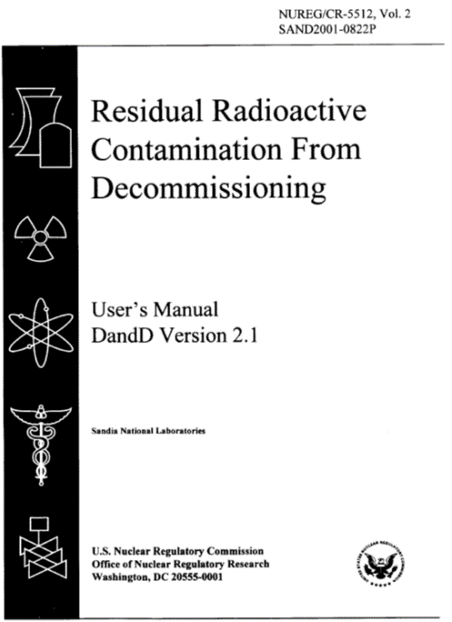
DandD Code
Developed by NRC to assesses compliance with the dose criteria of 10 CFR Part 20, Subpart E.
Specifically, DandD embodies NRC’s guidance on screening dose assessments to allow licensees to perform simple estimates of the annual dose from residual radioactivity in soils and on building surfaces.
For a screening assessment with DandD, NRC has predefined conceptual models for the scenarios along with default parameter distributions (based on NUREG/CR–5512, Volumes 1 and 3).

Slide 4
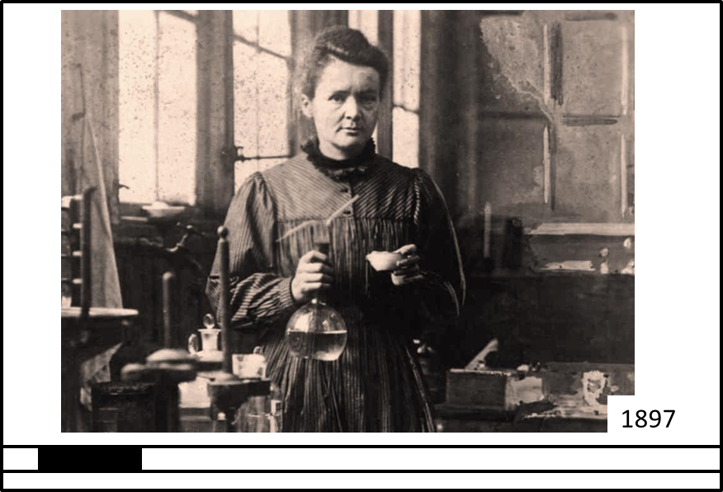
Radium
The turn of the 20th century saw many new scientific discoveries:
  X-rays, radioactivity, alpha and beta particles, the atomic nucleus, the isolation of radium…
The mystery and excitement surrounding these discoveries helped make radium a consumer and medicinal sensation.

Slide 5
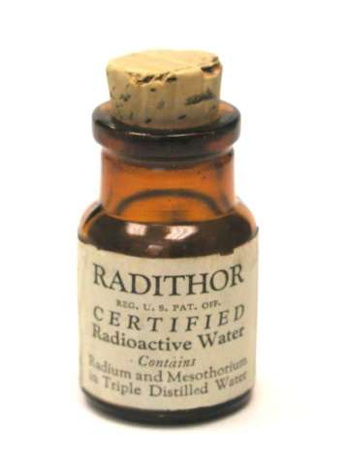
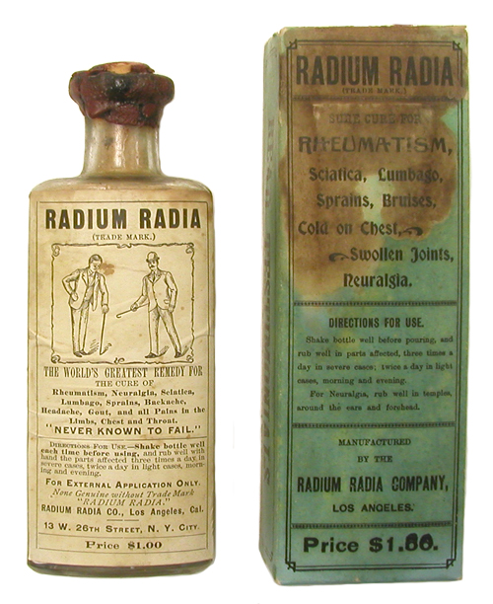
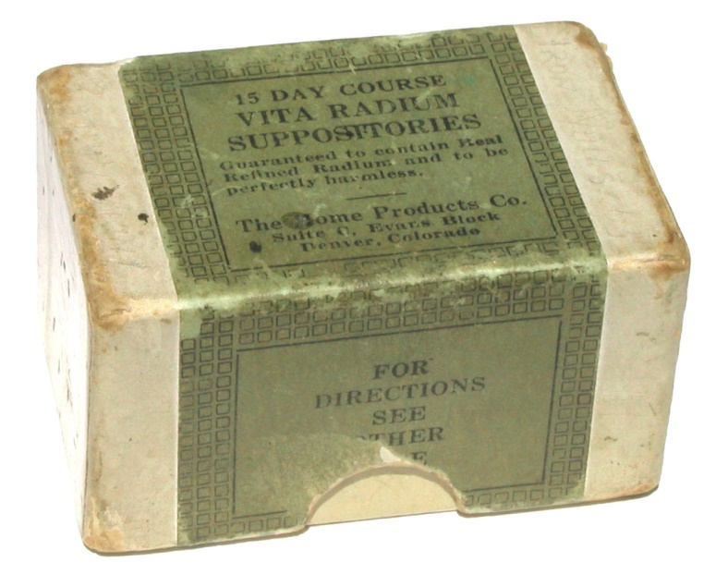
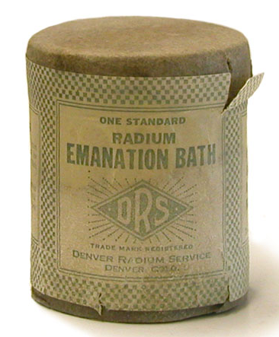
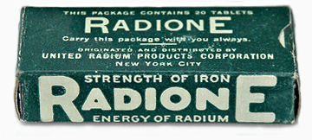
Historical Uses
www.orau.org/ptp/collection/quackcures/quackcures.htm

Slide 6
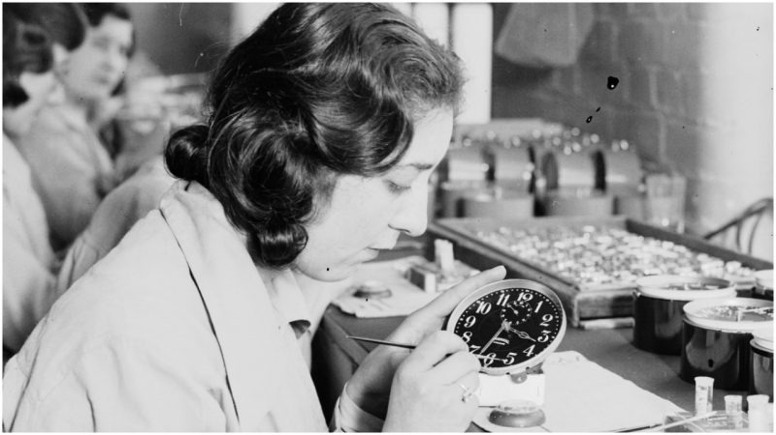
Historical Uses (cont’d)

Slide 7
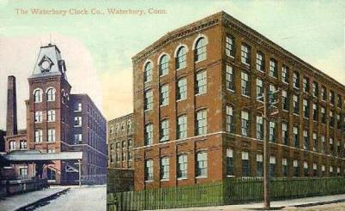
Legacy Sites
Many of the facilities used to produce/maintain Ra-226 products survive today.
However, many of these facilities have been re-purposed and, in some cases, the facility users are unaware of the Ra-226 legacy.

Slide 8
Subtitle D—Nuclear Security
SEC. 651. NUCLEAR FACILITY AND MATERIALS SECURITY.
Public Law 109–58
109th Congress
Energy Policy Act of 2005
Aug. 8, 2005
[H.R. 6]
2007 NARM Rule

Slide 9

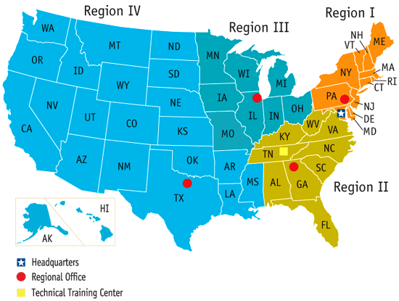

Identifying Legacy Sites
Identify
Gather
Prioritize

Slide 10
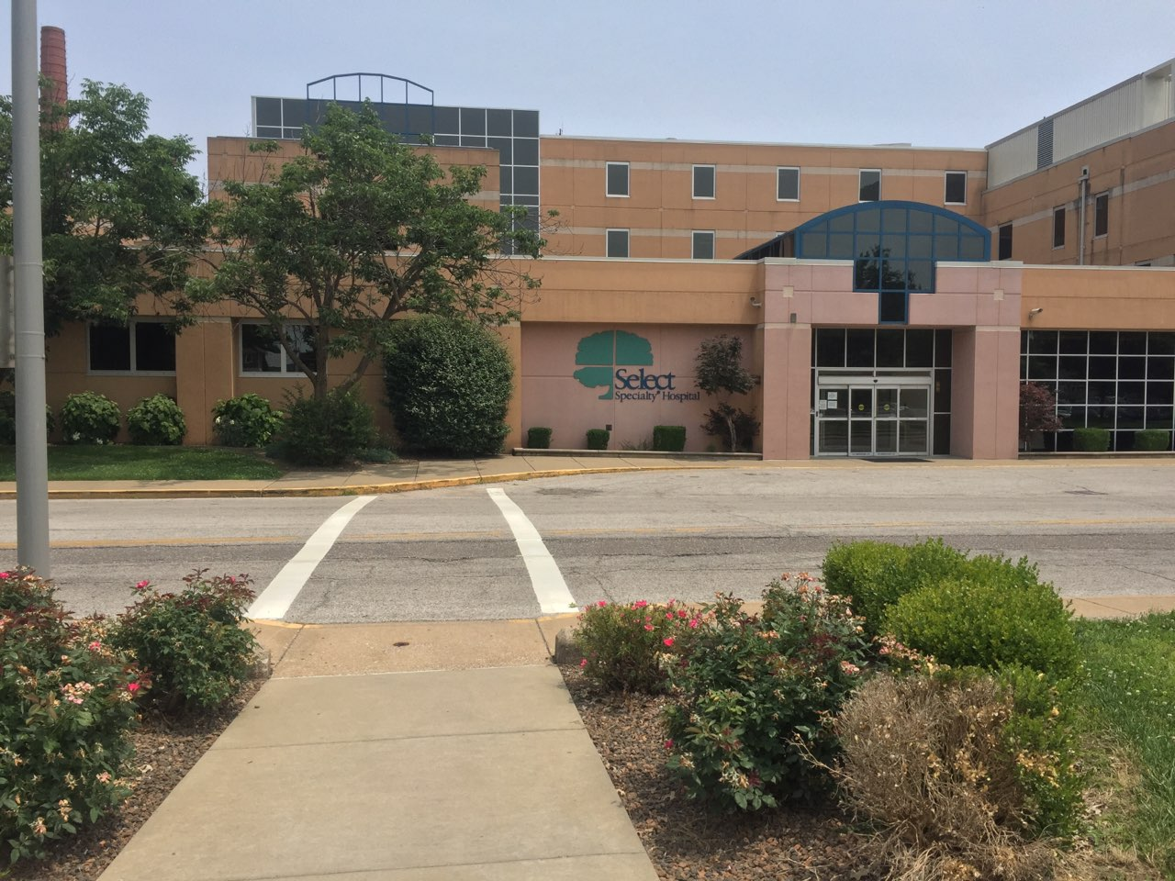

Initial Site Visits
From 2017-2019, NRC conducted 37 ISVs

Slide 11
DandD Conceptual Model
NRC’s Consolidated Decommissioning Guidance—Characterization, Survey, and Determination of Radiological Criteria (NUREG-1757, Vol. 2, Rev 1) presents dose-based screening values.
Using a similar approach for the radium program had advantages (i.e., conservatism, limited need for justification, characterization).
However, use of these values, also had three limitations, as will be described.

Slide 12
DandD Conceptual Model (cont’d)
Simplified list of two sets of exposure pathways for residential (soil) and industrial (building surfaces) considered by DandD (v2.4):
Residential Farmer (Soil) | Indoor Occupant (Building Surfaces)
External Exposure | External Exposure
Inhalation of suspended dust | Inhalation of suspended dust
Ingestion of soil | Ingestion of dust
Ingestion of groundwater
Ingestion of plant products
Ingestion of fish and animal products

Slide 13
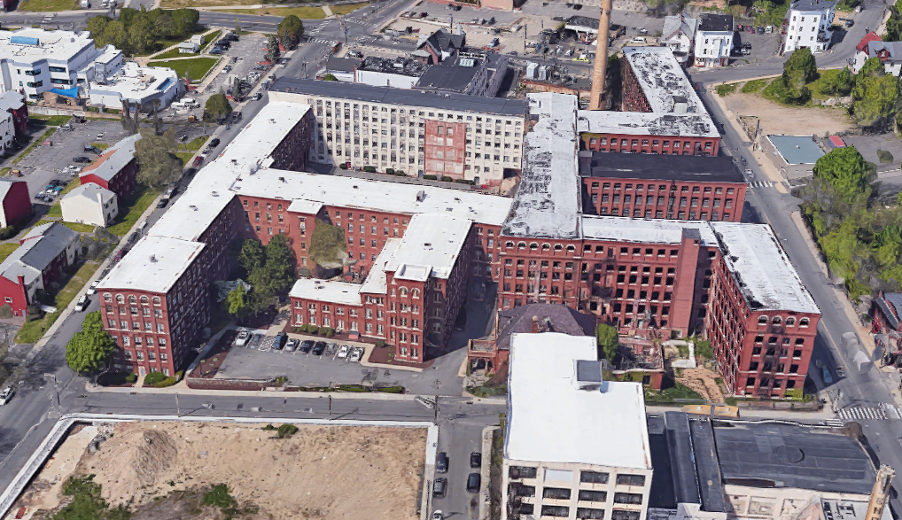
DandD Conceptual Model (cont’d)
DandD (v2.4) based on certain assumptions:
Building Surfaces
  Non-volumetric, mostly fixed, no buried structures
Soils
  Surficial, no groundwater contamination, ponding or surface run-off

Slide 14
DandD Conceptual Model (cont’d)
Some structures, like this former clock factory, are now residential
Limitation 1: need residential screening values for impacted buildings

Slide 15
DandD Conceptual Model (cont’d)
Limitation 2: default screening values are for large-area sources, but the program is looking for discrete sources of Ra-226.
Limitation 3: NRC did not publish surface screening values for alpha emitters like Ra-226 (i.e., the screening level must be derived)

Slide 16
Dose Model Method
NRC developed hypothetical receptors using a similar approach to existing guidance.
The more interesting challenge was to integrate flexibility in the modeling approach:
  Complete “Runs” for multiple surface areas for a range of discrete source sizes, and
  Compile pathway-specific dose-to-source ratios (DSRs).

Slide 17
Dose Model Method (cont’d)
Code runs were completed for surface areas of unlimited, 10 m², 7.5 m², 5.0 m², 2.5 m², 1.0 m², and 0.1 m².
Seven surface areas each for industrial (surfaces) and residential (soils and surfaces), for a total of 21 total runs.

Slide 18
Dose Model Method (cont’d)
DSRs were compiled for each combination of receptor, source material, source area, and pathway. For example:
  Industrial
  Building surfaces
  Unlimited, 10 m², 7.5 m², 5.0 m², 2.5 m², 1.0 m², and 0.1 m²
  External exposure, dust inhalation and ingestion

Slide 19
Dose Model Method (cont’d)
Why was this approach taken?
  What if, for example, the removable fraction is measured to be much different than the modeled value?
  What if drinking water or agricultural pathways are not reasonable for a given property?
The model provides flexibility to dose assessors

Slide 20
Dose Model Method (cont’d)
Radon decay products assume to be present in secular equilibrium with Ra-226
Radionuclide | Emission
Ra-226 | Alpha
Rn-222 | Alpha
Po-218 | Alpha
Pb-214 | Beta
Bi-214 | Beta
Po-214 | Alpha
Pb-210 | Beta
Bi-210 | Beta
Po-210 | Alpha

Slide 21
Dose Model Method (cont’d)
One additional detail before results:
  Runs were completed using unit concentrations (1 concentration unit), so DSRs are represent the dose from a particular pathway from exposure to 1 contamination unit.
  This dose not help while deriving screening values, but does help dose assessors when evaluating measured concentrations.

Slide 22
Results
Industrial Screening Levels—Surfaces

Slide 23
Results (cont’d)
Residential Screening Levels—Surfaces

Slide 24
Results (cont’d)
Residential Screening Levels—Soils

Slide 25
Results (cont’d)

Slide 26
Results (cont’d)
Residential without farming (from 42 to 380 pCi/g)
Only 1% removable fraction (from 14k to 63k dpm)

Slide 27
Discussion
The model produced media-specific, source-size-specific, pathway-specific, and receptor-specific screening levels.
Doses assessor have a scalable tool to estimate doses based on measured (not modeled) conditions.
Dose assessors have not been required to perform additional DandD runs.

Slide 28
Discussion (cont’d)
For additional details on the dose assessment methodology, see Dose Assessment Technical Basis Document for Potential Exposures to Discrete Sources of Radium-226 and Associated Contamination (ADAMS ML17072A414)

Slide 29
Thank You

