Slide 1
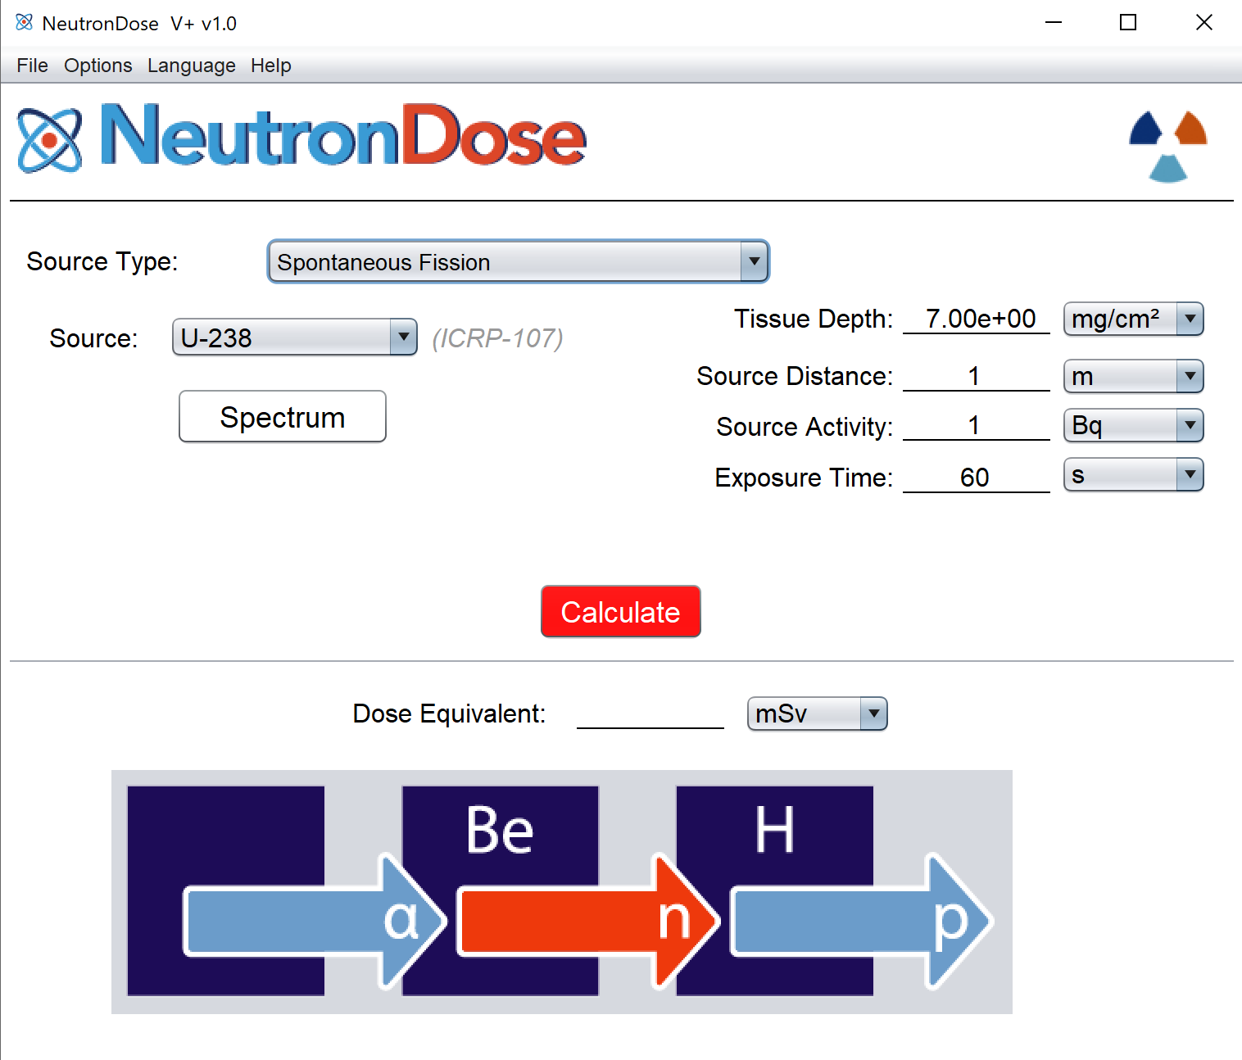
neutronDOSE
varSKIN+
Renaissance code development
Colby Mangini, PhD. CHP

Slide 2
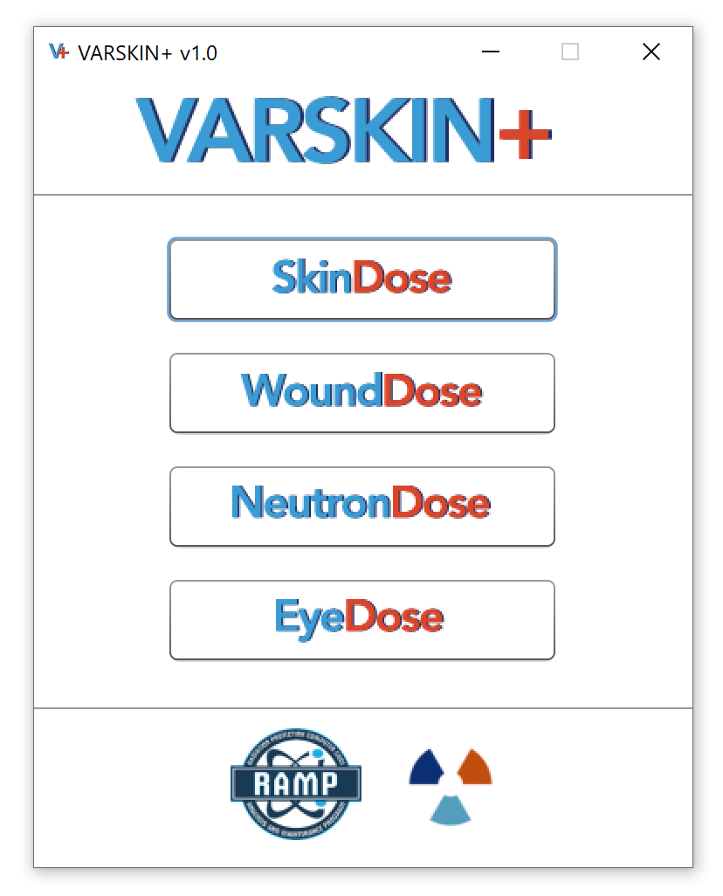
outline
Neutron Dosimetry Theory
Neutron Dosimetry in Skin
NeutronDose
Examples

Slide 3
Neutron Dosimetry
Principle concern of occupational radiation exposure is carcinogenesis in mitotically active cells (Stratum Basale)
  Unchecked DNA damage may lead to the proliferation of genetically mutated cells that can disrupt biological function
How radiation interacts with matter depends on its type, energy, and elemental composition of the medium
  Similar to photons, neutrons are indirectly ionizing, however, they interact with the nucleus of an atom rather than its atomic orbitals
Reactions of concern:
  Elastic Scatter and Inelastic Scatter
  Radiative Capture
  Absorption Reactions

Slide 4
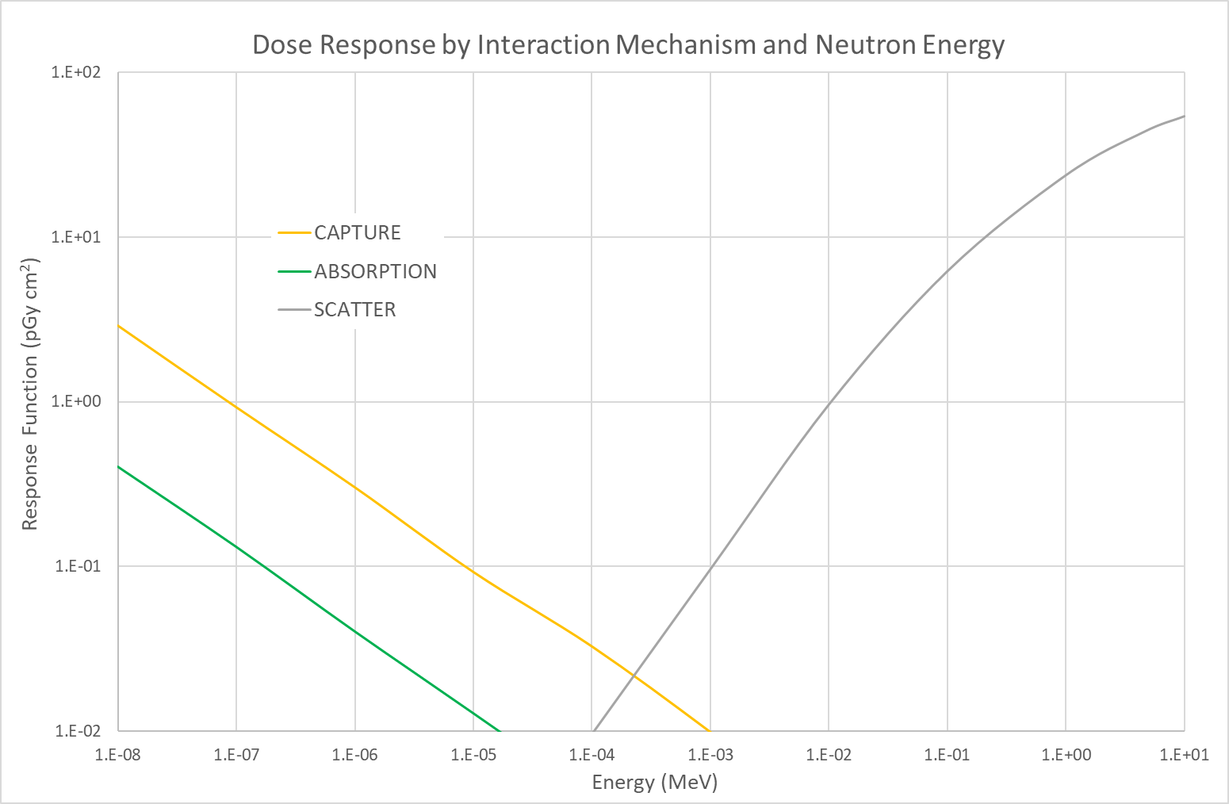
Response Function by Mechanism
f_{CPE} = 1

Slide 5
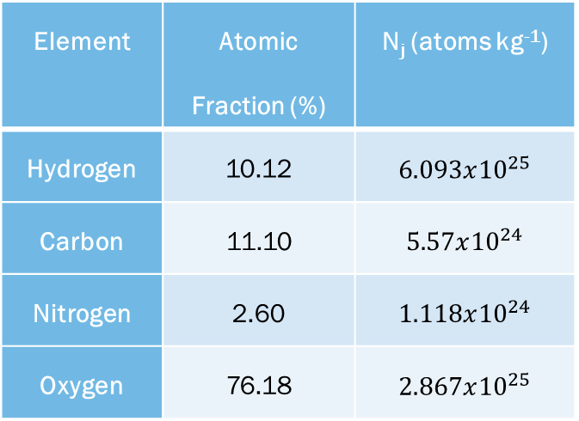
Neutron Dosimetry: Scatter
Dominant at higher energies
Neutrons transfer kinetic energy by direct collision with the atomic nuclei that make up tissue (H, C, N, and O)
The majority of energy (>85%) deposited by scatter occurs due to neutron collisions with hydrogen nuclei
Collisions with oxygen nuclei account for as much as 15% of scatter dose above ~1 MeV
Element | Atomic Fraction (%) | N_{j} (atoms kg⁻¹)
Hydrogen | 10.12 | $$6.093x{10}^{25}$$
Carbon | 11.10 | $$5.57x{10}^{24}$$
Nitrogen | 2.60 | $$1.118x{10}^{24}$$
Oxygen | 76.18 | $$2.867x{10}^{25}$$

Slide 6
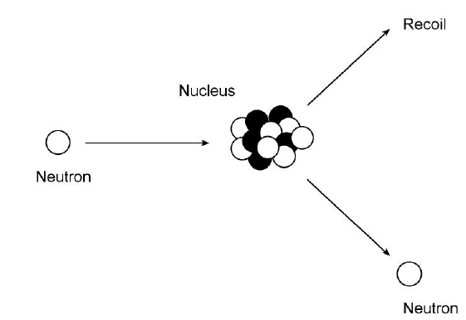
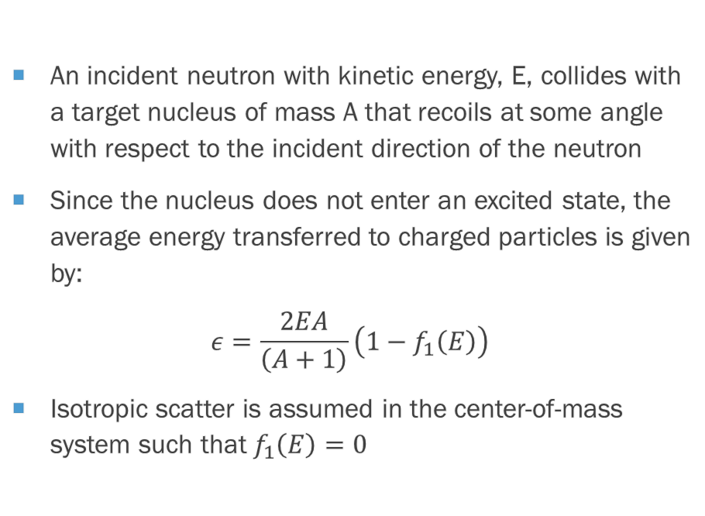
Neutron Dosimetry: Elastic Scatter
An incident neutron with kinetic energy, E, collides with a target nucleus of mass A that recoils at some angle with respect to the incident direction of the neutron
Since the nucleus does not enter an excited state, the average energy transferred to charged particles is given by:
$$ε=\frac{2EA}{\left(A+1\right)}\left(1−f_{1}\left(E\right)\right)$$
Isotropic scatter is assumed in the center-of-mass system such that $f_{1}\left(E\right)=0$

Slide 7
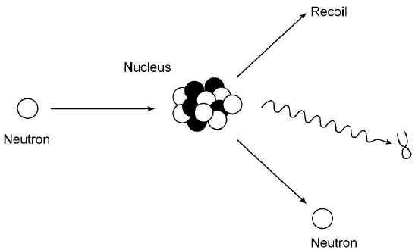
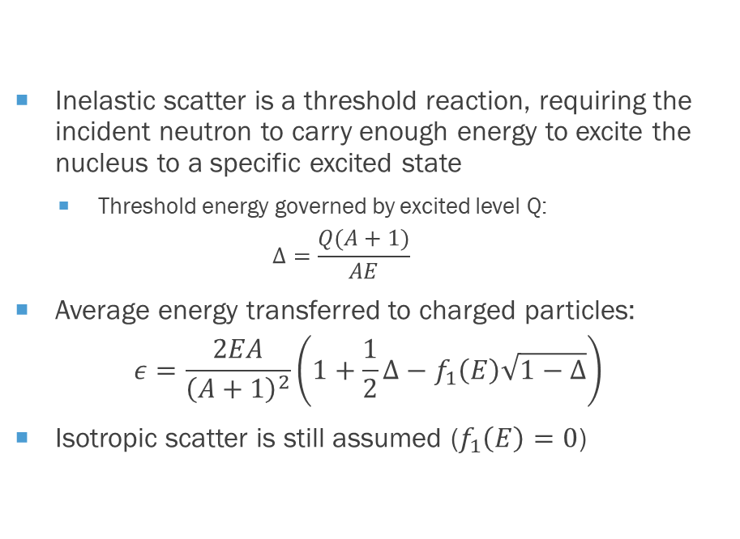
Neutron Dosimetry: Inelastic scatter
Inelastic scatter is a threshold reaction, requiring the incident neutron to carry enough energy to excite the nucleus to a specific excited state
  Threshold energy governed by excited level Q:
  $$Δ=\frac{Q(A+1)}{AE}$$
Average energy transferred to charged particles:
$$ε=\frac{2EA}{{\left(A+1\right)}^{2}}\left(1+\frac{1}{2}Δ−f_{1}\left(E\right)\sqrt{1−Δ}\right)$$
Isotropic scatter is still assumed ($f_{1}\left(E\right)=0$)

Slide 8
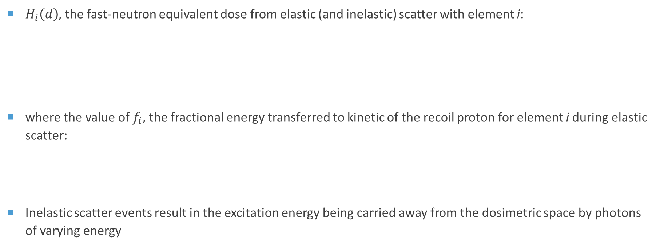
Neutron Dosimetry: Scatter
$H_{i}\left(d\right)$, the fast-neutron equivalent dose from elastic (and inelastic) scatter with element i:
where the value of $f_{i}$, the fractional energy transferred to kinetic of the recoil proton for element i during elastic scatter:
Inelastic scatter events result in the excitation energy being carried away from the dosimetric space by photons of varying energy
$$H_{i}\left(d\right)=1.602x{10}^{−13} \left(J/{MeV}\right)∙N_{i}∙f_{i}\int_{0}^{∞}{\left(E∙w_{R}\left(E\right)∙σ_{i}\left(E\right)∙f_{CPE}\left(d,E\right)∙Φ′\left(d,E\right)\right) dE}$$
$$f_{i}= \frac{2A}{{\left(A+1\right)}^{2}}$$

Slide 9
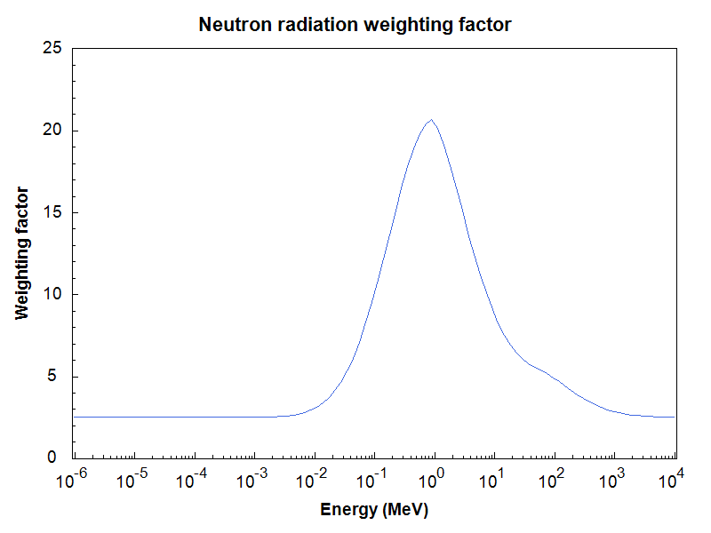
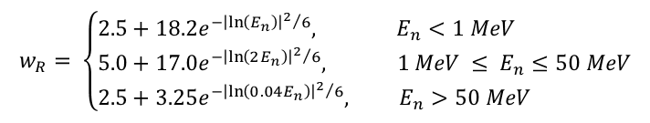
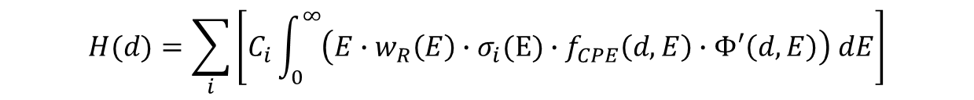
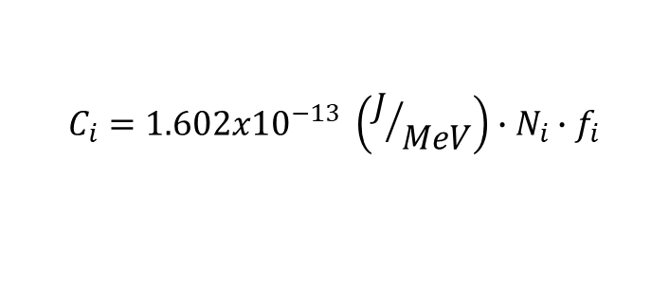
Neutron Dosimetry: Scatter
$$w_{R}= \left\{\begin{aligned}&2.5+18.2e^{{{−\left|\ln\left(E_{n}\right)\right|}^{2}}/6}, E_{n}<1 MeV \\ &5.0+17.0e^{{{−\left|\ln\left(2E_{n}\right)\right|}^{2}}/6}, 1 MeV ≤ E_{n}≤50 MeV \\ &2.5+3.25e^{{{−\left|\ln\left(0.04E_{n}\right)\right|}^{2}}/6}, E_{n}>50 MeV\end{aligned}\right.$$
Element, i | wt %* | Atomic Density (atoms kg⁻¹) | f_{i} | C_{i} (J MeV⁻¹ kg⁻¹)
Hydrogen(1) | 10.0 | 5.97x10²⁵ | 0.500 | 4.78x10¹²
Carbon(12) | 20.4 | 1.02x10²⁵ | 0.142 | 2.32x10¹¹
Nitrogen(14) | 4.2 | 1.81x10²⁴ | 0.124 | 3.60x10¹⁰
Oxygen(16) | 65.4 | 2.46x10²⁵ | 0.111 | 4.37x10¹¹
ICRP 103 (2007)
*ICRU 44 skin; 0.8 wt% of “other elements” has been added to oxygen
$$H(d)=\sum_{i}{\left[C_{i}\int_{0}^{∞}{\left(E∙w_{R}\left(E\right)∙σ_{i}(E)∙f_{CPE}\left(d,E\right)∙Φ′\left(d,E\right)\right) dE}\right]}$$
$$C_{i}=1.602x{10}^{−13} \left(J/{MeV}\right)∙N_{i}∙f_{i}$$

Slide 10
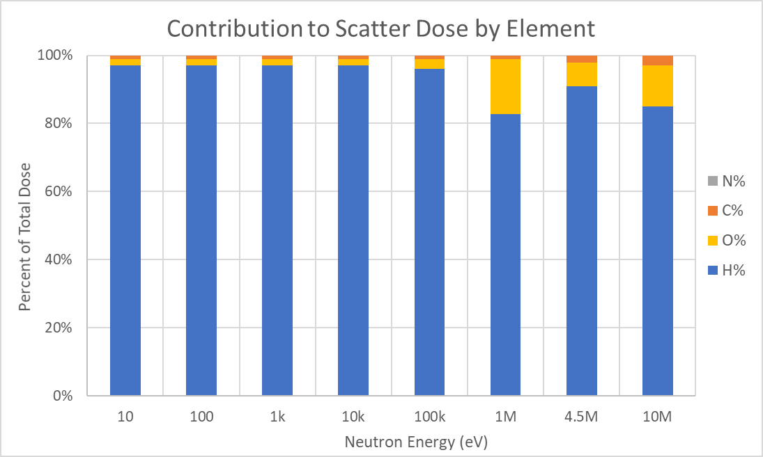
Neutron Dosimetry: Scatter
f_{CPE} = 1

Slide 11
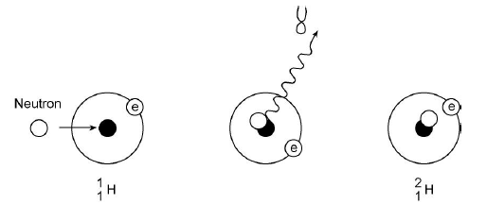
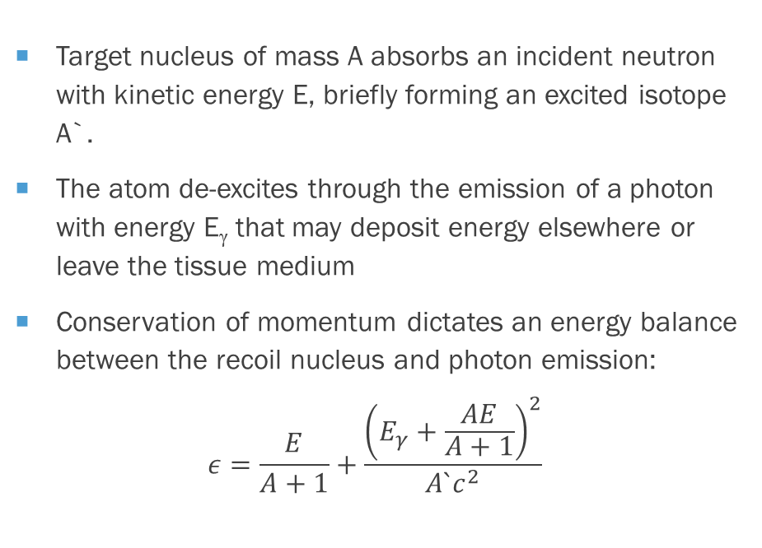
Neutron Dosimetry: Radiative Capture
Target nucleus of mass A absorbs an incident neutron with kinetic energy E, briefly forming an excited isotope A`.
The atom de-excites through the emission of a photon with energy E_{γ} that may deposit energy elsewhere or leave the tissue medium
Conservation of momentum dictates an energy balance between the recoil nucleus and photon emission:
$$ε=\frac{E}{A+1}+\frac{{\left(E_{γ}+\frac{AE}{A+1}\right)}^{2}}{A`c^{2}}$$

Slide 12
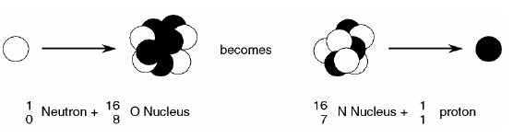
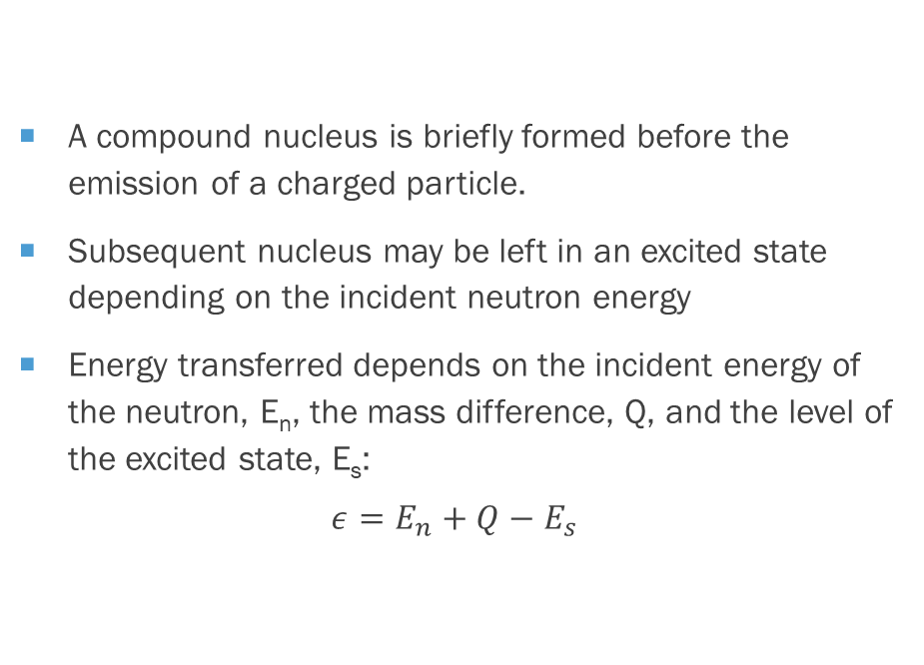
Neutron Dosimetry: Reactive
A compound nucleus is briefly formed before the emission of a charged particle.
Subsequent nucleus may be left in an excited state depending on the incident neutron energy
Energy transferred depends on the incident energy of the neutron, E_{n}, the mass difference, Q, and the level of the excited state, E_{s}:
$$ε=E_{n}+Q−E_{s}$$

Slide 13
Neutron Dosimetry: Capture/Absorption
Dominant at low (thermal) energies
Two significant capture/absorption interactions emerge:
  ¹H(n,γ)²H Q = 2.224 MeV
  ¹⁴N(n,p)¹⁴C Q = 0.626 MeV
Capture results in the emission of a high-energy photon to be absorbed elsewhere
  this mechanism may be insignificant when evaluating shallow skin dose
  but the generation of photons in shielding materials can be significant
Absorption in tissue results in an energetic proton and carbon recoil, the combined energy of which is deposited within the range of the proton
  in tissue, a distance of about 10 microns

Slide 14
Neutron Dosimetry: Capture/Absorption
𝐻(𝑑), the equivalent dose at depth, d, due to neutron capture by ¹H or absorption by ¹⁴N is calculated using:
where N is the atomic mass density of ¹H or ¹⁴N (atoms kg⁻¹)
Q is the reaction energy (MeV), AF is the fraction of energy absorbed locally in tissue
𝑤_{𝑅} (𝐸) is the radiation weighting factor (Sv/Gy)
𝜎(𝐸) is the energy-dependent cross section (cm² atom⁻¹)
𝑓_{𝐶𝑃𝐸} (𝑑,𝐸) accounts for fractional charged particle equilibrium
and Φ′(𝑑,𝐸) is the neutron fluence at depth (cm⁻² MeV⁻¹).
$$H\left(d\right)=1.602x{10}^{−13} \left(\frac{J}{MeV}\right)∙N∙Q∙AF\int_{0}^{∞}{\left(w_{R}\left(E\right)∙σ\left(E\right)∙f_{CPE}\left(d,E\right)∙Φ′\left(d,E\right)\right) dE}$$

Slide 15
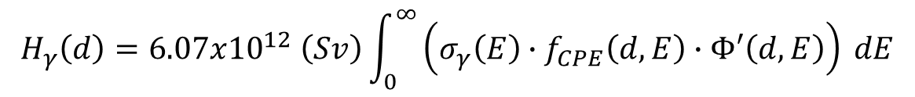
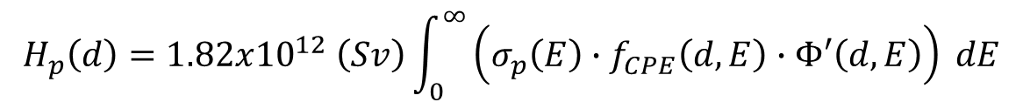
Neutron Dosimetry: Capture/Absorption
Some fraction of the photon energy is absorbed in the body, and all kinetic energy is absorbed w/in the range of the proton.
Reaction | wt %* | Atomic weight (kg/mol) | Atomic density (atoms/kg) | Q (MeV) | AF | w_{R} (Sv/Gy)
¹H(n,γ)²H | 10.0 | 0.001008 | 5.97x10²⁵ | 2.224 | 0.2856* | 1
¹⁴N(n,p)¹²C | 4.2 | 0.0140067 | 1.81x10²⁴ | 0.626 | 1 | 10
*ICRU 44 skin (absorbed fraction at depth)
$$H_{γ}\left(d\right)=6.07x{10}^{12} \left(Sv\right)\int_{0}^{∞}{\left(σ_{γ}\left(E\right)∙f_{CPE}\left(d,E\right)∙Φ′\left(d,E\right)\right) dE}$$
$$H_{p}\left(d\right)=1.82x{10}^{12} \left(Sv\right)\int_{0}^{∞}{\left(σ_{p}\left(E\right)∙f_{CPE}\left(d,E\right)∙Φ′\left(d,E\right)\right) dE}$$

Slide 16


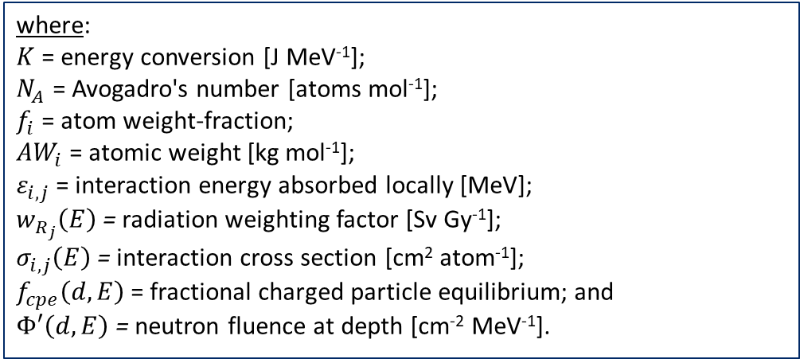
Neutron Dosimetry
Equivalent dose $H_{i,j}$ for interactions by neutrons of energy E, with element i, by mechanism j, at depth d:
$$H_{i,j}\left(d\right)=K∙\frac{N_{A}∙f_{i}}{{AW}_{i}}∙ε_{i,j}\int_{0}^{∞}{\left(w_{R_{j}}\left(E\right)∙σ_{i,j}\left(E\right)∙f_{cpe}\left(d,E\right)∙Φ′\left(d,E\right)\right) dE}$$
where:
$K$ = energy conversion [J MeV⁻¹];
$N_{A}$ = Avogadro's number [atoms mol⁻¹];
$f_{i}$ = atom weight-fraction;
${AW}_{i}$ = atomic weight [kg mol⁻¹];
$ε_{i,j}$= interaction energy absorbed locally [MeV];
$w_{R_{j}}\left(E\right)$= radiation weighting factor [Sv Gy⁻¹];
$σ_{i,j}\left(E\right)$= interaction cross section [cm² atom⁻¹];
$f_{cpe}\left(d,E\right)$= fractional charged particle equilibrium; and
$Φ′\left(d,E\right)$= neutron fluence at depth [cm⁻² MeV⁻¹].
$$ε_{i,s}=\frac{2A_{i}E}{{\left(A_{i}+1\right)}^{2}} (scatter)$$
$$ε_{i,a}=Q_{i,a}∙{AF}_{i,a} (absorption)$$
A_{i} is the atomic number of element i;
E is the incident neutron energy [MeV];
Q_{i} is the reaction energy [MeV];
and AF_{i} is the absorbed fraction.

Slide 17
NeutronDose
Goal: implement a neutron dose model in which the shallow skin dose from a monoenergetic neutron can be determined simply through the input of the neutron’s energy, fluence, and tissue depth
The generalized shallow neutron dosimetry model applied in NeutronDose is:
where H(d,E) is the equivalent dose at a specific depth in tissue for a given neutron energy relative to a perpendicular fluence of neutrons to the tissue surface
The neutron KERMA at depth d for incident energy E is K(d,E), and f_{cpe} (d,E) is the depth- and energy-dependent fractional charged particle equilibrium (CPE).
$$H\left(d,E\right)=w_{r}\left(E\right)∙K\left(d , E\right)̇∙f_{cpe}\left(d , E\right)$$

Slide 18

KERMA
Neutron KERMA represents the kinetic energy transferred from neutrons to charged particles in an absorbing medium
The type and abundance of reactions that could occur depends on the incident neutron energy, elemental composition of tissue, and the various reaction cross sections:
where N_{j} is the number of atoms per unit mass of element j defined by the ICRU 44 elemental composition of soft tissue
ϵ_{ij} (E) is the energy transferred to charged particles as kinetic for nuclide j and interaction I
and σ_{ij} (E) is the microscopic cross section for a given reaction
$$K\left(d,E\right)=\sum_{j}{N_{j}}\sum_{i}{ε_{ij}\left(E\right)∙σ_{ij}\left(E\right)∙Φ\left(d , E\right)}$$

Slide 19
KERMA
The neutron fluence after attenuation through thickness d of tissue is:
The total macroscopic cross section (Σ_{t}) describes the probability of any interaction within that medium and can be calculated by:
Unlike KERMA, absorbed dose requires consideration of energy transferred specifically to ionization by secondary charged particles within the dose volume. However, these two values are closely related such that determination of KERMA can be used to approximate dose, with the appropriate application of fractional CPE when they are not equal.
$$Φ\left(d,E\right)=Φ\left(E\right)∙e^{−Σ_{t}d}$$
$$Σ_{t}\left({cm}^{−1}\right)=\sum_{i}{N_{i}∙σ_{elastic}}+ N_{i}∙σ_{inelastic}+ N_{i}∙σ_{capture}+ N_{i}∙σ_{transfer}$$

Slide 20
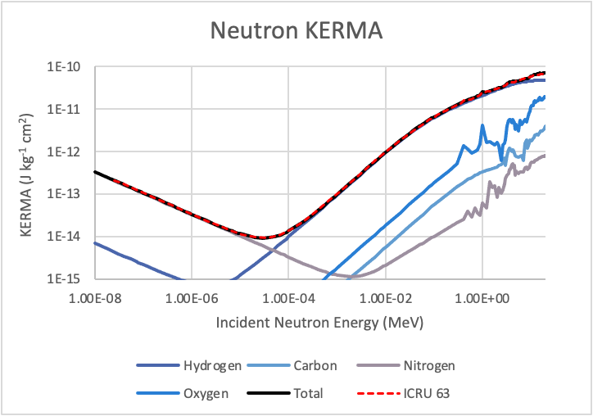
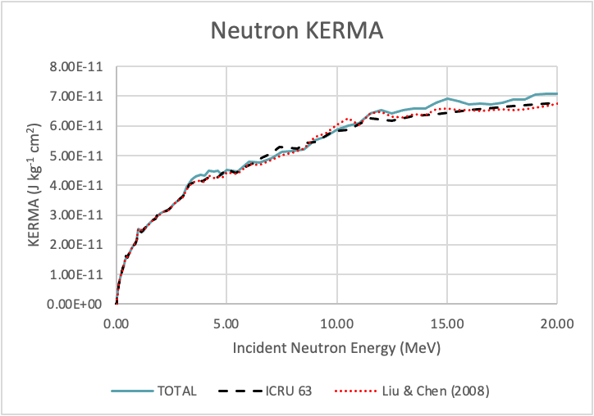
kerma
Pertinent cross sections were gathered from the Evaluated Nuclear Data File (ENDF) to build neutron KERMA in tissue
Each of the possible neutron reactions was evaluated individually before summation to determine the total KERMA at a given incident neutron energy

Slide 21
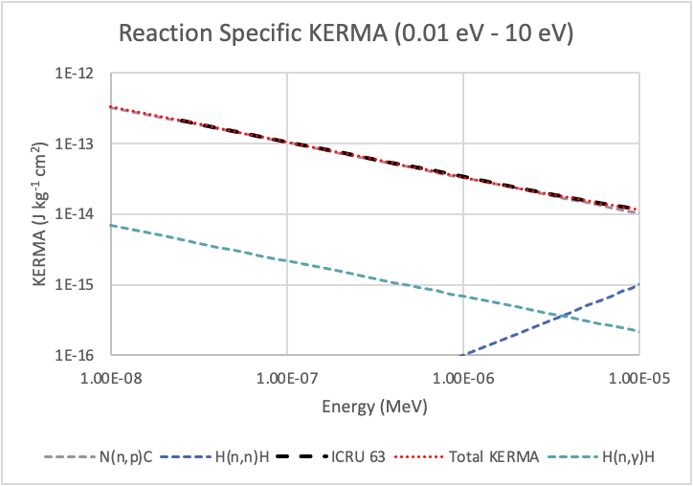
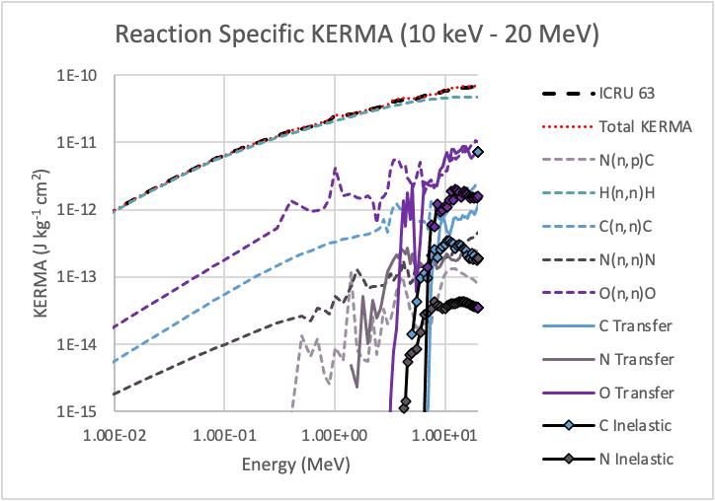
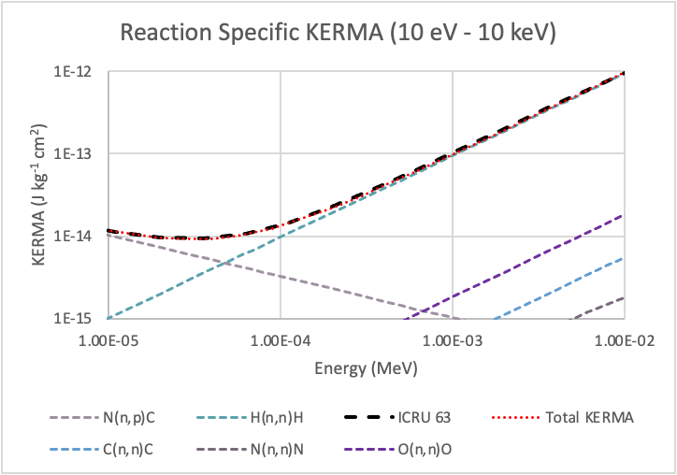
KERMA

Slide 22
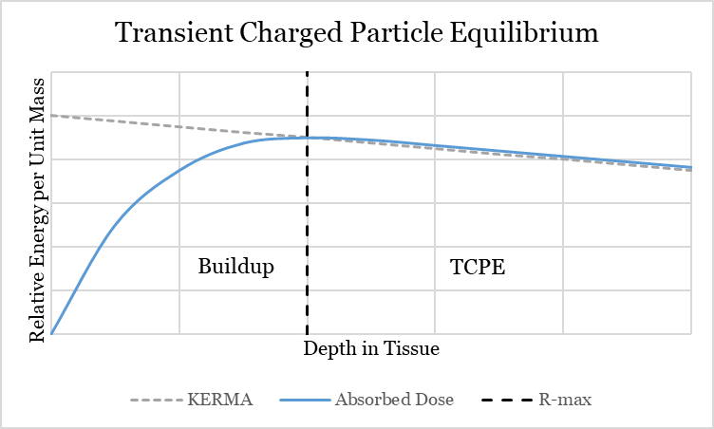
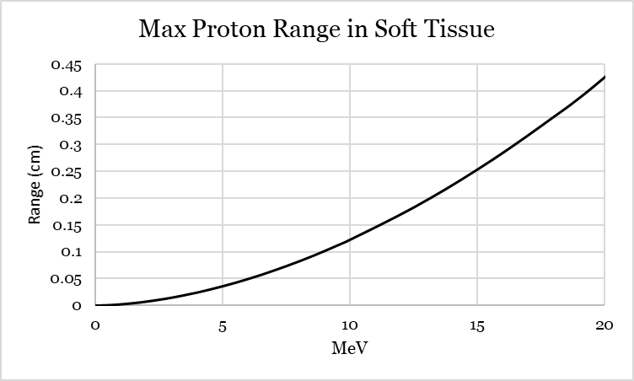
Fractional Charged Particle Buildup
Neutron KERMA is equivalent to dose where charged particle equilibrium is established
CPE is said to exist if for every charged particle leaving a volume an identical enters
In the buildup region each subsequent volume of interest approaches equilibrium
For shallow dosimetry the CPE approximation is not an accurate reflection of dose

Slide 23
Fractional Charged Particle Equilibrium
For neutrons incident on tissue, the primary contributor to KERMA is an elastically scattered hydrogen atom because of its large cross section and relatively high abundance
An elastically scattered hydrogen nucleus (proton) can have a maximum energy equivalent to the incident neutron energy
For incident neutron energies greater than about 2 MeV, the maximum range of the recoil proton exceeds the 0.007 cm depth at which shallow dose is determined
Absorbed dose for energies greater than 2 MeV, therefore, is only a fraction of KERMA at the shallow depth.

Slide 24
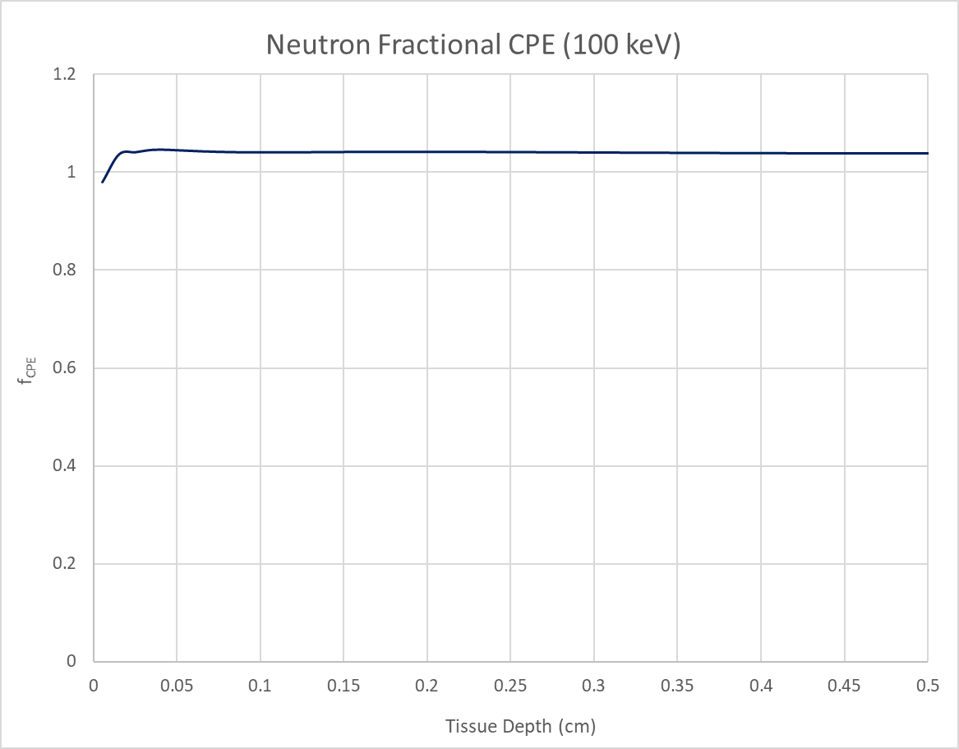
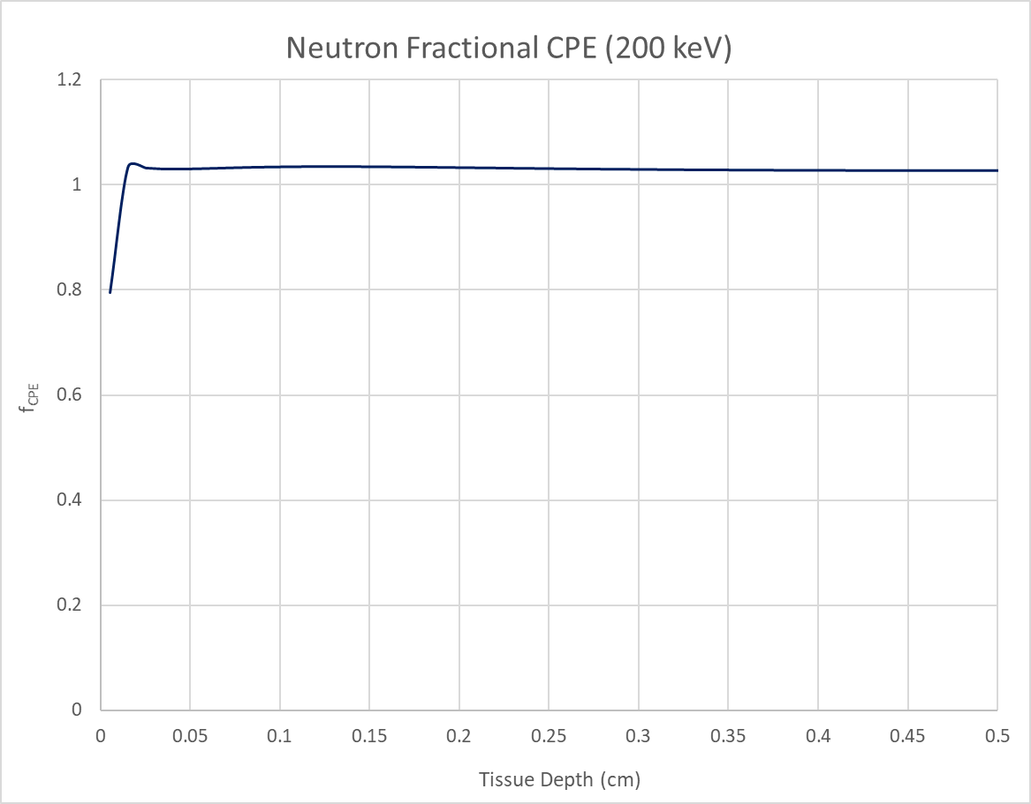
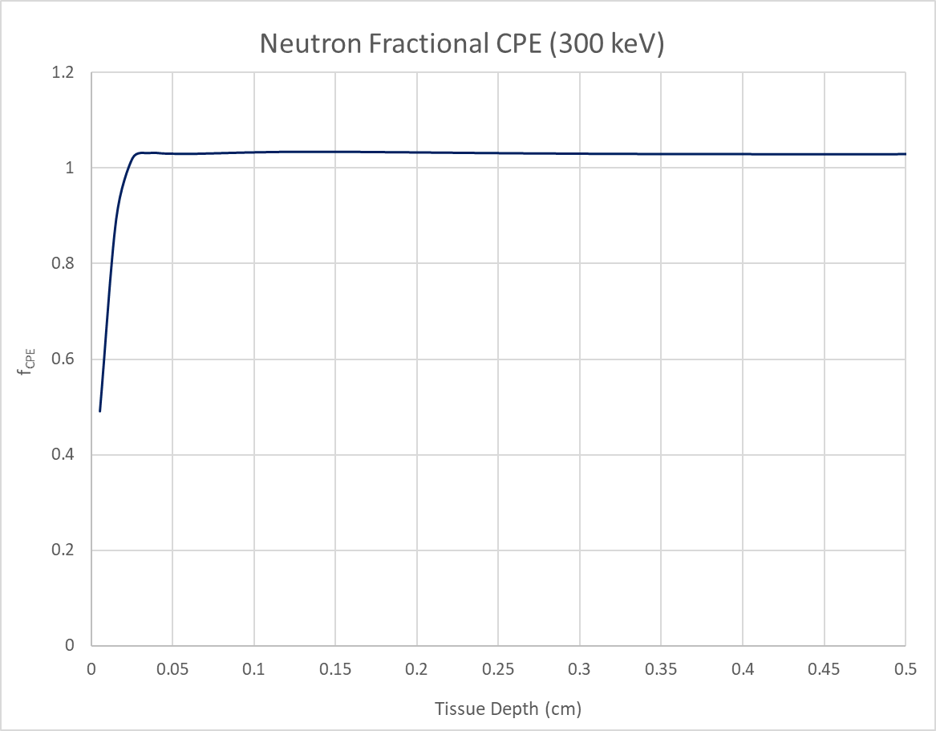
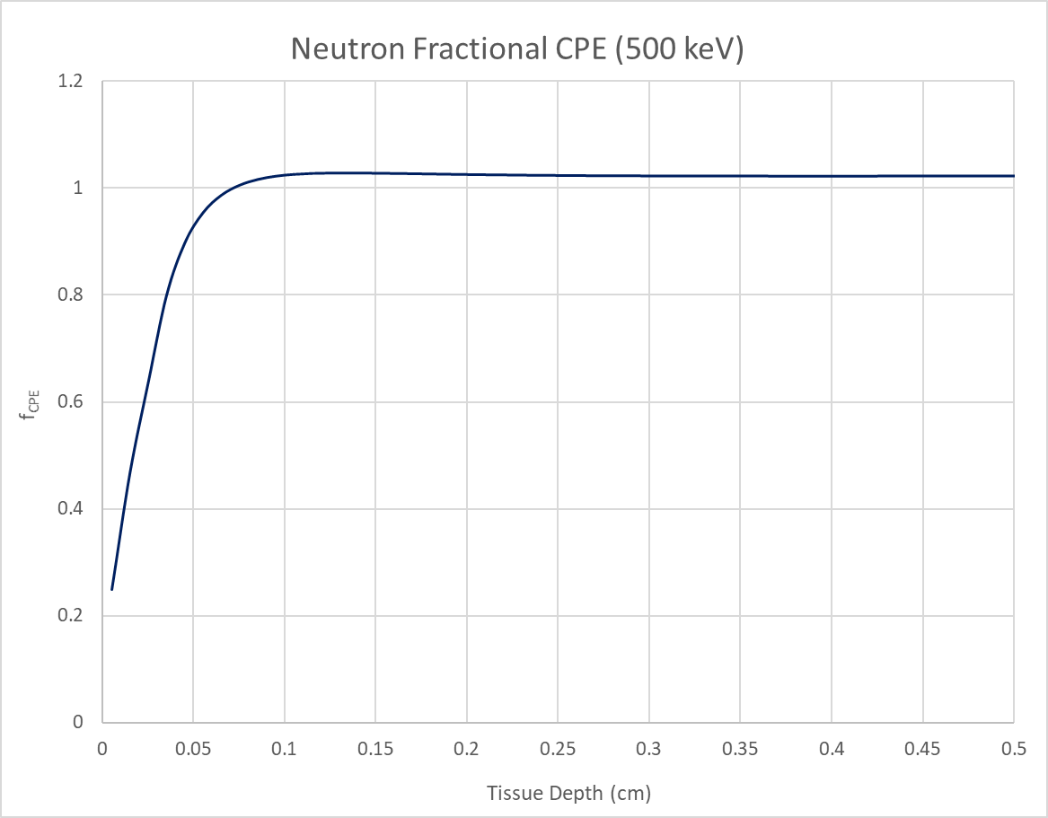
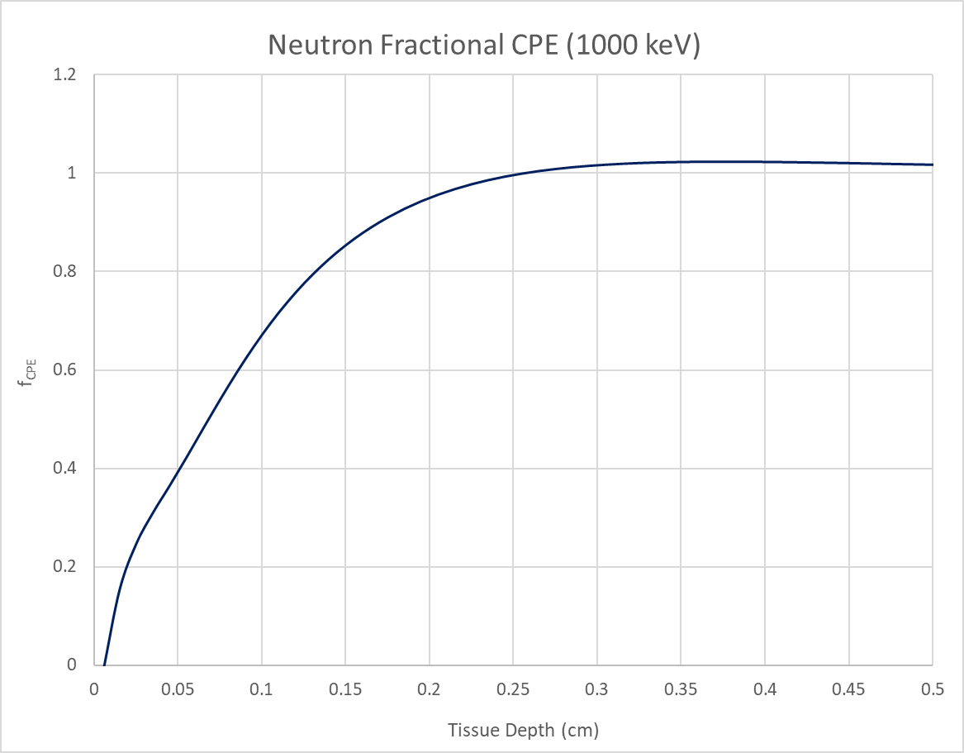
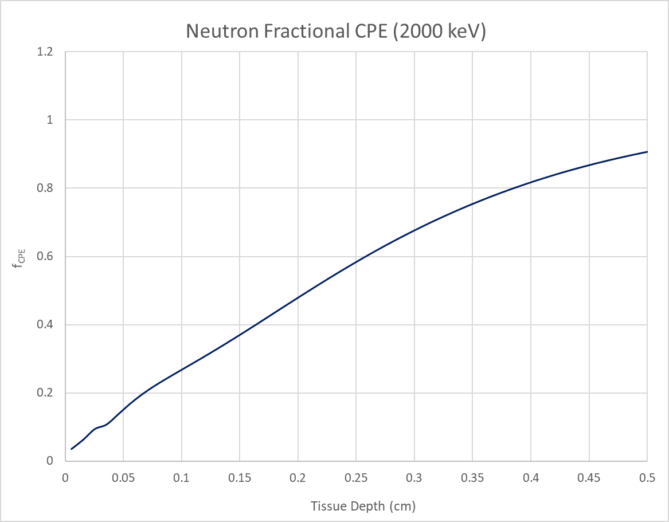
Neutron f_{CPE} in Tissue

Slide 25
Neutron f_{CPE} in Tissue
For relatively short range (< 350 microns) recoil protons from incident neutrons less than 5 MeV, tissue segments were simulated at thicknesses of 5 microns. The following function was developed from the MCNP results and is applicable for neutron energies between 1 and 5 MeV:
For incident neutrons from 5 to 20 MeV, the maximum recoil range of protons is enough to allow for tissue segmentation of 10 microns. The resulting functional fit to the MCNP data is given as:
where d is the tissue depth of interest in centimeters and A, B, and C are energy dependent coefficients each described by their respective fits
$$f_{cpe}\left(E,d\right)=A+B\left(10d\right)+C\left(10d\right)∗ln\left(10d\right)$$
$$f_{cpe}=A+Bd+Cd^{2}+Dd^{3}$$

Slide 26
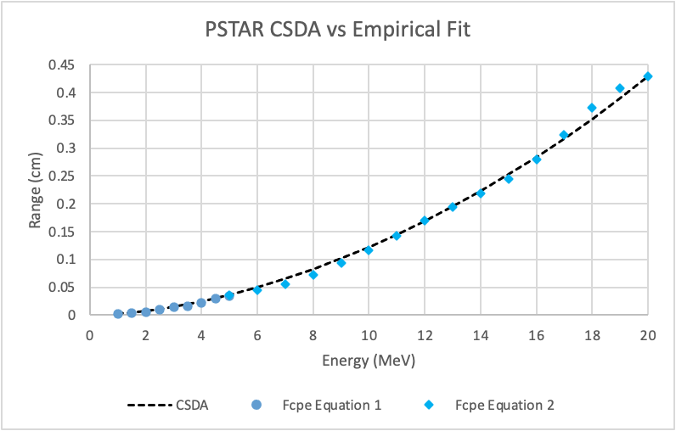
Neutron f_{CPE} in Tissue

Slide 27
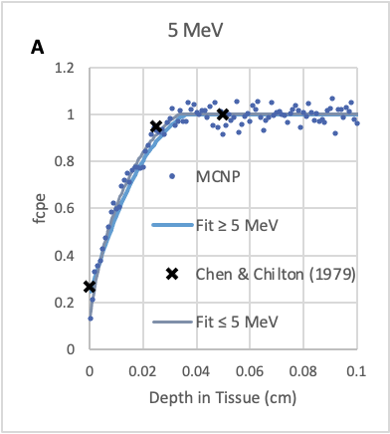
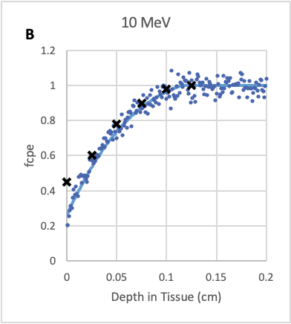
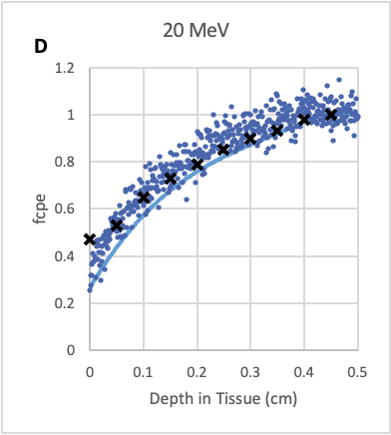
Neutron f_{CPE} in Tissue

Slide 28
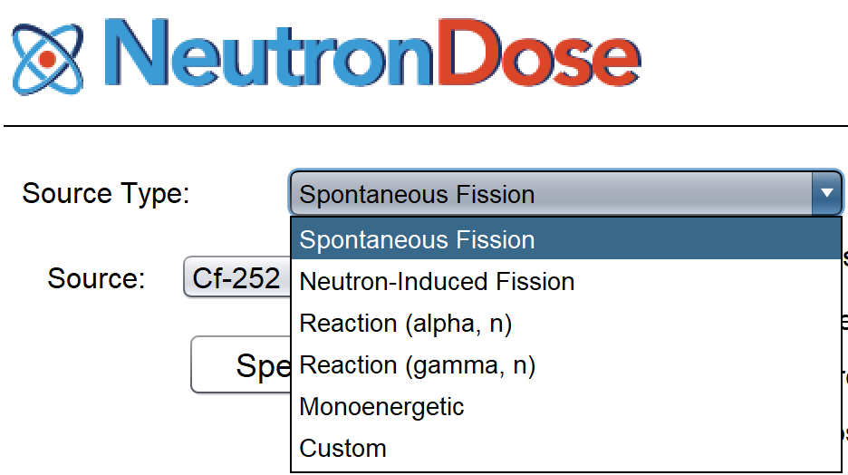
Neutron Sources
The NeutronDose module provides dosimetry for six different source types:
  -spontaneous fission -photoneutrons (γ,n)
  -neutron-induced fission -a monoenergetic neutron
  -alpha reaction neutrons (α,n) -a user-uploaded custom energy distribution

Slide 29
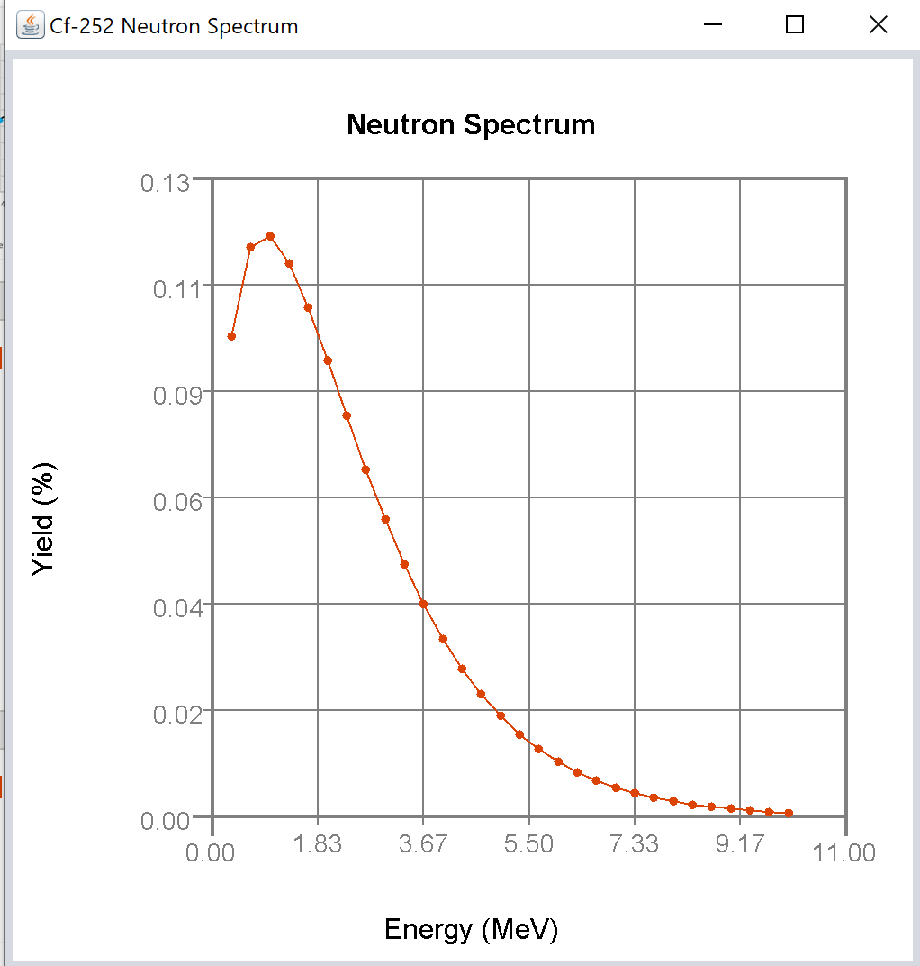
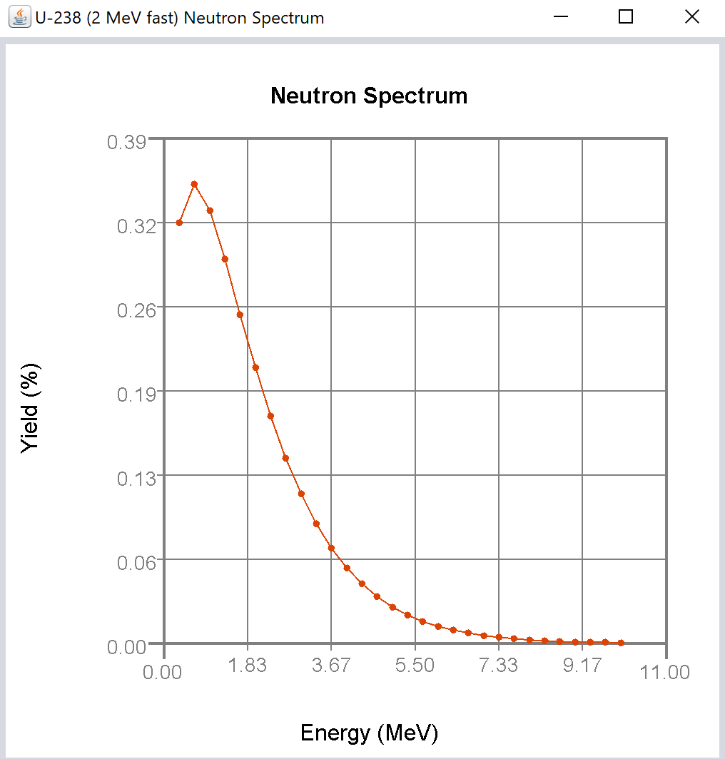

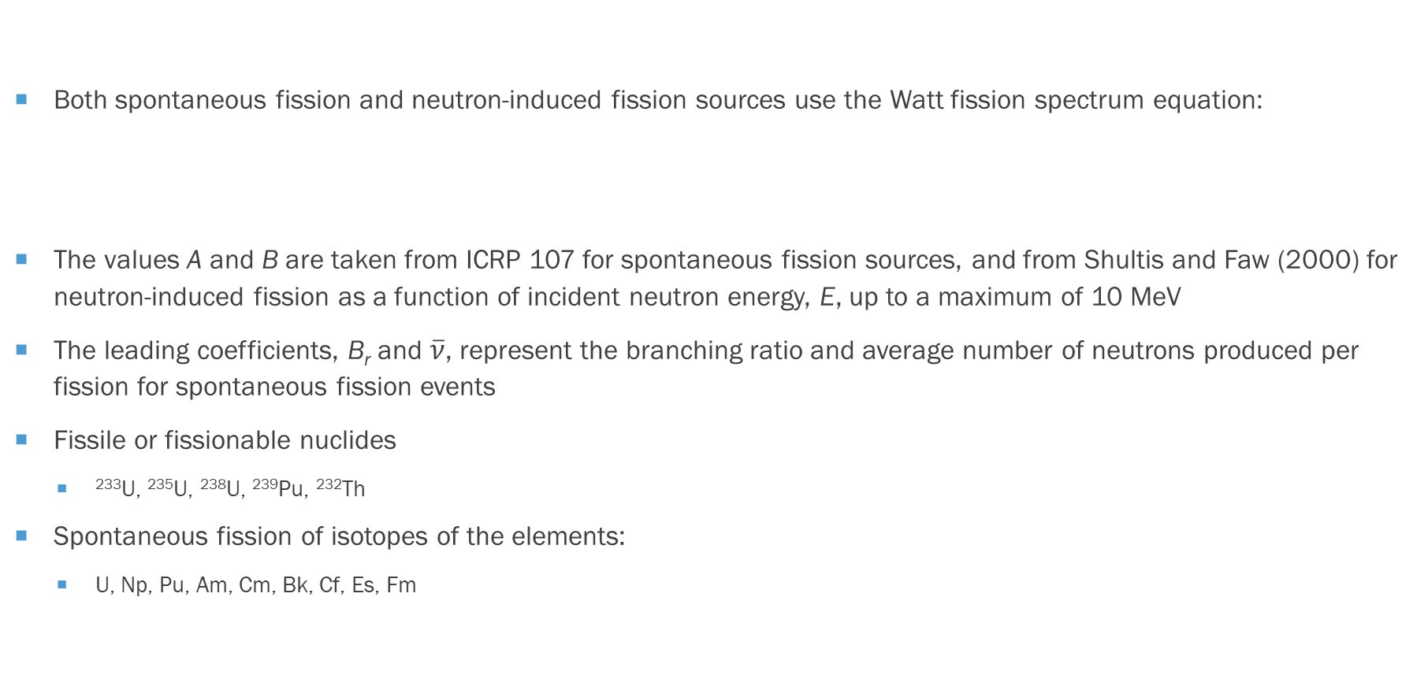
Neutron Sources
Both spontaneous fission and neutron-induced fission sources use the Watt fission spectrum equation:
The values A and B are taken from ICRP 107 for spontaneous fission sources, and from Shultis and Faw (2000) for neutron-induced fission as a function of incident neutron energy, E, up to a maximum of 10 MeV
The leading coefficients, B_{r} and $\overline{ν}$, represent the branching ratio and average number of neutrons produced per fission for spontaneous fission events
Fissile or fissionable nuclides
  ²³³U, ²³⁵U, ²³⁸U, ²³⁹Pu, ²³²Th
Spontaneous fission of isotopes of the elements:
  U, Np, Pu, Am, Cm, Bk, Cf, Es, Fm
$$χ\left(E\right)=B_{r}\overline{ν}\exp\left(−\frac{E}{A}\right)\sinh\left(\sqrt{BE}\right)$$

Slide 30
Neutron Sources
Source | Reaction | Avg. Neutron Energy (MeV) | Number of photons per decay | Neutron yield per decay*
As-76 / ⁹Be | ⁹Be(γ,n)⁸Be | 0.108; 0.382 | 0.010 | 1.9E-6
Ga-72 / ⁹Be | ⁹Be(γ,n)⁸Be | 0.173; 0.476; 0.733; 0.748 | 0.0517 | 1.4E-6
Ga-72 / D₂O | ²H(γ,n)¹H | 0.131; 0.139 | 0.205 | 1.6E-6
In-116m / ⁹Be | ⁹Be(γ,n)⁸Be | 0.396 | 0.154 | 2.2E-7
La-140 / ⁹Be | ⁹Be(γ,n)⁸Be | 0.761 | 0.034 | 8.0E-8
La-140 / D₂O | ²H(γ,n)¹H | 0.146 | 0.034 | 2.0E-7
Mn-56 / ⁹Be | ⁹Be(γ,n)⁸Be | 0.128; 0.397; 0.761 | 0.425 | 7.8E-7
Mn-56 / D₂O | ²H(γ,n)¹H | 0.146; 0.214 | 0.017 | 8.0E-8
Na-24 / ⁹Be | ⁹Be(γ,n)⁸Be | 0.967 | 1.0 | 3.5E-6
Na-24 / D₂O | ²H(γ,n)¹H | 0.262 | 1.0 | 7.3E-6
Sb-124 / ⁹Be | ⁹Be(γ,n)⁸Be | 0.022; 0.378 | 0.547 | 5.1E-6
Y-88 / ⁹Be | ⁹Be(γ,n)⁸Be | 0.151; 0.949 | 0.999 | 2.7E-6
Y-88 / D₂O | ²H(γ,n)¹H | 0.252 | 0.006 | 8.0E-8
Source | Reaction | Avg. Neutron Energy (MeV) | Neutron yield per alpha
Am-241 / ¹⁰B | ¹⁰B(α,n)¹³N | 3.0 | 1.39E-5
Am-241 / ⁹Be | ⁹Be(α,n)¹²C | 4.4 | 7.22E-5
Am-241 / ¹⁹F | ¹⁹F(α,n)²²Na | 1.5 | 4.17E-6
Cm-242 / ⁹Be | ⁹Be(α,n)¹²C | 4.1 | 9.17E-5
Pu-239 / ⁹Be | ⁹Be(α,n)¹²C | 4.6 | 4.70E-5
Pu-239 / ¹³C | ¹³C(α,n)¹⁶O | 4.2 | 3.17E-6
Characteristics of Alpha Reaction Sources Provided in V+ (Lorch 1973)
*neutrons emitted from 1 g of Be or D2O placed 1 cm away.
Characteristics of Photoneutron Sources Provided in V+ (Shultis & Faw 2000)

Slide 31
Questions

Slide 32
Examples…

