Slide 1
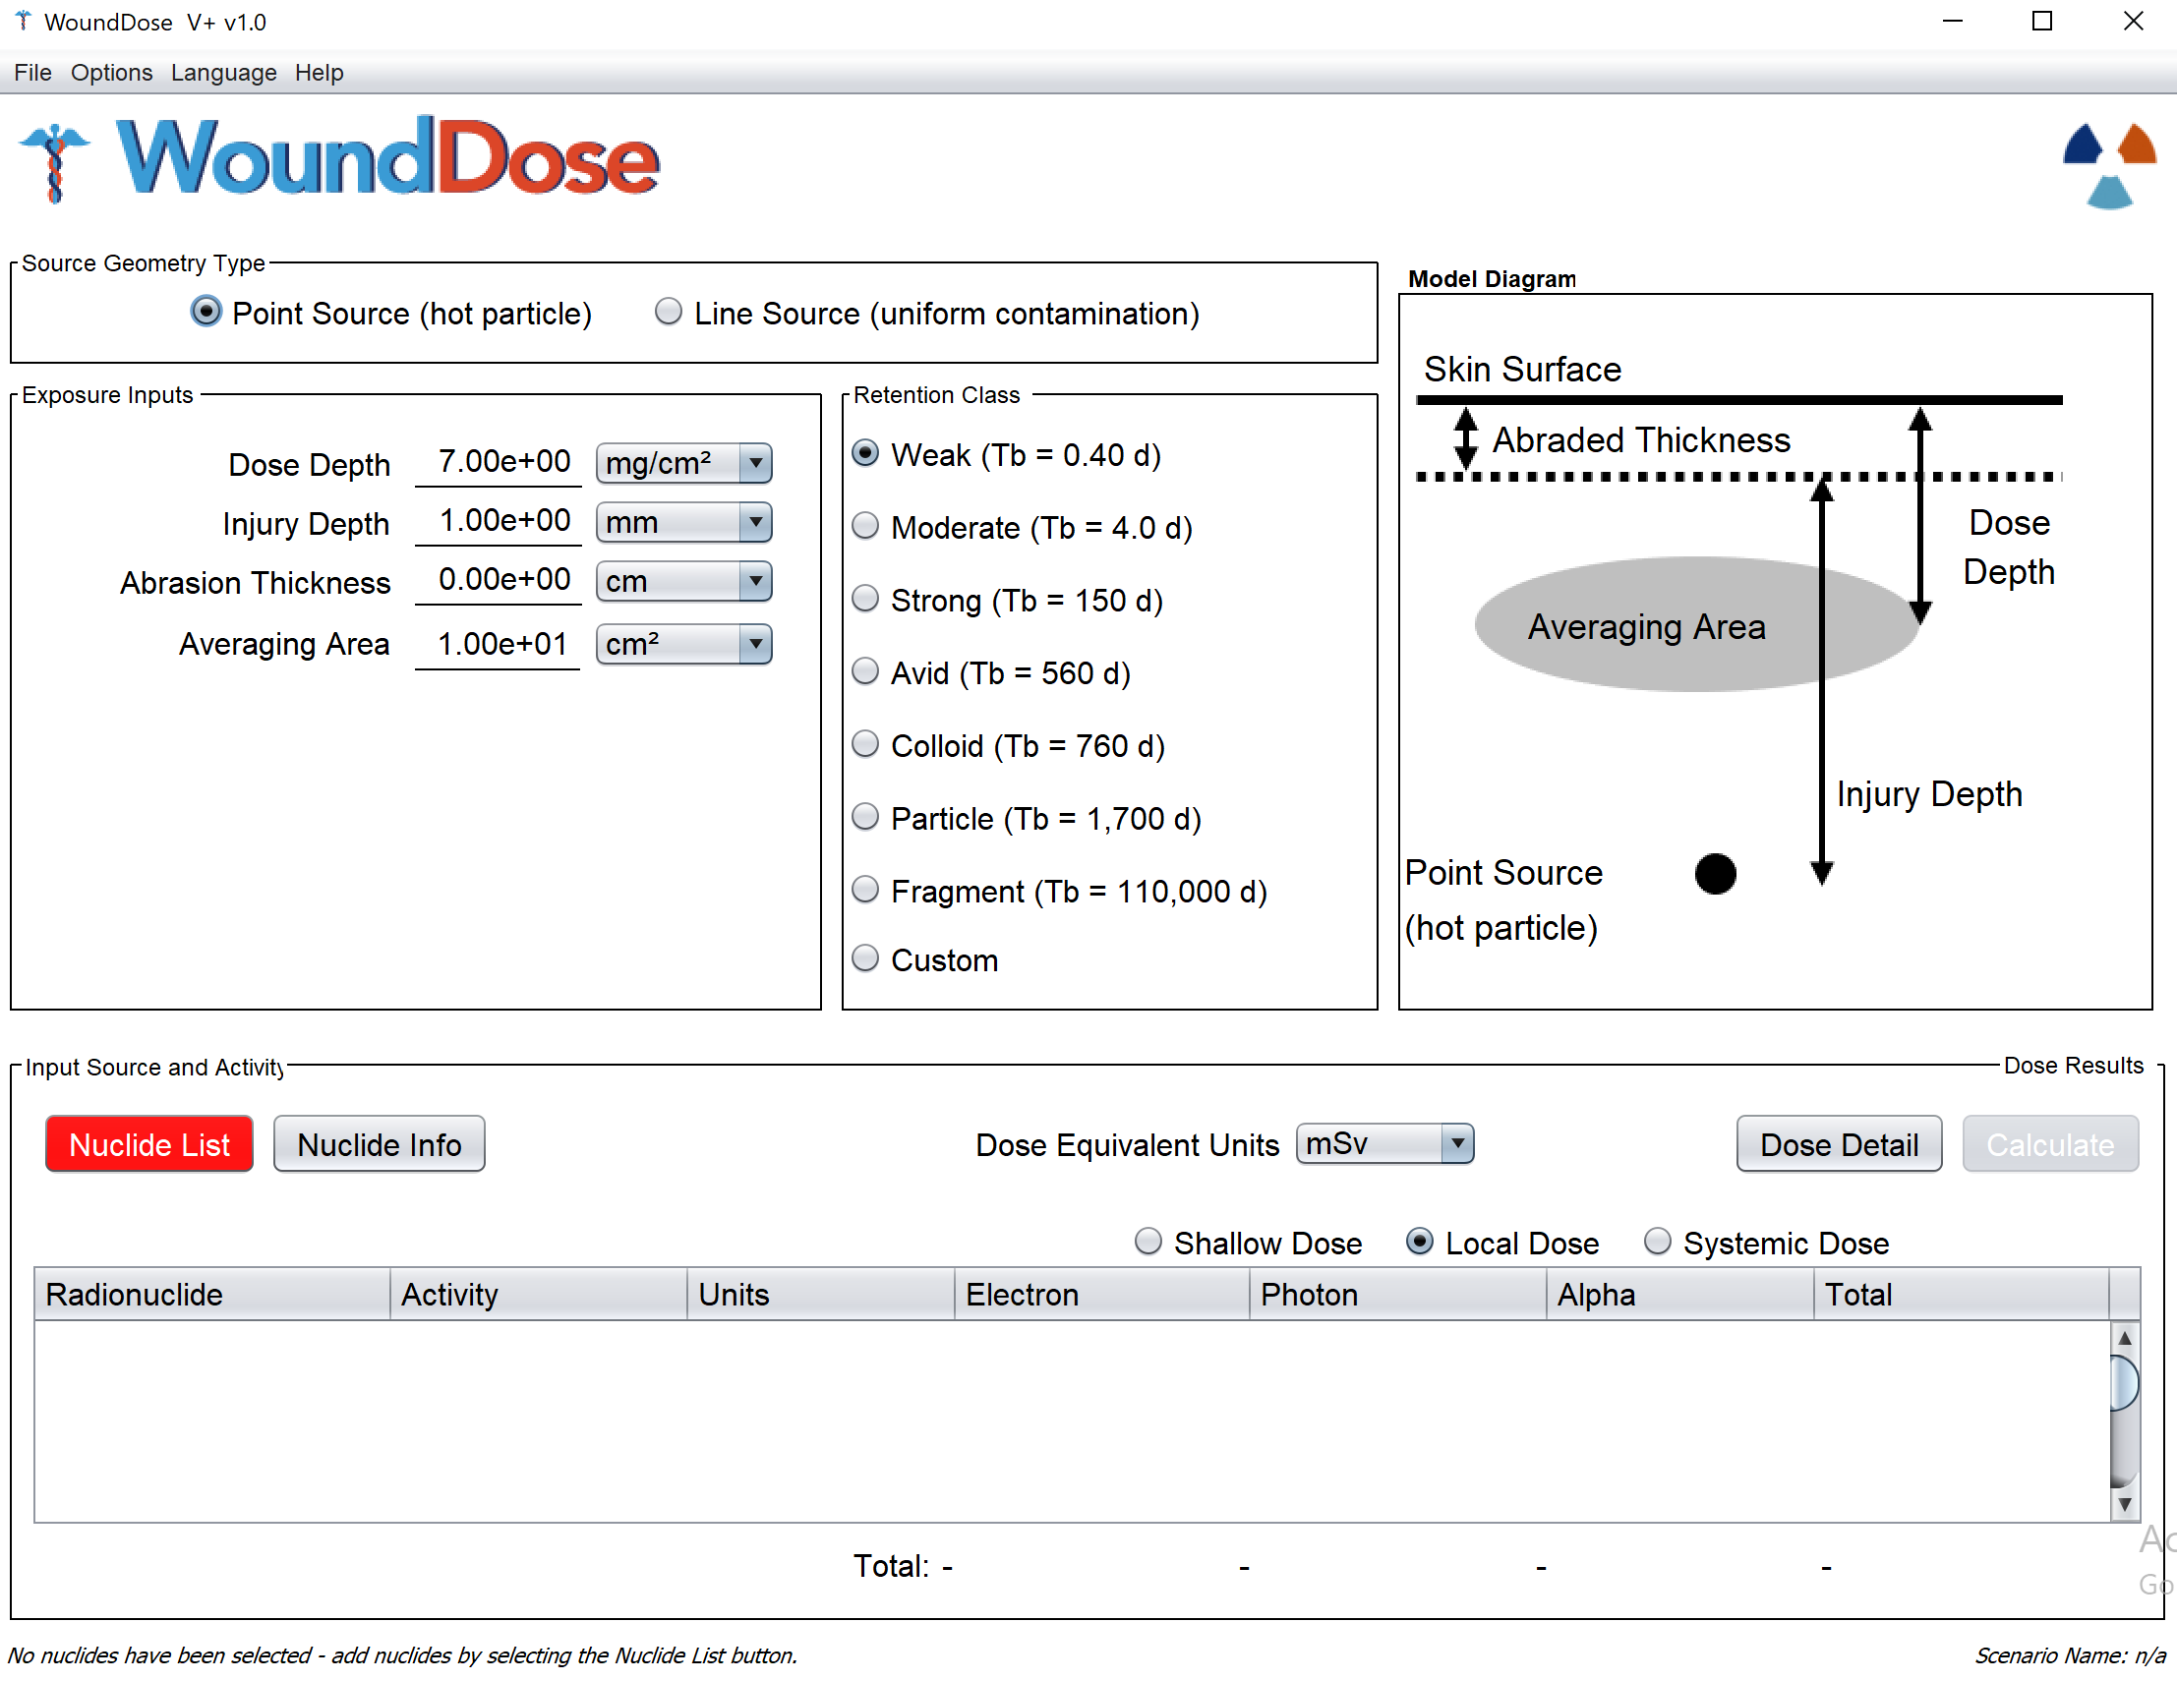
wound DOSE
varSKIN+
Renaissance code development
Colby Mangini, PhD, CHP

Slide 2
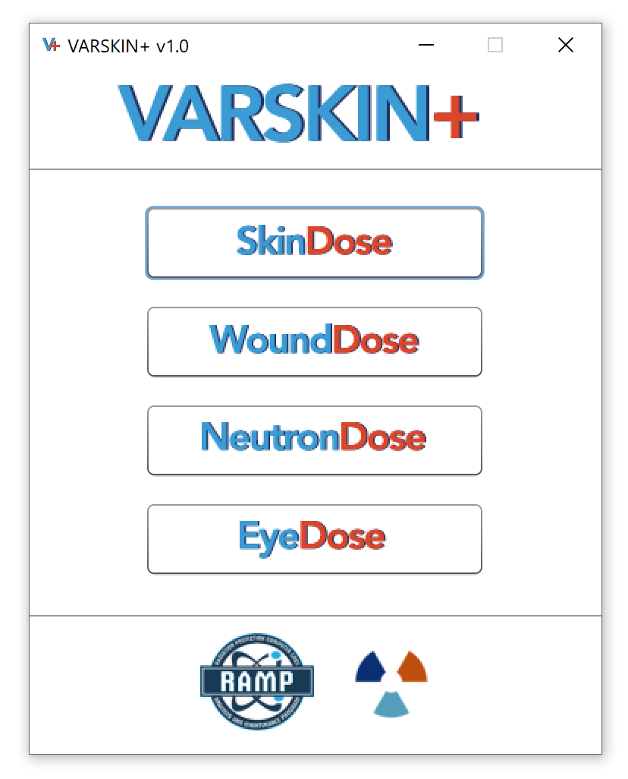
outline
Wound Dosimetry Model
  Technical Basis and Theory
Overview of new SkinDose GUI
Examples

Slide 3
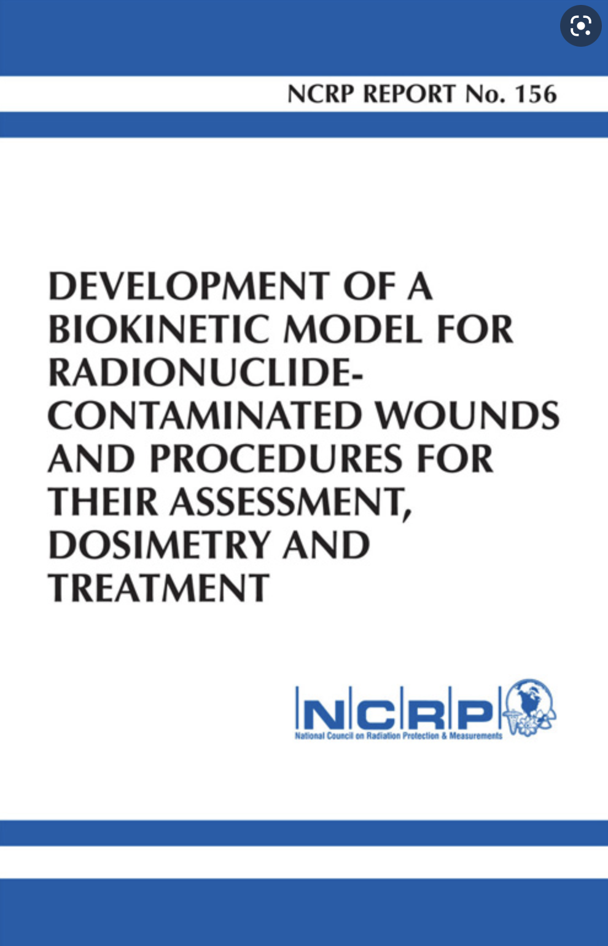
Basis for Wound Model Dosimetry
NCRP Report No. 156, “Development of a Biokinetic Model for Radionuclide-Contaminated Wounds and Procedures for Their Assessment, Dosimetry, and Treatment” (2007)
The wound model consists of three distinct dosimetry calculations:
  (1) Shallow dose Equivalent (@ 7 mg/cm2)
  (2) Local dose equivalent (to tissue)
  (3) organ/effective dose equivalent (systemic uptake)
Type of wound will determine applicable dose calculations

Slide 4
Intact Skin, Abrasions and Nonsevere Burns
For contamination events involving less-severe wounds where the skin remains intact, is lightly abraded, or has been lightly burned, dose assessments can be conducted using WoundDose to estimate the SDE calculations in a manner similar to that of SkinDose (i.e., no activity gets in the bloodstream).
The shallow dose model is altered only by the removal of some or all of the protective dead layer of skin. NCRP 156 states the following,
  For contaminated wounds in which the skin is largely intact, [VARSKIN] dose calculations may be directly applicable. For embedded contamination, Berger’s point kernels may be integrated over the depth of interest.
Previous versions of VARSKIN (before V5) for beta dosimetry were based on point kernels developed by Berger (1971). The more recent VARSKIN and SkinDose packages (V5.0 and later) have their foundation in Monte Carlo simulations using EGSnrc for electron dosimetry, but the methods are essentially the same.
  WoundDose draws on the shallow dose model of SkinDose.

Slide 5
Severe Burns, Lacerations and Penetrating Wounds
For penetrating wounds where radioactive contamination has been forced under the skin surface, WoundDose will calculate dose for electrons, alpha particles, and photons for all three dose outcomes:
(1) Shallow dose Equivalent (@ 7 mg/cm2)
  Draws on SkinDose
(2) Local dose equivalent (to tissue)
  Refers to a determination of the dose to tissue surrounding the contaminated wound
(3) organ/effective dose equivalent (systemic uptake)
  Committed systemic dosimetry for uptakes to the bloodstream, which potentially affects all organs of the body

Slide 6

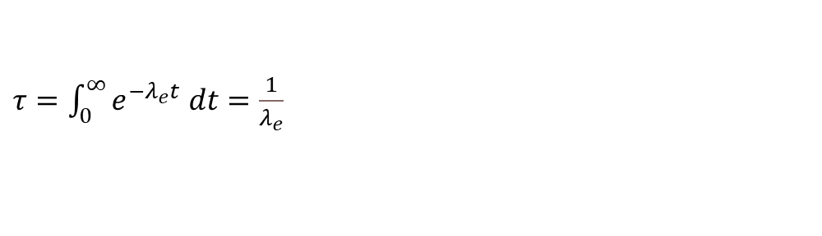
Residence time
Calculations of shallow and local dose in WoundDose are conducted for an estimated time that the radioactive contamination remains at the wound site (e.g., residence time). This residence time is determined by time-integrating the retention function
$$τ=1.44 T_{e}=1.44\left(\frac{T_{r} T_{b}}{T_{r}+T_{b}}\right)$$
$τ=\int_{0}^{∞}{e^{−λ_{e}t} dt}=\frac{1}{λ_{e}}$
where λ_{e} is equal to the sum of the radiological decay constant and the rate constant for biological loss, T_{e}, T_{r}, and T_{b} are the effective, radiological, and biological half-lives, respectively.

Slide 7
Biological Residence time by Retention class
Class | Biological Half-life (d) | Biological Residence Time* (d) | Biological Residence Time (yr)
Weak | 0.40 | 0.58
Moderate | 4.0 | 5.7
Strong | 150 | 210 | 0.58
Avid | 560 | 810 | 2.2
Colloid | 760 | 1,100 | 3.0
Particle | 1,700 | 2,400 | 6.6
Fragment | 110,000 | 150,000 | 410**
*time integral of triple-exponential wound retention; derived from NCRP 156 Table 4.11
**50-year maximum

Slide 8
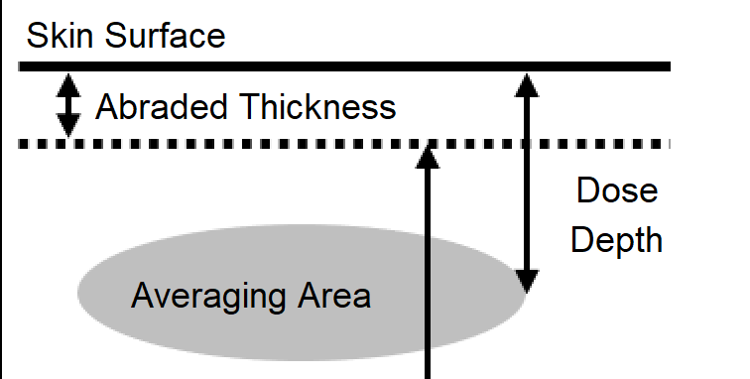
Shallow Dose
In 10 CFR 20.1003, shallow skin dose is defined for external exposures and is to be determined at a basal-layer depth of 70 microns (7 mg/cm2, 0.007 cm) beneath the surface of the skin.
  This depth is assumed to be appropriate for the determination of risk (~dead layer thickness)
The regulation in 10 CFR 20.1201 also requires that shallow skin dose be “averaged over the contiguous 10 square centimeters of skin receiving the highest exposure”
If an abrasion were to occur, in which a portion or all of the dead layer of skin were removed, the depth at which shallow dose is determined would be altered by the thickness of removed tissue (alive or dead).

Slide 9
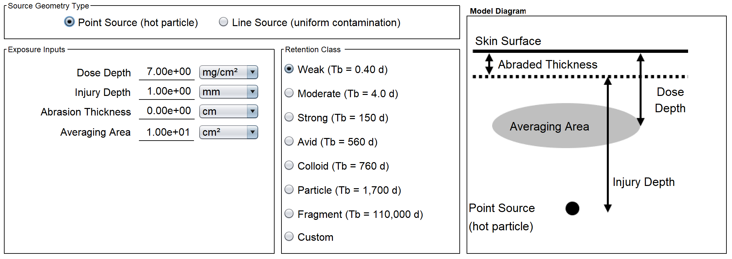
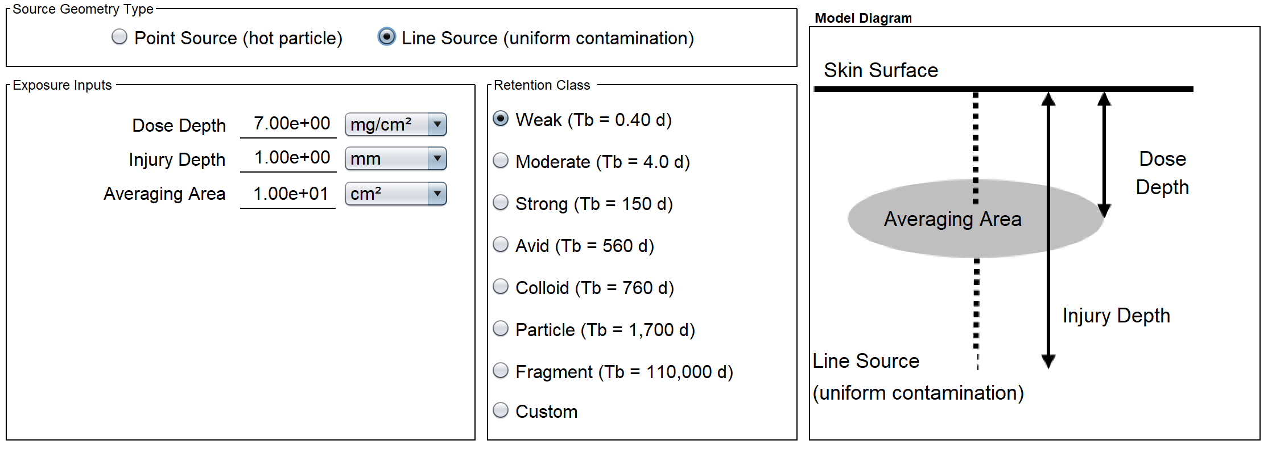
Shallow Dose
To estimate total dose at the shallow depth (70 microns) with an embedded wound source, the models of SkinDose are accessed, but with modified backscatter correction
In addition to the typical skin dosimetry inputs, the user would enter the thickness of any surface tissue that might have been removed by the wound, as well as the wound retention class (e.g., weak, moderate, strong), and an estimate of its penetration depth

Slide 10
Shallow Dose
Point Source at Depth: In this case, the distance between source and skin averaging area is determined by the difference between source depth and the defined shallow depth (70 microns)
The user should still have the option to select the depth at which dose is calculated, but 70 microns would remain as the default
point
source
Air
Skin
Air
Skin
dose averaging
area (at 70 μm)
dose averaging
area (at 70 μm)
point
source

Slide 11
Shallow Dose
Line Source Surface to Depth: In this instance, it is assumed that a puncture has occurred (e.g., contaminated screwdriver) and any remnant of contamination is evenly distributed along the puncture route
The shallow dose at 70 microns to a specified skin averaging area (10 cm²) is calculated under the assumption that the line source begins at the surface, possibly penetrates the averaging area, and continues to the user-specified wound depth
The problem in this case requires the numerical integration of dose over a series of point sources at depth, along the wound penetration line. The penetrating wound is assumed to be perpendicular to the skin
Air
Skin
dose averaging
area (at 70 μm)
line
source

Slide 12
Local dosE
Local wound dosimetry is straightforward … energy absorbed per unit mass
NCRP 156 states, “If the activity in the wound is known, … dose calculations may be limited to the volume [mass] of tissue actually irradiated …”
But, “irradiated mass” can be ambiguous
For radioactivity in the liver, the mass of liver is assumed to be uniformly irradiated
If radioactivity were localized in skin, the irradiated mass is that which absorbs energy (range)
For example, ³²P electrons have a range (95%) of about 0.54 cm in tissue, i.e., ρV = 6.7x10⁻¹ g
whereas, ¹⁵⁰Gd alphas have a range of about 18 microns in tissue, i.e., ρV = 2.4x10⁻⁸ g

Slide 13
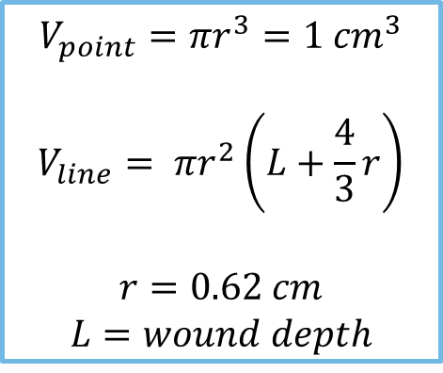
Local Dose
For estimates of local dose, particle/photon energy emitted from a point source is assumed to be deposited in a standard spherical volume of 1 cm³ (radius = 0.62 cm). For a line source, the deposition volume is assumed to be a cylinder of radius 0.62 cm with hemispherical endcaps (NRCP 156).
Source geometry options:
$$V_{point}=πr^{3}=1 {cm}^{3}$$
$$V_{line}= πr^{2}\left(L+\frac{4}{3}r\right)$$
$$r=0.62 cm$$
$$L=wound depth$$
spherical volume
around the point source
cylindrical volume
along the line source

Slide 14
Local dosE
Dose for a 1 kBq point source of ³²P (E_{avg} = 0.695 MeV): LDE = 0.60 mSv/h
And, a 1 kBq point source of ¹⁵⁰Gd (E_{α} = 2.75 MeV): LDE = 1.3 MSv/h
But, a wound with both nuclides (i.e., using larger volume): LDE = 48 mSv/h
However, with a standard volume (1 cm³, r = 0.62 cm):
  1 kBq ³²P LDE = 0.4 mSv/h
  1 kBq ¹⁵⁰Gd LDE = 31.7 mSv/h
  1 kBq ¹⁵⁰Gd + 1 kBq ³²P LDE = 32.1 mSv/h
All alpha and electron energy is assumed deposited with 1 cm³
  good assumption for 95% absorption until about E_{e} > 2 MeV

Slide 15

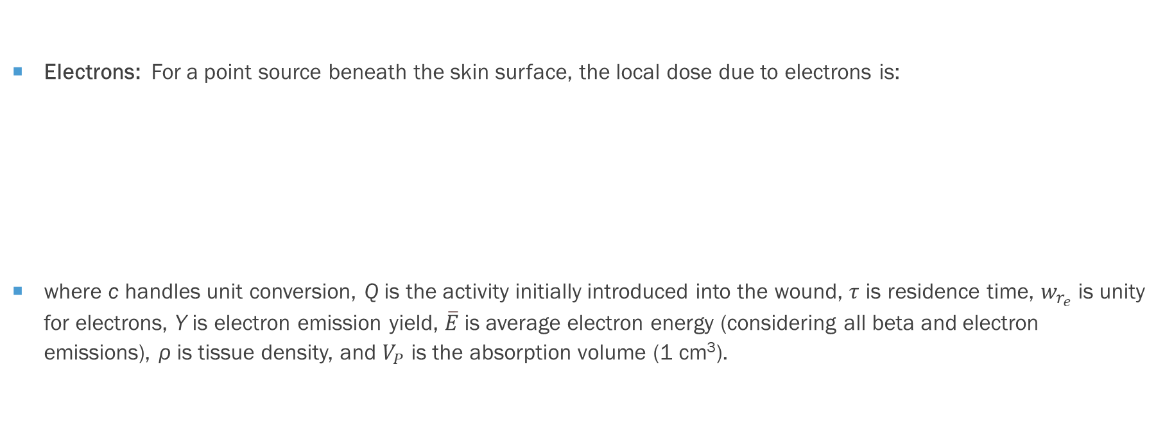
Local Dose
Electrons: For a point source beneath the skin surface, the local dose due to electrons is:
where c handles unit conversion, Q is the activity initially introduced into the wound, $τ$ is residence time, $w_{r_{e}}$is unity for electrons, Y is electron emission yield, $\overline{E}$is average electron energy (considering all beta and electron emissions), ρ is tissue density, and $V_{P}$ is the absorption volume (1 cm³).
$$D_{e}=c\frac{Q τ w_{r_{e}} Y \overline{E}}{ρ V_{P}}$$

Slide 16

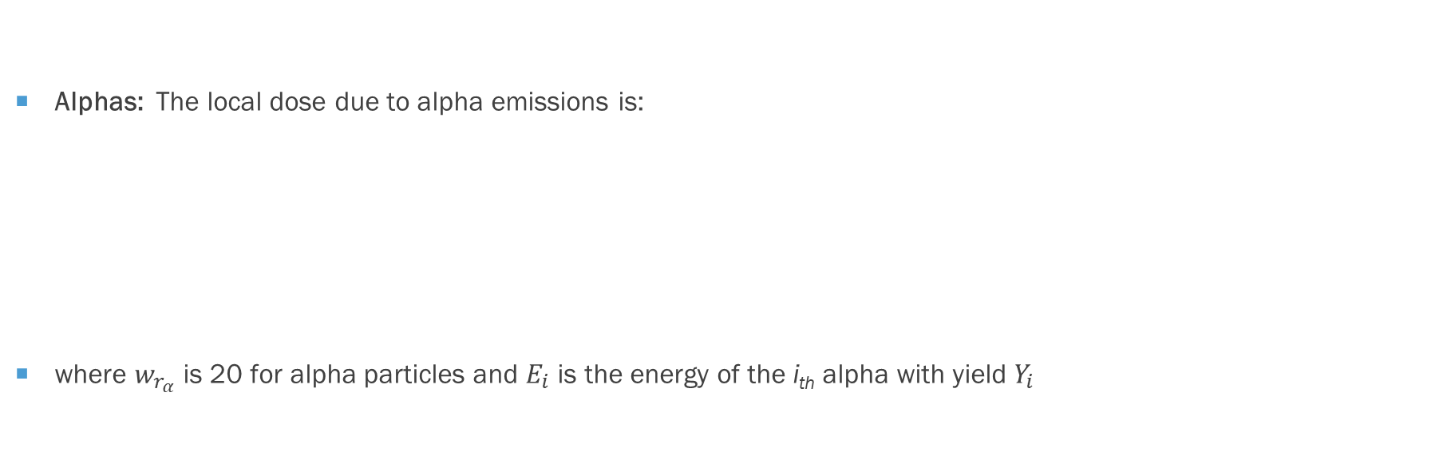
Local Dose
Alphas: The local dose due to alpha emissions is:
where $w_{r_{α}}$is 20 for alpha particles and $E_{i}$ is the energy of the i_{th} alpha with yield $Y_{i}$
$$D_{α}=c\frac{Q τ w_{r_{α}}}{ρ V_{P}}\sum_{i}{Y_{i} E_{i}}$$

Slide 17

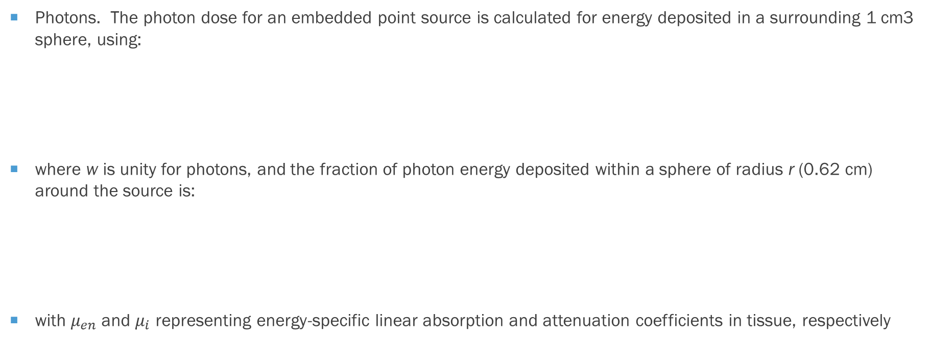

Local Dose
Photons. The photon dose for an embedded point source is calculated for energy deposited in a surrounding 1 cm3 sphere, using:
where w is unity for photons, and the fraction of photon energy deposited within a sphere of radius r (0.62 cm) around the source is:
with $μ_{en}$and $μ_{i}$ representing energy-specific linear absorption and attenuation coefficients in tissue, respectively
$$D_{γ}=c\frac{Q τ w_{r_{γ}}}{ρ V_{P}}\sum_{i}{Y_{i} E_{i} f_{i}}$$
$$f_{i}=\frac{{\left(μ_{en}\right)}_{i}}{μ_{i}}\left(1−e^{{−μ}_{i}r}\right)$$

Slide 18
Systemic Dose
The biokinetic model for radiologically contaminated wounds considers four uptake categories:
  radionuclides in soluble form
  particulates, aggregates, and bound states
  colloid and intermediate states
  Fragments
Movement of material from the wound and through the body to the bloodstream is characterized by the biokinetic model in NCRP 156

Slide 19
Retention categories of NCRP 156 systemic uptake
Accidental Injection
Fragment
Trapped Particles & Aggregates
Soluble
Particles, Aggregates & Bound States
Colloid & Intermediate State
Lymph Nodes
Blood

Slide 20
NCRP 156 systemic model default transfer rates
Transfer Rates (d⁻¹) | Weak | Moderate | Strong | Avid | Colloids | Particles | Fragments
Soluble to blood | 45 | 45 | 0.67 | 7.0 | 0.5 | 100 | -
Soluble to CIS | 20 | 30 | 0.6 | 30 | 2.5 | - | -
CIS to soluble | 2.8 | 0.4 | 0.024 | 0.03 | 0.025 | - | -
CIS to PABS | 0.25 | 0.065 | 0.01 | 10 | 0.05 | - | -
CIS to lymph nodes | 0.00002 | 0.00002 | 0.00002 | 0.00002 | 0.002 | - | -
PABS to soluble | 0.08 | 0.02 | 0.0013 | 0.005 | 0.0015 | 0.0002 | -
PABS to lymph nodes | 0.00002 | 0.00002 | 0.00002 | 0.00002 | 0.0004 | 0.0036 | 0.004
PABS to TPA | - | - | - | - | - | 0.04 | 0.7
TPA to PABS | - | - | - | - | - | 0.0036 | 0.0005
Lymph nodes to blood | - | - | - | - | 0.03 | 0.0006 | 0.03
Fragment to soluble | - | - | - | - | - | - | -
Fragment to PABS | - | - | - | - | - | - | 0.008

Slide 21
Biokinetic Modeling results*
*Ishigure, N. Implementation of the NCRP wound model for interpretation of bioassay data for intake of radionuclides through contaminated
wounds. Journal of Radiation Research. 50(3): 267-276; 2009.

Slide 22
Wound dose coefficients for systemic uptake
For 38 radionuclides, Toohey et al. (2014)* contains tables of:
  compartment transfer rates by retention class
  ODE coefficients by retention class
  EDE coefficients by retention class
  derived regulatory guides and clinical decision guides for a subset of radionuclides
For example, each nuclide (²⁴¹Am in this case) has 7 effective dose coefficients [x10⁻⁴ Sv/Bq]:
  Soluble 3.97 (weak) 3.96 (moderate) 3.91 (strong) 3.79 (avid)
  Insoluble 3.80 (colloid) 2.23 (particle) 0.141 (fragment)
*Toohey, R.E; Bertelli, L.; Sugarman, S.L.; Wiley, A.L.; Christensen, D.M. Dose coefficients for intakes of radionuclides via contaminated wounds. Oak Ridge Institute for Science and Education. US DOE Contract No. DE-AC05-06OR23100. Oak Ridge, TN; Ver. 2, August 2014.

Slide 23
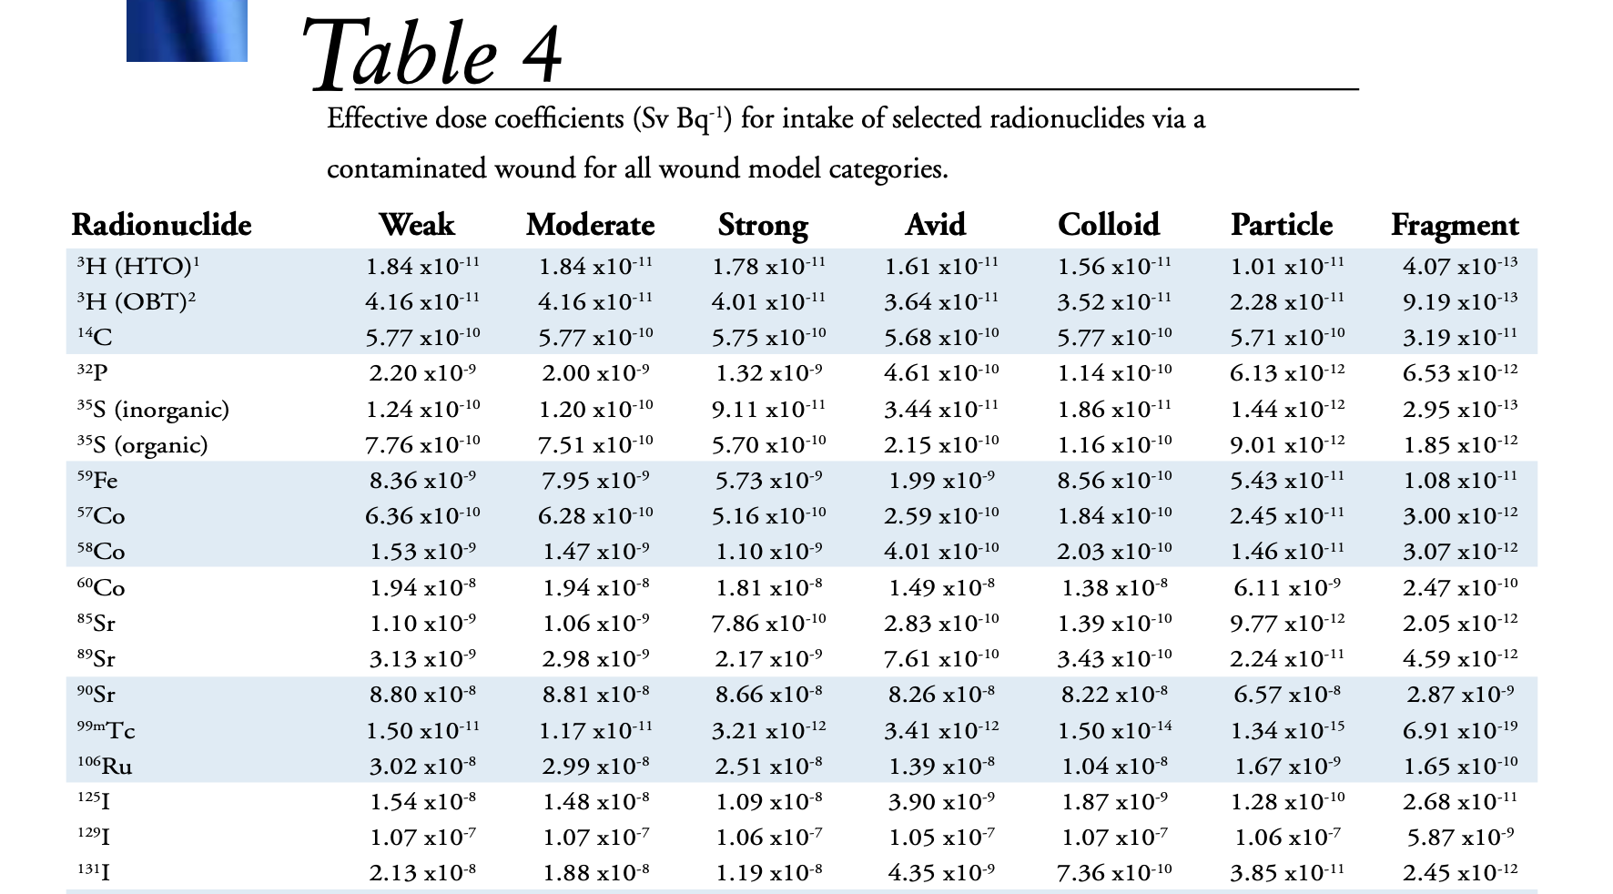
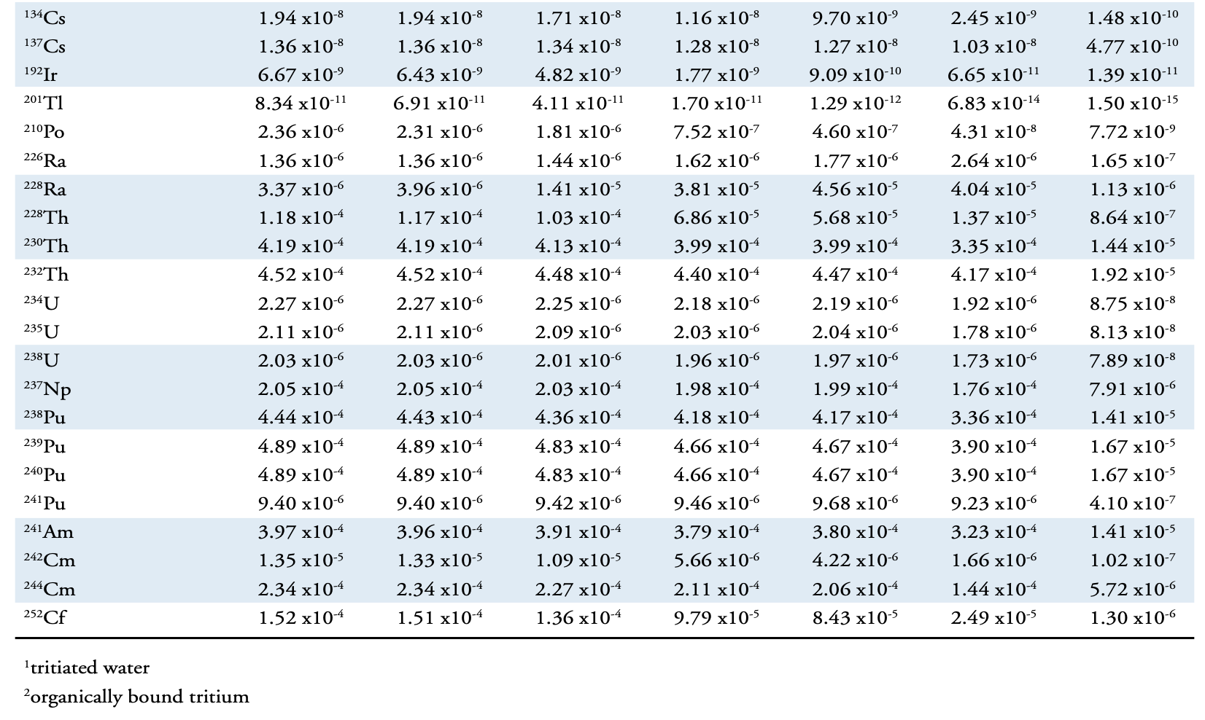

Slide 24
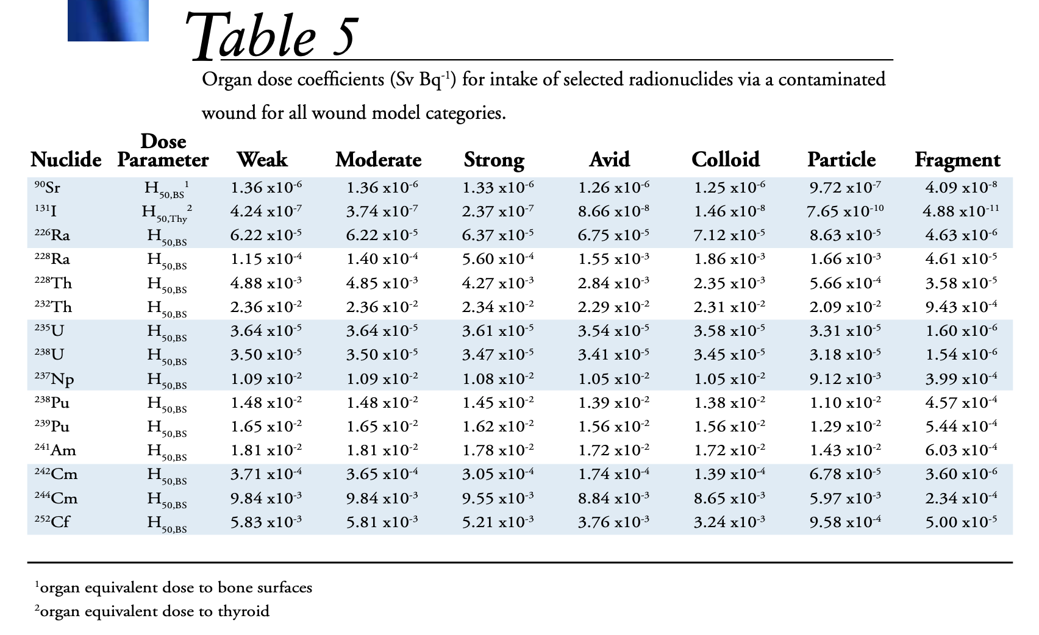

Slide 25
Historical wound experience
Industrial
  vast majority of contaminated wounds involved actinides
  > 90% occur in hands and arms, primarily fingers
  ~ 90% involve punctures and chemical burns
Military
  embedded U and Pu compounds/fragments
Medical
  needle sticks in radiopharmaceutical labs
  accidental injections of Thorotrast® (²³²Th)

Slide 26
Basic Demonstration
Assume a 0.01 uCi Co-60 (ICRP 107) point source
Particle retention class
1 mm abrasion depth
1 cm injury depth
Shallow Dose to a 10 cm² averaging area at a depth of 7 mg cm⁻²

Slide 27
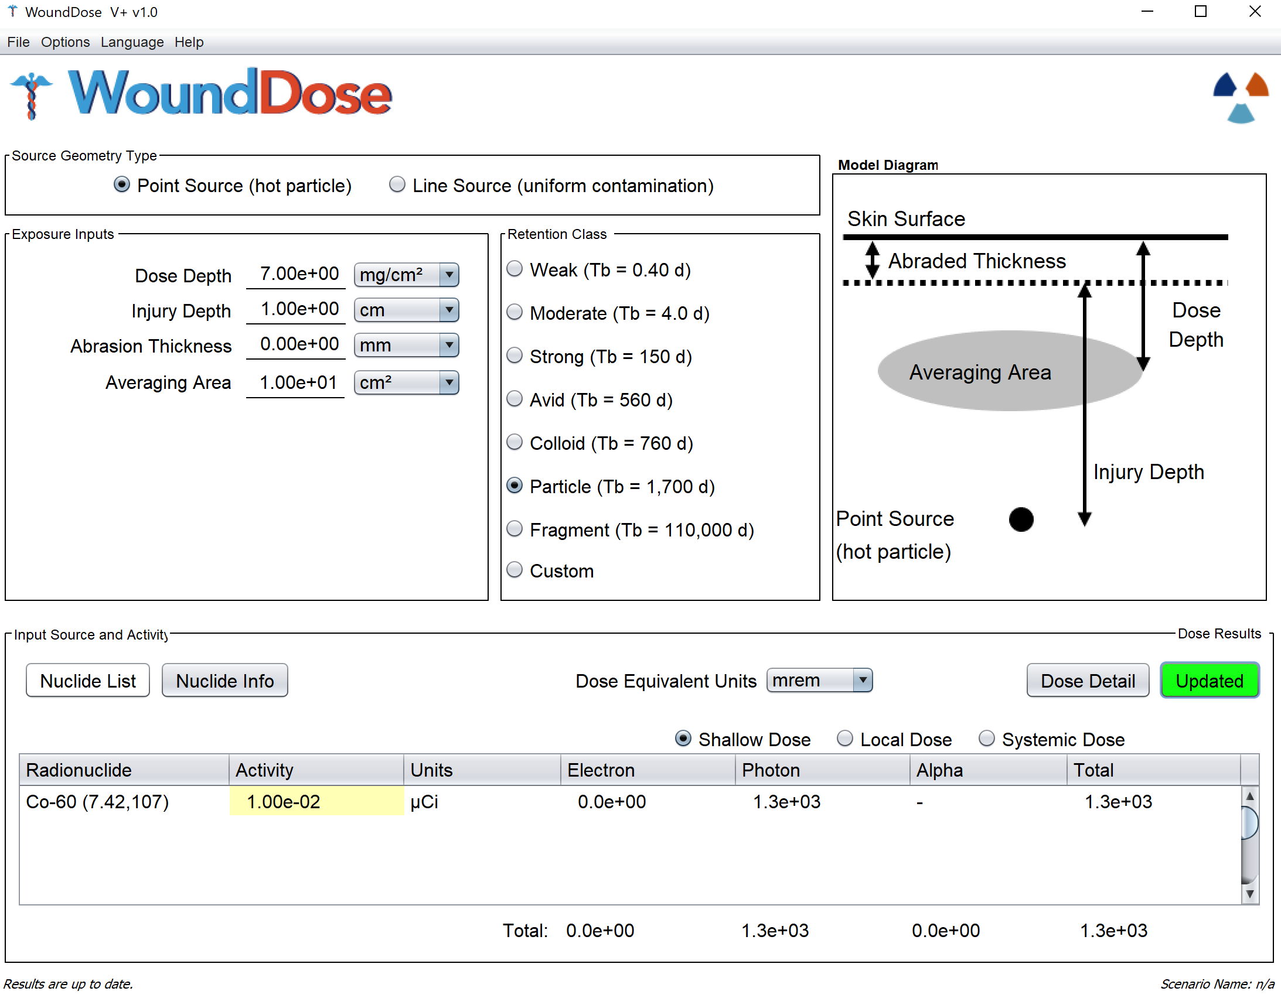

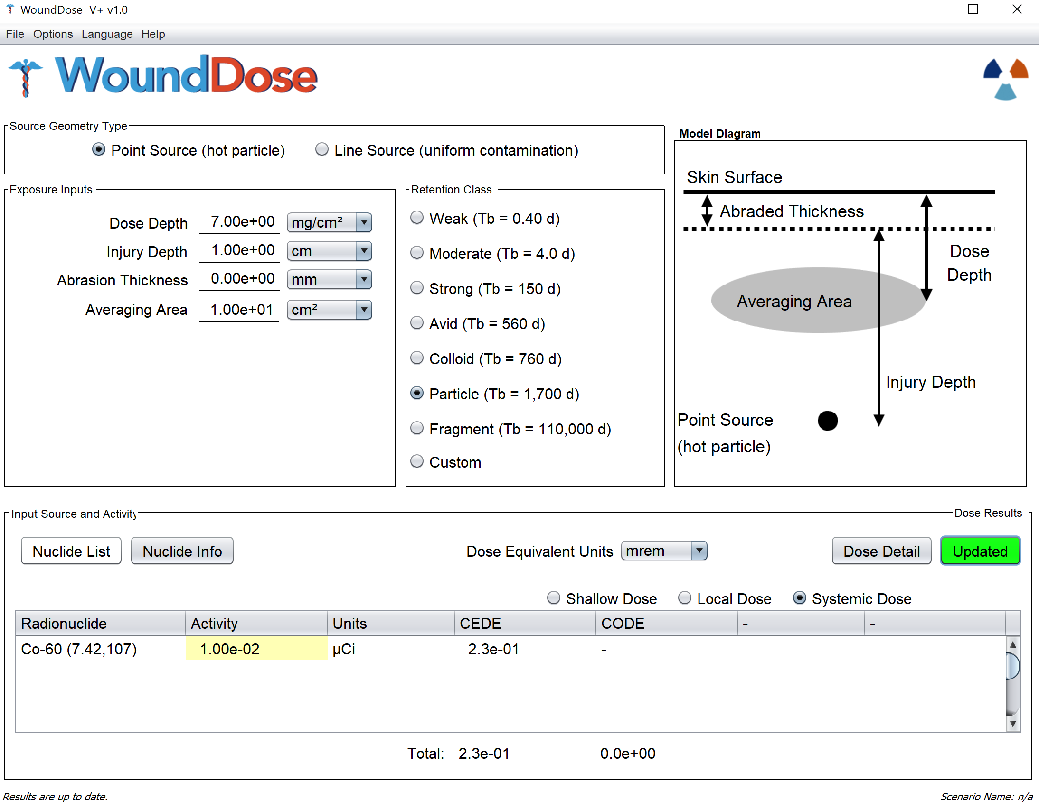

Slide 28
Examples…

