Slide 1
CAUG: PiMAL
MCMP™ Overview
Charlotte Rose MS (RHP)

Slide 2
Outline
How to get MCNP ™
MCNP ™ Code overview
Principles for good calculations
Geometry
Tally types
How does PiMAL use MCNP ™?
What does an input file look like?
How to run MCNP ™
What does the output file mean?

Slide 3

How to get MCNP ™
rsicc.ornl.gov
Customer service
Register
Submit a request
  Verify your info
  Select codes:
    MCNP6.2 ™ exe
    Visual editor 61
    Choose platform
  End user info: job uses

Slide 4
MCNP ™
MCNP ™ is a general purpose continuous energy, generalized geometry, time dependent code designed to track 37 particle types over a broad range of energies.
But what does that mean?

Slide 5
Continuous Energy
Energy is continuous and not discretized; each particle iteration or history is probabilistically evaluated based on possible positions or scattering events, rather than given a discrete (specific) value that is probabilistic.

Slide 6
Generalized Geometry – think cartesian!
Geometry options are limited to:
  Plane
  Sphere
  Cylinder
  Cone
  Ellipsoid/hyperboloid/parabaloid
  Cylinder/cone
  Torus

Slide 7
Macrobodies – think pre-made cell
Box
Rectangular parallelepiped
Sphere
Right circular cylinder
Right hexagonal prism
Right elliptical cylinder
Truncated right angle cone
Ellipsoid
Wedge
Arbitrary polyhedron

Slide 8
Macrobodies
Facets of a microbody rather than surfaces
Use them for tally specification
Can be complicated
Visual editor can help locate surface of choice

Slide 9
Particle types
37
Generally, PiMAL users will encounter
  Photons
  neutrons
But might also find use for
  Electrons
  Alpha
  Protons
  etc

Slide 10
Problem Description
Geometry
Material
Source
Tally
Variance reduction

Slide 11
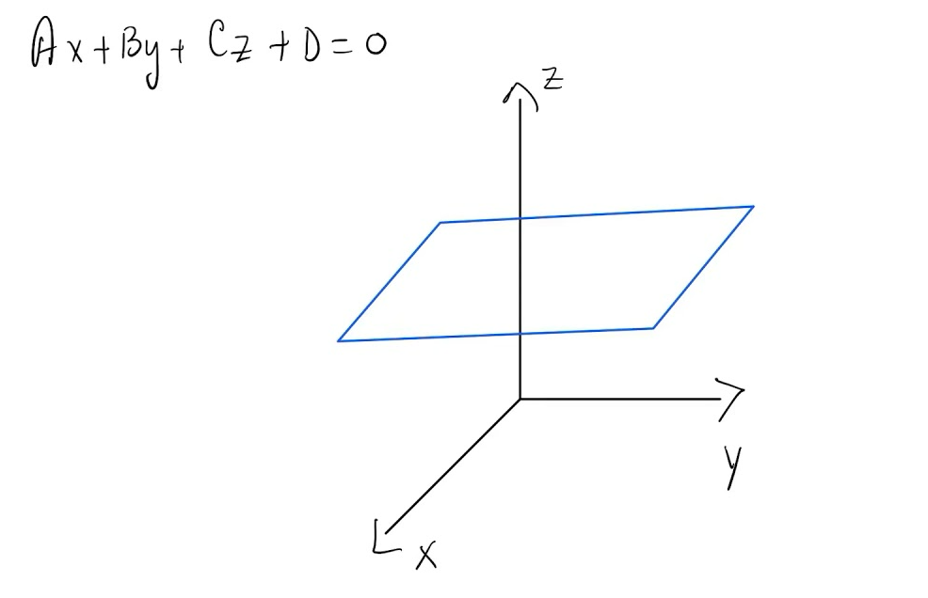
Coordinate Geometry
Think cartesian!
Where does my volume exist if I used this equation to define it? Above (more positive)? Below (more negative)?
Rule of 3

Slide 12
Tally types
More than this; but generally:
  1: current (#)
  2: flux (area) (#/cm²)
  4: flux (volume) (#/cm²)
  6: energy deposition in volume (MeV/g)
  8: energy distribution of pulses created in a detector by radiation (MeV)

Slide 13
Tallies
Can modify tallies for dose (rem, Sv, etc)
Can break it down by energy
Can break it down by angle
So much more… but we’ll keep it simple

Slide 14
5 principles for good calculations
Define and sample geometry and source well
Cannot recover lost info (be careful of areas with zero importance, and tally where you want to without ignoring other areas you think won’t sample)
Question statistical convergence – are the results stable and reliable?
Be conservative with applying variance reduction
Number of histories is not indicative of the quality of the answer

Slide 15
How does PiMAL use MCNP ™?
Base model of the human body
Modifications can be made in the GUI to move arms/legs/change gender etc.

Slide 16
What do we get if we learn more about MCNP ™?
Geometry can be added for more complexity of sources or situations
Source specifications can be more diverse
Materials can be added
Variance reduction can be used for better efficiency or statistics
Batch runs for multiple iterations of similar problems
Understanding the reliability of the results and fundamentals of the code can help to problem solve or critically think through problems: DOES THIS MAKE SENSE? Why? Why not?

Slide 17
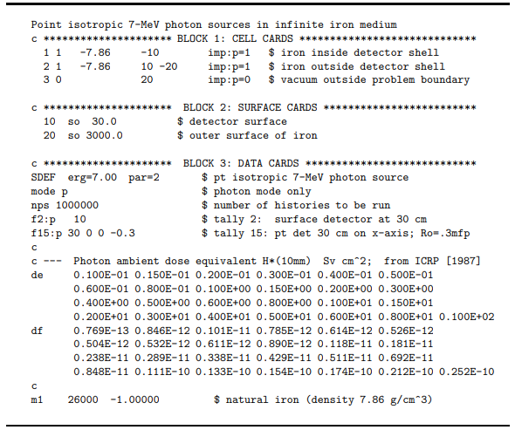
Input file
Title
Cells
Space
Surfaces
Space
Everything else
  Material, source, mode, tallies, print, nps, etc
Blank line
Shultis, J. Kenneth and Richard E. Faw. “An MCNP primer.” (2011).

Slide 18
Tips
Never leave an unintended blank line
Never use tabs
Never have code beyond 80 characters; use continue line
“c” at beginning of line for comment
$ at end of code for comment

Slide 19
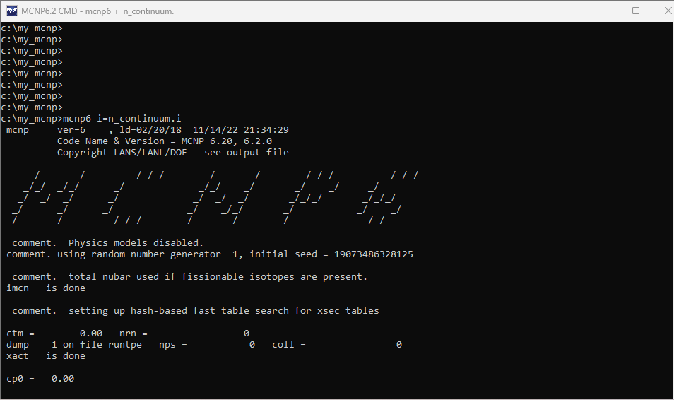
Running MCNP
MCNP command line
mcnp6
N vs I -> outputs
tasks

Slide 20
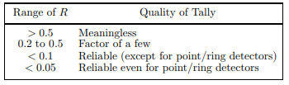
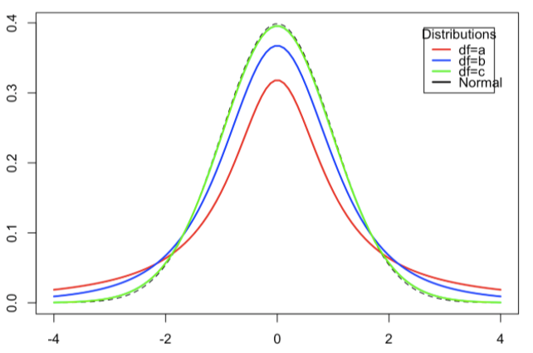
Output
Value, and value behavior
  Should be random – why?
S error, and s error behavior
  Should decrease predictably – why?
VoV
  Evaluates if the s error is reliable
FOM
  Simulation time should be proportional to number of histories – why?
PDF
  Quality of the confidence interval – were enough high scoring events sampled? Is the distribution “normal enough”?
  200 larges histories’ scores to estimate the slope of the high tally tail
Shultis, J. Kenneth and Richard E. Faw. “An MCNP primer.” (2011).

Slide 21
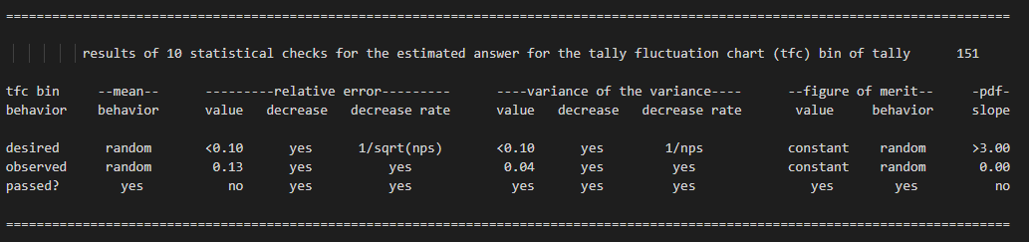
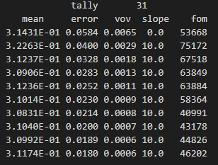
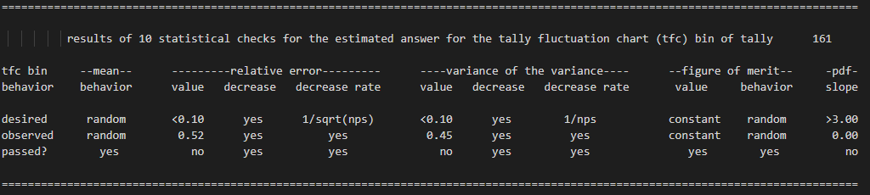

Slide 22
References
Shultis, J. Kenneth and Richard E. Faw. “An MCNP primer.” (2011).
C.J. Werner (editor), "MCNP Users Manual - Code Version 6.2", LA-UR-17-29981 (2017).

