Slide 1
CAUG 10: Tallies
Charlotte Rose MS (RHP)

Slide 2
Last Class
Sources

Slide 3
Intermediate MCNP
Trey will share his experience with MCNP
Tallies

Slide 4
Tallies
At the heart of our work
Accounting of activities
What the statistics are reported on; statistics are not a report of the problem or model as a whole
Remember from first class: we cannot recover lost info! (be careful of areas with zero importance, and tally where you want to without ignoring other areas you think won’t sample)
7 types

Slide 6
Tallies
Or use with dose functions
Note: no particle designator!

Slide 7
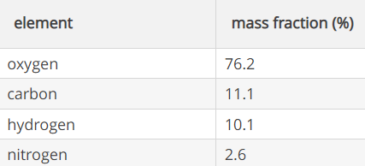
Ways to tally Dose
PIMAL Phantom
ICRU Sphere
Sphere 30 cm diameter (15 cm radius)
~ 14 L
ICRU Slab
30 cm x 30 cm x 15 cm
~14 L
ICRU 4-component tissue

Slide 8
Ways to tally Dose
F4n Tally with dose function
F6n Tally *need* multipliers for biological dose
Most exact
F4 Tally with FM -1 -4 (total collision heating)
+F6 Energy from all particles averaged over the cell
*F8n energy deposition
Always P and E (particle designation does not matter, all photons and electrons are tracked
Results not per g

Slide 9
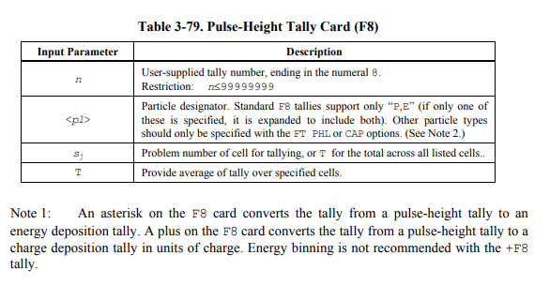
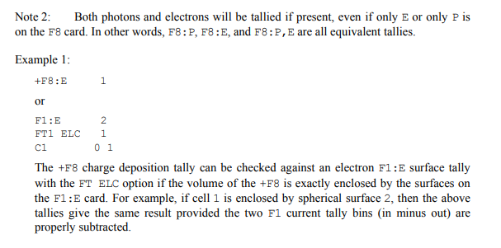

Slide 10
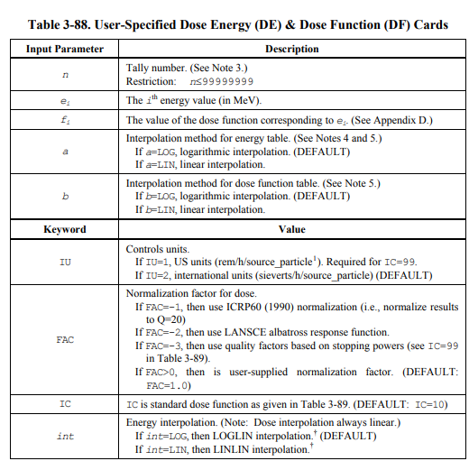

Slide 11
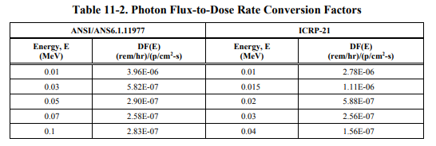
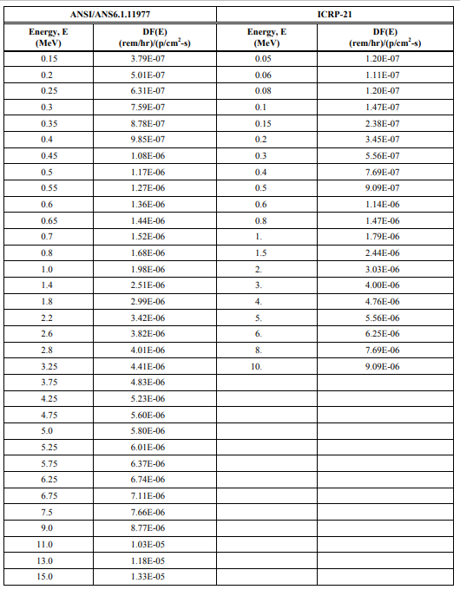
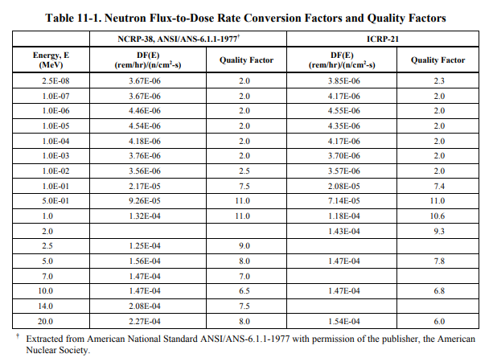

Slide 12
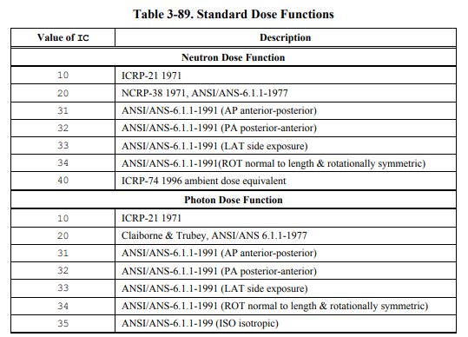
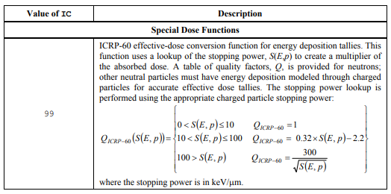
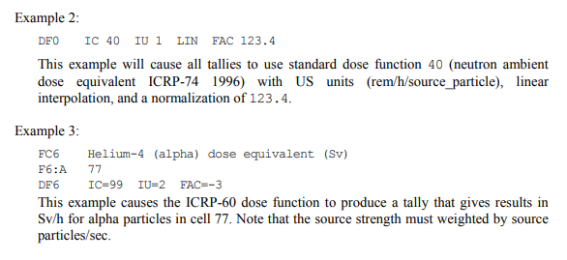

Slide 13
Tallies
Normalized to one
Activity can be input in the WGT parameter (SDEF card) or modified after

Slide 14
Tally Energy
Default to one energy bin with total energy
E0 will set up energy bin structure for all tallies in model
Entered in order of increasing magnitude
If energy of a particle exceeds highest bin, it will NOT BE TALLIED
eg: E4 0.01 0.1 1 10
This will break down the tally into 4 energy bins:
from 0 to 0.01
from 0.01 to 0.1
from 0.1 to 1
from 1 to 10

Slide 15
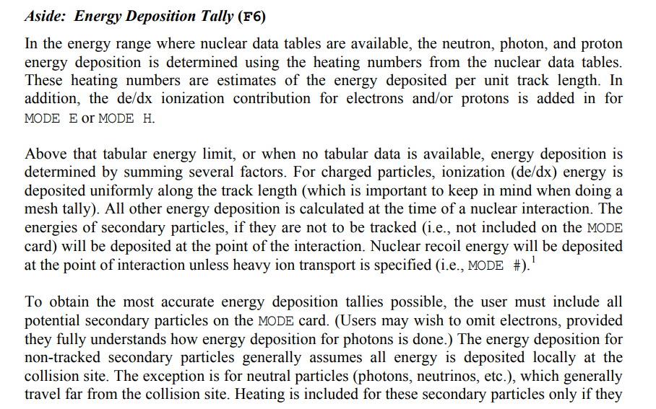
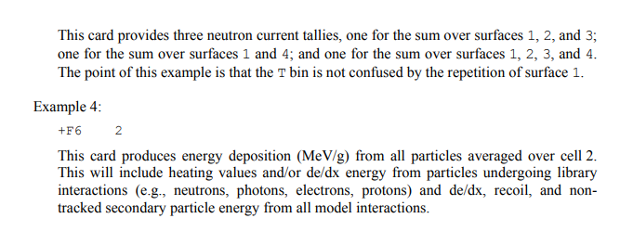

Slide 16
