Slide 1
CAUG 11: Mesh Tallies
Charlotte Rose MS (RHP)

Slide 2
Last Class
Tally fundamentals
Sharing

Slide 3
Intermediate MCNP
Mesh Tallies
MCNP input file syntax
Mesh tally plotting – would love to show you but I learned that I am missing an important bit of software/setup, and so we will go through that as we start advanced. It might be more appropriate there, anyway.

Slide 4
Tallies
At the heart of our work
Accounting of activities
What the statistics are reported on; statistics are not a report of the problem or model as a whole
Remember from first class: we cannot recover lost info! (be careful of areas with zero importance, and tally where you want to without ignoring other areas you think won’t sample)
7 types; FMESH tallies only type 4

Slide 5
This is one of the times Tally Comment can be really helpful since we will likely not read this from the output file, rather the meshtally file.

Slide 6
Mesh tallies
Advantages
Disadvantages
Do not need cell
Can provide a lot of information
Make a heat/dose map or graph an attenuation coefficient
Can be hard to read
Only error is reported (1/10 statistical checks)
Take care to understand if there are more than one materials in the area tallied

Slide 7
PIMAL phantom
Use a base model with already determined geometry and put a tally in a location
Put a grid of tallies in a location
Grid the entire room

Slide 8
FMESH syntax for cartesian meshes
FMESH4:P
GEOM=REC ORIGIN= starting points (x,y,z)
IMESH x end points IINTS how many steps between x
JMESH y end points JINTS how many steps between y
KMESH z end points KINTS how many steps between z
OUT IJ/IK/JK
FM -1 0 -4 (turns it into an energy deposition tally mev/g)

Slide 9
FMESH syntax for cylindrical meshes
FMESH4:P
GEOM=CYL ORIGIN= Base of cylinder (x,y,z)
IMESH radius from 0 to this # IINTS how many steps between radii /vec
JMESH heigh gradations JINTS how many steps for height/axs
KMESH rotational end point KINTS how many radial divisions from 0
(default start 0, to 1 in whole revolutions; 1 is 360 degrees)
AXS axis vector VEC radial vector
OUT IJ/IK/JK (optional, but I like this for 3D outputs)
DE DF for dose conversion factors (cannot use pre built modifiers)

Slide 10
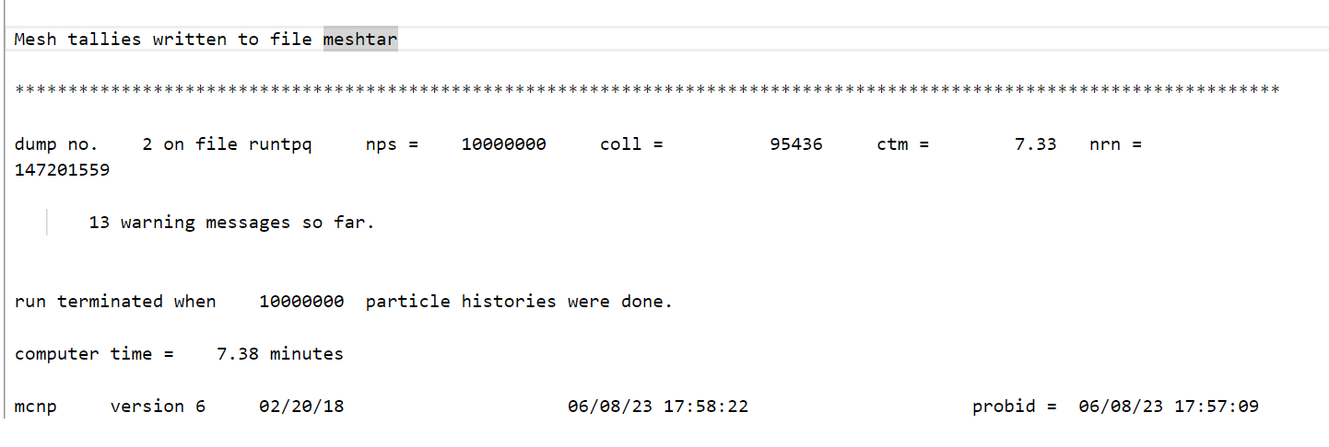
MESHTAL file
This can be when using the i= and n= commands can be very helpful!!
How to read it – little description
Simplifying with FC (comment)
Output comparison
Using Excel to help graph/convert

