Slide 1
CAUG 8:
Intermediate MCMP
Charlotte Rose MS (RHP)

Slide 2
Last Class
MODE
NPS
Materials
  Atom fraction
  Mass fraction
Material Collections

Slide 3
Intermediate MCNP
Done with Data card fundamentals
  Mode, NPS, and materials
  Resources for materials
Run an input file
Look at the output file (simple; just the values)
Change parameters and compare output files’ simple values
Go over assignment

Slide 4
Now that we have all we need..
Let’s run a few files.
  How do we do that?
  Elements of the command line
mcnp6
n= vs i=
o=
tasks

Slide 5
Running your input file in MCNP
Basics
Specifics
Open command line
Navigate to my_mcnp folder
Call MCNP with input file
Repeating a command
mcnp6 *calls the program
n= vs i= * points to your input file
o= *specifies an output file NAME for this run
task threading; will use multiple cores if available: personal machines I use 8. If you don’t have that many it won’t use them all

Slide 6
Change a few things…..
Tally locations
Source locations
Material differences
Read an output file (simple) how does it change with variables changing?
  Answer (values)
  Variance

Slide 7
Tally Locations
The example of the eye has 6 cells to chose from. We can use any of them to pick as a tally location. This being a simple example, it should be very similar what answers we get, but lets do the simulation anyway

Slide 8
Source locations
Default is at origin.
This example is a point source.
Changing the location, we need the POS parameter in the SDEF card
Uses an x,y,x coordinate
or an explicit x=, y=, z= in stead of POS=

Slide 9
Material differences
Changing the material will change the length of the problem
The radiation transport is different through different materials **and** different densities.
Warnings will occur if you use the same material with a different density. This is OK, sometimes, but it’s good to always double check

Slide 10
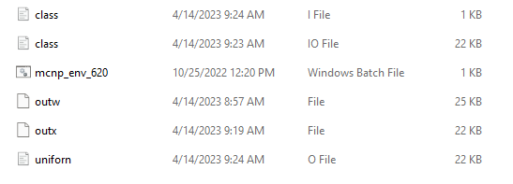
Reading the output file

Slide 11
Notice the 10 checks
Notice the difference between uniform.o and uniform.boo
Same file with 10 checks sometimes not passing and sometimes passing
Sometimes when you look at the slope history, it goes down then up… be careful of this when you are running files, and make sure that you look at the breakdowns.. It’ll give you some insight.

Slide 12
Review assignment 3
What are the differences in the files?
If we have time, lets make a few mistakes in the input files to see what they look like.
Notes:
UO2, N2O, NaOH
Cell/importance, source definition (default if only 1, need to specify if 2, like n,p eg)
Cell block
Guesses:
lots (outw bad, outx good)
Fewer than a -> 5e6 (class.io)
Little 1e6 (uniform.o, uniform.boo)
Mistakes in input files:
- symbol in imp
Extra blank lines
No blank lines
Tabs
Not defining p type if 2 in mode
Imp=1 on graveyard

