Slide 1
CAUG 9:
Intermediate MCMP
Charlotte Rose MS (RHP)

Slide 2
Last Class
Run input files
Brief look at output files
Assignment 3

Slide 3
Intermediate MCNP
Trey will share his experience with MCNP
Sources

Slide 4
Source Card
So many variables!
Focus on just the source term
Energy
Particle type
Importances
Location
  Point source
  Volume source

Slide 5
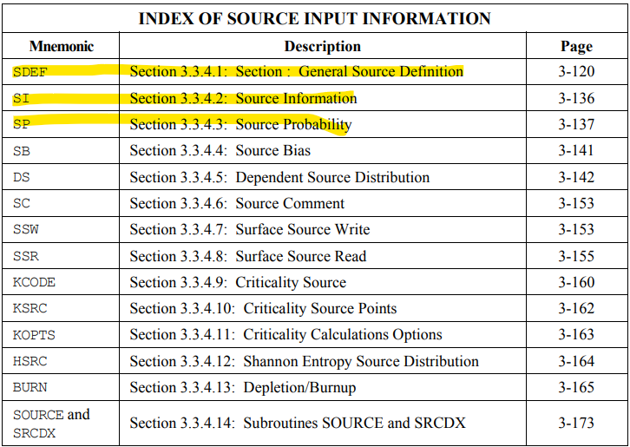

Slide 6
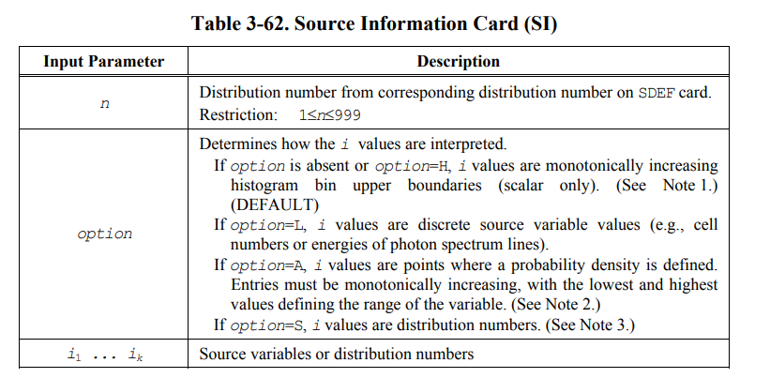

Slide 7
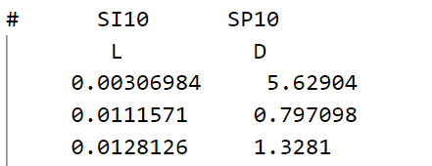
SI
Probabilities do not need to be normalized; MCNP does automatically
H must start with 0
L entries for each; ratios
A probability density; must be monotonically increasing
S we won’t worry about for now
Use of #

Slide 8
SP
Distributions
Or -21, for example; we will discuss this in more detail later

