Slide 1
IMBA Training Fall 2022 RAMP Users’ Group Meeting
Colby Mangini, PhD, CHP

Slide 2

Agenda
Internal Dose and Dosimetry Models
ICRP 66 Human Respiratory Tract Model
ICRP 30 Gastrointestinal Tract Model
NCRP 156 Wound Model
Overview of IMBA
IMBA Lite vs Plus vs Pro
Quick Tour of Main Screen, Bioassay Calculations Screen, and Dose Calculations Screen
In-Depth IMBA Pro Exercises
Select Limitations and Workarounds
Discussion

Slide 3
Definitions
Internal Dose: portion of the dose equivalent received from radioactive material taken into the body
Internal Dosimetry: the sub-field of health physics that includes calculation of dose, development of metabolic models, derivation of absorbed fractions and specific effective energies.
Bioassay: measurement of radiation contained in an individual’s body (direct or in vivo counting) or their excreta (indirect or in vitro measurement).

Slide 4
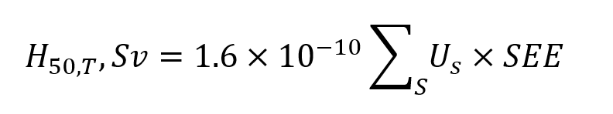
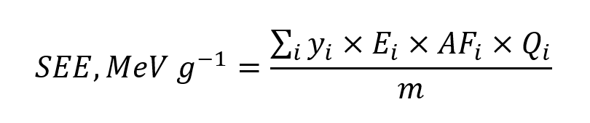
Committed Dose Equivalent
Committed dose equivalent from each source organ (S)
and the value of SEE is
where
U_{s} = number of transformations of radionuclide i in the source organ over 50 years
y_{i} = yield of radiations of energy E emitted per transformation (T⁻¹)
E_{i} = energy per radiation (MeV/dis)
AF_{i} = specific absorbed fraction
Q_{i} = radiation weighting factor
m = mass of target organ (g)

Slide 5
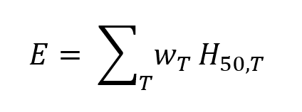
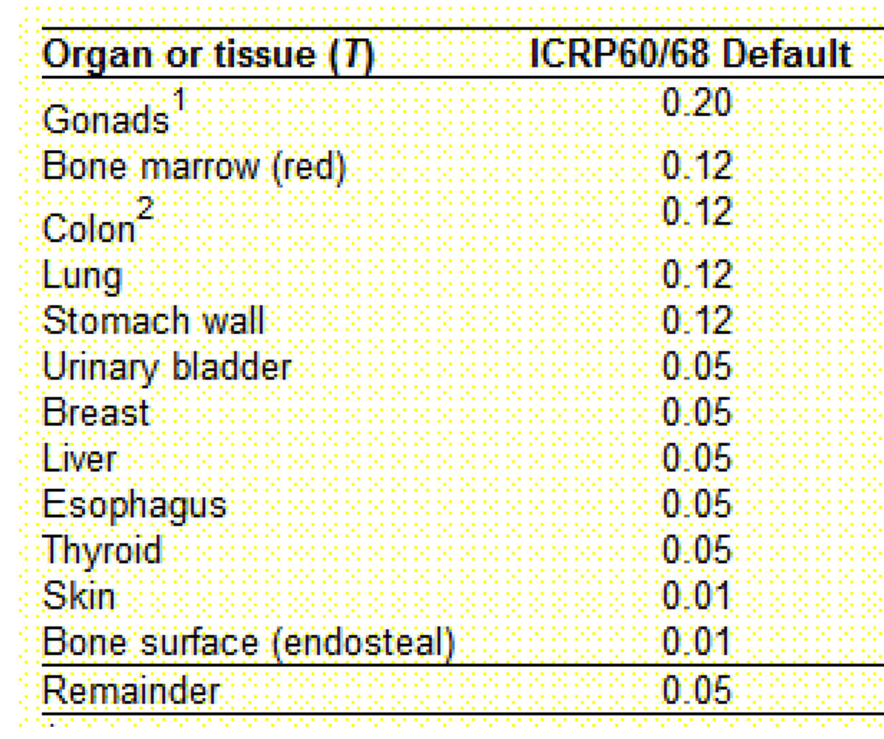
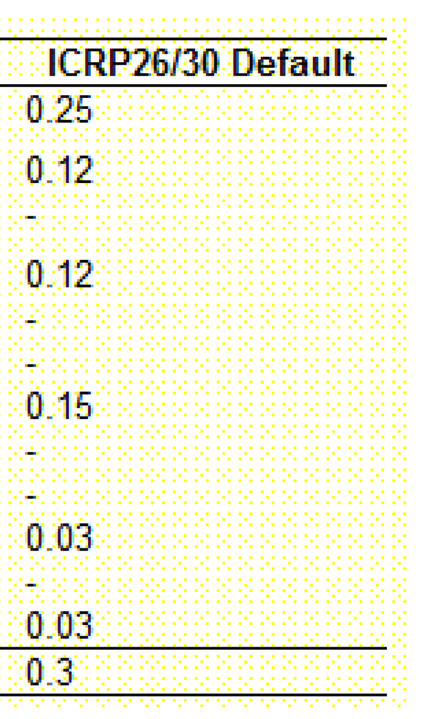
Committed Effective Dose Equivalent
Committed Effective Dose Equivalent
where w_{T} is the tissue weighting factor

Slide 6
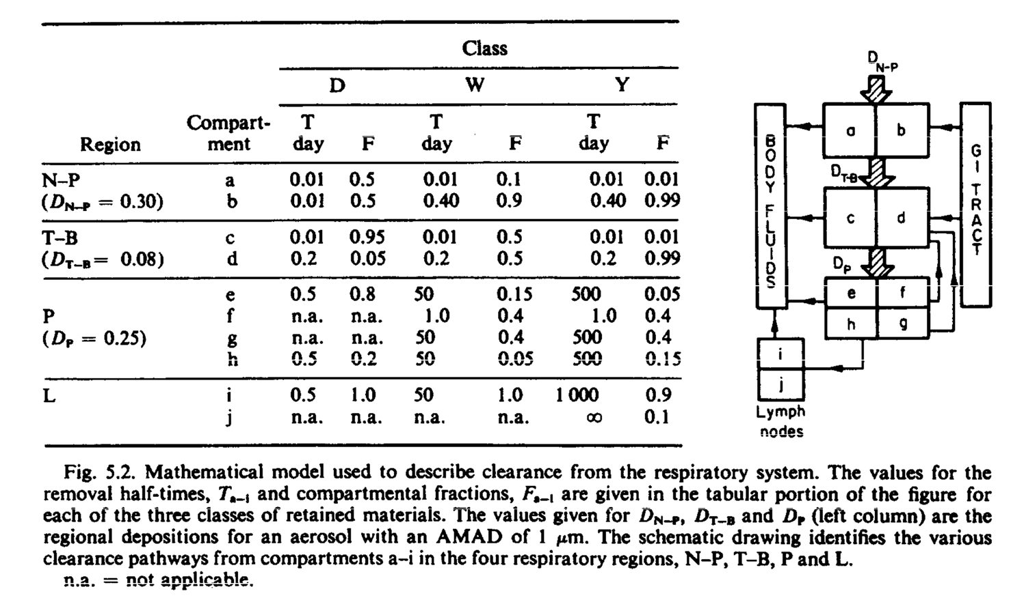
ICRP 66 Human Respiratory Tract Model
First look at ICRP 30 Respiratory Tract Model

Slide 7
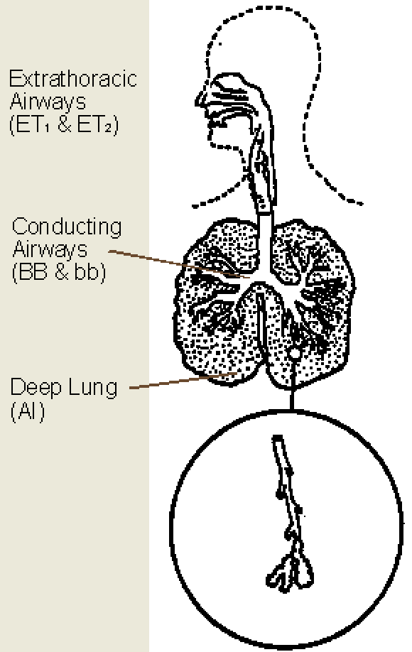
ICRP 66: Regions
The Extrathoracic Airways (ET) consists of the airways of the head and neck
ET1 consists of the anterior part of the nose, and is lined with impervious skin
ET2 consists of the posterior nasal passages, larynx, pharynx, and mouth, which are lined with absorbent stratified squamous epithelium
The Conducting Airways are sub-divided into
Bronchi (BB), lined with ciliated epithelium
Bronchioles (bb), lined with thinner and less-well-ciliated epithelium
The Deep Lung, termed the Alveolar-Interstitial Region (AI), consists of the respiratory bronchioles, alveolar ducts and sacs with their alveoli, and the interstitial connective tissue.

Slide 8
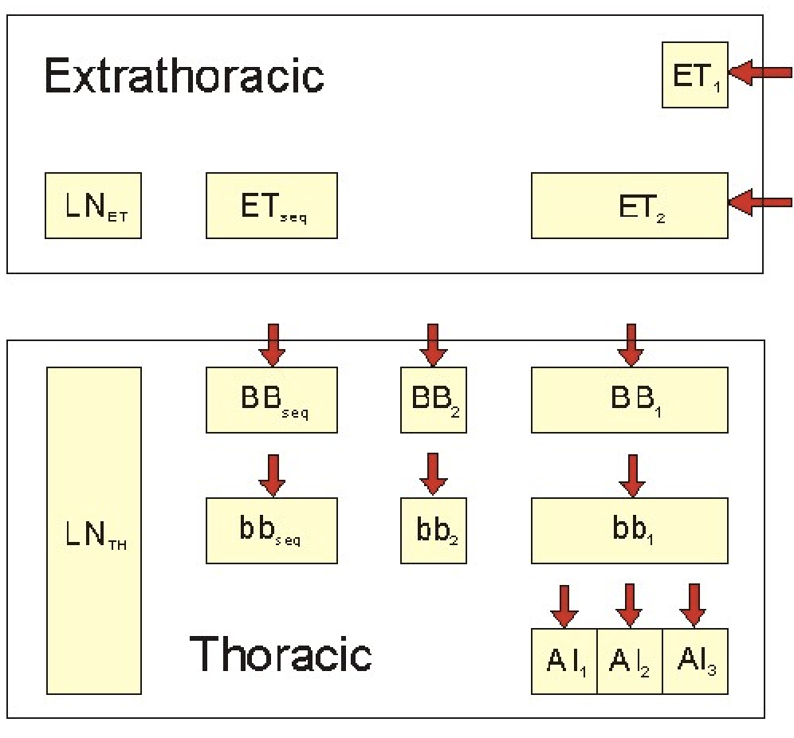
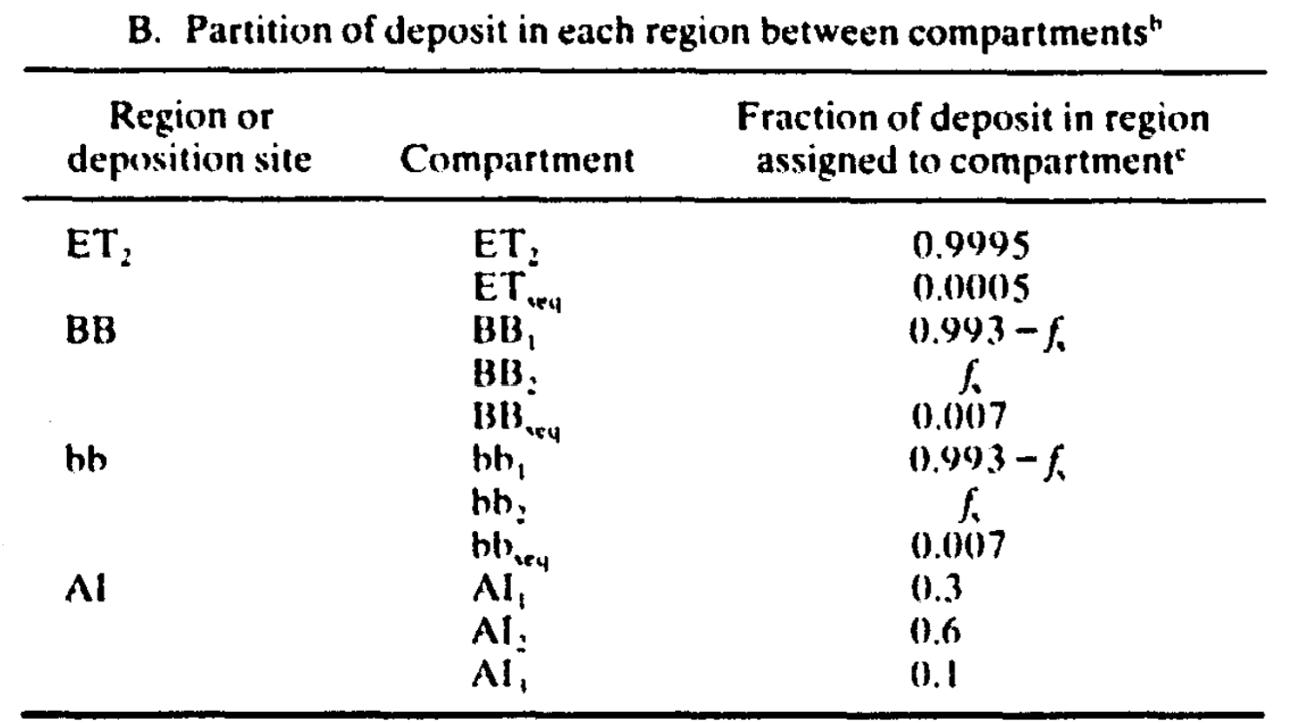
ICRP 66: Deposition

Slide 9
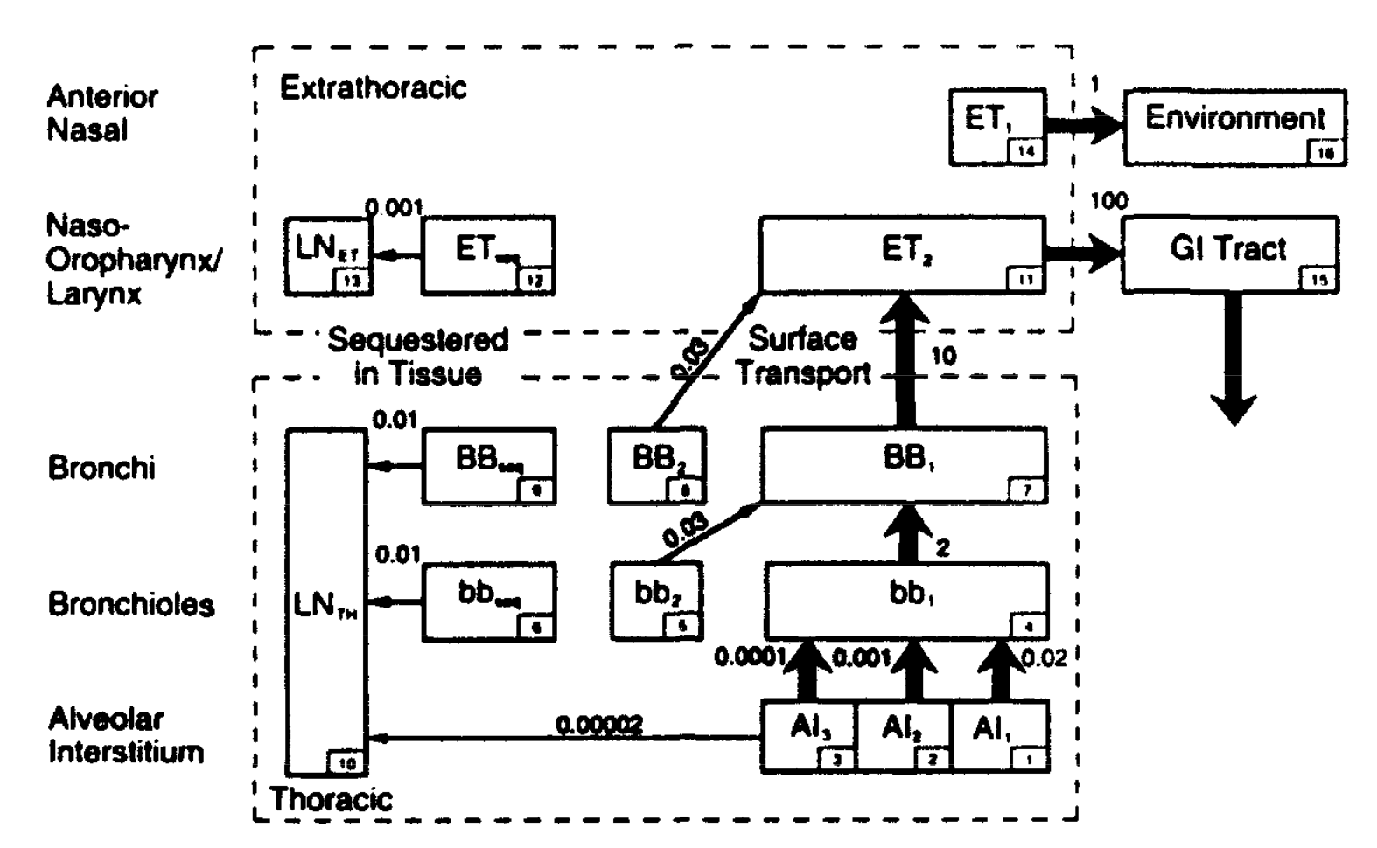
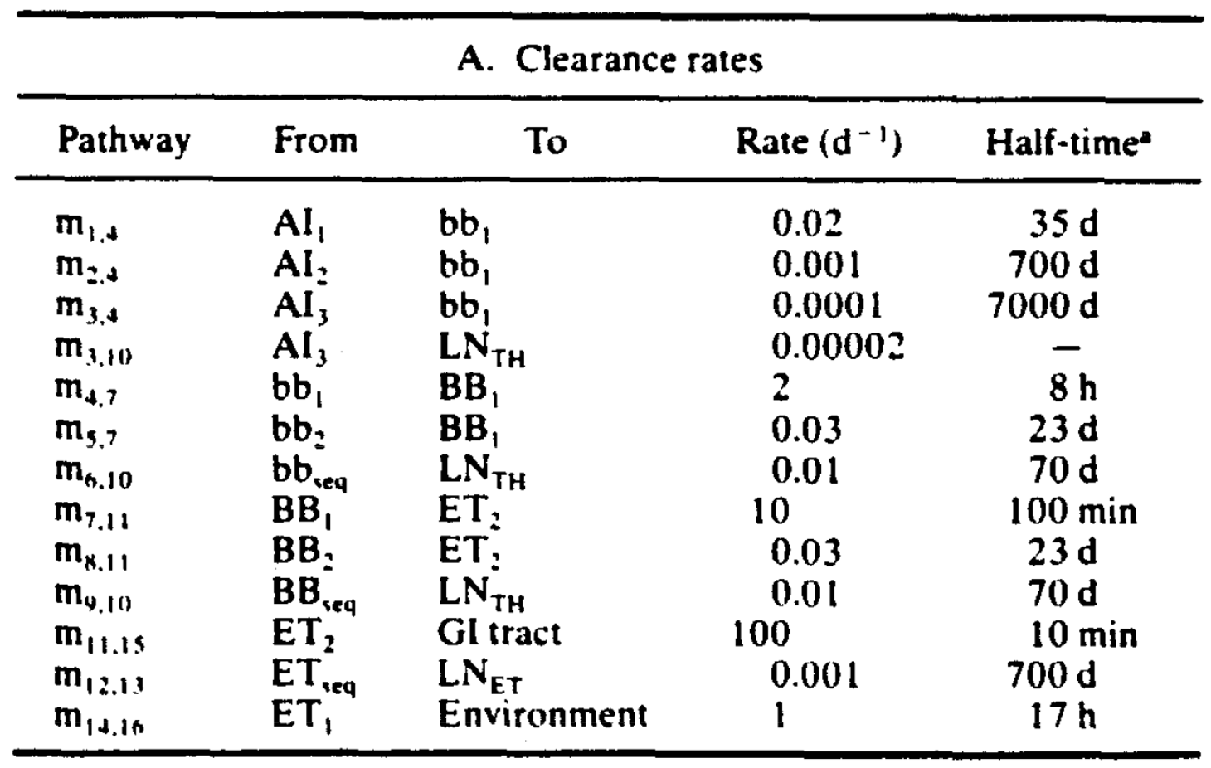
ICRP 66: Clearance

Slide 10
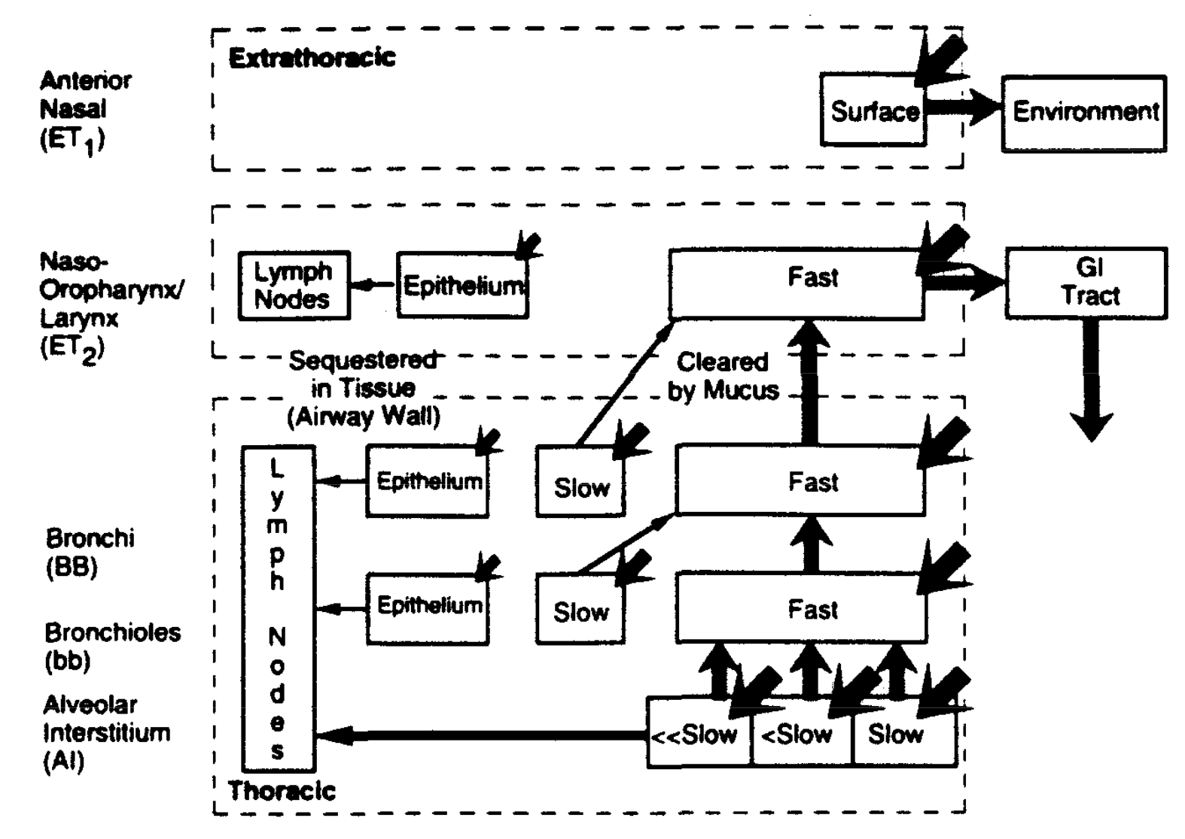
ICRP 66: Deposition and Clearance

Slide 11
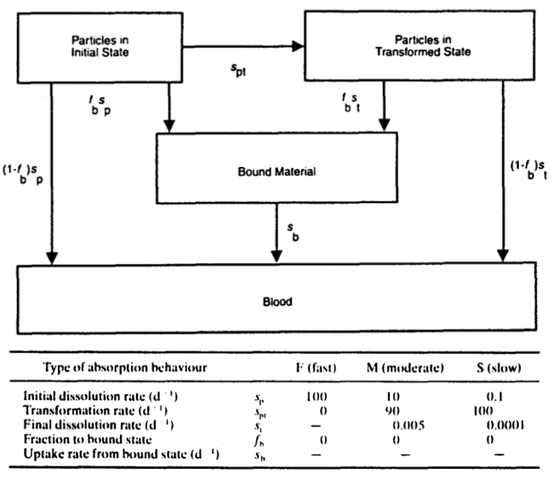
ICRP 66: Material Absorption
Particles are deposited in each deposition compartment of the respiratory tract in an Initial State from which the rate of dissolution and absorption is s_{p} ("particle" dissolution)
The model allows for the presence of any Bound Material (material that is "bound" to tissue)

Slide 12
ICRP 66: Regional Dosimetry
Dose to each region of the respiratory tract is given by the average dose to the target tissue in that region
The target cells identified in the Extrathoracic Airways (ET₁ and ET₂), Conducting Region (BB and bb), and Deep Lung (AI)
AF(T S) taken from ICRP 66 for photon, alpha, beta radiation

Slide 13
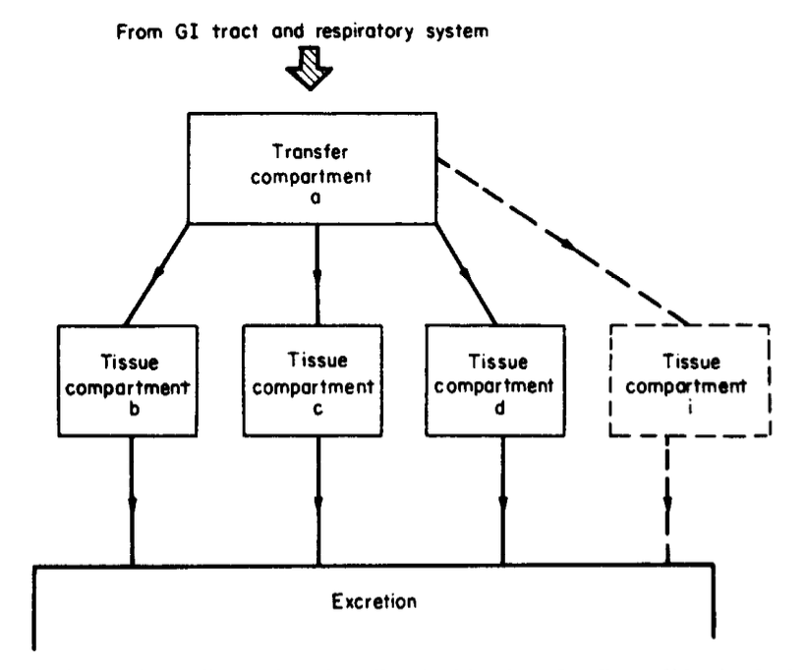
ICRP 30 Gastrointestinal Tract Model
Simple Once-Through System
After a radionuclide has been ingested it will be translocated to compartments representing the various organs and tissues of the body
It will be translocated to the body fluids at a rate determined by the rate constants for the different compartments

Slide 14
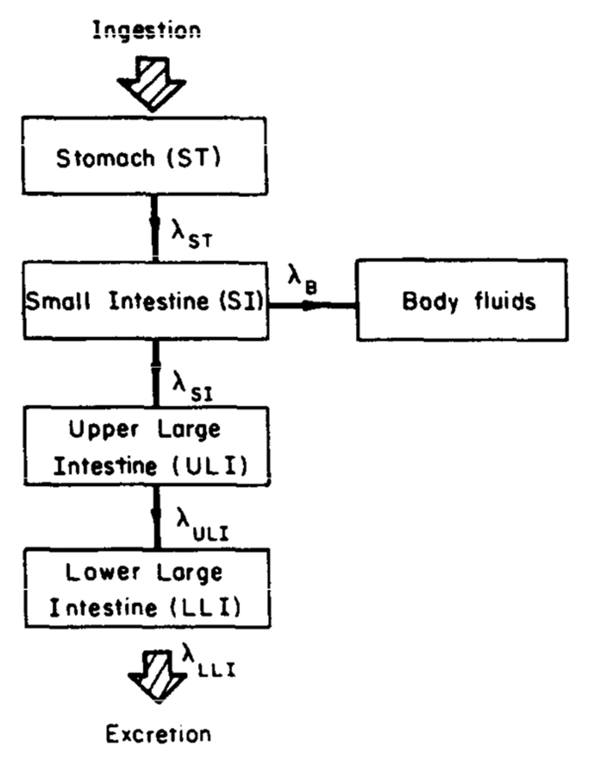
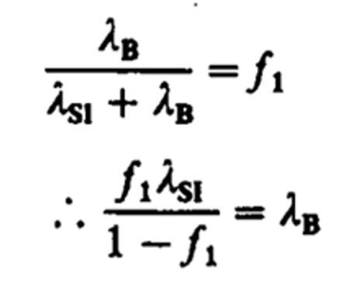
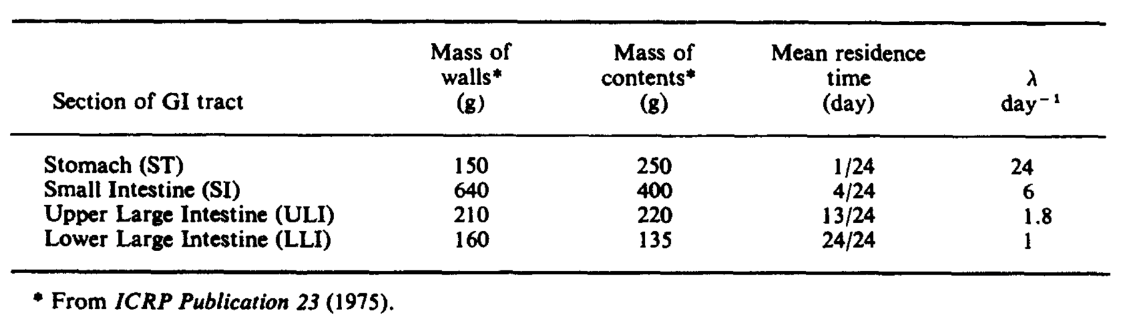
ICRP 30 Gastrointestinal Tract Model

Slide 15
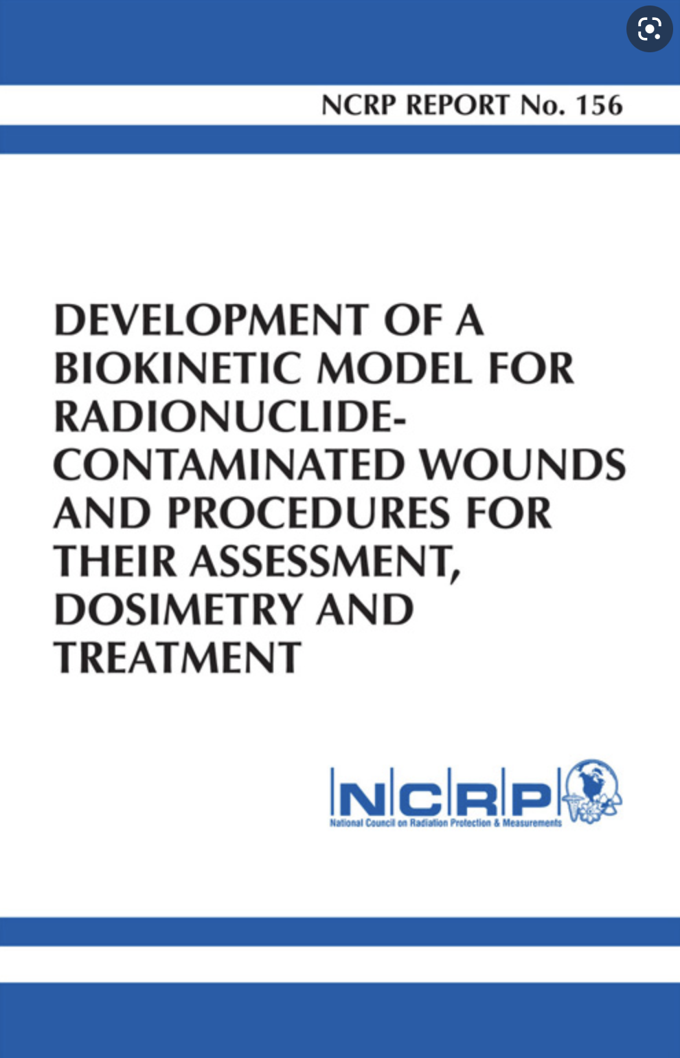
NCRP 156 Wound Model
NCRP Report No. 156, “Development of a Biokinetic Model for Radionuclide-Contaminated Wounds and Procedures for Their Assessment, Dosimetry, and Treatment” (2007)
The wound model consists of three distinct dosimetry calculations:
(1) Shallow dose Equivalent (@ 7 mg/cm2)
(2) Local dose equivalent (to tissue)
(3) organ/effective dose equivalent (systemic uptake)

Slide 16
NCRP 156 Wound Model
The biokinetic model for radiologically contaminated wounds considers four uptake categories:
radionuclides in soluble form
particulates, aggregates, and bound states
colloid and intermediate states
Fragments
Movement of material from the wound and through the body to the bloodstream is characterized by the biokinetic model in NCRP 156
Accidental Injection
Fragment
Trapped Particles & Aggregates
Soluble
Particles, Aggregates & Bound States
Colloid & Intermediate State
Lymph Nodes
Blood

Slide 17
NCRP 156 systemic model default transfer rates
Transfer Rates (d⁻¹) | Weak | Moderate | Strong | Avid | Colloids | Particles | Fragments
Soluble to blood | 45 | 45 | 0.67 | 7.0 | 0.5 | 100 | -
Soluble to CIS | 20 | 30 | 0.6 | 30 | 2.5 | - | -
CIS to soluble | 2.8 | 0.4 | 0.024 | 0.03 | 0.025 | - | -
CIS to PABS | 0.25 | 0.065 | 0.01 | 10 | 0.05 | - | -
CIS to lymph nodes | 0.00002 | 0.00002 | 0.00002 | 0.00002 | 0.002 | - | -
PABS to soluble | 0.08 | 0.02 | 0.0013 | 0.005 | 0.0015 | 0.0002 | -
PABS to lymph nodes | 0.00002 | 0.00002 | 0.00002 | 0.00002 | 0.0004 | 0.0036 | 0.004
PABS to TPA | - | - | - | - | - | 0.04 | 0.7
TPA to PABS | - | - | - | - | - | 0.0036 | 0.0005
Lymph nodes to blood | - | - | - | - | 0.03 | 0.0006 | 0.03
Fragment to soluble | - | - | - | - | - | - | -
Fragment to PABS | - | - | - | - | - | - | 0.008

Slide 18
IMBA Overview
Understand Lite vs Plus vs Pro
Step through IMBA Modules
Highlight of key, commonly used aspects of IMBA
WE WILL NOT COVER EVERYTHING

Slide 19
What is IMBA?
Short Answer: Integrated Modules for Bioassay Analysis
The IMBA code is a suite of software modules for internal dosimetry that implements respiratory tract, GI-tract, tissue dosimetry, biokinetic and bioassay models as recommended by the International Commission on Radiological Protection (ICRP)
Originally designed by the UK's Health Security Agency, the IMBA modules can estimate single or multiple intakes of different radionuclides and calculate resulting doses in the body for the ICRP 68 Reference Worker

Slide 20
A Bit of History
Mid 1980’s codes to evaluate bioassay data and calculate internal doses
GENMOD, INDOS, REMEDY, and CINDY… based on ICRP 26/20
Mid 1980’s these codes couldn’t use new ICRP 66 HRTM
IMBA was born in 1997
British Nuclear Fuels
Westlakes Research Institute
UK National Radiological Protection Board (NRPB) (absorbed into UK Health Protection Agency)
Fast forward to today…
IMBA 5.0.1: developed by UK HPA and licensed by RAMP

Slide 21
IMBA Lite
The base unit is the core of IMBA Professional Plus and enables the user to perform basic internal dosimetry calculations (e.g., calculating doses from a specified intake, estimating an intake from bioassay measurements and calculating bioassay quantities from a given intake)
Includes 75 radionuclides
Additional Radionuclides Pack1 and 2 adding ~665 more
Assess an intake from either inhalation , ingestion , or direct injection
Full access to ICRP 60/68 and ICRP 26/30 models and parameters

Slide 22
IMBA Plus Ad-Ons
All IMBA Base Unit functionality
(1) Multiple Intake Regimes
(2) Multiple Bioassay Types
(3) Associated Radionuclides
(4) Uranium Mixtures
(5) Uptake from Wounds

Slide 23
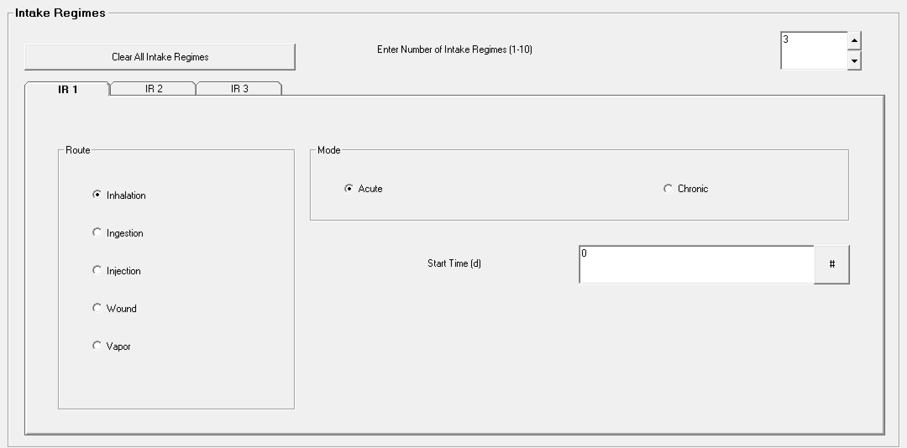
Multiple Intake Regimes (#1)
Up to 10
Contributions from each included in bioassay and dose calculations
Different model parameters assigned to each

Slide 24
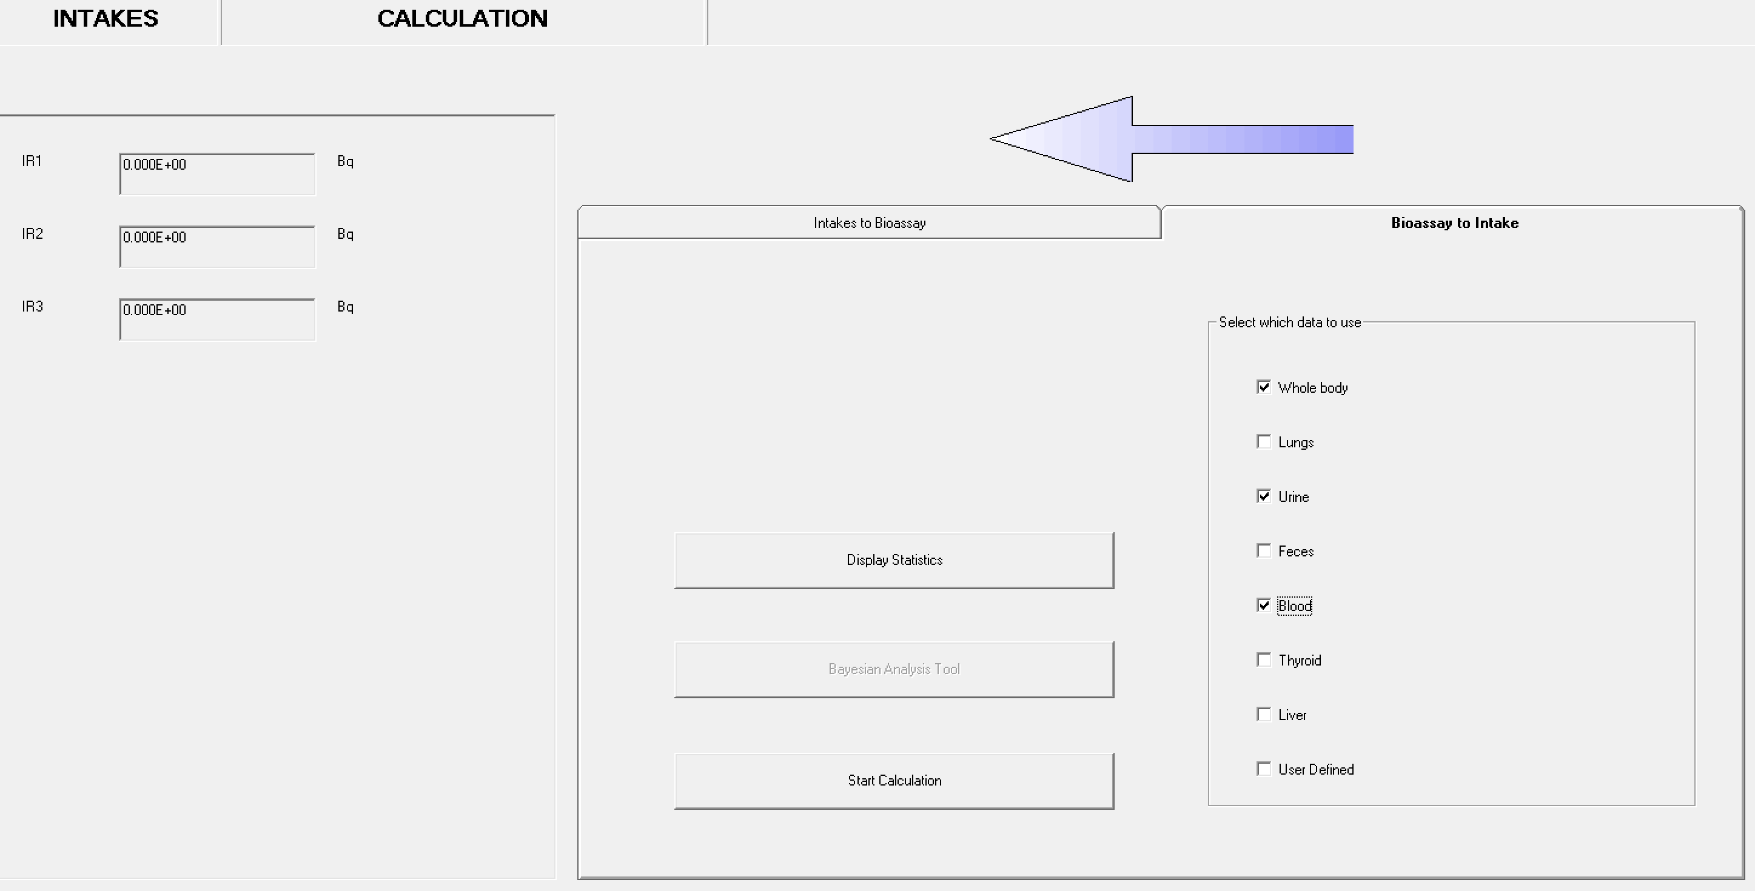
Multiple Bioassay Types (#2)
8 different bioassay quantities
This allows user to fit the intake to different bioassay types simultaneously
This Add-on also works with Add-On 1 to enable multiple intakes to be fitted to multiple bioassay data types simultaneously

Slide 25
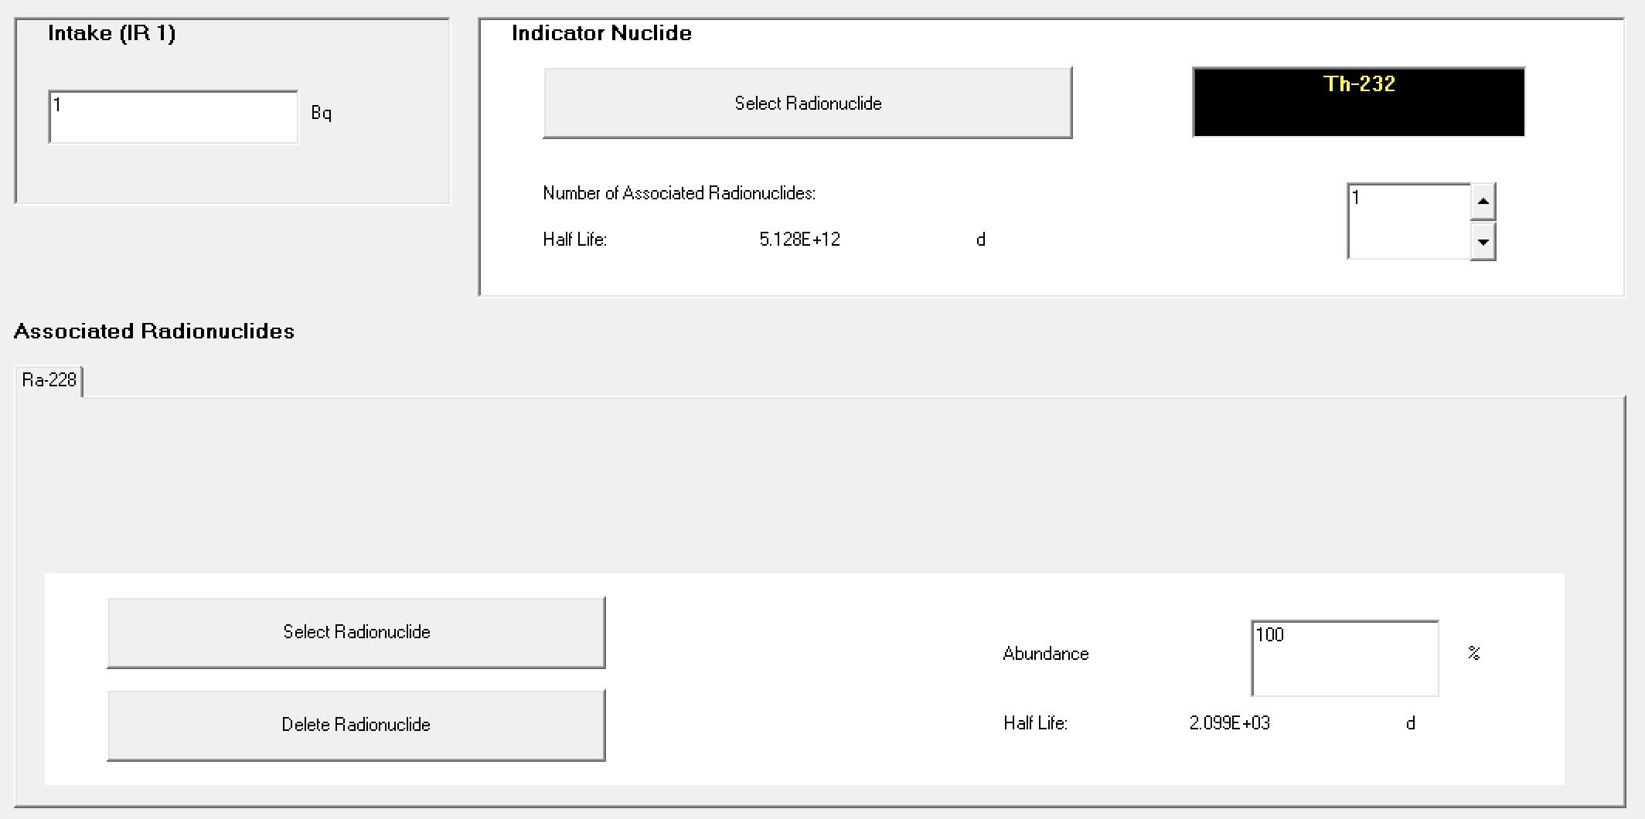
Associated Radionuclides (#3)
Enables the user to specify up to 30 additional associated radionuclides
Subsequent dose calculations will include the components from all of the associated radionuclides
In the dose calculations, it is assumed that the absorption rates (and f₁ values) of each associated radionuclide are identical to that of the indicator radionuclide

Slide 26
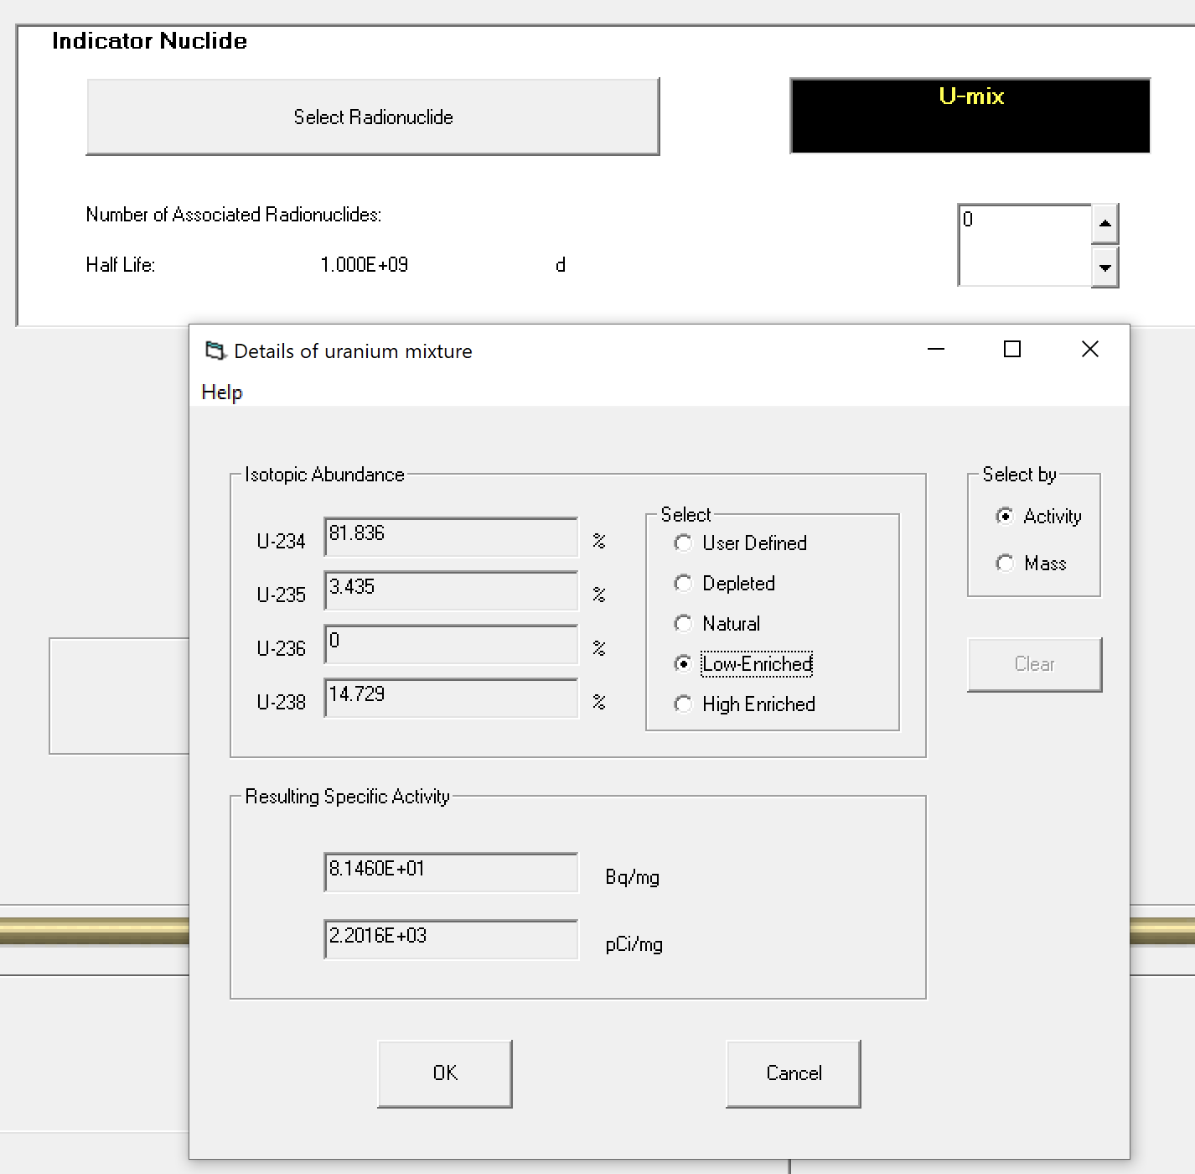
Uranium Mixtures (#4)
Enables the user to specify a mixture of uranium isotopes (U-234, U-235, U-236 and U-238) for dose and bioassay calculations
The user can choose default values for enriched, depleted, or natural uranium, or specify the mixtures directly
The specific activity of the resulting mixture is automatically calculated
This option also allows the user to specify the intakes in terms of mass (mg).

Slide 27
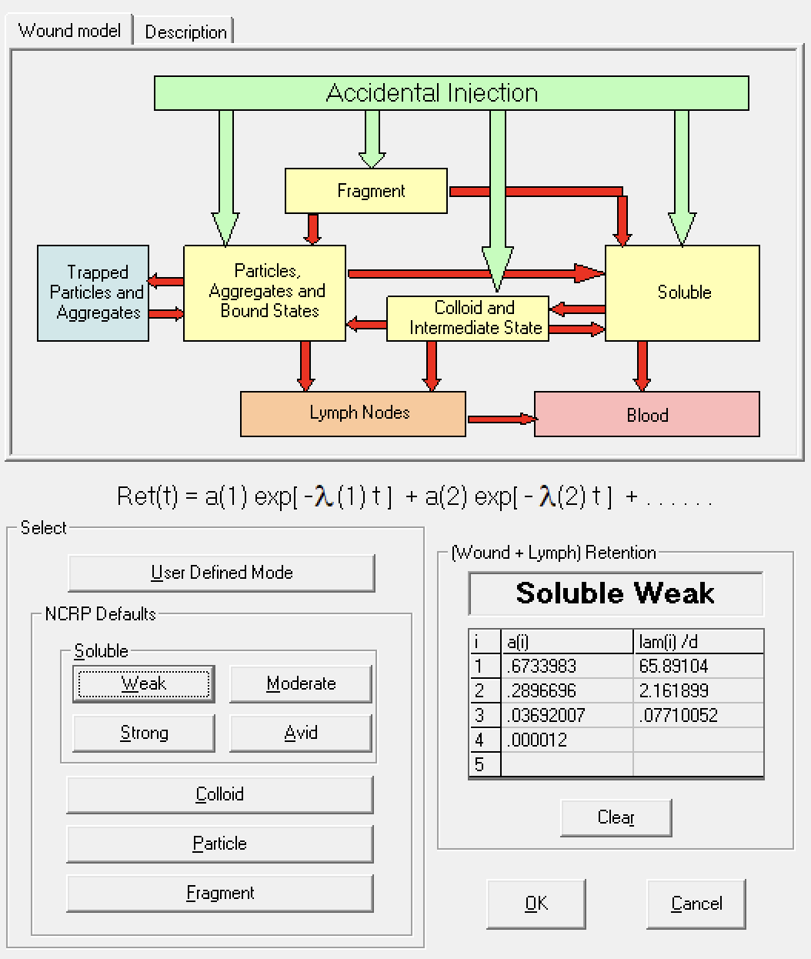
Uptake from a Wound (#5)
Enables the user to specify how the activity reaches the blood following a wound contamination
Implements NCRP No. 156 wound model
Choose one of the "NCRP Defaults" wound categories: Soluble, Colloid, Particle or Fragment.
Users may enter their own values for the retention function as a sum of exponentials (User Defined Mode)

Slide 28
IMBA Pro
All IMBA Plus functionality
(6) Errors on Intake
(7) Bayes Implementation
(8) Tritium Tool
(9) Compensation Type Calculations
(10) Ingrowth of Americium
(11) Statistics Package

Slide 29
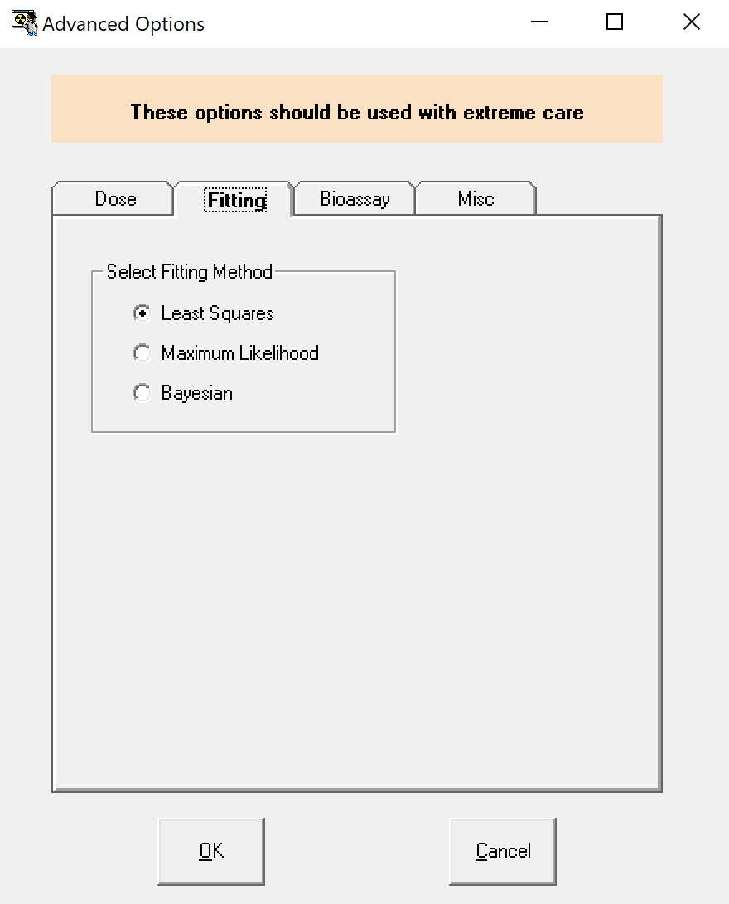
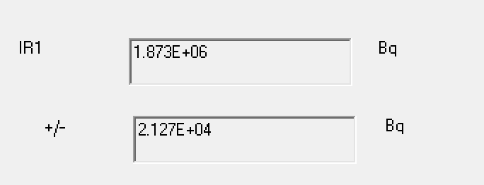
Errors on Intake (#6)
In cases where an intake is being estimated from bioassay data, and all of the data are assumed to be normally distributed with a specified standard deviation, then this Add-On will propagate the errors to calculate their contribution to the error in the estimate of intake
The error propagation is based on the Least Squares method.

Slide 30
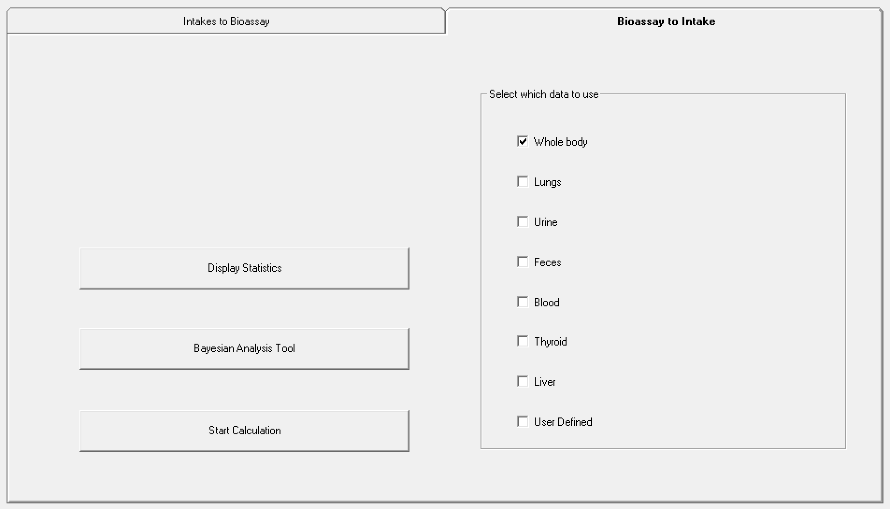
Bayes Implementation (#7)
Enables you to use a Bayesian approach to estimate an intake
Prior knowledge about the intake (either from other measurements such as air sampling, or from hypothetical judgements) can be used in conjunction with the bioassay measurement data to obtain the probability distribution of intake

Slide 31
Tritium Tool (#8)
Typical procedures for estimating tritium intakes which have occurred at some unknown time in a monitoring interval involve making assumptions about
the time of intake
the contribution to the current measurement from intakes in previous monitoring intervals
This Add-On enables the user to select up to 10 previous tritium measurements, and to fit simultaneously the best 10 intakes. In a sense, the previous 9 intakes are used to correct for the current estimate of intake
See “Case Implementing Tritium Tool” example for more details

Slide 32
Compensation Type Calculations (#9)
Enables the user to select an organ, and a date on which cancer was diagnosed in the organ
The program then calculates the equivalent dose to the organ in each (of up to 99) calendar years previous to the cancer diagnosis
A simple wizard for exporting this data to other files or databases is also included
This type of information is required as part of the process of estimating causation probabilities for compensation type calculations
See “Dose Calculations for Causation” in manual for more details

Slide 33
Ingrowth of Americium (#10)
The interpretation of measurements of Am-241 in an individual can be complicated if the individual has also had an intake of Pu-241
continuous ingrowth of Am-241 from Pu-241
Allows the user to take ingrowth into account automatically when performing calculations.
See “Case of Am-241 In-growth” example

Slide 34
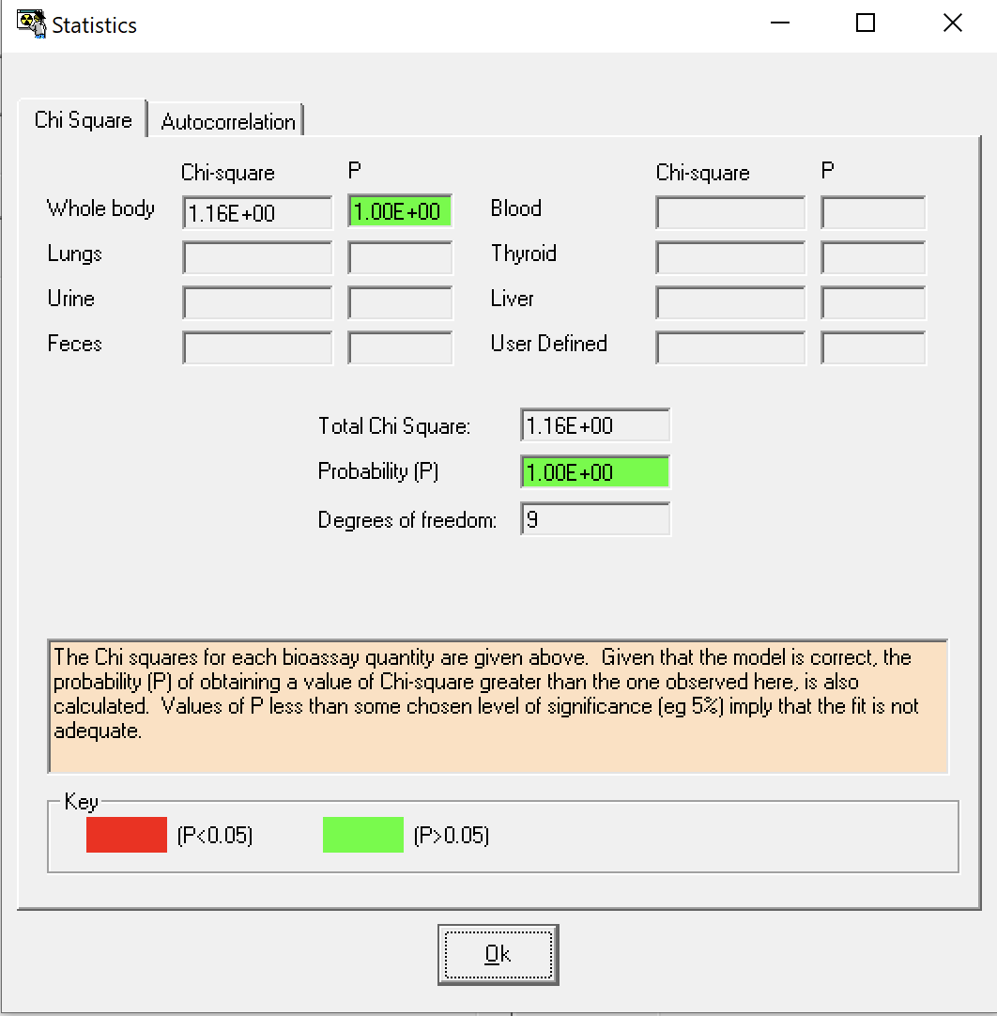
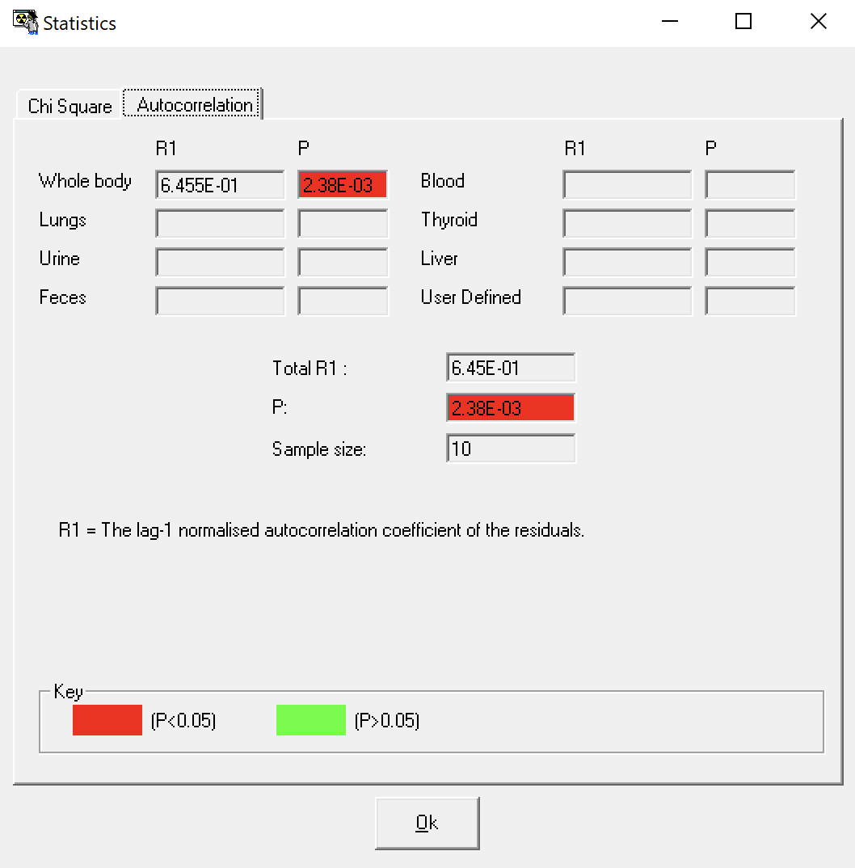
Statistics Package (#11)
Allows the user to examine useful statistical information immediately after fitting intakes to measurement data

Slide 35
IMBA Tour…
Main Screen
Bioassay Calculations
Dose Calculations

Slide 36
Exercises
Th-232 CEDE_inh and CEDE_ing dose coefficients
Co-60 inhalation with 1 type of bioassay data
Co-60 inhalation with 2 types of bioassay data
I-125 inhalation and injection/wound

Slide 37
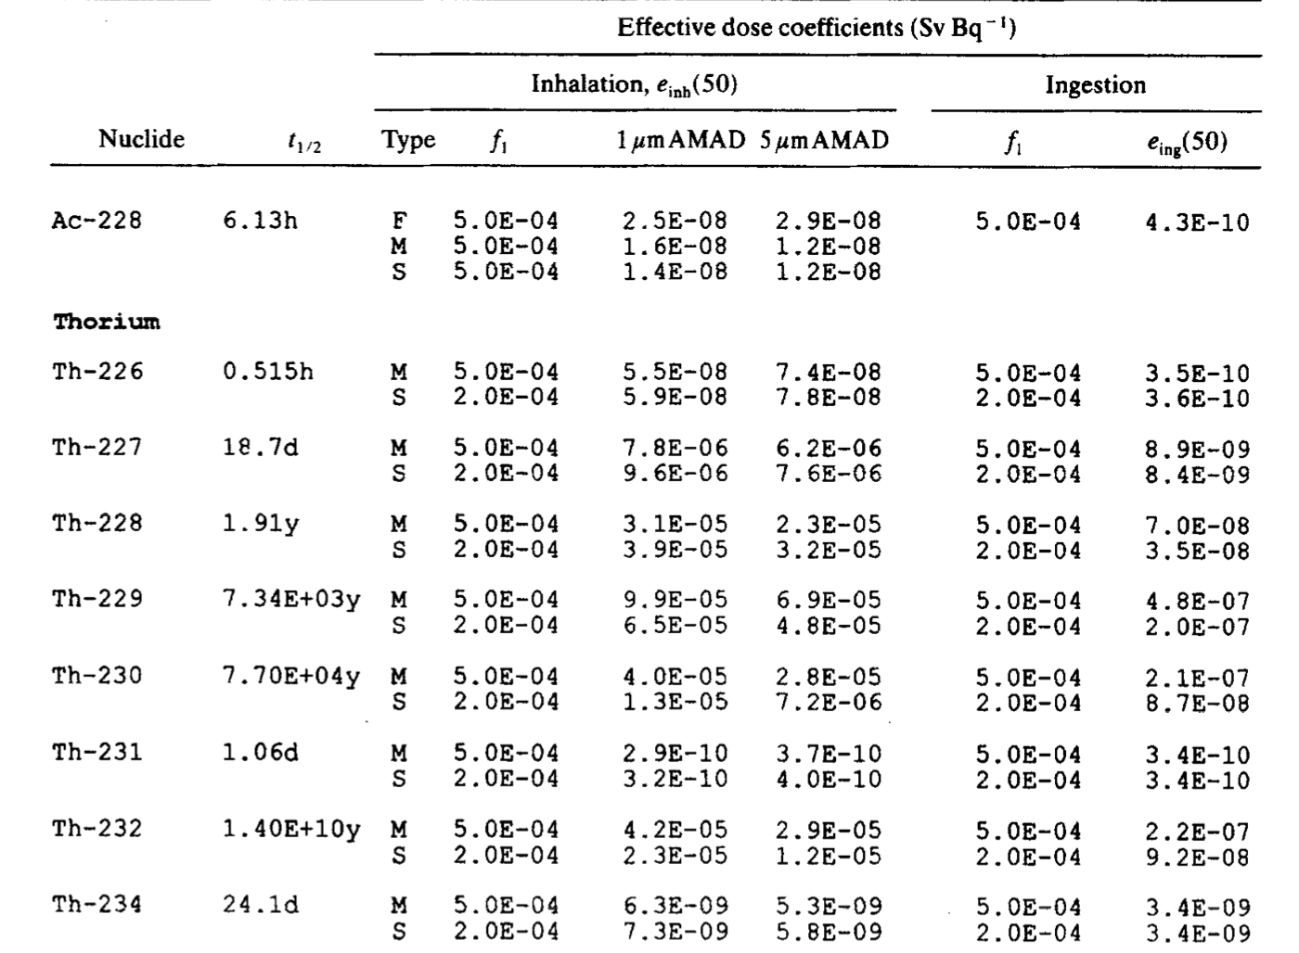
Th-232 Dose Coefficients
ICRP 68
Inhalation and Ingestion
5 µm AMAD
Type M
Units of Sv/Bq

Slide 38
Th-232 Dose Coefficients
ICRP 68
Inhalation
1.47E-04 Sv/Bq
Ingestion
1.18E-06 Sv/Bq
Why are they so different than ICRP 68?

Slide 39
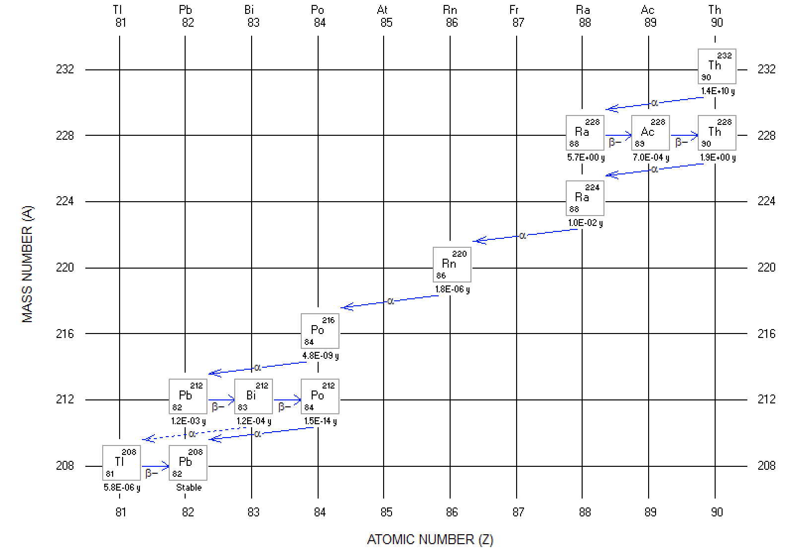
Th-232 Dose Coefficients
IMBA accounts for in-growth
Uses shared biokinetics
Can result in overestimation of dose in some cases
When progeny contribute large fraction of total dose
ICRP 68 coefficients use independent biokinetics

Slide 40
Co-60 Inhalation: 1 bioassay dataset
The data are whole-body activity measurements of Co-60 commencing 1 day after an accidental inhalation of a cobalt aerosol
All external body surface contamination was removed by shower-bathing
A profile scan indicated dominant lung deposition
The accident occurred on February 24th, 2012. The whole-body activity measurements
Assessment requires the calculation of CEDE

Slide 41
Co-60 Inhalation: 1 bioassay dataset
Initial Assumptions
Type M
5 µm AMAD
ICRP 60/68 W_{T}
Answers
1.04E+04 Bq Intake
7.41E-05 Sv Effective Dose
Measurement Data | Whole-Body Activity (Bq)
3/25/2012 | 2720
4/1/2012 | 1150
4/11/2012 | 1010
4/28/2012 | 790
6/16/2012 | 482
9/11/2012 | 358
12/29/2014 | 78
3/19/2016 | 35

Slide 42
Co-60 Inhalation: 2 bioassay datasets
Worker inhalation of fine dust containing Co-60 (acute intake)
After the incident, the worker followed up with internal monitoring and it was decided to collect urine samples and perform whole body counting
Urine samples had a 1-day collection period
Assume 10% relative uncertainty in bioassay data
There are no earlier known intakes
Assessment requires the calculation of CEDE

Slide 43
Co-60 Inhalation: 2 bioassay datasets
Whole Body Urine
Time after intake (d) | Bioassay (Bq)
1 | 9.76E+05
2 | 5.07E+05
3 | 2.90E+05
4 | 2.01E+05
5 | 1.65E+05
6 | 1.49E+05
8 | 1.38E+05
10 | 1.32E+05
13 | 1.26E+05
16 | 1.21E+05
Time after intake (d) | Bioassay (Bq/d)
1 | 2.09E+04
2 | 9.82E+03
3 | 3.95E+03
4 | 2.33E+03
5 | 1.79E+03
6 | 1.55E+03
8 | 1.27E+03
10 | 1.06E+03
13 | 8.22E+02
16 | 6.53E+02

Slide 44
I-125 Inhalation
A lab worker working with an I‐125 radiolabeling solution gets sprayed on her arm from a leak in a syringe‐to‐needle fitting. The liquid is reportedly deposited on the lab coat above her gloves. The solution penetrates the coat and contaminates the skin.
The skin is decontaminated and no signal can be detected at the thyroid with a handheld monitor during the rest of day of the incident
The chemical composition of the I‐125 solution is unknown
Urine spot samples (25 ml) were taken
The spill happens at 11:00 on 8/5/2015

Slide 45
I-125 Inhalation
Determine the CEDE from acute inhalation
Could these be modeled as a wound?
What about a vapor?
Is it surprising that no signal could be observed at the thyroid the day of the intake?
Measurement Date | Bioassay (Bq/l) | Bioassay (Bq/d)
8/5/2015 17:00 | 406.6 | 569.2
8/7/2015 12:00 | 18.7 | 26.2
9/2/2015 12:00 | <4.5 [LOD] | <6.3
Assumed daily urine production of 1.40 liters

Slide 46
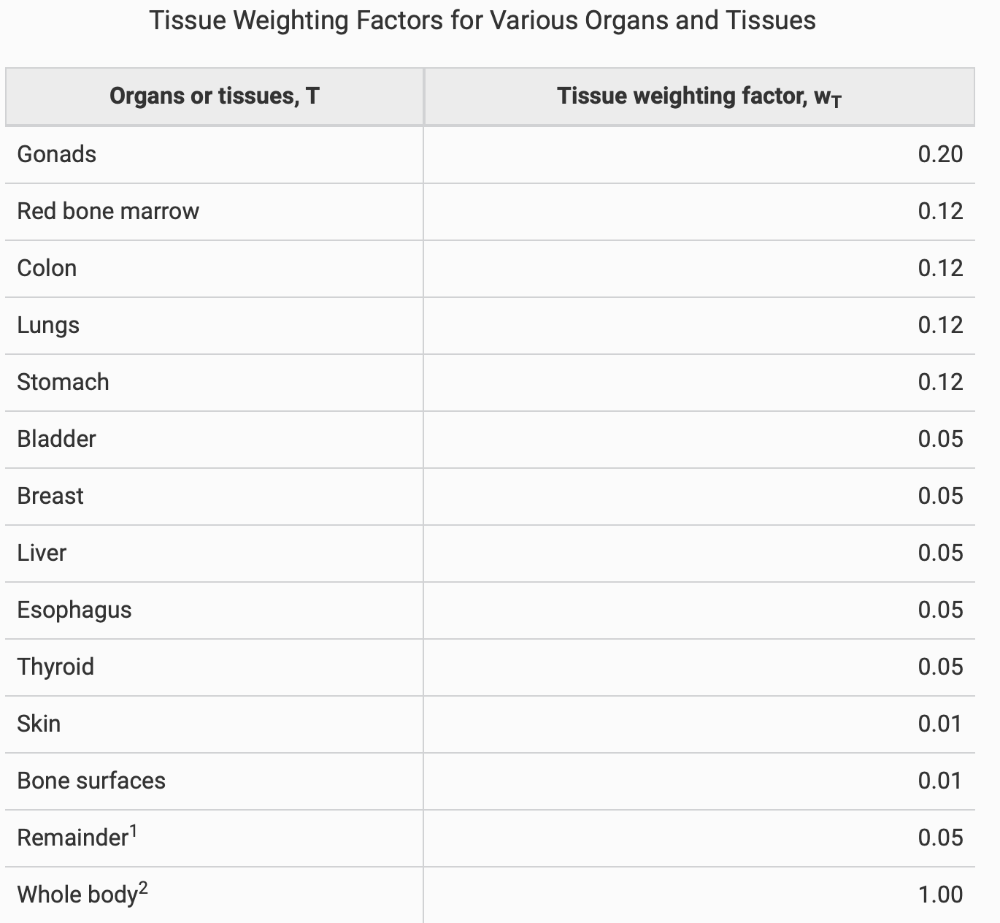
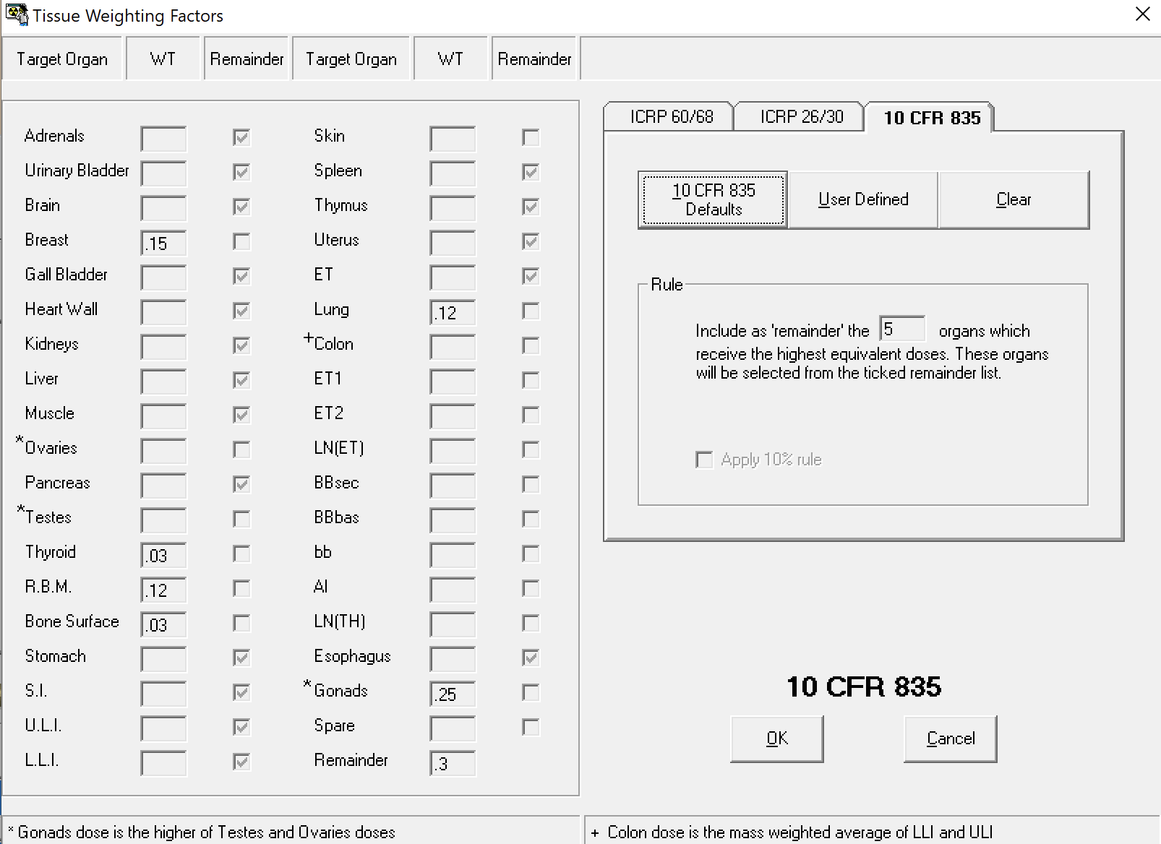
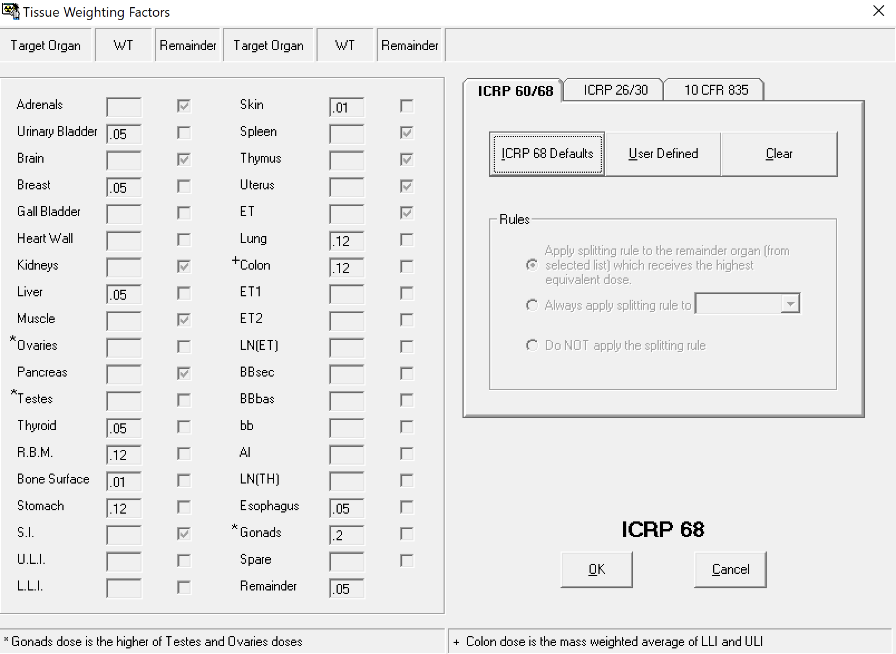
Select Limitations and Workarounds: 10CFR835

Slide 47
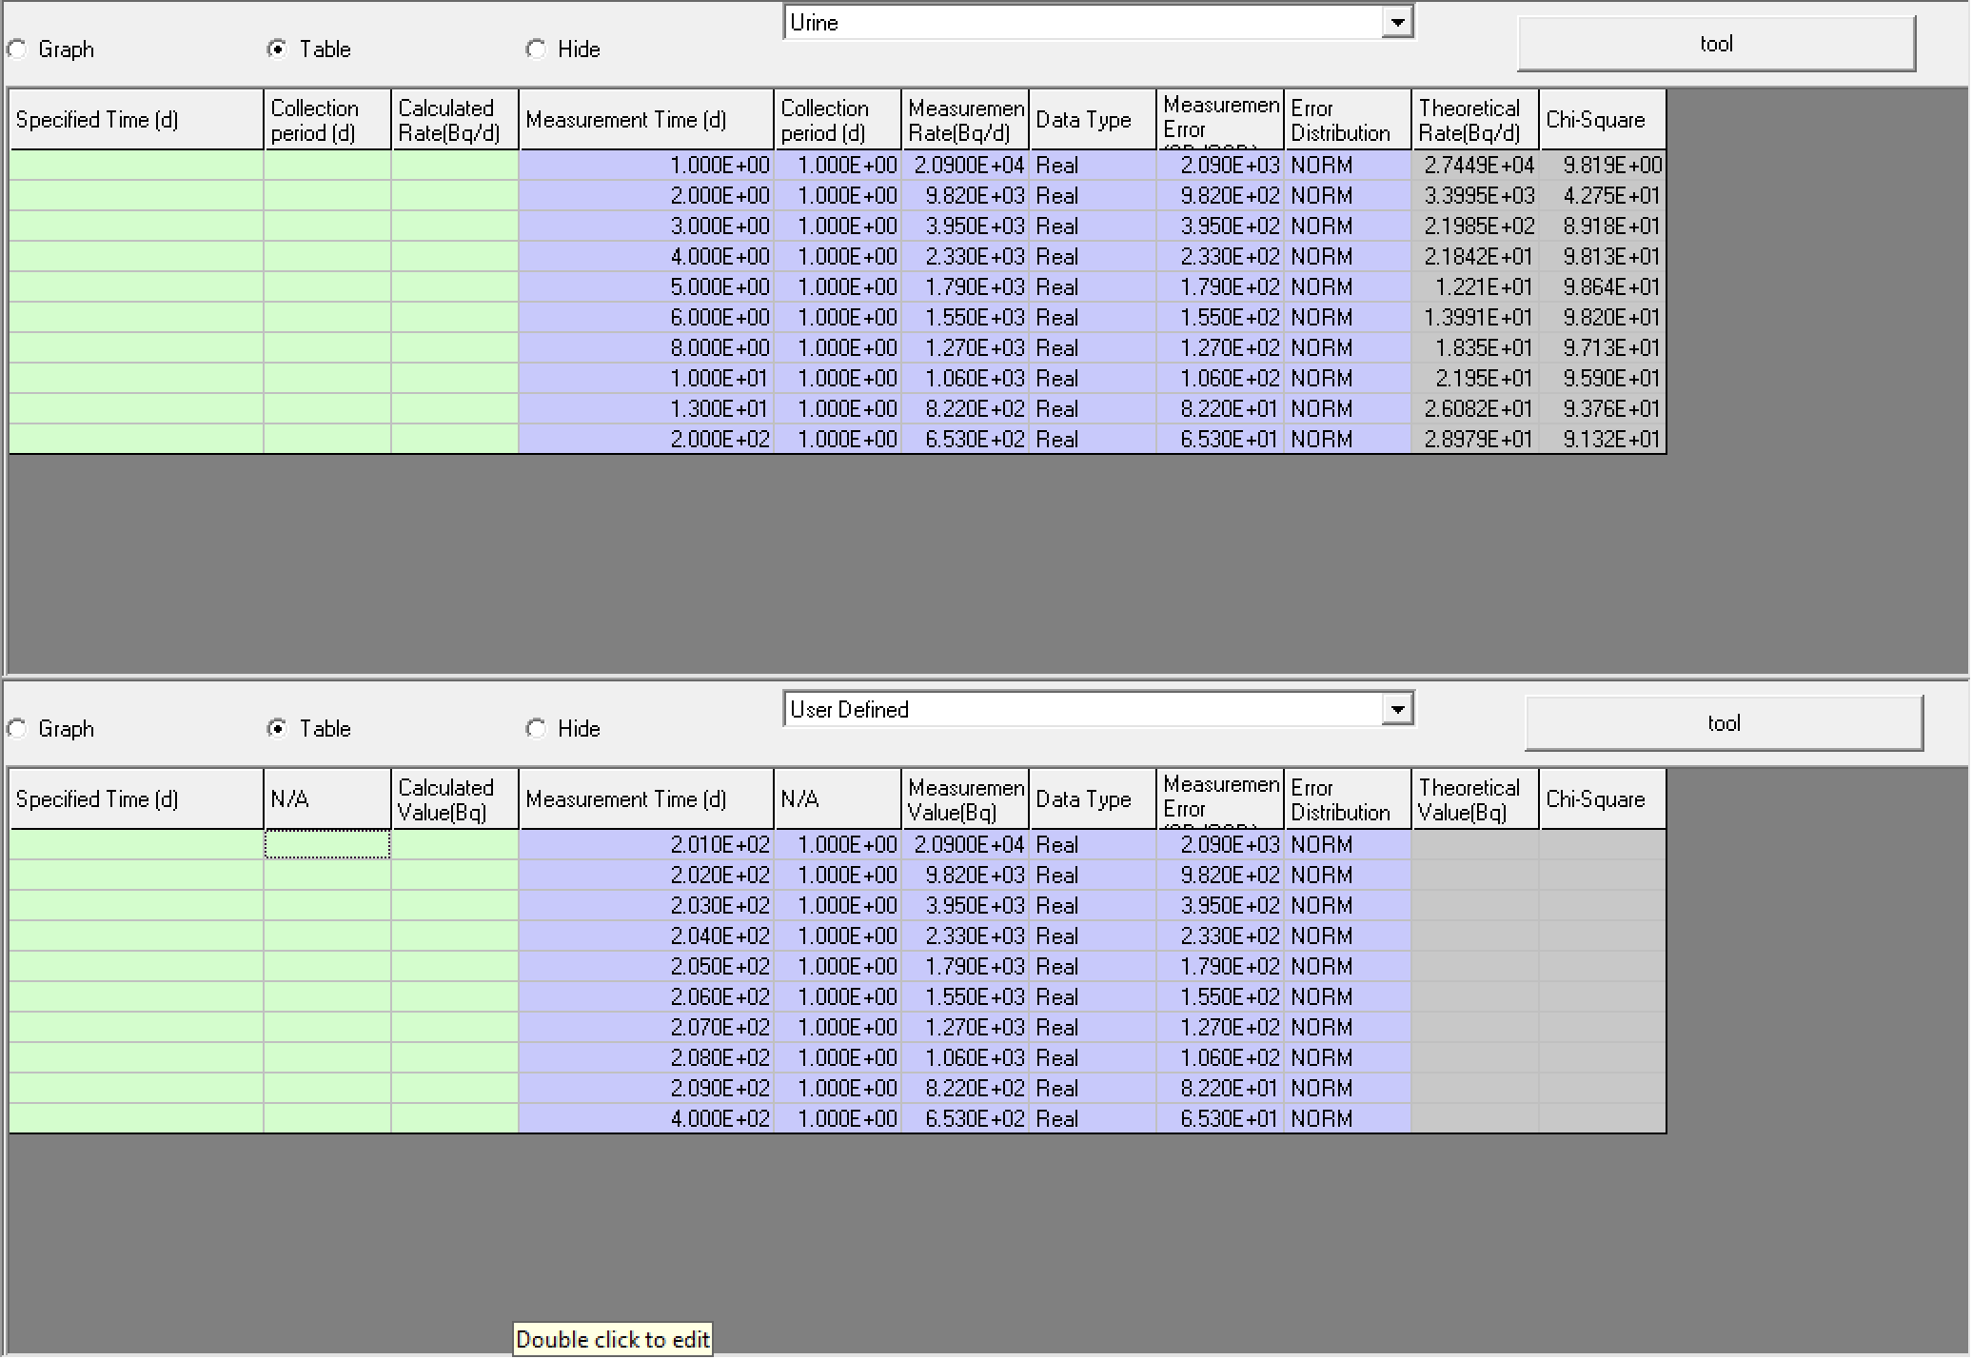
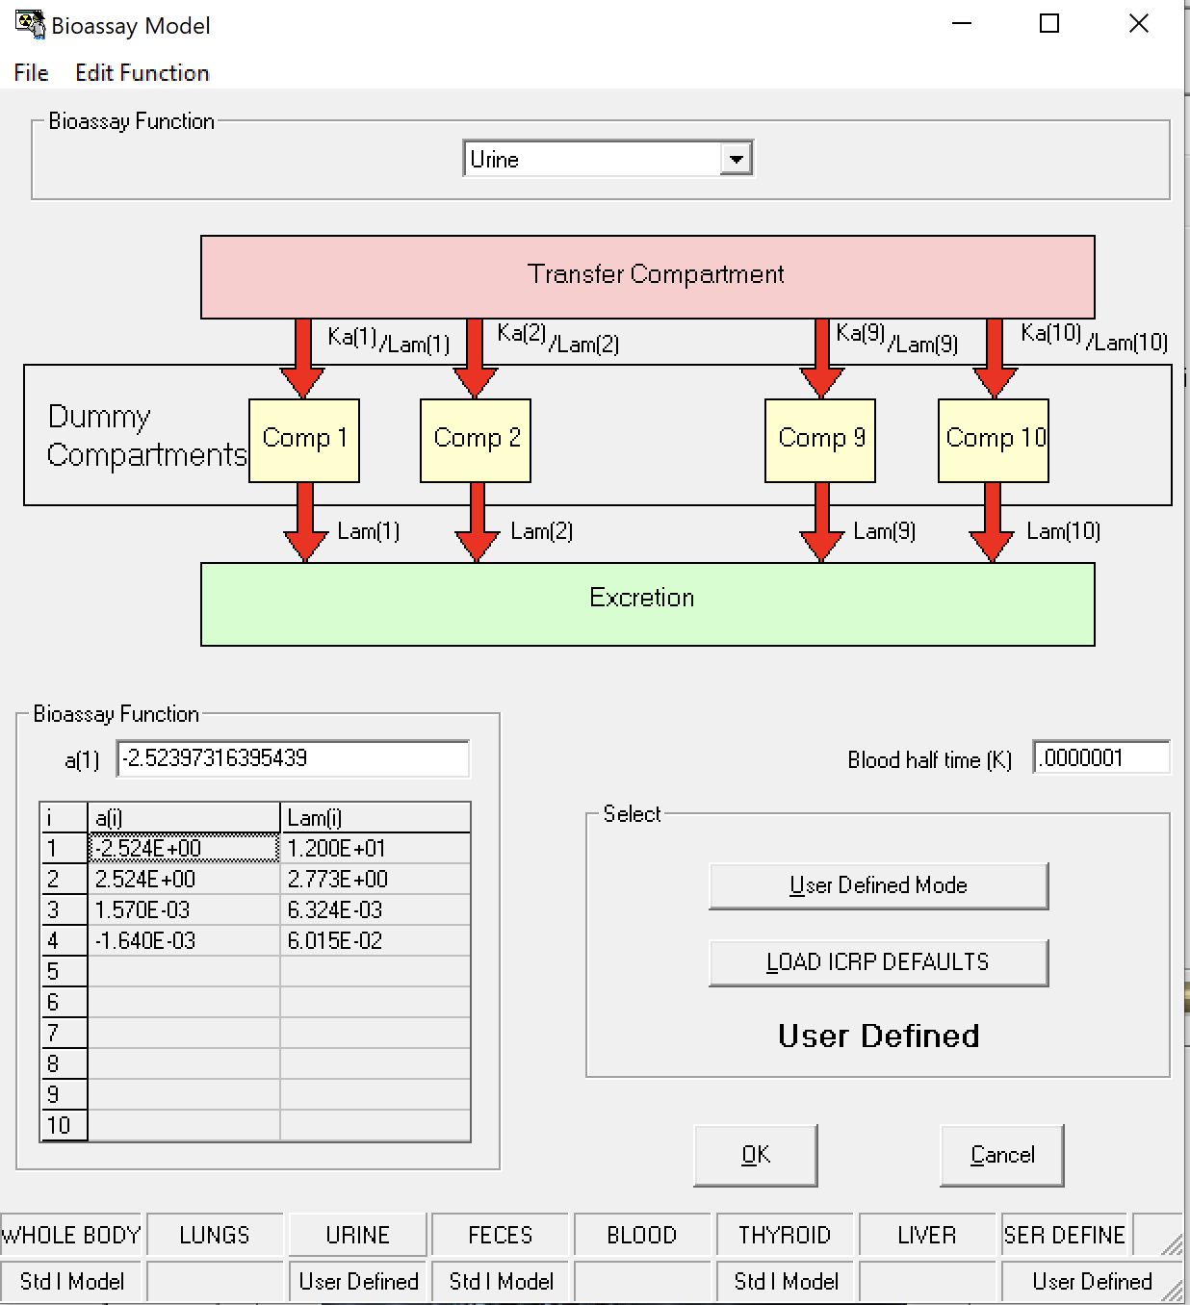
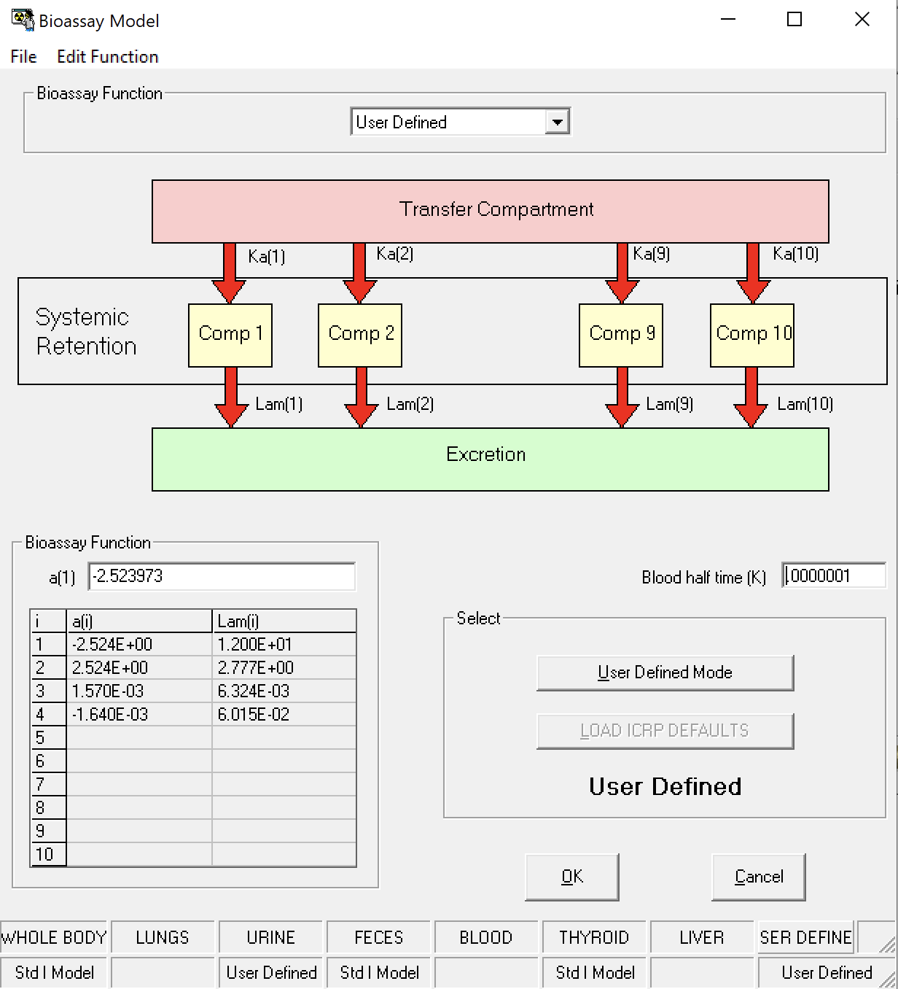
Select Limitations and Workarounds: 200 bioassay
IMBA has an upper limit of 200 bioassay results
Utilize User Defined bioassay

Slide 48
Select Limitations and Workarounds: Shared Kinetics
See Th-232 example
Shared kinetics allows for more efficient computations
Ingrowth algorithm combined with ”super-merged” SEE files
Major coding overhaul to depart of shared kinetics
Most concerning when progeny contributes large portion of total dose and there are notable differences in progeny kinetics
Use Bioassay module to compute intake and then use independent kinetic based dose coeeficients

Slide 49
Thank you for attending! We hope this met your training needs. If there is time, please let us know if there are any questions.

