Slide 1
U.S. Nuclear Regulatory Commission Overview and Current Activities
Andrea Kock
Deputy Director, Office of Nuclear Reactor Regulation
2023 Fall RAMP Users’ Group Meeting
October 23–27, 2023
Rockville, MD

Slide 2
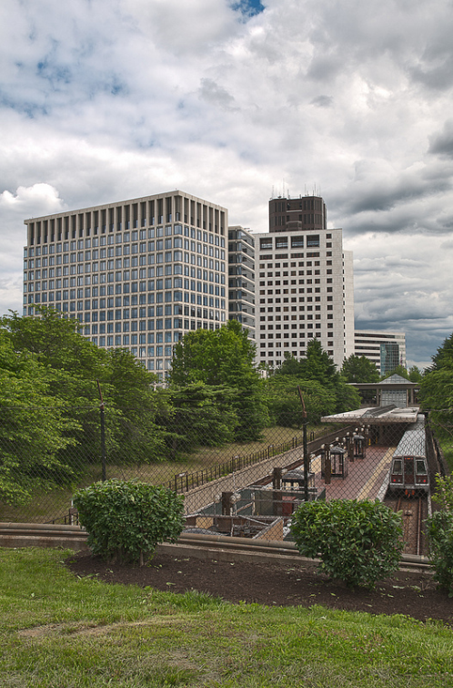
Outline
NRC overview, mission, and goals
Office of Nuclear Reactor Regulation Focus Areas

Slide 3
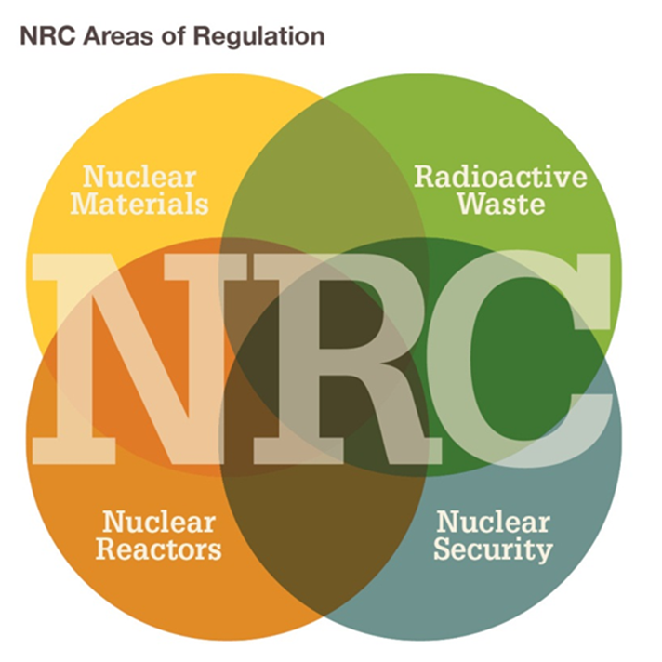
NRC’s Mission
To license and regulate the nation’s civilian use of byproduct, source, and special nuclear materials to ensure adequate protection of public health and safety, to promote the common defense and security, and to protect the environment.
The NRC’s regulatory mission covers four main areas:
  Reactors – Commercial reactors for generating electricity, research and test reactors, and new reactor designs
  Materials – Uses of nuclear materials in medical, industrial, and academic settings and facilities that produce nuclear fuel
  Waste – Transportation, storage, and disposal of nuclear materials and waste, and decommissioning of nuclear facilities
  Security – Physical security and cyber security of nuclear facilities and materials from sabotage or attacks

Slide 5

Nuclear Reactor Safety Program
Nuclear Safety Issues​
Vogtle 3&4​
Advanced Reactor Preparation and Licensing, including 10 CFR Part 53 Rulemaking​
Subsequent License Renewal​
Digital I&C ​
Accident Tolerant Fuel​
Reactor Oversight
Risk Informed Decision Making

Slide 6
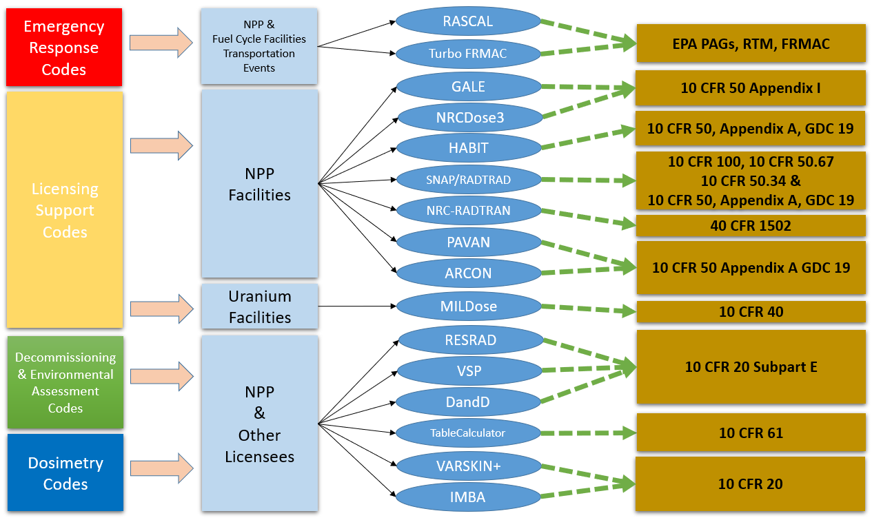
Computer Code Regulatory Applications

Slide 7

Preparing for the Future of the Operating Fleet
Subsequent License
Renewal
Light Water Reactor Sustainability Program
Reactor Decommissioning
By 2030-2050, nearly all U.S. operating power reactors will need to pursue subsequent license renewal in order to operate past 60 years.
Twenty-five power reactors are currently in decommissioning. More may announce plans to shutdown in the coming years.

Slide 8
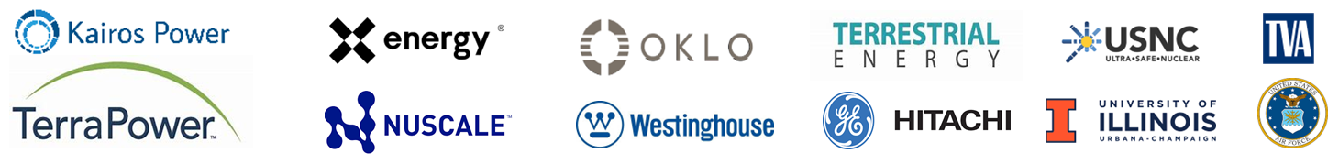
NRC is Preparing for an Increase in New and Advanced Reactor Licensing
Research and Test Reactors
Molten Salt Reactors
SMRs and Microreactors
20+ Current and potential applications by 2027
6+ Potential operating licenses by 2027
15+ Entities actively engaged in pre-app activities
96 Topical reports & white paper reviews completed
40 Topical reports & white papers under evaluation
EVOLVING LANDSCAPE
High-Temperature Gas-Cooled Reactors
Liquid Metal Cooled Fast Reactors

Slide 9
Modernizing Our Decision-Making
Surveillance Frequency Control Program, TSTF-425
Provides a risk-informed method for
surveillance test intervals.
Lower chance of initiating event
Greater equipment availability
Risk-Informed Categorization of Structures, Systems, and Components, 10 CFR 50.69
Determines safety significance of SSCs, based on a
risk-informed categorization process.
Improved focus on safety
Increased operational flexibility
Accelerated completion of deferred
maintenance
Risk-Informed Completion Times, TSTF-505
Allows technical specification completion times to be extended using a risk informed approach
Averted shutdowns
Reduced outage complexity
Risk-Informed Process for Evaluations (RIPE)
Leverages existing regulations and approved risk-informedinitiatives to create a streamlined NRC review process.
Establishes more efficient means to review licensing actions that address issues of very low safety significance that are within the licensing basis
9

Slide 10



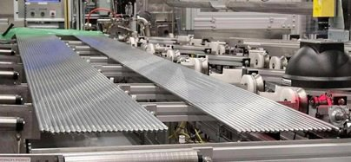
Digital I&C
We Are Modernizing our Regulatory Infrastructure to Prepare for New Technologies
Accident Tolerant Fuel
10

