Slide 1
CAUG
Charlotte Rose MS (RHP)

Slide 2
What is CAUG
Computational Analysis User Group
Online classroom to better understand, use, and evaluate codes commonly encountered
MCNP™ basics and intermediate use in 2022-2023
Advanced MCNP™ class forthcoming
Other code classes for IMBA, PIMAL will be delivered

Slide 3
Dosimetry Codes
Charlotte Rose MS (RHP)

Slide 4
RCD administers 5 codes
VARSKIN+
RadToolbox
DCF Pak
PIMAL
IMBA

Slide 5
Radiological Toolbox
An electronic handbook of data for radiation protection
Dose coefficients
Interaction constants
Nuclear transformation data
Supplemental information
To be added into VARSKIN+ as a new module
About 6 months

Slide 6
VARSKIN+
Extravasation (Roland Benke will be giving a presentation on this)
To be added as a new module in VARSKIN+
1.2 Just released
Updates include
1.3 to be released 6-12 months
Radiological Toolbox

Slide 7
DCFpak
Dose Coefficient Data File Package
DCFPAK provides dose coefficient data files and access to standard information regarding decay chains and assembles dose coefficients for all dosimetrically significant radioactive progeny of a specified radionuclide.
On hold
Upper-level decisions need to be made before work goes forward

Slide 8
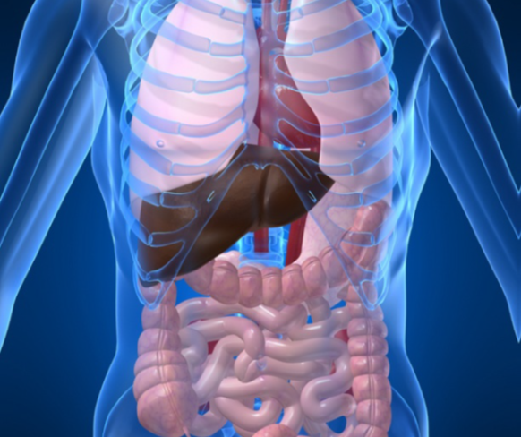
IMBA
Integrated Modules for Bioassay Analysis
Internal dosimetry
Free for government agencies
Cost for commercial
Estimates single or multiple intakes of different radionuclides and calculate resulting doses in the body and/or excrement

Slide 9
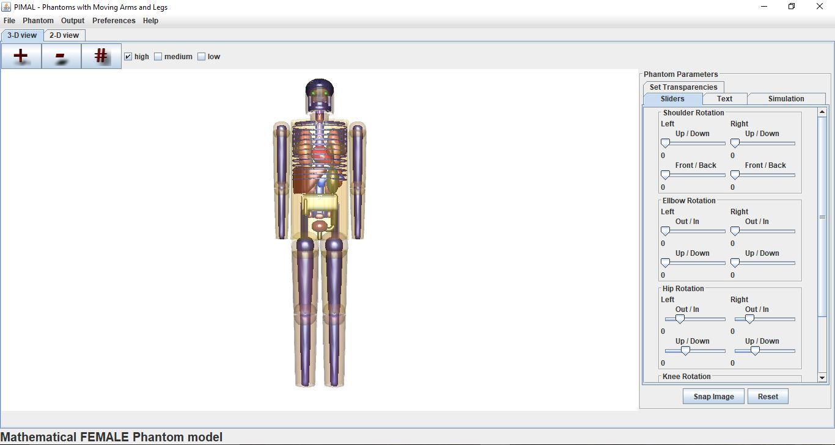
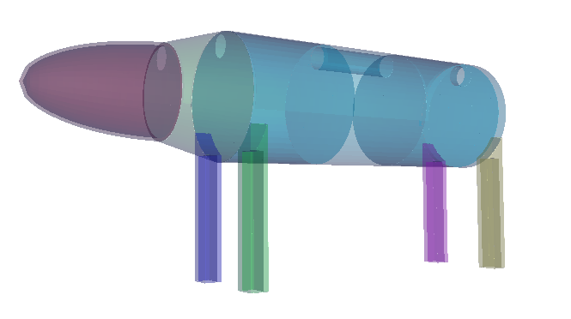
PIMAL
Lots of updates
Code cleanup for faster running and better ability to translate geometry
Addition of cats, dogs, and horses
Dose and effective dose calculations for output with option of ICRP 103, 60, or 26

