Slide 1
Examples using RAMP codes and general dosimetry considerations at ARPANSA
Blake Orr
US NRC RAMP User Group Meeting – Dosimetry Symposium 26th October 2023

Slide 2
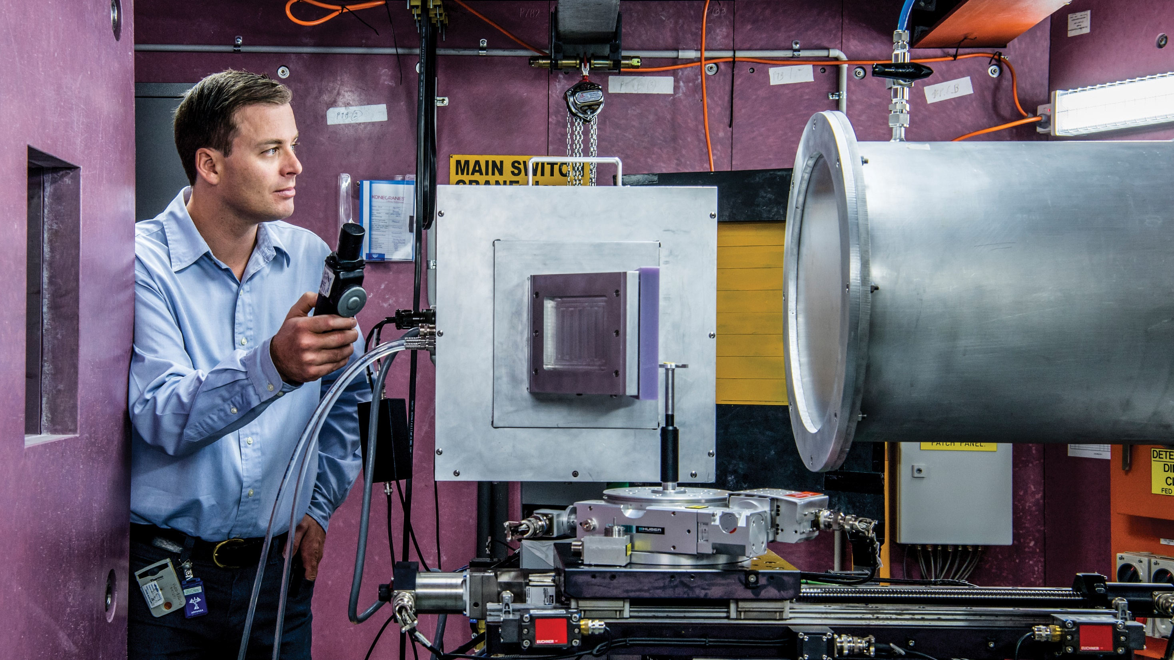
^{ARPANSA is an}
^{independent}
^{regulator}
We are the independent regulator of Commonwealth entities that use or produce radiation.
Using a risk‑informed regulatory approach, we ensure that licensees take responsibility for protection of people and the environment from the harmful effects of radiation.
Notes:
Fiona talking points:
ARPANSA is the Australian Government’s primary authority on radiation protection and nuclear safety.
ARPANSA is the independent regulator of Commonwealth entities the us or produce radiation.
ARPANSA is a Health advisor. We build and maintain expertise in measurement of radiation and assessment of health impacts, including the assessment of risks and responses to radiation incidents. We provide high quality advice to the government and the community.
ARPANSA is a service provider. We offer high quality services for the purpose of protection against the harmful effects of radiation.

Slide 3


Australian regulatory framework for nuclear and radiological safety
Australia has:
Department of Health
Queensland Health
9 JURISDICTIONS
NT
Environment Protection Authority
QLD
6
STATES
2
TERRITORIES
THE COMMON-WEALTH (ARPANSA)
Radiological Council
WA
NSW
SA
ACT
All have regulatory regimes for radiation protection.
VIC
ACT Health
TAS
Commonwealth
regulator
The states and territories regulate radiation use for
non-commonwealth entities.
Department of Health and Human Services
Notes:
Fiona talking points:
The Australian Regulatory Framework is complex. There are 9 jurisdictions as show in this slide, all of which have their own radiation protection act and regulations. The State And Territories regulators regulate the use of radiation in areas such as industry and research for example mining and medical facilities. ARPANSA is the commonwealth regulator. And one of the remits of our CEO is to promote national uniformity across the 9 jurisdictions.
CLAUSE:
This is where I also need to make sure you are aware that the WA regulators – The radiological council of Western Australia have this incident still under investigation with no reports provided yet. I will not comment on any West Australian regulatory matters – but I will tell the story of the overarching Incident – Response and Recovery. We all hope the WA reports are published in the not to distant future.

Slide 4
Overview
Use of RAMP codes
VARSKIN assessment in contamination event
VARSKIN to support W.A. Lost source recovery
General dosimetry
ICRP Update to internal dose coefficients for workers
ICRP Update to external dose coefficients
ICRP Update to internal dose coefficients for the public

Slide 5
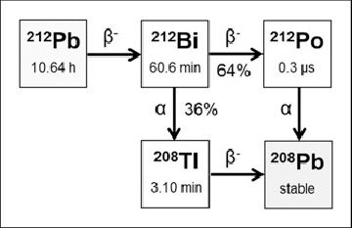
Contamination event
Contamination event occurred at laboratory site of an ARPANSA license holder
Lab technician was preparing a Lead-212 sample for delivery
Radioactive contamination inadvertently transferred from the vial to outer container and transport package
Technician was double gloved. Changed outer gloves, then finished preparing the package for delivery
Transport package was not checked for contamination prior to leaving
Contamination was detected at delivery site upon receipt

Slide 6
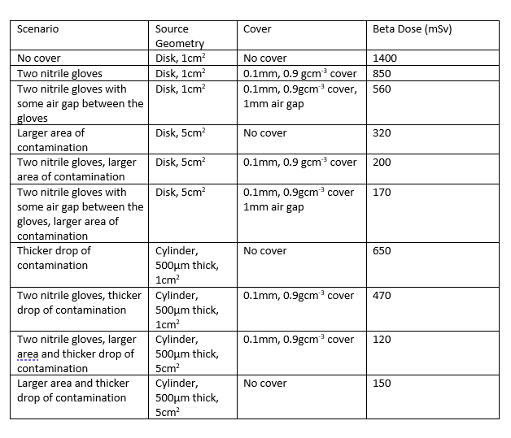
Contamination event
Setting up the exposure scenario
Technician's gloves were recovered and monitored
  Glove 1 – Contaminated with 2MBq of Pb-212. Estimated wear time of 15 mins
  Glove 2 – Contaminated with 0.13 MBq of Pb-212
  Later monitoring estimated 100 Bq of residual Pb-212 on hands
Initial assessment showed that doses above the regulatory limit of 500 mSv to skin were possible. Doses high enough to cause acute health affects seemed unlikely.

Slide 7
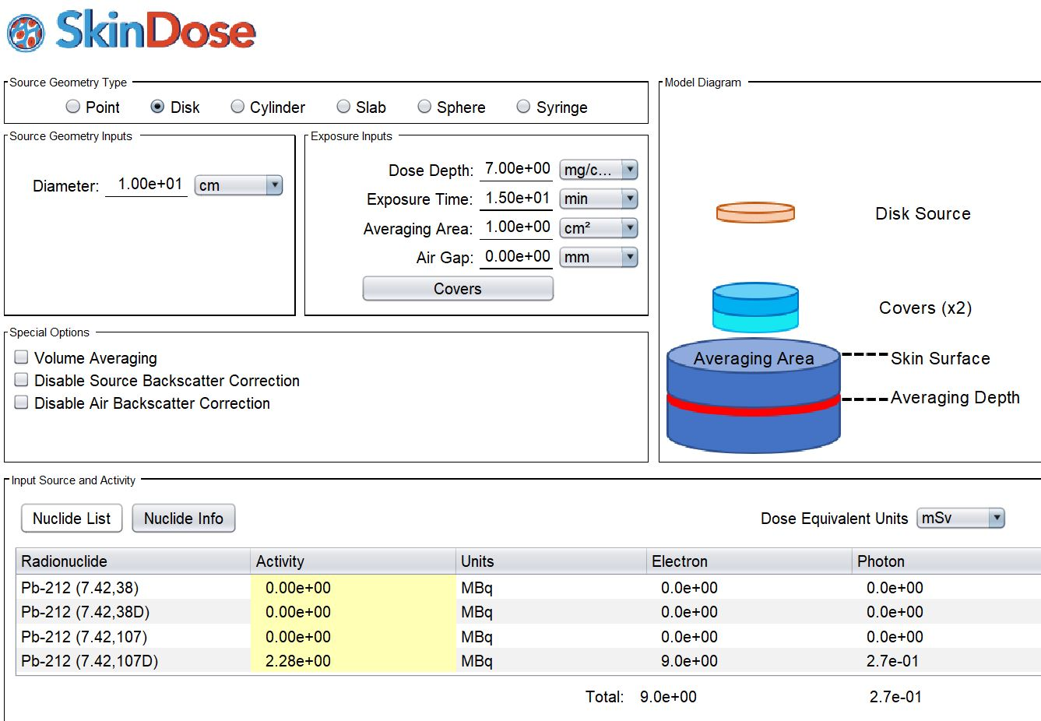
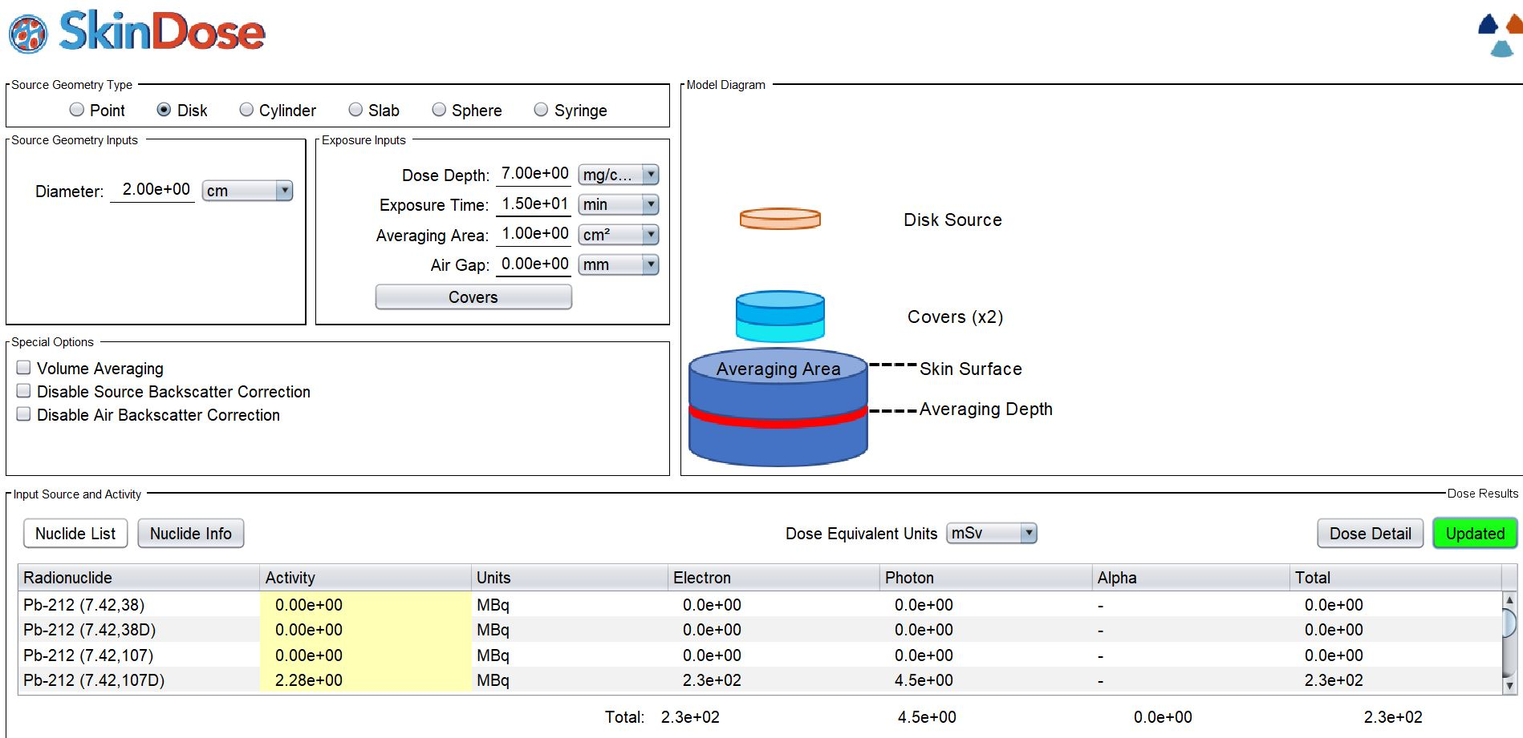
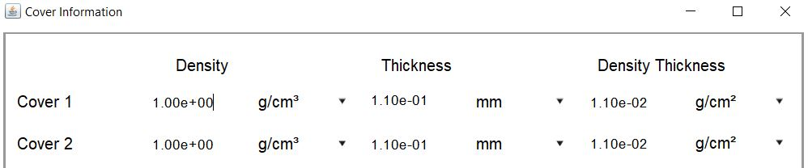
Contamination event
Further refining of the scenario
Contaminated area estimated to be between 2 and 10 cm.
Gloves of thickness 0.11mm and density of 1 g/cm3
Decay corrected activity of 2.28 MBq
Additional skin dose from 100 Bq of 6.4 uSv
Driver and lab technician at receiver end
  Less than 100 Bq recorded on hands
  Other areas checked for contamination
  Skin Dose estimated to be in the range of 10 uSv
Skin dose estimated to be in the range of 9 to 230 mSv.

Slide 8
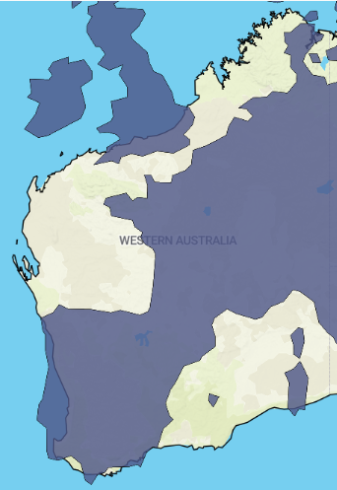
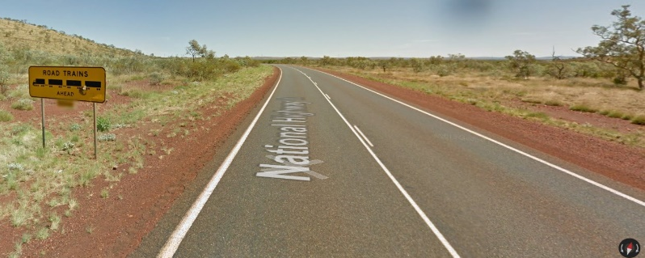
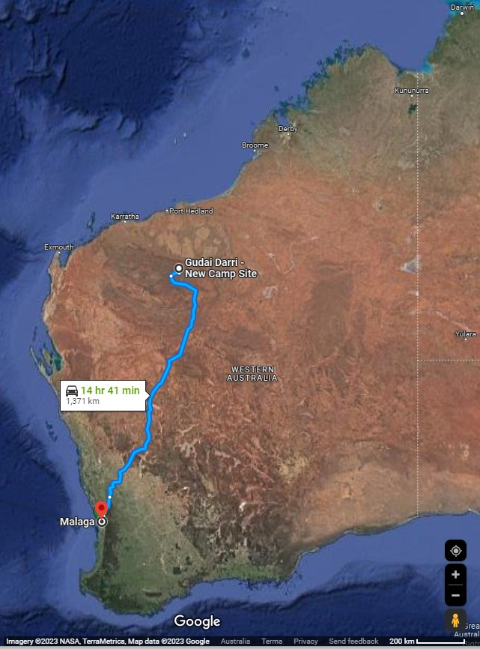
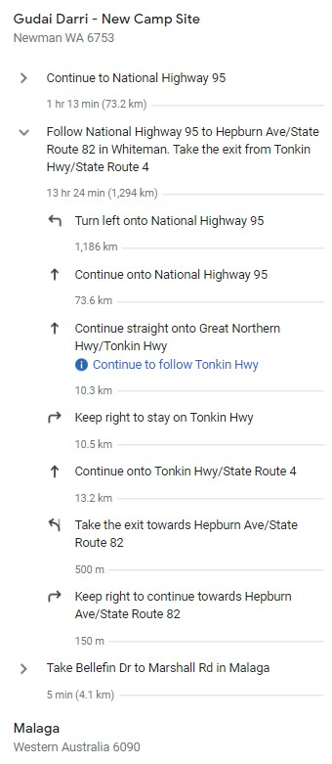
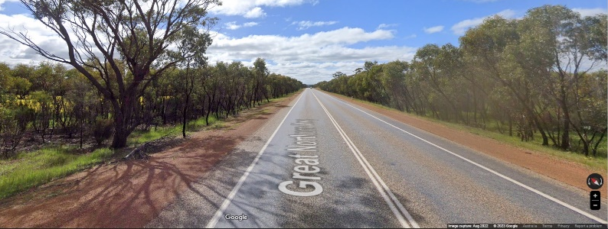
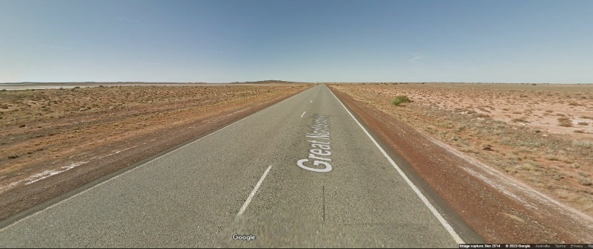

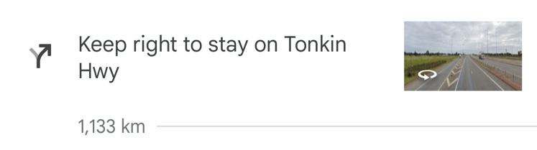
The incident – Source lost during long-distance transport
Challenge #1:
A large search distance
Notes:
Fiona talking points:
Located about 110 kilometres north-west of Newman in Western Australia, (Goodeye Darri) Gudai-Darri is a remote mine site nestled in the heart of the beautiful Pilbara region. Its main purpose is to mine Iron Ore – and is one of the newest mine sites, utilizing the most sophisticated technologies for Rio Tinto.
There is significant distance between Perth and this Minesite and it really sets the scene for the mammoth search task ahead.
So we are understanding we are covering 1/3 of the country to find something the size of a button battery.

Slide 9
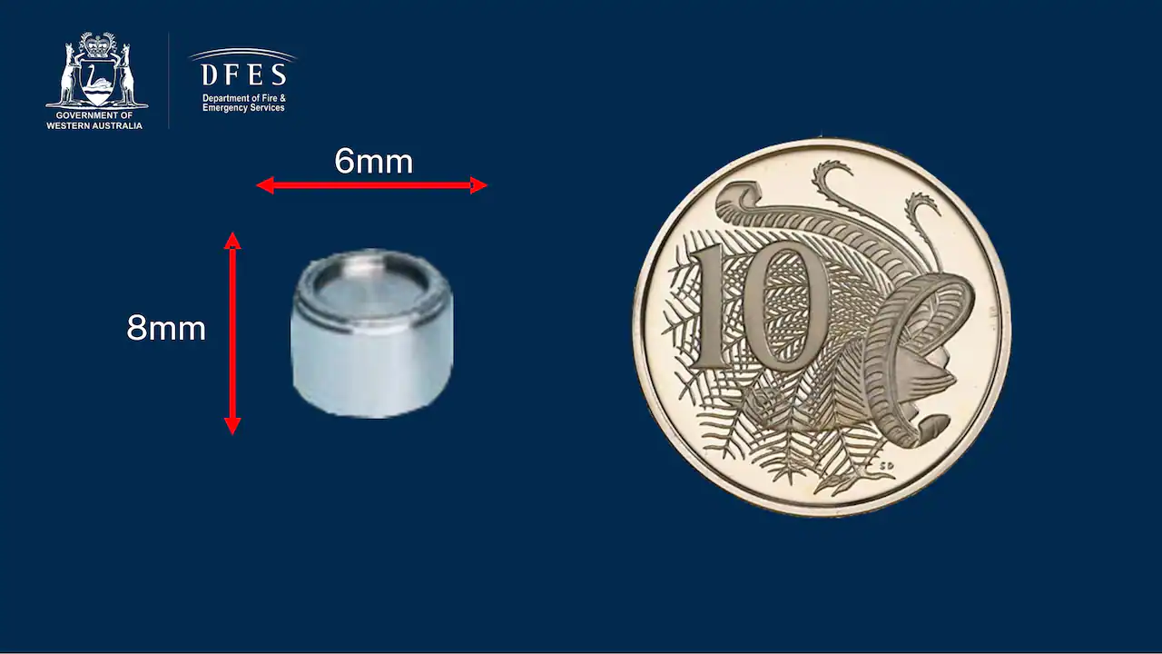
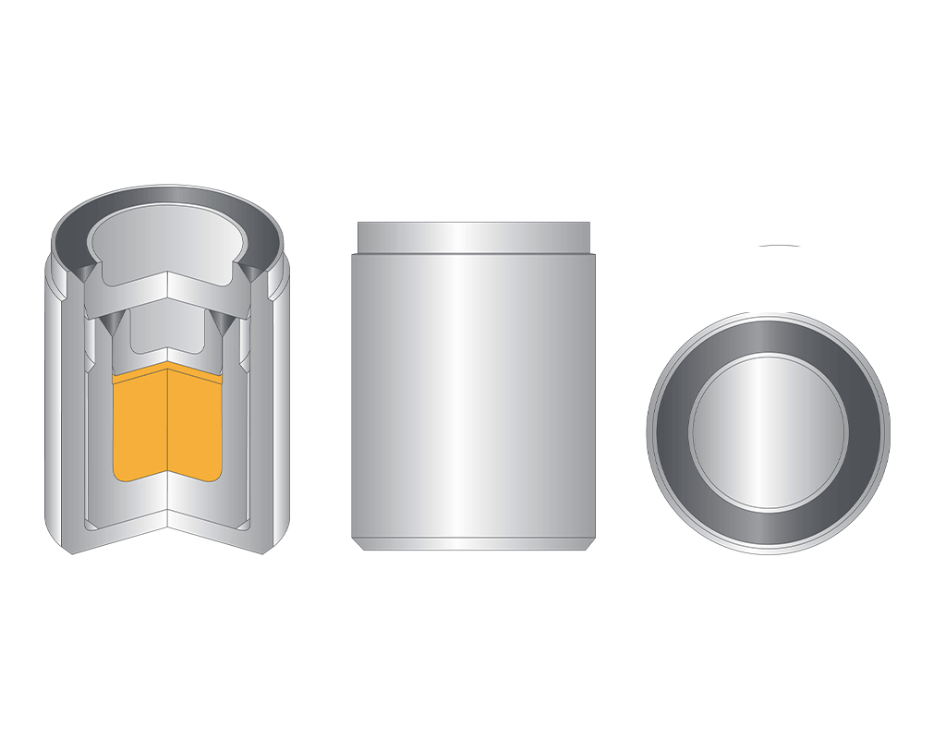
The incident – Source lost from a density gauge
Challenge #2:
A small
source
20 GBq Cs-137
density gauge source
1.5 mSv/h @ 1m
Notes:
Fiona talking points:
A 19.9 Gigabequerel (GBq) industrial radiation source in a level gauge similar to this one in the image.
The ceramic radioactive material was inside a metal capsule which is 6 mm diameter and 8 mm long.
Cesium-137, the radioactive material inside the capsule, is used for, among other things, detecting the flow of liquid through pipes and determining the thickness of materials like sheets of metal
The strength of the radiation could cause harm if someone was to pick it up and leave it in a pocket or in close proximity to themselves for long periods of time.
But if it was somewhere on the highway driving past it at 110kms/hr wouldn’t have any significant dose received at all by any passer by.

Slide 10
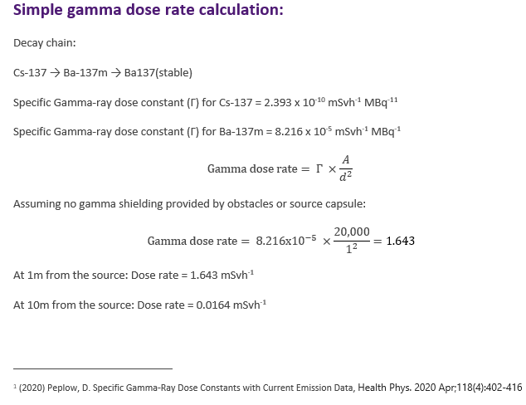
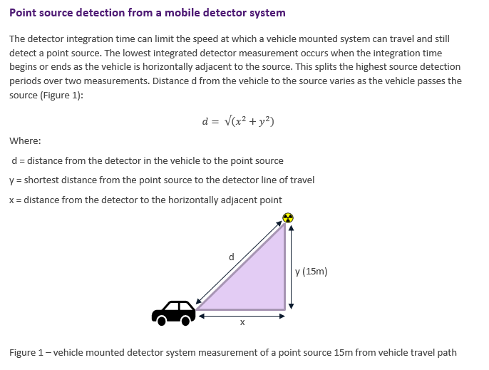
Simple dose approximations – could we detect it with our equipment?

Slide 11
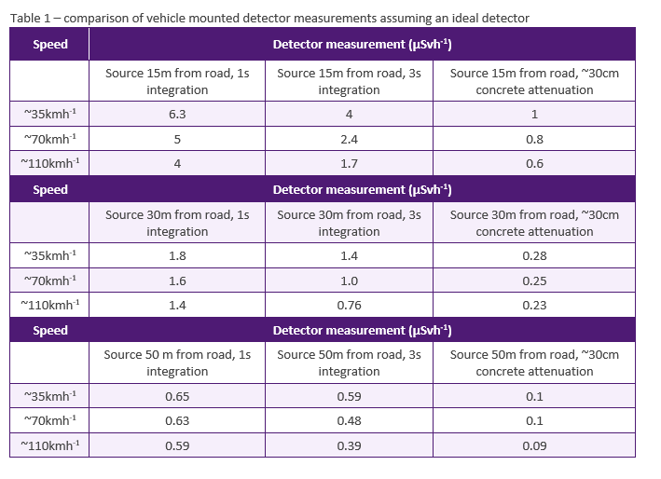
Simple dose approximations – could we detect it with our equipment?
Travelling at 70 km/h. We were confident of picking up the source at least 50m away based on calculations.
This was later confirmed by testing using a live source at the ARPANSA site. Looking at detector output, distances in the range of 70 – 100 gave confidence in a detection at a speed of 70 km/h.

Slide 12
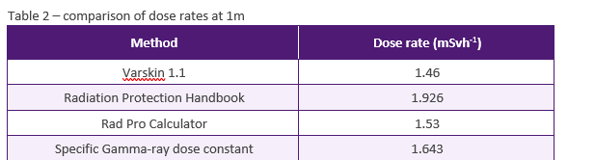
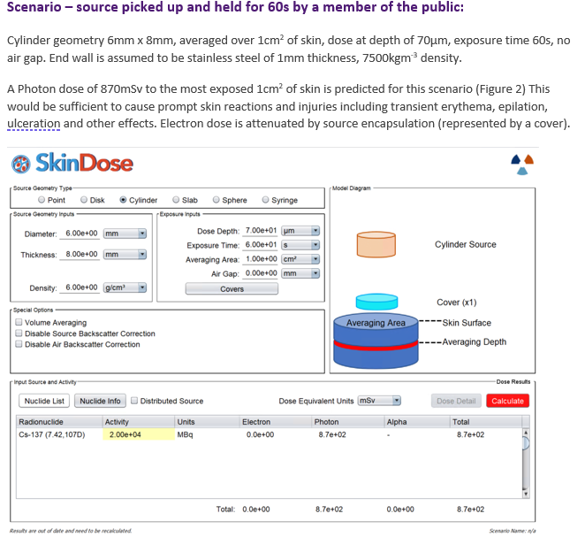
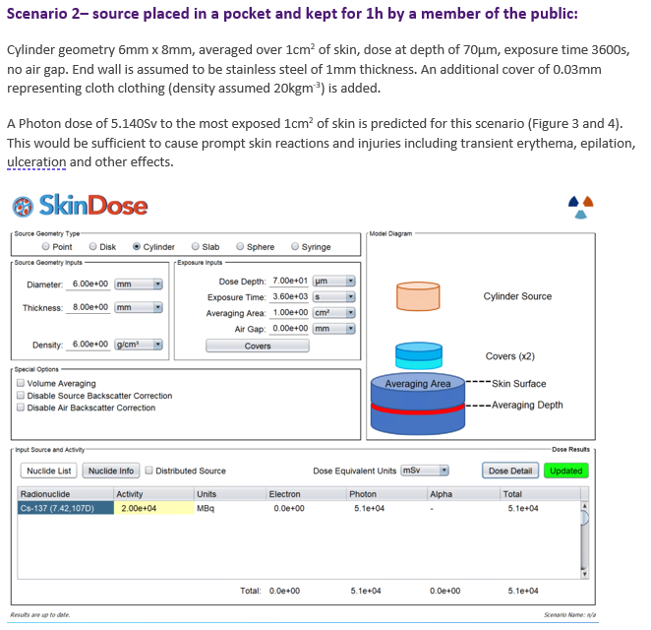
Some what-if scenarios

Slide 13
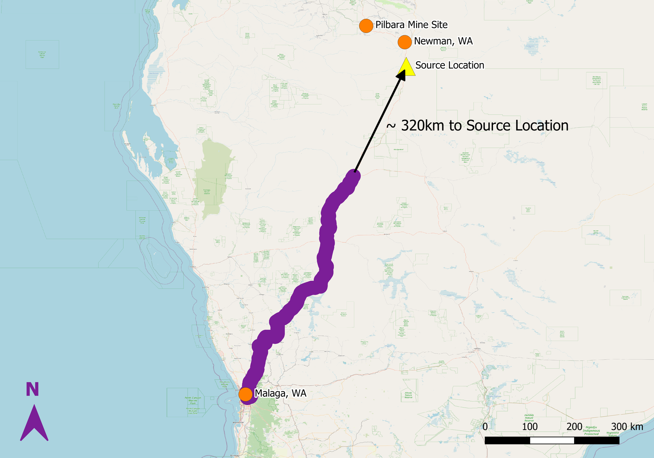
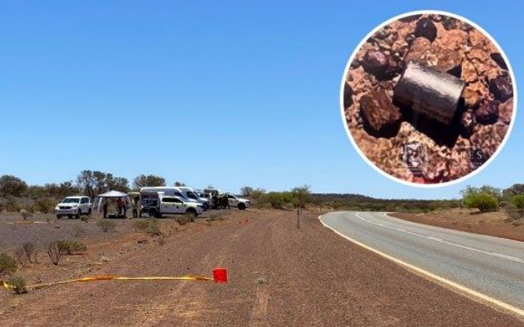
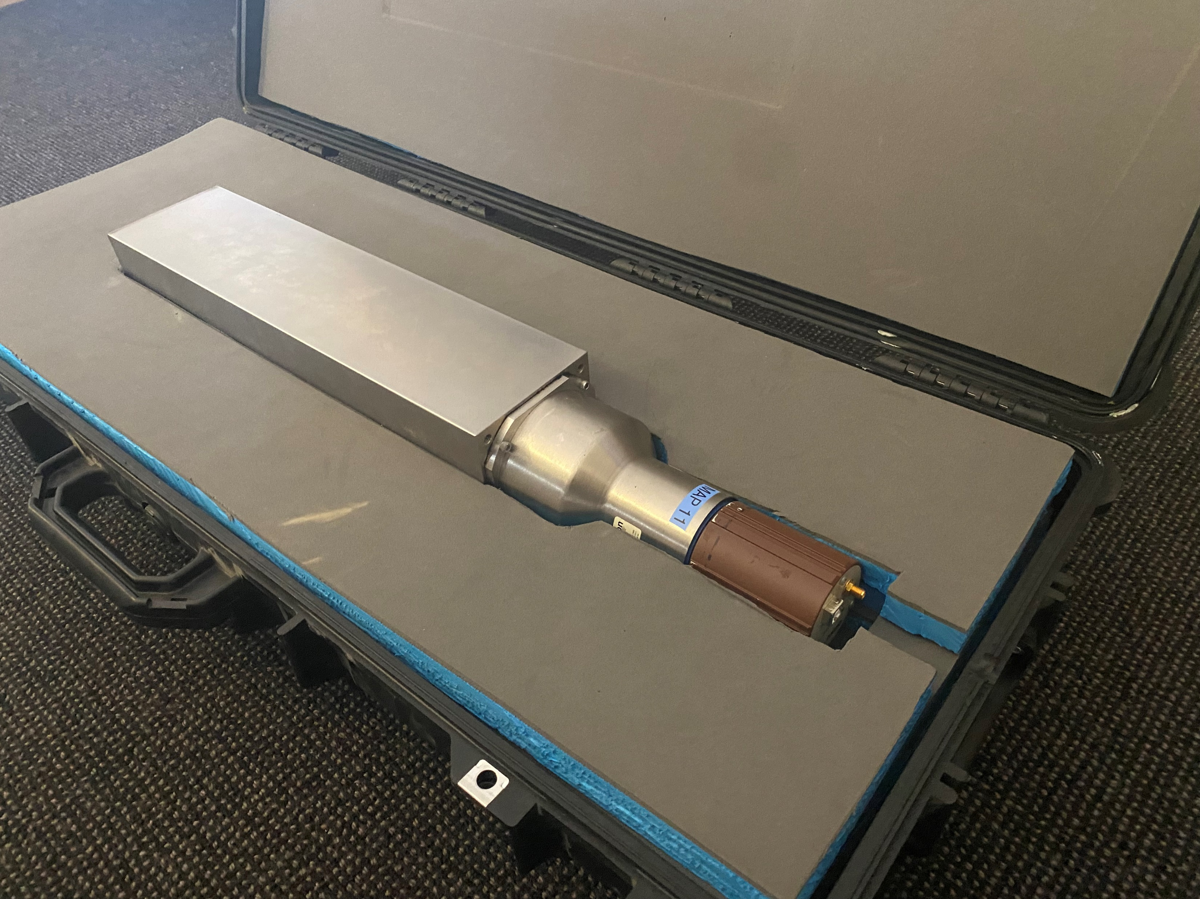
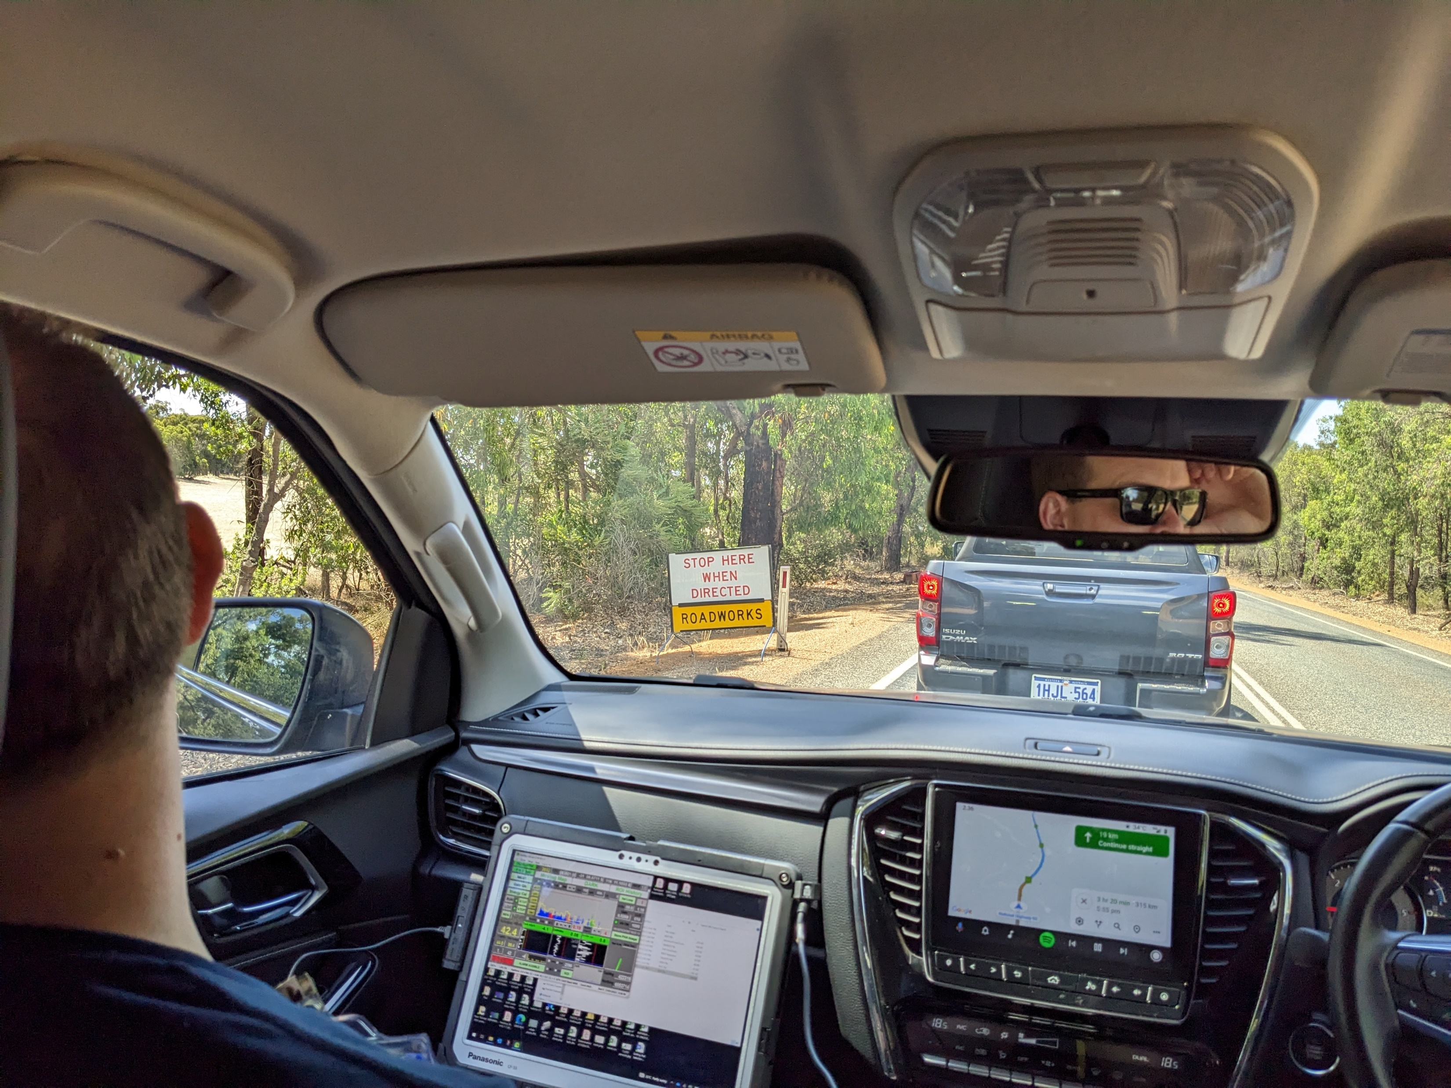
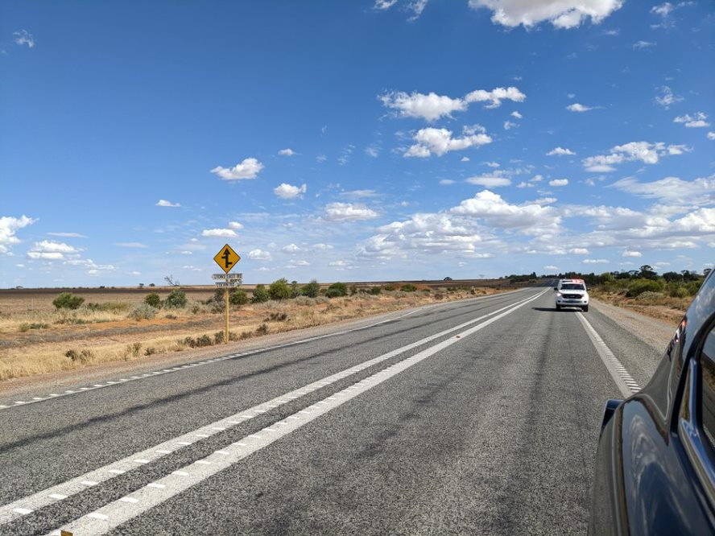
1 Feb 2023
Recovery
Identifying and recovering the source, and stepping down the response
Found 160 km from mine site
2 m off side of road
Verified by serial number
Capsule intact - no leakage of radiological material
Source returned to Perth
Notes:
Chennell talking points:
Found by Bravo Team 160 km from mine site
2 m off the side of the road
Verified by serial number
Capsule intact - no leakage of radiological material the ground was monitored after the capsule was removed and placed in its shielding.
Source returned to Perth in convoy
Here the considerations to transporting it were now front of mind
Understanding it’s not an emergency anymore and everyone was working through what the requirements are and what made everyone comfortable. Eg Plaquareds on the vehicles, lights and sirens vs no sirens… completing the recovery plan and bringing the source back to a safe place…

Slide 14
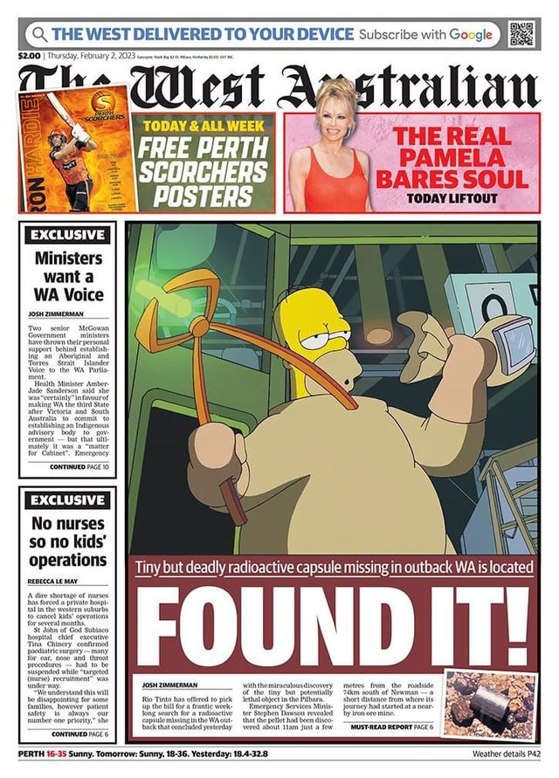
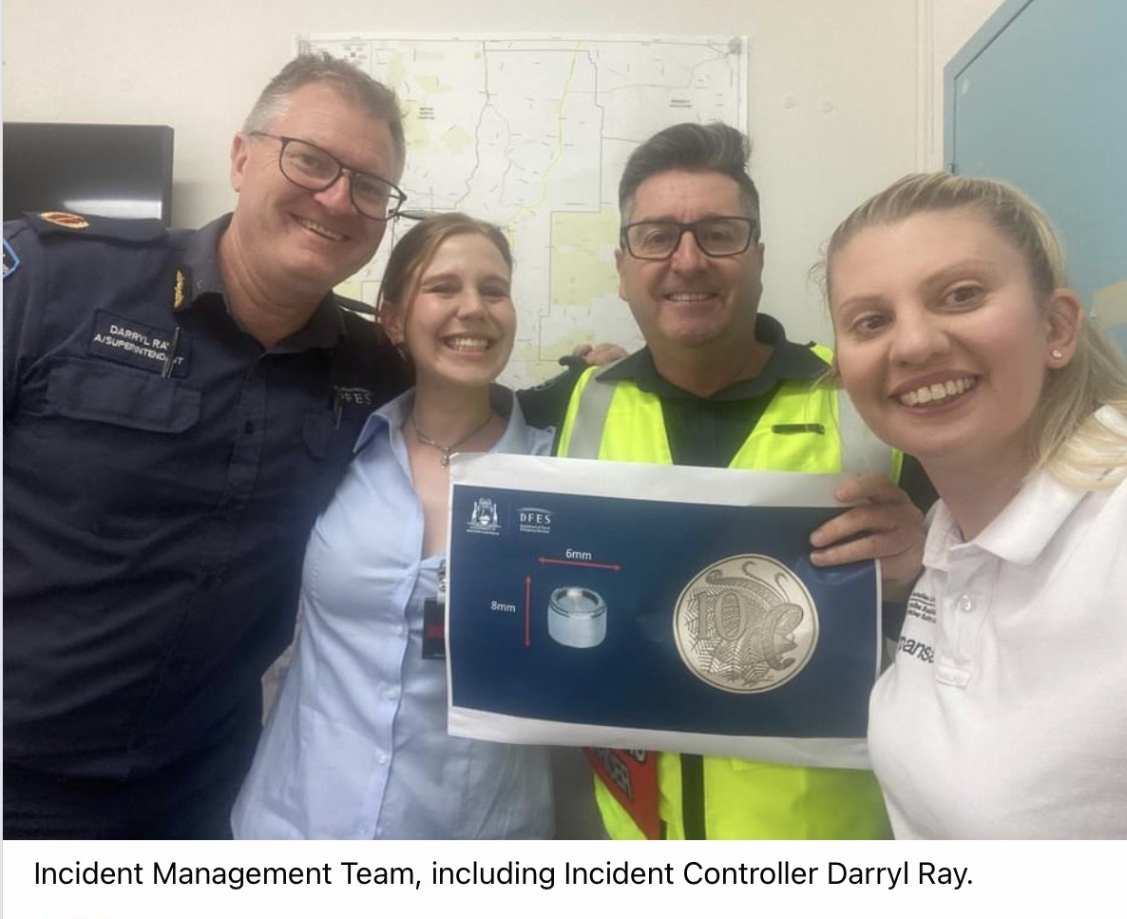
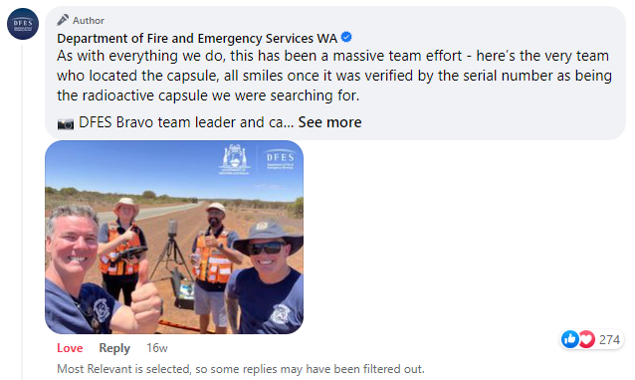
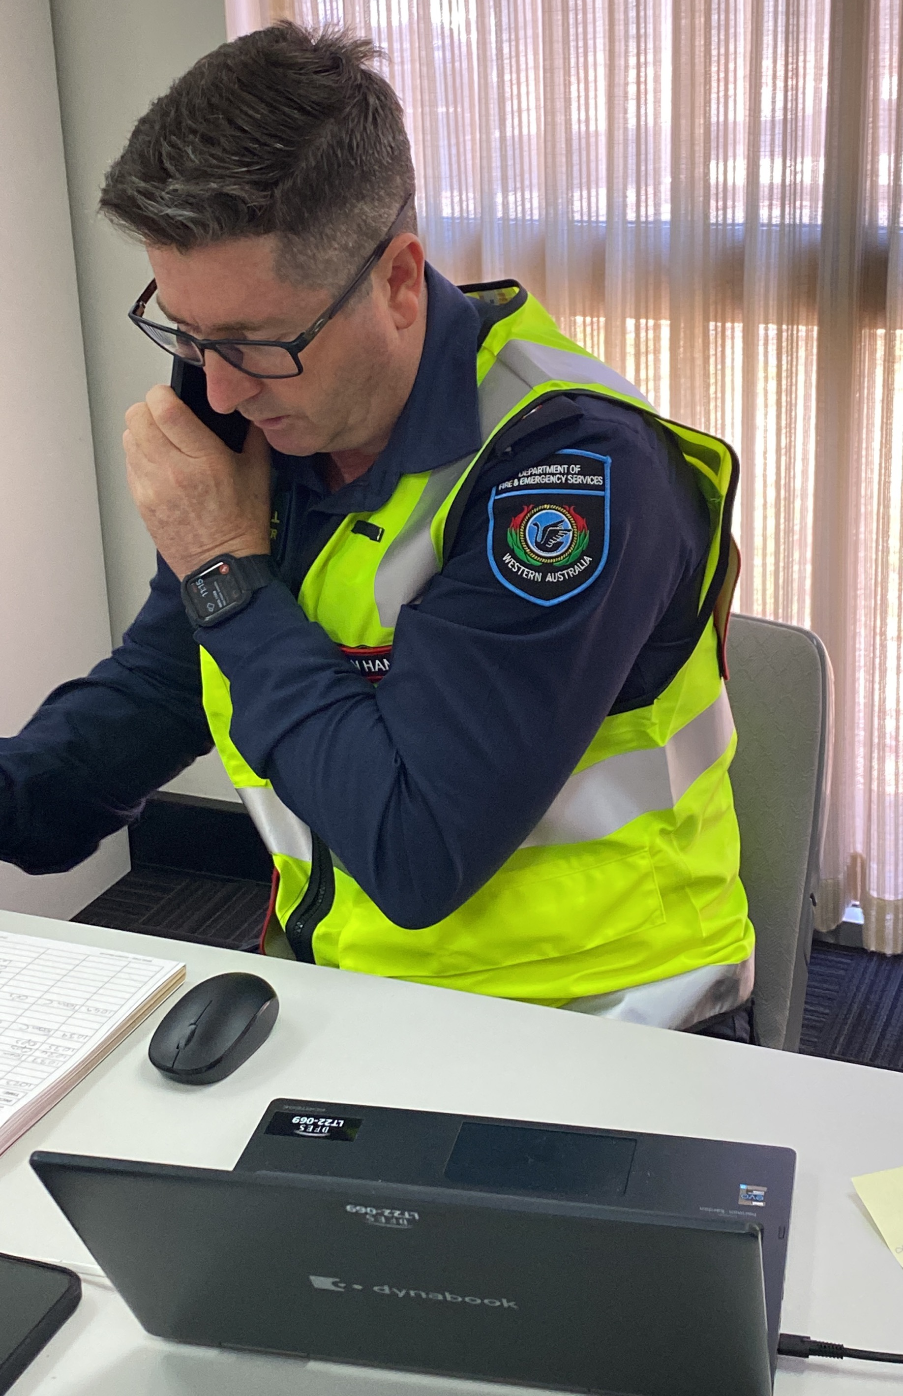
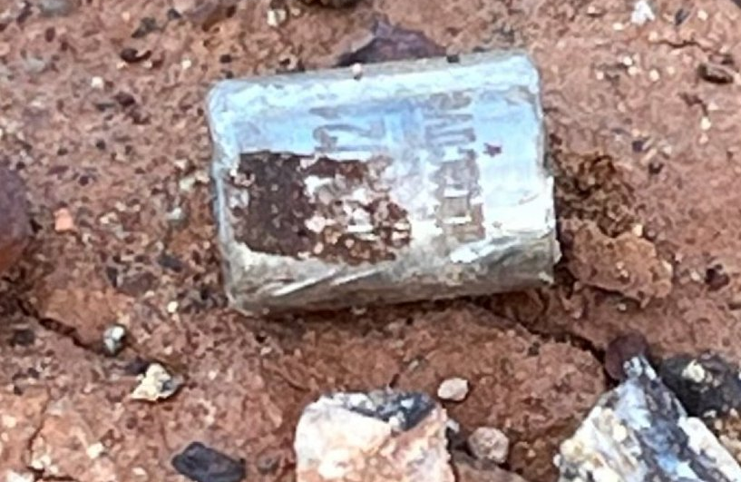
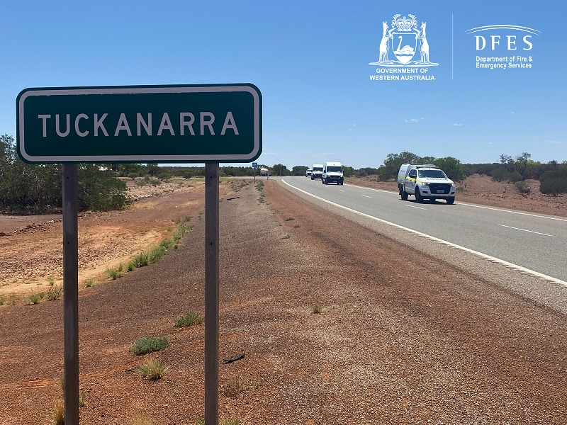
Notes:
Chennell talking points:
Darryl Ray the IC stated “I am incredibly proud of the thorough work done to comb a massive area spanning from the outback to main roads of Perth. This capsule was not found by luck, it is thanks to the detailed plans and perseverance of all those involved.”
We spent the Tuesday planning – preparing and organising the logistical aspects of the trip – Then the teams deployed. Bravo team actually had their flight cancelled on the 31st so they didn’t get to fly up to Newman until early on the 1st .
When we were all being briefed we all wanted to be team bravo – because we all thought the capsule would be at the beginning of the drive.
The elation we felt when we found it – of course there was no phone or radio coverage in the area – they had to drive 10mins for satellite phone coverage to communicate with us!
Once it was found – It took 2hours for the lead shielding (with Defence) to make it to the site to render it safe in the shielding. We also had to wait for the capsule ID to be verified… As soon as it was verified – the Fire Commissioner announced via press conference it was found!

Slide 15
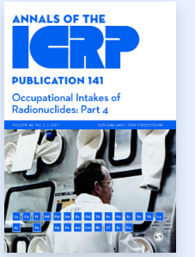
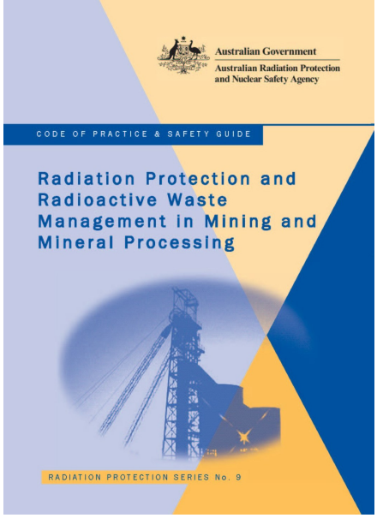
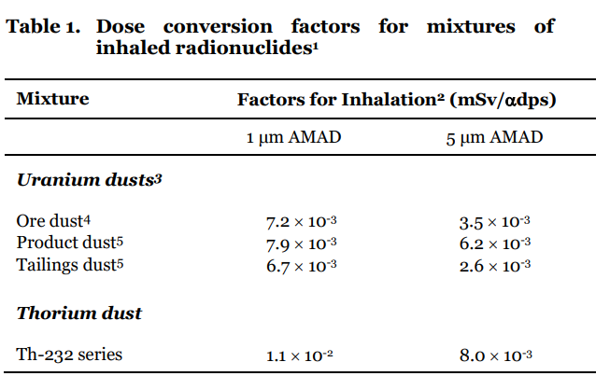
ICRP Occupational Intakes of Radionuclide
ICRP OIR series 130, 134, 137, 141
Update on ICRP 60 series
  Dose co-efficients provided in ARPANSA documents
  In particular with reference to Mining and Naturally Occurring Radioactive Material (NORM)
Our focus was on providing guidance on calculating doses for NORM activities

Slide 16
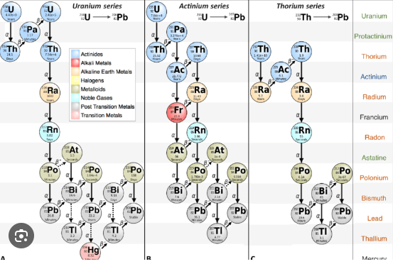
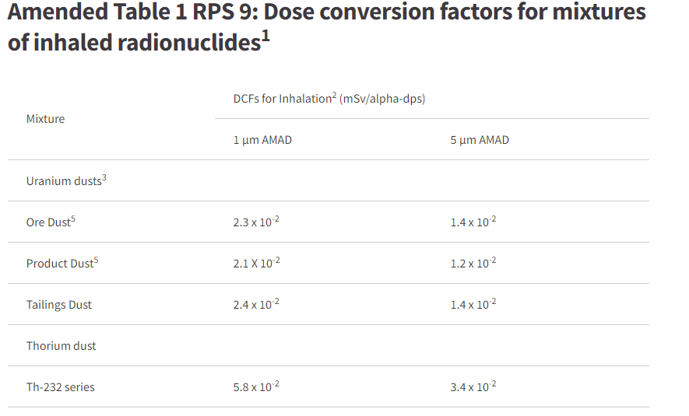
ICRP OIR updates
Impact of change
  Approx. doubling of dose co-efficients for NORM
  Additional guidance on Radon retention
  Amended tables published on our web-site
  https://www.arpansa.gov.au/amended-tables-rps-9-and-rps-91
  Spreadsheet created to allow for site specific conversion factors

Slide 17
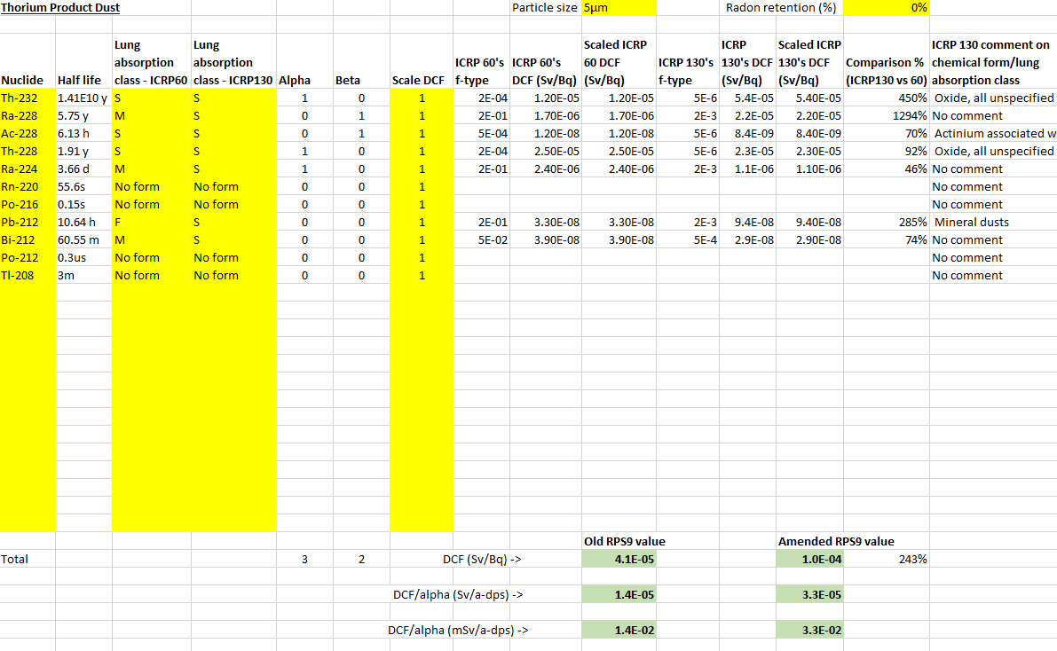
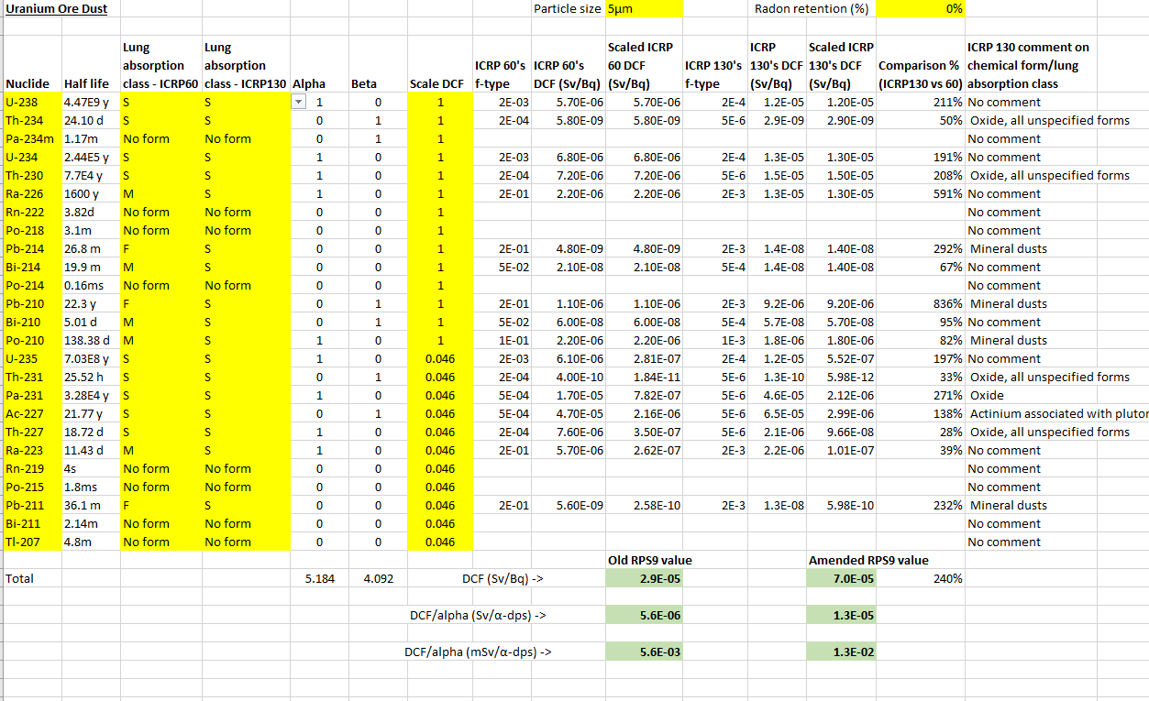
ICRP OIR Update – ARPANSA NORM Spreadsheet

Slide 18
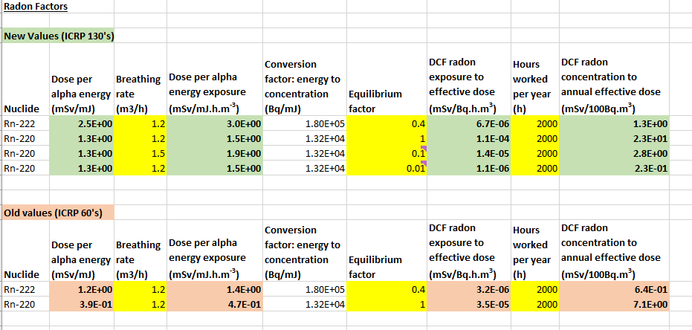
ICRP OIR Update – ARPANSA NORM Spreadsheet

Slide 19
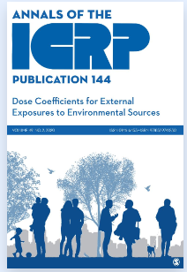
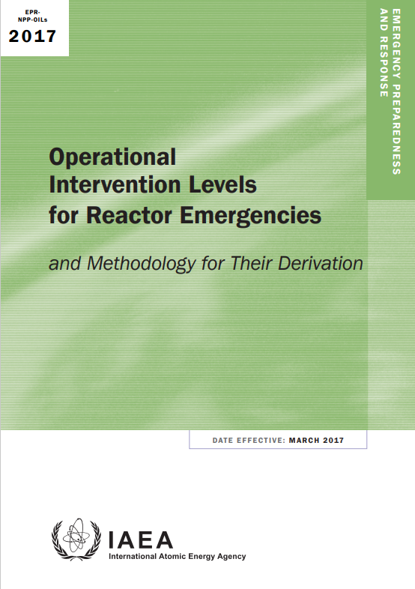
ICRP 144 – External Dose Coefficients
In 2020 ICRP published External Dose Co-efficients from exposure to environmental sources
  Previously ARPANSA had used U.S. EPA FGR12, Adult only.
Dose co-efficients provided for reference age groups (newborn, 1y, 5y, 10y, 15y and adult male, female)
  Impact on current assessment models in APRANSA. As current tools (e.g. ARGOS) only use Adult DCFs for external exposure.
Operational Intervention Levels (OILs) for emergency situations were previously based on FGR12.

Slide 20
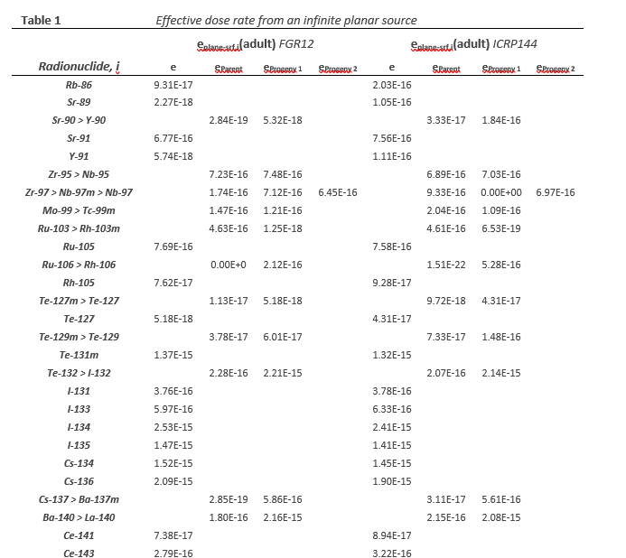
ICRP 144 – External Dose Coefficients
Check was undertaken against IAEA OIL document to see if there was a noticeable difference.
There was different in the newborn doses. Although the current IAEA approach did try and account for this with a modifying factor
Overall, there were differences found, but were not sufficient to change the ‘default’ OILs
Looking to integrate these new factors into the tools and software packages used at ARPANSA

Slide 21
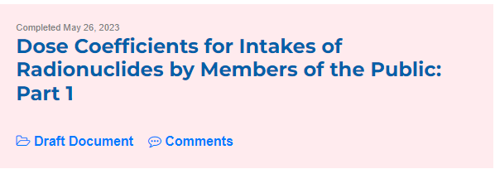
Upcoming – ICRP changes to Public intakes of radionuclides – inhalation and ingestion doses
Update to ICRP 60 series (ICRP119 compendium)
Potential to impact dose co-efficients of nuclides
  We saw this in OIR for NORM nuclides
Consultation period has ended, publication will be soon
Work to be undertaken in 2024 at ARPANSA to assess the impact of the updates
  What codes/guidance documents need to be updated?
  What assessment methods need to be updated?
  Potential to impact tools and software packages
    Look to integrate provide dose assessments based on up-to-date dose coefficients
https://www.icrp.org/consultations.asp
Nuclide | Absorption Type | ICRP119 5 yo | New ICRP 5 yo
I-131 | F | 3.7E-8 | 3.3E-8
Cs-137 | F | 3.6E-9 | 5.7E-9
Sr-90 | M | 6.5E-8 | 5.6E-8
Inhalation DCF for 1um

Slide 22
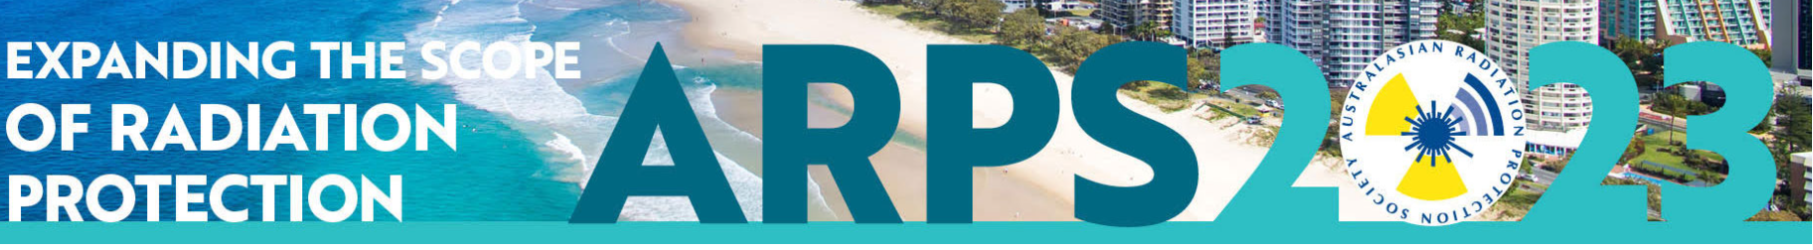
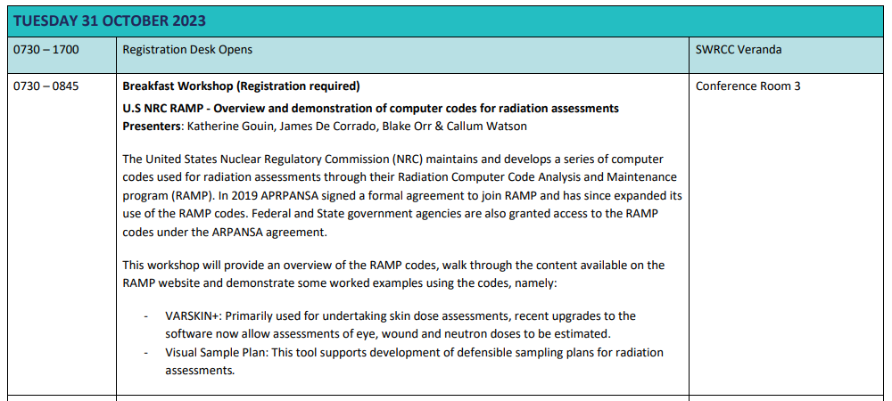
…..Lastly – Australian RAMP demo workshop
RAMP workshop as part of the Australian Radiation Protection Society conference next week
Around 30 participants registered. Hoping to form an Australian RAMP community

Slide 23
Blake.orr@arpansa.gov.au

