Slide 1
NRC- RADTRAN Primer and Updates
Harish Gadey
Pacific Northwest National Laboratory
2023 Fall RAMP Users’ Group Meeting October 23–27, 2023 Rockville, MD
PNNL-SA-191369

Slide 2
Outline
Introduction
NRC-RADTRAN Concepts
NRC-RADTRAN Installation
NRC-RADTRAN Use
Updates and New Features
Conclusions

Slide 3
Introduction
NRC – Radioactive Material Transport (NRC-RADTRAN)
Risk and consequence analysis of radioactive material (RAM) transportation
Modes of transportation: rail, trucks, barge, aircraft
First released in 1977 (SNL)
6 versions released to date
GUI compatibility added to RADTRAN 6.02.1 → NRC-RADTRAN v1.0

Slide 4
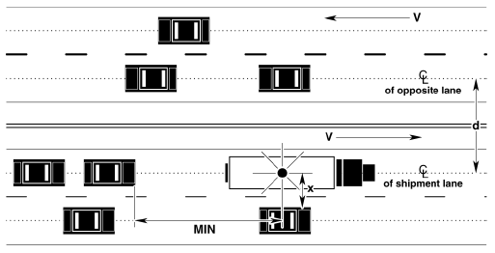
NRC-RADTRAN Concepts
Calculations
With traffic
Opposing traffic
Population
Treats shipment as a stationary object
Relative velocity used for everything
Taken From RADTRAN 6 Technical Manual SAND2014-0780

Slide 5
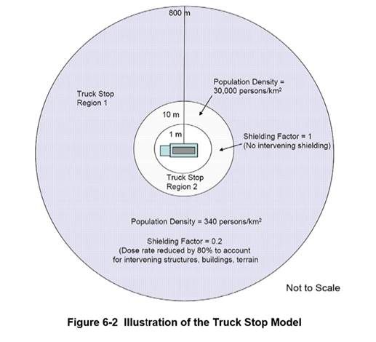
NRC-RADTRAN Concepts (cont.)
Example Truck Route Stop Figure from page 6-29 of U.S. NRC Environmental Impact Statement for an Early Site Permit (ESP) at the Clinch River Nuclear Site
NUREG-2226, Vol. 1
Notes:
-walk through example in the image.

Slide 6
NRC-RADTRAN Concepts (cont.)
Two types of exposures modeled:
Direct exposure from loss of shielding
Exposure associated with release of particulates, gases, volatiles, and crud; several pathways:
Inhalation
Cloudshine
Resuspension
Groundshine

Slide 7
NRC-RADTRAN Concepts (cont.)
Doses are calculated and summed for all appropriate exposure pathways for all isotopes in each material for the shipment(s) being analyzed and for all downwind isopleths for each accident severity to yield a consequence (total dose) per accident of each severity
Probability of occurrence of each accident severity class is calculated from input values for accident rate, fractional occurrence, and distance traveled
Total Dose is multiplied by probability of occurrence for each accident severity to yield Dose-Risk
Results and intermediate calculations are included in the output file
Notes:
Doses summed for each pathway and not isotope.
Dose * probability = dose risk.

Slide 8
NRC-RADTRAN Concepts (cont.)
Changes in RADTRAN 6
Command line is no longer used for any functionalities
RadCat is no longer maintained, distributed, or used
NRC-RADTRAN 1.0 is current version
Runs RADTRAN 6.02.1
New Graphic User Interface for Inputs
RADTRAN/RadCat 6 User Guide and Technical Manual are still valid references
Notes:
-radcat -> graphic representation

Slide 9
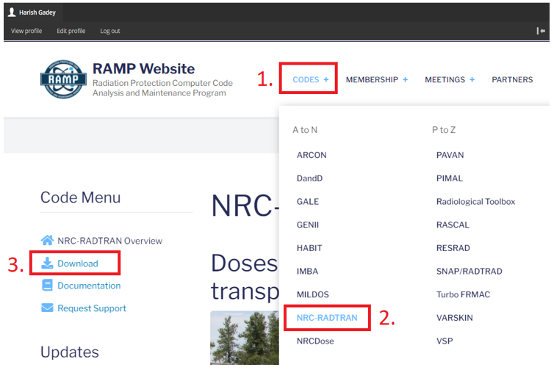
NRC-RADTRAN Installation
Login to NRC-RAMP
Codes
NRC-RADTRAN
Download

Slide 10
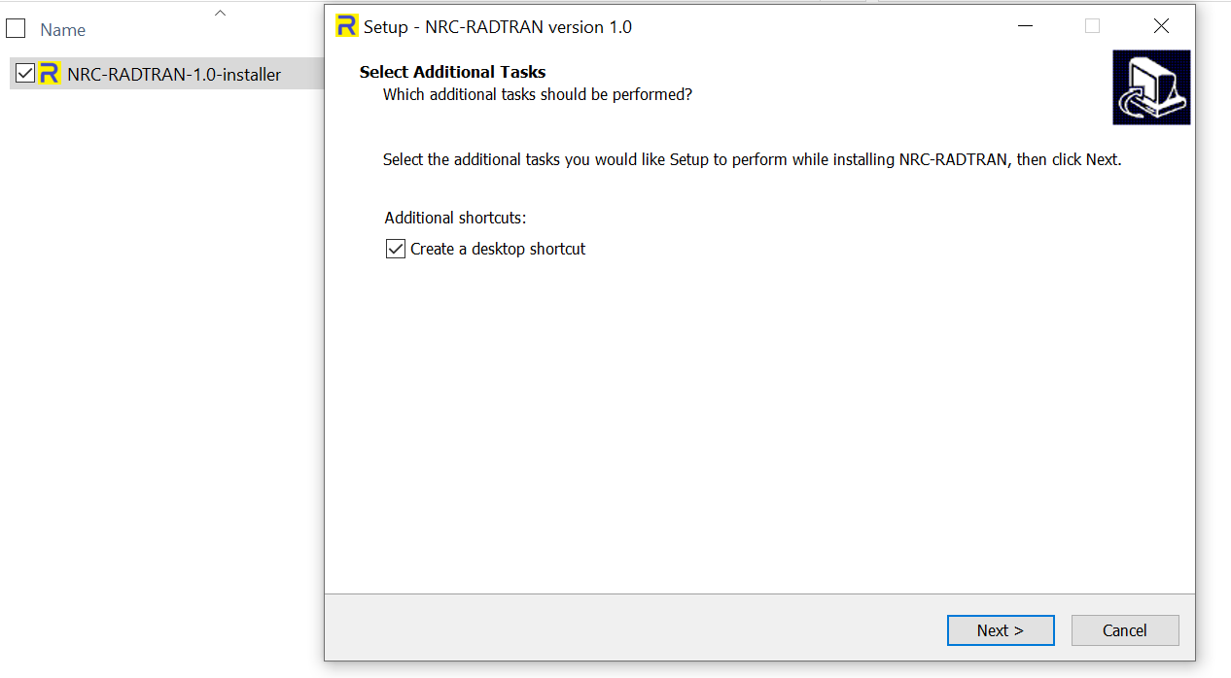
NRC-RADTRAN Installation (cont.)
Double click on the downloaded file to install

Slide 11
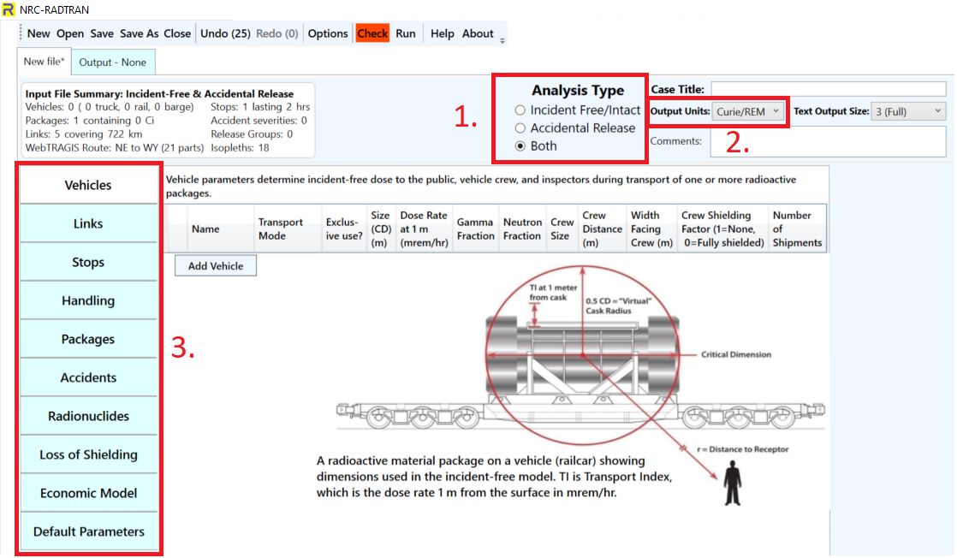
NRC-RADTRAN Use
Defining the problem:
Type of Analysis
Units
Curies/ Rem
Bq/Sv
Item 1 selection dictates available input panels
Notes:
-explain each button on the file menu

Slide 12
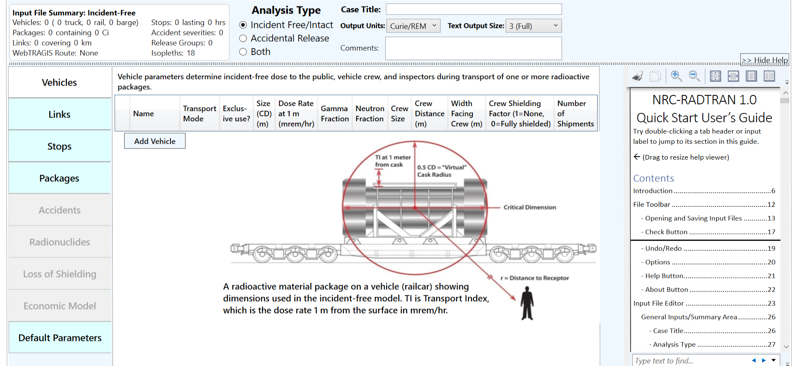
NRC-RADTRAN Use (cont.)
Basic functions: opening, closing, and saving files
Undo/ Redo: maintains list of prior 99 actions
Options: display, file, open/save, and other legacy options
Check: Indicates any file errors (errors, warnings)
Help/ About: opens the viewer and provides basic information about NRC-RADTRAN
Help Viewer

Slide 13
NRC-RADTRAN Use (cont.)
Transport Mode: highway, rail, waterway
Size (CD): Largest dimension of package (max. 9 m)
Gamma/ Neutron Fraction: split between gamma and neutron external package dose (must add to unity)
Crew Distance: Average distance of crew to nearest radioactive package
Width Facing Crew: largest dimension of the cargo facing crew
Crew Shielding Factor: fraction of radiation exposed to the crew
Number of Shipments: values calculated for single shipment and multiplied
Notes:
Vehicle
Dose rate -> transportation index. Dose at 1m in mSv/hr * 100 or X mrem/hr.
Crew distance -> need to consider escort vehicle as well.
Crew shielding -> regulator check enabled then crew dose will be < 2mrem/hr

Slide 14
NRC-RADTRAN Use (cont.)
Mode: highway, secondary road/ non road. Do not select unknown
Adjacent Vehicle Occupants: average number in vehicles
Traffic: number of vehicles travelling per hour on the link
Traffic, Accidents per km, and Deaths per accident are user defined
Population Type: Either rural, suburban or urban. Affects shielding factors and dose to pedestrians
Farm fraction if rural: fraction of surrounding area used for agriculture (only for rural)
Notes:
Links
Population type -> shielding factors. Dose for peds (only to urban population).

Slide 15
NRC-RADTRAN Use (cont.)
Creation of Links using WebTRAGIS
Limited to contiguous 48 states
Requires US Government Sponsorship
Populations are not currently being updated
Creation of Links in Google Earth
Requires population density files
Manual Entry

Slide 16
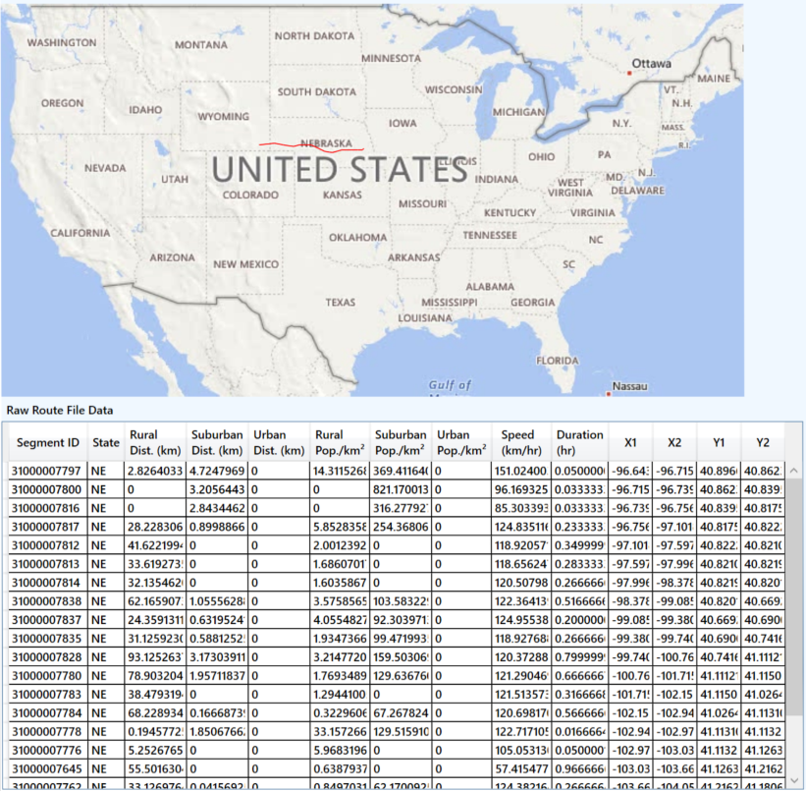
NRC-RADTRAN Use (cont.)
WebTRAGIS information is intersection based
Each link is the distance between two intersections
Uses known
Population density
Distance
Speed
Time of transit

Slide 17
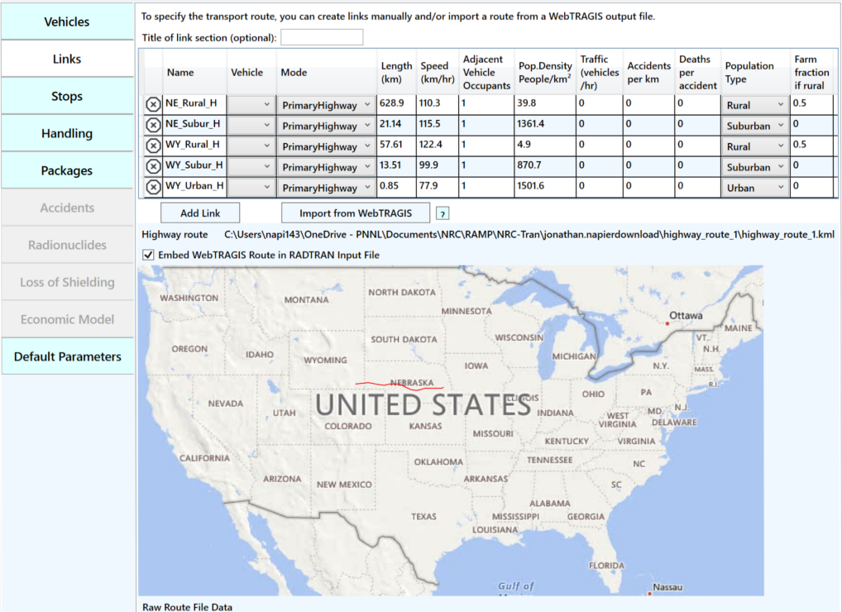
NRC-RADTRAN Use (cont.)
Summarized into three links per state
Rural
Urban
Suburban

Slide 18
NRC-RADTRAN Use (cont.)
Vehicle: select any vehicle defined in the vehicles tab
Population Density: the population density in # per km²
Inner Radius: minimum distance from where dose to public is calculated
Outer Radius: maximum distance till where dose to public is calculated
Shielding Factor: used for dose calculations during a stop
Duration: time period for a given stop in hours
Notes:
Stops
Inner and outer same -> population at the exact distance.

Slide 19
NRC-RADTRAN Use (cont.)
Optional for incident free analysis
Required for accident analysis
Enter the critical dimension in meters
Package Dimensions greater than 9 m should not be used
Enter dose at 1 m from surface and gamma/ neutron fraction
Enter number of packages of given type in each vehicle
Notes:
Handling is deprecated.
Package

Slide 20
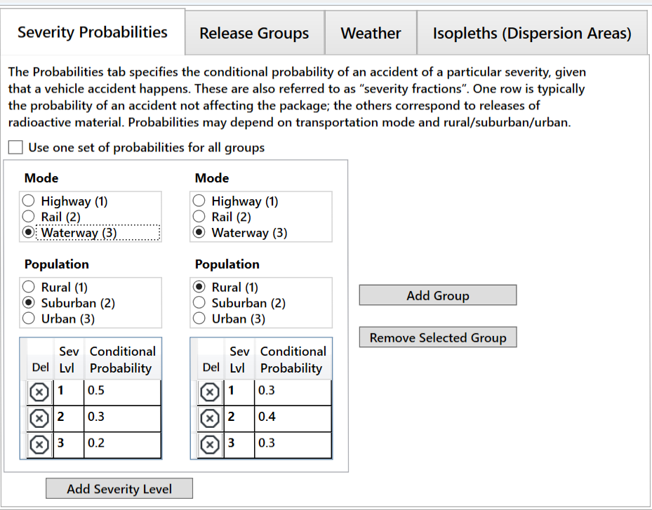
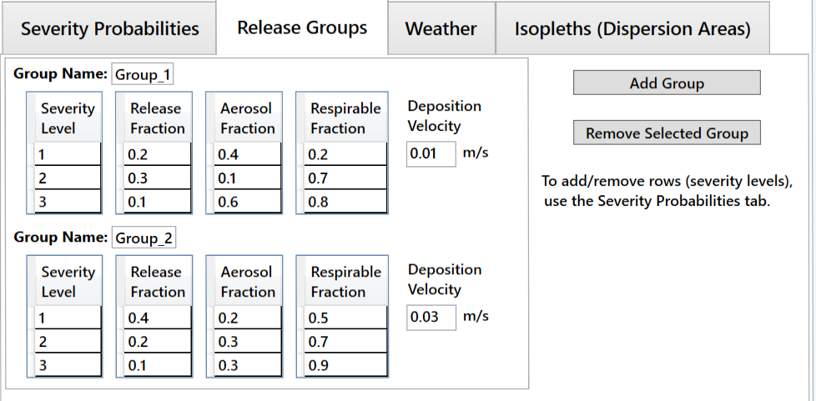
NRC-RADTRAN Use (cont.)
Select the mode of transportation and population type
Add probability of each severity level (must sum to unity)
Define Release Fractions → Aerosol Fractions → Respirable Fraction
Enter Deposition Velocity:
Above 0.384 m/s (error)
Above 0.1 m/s (warning)
Notes:
Accident

Slide 21
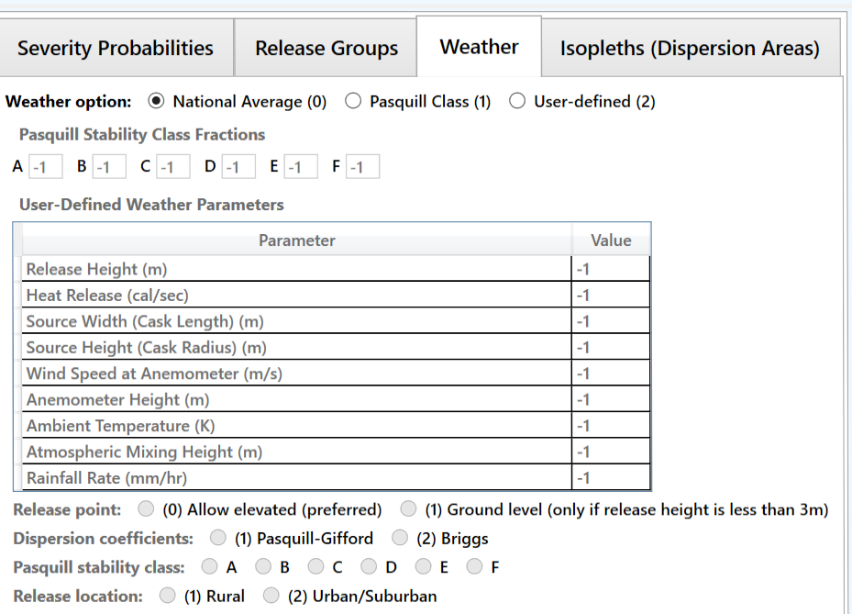
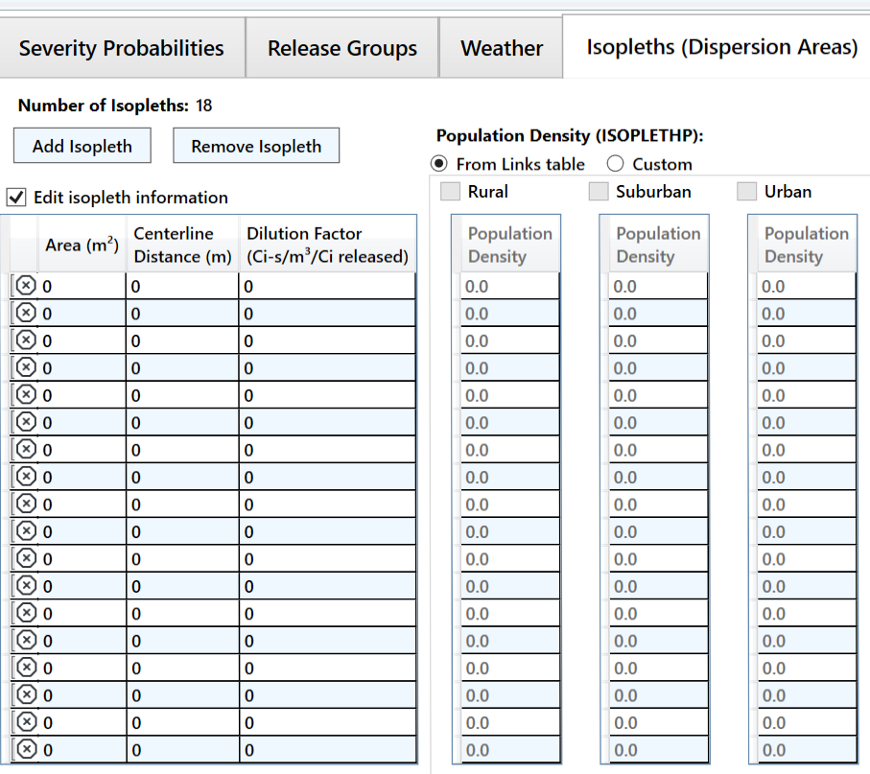
NRC-RADTRAN Use (cont.)
National Average (0): simplest and requires no inputs
Pasquill Class (1): requires values for each Pasquill stability class
User-Defined (2): allows more detailed analysis
Define area, centerline distance, and dilution factor of each isopleth (max. number of isopleths: 18)
NOTE: if population density is being used, first two isopleths shall have same population density
Notes:
Accident

Slide 22
NRC-RADTRAN Use (cont.)
Radionuclide inventory can be defined for package
Isotope inventory assigned according to release group
Each package has independent isotope inventory
User-defined radionuclides can also be defined
Half-lives, energies, and Dose Conversion Factors (DCFs) are required to be specified
Notes:
Radionuclide

Slide 23
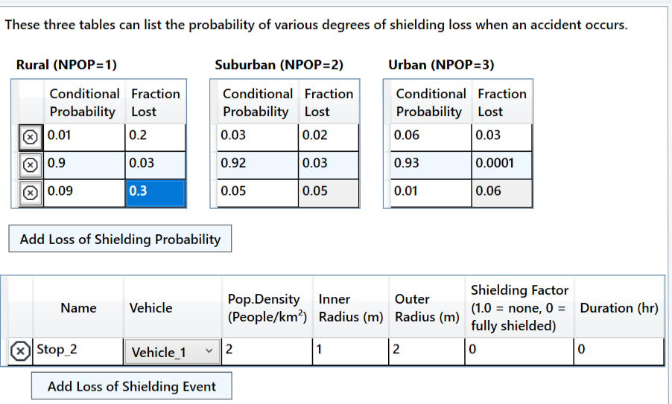
NRC-RADTRAN Use (cont.)
Conditional Probability and Fractional Loss are defined
Probability for all scenarios shall sum to unity
Parameters for stop are defined
Notes:
Loss of Shielding

Slide 24
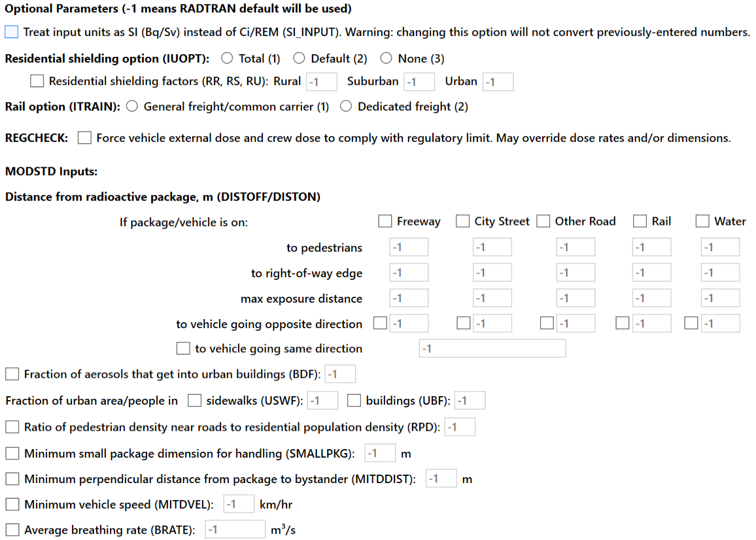
NRC-RADTRAN Use (cont.)
Values of “-1” mean NRC-RADTRAN defaults shall be used
Potential user defined options include:
Residential shielding factors
Distance from radioactive packages
Dispersion options
Transfer coefficients
REGCHECK: used to force regulatory limits for external dose and crew dose
Notes:
Economic Model not shown -> data entered specifically according to sev. level
Default Parameters

Slide 25
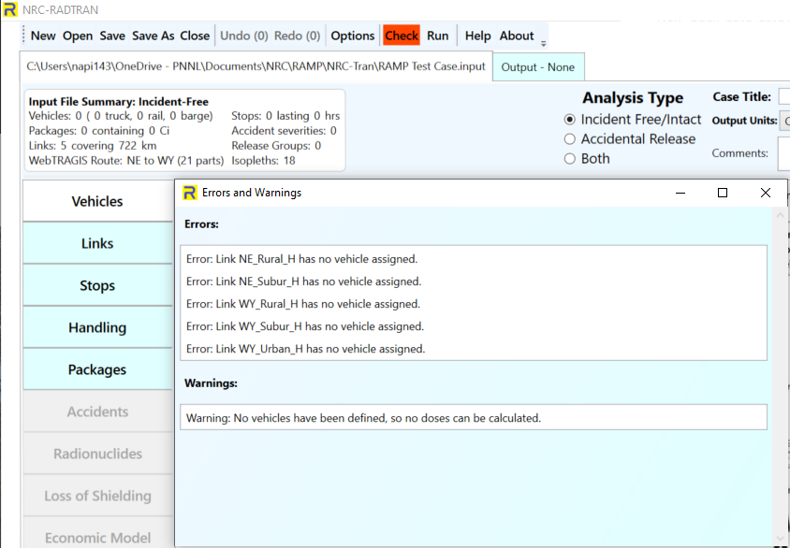
NRC-RADTRAN Use (cont.)
Check button changes color based on potential Errors and Warnings
Be certain to resolve errors/ warnings before running or saving
Some saved files may not be recoverable without editing the saved text files
Default save location is not OneDrive

Slide 26
NRC-RADTRAN Use (cont.)
Click the Run button
Output window will populate
Input Echo – text version of all inputs into the GUI
NRC-RADTRAN Output – standard text output also viewable in spreadsheet form
Non-rad incident summary
Exposure Summary for links and Rural, Suburban, Urban transit zones
Input sensitivity analysis (effect of 1% change of input value)
Automatically saves each run in a new output file

Slide 27
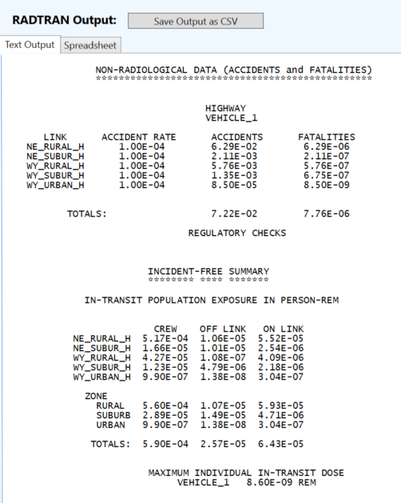
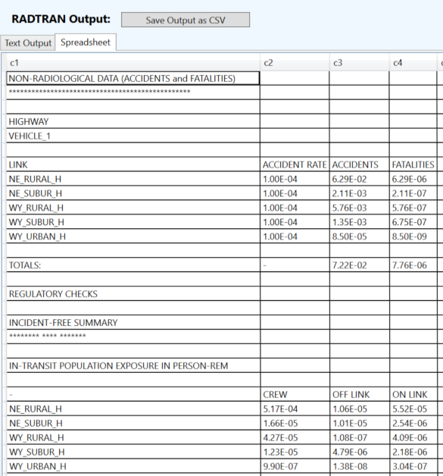
NRC-RADTRAN Use (cont.)

Slide 28
NRC-RADTRAN Use (cont.)
Shielding Factors: two runs should be completed using 100% neutron or 100% gamma emissions and the results ratioed externally
Incident-Free Off-Link Neutron Doses: hand-calculated MEI results do not match NRC-RADTRAN results. Until this issue is investigated and resolved, it is recommended that NRC-RADTRAN should be used to estimate incident-free off-link doses through gamma radiation only
Rail Crew Doses: for the rail crew gamma and neutron doses calculating a stop with duration of transit will provide a more representative crew dose estimate
MEI In-Transit Doses: the MEI in-transit doses estimated by NRC-RADTRAN cannot be duplicated using spreadsheet calculations. In addition, gamma and neutron MEI in-transit doses are estimated using the same equations. For this reason, it is recommended that the MEI in-transit doses not be used currently

Slide 29
NRC-RADTRAN Use (cont.)
The LOS model was developed for gamma radiation exposures and does not consider neutron radiation exposures
The LOS model was based on modeling simulations performed for a generic 5.21-meter-long steel-lead-steel spent nuclear fuel truck transportation cask, and Dennis et al. (2009) states that the model should only be applied to truck transportation casks
For the inhalation, resuspension, and immersion pathways, NRC-RADTRAN calculates doses using the geometric mean of the depleted atmospheric dilution factors (χ/Qs). For the groundshine pathway, NRC-RADTRAN calculates doses using the depleted χ/Qs, not the geometric mean of the depleted χ/Qs
For accident risks, NRC-RADTRAN output does not provide totals for the expected values of population risks across all links, and users must sum these quantities externally

Slide 30
Updates and New Features
WebTRAGIS alternatives and integration → DOE Stakeholder Tool For Assessing Radioactive Transportation
User Interface Changes:
Default Values Display
Air option
Code Maintenance and Quality Assurance Activities
Notes:
- Investigate KML pop den errors.
WebTRAGIS alternatives.
Sum population risks along all links
Default value coding changes
GUI changes to include air travel
Coding errors while using greater than 9 links
Internal code maintenance (hard coded values, QAQC and SQAP development)
Incident free neutron dose
Investigate shielding factors
General code maintenance and updates

Slide 31
Conclusion
History of RADTRAN was explored
High-level understanding of RADTRAN concepts were gained
RADTRAN download and installation procedures covered
Options and RADTRAN screens explored
Covered future activities and development efforts

