Slide 1
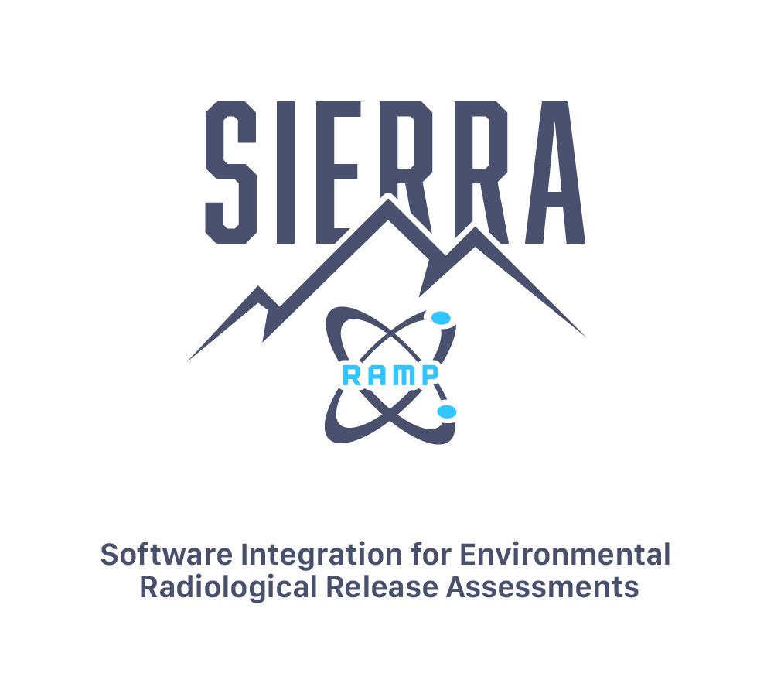
Update on SIERRA Code Consolidation
C. Condon, J. Flaherty, H. Gadey
Pacific Northwest National Laboratory
2023 Fall RAMP Users’ Group Meeting
October 23–27, 2023
Rockville, MD

Slide 2
Outline
Motivation for Code Consolidation Efforts
Status of SIERRA ATD (Atmospheric Transport and Diffusion) Module
  Example Case
  Software Quality Assurance Testing
Sneak peek at SIERRA Source Term

Slide 3
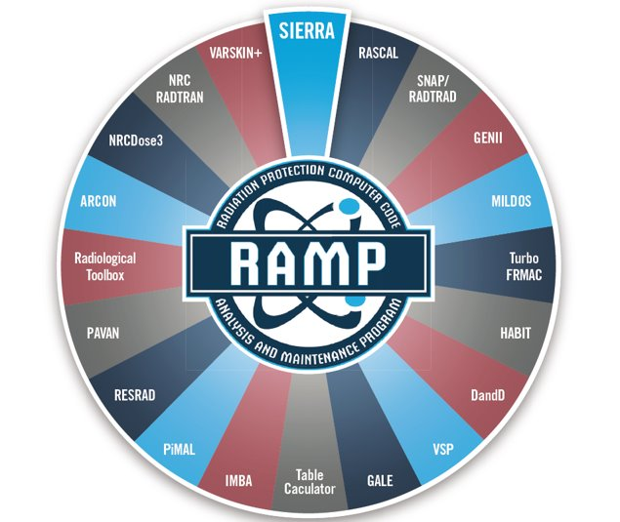
Software Integration for Environmental Radiological Release Assessments (SIERRA)

Slide 4
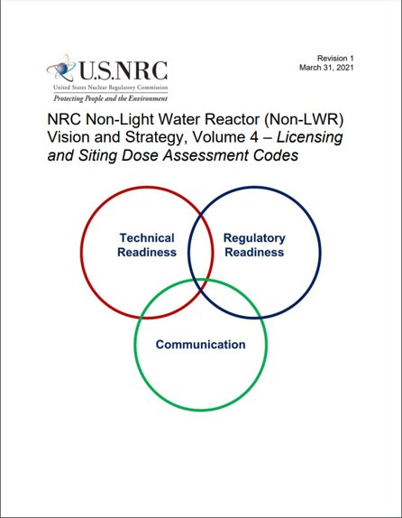
Motivation for Code Consolidation - LWRs
NRC Non-Light Water Reactor (Non-LWR) Vision and Strategy, Volume 4 –– Licensing and Siting Dose Assessment Codes (RAMP) ​
  describes the computer codes in RAMP and how they would be applied to each of the principal non-LWR design types, and summarizes the tasks necessary to resolve “gaps” in the capability to model and simulate those designs with the accuracy required by the regulator ​
Code consolidation can help resolve the identified gaps in the RAMP suite of codes

Slide 5

Motivation for Code Consolidation – Legacy Issues
Incompatible with non-LWRs​
Ownership issues​
Lack of standardized code development​
Lack of maintenance​
Dated science​
Lack of standardized quality assurances​
Functional redundancy/data transfer​
Inefficiency​

Slide 6
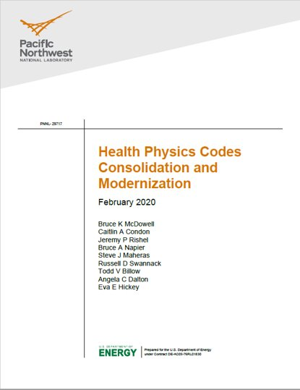
Thesis Statement for RAMP Code Modernization and Consolidation
The computer codes in the RAMP program have been developed since the 1970’s to address specific regulatory needs. ​
These codes today have numerous current and legacy issues that reduce the efficiency of operation and maintenance of the codes and increase cost. In their current state, these codes are also unable to fully assess radiological doses from advanced non-light water reactor designs. ​
These current and legacy issues could be addressed by transforming the current suite of single-purpose radiation protection and dose assessment computer codes to a consolidated functional and modern suite of codes that is modular, flexible, efficient and user-friendly.​

Slide 7

SIERRA
Atmospheric Transport and Dispersion (ATD) Engine

Slide 8
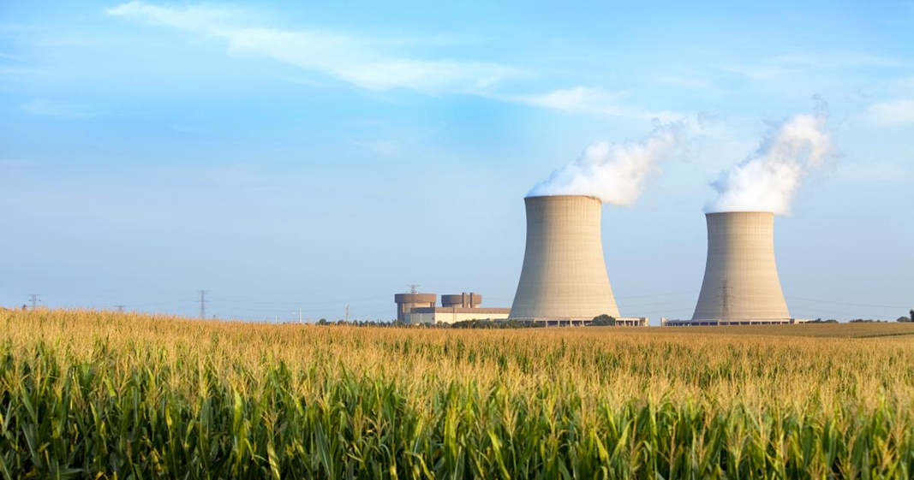
SIERRA Atmospheric Dispersion Software Development
A new atmospheric dispersion module was developed (rather than directly using the legacy codes) for SIERRA for the following reasons:
  To support a single user interface that allows users to access each of the codes (ARCON, PAVAN, XOQDOQ) in a relatively uniform manner
  To facilitate future development to share data with other health physics codes in SIERRA
  To allow users to estimate relative
  concentrations based on hourly
  meteorological data for all three codes,
  rather than use JFDs
  To employ a more modern FORTRAN
  code development practice, which makes
  the code easier to maintain in the future

Slide 9
Legacy ATD Codes
Code​ | Description​
ARCON​ | Used to calculate relative air concentrations (χ/Qs) in support of control room habitability assessments required by general design criteria (GDC) 19 of 10 CFR Part 50 Appendix A and RG 1.194. ​
PAVAN​ | Used to estimate relative ground-level air concentrations (χ/Qs) resulting from radioactive material releases from design-basis accidents at NPPs following the methodology in RG 1.145. ​
NRCDose​ | Software suite that integrates the functionality of three individual Fortran codes: LADTAP II, GASPAR II, and XOQDOQ, which were developed by the NRC and have been in use by NPP licensees and the NRC staff for assessments of liquid radioactive releases and offsite doses, gaseous radioactive effluents and offsite doses, and meteorological transport and dispersion, respectively. XOQDOQ implements the atmospheric dispersion modeling described in RG 1.111. ​

Slide 10
SIERRA ATD Assessment Types / Applicability
SIERRA Assessment Type | Legacy Model | NRC Guidance Document | Applicability
Control room habitability assessment | ARCON | RG 1.194 SRP 2.3.4 | Evaluate personnel exposures inside the control room during accidents
 |  | SRP 15.0.3 | Protection against radiation inside the onsite technical support center
Design basis accident analyses | PAVAN | RG 1.145 SRP2.3.4 | Offsite consequence at EAB and LPZ for plant design
 |  |  | Offsite consequence at EAB and LPZ for safety assessment
 |  |  | Determine acceptable EAB and LPZ for siting
 |  |  | Offsite consequence at EAB and LPZ for postulated accidents
Routine release analysis | NRCDose / XOQDOQ | RG 1.111 SRP 2.3.5 | Annual dose assessment to ensure below threshold limit during operations
 |  |  | Annual dose assessment to meet as low as is reasonably achievable (ALARA) criterion during preliminary plant design
Notes:
This is a bit repetitive from the previous slide. But we are mapping the legacy code to the SIERRA assessment type, and splitting out the Guidance docs and the applicable analysis.

Slide 11
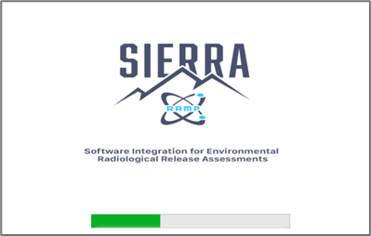
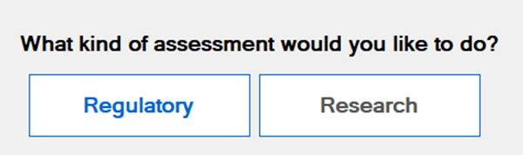
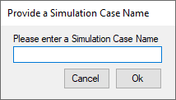
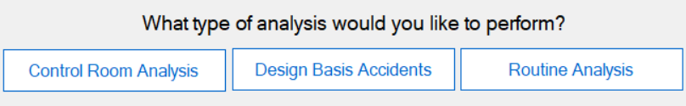

SIERRA ATD UI Overview
Regulatory vs Research​
Analysis Types:​
  Control Room Analysis​
  Design Basis Accidents​
  Routine Analysis​
Module Selection:​
  Atmospheric Dispersion​
Notes:
Speaker Notes: This slide provides an overview of how to navigate to the atmospheric dispersion analysis of interest. Start the software (Splash Screen), accept the disclaimer text (not shown), and select “Regulatory” assessment (Research is not currently available). A window requesting the Simulation Case Name appears, and the user should define a case name that will serve as the name of the folder where the simulation input/output files will be stored. Select one of the three available analysis types (control room, design basis, and routine), and then select Atmospheric Dispersion (other module, to be developed, are grey and not available for selection).

Slide 12
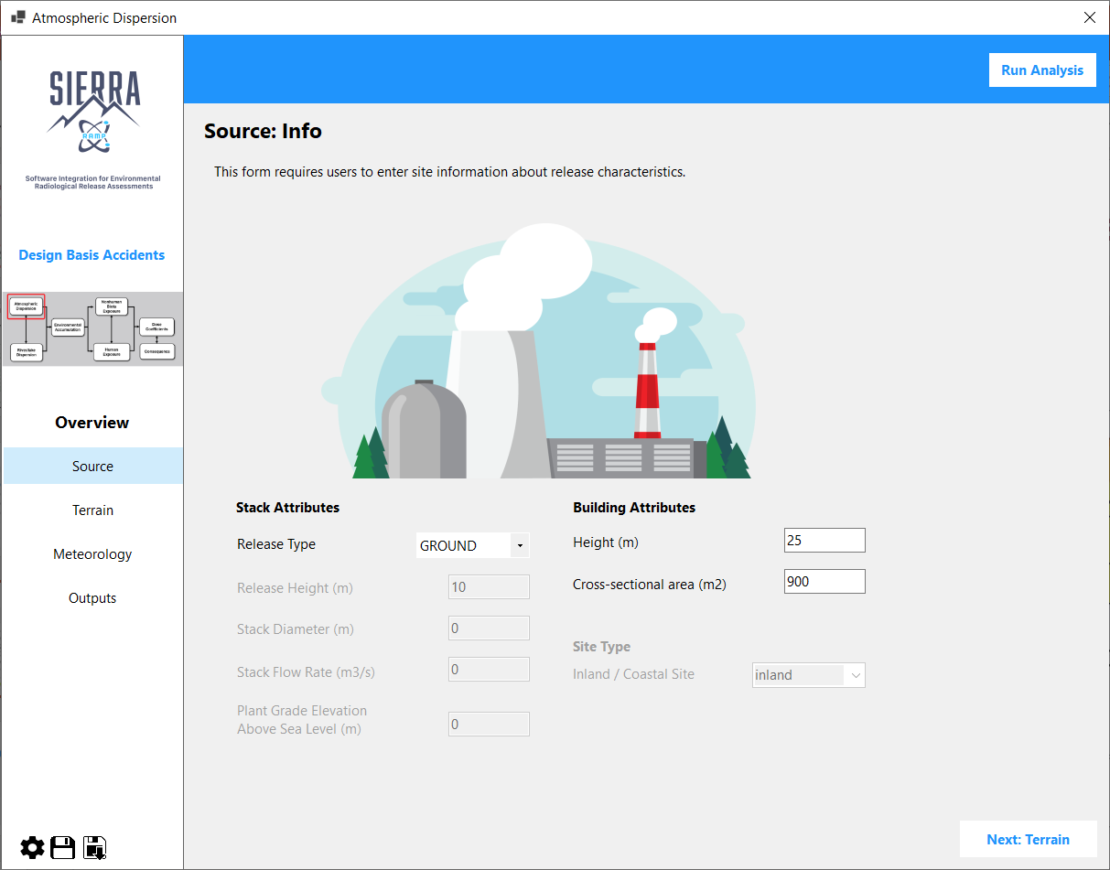
Design Basis Accidents / Ground Case Example – Source Panel
Design Basis Accidents Case set-up
Ground Release (stack attributes, site type are grey, as they don’t apply for ground cases)
Users can navigate via the sidebar (Source / Terrain / Meteorology / Outputs) or the Next/Back button at the bottom of the panel
Save/Load JSON files, or set up simulation defaults
Notes:
Speaker Notes: Next, we’ll step through an example Design Basis Accidents case, which is the ground case available from the set of Test Cases that are delivered with the software installation. This design basis accidents analysis is interested in the normalized concentration at the Exclusion Area Boundary and Limited Population Zone from a ground level release. This means the release height is 10m, and there is no stack, so stack variables are grey in the UI. The Building Attributes of height and cross-sectional area are available for entries. In this case, we’ve selected a 25m building with a cross-sectional area of 900 m2.
Purple outlines highlight some of the important areas in the panel. In the lower left, the gear symbol, if selected, allows users to set module defaults, such as diffusion coefficients (NRC, ISC, Briggs) and the criteria for missing data for averaging periods (set to 10% by default). The dark/light floppy disc icons allow users to save/load input files.
The left bar contains the overview of the panels, and users can navigate among them by selecting the text in the side bar. Alternatively, user’s can select the Next/Back button in the lower right. The Outputs panel is visible in the overview, but the output panel is not available for viewing until the Run Analysis button in the upper right is selected. And the Run Analysis button will not run the analysis unless all of the necessary inputs are provided in the various input panels.

Slide 13
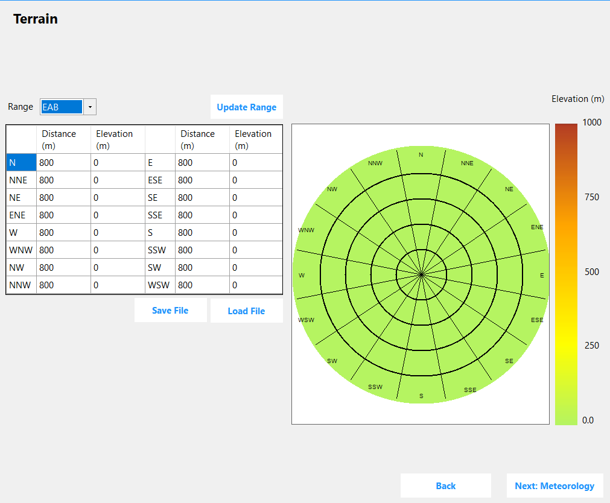
Design Basis Accidents / Ground Case Example – Terrain Panel
EAB and LPZ distance and elevation entries
Users can save the terrain entries for use (by using the "Save File" button) in another simulation (by using the "Load File" button)
Notes:
Trimmed to just show the Terrain content from the overall panel.

Slide 14
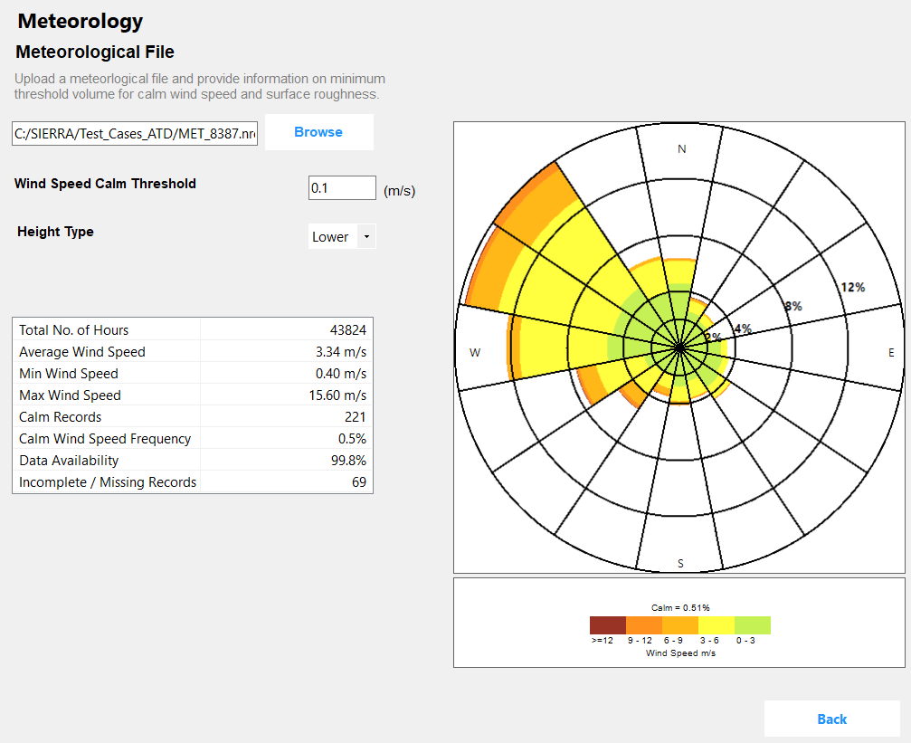
Design Basis Accidents / Ground Case Example – Meteorology Panel
Users select an existing meteorological data file that is in RG 1.23 format (hourly data)
Users define the wind speed calm threshold (0-1 m/s) to be used within the simulation
Users select Height Type (lower or upper) to change polar plot display
Statistical summary of the meteorological data also changes with Height Type and wind speed calm threshold
Notes:
Speaker notes: The meteorological input for each of the three assessment types is an hourly file formatted according to RG 1.23. When the file is loaded, basic statistics from the file, along with the wind rose from the data, are presented on the screen. This allows users to view the summary of the meteorology at the site to inform the outputs.

Slide 15
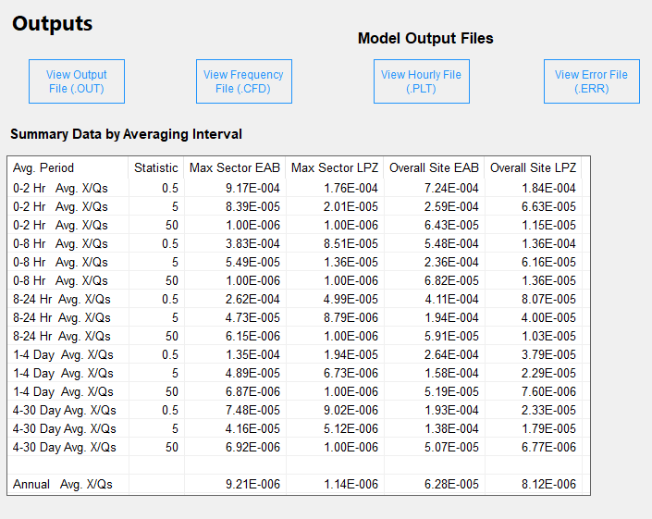
Design Basis Accidents / Ground Case Example – Outputs Panel
When the “Run Analysis” button is selected, a command line window is briefly displayed, and then the UI automatically displays the Outputs Panel
A summary of the output is presented in tabular form
The model output files (in text format) can also be viewed from the interface
Output files are also available from C:\SIERRA\Users\Username\SimulationCaseName\DateTime\outputs

Slide 16
PNNL Software Testing – QA, Success Criteria
Software QA Plan defines QA approach to provide adequate confidence that
  Software development process is controlled
  Software products meet established requirements
User Interface Success Criteria
  Invalid entries result in an error message or prevents simulations from running
  Information displayed within each panel (e.g., meteorology, terrain) are correct
  Saving / loading files functions correctly
  When simulations are run, the appropriate output are saved to the appropriate locations
Atmospheric Modules Success Criteria
  Meteorology panel summary table in the UI aligns with atmospheric module output
  The intended analysis is implemented by the code
  Comparisons with the legacy code primarily fall within a factor of 2, with few cases up to and beyond a factor of 10.

Slide 17
PNNL Software Testing – Testing Approach, Outcomes
Independent reviewers test the UI or atmospheric modules by following test cases identified in a Test Plan
Any issues that were identified was reviewed / corrected by developers
  New version(s) were tested by independent reviewers to check that the new functionality is appropriate
User Interface
  Testing involved setting up cases exclusively through the UI and by loading a JSON file and modifying variables; all cases were run until the outcomes were successful
Atmospheric Modules
  Testing involved both input through the UI and direct input to the ATD.exe software
  Test cases were performed with 22 meteorological files from locations across the US
  Modifications were made to ensure consistency with the legacy codes

Slide 18
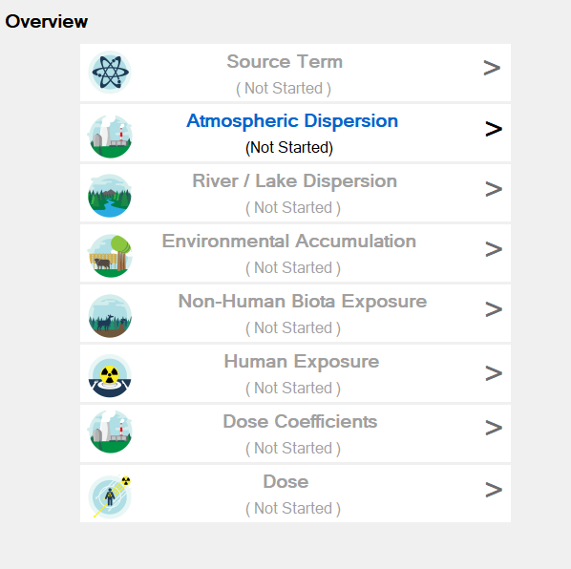
Next Steps
PNNL is working on the beta version of the SIERRA ATD software to the NRC
Beta testing will be performed in the coming months
Software improvements as an outcome of beta testing will be implemented in CY24
SIERRA ATD projected to be available from RAMP in winter 2024
The Source Term module is also under current development

Slide 19
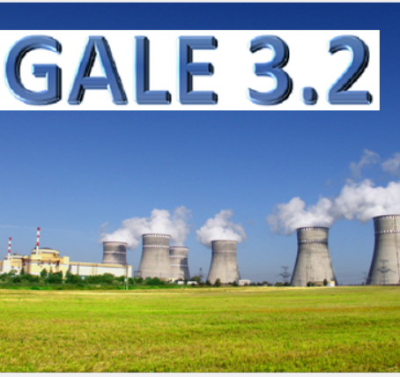
GALE
Gaseous and Liquid Effluents (GALE) → calculate radioactive gaseous and liquid effluents from LWRs.
Calculations based on:
  Operating Reactors,
  Field and Lab Tests, and
  Plant specific design considerations.
Latest version 3.2 released 2020.

Slide 20
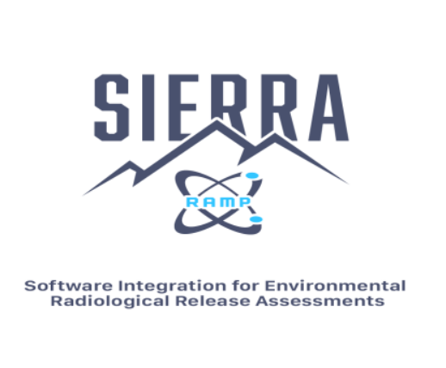
SIERRA
HP code consolidation effort → Software Integration for Environmental Radiological Release Assessments (SIERRA).
Consolidate and modernize existing codes within the NRC’s RAMP program.
Developed based upon existing RAMP codes and incorporate scientific methods for environmental transport, diffusion, and dose assessment of radionuclides in various modules.

Slide 21
Source Term Module
Provides Source Term data from Light Water Reactors (LWRs).
From reactor inputs pertaining to normal operational fluxes and processing values, two outputs files are created outlining the gaseous and liquid effluents for any given scenario.
Based intrinsically on the prior functionality of GALE 3.2.

Slide 22
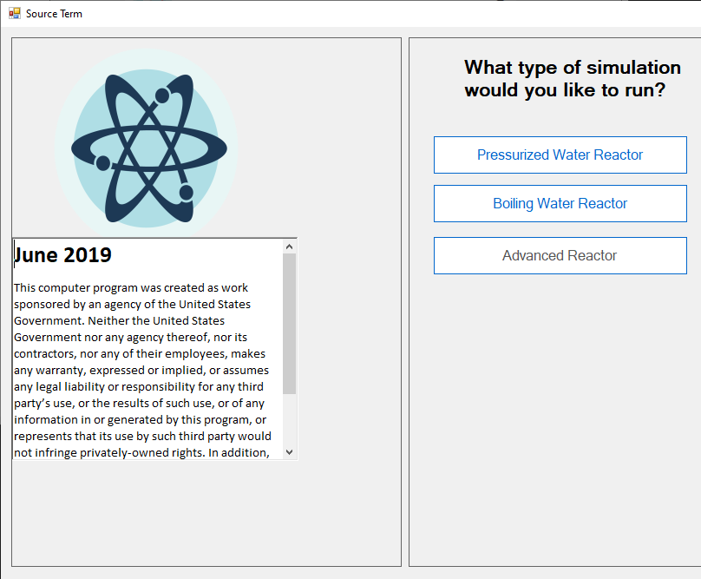
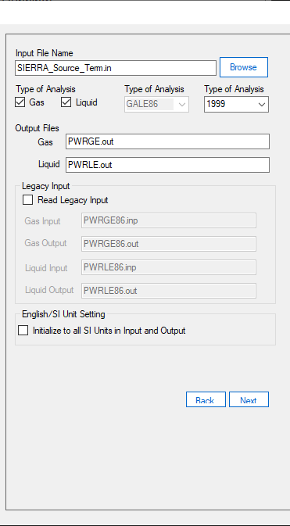
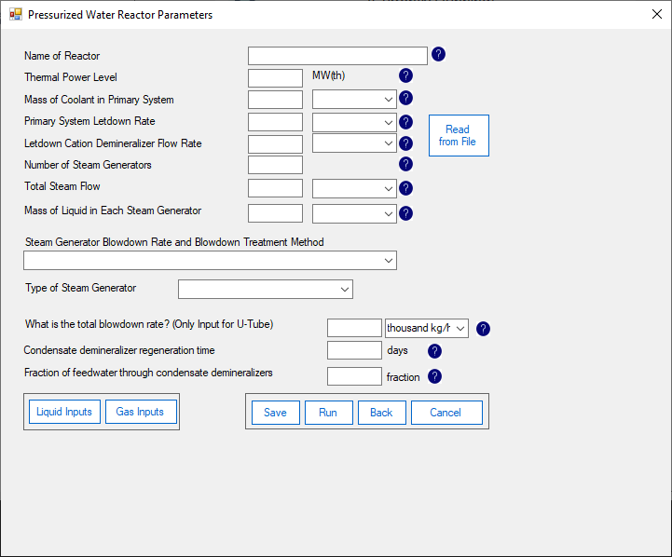
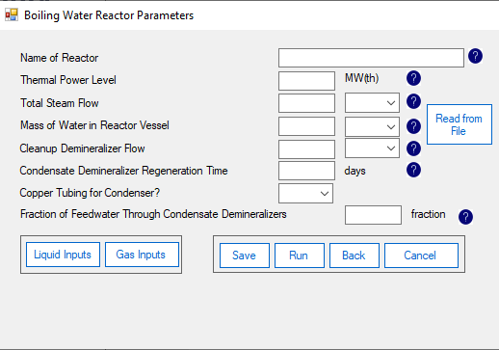
Source Term Input
UI designed to match SIERRA-ATD module.
Real-time checks of input values.
Single executable file as opposed to GALE.
Enhanced range buttons on the UI.

Slide 23
Source Term Module Additional Changes and Fixes
Coding changes implemented for compatibility in C# language.
File structure changed on back-end to match SIERRA format.
The GUI and the FORTRAN based back-end decouple for ease of future development activities.
Input files can be present outside SIERRA executable directory as opposed to the existing GALE format.

