Slide 1
Development of Dose Coefficients for Discrete Radioactive Particles using VARSKIN+, IMBA, and PiMAL
Charlotte Rose MS (RHP)
Colby Mangini, PhD, CHP

Slide 2
Scope of Project
Stationary DRP EDE calculations using PIMAL
Stationary DRP DE calculations with VARSKIN+
Mobile DRP Dose Coefficients with IMBA

Slide 3
DRP: Discrete Radioactive Particle
“hot particle”
fragments less than 1 mm in any dimension
containing radioactive material
insoluble in water
High specific activity
Created during normal operations and decommissioning

Slide 4
5 DRP Materials
Stellite 6
Inconel 718
Concrete
Fuel Fragment
Thoriated welding rods
23 activated radionuclides amongst the materials; alpha, electron or photon emitters

Slide 5
Dose Coefficients
Dose conversion factors
Support USNRC staff’s evaluation of the regulatory framework for discrete radioactive particles in the environment at decommissioning nuclear power plants.
Can be used to estimate dose given activity of specific nuclides in various exposure scenarios.

Slide 6
Exposure Scenarios
Stationary particle in upper respiratory tract (inhaled particle)
  DRPs are single particles and are assumed to be too large to get past the nasal vestibule and nasopharynx of the upper respiratory tract
Stationary particle on trunk skin surface (particle on skin)
Stationary particle in gastrointestinal tract (stuck ingested particle)
Mobile particle in GI tract (ingested particle traveling with intestinal contents)

Slide 7
PiMAL for EDE
Charlotte Rose MS (RHP)

Slide 8
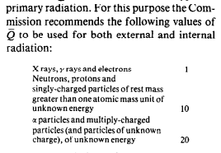
Method
PIMAL phantom was used to calculate EDE from nuclides by simulating the dose to organs
ICRP26 tissue weighting factors, radiation weighing factors, and methods were applied
Organ | W_{T}
Gonads | 0.25
Bone Marrow | 0.12
Lungs | 0.12
Breast | 0.15
Thyroid | 0.03
Bone Surface | 0.03
5 maximally exposed organs (excluding skin) | 0.06 each

Slide 9
Determining Maximally Exposed Locations
Female phantom consistently had higher dose consequence
Multiple locations were evaluated for the nuclides of note to find the particle location that resulted in the maximum EDE
For inhaled particles, the lower larynx was the most maximally exposed location
  Inhaled particles were expected to not go past the larynx; locations modeled were the mouth, nasopharynx, and upper/lower larynx.

Slide 10
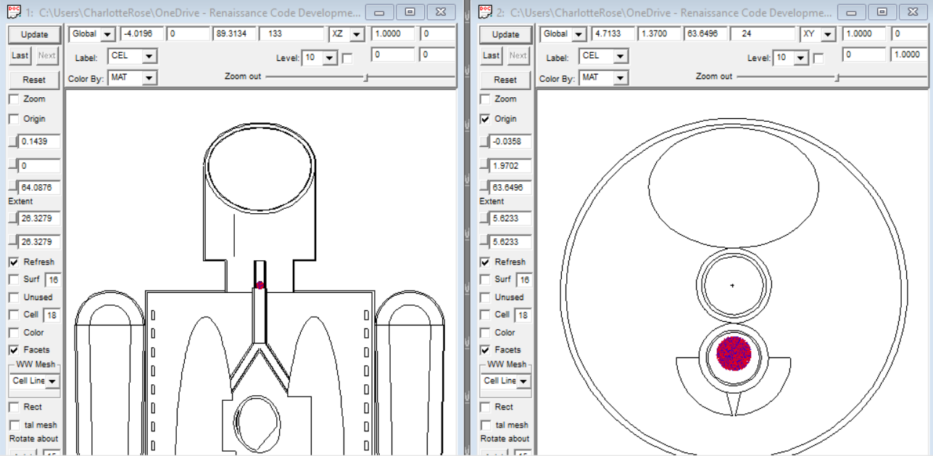
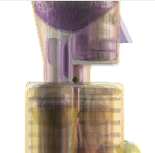
Inhaled/Upper Respiratory Tract
*sources enlarged for greater visibility

Slide 11
Surface of Chest
For chest skin particles, the central chest was the maximally exposed location
9 locations on the front chest; right/left, upper/middle/lower

Slide 12
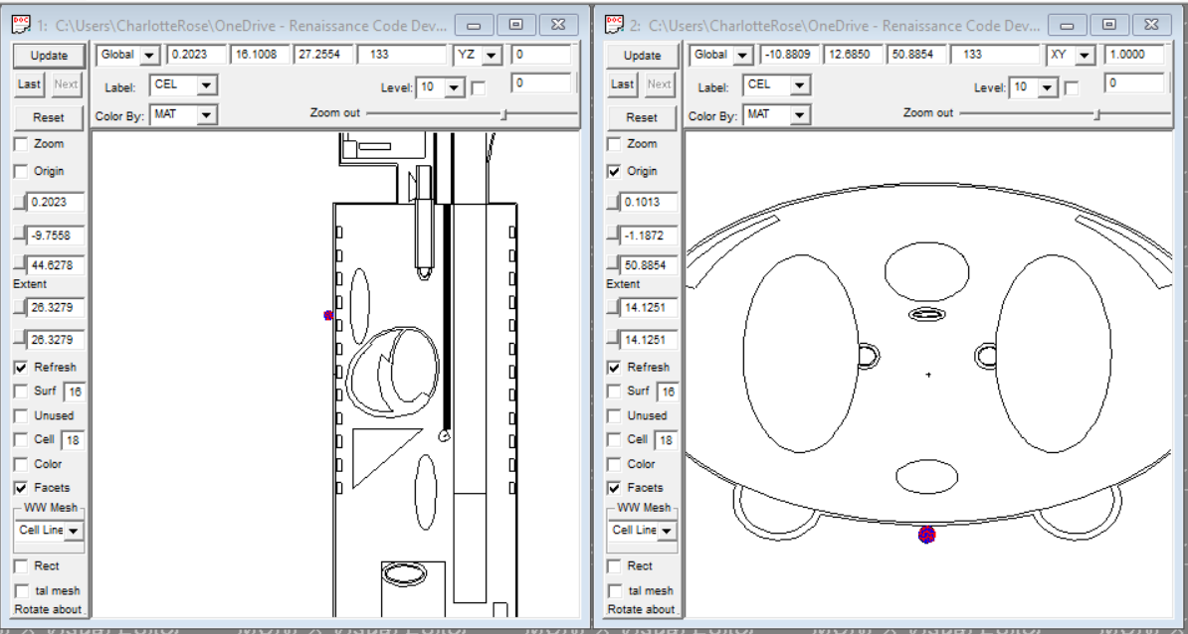
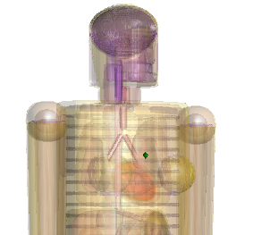
Surface of Chest

Slide 13
Ingested Particle
For ingested particles, the lower small intestine was the maximally exposed location for photons, which had the greatest EDE
Locations in the left, right, upper and lower locations of stomach, small intestine and colon were modeled

Slide 14
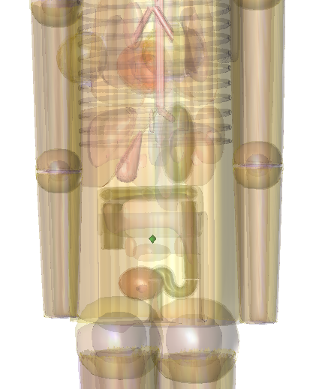
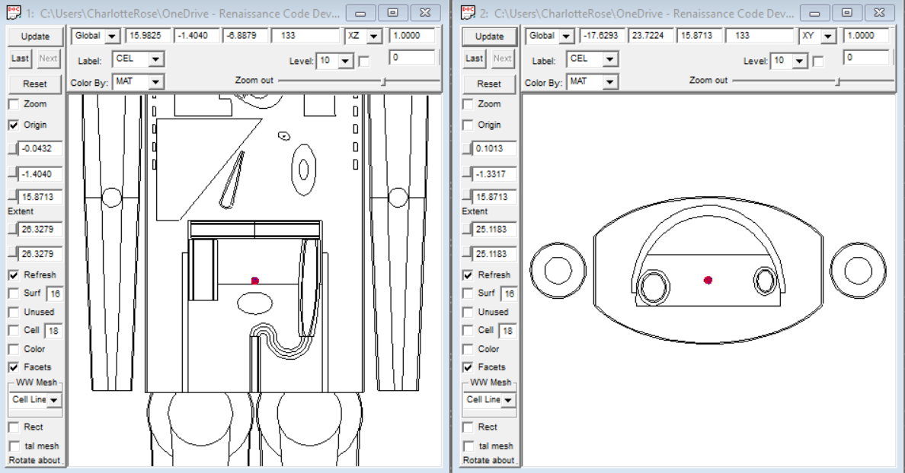
Ingested Particle

Slide 15
Source Definition and DCF Calculation
For each of the radionuclides examined, detailed energy source information was input in MCNP
Results are normalised and output on a per photon basis, so yield is multiplied in a post processing calculation.
  E.g. Co-60 has 2 photons per yield at 1.17MeV and 1.33MeV, while Eu-155 has 0.85 photons per yield, averaging 38keV with a low of 5keV (0.26%) and a high of 105kev (21%).

Slide 16
Energy Deposition
Energy deposition tallies were used in each volume (organ)
Results were then ranked for importance according to ICRP 26.
Results were converted from MeV/g s to Sv/Bq h

Slide 17
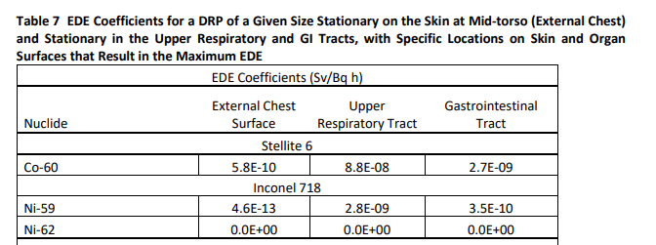
Results

Slide 18
Development of Dose Coefficients for Discrete Radioactive Particles using VARSKIN+ and IMBA
Colby Mangini, PhD, CHP

Slide 19
Stationary DRP DE calculations with VARSKIN+
SkinDose module of VARSKIN+ v1.1 was used to estimate DRP radiation doses:
  SDE from DRP resting on random skin surface location
  Local DE to URT from DRP resting on random URT location
  Local DE to SI/LI from DRP resting on random SI/LI location
SkinDose assumptions and inputs were unique for each case

Slide 20
SDE Coefficients
To be consistent with NRC regulations (10 CFR 20.1201)
  SDE was estimated to an infinitely thin 10 cm² disk at a depth of 7 mg/cm² (70 µm) in unit-density tissue
  Averaging to a smaller disk (e.g., 1 cm²), a modified dose coefficient could be roughly approximated by a factor equal to the ratio of averaging areas (e.g., 10 cm²/1 cm² = 10)
Spherical DRPs between 10 and 1,000 µm in diameter
Backscatter factors (BSCF) were implemented to account for air above a source directly on the skin.

Slide 21
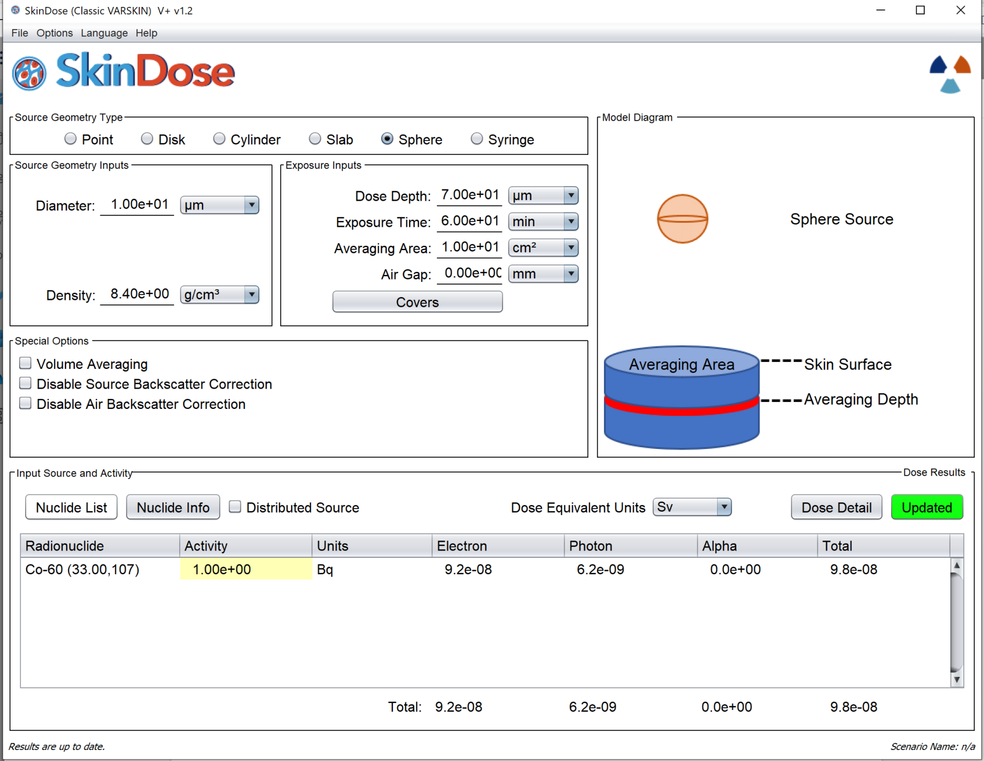
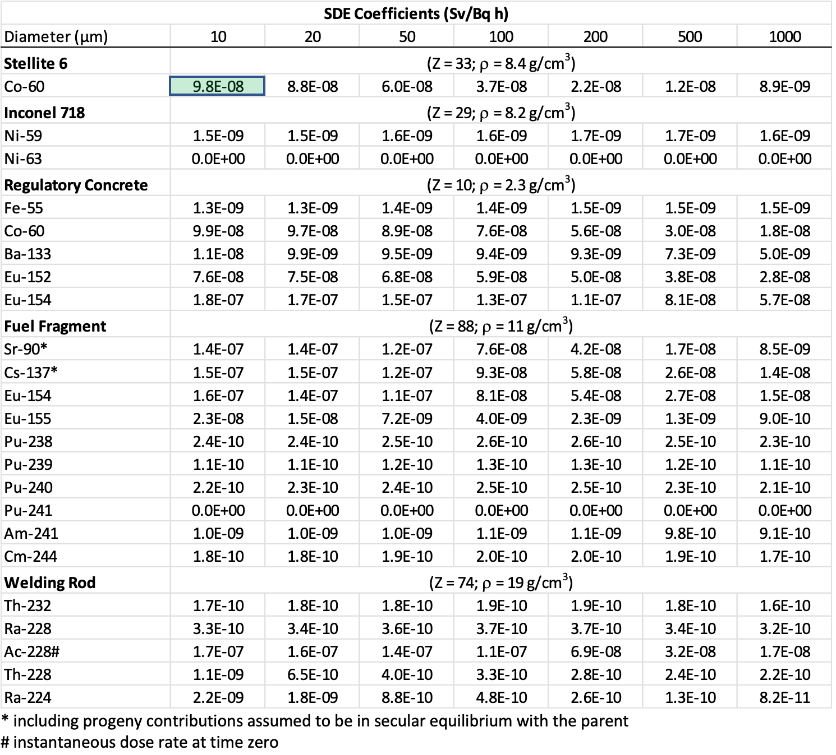

Slide 22
Local DE Coefficients to URT
DE was estimated to an infinitely thin 1 cm² disk at a depth of 4.5 mg/cm² (45 µm) in tissue
Spherical DRPs between 10 and 1,000 µm in diameter
  Particles less than 10 µm are “respirable,” meaning they can be breathed deep into the lung
  Particles less than 100 µm are “inhalable” and can be captured in the inhalation airstream and lodged in the nasal vestibule or nasopharynx
  Particles greater than about 100 µm are generally assumed to fall out of the air quickly and are too large to be inhaled (worksafe.qld.gov.au)
Particle assumed to be resting on a flat surface with air behind the source → BSCF turned ON

Slide 23
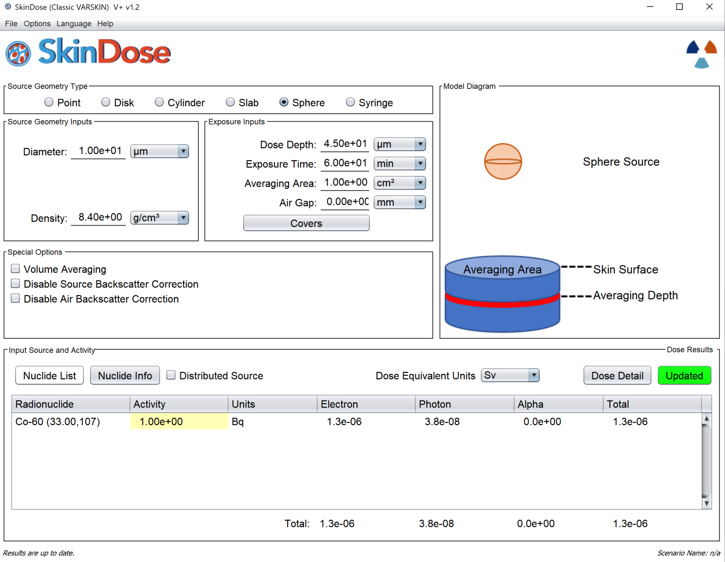
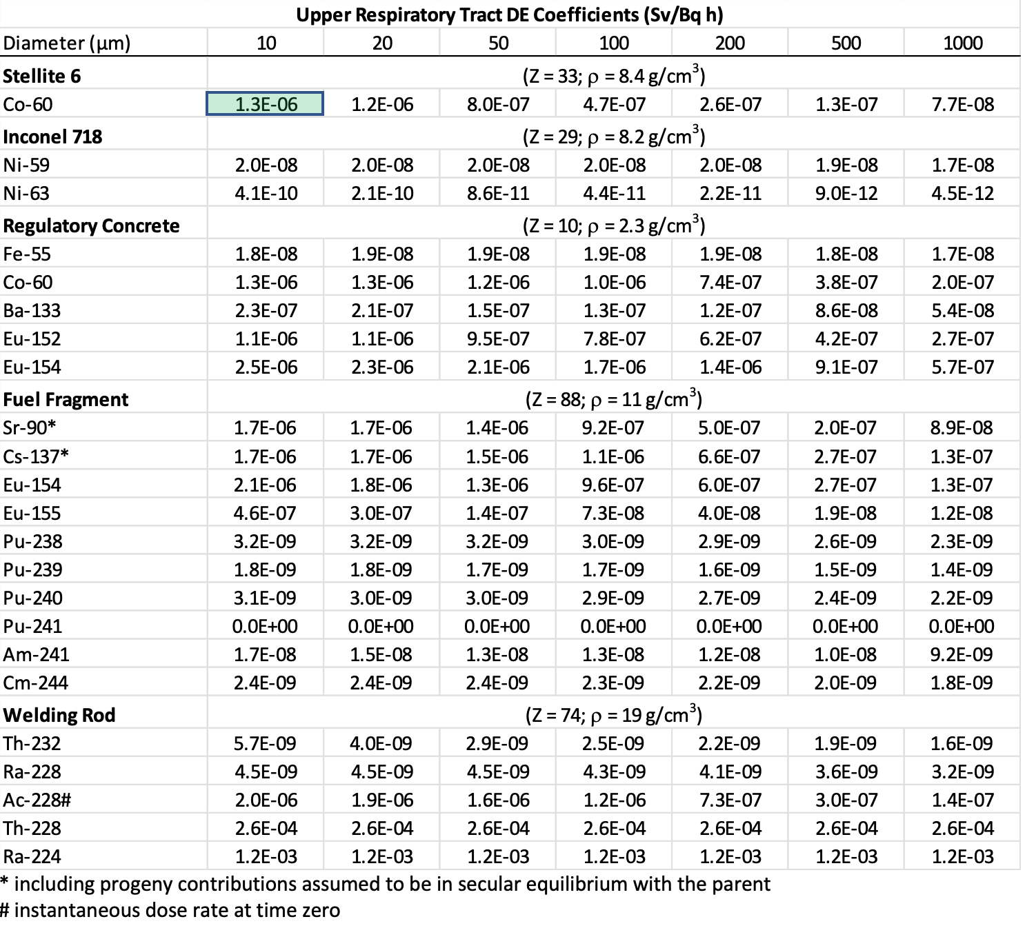

Slide 24
Local DE Coefficients to SI/LI
DE was estimated to an infinitely thin 1 cm² disk
Tissue depth of 14 mg/cm² (140 µm) in the small intestine (SI)
Tissue depth of 29 mg/cm² (290 µm) in the large intestine(LI)
Spherical DRPs between 10 and 1,000 µm in diameter
Particle resting on a flat surface with intestinal contents (density of 1 g/cm³) behind the source → BSCF turned OFF

Slide 25
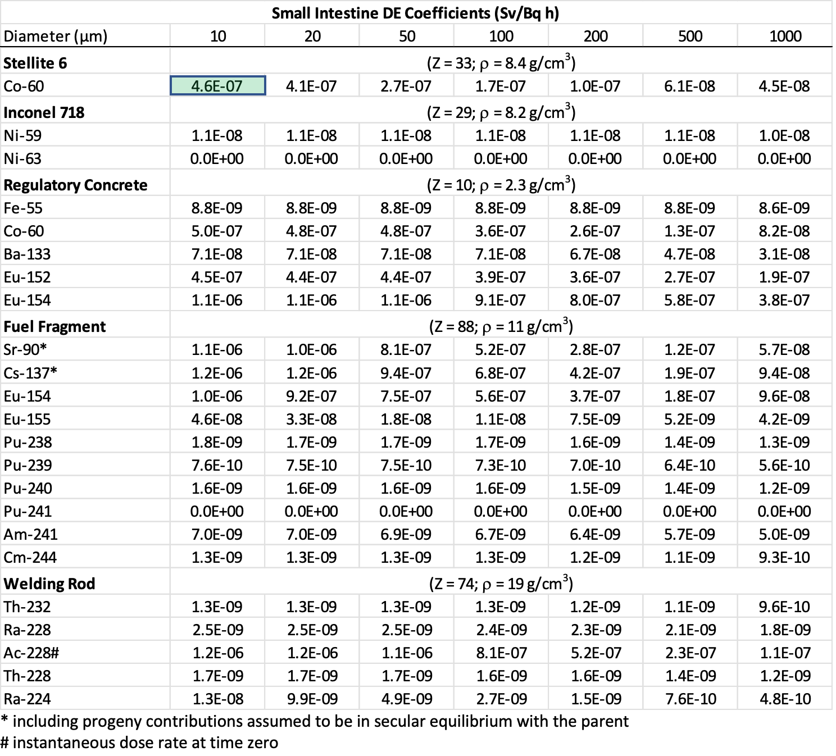
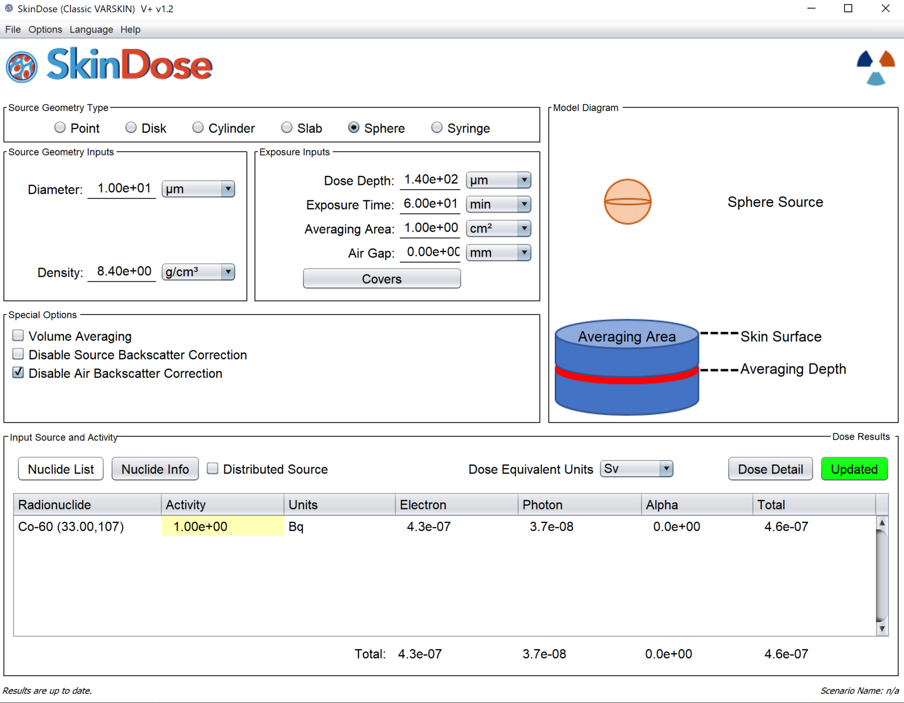

Slide 26
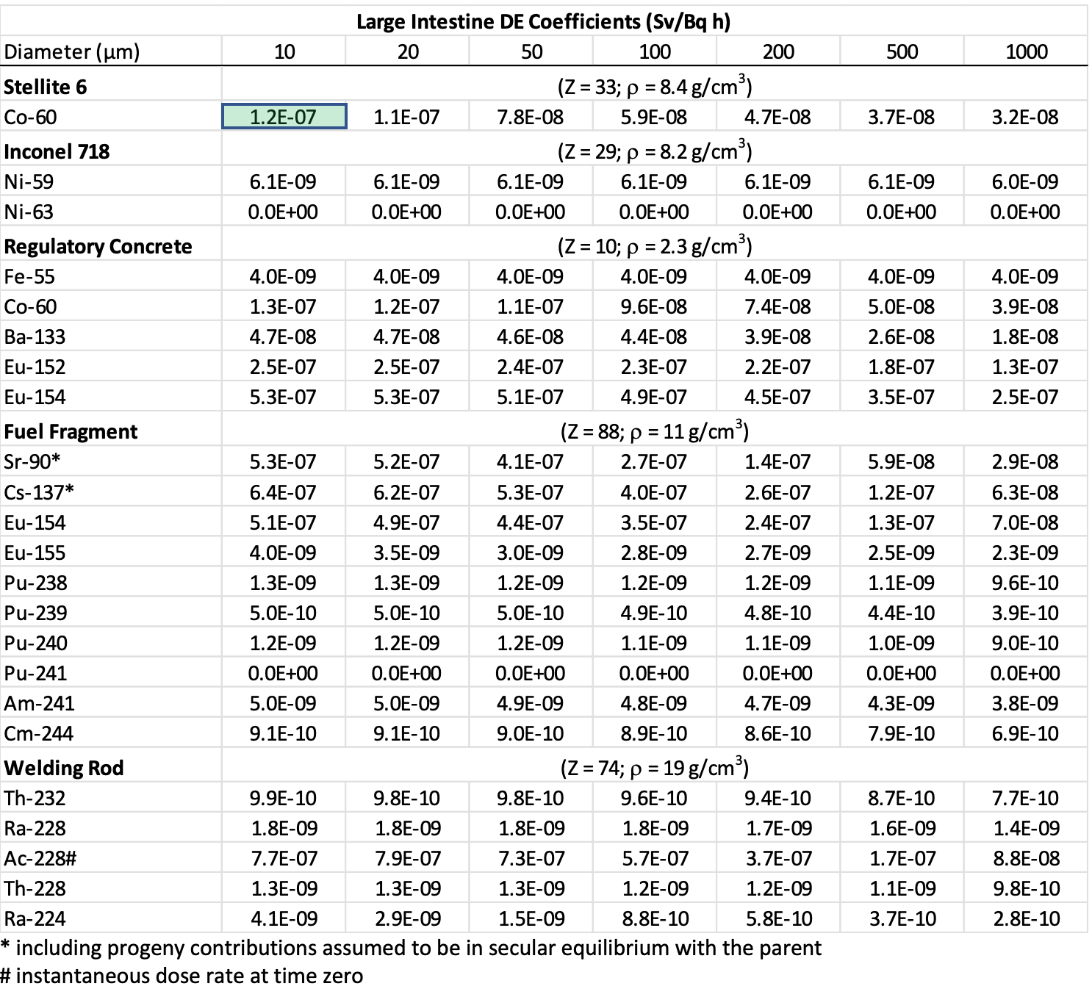
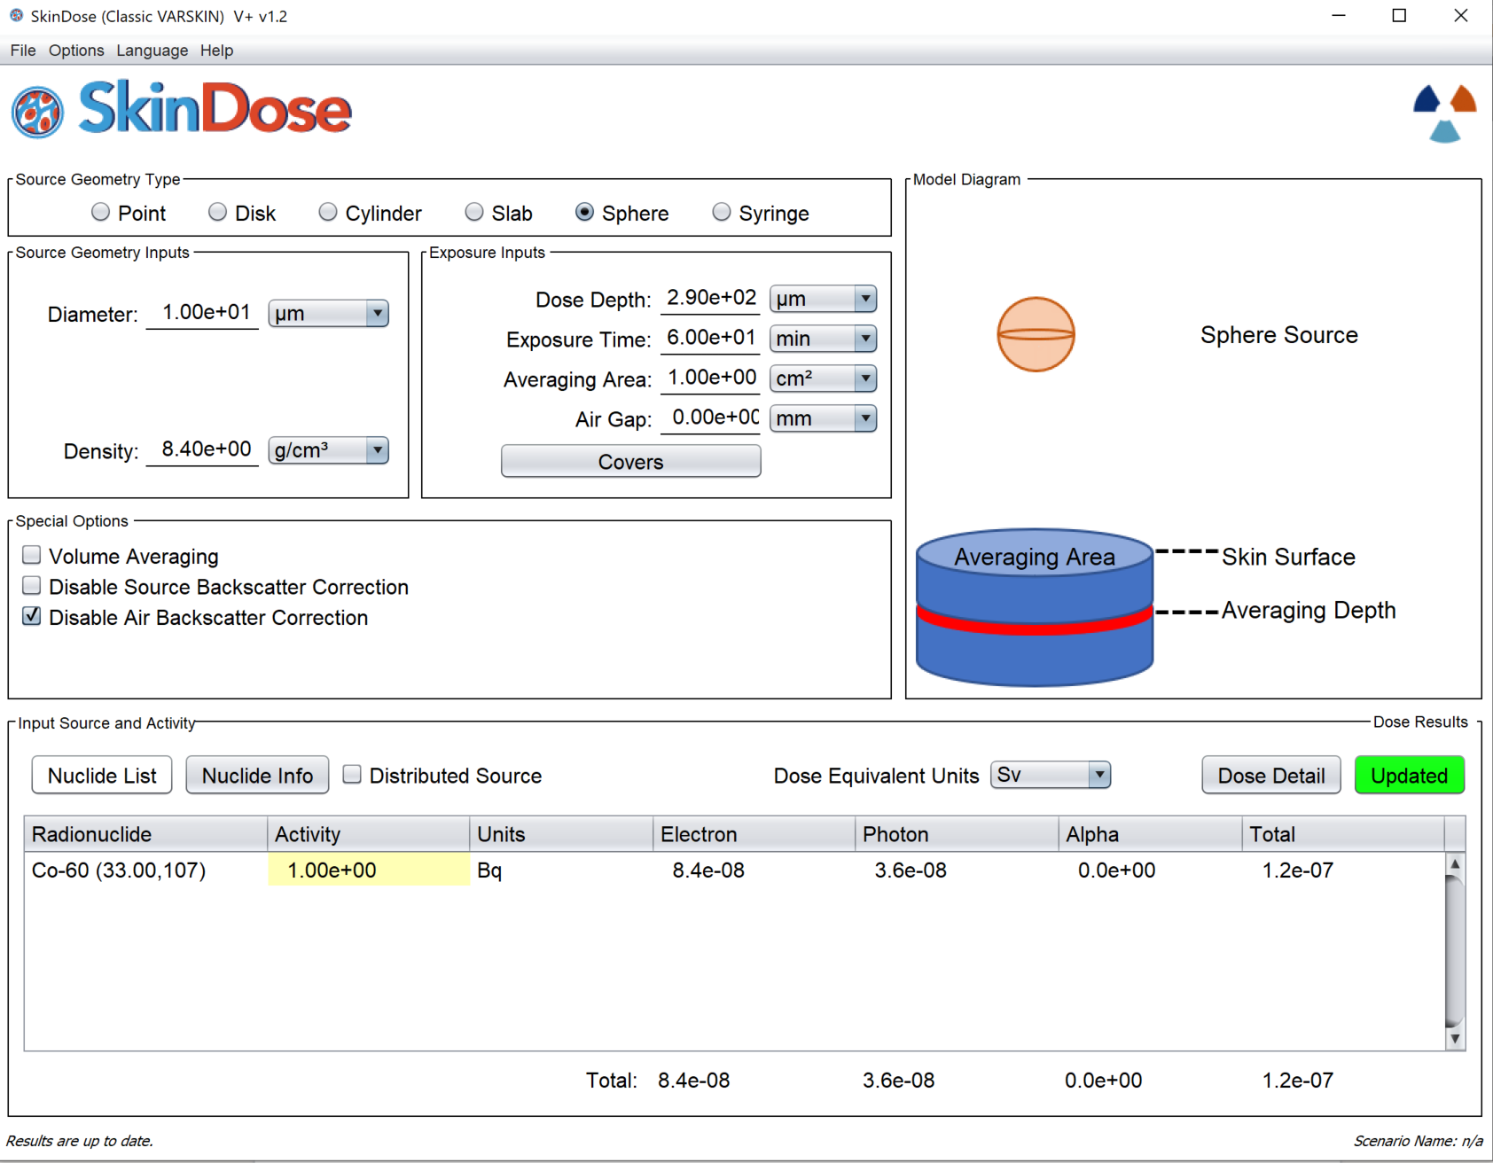

Slide 27
Mobile DRP Dose Coefficients with IMBA
CEDE from DRP ingestion
  Non-fuel fragments vs fuel fragment DRPs
Based on ICRP 30 GI Tract Model as implemented in IMBA
  Assumed ICRP 26/30 tissue weighting factors
DRP is assumed to follow the same biokinetics as a “dispersed” radioactive material

Slide 28
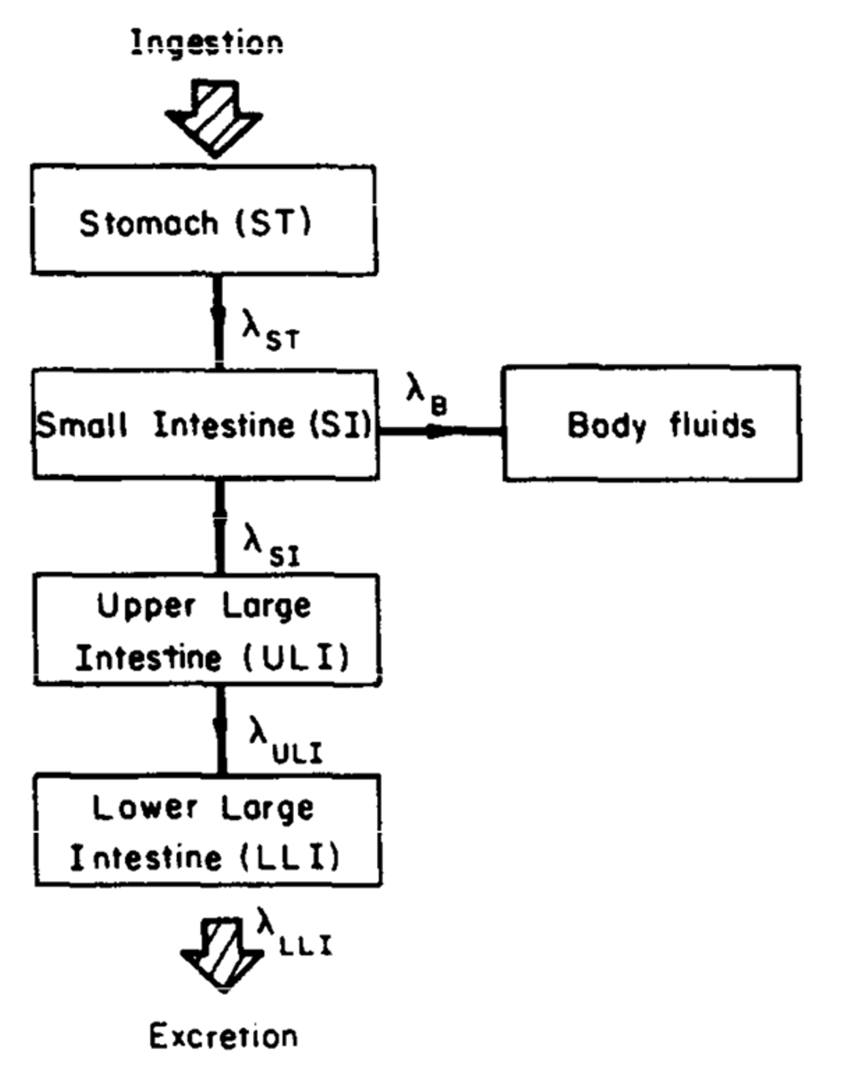
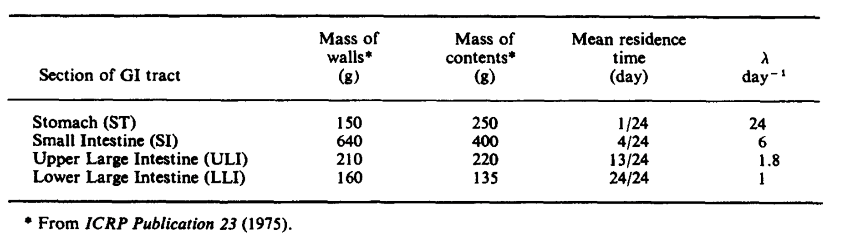
ICRP 30 GI Tract Model
First order kinetics are used to model the movement of GI contents regardless of the presence of radioactive material
DRP is assumed to be randomly located in GI contents

Slide 29
ICRP 30 GI Tract Model
Translocation to the body fluids, and subsequently to organs other than the GI tract, only occurs in the SI compartment
Clearance to the body fluids is also governed by first order kinetics and is driven by f₁
  fraction of a stable element reaching the body fluids following ingestion
For DRPs (other than fuel fragments), f₁ is assumed to be ZERO
  DRPs are assumed to remain completely intact while in GI tract

Slide 30
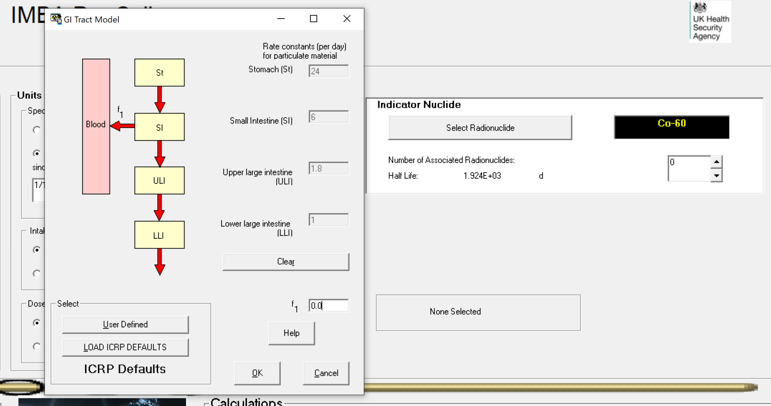
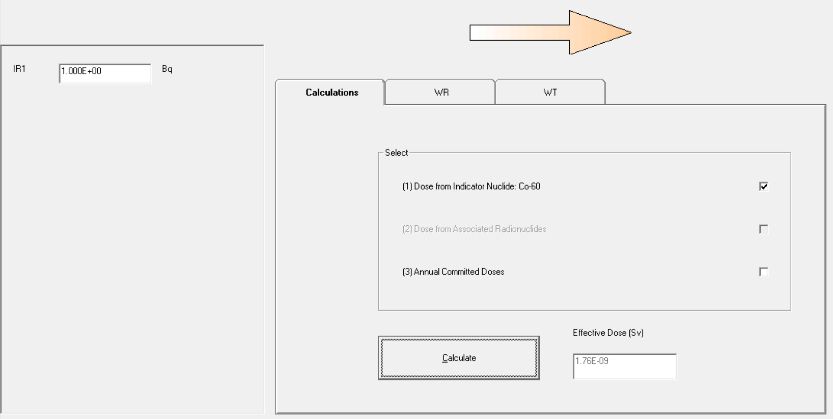
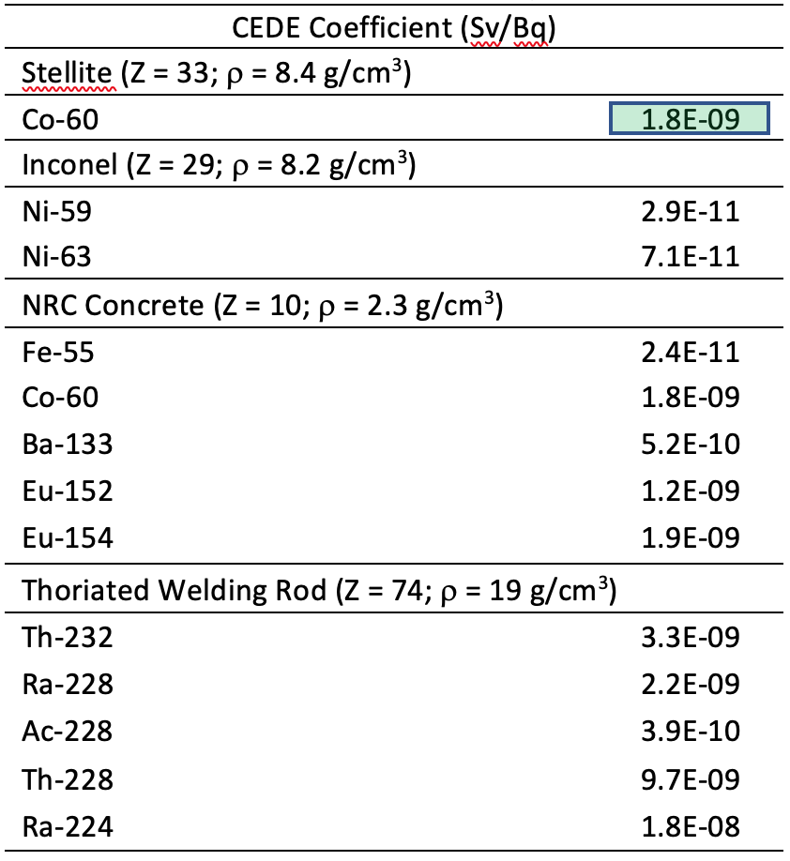

Slide 31
ICRP 30 GI Tract Model – Fuel Fragments
There is some evidence that irradiated fuel fragments are partially soluble in the fluids of the stomach and small intestine (ICRP 137, 141)
DRPs will follow the biokinetics that allow for translocation to the body fluids
Fuel fragment CEDE coefficients were taken as the FGR 11 coefficient reported for the maximum (most limiting) f₁ value
CEDE coefficients were computed in IMBA for fuel fragments using 10 percent and 1 percent of the maximum f₁ value in FGR 11

Slide 32
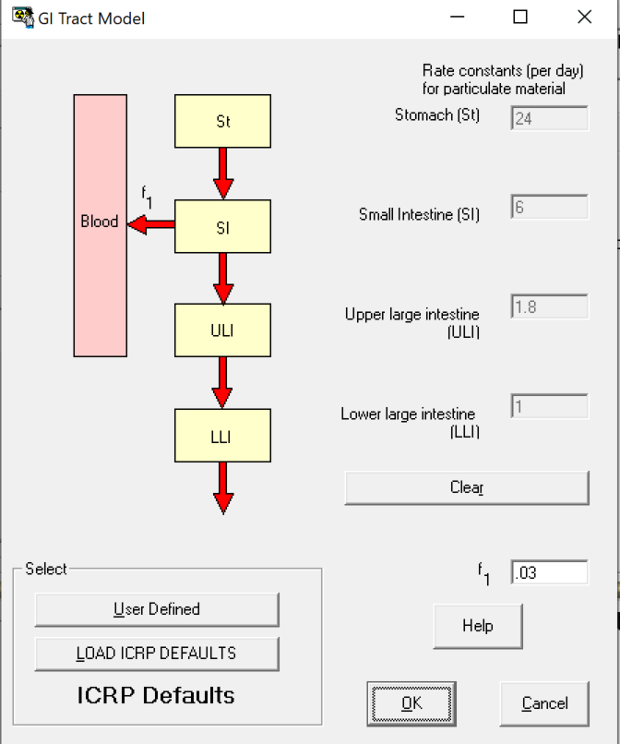
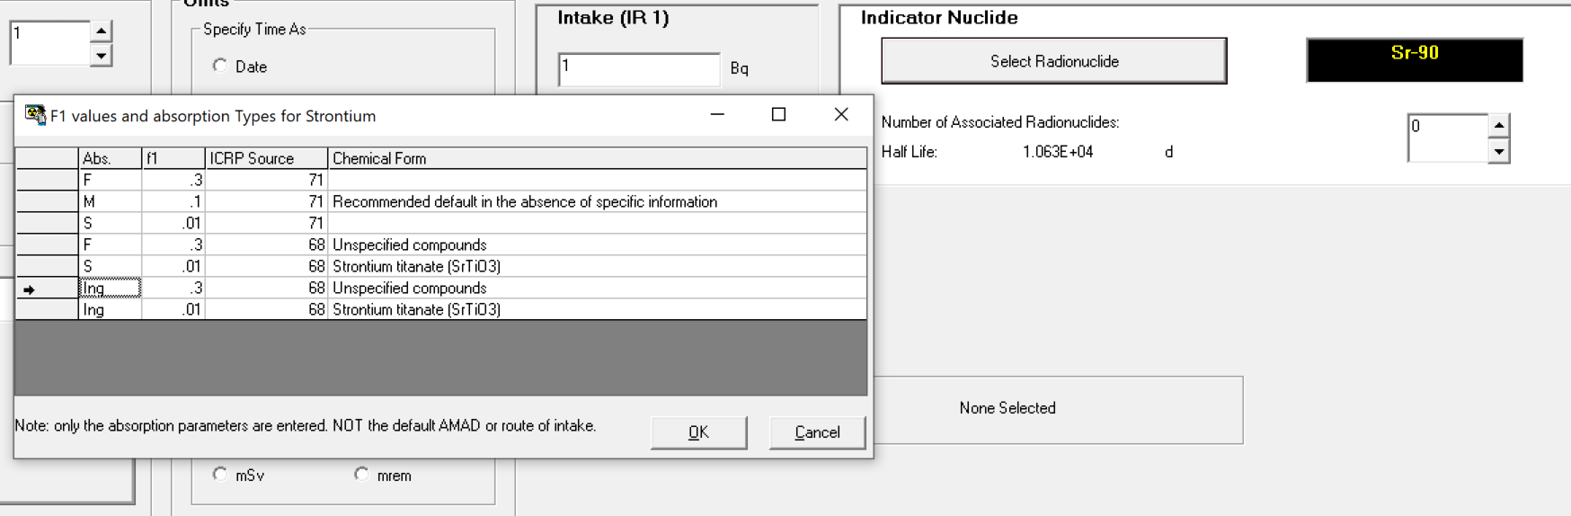
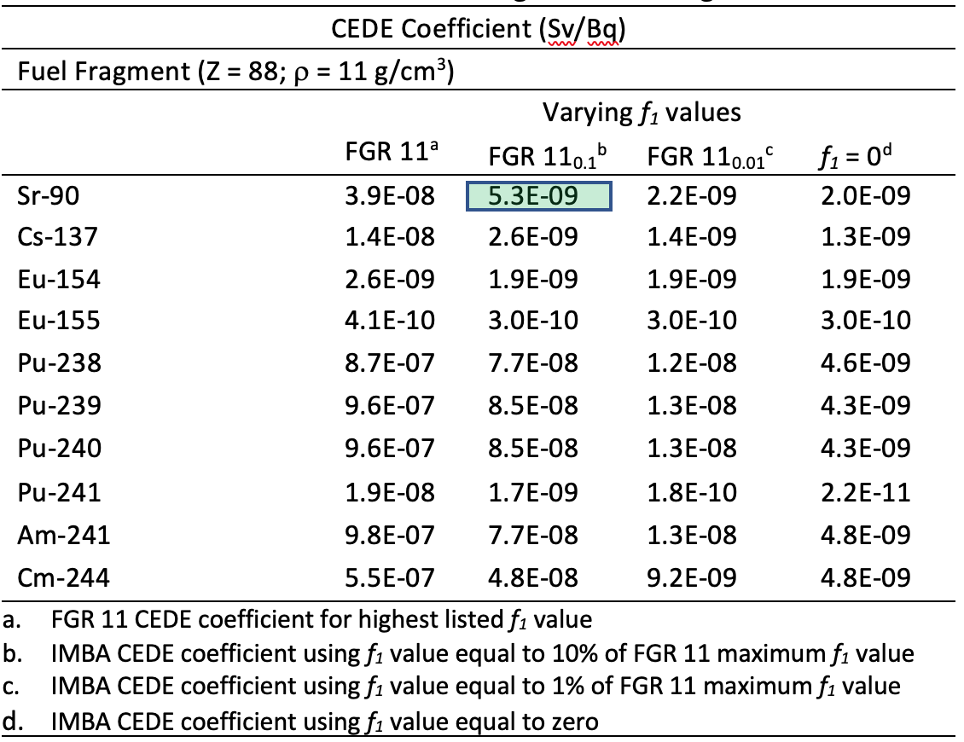
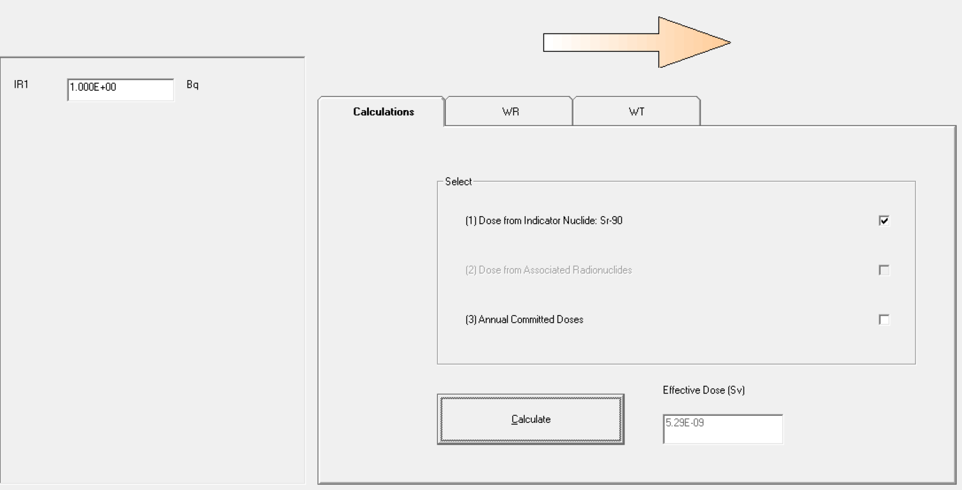

Slide 33
CEDE from DRP Inhalation
The ICRP 30 respiratory tract model biokinetics are highly dependent on the inhaled aerosol activity median aerodynamic diameter (AMAD)
AMAD is based on the distribution of aerodynamic diameters of particles present in an aerosol
DRP with a single physical diameter and corresponding aerodynamic diameter would not permit the determination of an AMAD
Application of the ICRP 30 respiratory tract model inappropriate if trying to determine a CEDE coefficient resulting from inhalation of a single DRP

Slide 34
CEDE from DRP Inhalation
Upon inhalation of a DRP, it can be assumed that the particle is either
  swallowed and enters the GI tract (i.e., reaches the pharynx)
  resides in the anterior part of the nasal region until removed extrinsically.
DRP is swallowed, the CEDE coefficients for ingestion applies
DRP is assumed to stay in the anterior part of the nasal region until removed extrinsically, the stationary EDE coefficients apply

