Slide 1
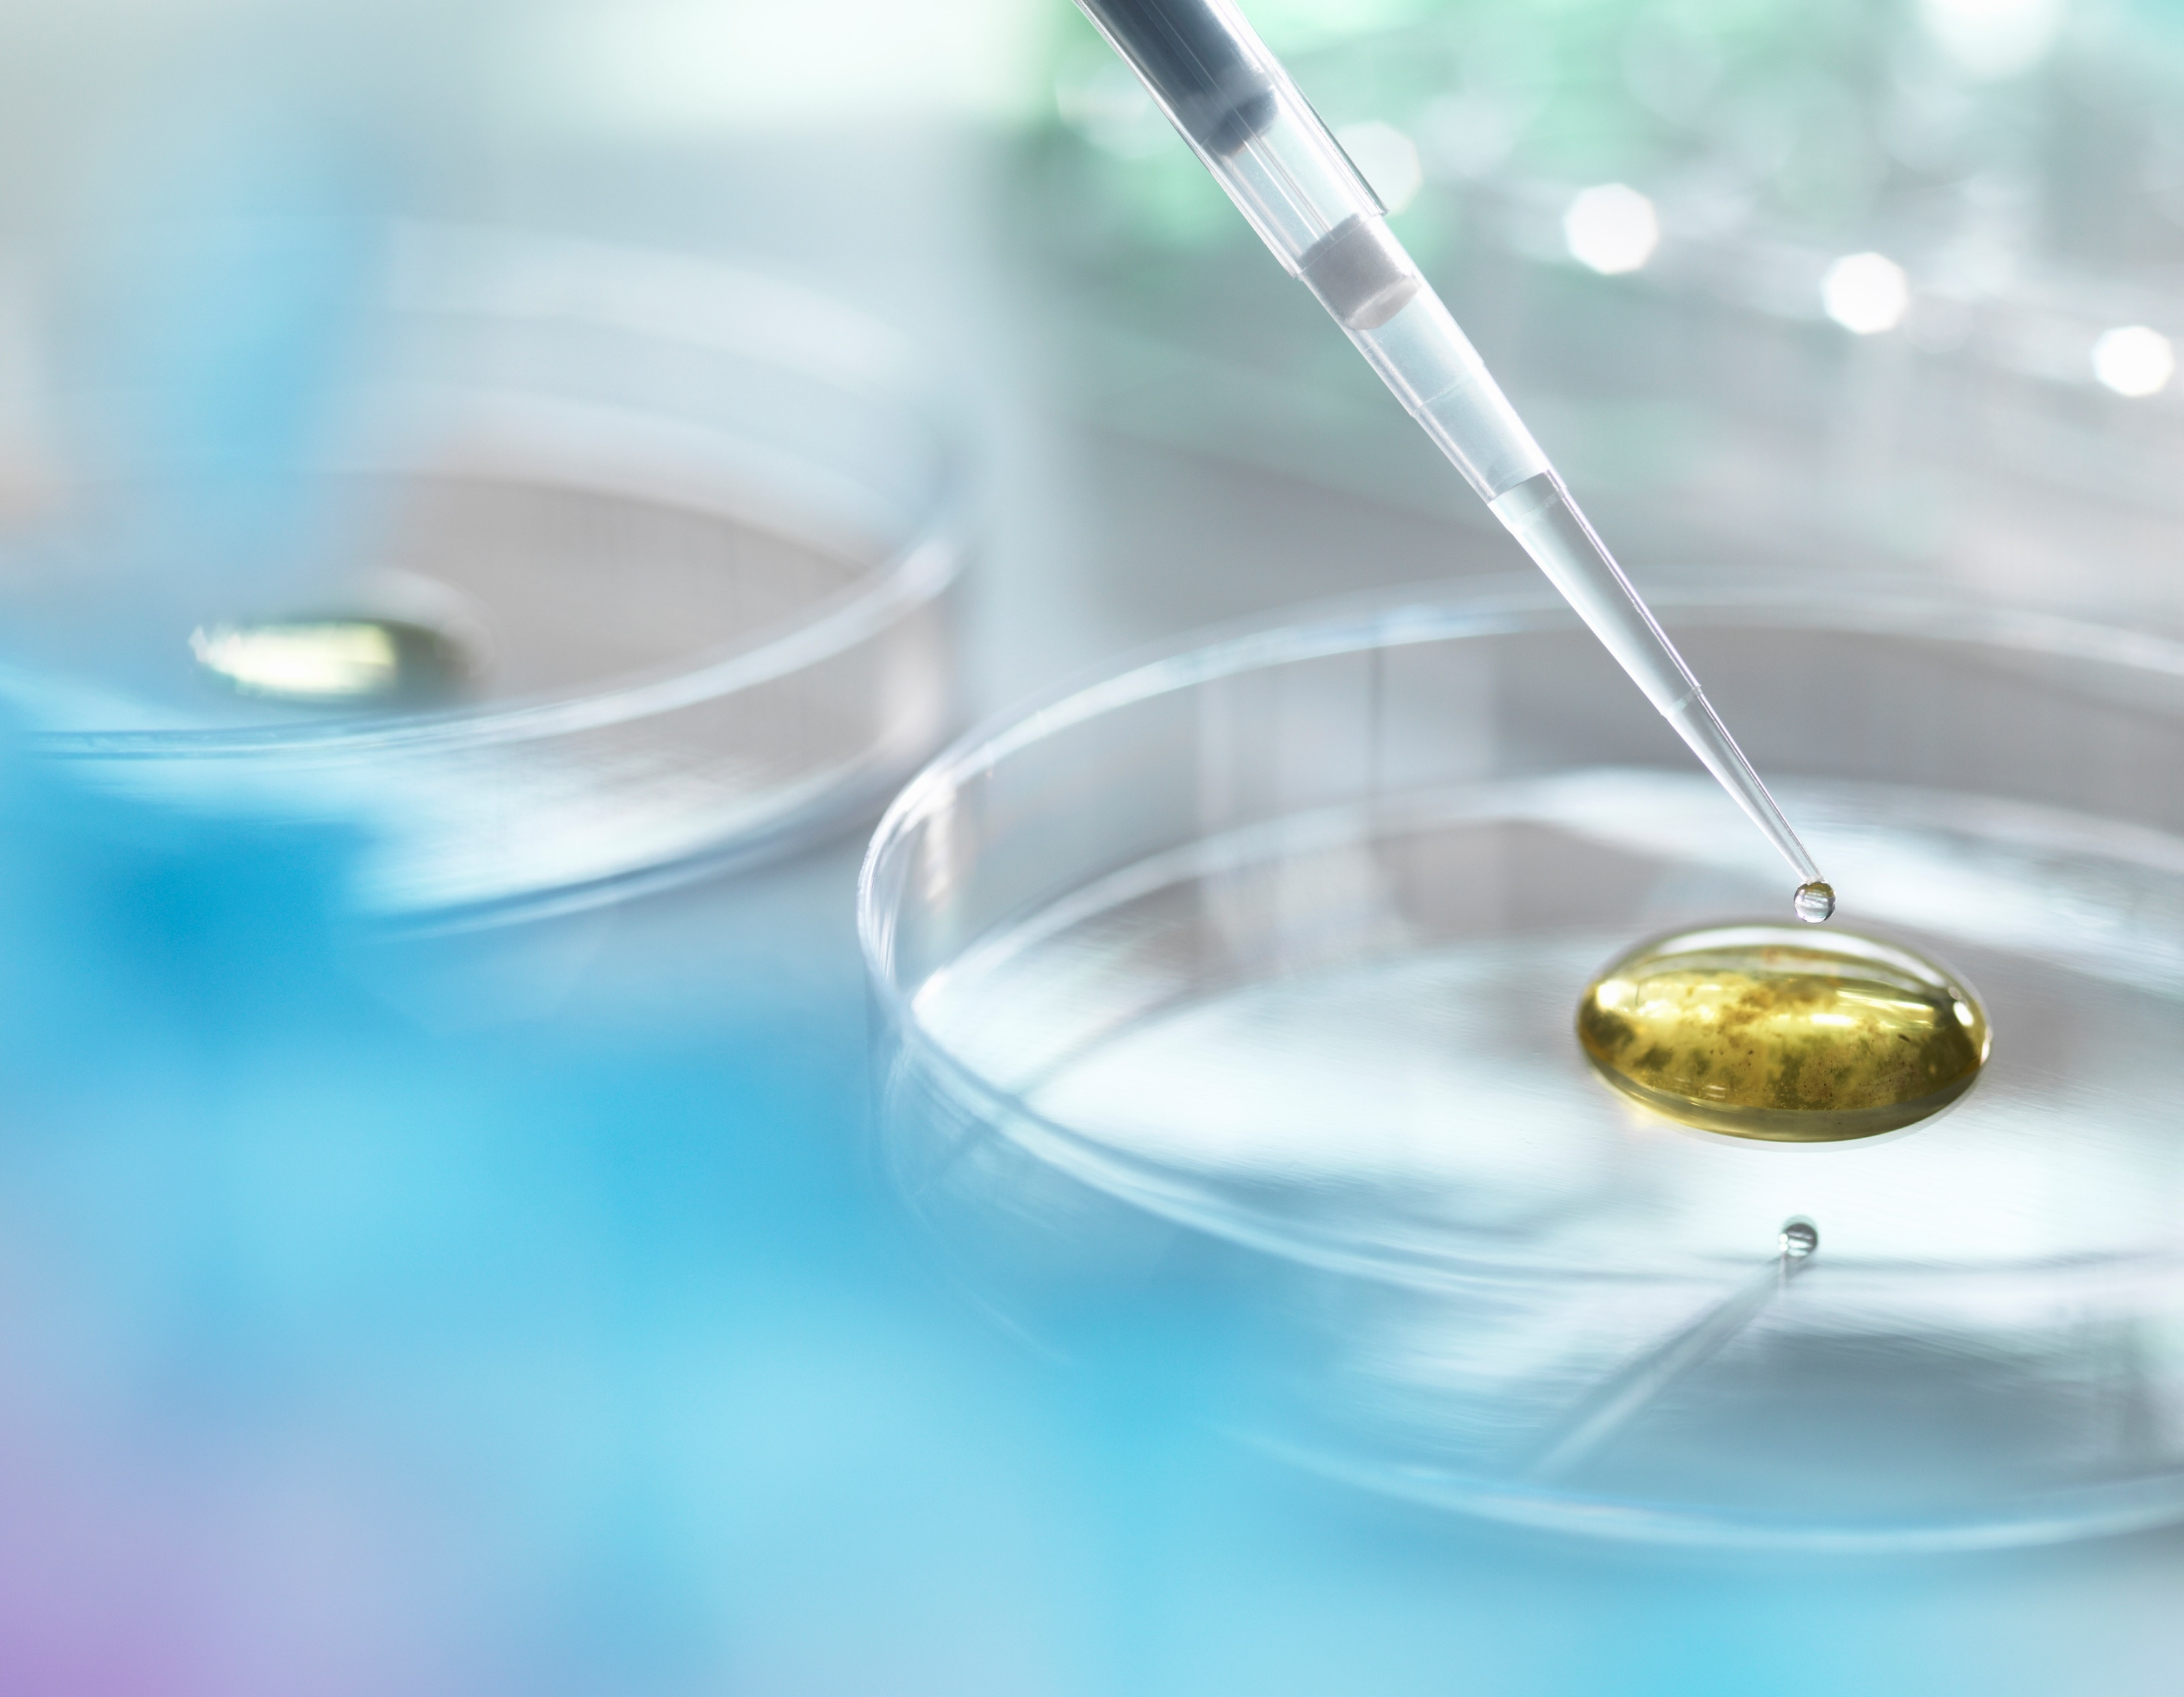

Extravasation FLOW AND DOSIMETRY MODEL UPDATE
October 26, 2023
RENAISSANCE CODE DEVELOPMENT
Roland Benke, PhD, CHP

Slide 2
outline
Objective | Overview | Project Scope
Model Descriptions
Summary

Slide 3
OBJECTIVE
Extravasation occurs when the radiopharmaceutical intended for the bloodstream leaks into surrounding tissue.
Build a computational tool (software) to calculate 3D dose distributions in tissue with interfaces and flexibility appropriate for radionuclide extravasations

Slide 4
What MATTERS?
Physical and chemical characteristics of the radiopharmaceutical
Administration flow rate and duration (gravity method, infusion pump, injection)
Biological composition and structure at the site of extravasation (tissue matrix)
Physical changes to the site (elevation of site, warm compress)
Biophysical movement and dissipation of extravasated fluid (flow & vascular removal)
  Volume of tissue affected by extravasated fluid
  Extravasated fluid concentrations in tissue over time
Radioactivity extravasated (initial source term)
Radioactive decay, emission type and energy

Slide 5
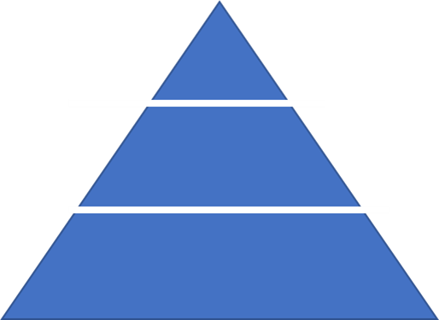
PRoject SCOPE
Users
Insights & Action
Graphical user interface
Software
Software coding
Output visualization
This presentation
Model
Documentation
Model development

Slide 6
What IS BEING CALCULATED?
Flow Model
Movement of radioactive extravasated fluid in tissue
Activity concentration in tissue over time in three dimensions
Local tissue dose over time in three dimensions
Activity Concentration Model
Dosimetry Model

Slide 7
Flow Model

Slide 8
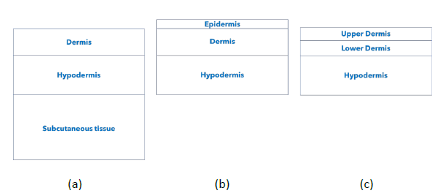
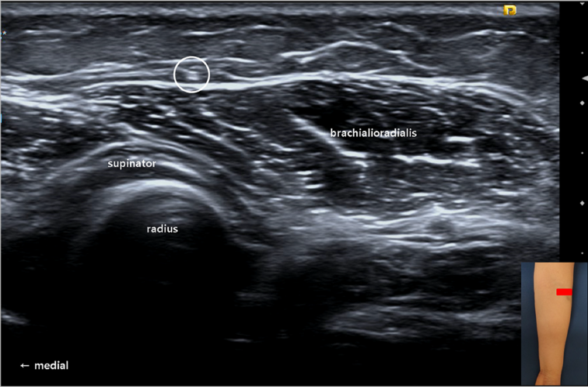
FLEXIBLE LAYERING for extravasation modeling
(a) (b) (c)
to accommodate a variety of circumstances
  Deep infiltration without appreciable extravasation in epidermis
  Dermal extravasation with explicit infiltration into the epidermis
  Confined extravasation within multiple dermal layers
Kwak and Chang (2020) Compression of the lateral antebrachial cutaneous nerve due to leakage of iron after an intravenous iron infusion. Diagnostics 2020, 10, 516. Figure 1(C).

Slide 9
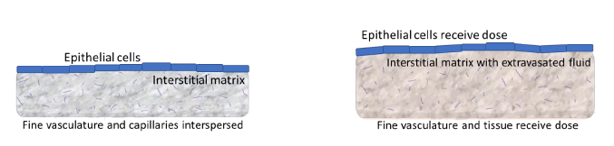
HOMOGENEOUS TISSUE MATRIX
Interstitial components include fine vascular bathed in extracellular fluid
before extravasation
after extravasation
In initial modeling
Fluid movement is tracked without tissue shape changes
Stationary grid

Slide 10
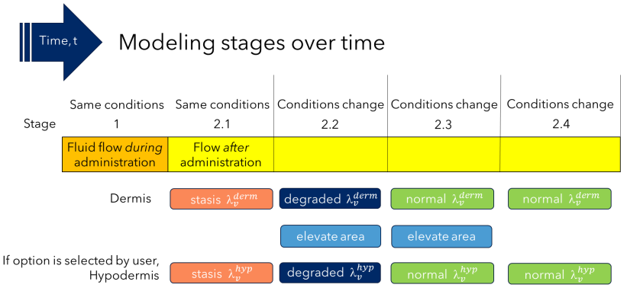
Two layers shown {Dermis, Hypodermis}
Vascular removal rates λ_{v} change over time {Statis, Degraded, Normal}

Slide 11
FLOW PRIMARILY DRIVEN BY PRESSURE
STAGE 1
External driving force to flow
Theis equation for confined flow
2D lateral calculation initially
+ vertical fluid distribution
STAGE 2
No external driving force
Darcy flow with hydrostatic pressure from fluid in tissue
3D calculation

Slide 12
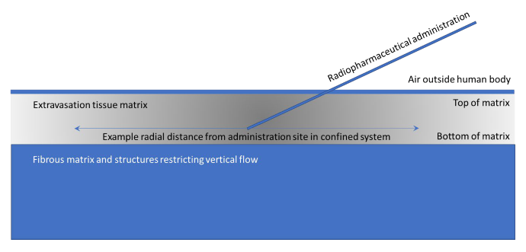
CONFINED FLOW IN STAGE 1

Slide 13
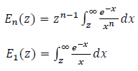

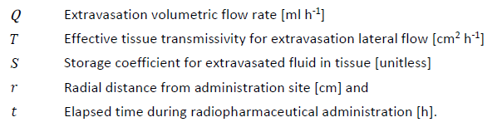
THEIS EQUATION USED IN STAGE 1
Exponential integral definitions
Hydrostatic pressure head [cm] as function of space and time

Slide 14



darcy flow AND TRANSMISSIVITY
Darcy flow velocity [cm s⁻¹] depends on pressure differentials and properties of the flow matrix
“Effective” accounts for spatial heterogeneity within the tissue matrix

Slide 15
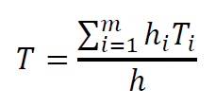
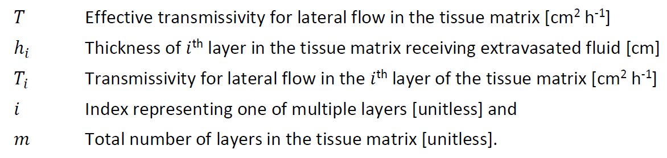
EFFECTIVE TRANSMISSIVITY FOR TISSUE LAYERS
Calculated as a weighted sum of transmissivities for individual layers i

Slide 16
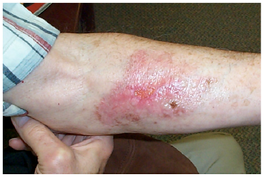

LATERAL Extravasated FLUID FLOW DURING ADMINISTRATION
For a constant volumetric flow rate of the radiopharmaceutical during administration
Quasi-steady-state conditions for lateral extravasation flow would be reached within ~5 minutes
Simplification is made to remove the time dependence from the Theis equation
Radial pressure gradient from the Theis equation yields a quasi-steady-state velocity profile:
Bonta et al. (2011) Extravasation of a therapeutic dose of ¹³¹I-metaiodobenzylguanidine: Prevention, Dosimetry, and Mitigation. J Nucl Med 52: 1418-1422.

Slide 17
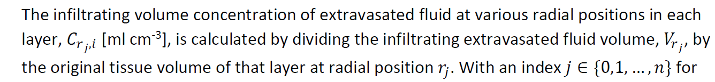
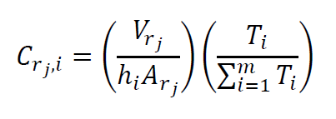


Extravasated FLUID APPORTIONED TO LAYERS BASED ON TRANSMISSIVITY
Volume of extravasated fluid [ml] in radial ring j is apportioned to layer i
for radial rings
for tissue layers
Tissue volume [cm³] for layer i within radial ring j

Slide 18
STAGE 1 FLOW TESTiNg EXAMPLE

Slide 19
TEST OF LARGE-VOLUME EXTRAVASATION IN TISSUE DURING ADMINSTRATION
after 15 s
Extravasated fluid volume concentration [ml cm⁻³]
Top layer (0.2 cm)
Middle layer (0.3 cm)
Bottom layer (0.5 cm)

Slide 20
TEST OF LARGE-VOLUME EXTRAVASATION IN TISSUE DURING ADMINSTRATION
after 1 min
Extravasated fluid volume concentration [ml cm⁻³]
Top layer (0.2 cm)
Middle layer (0.3 cm)
Bottom layer (0.5 cm)

Slide 21
TEST OF LARGE-VOLUME EXTRAVASATION IN TISSUE DURING ADMINSTRATION
after 3 min
Extravasated fluid volume concentration [ml cm⁻³]
Top layer (0.2 cm)
Middle layer (0.3 cm)
Bottom layer (0.5 cm)

Slide 22
TEST OF LARGE-VOLUME EXTRAVASATION IN TISSUE DURING ADMINSTRATION
after 10 min
Extravasated fluid volume concentration [ml cm⁻³]
Top layer (0.2 cm)
Middle layer (0.3 cm)
Bottom layer (0.5 cm)

Slide 23
TEST OF LARGE-VOLUME EXTRAVASATION IN TISSUE DURING ADMINSTRATION
after 20 min
Extravasated fluid volume concentration [ml cm⁻³]
Top layer (0.2 cm)
Middle layer (0.3 cm)
Bottom layer (0.5 cm)

Slide 24
TEST OF LARGE-VOLUME EXTRAVASATION IN TISSUE DURING ADMINSTRATION
after 40 min
Extravasated fluid volume concentration [ml cm⁻³]
Top layer (0.2 cm)
Middle layer (0.3 cm)
Bottom layer (0.5 cm)

Slide 25
TEST OF LARGE-VOLUME EXTRAVASATION IN TISSUE DURING ADMINSTRATION
after 60 min
Extravasated fluid volume concentration [ml cm⁻³]
Top layer (0.2 cm)
Middle layer (0.3 cm)
Bottom layer (0.5 cm)

Slide 26
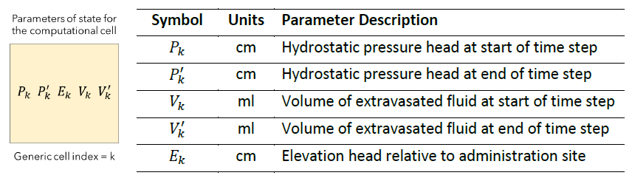

STAGE 2 AFTER ADMINISTRATION CEASES
Residual pressure from extravasated fluid temporarily trapped in tissue

Slide 27

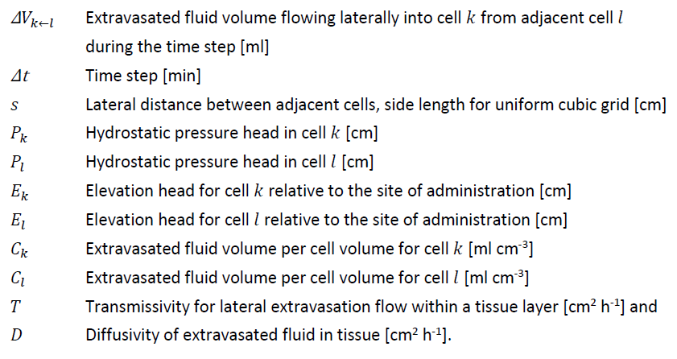
STAGE 2 LATERAL FLOW in 3D GRID

Slide 28

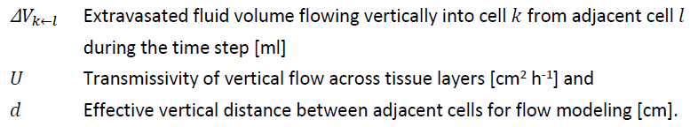
STAGE 2 Vertical FLOW in 3D GRID

Slide 29
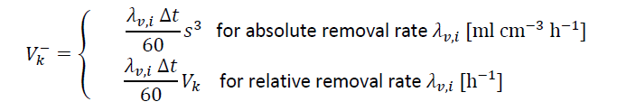
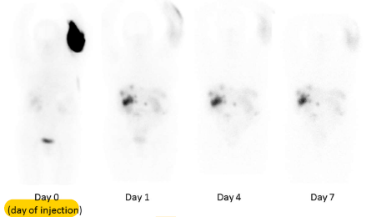

VASCULAR REMOVAL of extravasated FLUID

Slide 30
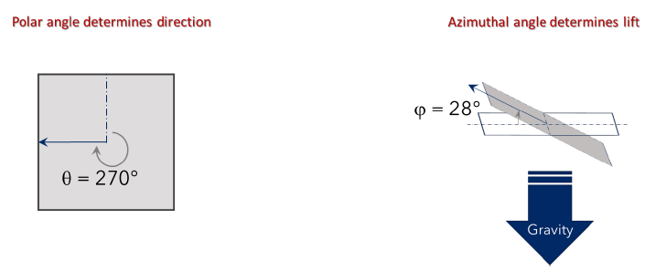

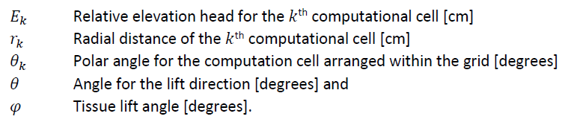
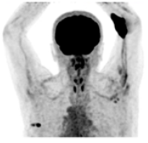
RELATIVE ELEVATION HEAD
Fig. 3(C) in Iori et al. (2022)
https://doi.org/10.21203/rs.3.rs-2009242/v1

Slide 31
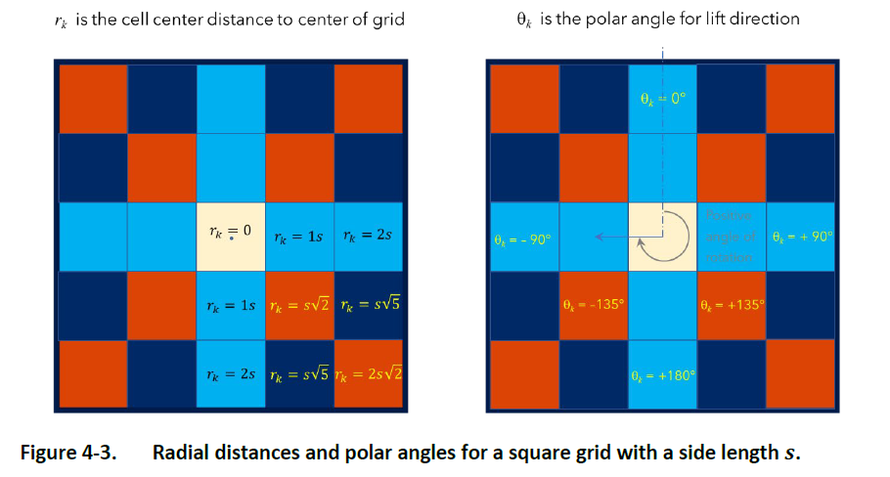
RADIAL DISTANCES FOR ELEVATION HEAD

Slide 32
STAGE 2 FLOW TESTiNg EXAMPLE

Slide 33

TEST OF LARGE-VOLUME EXTRAVASATION FLOW AFTER ADMINSTRATION
Affected tissue is immediately elevated
when administration ceases + 0 min
Extravasated fluid volume conc. [ml cm⁻³]
Top layer (0.2 cm)
Middle layer (0.3 cm)
Bottom layer (0.5 cm)

Slide 34
TEST OF LARGE-VOLUME EXTRAVASATION FLOW AFTER ADMINSTRATION
Affected tissue is immediately elevated
when administration ceases + 18 min
Extravasated fluid volume conc. [ml cm⁻³]
Top layer (0.2 cm)
Middle layer (0.3 cm)
Bottom layer (0.5 cm)

Slide 35
TEST OF LARGE-VOLUME EXTRAVASATION FLOW AFTER ADMINSTRATION
Affected tissue is immediately elevated
when administration ceases + 33 min
Extravasated fluid volume conc. [ml cm⁻³]
Top layer (0.2 cm)
Middle layer (0.3 cm)
Bottom layer (0.5 cm)

Slide 36
TEST OF LARGE-VOLUME EXTRAVASATION FLOW AFTER ADMINSTRATION
Affected tissue is immediately elevated
when administration ceases + 46 min
Lower maximum
in this scale
Extravasated fluid volume conc. [ml cm⁻³]
Lower maximum
in this scale
Top layer (0.2 cm)
Middle layer (0.3 cm)
Bottom layer (0.5 cm)

Slide 37
TEST OF LARGE-VOLUME EXTRAVASATION FLOW AFTER ADMINSTRATION
Affected tissue is immediately elevated
when administration ceases + 54 min
Lower maximum
in this scale
Extravasated fluid volume conc. [ml cm⁻³]
Lower maximum
in this scale
Top layer (0.2 cm)
Middle layer (0.3 cm)
Bottom layer (0.5 cm)

Slide 38
TEST OF LARGE-VOLUME EXTRAVASATION FLOW AFTER ADMINSTRATION
Affected tissue is immediately elevated
when administration ceases + 58 min
Lower maximum
in this scale
Extravasated fluid volume conc. [ml cm⁻³]
Lower maximum
in this scale
Top layer (0.2 cm)
Middle layer (0.3 cm)
Bottom layer (0.5 cm)

Slide 39
Activity Concentration Model

Slide 40



ACTIVITY CONCENTRATION MODEL
Converts extravasated fluid in tissue into activity per unit volume
Applies to 3D computational grid of tissue with unit density that does not flex or deform
Two input parameters
Model without F input & model with F input
Transfers spatial- and time-dependent concentration data to the dosimetry model
Includes time-integrated activity concentration
Activity concentration in tissue ≤ Activity concentration of administered radiopharmaceutical

Slide 41
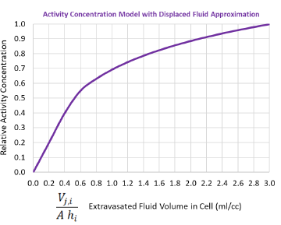

ACTIVITY CONCENTRATION in tissue without F INPUT
For cubic computational cells, A = s² lateral area [cm²]

Slide 42
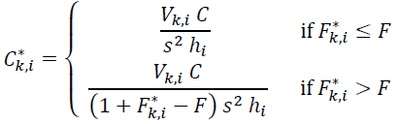

ACTIVITY CONCENTRATION WHEN F INPUT is provided

Slide 43
Dosimetry Model

Slide 44

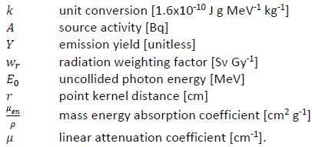
PHOTON DOSE RATE
Point kernel for uncollided photons (no scatter) with cell center to cell center distance r
Point-pair distribution for 26 target cells immediately surrounding source cell

Slide 45
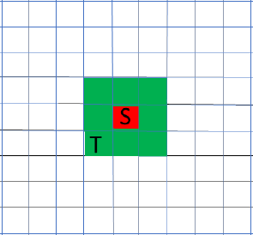

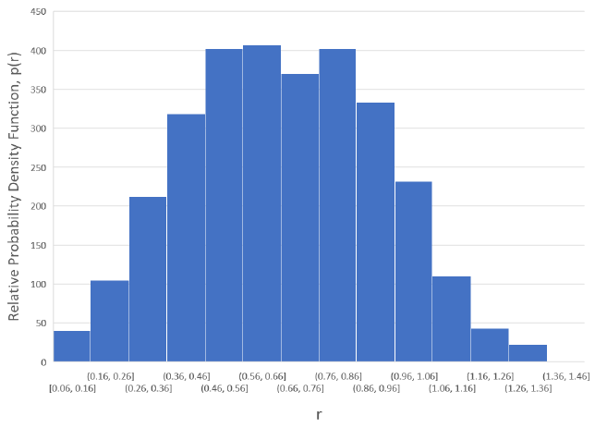
PHOTON DOSE RATE FROM Point-pair distribution
Source cell S
Target cell T

Slide 46


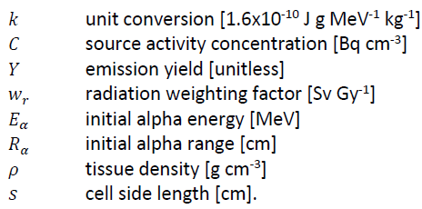
Alpha particle DOSE RATE
To adjacent cells sharing a planar face
To source cell (self-irradiation)

Slide 47
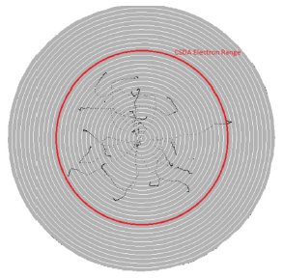

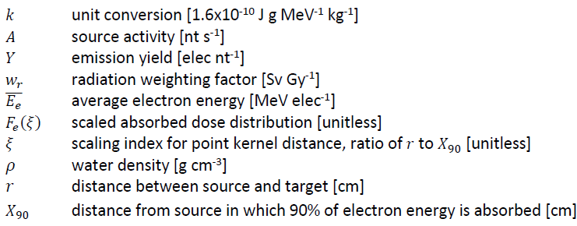
ELECTRON DOSE RATE
Based on SkinDose in VARSKIN+ 1.0 computer code
Details in NUREG/CR-6918, Revision 4 (July 2021)
Scaled absorbed dose distribution

Slide 48
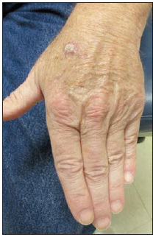
SUMMARY
Local Tissue Dose from Extravasation
Flow Model
  Stage 1 during Radiopharmaceutical Administration
  Stage 2 after Radiopharmaceutical Administration
Activity Concentration Model
Dosimetry Model
Benjegerdes et al. (2017) Focal cutaneous squamous cell carcinoma following Radium-223 extravasation. Baylor University Medical Center Proceedings 30:1, 78-79, DOI: 10.1080/08998280.2017.11929538.

