Slide 1

GENII Training for Novice Users
Fall 2023 RAMP USERS GROUP MEETING
October 23 – 27, 2020
U.S. Nuclear Regulatory Commission Virtual Meeting
Caitlin Condon and Josh Hargraves
Pacific Northwest National Laboratory
PNNL-SA-157258

Slide 2
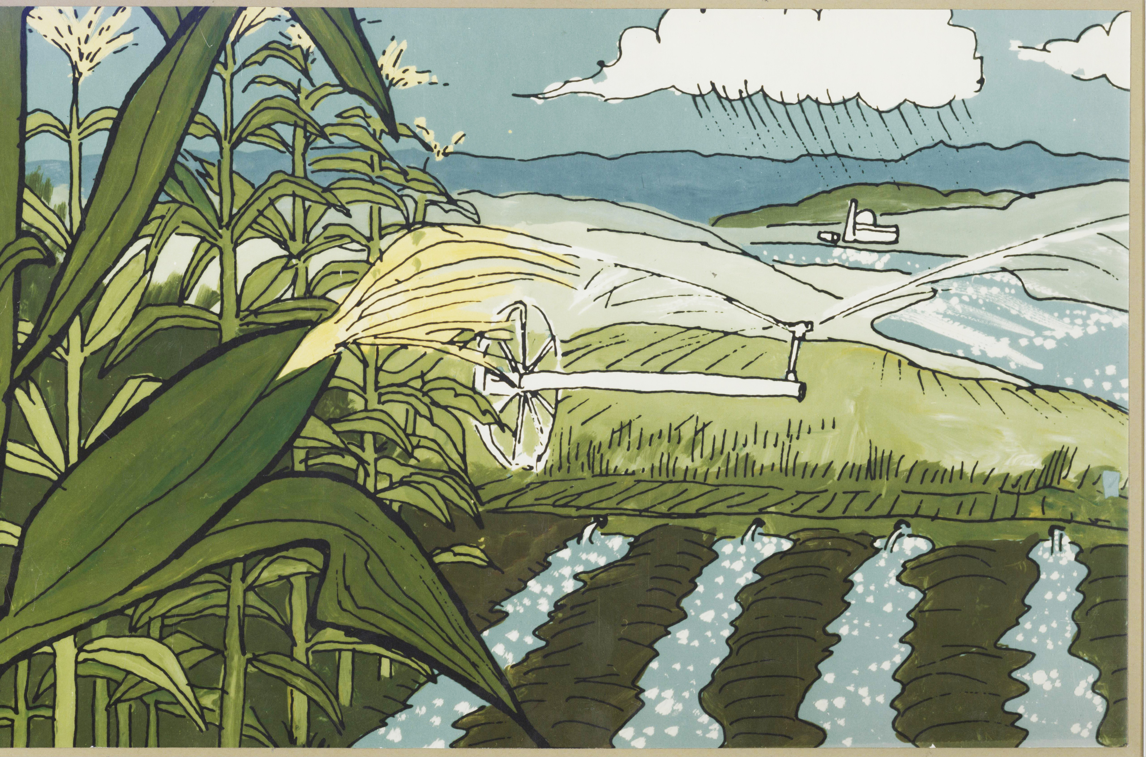
Outline
Introduction to GENII
Workbook Example
User Questions

Slide 3
GENII
Originally developed at PNNL as an environmental dispersion code for the Hanford Site
Later generalized for the EPA by PNNL to handle a variety of sites and scenarios
Powerful environmental dispersion software
It is now officially an NRC RAMP code

Slide 4
What is the Assessment Question?
Are we compliant?
  Often regulatory requirements of facility operations are posed in terms of radiation dose limits
Design requirements
  How much material may be released and still meet the criteria?
Safety analyses
  How much redundancy is necessary to prevent this event?
Accident Planning
  How bad could this event be?

Slide 5
Scenario Analysis
All of these questions can be answered through the analysis of a scenario that considers:
  Radionuclides inventories
  Radionuclide releases
  Environmental transport
  Environmental accumulation and dilution
  Subsequent human exposure

Slide 6
Scenarios
A scenario is a conceptual model that describes patterns of human activity, events, and processes that result in radiation exposure to people
GENII is designed to allow flexible application to most scenarios of interest in a regulatory setting at an appropriate level of detail

Slide 7
Types of Scenarios
Far-Field scenarios
  Atmospheric transport (Acute or chronic)
  Surface water transport (Acute or chronic)
Near-Field scenarios
  Spills
  Buried waste
  Groundwater Use (Ground water transport modeling is NOT an explicit part of GENII)

Slide 8
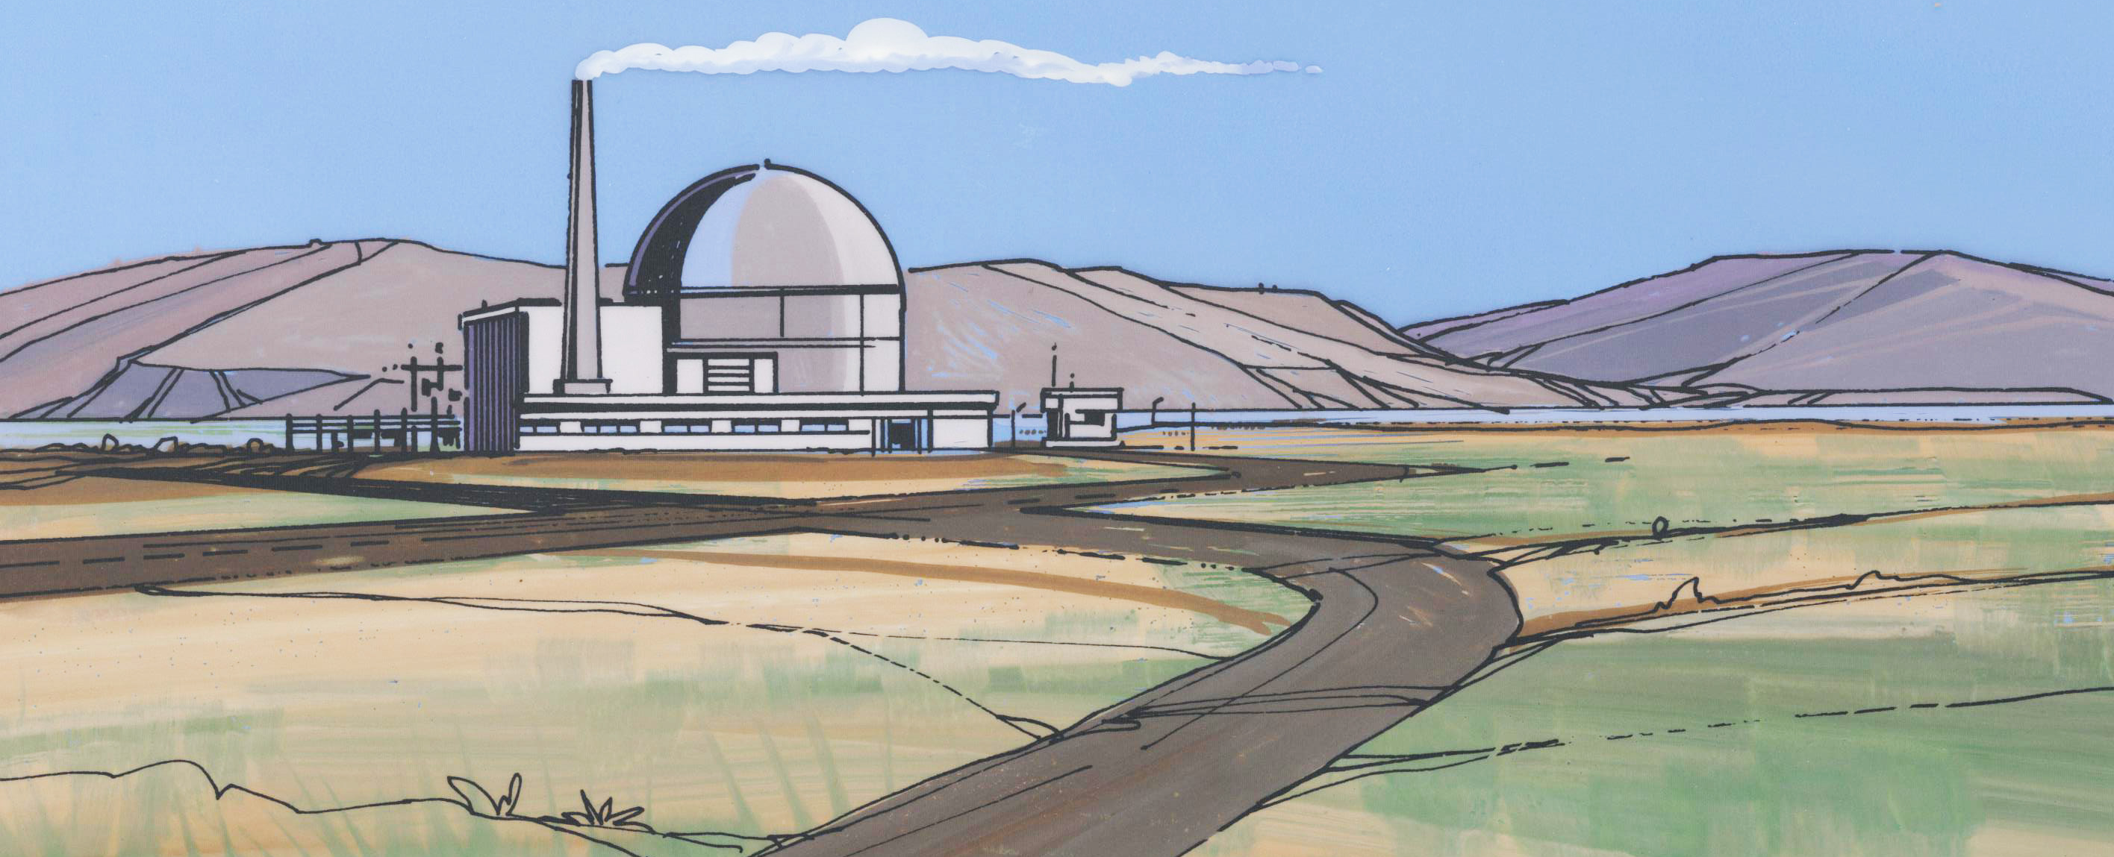
Radionuclide Source Terms
GENII dose not calculate reactor inventories
Input is flexible; chain decay progeny grow in

Slide 9
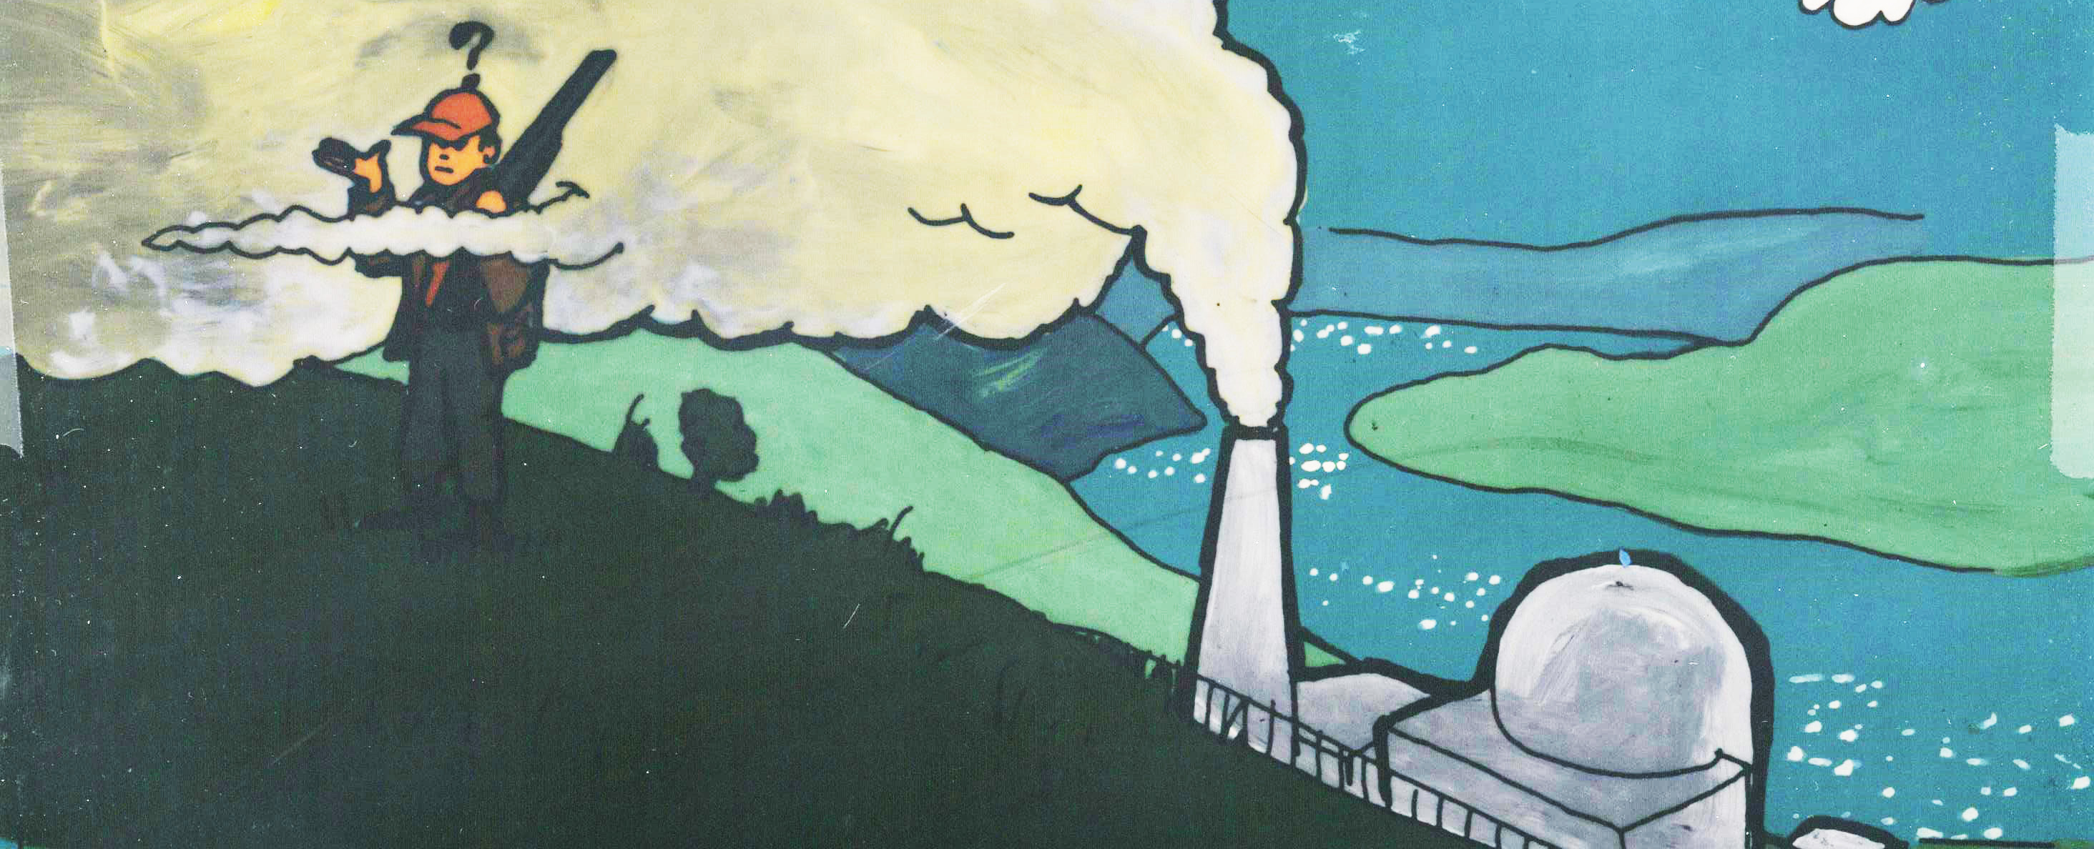
Atmospheric Transport Models
Chronic Plume
Acute Plume
Acute 95th Percentile Plume
Chronic Puff
Acute Puff
Chronic X/Q
Acute X/Q

Slide 10
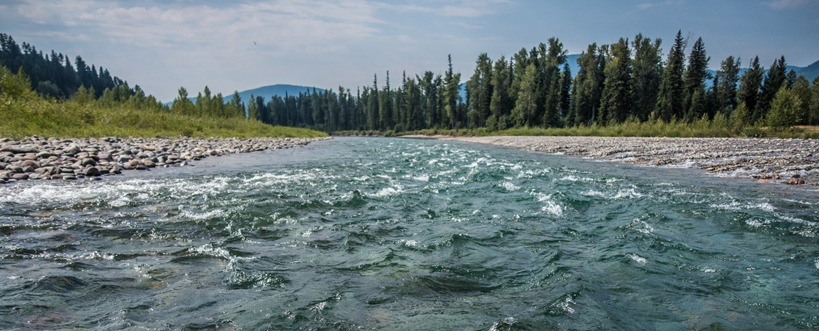
Surface Water Models
Chronic River
Chronic Flow Dilution
Acute River
Near-shore Lake/Ocean
  Once-through pond
  Fully-mixed pond
  Partially-mixed pond

Slide 11
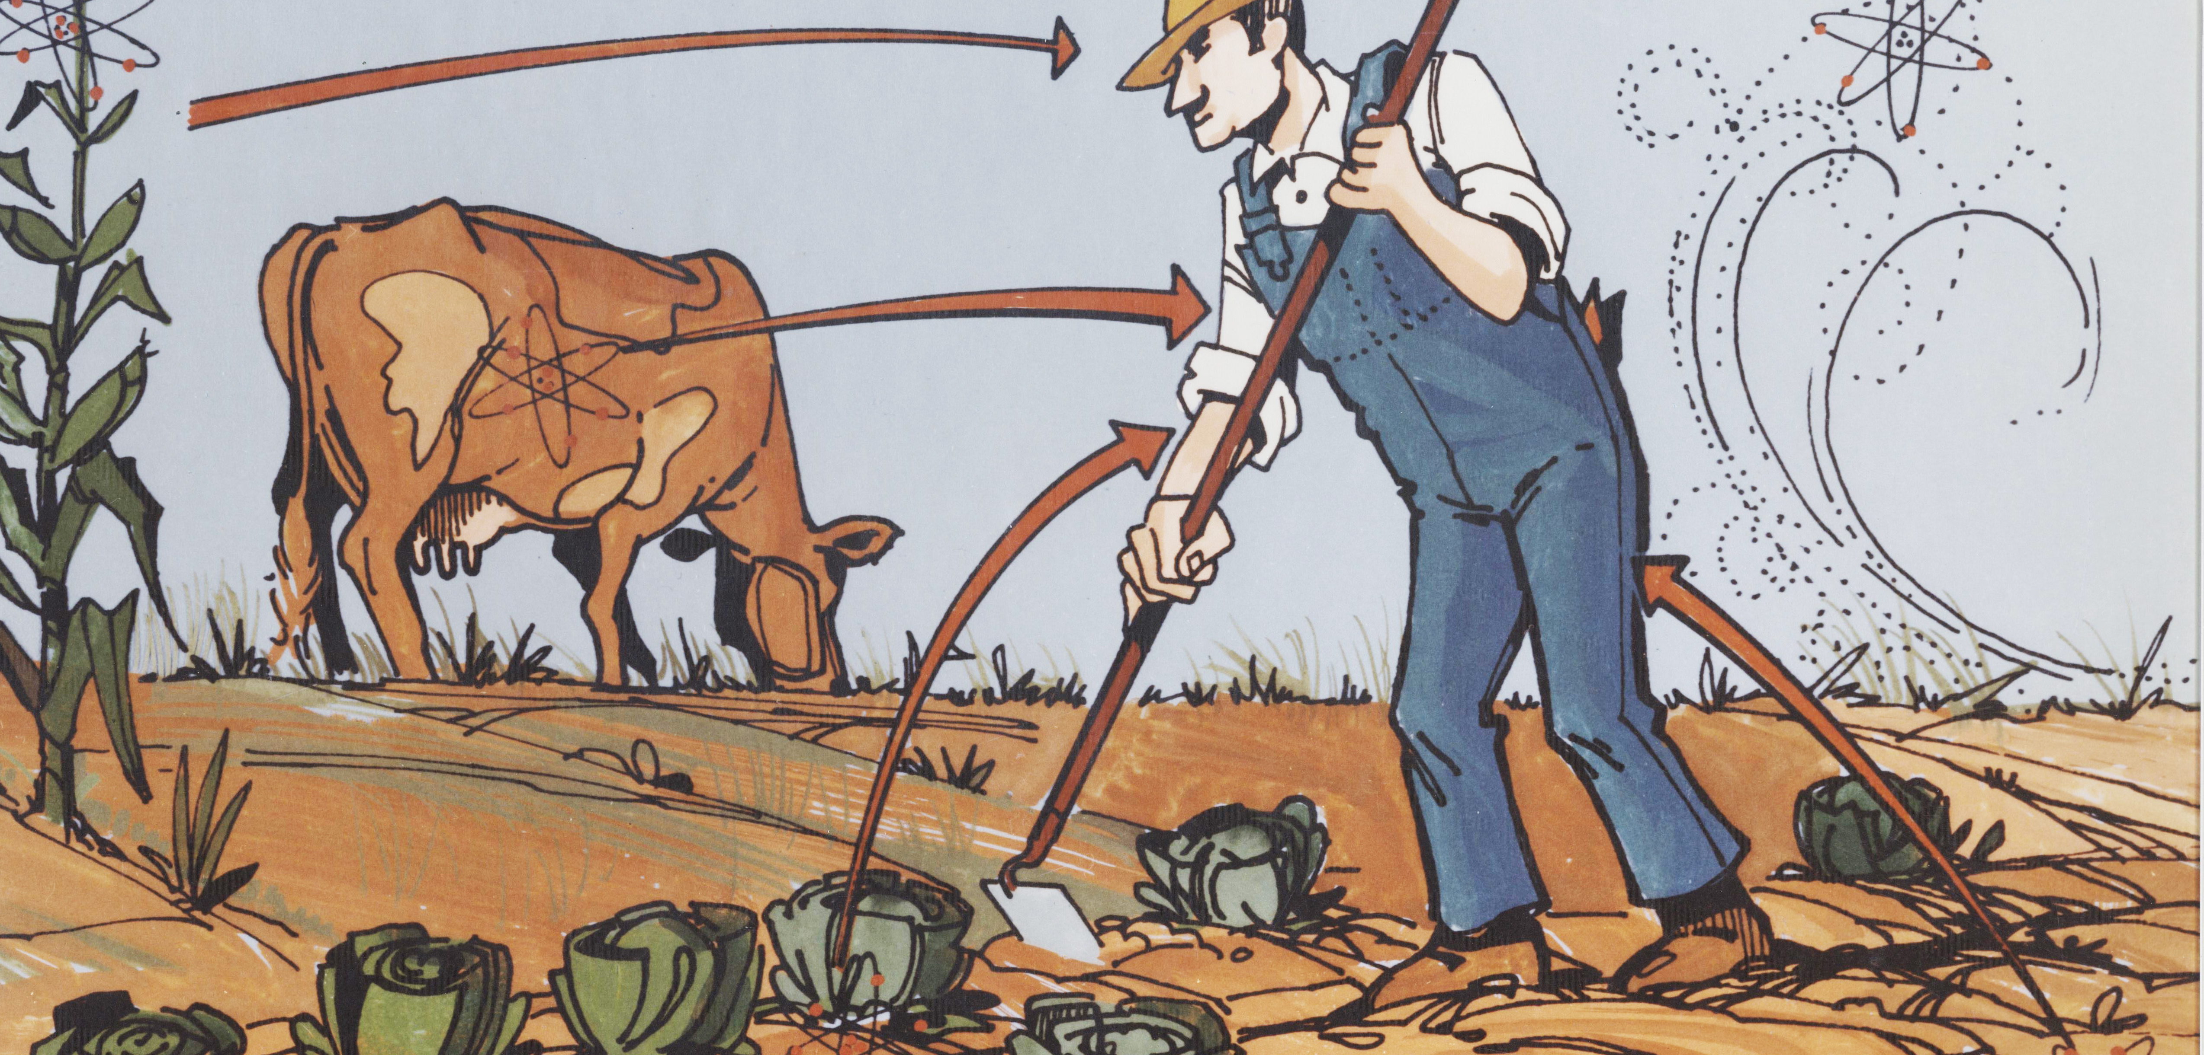
Accumulation/Exposure Models
Initial contaminated conditions
Acute deposition
Chronic deposition

Slide 12
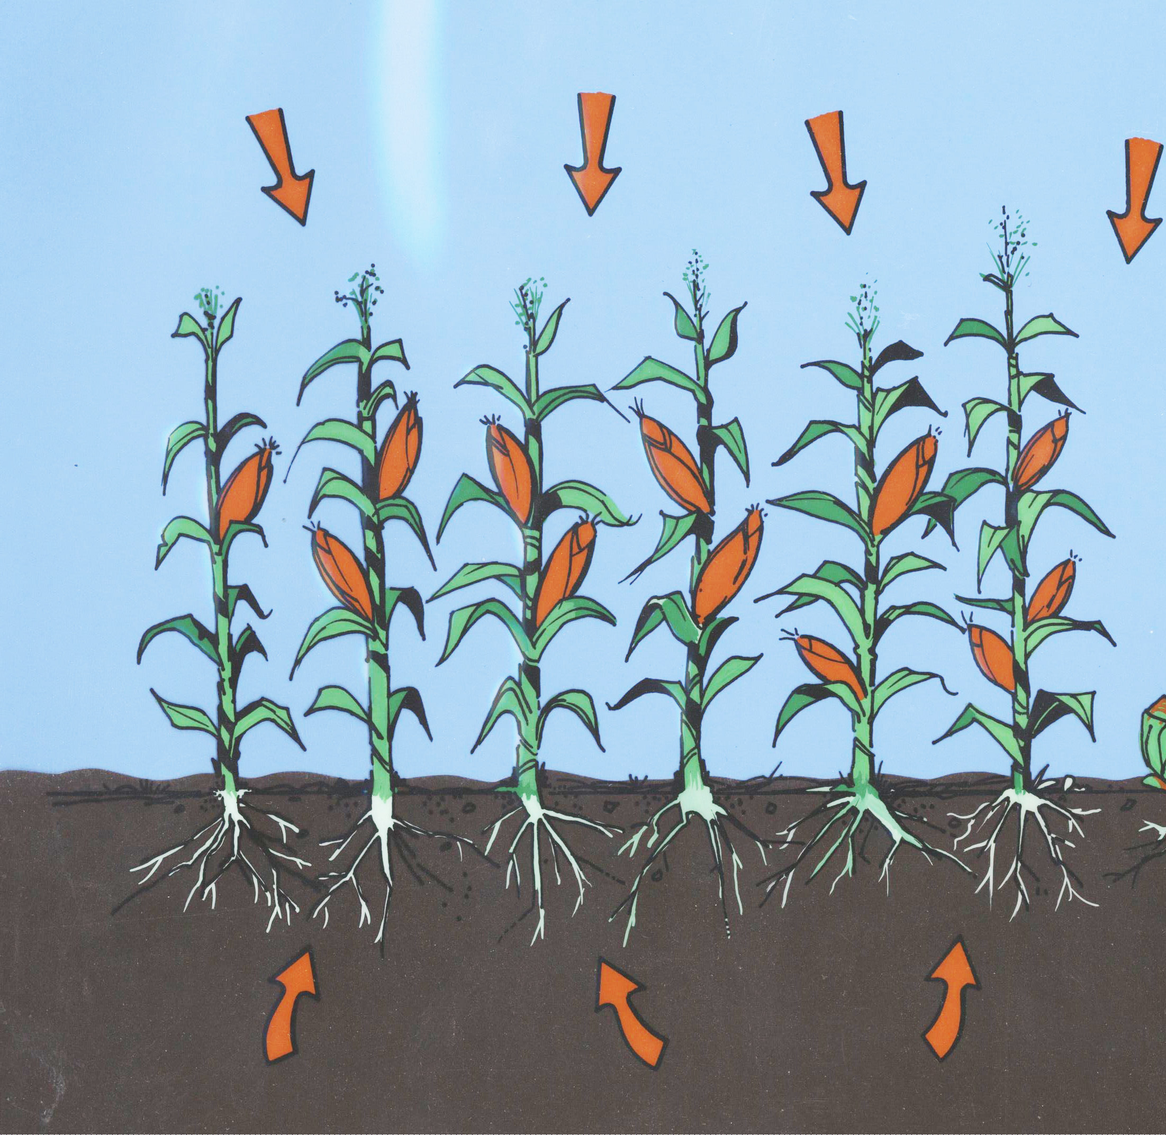
Biotic Transport and Exposure
Accumulation in plants and animals for both direct evaluation of environmental effects and human exposure

Slide 13
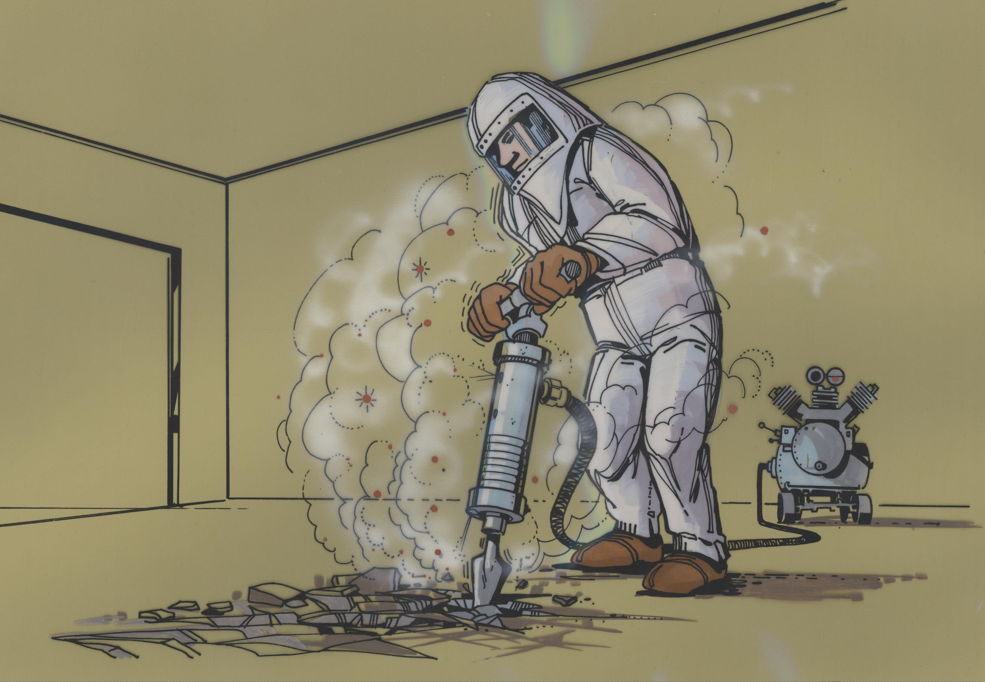
Human Intrusion
Models for evaluating transfer of buried waste to soil surface, resuspension; etc.

Slide 14

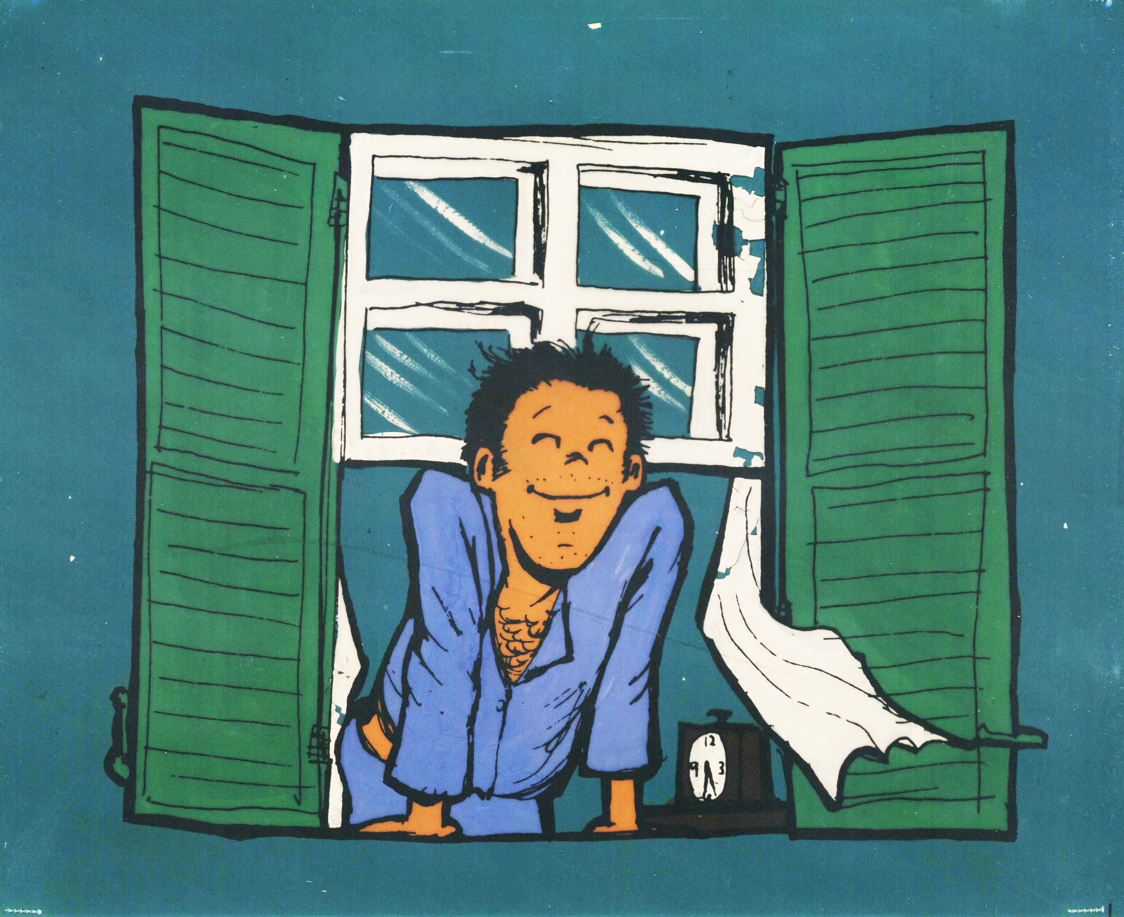

Human Exposure Pathways
External
  Transported air
  Soil
  Swimming
  Shoreline
Inhalation
  Transported air
  Resuspended soil
  Volatilized indoor air pollutants from water

Slide 15
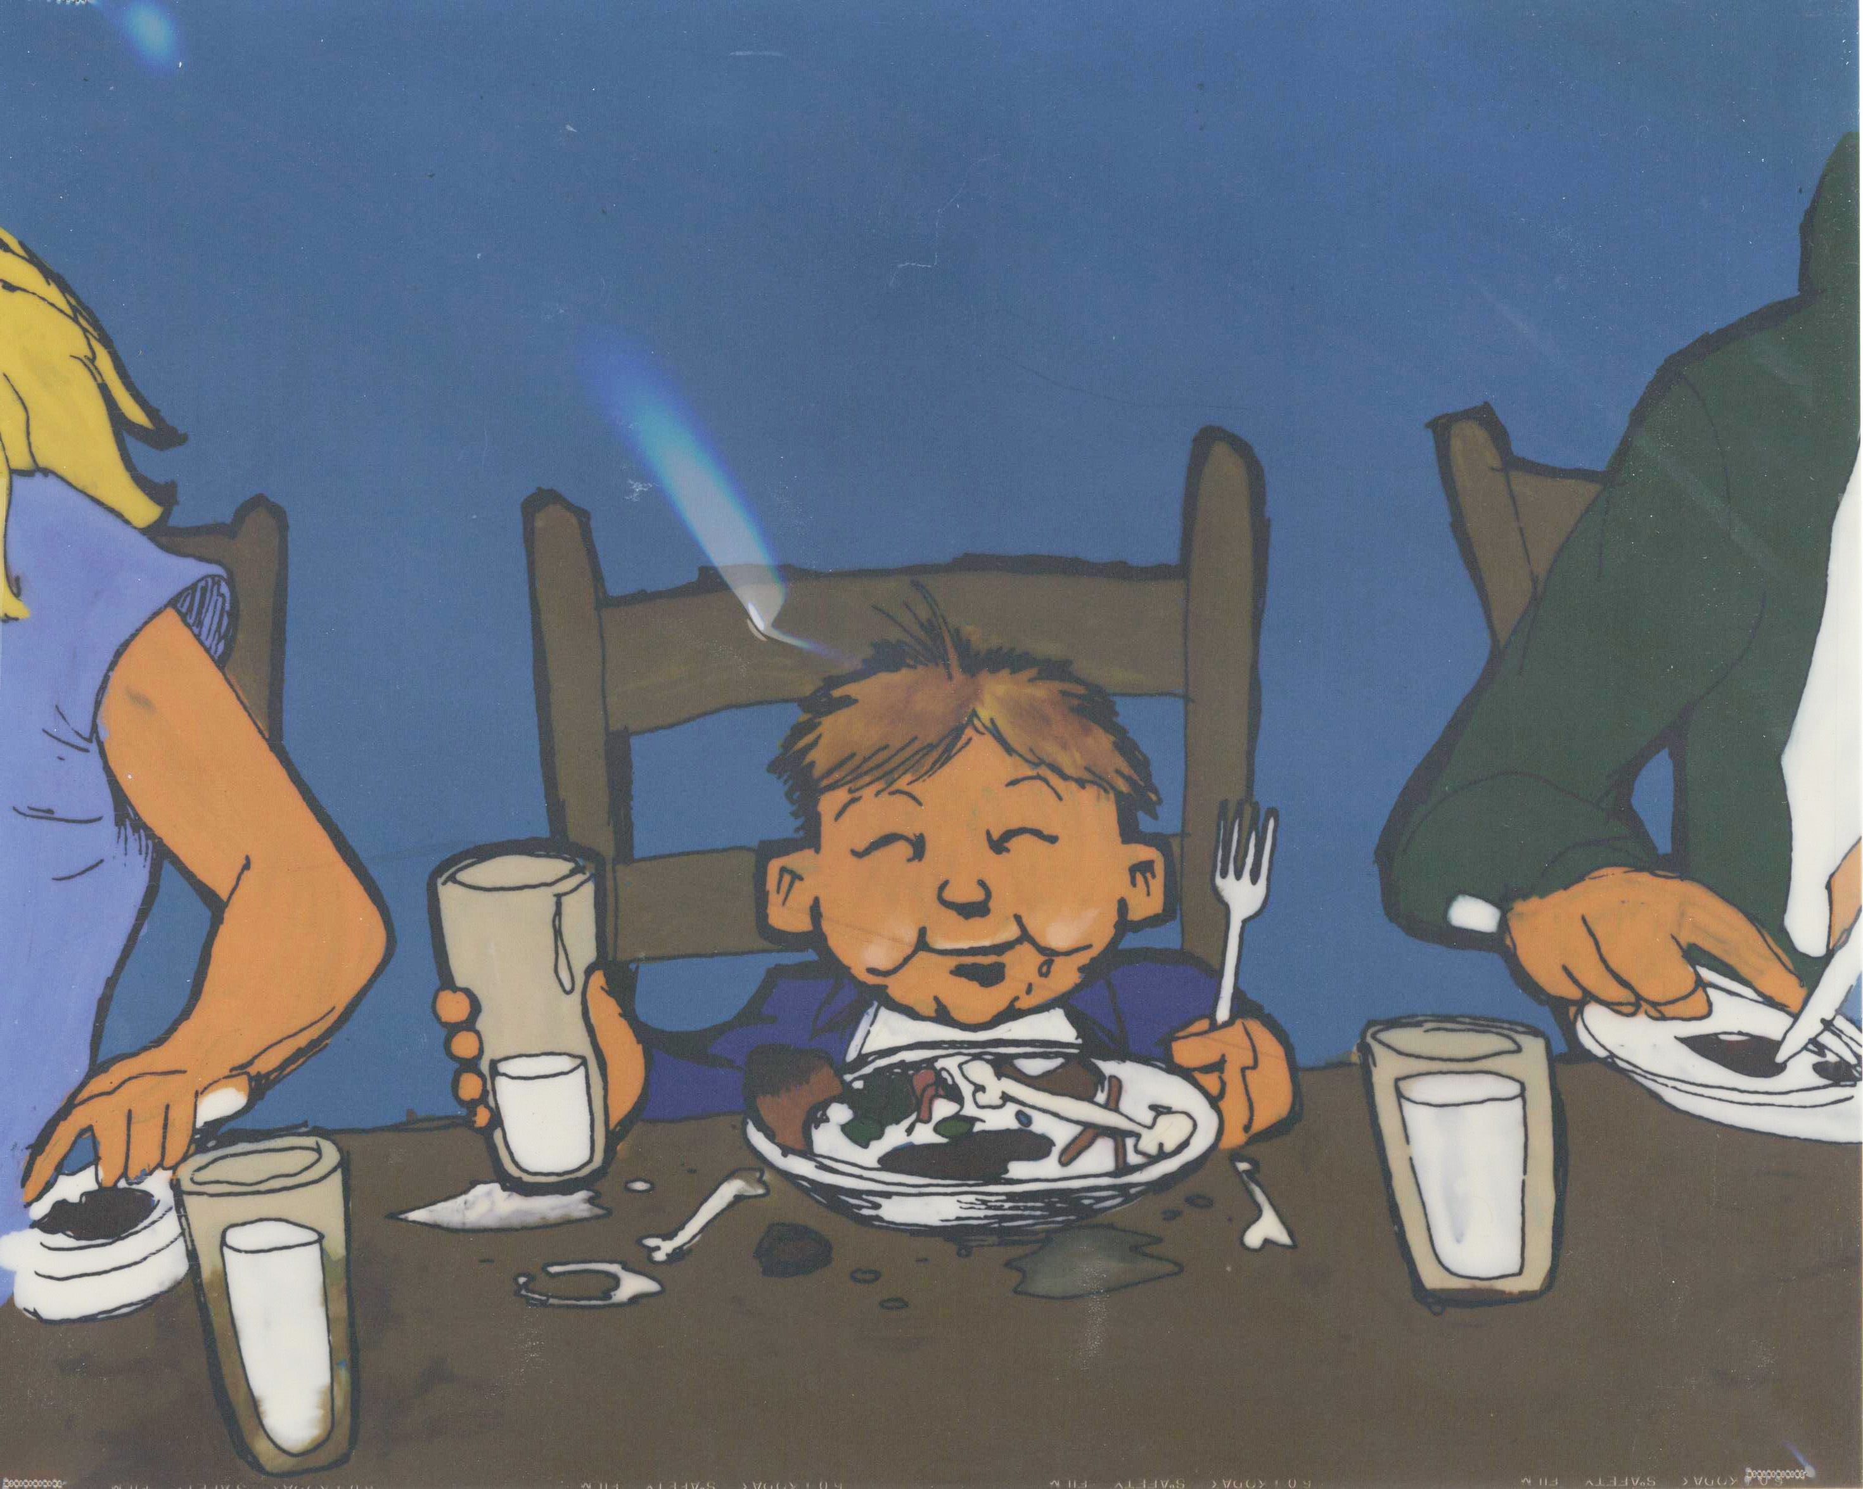
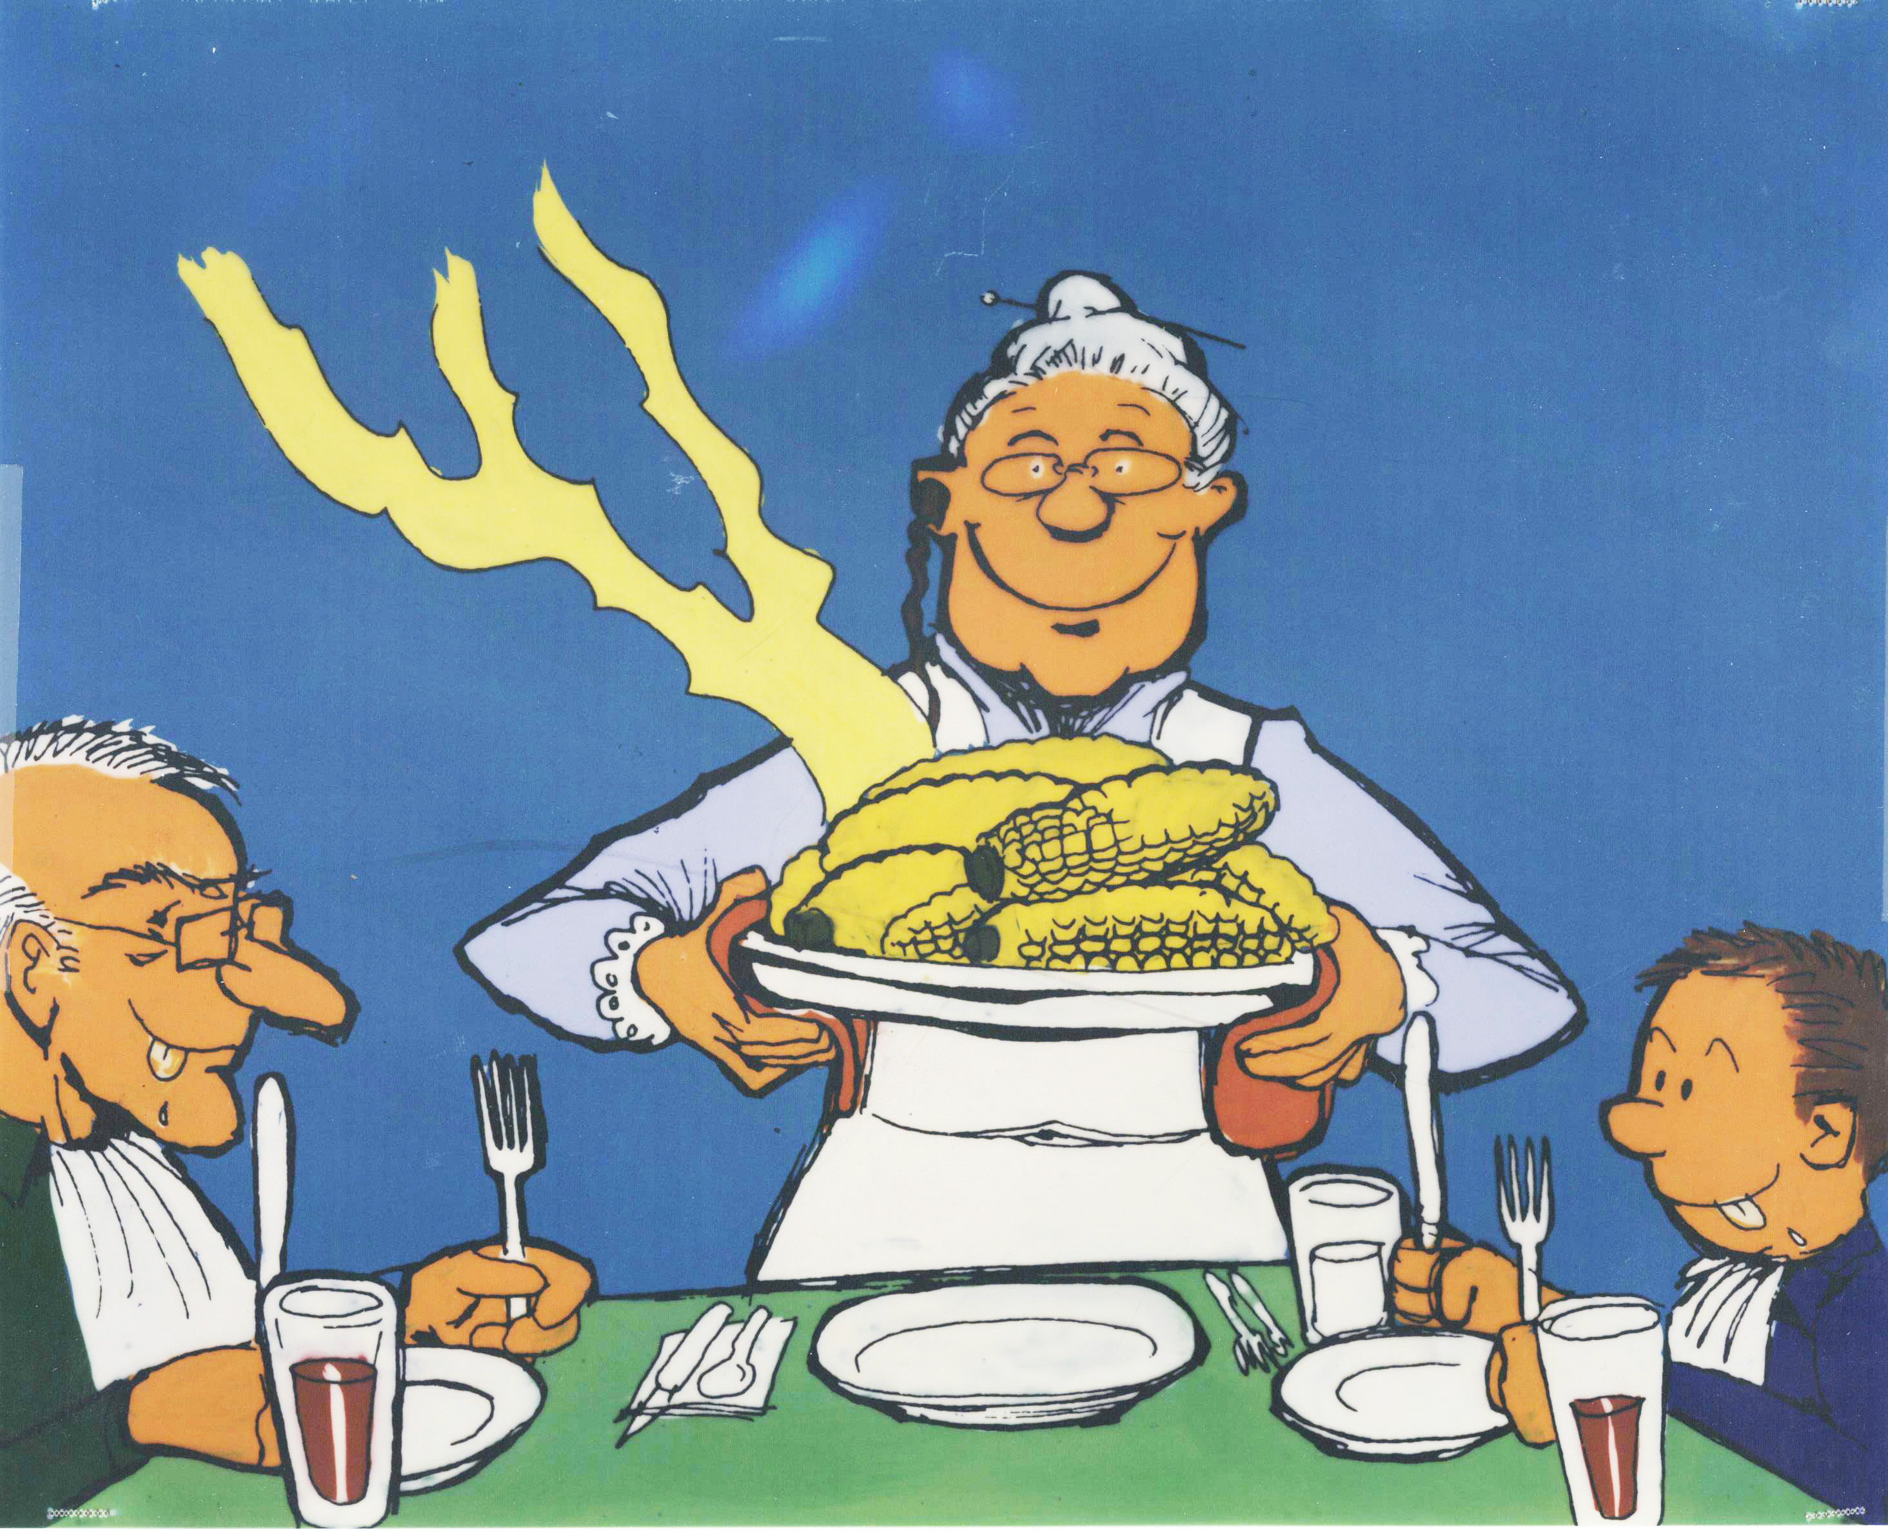
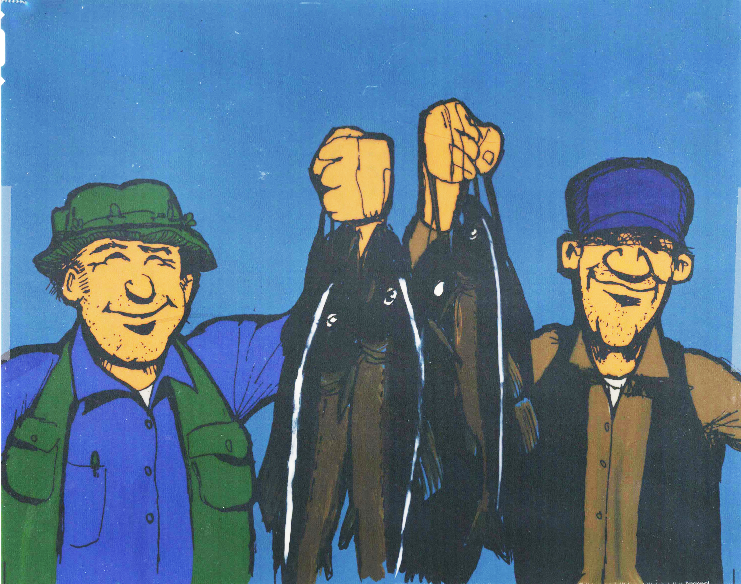
Human Exposure Pathways – Ingestion
Leafy Vegetables
Other Vegetables
Fruit
Grain
Meat
Milk
Poultry
Eggs
Fish
Crustaceans
Mollusks
Water Plants
Drinking Water
Shower water
Swimming water
Soil

Slide 16
Acute-Deposition Food Pathways
GENII V.2 presents results for 4 seasons (Winter/spring/summer/autumn)
“Seasons” are surrogates for complex sets of underlying assumptions about plant growth, weathering, uptake, and time-to-harvest
Selection of season depends on meteorological input (this is related to the uncertainty capability)
Seasons below the equator are reversed! A minor change in an external file to adjust…

Slide 17
Human Exposure
Up to 6 age groups allowed, following ICRP-56,67,69 (International Commission on Radiological Protection)
ICRP Age Group | GENII Age Range
3 months | 0-1 year
1 year | 1-2 years
5 years | 2-7 years
10 years | 8-12 years
15 years | 13-17 years
20+ years | 17-110 years

Slide 18
External Exposure – Doses
Dose rate conversion factors from Federal Guidance Report 12, provided by Keith Eckerman, ORNL
  Air Submersion
  Water Immersion
  Soil Plane
  Soil Volume
  Eckerman, K. F. and J. C. Ryman. 1993. Federal Guidance Report No. 12: External Exposure to Radionuclides in Air, Water, and Soil, Oak Ridge National Laboratory. FGR 12.

Slide 19
Internal Exposure - Doses
Effective dose equivalent: ICRP-30
  Adult only
Effective dose: ICRP-72
  6 age groups
  24 organs/tissues
  Inhalation classes F, M, S

Slide 20
Risk Calculations – FGR 13
US Federal Guidance Report 13 provides coefficients for 15 cancer sites
  Inhalation (risk/Bq)
    Inhalation classes F, M, S
  Ingestion (risk/Bq)
    Accounts for different consumption patterns with age
      Drinking water
      Food crops
  Eckerman, K.F., Legget, R.W., Nelson, C.B., Puskin, J.S., Richardson, A.C.B. 1999. Federal Guidance Report No. 13: Cancer Risk Coefficients for Environmental Exposure to Radionuclides. EPA 402-R-99-001.

Slide 21
Uncertainty Analysis
Parameter uncertainty and sensitivity may be addressed using the SUM³ processor in FRAMES.
All non-control parameters are allowed to be varied, using description files to define ‘available’ parameters
Acute atmospheric releases are an important subset. SUM³ is used to vary start times, creating distribution functions of dose.

Slide 22
Example
We will now begin our guided use case of GENII
Please access the training workbook to follow along with our guided examples
If at any time you have a questions about the code, please enter it in the chat
  Questions relevant to the whole class will be answered through the main training room
  Simple questions will be answered directly via chat when possible
  Any people experiencing difficulties with the GENII example will be directed into the breakout room for one-on-one help with a GENII trainer
Any questions on GENII after the Webinar has closed can be asked through the RAMP website by navigating to the GENII Support Page or emailing Caitlin Condon at PNNL.

Slide 23
Questions?
Thank you!
Caitlin Condon
caitlin.condon@pnnl.gov

