Slide 1
Using IMBA to Estimate Uptake from Excretion Measurement
2023 RAMP Users’ Group Meeting
Colby Mangini, PhD, CHP

Slide 2
Agenda
Quick Overview of IMBA
  IMBA Lite vs Plus vs Pro
  Tour of Main Screen, Bioassay Calculations Screen, and Dose Calculations Screen
Using IMBA to estimate intake from one excretion data set with multiple intake regimes
Using IMBA to estimate intake from two bioassay data sets

Slide 3

IMBA Overview
Understand Lite vs Plus vs Pro
Step through IMBA Modules
Highlight aspects that will be used for todays discussion

Slide 4
What is IMBA?
Short Answer: Integrated Modules for Bioassay Analysis
The IMBA code is a suite of software modules for internal dosimetry that implements respiratory tract, GI-tract, tissue dosimetry, biokinetic and bioassay models as recommended by the International Commission on Radiological Protection (ICRP)
Originally designed by the UK's Health Security Agency, the IMBA modules can estimate single or multiple intakes of different radionuclides and calculate resulting doses in the body for the ICRP 68 Reference Worker

Slide 5
A Bit of History
Mid 1980’s codes to evaluate bioassay data and calculate internal doses
  GENMOD, INDOS, REMEDY, and CINDY… based on ICRP 26/30
Mid 1980’s these codes couldn’t use new ICRP 66 HRTM
  IMBA was born in 1997
    British Nuclear Fuels
    Westlakes Research Institute
    UK National Radiological Protection Board (NRPB) (absorbed into UK Health Protection Agency)
Fast forward to today…
  IMBA 5.0.1: developed by UK HPA and licensed by RAMP

Slide 6
IMBA Lite
The base unit is the core of IMBA Professional Plus and enables the user to perform basic internal dosimetry calculations (e.g., calculating doses from a specified intake, estimating an intake from bioassay measurements and calculating bioassay quantities from a given intake)
Includes 75 radionuclides
  Additional Radionuclides Pack 1 and 2 adding ~665 more
Assess an intake from either inhalation, ingestion, or direct injection
Full access to ICRP 60/68 and ICRP 26/30 models and parameters

Slide 7
IMBA Plus Ad-Ons
All IMBA Lite functionality
(1) Multiple Intake Regimes
(2) Multiple Bioassay Types
(3) Associated Radionuclides
(4) Uranium Mixtures
(5) Uptake from Wounds

Slide 8
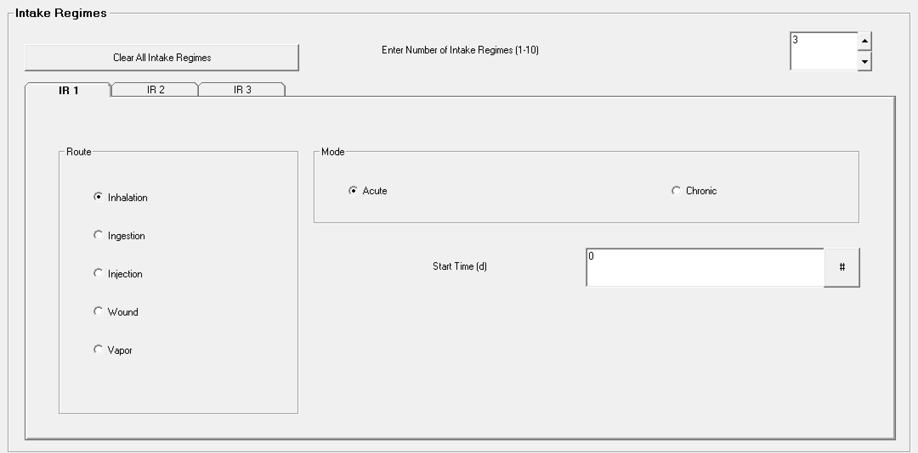
Multiple Intake Regimes (#1)
Up to 10
Contributions from each included in bioassay and dose calculations
Different model parameters assigned to each

Slide 9
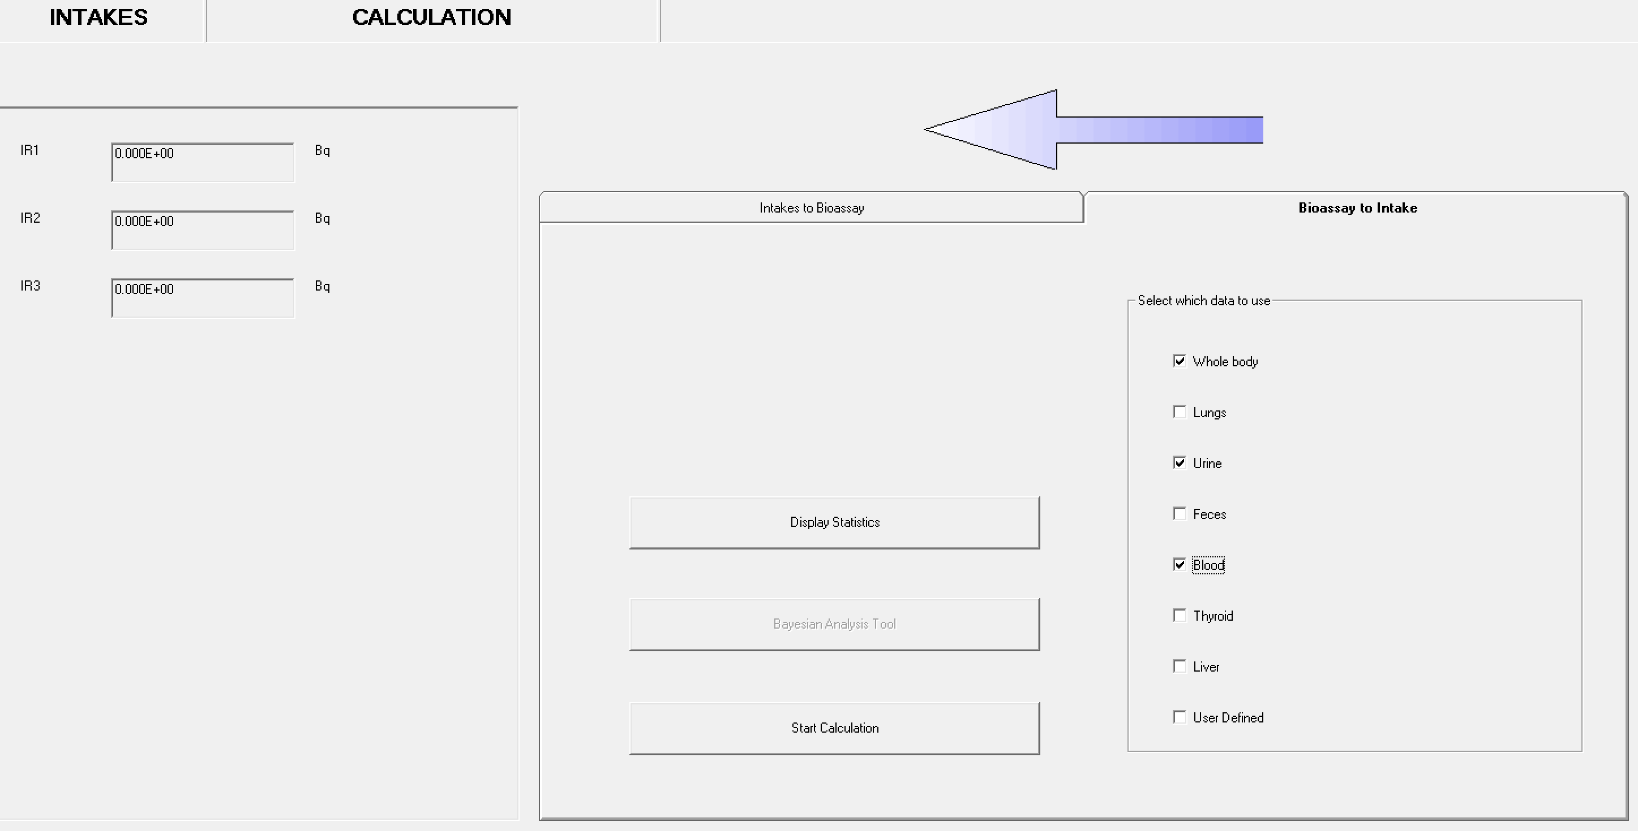
Multiple Bioassay Types (#2)
8 different bioassay quantities
This allows user to fit the intake to different bioassay types simultaneously
This Add-On also works with Add-On 1 to enable multiple intakes to be fitted to multiple bioassay data types simultaneously

Slide 10
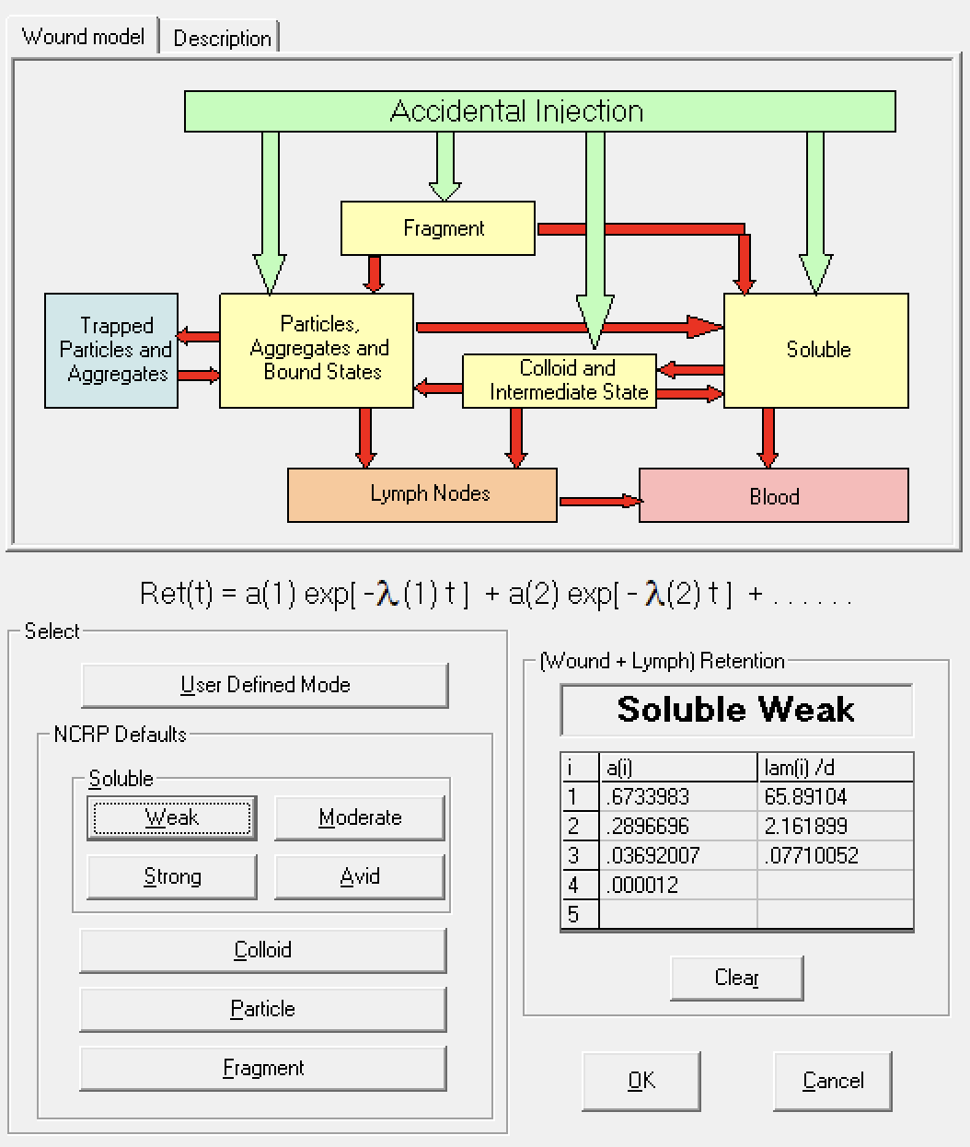
Uptake from a Wound (#5)
Enables the user to specify how the activity reaches the blood following a wound contamination
Implements NCRP No. 156 wound model
Choose one of the "NCRP Defaults" wound categories: Soluble, Colloid, Particle or Fragment.
Users may enter their own values for the retention function as a sum of exponentials (User Defined Mode)

Slide 11
IMBA Pro
All IMBA Plus functionality
(6) Errors on Intake
(7) Bayes Implementation
(8) Tritium Tool
(9) Compensation Type Calculations
(10) Ingrowth of Americium
(11) Statistics Package

Slide 12
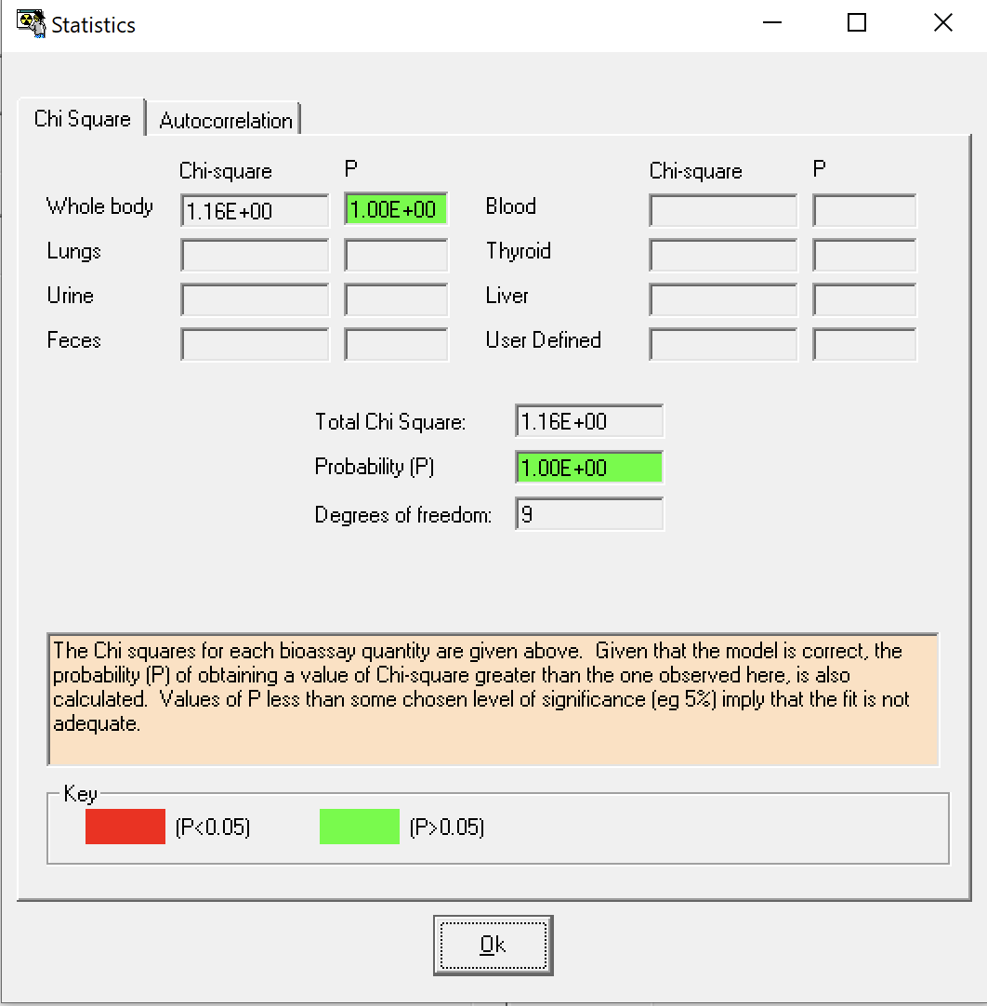
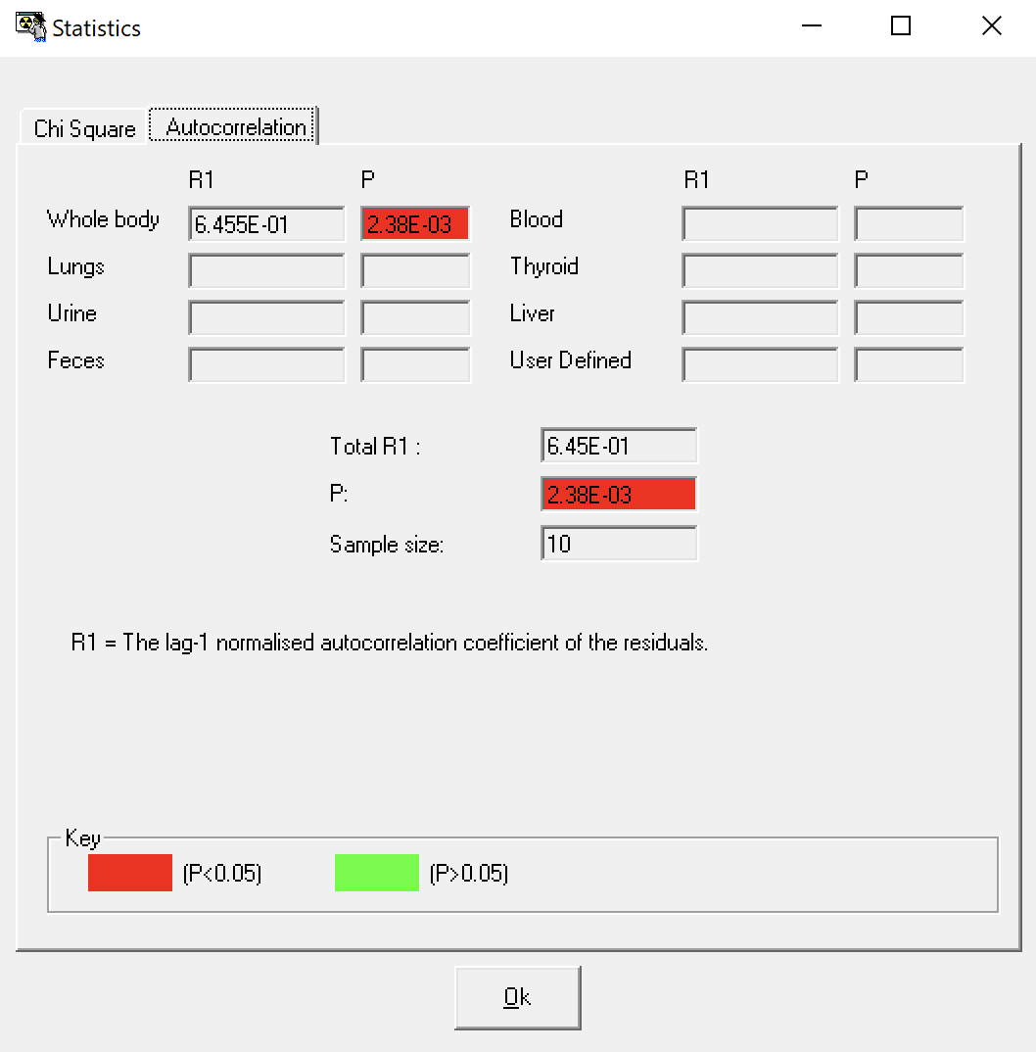
Statistics Package (#11)
Allows the user to examine useful statistical information immediately after fitting intakes to measurement data

Slide 13
Demonstrations
I-125 inhalation with limited urine excretion data
  Find acute inhalation intake
  Find intake assuming vapor form
  Find intake assuming uptake via a wound
  Determine most likely intake
Co-60 inhalation with 2 types of bioassay data

Slide 14
I-125 Inhalation
A lab worker working with an I‐125 radiolabeling solution gets sprayed on her arm from a leak in a syringe‐to‐needle fitting. The liquid is reportedly deposited on the lab coat above her gloves. The solution penetrates the coat and contaminates the skin.
The skin is decontaminated and no signal can be detected at the thyroid with a handheld monitor during the rest of day of the incident
The chemical composition of the I‐125 solution is unknown
Very few urine spot samples (25 ml) were taken
The spill happens at 11:00 on 8/5/2015

Slide 15
I-125 Inhalation
Determine acute inhalation intake from urine samples
  2.242E+03 Bq (P = 2.09E-01)
Intake as a vapor?
  1.268E+03 Bq (P = 9.97E-02)
Intake via wound model?
  6.649E+02 Bq (P = 7.34E-01)
Wound intake AND acute inhalation?
  5.042E+02 Bq – wound
  4.338E+02 Bq – inhalation
  9.380E+02 Bq – total (P = 9.98E-01)
Measurement Date | Bioassay (Bq/l) | Bioassay (Bq/d)
8/5/2015 17:00 | 406.6 | 569.2
8/7/2015 12:00 | 18.7 | 26.2
9/2/2015 12:00 | <4.5 [LOD] | <6.3
Assumed daily urine production of 1.40 liters
Collection period is 25ml/1400ml or 0.018

Slide 16
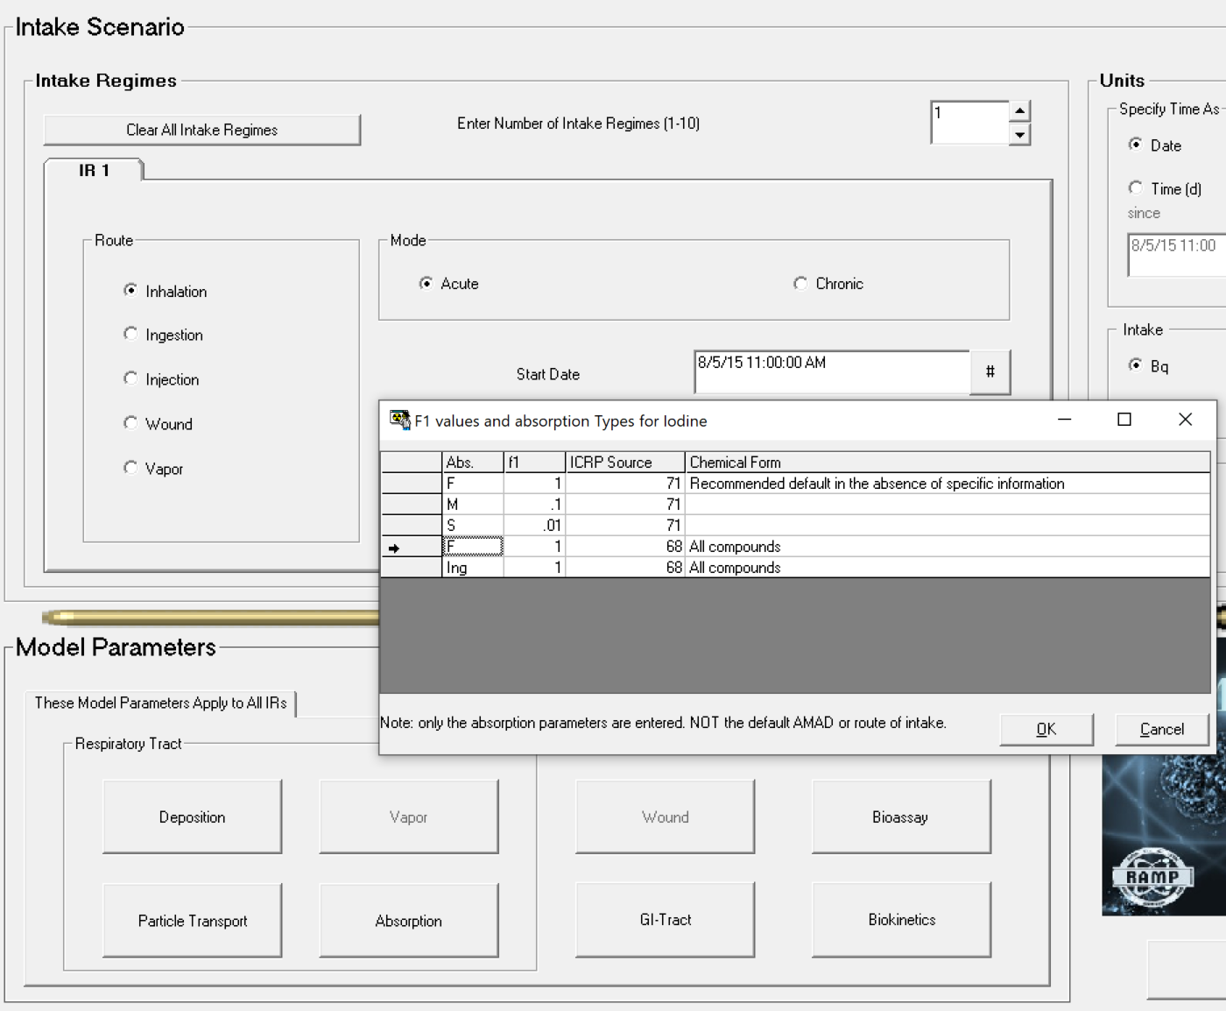
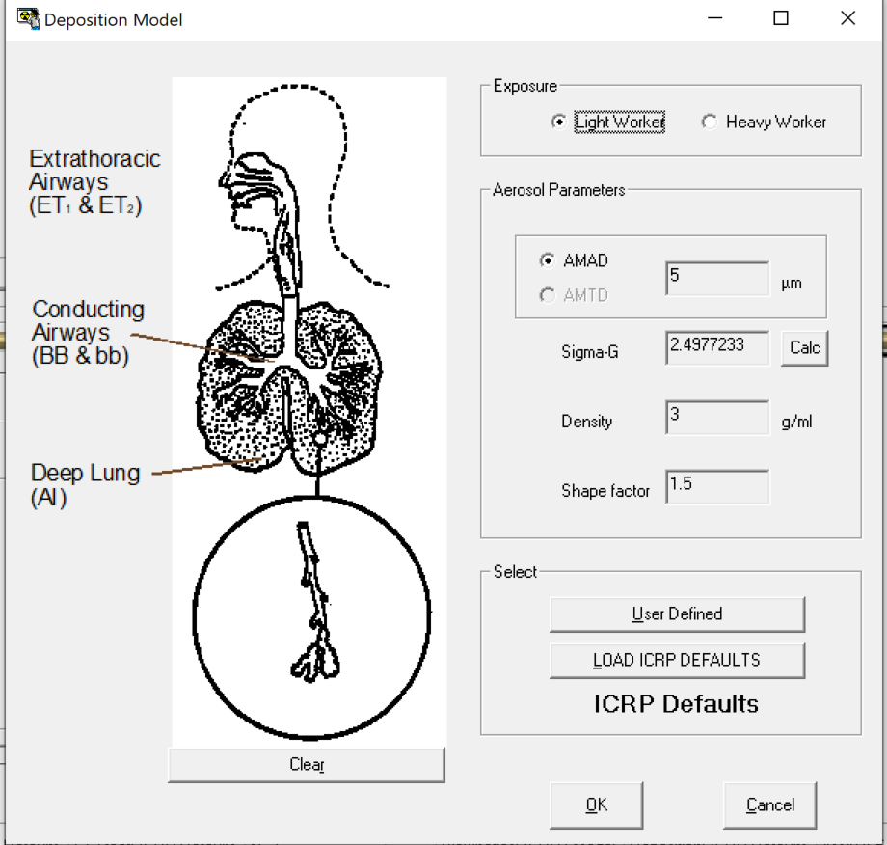
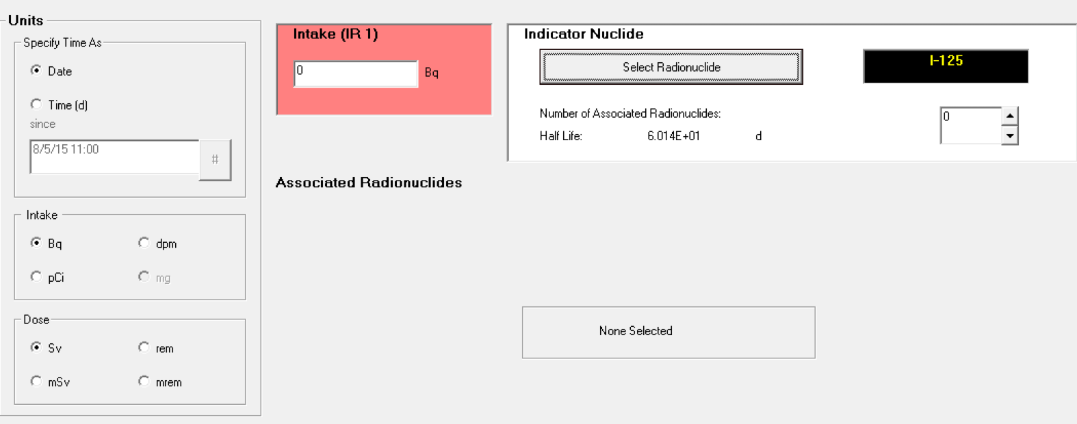
I-125 Inhalation

Slide 17
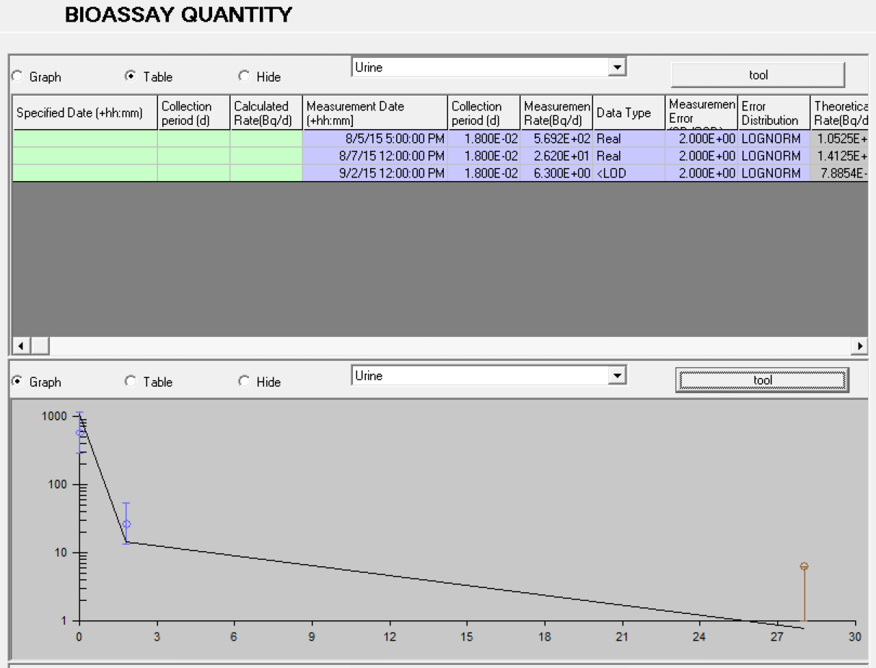
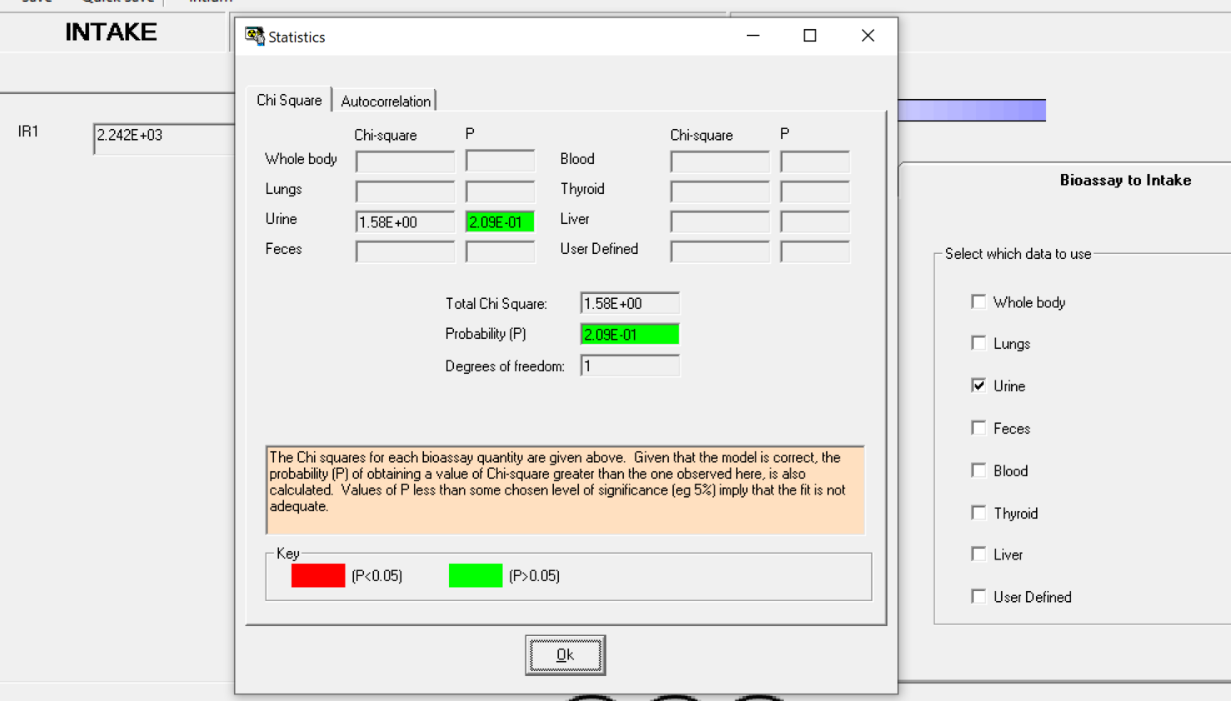
I-125 Inhalation

Slide 18
I-125 Inhalation
Determine acute inhalation intake from urine samples
  2.242E+03 Bq (P = 2.09E-01)
Intake as a vapor?
  1.268E+03 Bq (P = 9.97E-02)
Could these be modeled as a wound?
  6.649E+02 Bq (P = 7.34E-01)
Wound intake AND acute inhalation?
  5.042E+02 Bq – wound
  4.338E+02 Bq – inhalation
  9.380E+02 Bq – total (P = 9.98E-01)
Measurement Date | Bioassay (Bq/l) | Bioassay (Bq/d)
8/5/2015 17:00 | 406.6 | 569.2
8/7/2015 12:00 | 18.7 | 26.2
9/2/2015 12:00 | <4.5 [LOD] | <6.3
Assumed daily urine production of 1.40 liters
Collection period is 25ml/1400ml or 0.018

Slide 19
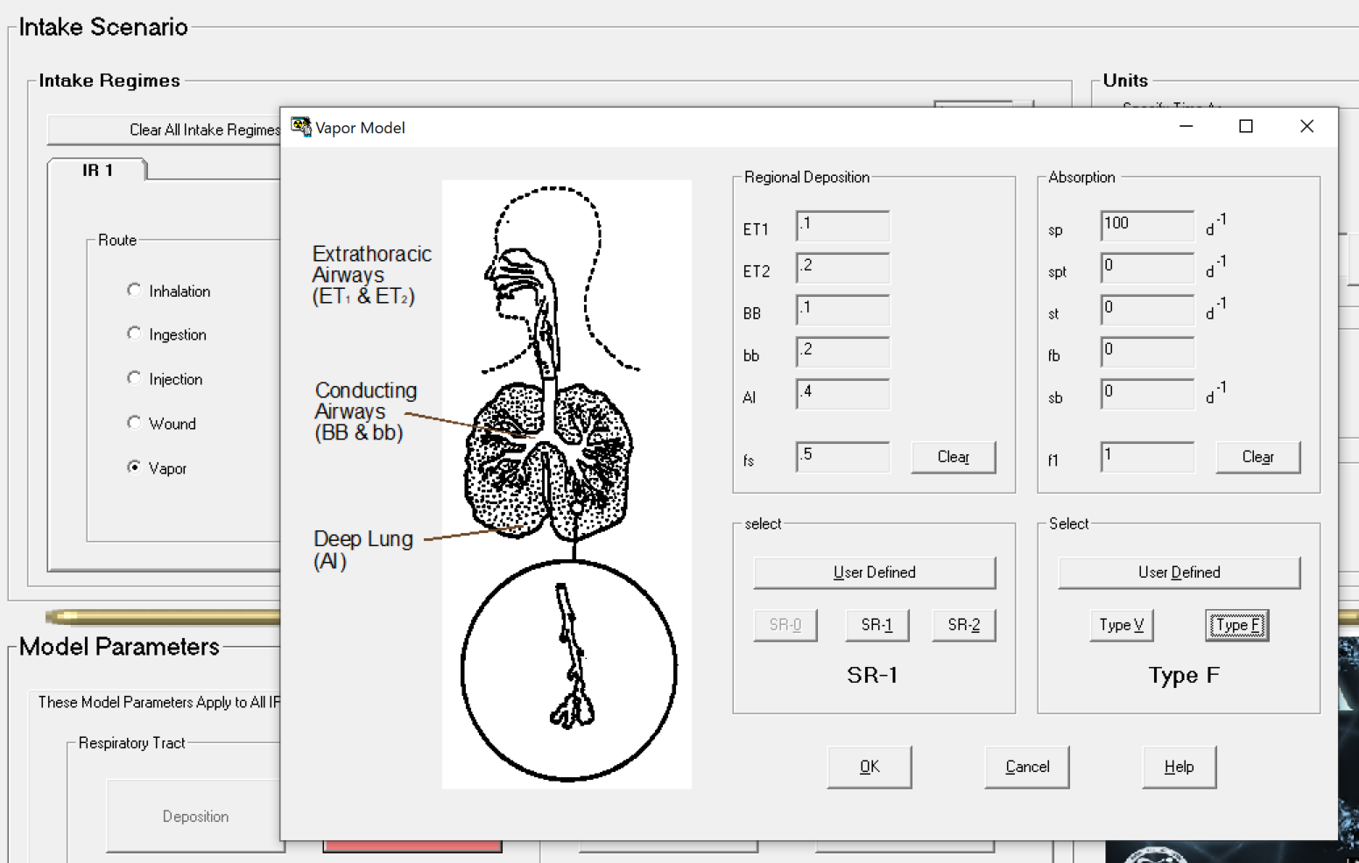
I-125 Inhalation: Vapor

Slide 20
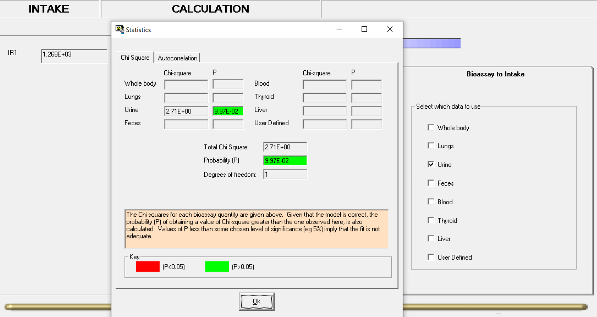
I-125 Inhalation: Vapor

Slide 21
I-125 Inhalation
Determine acute inhalation intake from urine samples
  2.242E+03 Bq (P = 2.09E-01)
Intake as a vapor?
  1.268E+03 Bq (P = 9.97E-02)
Intake via wound model?
  6.649E+02 Bq (P = 7.34E-01)
Wound intake AND acute inhalation?
  5.042E+02 Bq – wound
  4.338E+02 Bq – inhalation
  9.380E+02 Bq – total (P = 9.98E-01)
Measurement Date | Bioassay (Bq/l) | Bioassay (Bq/d)
8/5/2015 17:00 | 406.6 | 569.2
8/7/2015 12:00 | 18.7 | 26.2
9/2/2015 12:00 | <4.5 [LOD] | <6.3
Assumed daily urine production of 1.40 liters
Collection period is 25ml/1400ml or 0.018

Slide 22
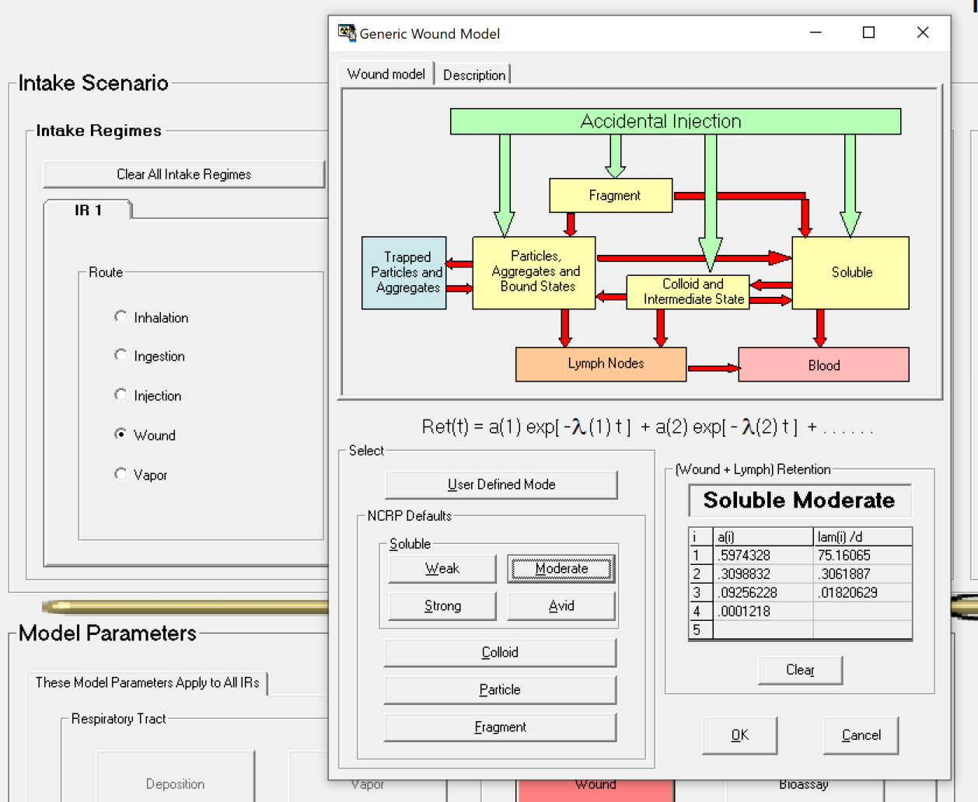
I-125 Inhalation: Wound

Slide 23
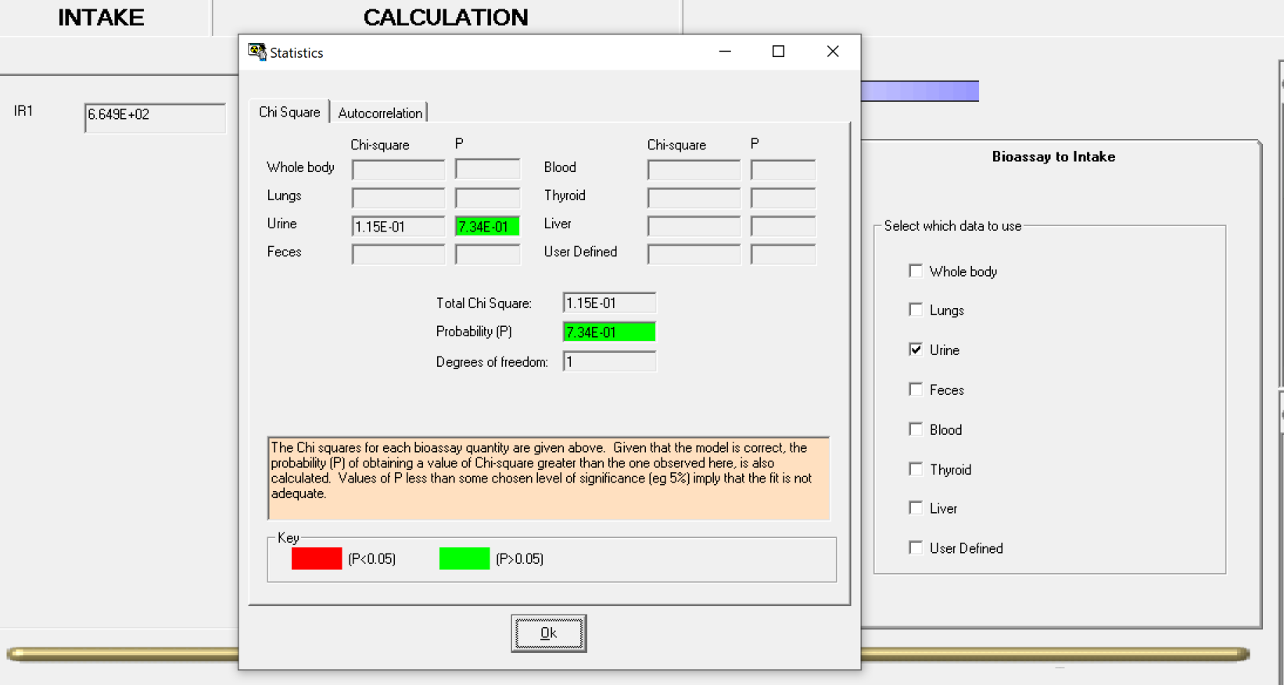
I-125 Inhalation: Wound

Slide 24
I-125 Inhalation
Determine acute inhalation intake from urine samples
  2.242E+03 Bq (P = 2.09E-01)
Intake as a vapor?
  1.268E+03 Bq (P = 9.97E-02)
Intake via wound model?
  6.649E+02 Bq (P = 7.34E-01)
Wound intake AND acute inhalation?
  5.042E+02 Bq – wound
  4.338E+02 Bq – inhalation
  9.380E+02 Bq – total (P = 9.98E-01)
Measurement Date | Bioassay (Bq/l) | Bioassay (Bq/d)
8/5/2015 17:00 | 406.6 | 569.2
8/7/2015 12:00 | 18.7 | 26.2
9/2/2015 12:00 | <4.5 [LOD] | <6.3
Assumed daily urine production of 1.40 liters
Collection period is 25ml/1400ml or 0.018

Slide 25
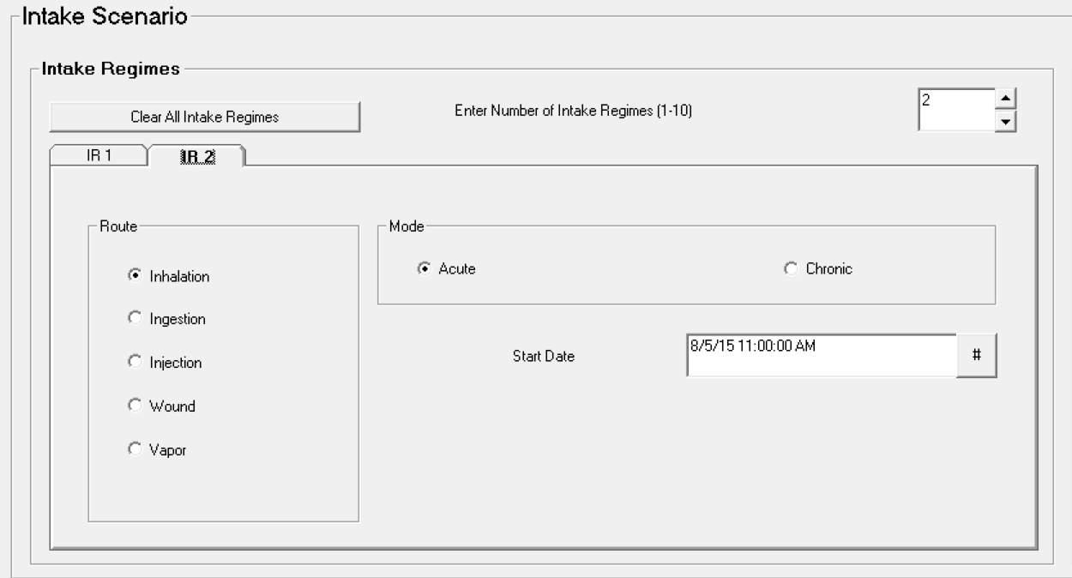
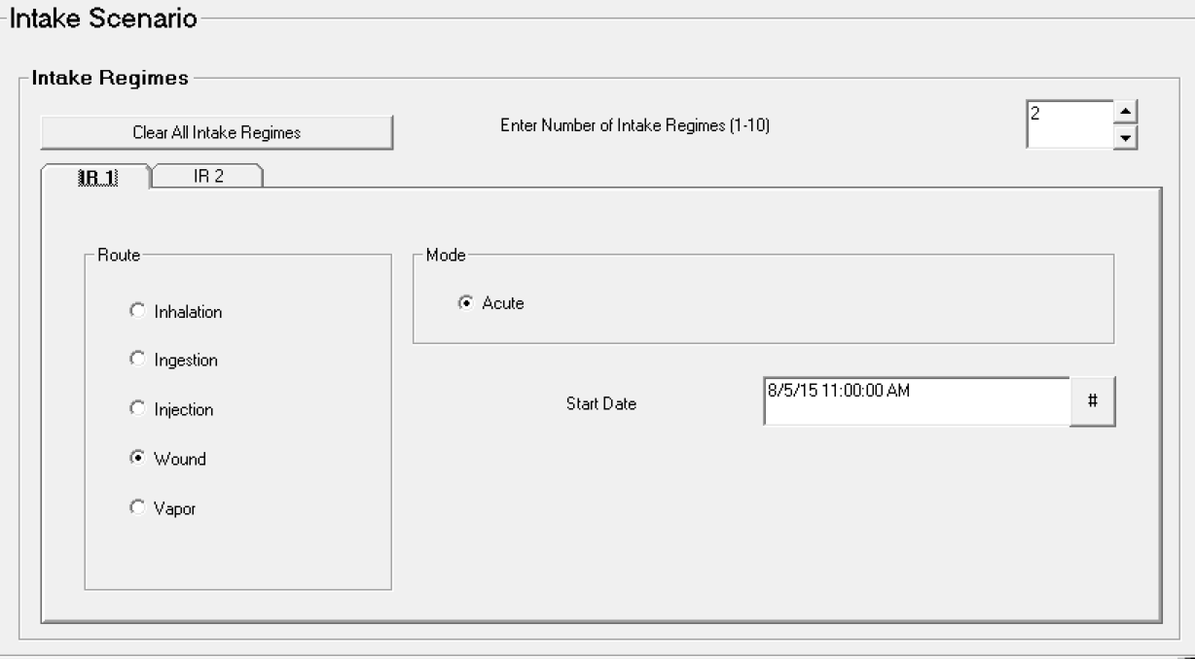
I-125 Inhalation: Wound and Acute

Slide 26
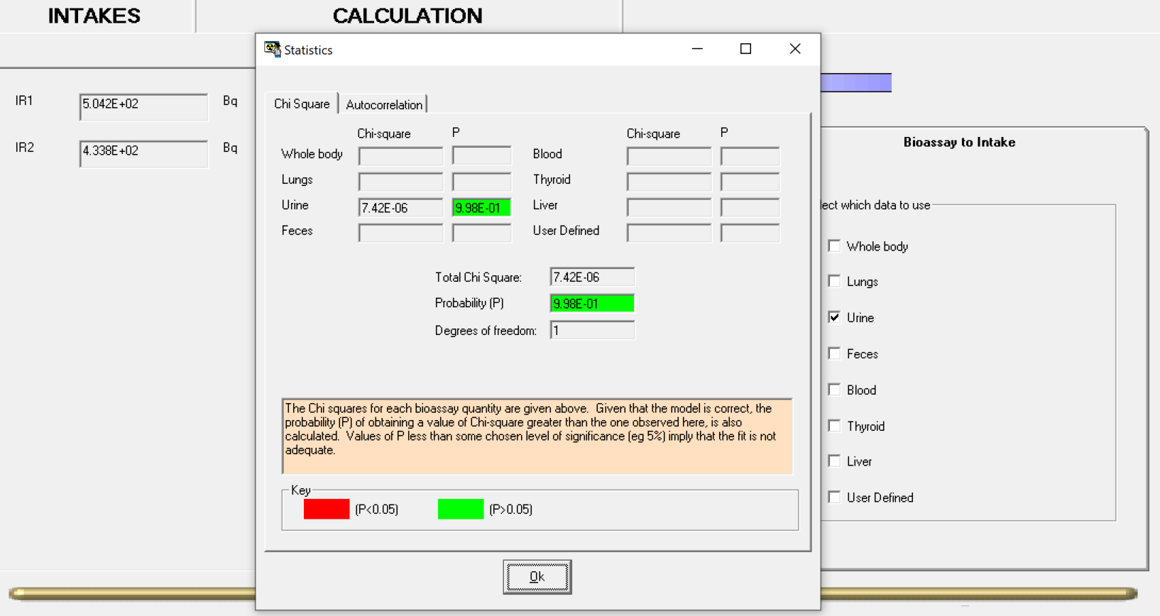
I-125 Inhalation: Wound and Acute

Slide 27
I-125 Inhalation
Determine acute inhalation intake from urine samples
  2.242E+03 Bq (P = 2.09E-01)
Intake as a vapor?
  1.268E+03 Bq (P = 9.97E-02)
Intake via wound model?
  6.649E+02 Bq (P = 7.34E-01)
Wound intake AND acute inhalation?
  5.042E+02 Bq – wound
  4.338E+02 Bq – inhalation
  9.380E+02 Bq – total (P = 9.98E-01)
Measurement Date | Bioassay (Bq/l) | Bioassay (Bq/d)
8/5/2015 17:00 | 406.6 | 569.2
8/7/2015 12:00 | 18.7 | 26.2
9/2/2015 12:00 | <4.5 [LOD] | <6.3
Assumed daily urine production of 1.40 liters
Collection period is 25ml/1400ml or 0.018

Slide 28
Co-60 Inhalation: Urine samples coupled with whole body counting
Worker inhalation of fine dust containing Co-60 (acute intake)
After the incident, the worker followed up with internal monitoring and it was decided to collect urine samples and perform whole body counting
Urine samples had a 1-day collection period
Assume 10% relative uncertainty in bioassay data
There are no earlier known intakes
Assume moderate (M) clearance and 5 um AMAD

Slide 29
Co-60 Inhalation: 2 bioassay datasets
Whole Body Urine
Time after intake (d) | Bioassay (Bq)
1 | 9.76E+05
2 | 5.07E+05
3 | 2.90E+05
4 | 2.01E+05
5 | 1.65E+05
6 | 1.49E+05
8 | 1.38E+05
10 | 1.32E+05
13 | 1.26E+05
16 | 1.21E+05
Time after intake (d) | Bioassay (Bq/d)
1 | 2.09E+04
2 | 9.82E+03
3 | 3.95E+03
4 | 2.33E+03
5 | 1.79E+03
6 | 1.55E+03
8 | 1.27E+03
10 | 1.06E+03
13 | 8.22E+02
16 | 6.53E+02
Estimate acute inhalation intake
  One intake, type M
    1.261E+06 Bq (P = 0.00E+00)
  One intake, type S
    2.401E+06 Bq (P = 0.00E+00)
  Type M and S combined
    1.275E+06 Bq (S)
    6.908E+05 Bq (M)
    1.966E+06 Bq (total) (P = 1.00E+00)

Slide 30
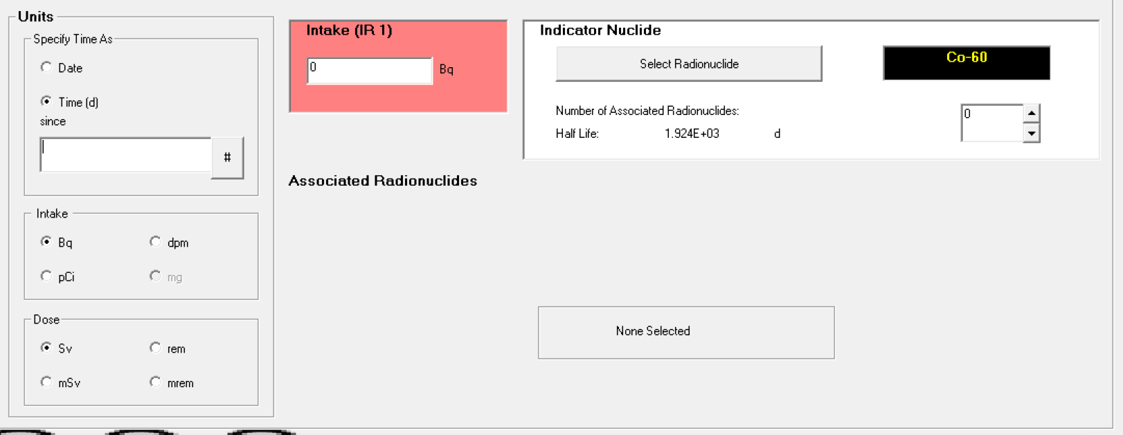
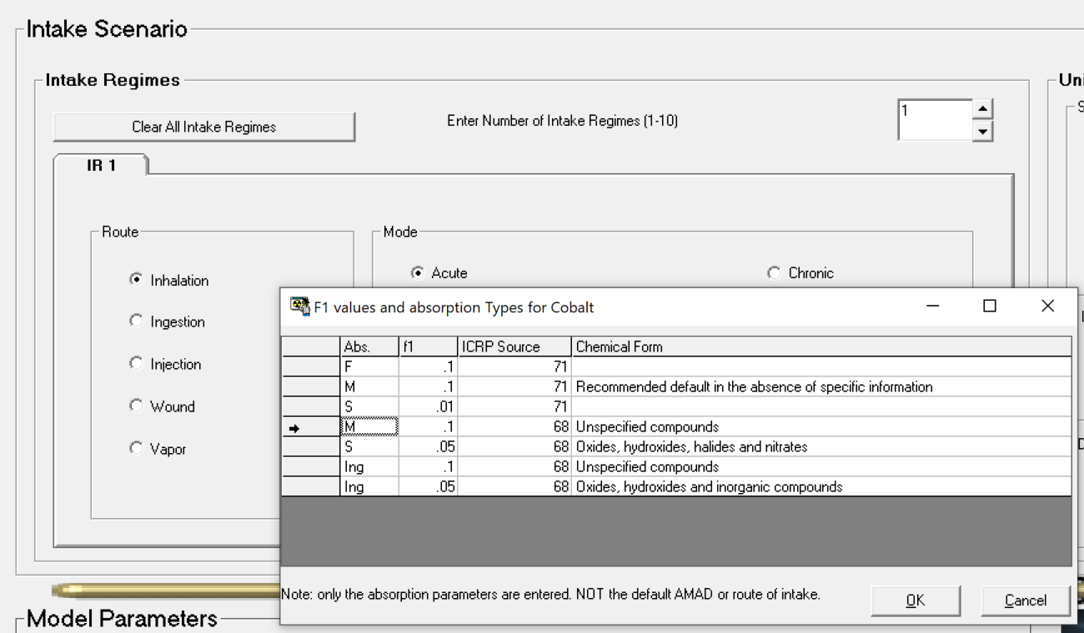
Co-60 Inhalation

Slide 31
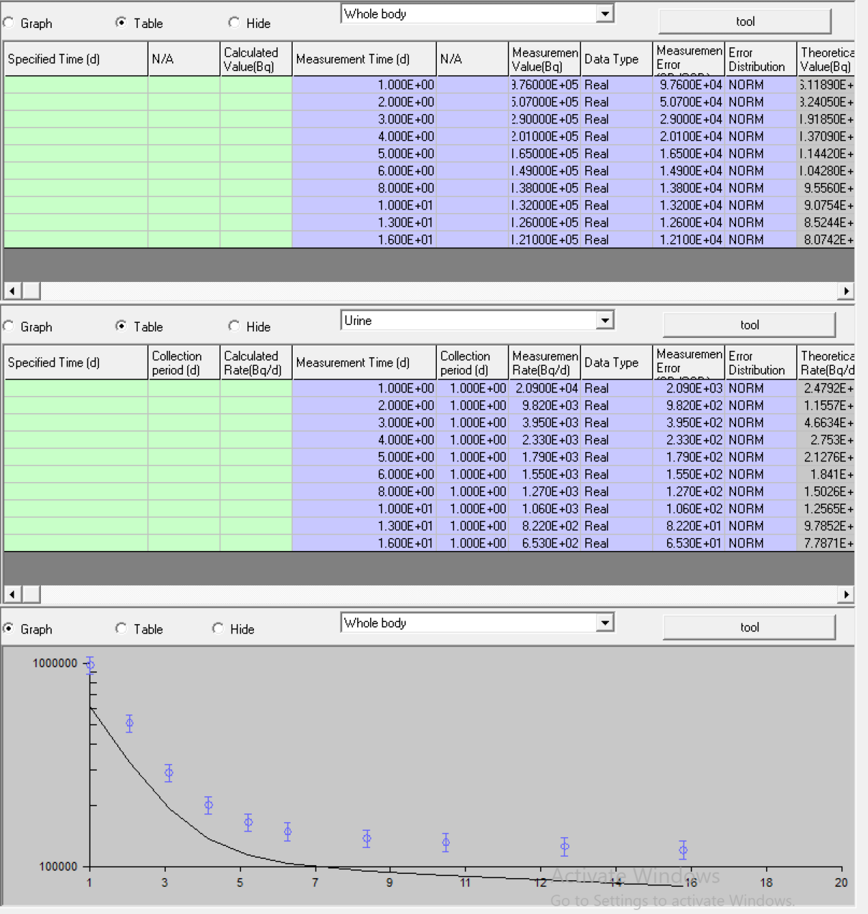
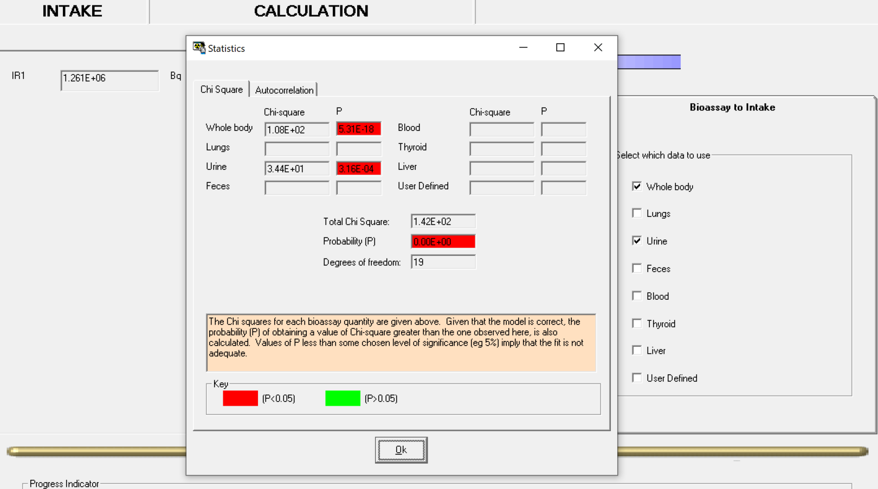
Co-60 Inhalation

Slide 32
Co-60 Inhalation: 2 bioassay datasets
Whole Body Urine
Time after intake (d) | Bioassay (Bq)
1 | 9.76E+05
2 | 5.07E+05
3 | 2.90E+05
4 | 2.01E+05
5 | 1.65E+05
6 | 1.49E+05
8 | 1.38E+05
10 | 1.32E+05
13 | 1.26E+05
16 | 1.21E+05
Time after intake (d) | Bioassay (Bq/d)
1 | 2.09E+04
2 | 9.82E+03
3 | 3.95E+03
4 | 2.33E+03
5 | 1.79E+03
6 | 1.55E+03
8 | 1.27E+03
10 | 1.06E+03
13 | 8.22E+02
16 | 6.53E+02
Estimate acute inhalation intake
  One intake, type M
    1.261E+06 Bq (P = 0.00E+00)
  One intake, type S
    2.401E+06 Bq (P = 0.00E+00)
  Type M and S combined
    1.275E+06 Bq (S)
    6.908E+05 Bq (M)
    1.966E+06 Bq (total) (P = 1.00E+00)

Slide 33
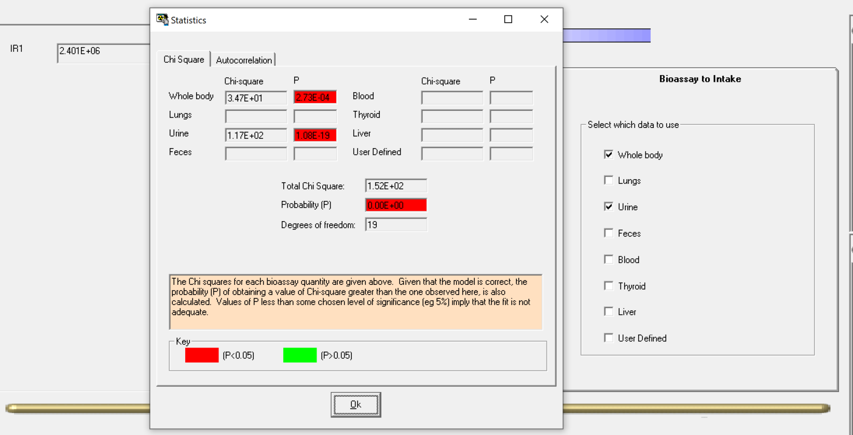
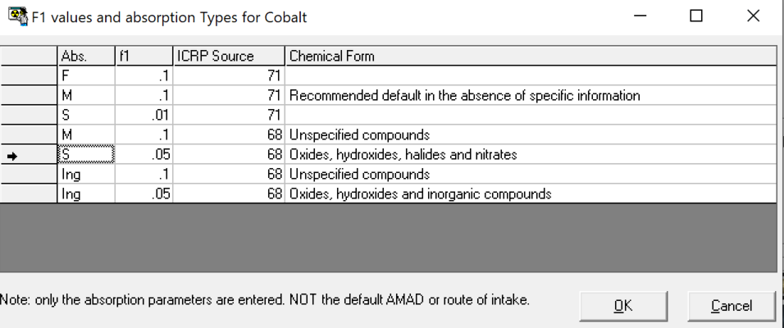
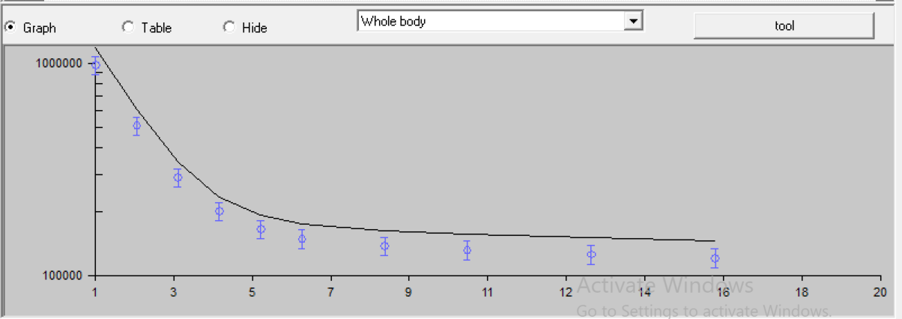
Co-60 Inhalation: Type S

Slide 34
Co-60 Inhalation: 2 bioassay datasets
Whole Body Urine
Time after intake (d) | Bioassay (Bq)
1 | 9.76E+05
2 | 5.07E+05
3 | 2.90E+05
4 | 2.01E+05
5 | 1.65E+05
6 | 1.49E+05
8 | 1.38E+05
10 | 1.32E+05
13 | 1.26E+05
16 | 1.21E+05
Time after intake (d) | Bioassay (Bq/d)
1 | 2.09E+04
2 | 9.82E+03
3 | 3.95E+03
4 | 2.33E+03
5 | 1.79E+03
6 | 1.55E+03
8 | 1.27E+03
10 | 1.06E+03
13 | 8.22E+02
16 | 6.53E+02
Estimate acute inhalation intake
  One intake, type M
    1.261E+06 Bq (P = 0.00E+00)
  One intake, type S
    2.401E+06 Bq (P = 0.00E+00)
  Type M and S combined
    1.275E+06 Bq (S)
    6.908E+05 Bq (M)
    1.966E+06 Bq (total) (P = 1.00E+00)

Slide 35
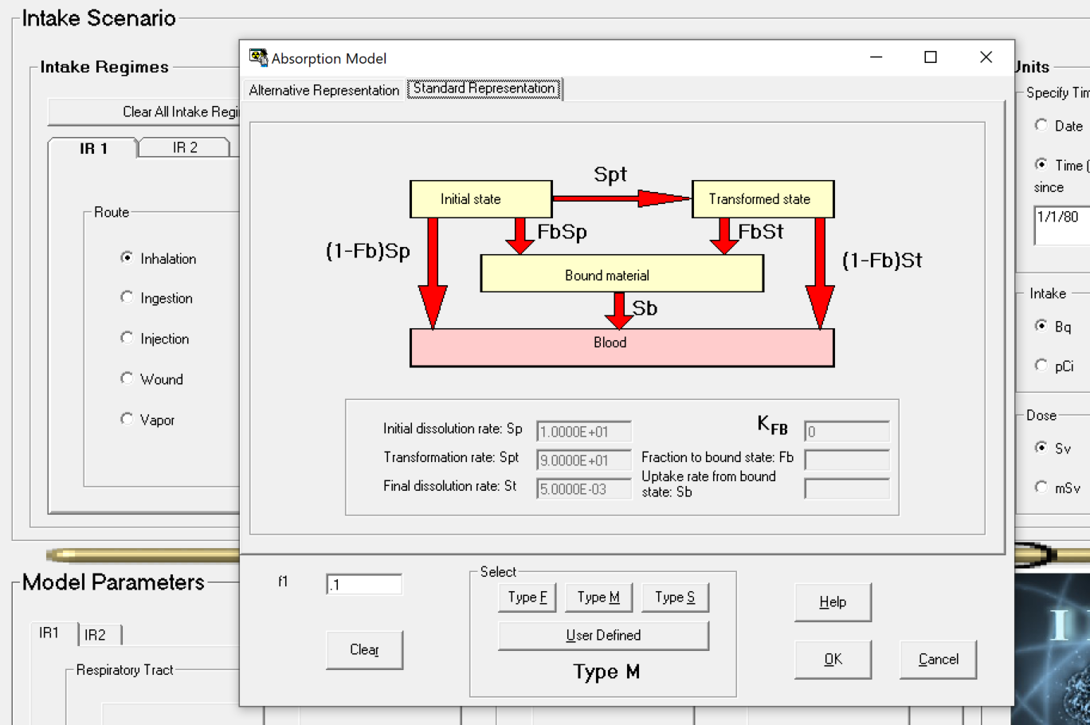
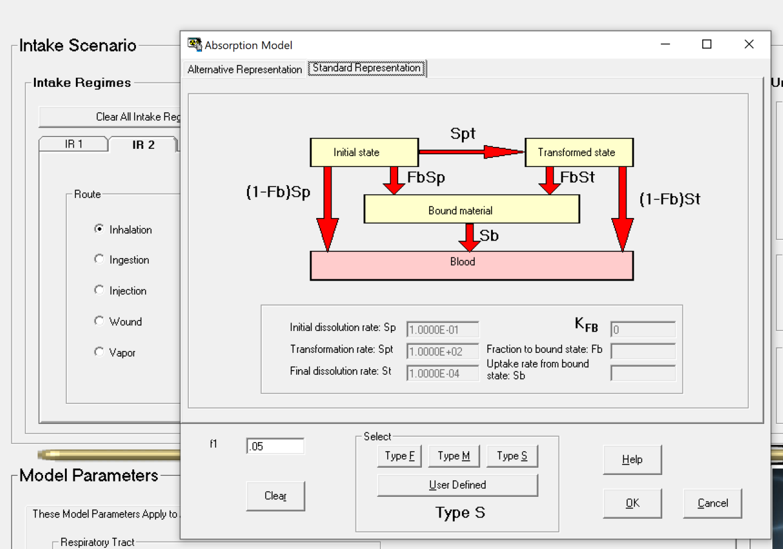
Co-60 Inhalation: Type M and Type S

Slide 36
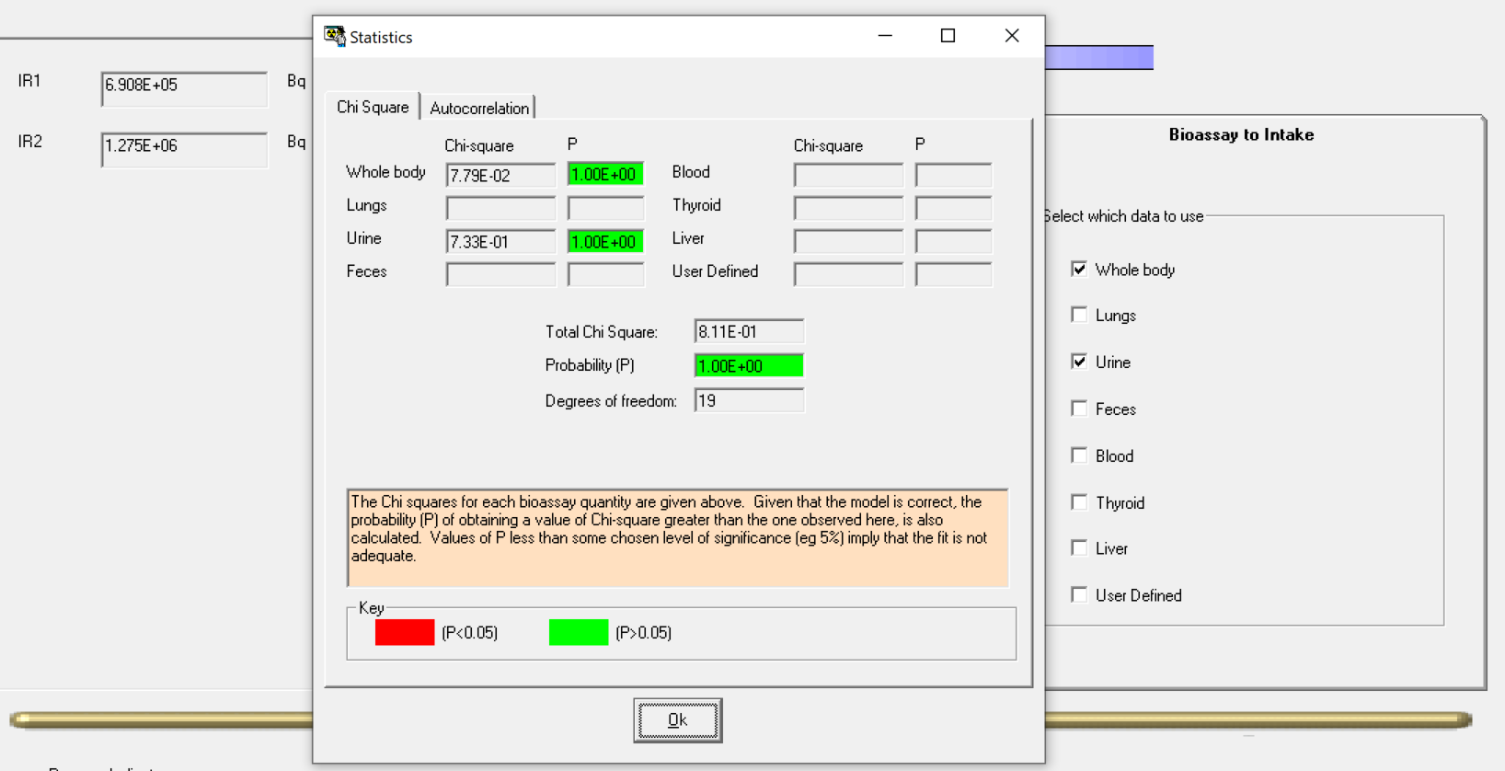
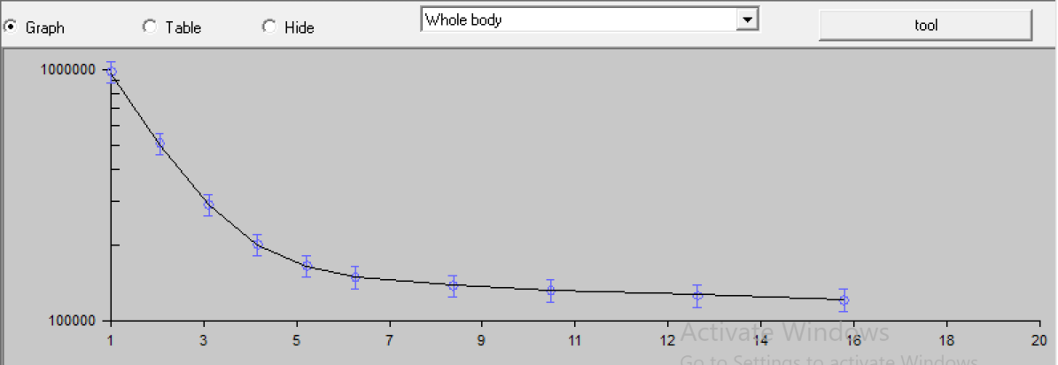
Co-60 Inhalation: Type M and Type S

Slide 37
Co-60 Inhalation: 2 bioassay datasets
Whole Body Urine
Time after intake (d) | Bioassay (Bq)
1 | 9.76E+05
2 | 5.07E+05
3 | 2.90E+05
4 | 2.01E+05
5 | 1.65E+05
6 | 1.49E+05
8 | 1.38E+05
10 | 1.32E+05
13 | 1.26E+05
16 | 1.21E+05
Time after intake (d) | Bioassay (Bq/d)
1 | 2.09E+04
2 | 9.82E+03
3 | 3.95E+03
4 | 2.33E+03
5 | 1.79E+03
6 | 1.55E+03
8 | 1.27E+03
10 | 1.06E+03
13 | 8.22E+02
16 | 6.53E+02
Estimate acute inhalation intake
  One intake, type M
    1.261E+06 Bq (P = 0.00E+00)
  One intake, type S
    2.401E+06 Bq (P = 0.00E+00)
  Type M and S combined
    1.275E+06 Bq (S)
    6.908E+05 Bq (M)
    1.966E+06 Bq (total) (P = 1.00E+00)

Slide 38
Main Takeaways when estimating intakes
Understand the ICRP biokinetic models before you use IMBA!
Use realistic assumptions with biokinetic models
Don’t always assume “one size fits all” with bioassay data
Avoid “this fits best mentality”

Slide 39
Questions?

