Slide 1
RAMP Codes in the Regulatory Environment
Stephanie Bush-Goddard, Ph. D.
Senior RAMP Program Manager
2024 Fall RUG & MUG Meeting
October 21–25, 2024
Rockville, MD

Slide 2

Agenda/Goals
Update on most RAMP Codes
How US NRC Regulates
RAMP and the Regulatory Environment
Who’s Who in RAMP!

Slide 3
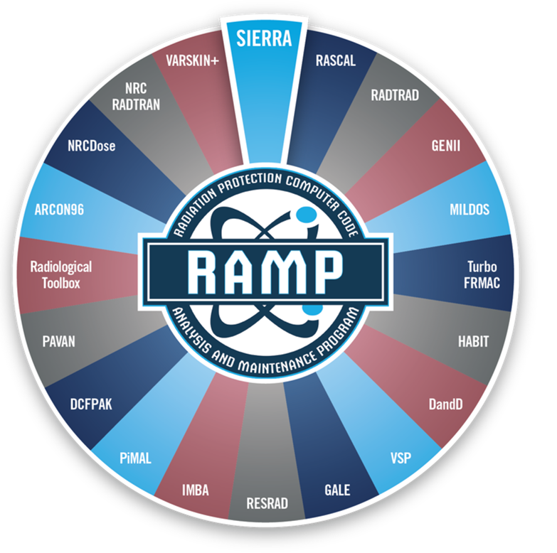



RAMP
Develops, maintains, improves, distributes, and provide training on NRC-sponsored radiation protection and dose assessment computer codes.

Slide 4
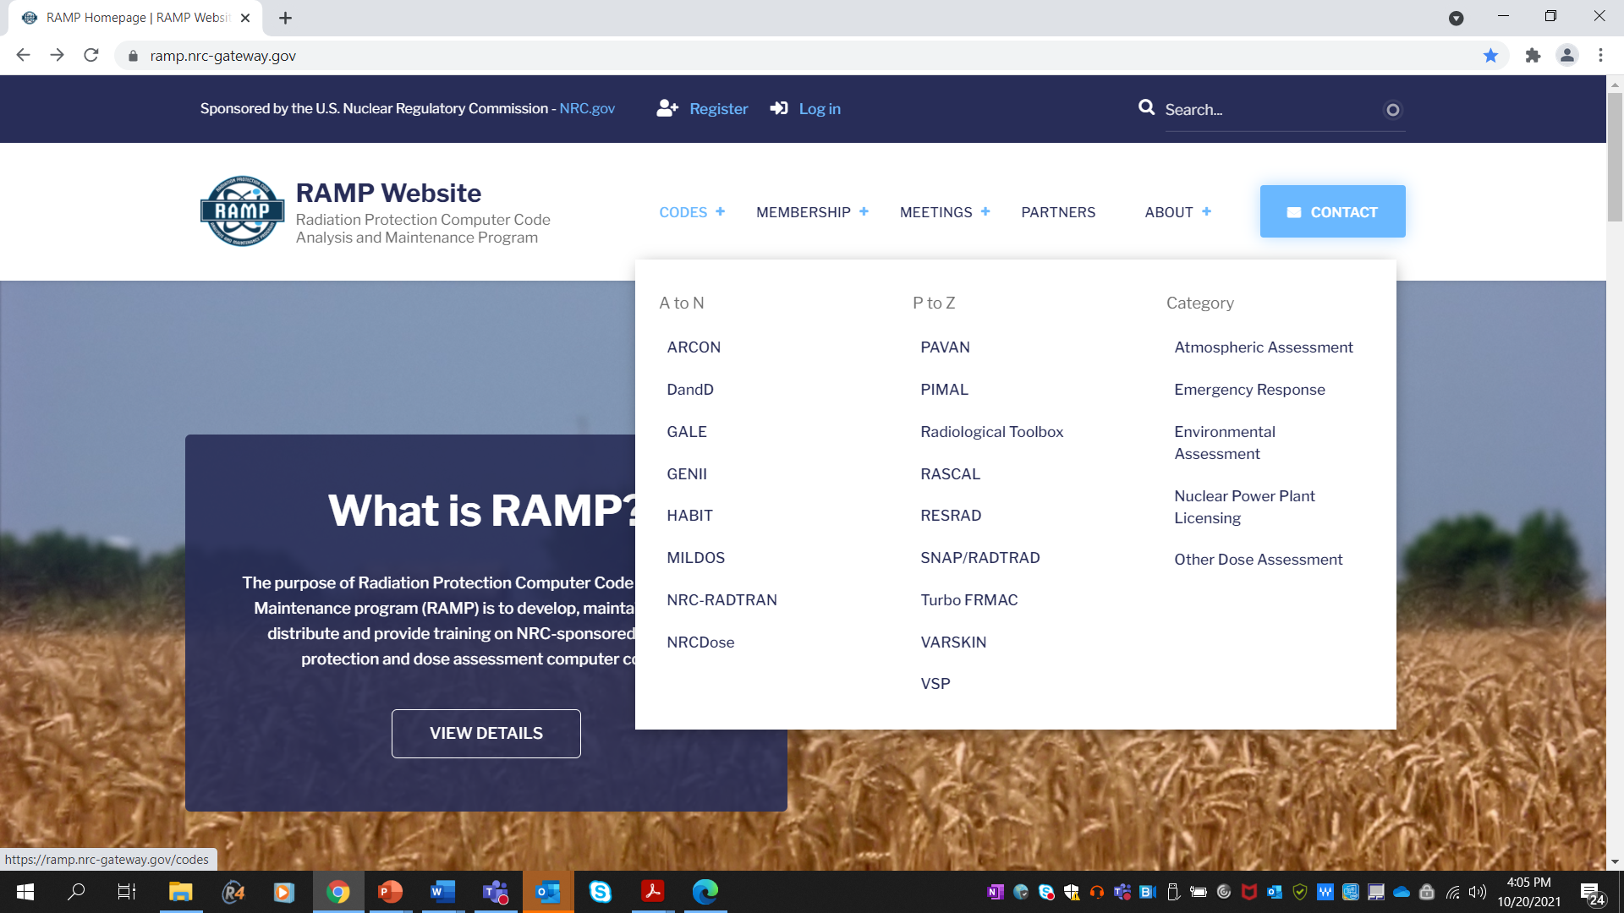



RAMP Website https://ramp.nrc-gateway.gov/
Major communication tool for RAMP
  Download all codes
  Documentation
  Training/webinar recordings
  Support
Current Activities
  Maintaining
  Upgrade Forums
  University Corner Page

Slide 5
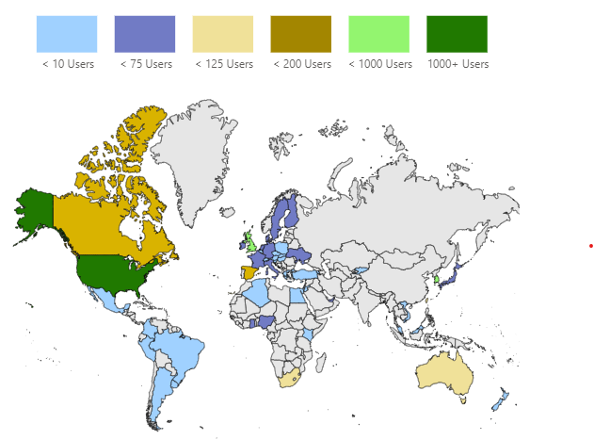
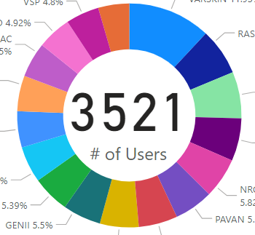
RAMP Stats!
Over 3500 RAMP Members
  350 participants/70 in house
RASCAL and VARSKIN most requested codes
Strong international cooperation (15 Agreements for RAMP)
  18 Countries/8 inhouse
2 meetings per year
Future....quarterly/shorter meetings with seminars, lunch and learns etc

Slide 6
How NRC regulates.

Slide 7
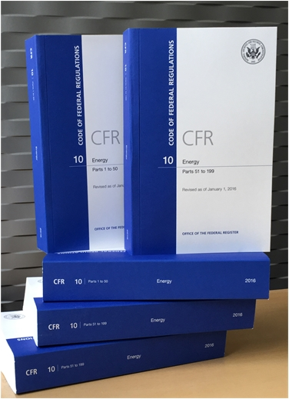
Regulations/Guidance

Slide 8
1. Regulations and Guidance : Codes vs Regulations

Slide 9

Licensing, Decommissioning, and Certification

Slide 10
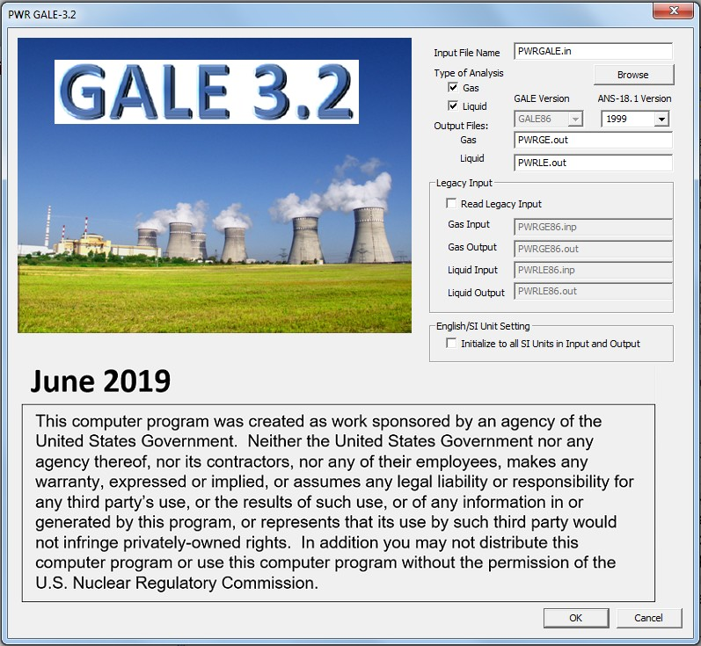
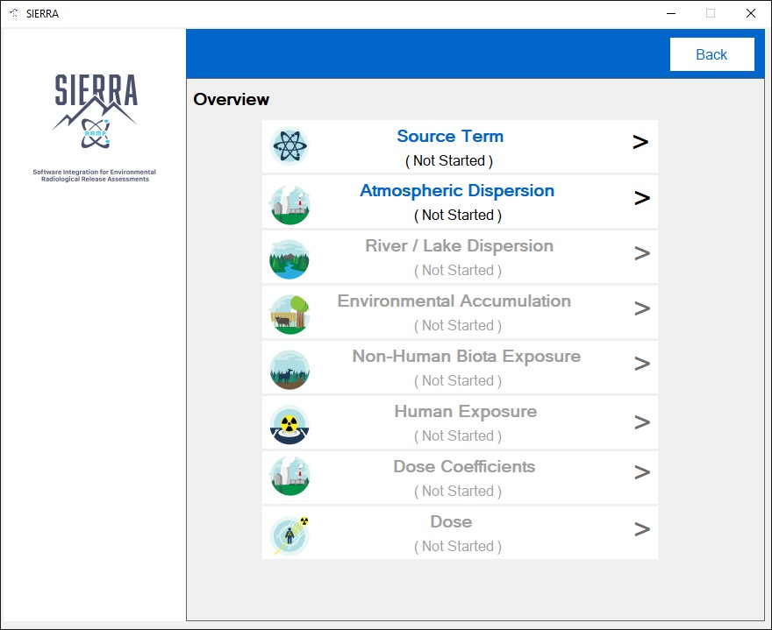
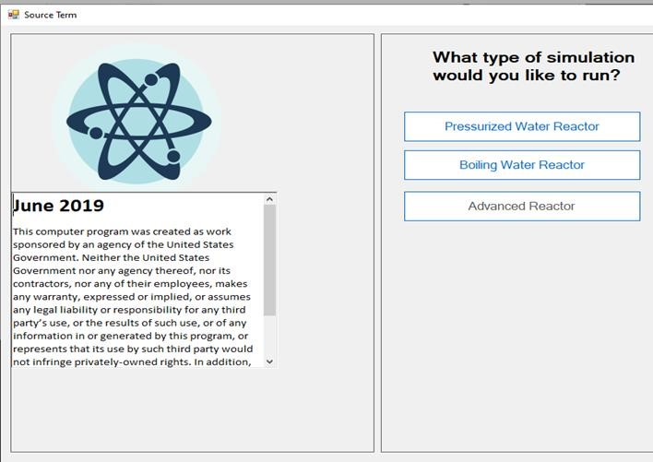


2. Licensing Support Codes
GALE
Gaseous And Liquid Effluents
Calculates the gaseous and liquid effluents from routine releases (normal source term) from light water reactors. Aids in determination of compliance with the requirements of Appendix I to 10 CFR Part 50.
Current Activities:
  Code Consolidation – Incorporating into Software Integration for Environmental Radiological Release Assessments (SIERRA) code, including lwr and non-lwr source terms.

Slide 11
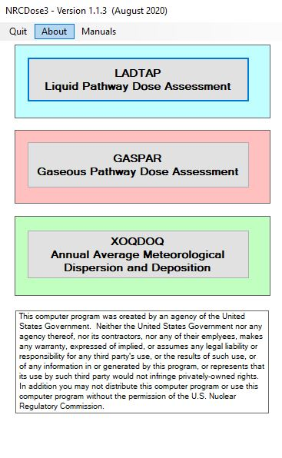
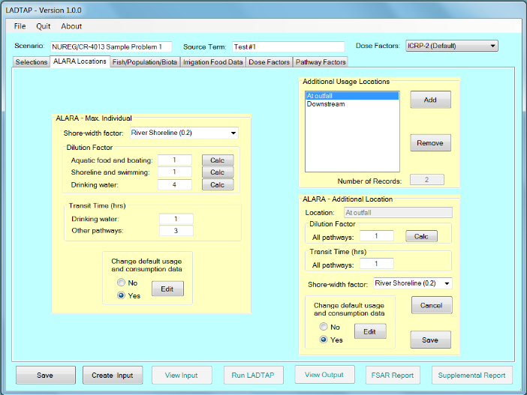
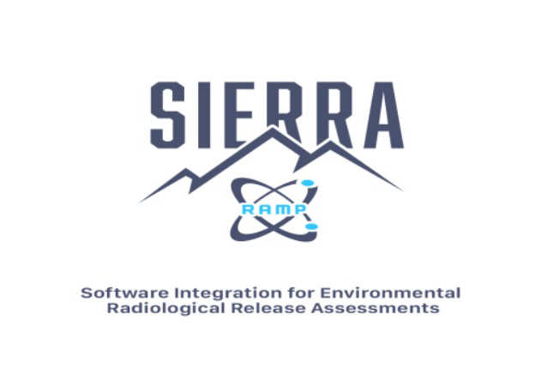


Licensing Support Codes
NRCDose3
Calculates offsite doses of liquid and gaseous releases from normal nuclear operations.
Current Activities:
  NRCDose3 v1.1.4 – released in late 2023.
  Publish NUREG: User Guide and Technical Manual in early 2024
  Code Consolidation into SIERRA.

Slide 12

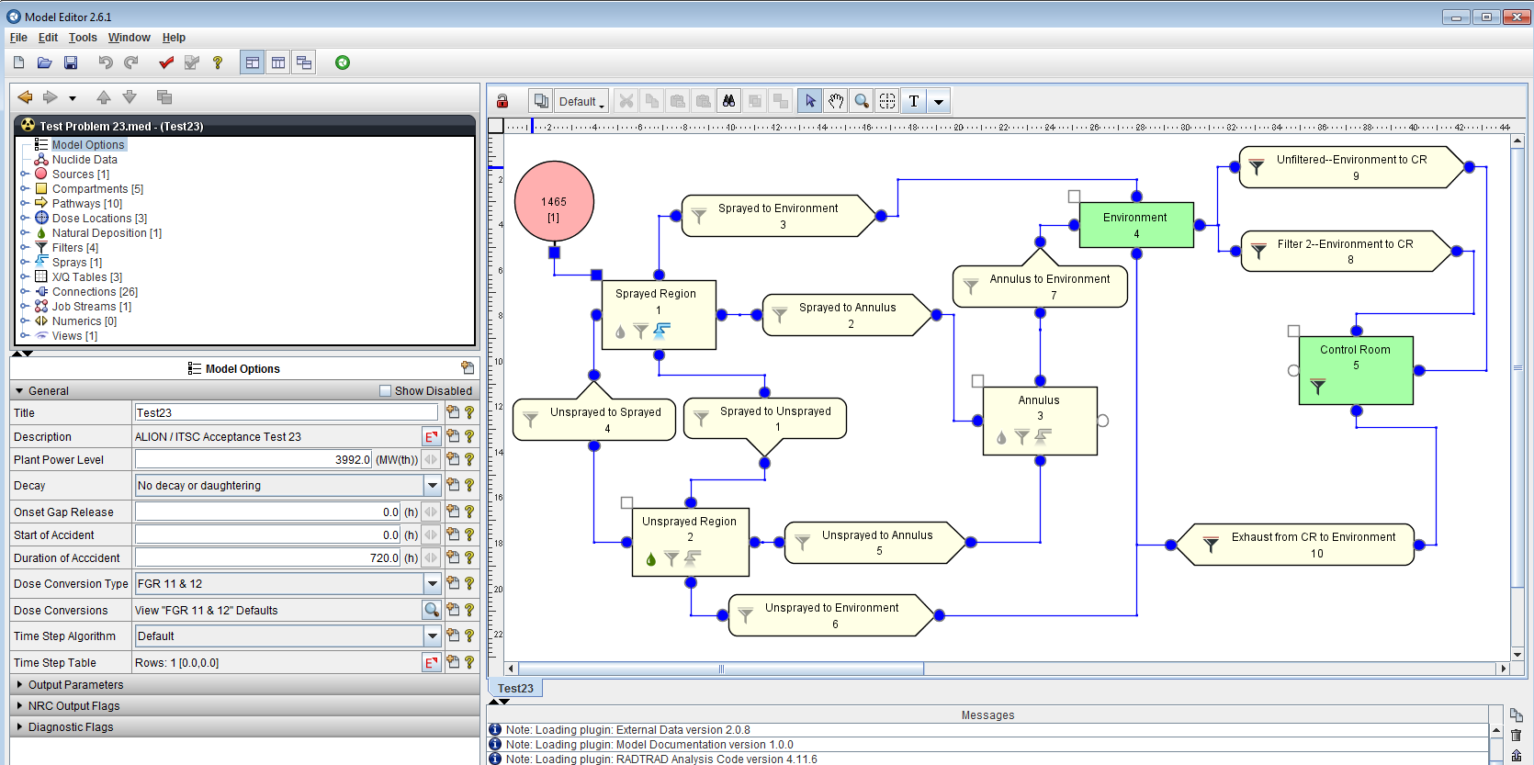
Licensing Support Codes
SNAP/RADTRAD
Symbolic Nuclear Analysis Package/RADionuclide Transport Removal And Dose Evaluation
Performs dose calculations for design-basis accidents at the exclusion area boundary, low population zone, and control room.
NRC staff uses to perform licensing confirmatory analyses of the plant’s design and the licensee’s offsite and control room dose calculations following a design basis accident.
Current Activities:
  SNAP/RADTRAD v5.0.4– released in March 2024.
  Revising code to incorporate RG-1.183 revision 1 (March 2025) and 2 (TBD).

Slide 13
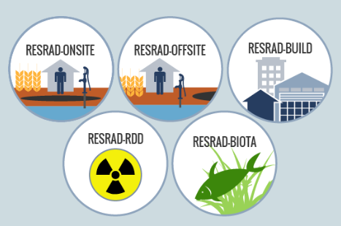
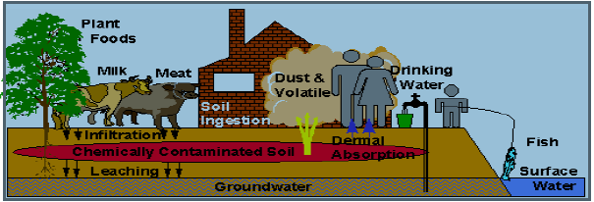
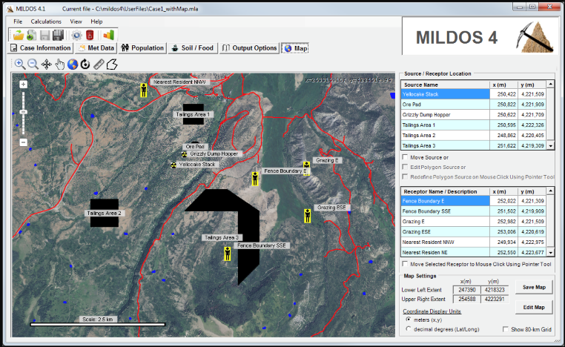
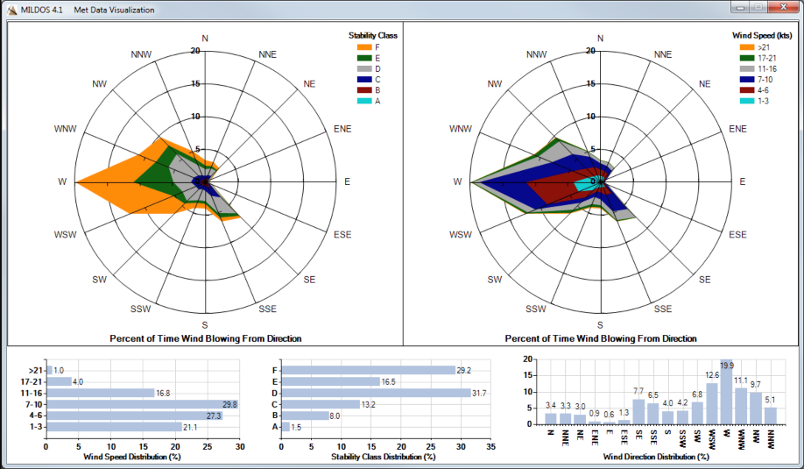
2. Decommissioning & Environmental Assessment
RESRAD
Residual Radioactivity
Family of codes used to analyze human and biota radiation exposures from environmental contamination of residual radioactive materials.
Uses pathway analysis to evaluate exposure and associated risks, which then informs cleanup criteria and authorized limits.
Current Activities: RESRAD ONSITE v8.0 FGR-15 DCFs.
MILDOS
Evaluates radiation protection compliance at uranium recovery facilities, both ore mining and the associated on-site milling facilities.
Calculates the radiological dose commitments received by individuals and the general population with an 80-kilometer radius of operating uranium recovery facility.
Estimates air and ground concentrations of radionuclides for individual locations as well as for a generalized population grid.
Current Activities: Current version 4.21.

Slide 14
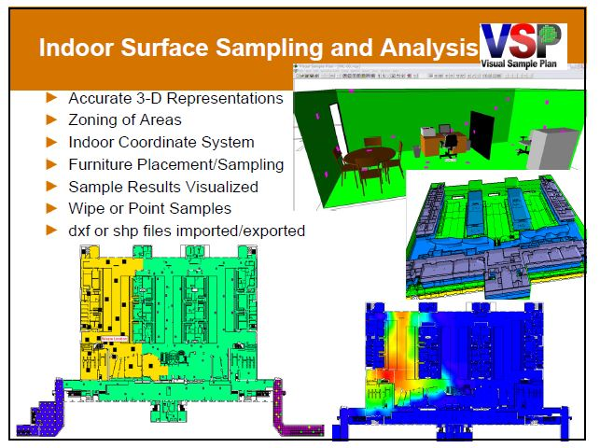
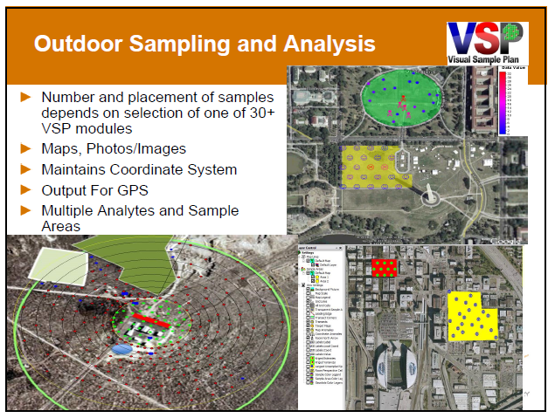
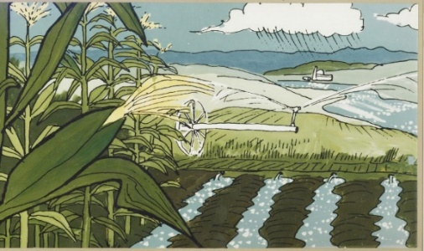
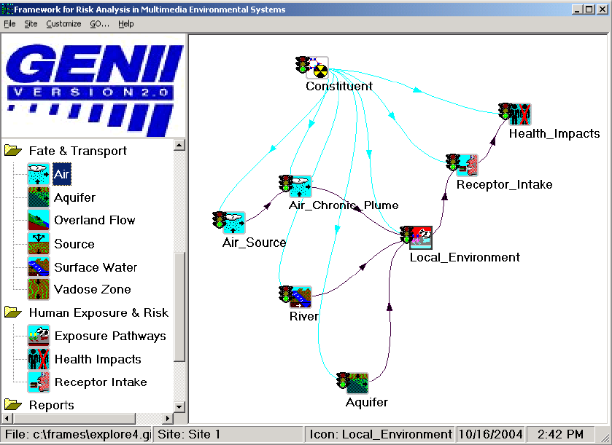
Decommissioning & Environmental Assessment
VSP
Visual Sample Plan
VSP is a software tool that assists in creating a defensible sampling plan based upon statistical sampling theory and the analysis of sample results.
Ensures the right type, quality, location, and quantity of data are gathered for statistical evaluations for regulatory decision making (decommissioning).
Distributed by Pacific Northwest National Laboratory.
Current Activities: improvement of VSP subsurface radiological survey design, visualization and analysis tools and improvement of continuously collected data visualization and analysis tools
GENII
GENII is an environmental assessment code for estimating radionuclide concentrations in the environment from acute and chronic radiological releases
Dose to humans and biota from acute and chronic radiological releases.
Supported radionuclide transport options include:
  Air
  Water
  Biological Activity

Slide 15
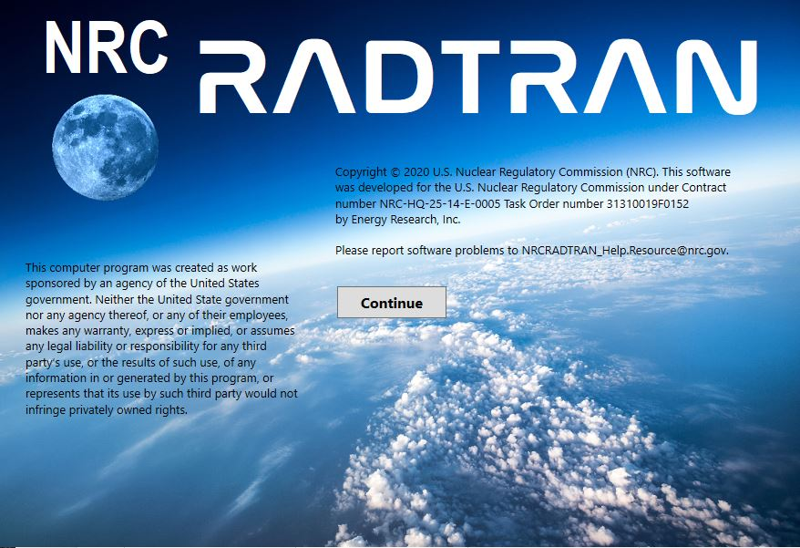
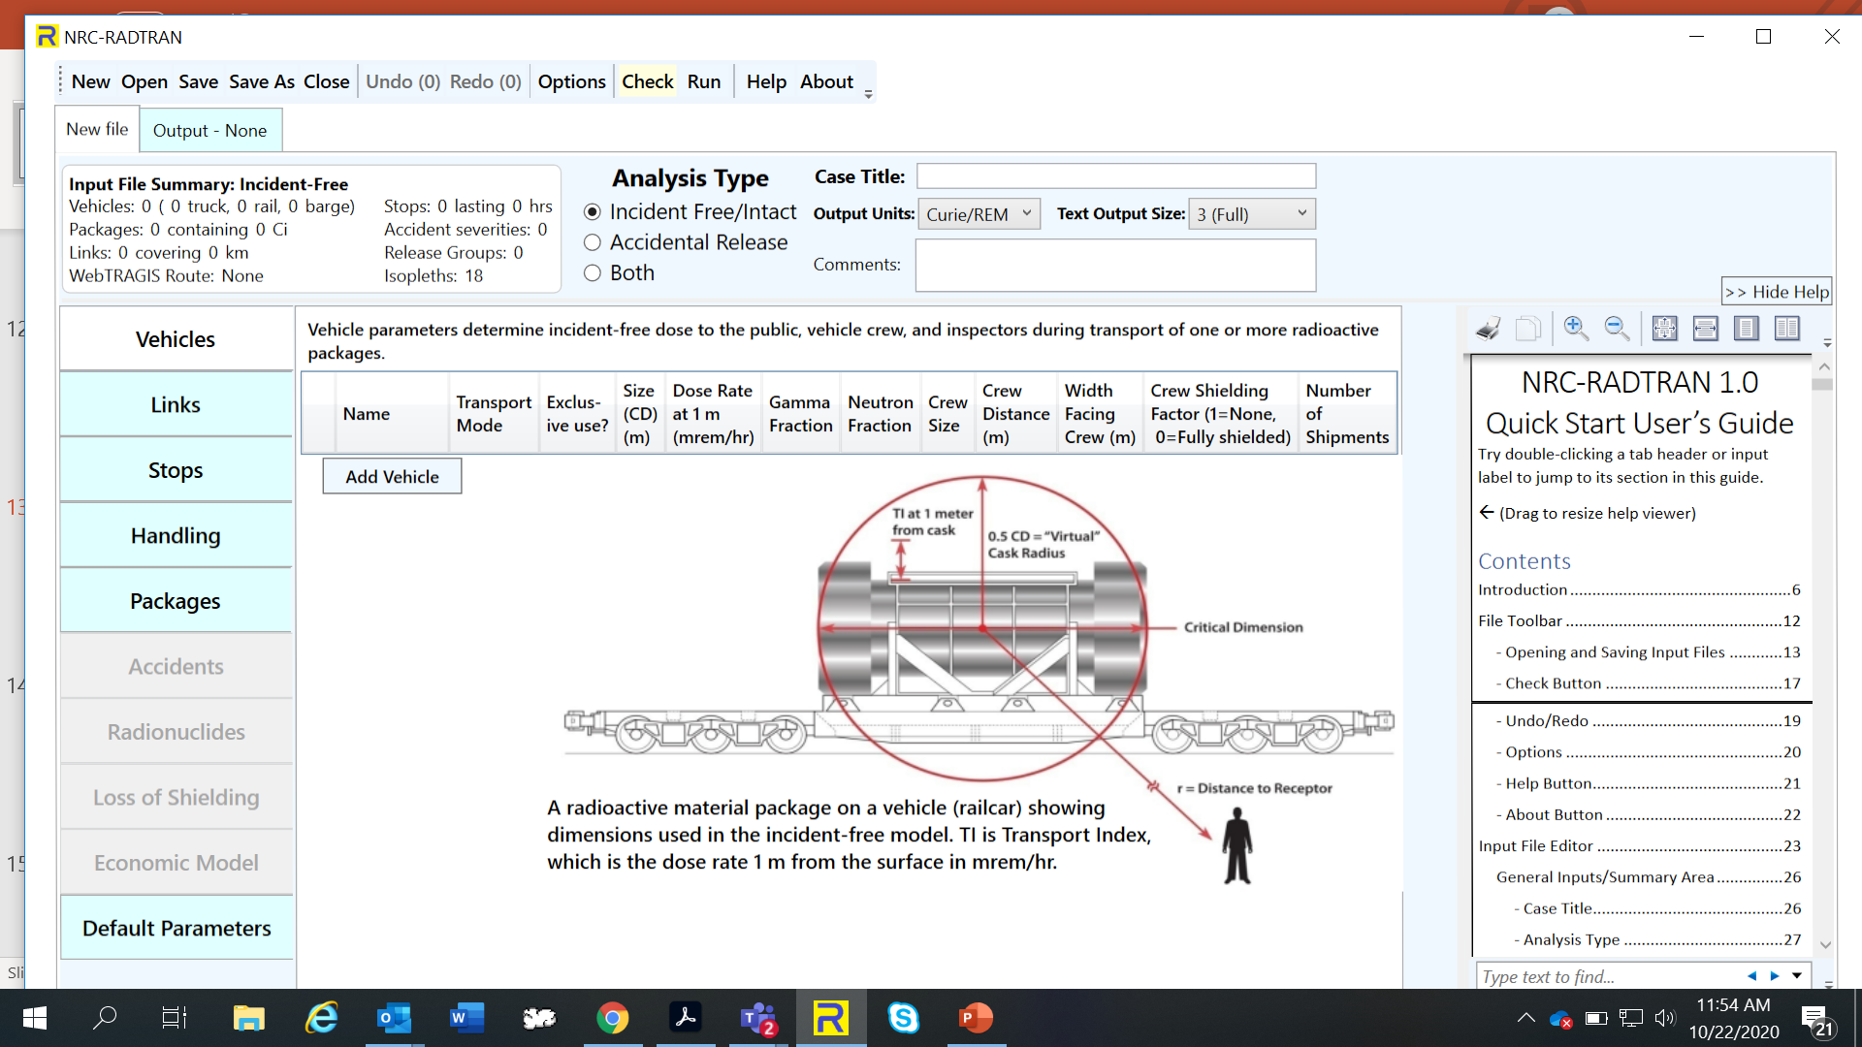
3. Licensing/Environment
NRC-RADTRAN
Radioactive Material Transport
Code for risk and consequence analysis of radioactive material transportation.
Current Activities:
  Updated Code ‒ NRC-RADTRAN v1.1 in FY 2025, to include:
    .Corrections to population densities and route speeds
  Preparing for non-lwr activities

Slide 16
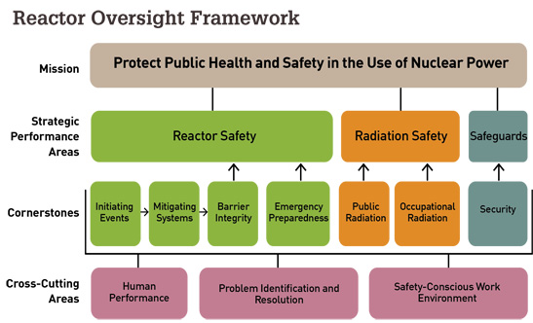
Oversight

Slide 17
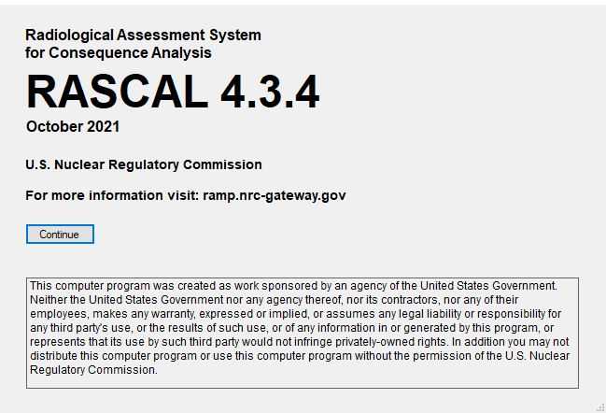
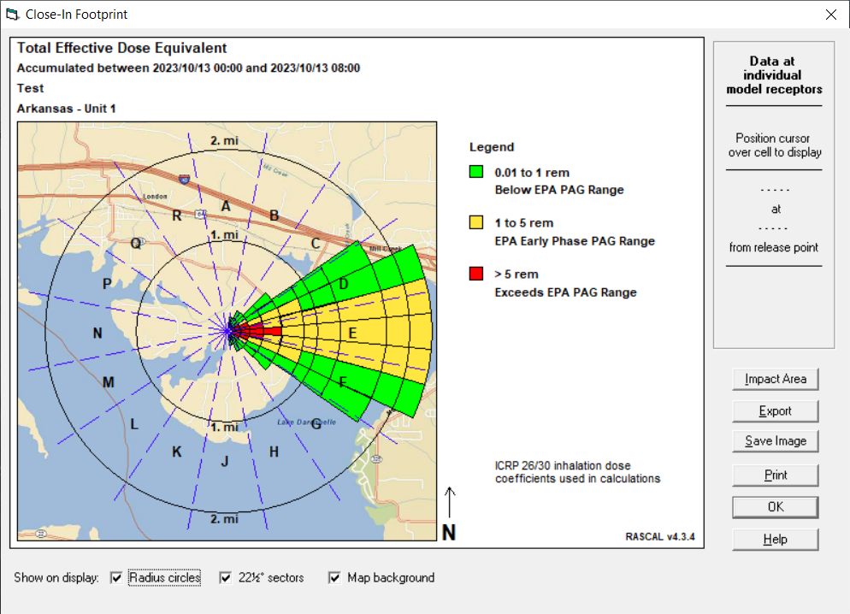


3. INCIDENT RESPONSE
Emergency Response Codes
RASCAL
Radiological Assessment System for Consequence Analysis
Fast-running software used for beyond-design-basis radiological incidents to assess off-site dose consequences and to help inform or evaluate protective actions.
Current Activities:
  RASCAL 5.0 development underway with PNNL.

Slide 18
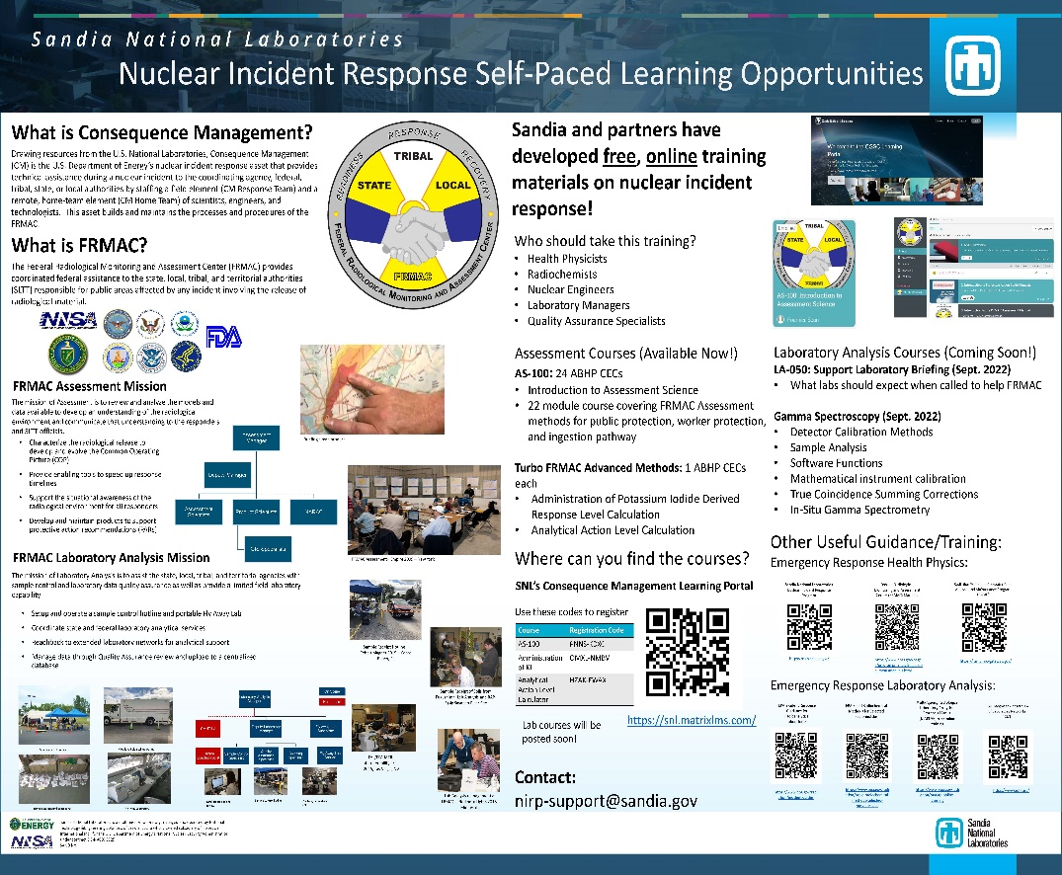
Emergency Response Codes
Turbo FRMAC
Turbo FRMAC performs complex calculations to quickly evaluate radiological hazards during an emergency response by assessing impacts to the public, workers, and the food supply.
Sandia National Laboratories maintains distribution of Turbo FRMAC, but RAMP users have access to code discussions, training, and technical support.
Web-based training that will be available on demand is in development.
If you need technical support for Turbo FRMAC please email: nirp-support-fogbugs@sandia.gov
https://nirp.sandia.gov/Software/TurboFRMAC/TurboFRMAC.aspx
MACCS: IMUG Code
See Next Presentation

Slide 19
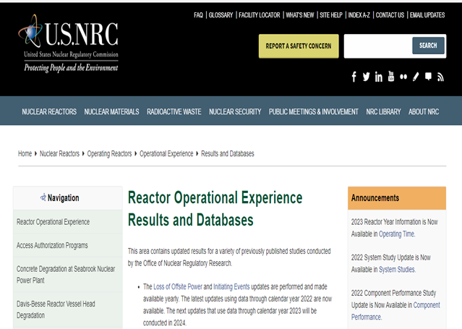
Operational Experience

Slide 20
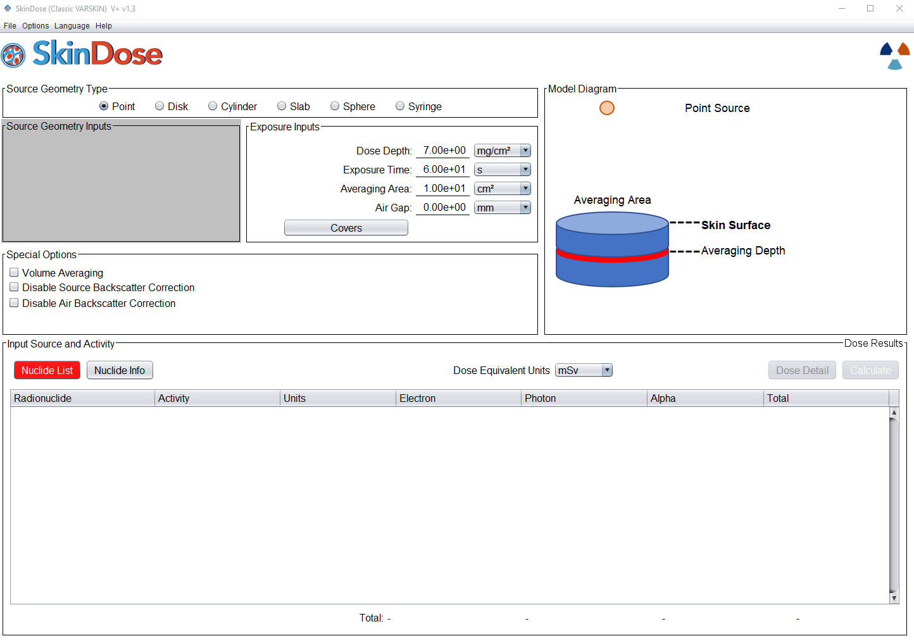
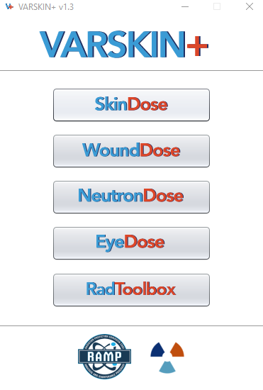
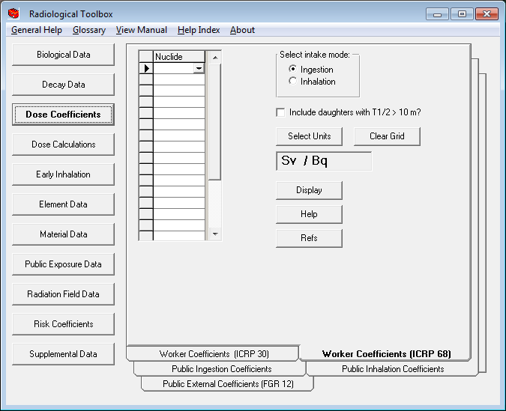

4. OPERATIONAL EXPERIENCE
Dosimetry Code
VARSKIN+ (V+)
Historically been used to calculate occupational dose to the skin resulting from exposure to radiation emitted from contamination on or near skin.
Recently, expanded to calculate radiation dose to a wound area, the human eye, and dose equivalent contributed by neutrons
Radiological Toolbox was consolidated into V+
  An Electronic handbook containing Biological Data, Decay Data, Dose Coefficients, Element and Material Data, and Risk Coefficients.
Current Activities:
  Release of Extravasation Dose Module in FY25.
  Code consolidation of Radiological Toolbox by combining with VARSKIN+ – FY 2024.

Slide 21
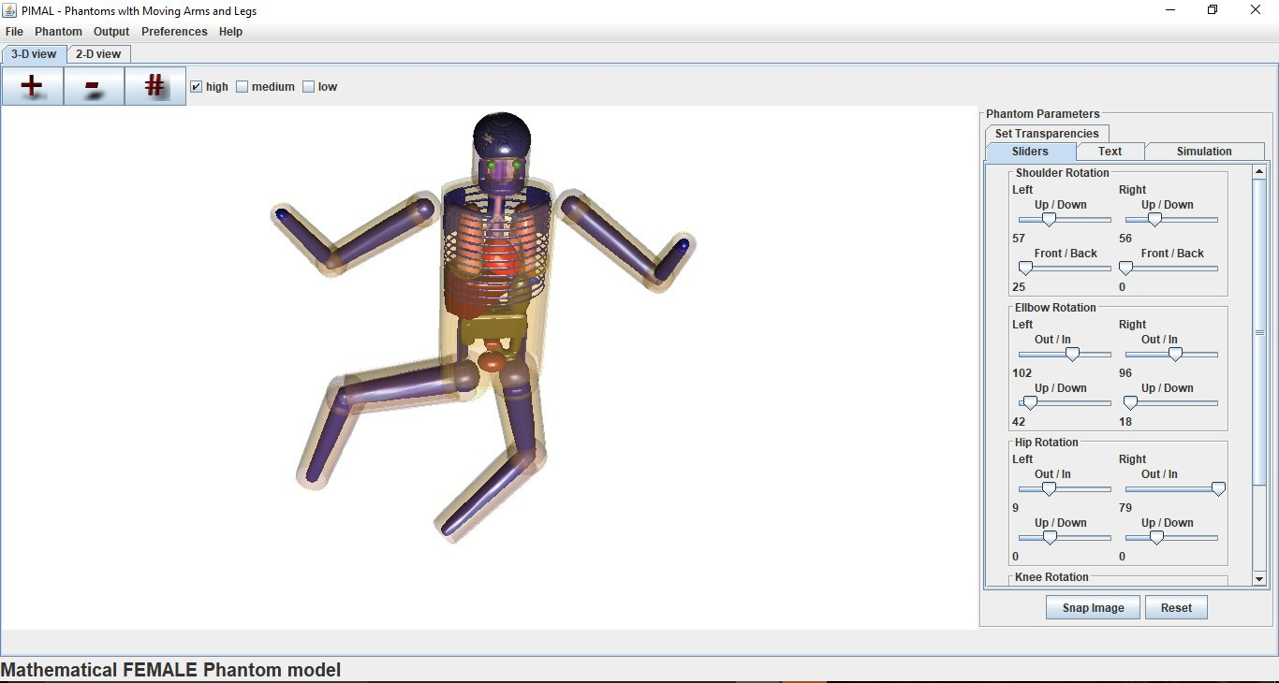
Dosimetry GUI
PiMAL
Phantom with Moving Arms and Legs
Graphical User Interface which assists users in developing Monte Carlo N-Particle (MCNP) geometry input decks.
PiMAL allows for manipulation of the phantom within the GUI and will then provide the input deck to be utilized in MCNP.
  Includes 23 organs
Current Activities:
  Incorporation of three animal phantoms due to increasing frequency of radiological veterinary treatments
    Equine
    Canine
    Feline

Slide 22
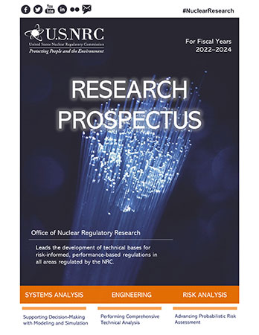
Support for Decisions

Slide 23
5. SUPPORT FOR DECISIONS
Research Activities
HABIT
DandD
ARCON
PAVAN
IMBA
GENII
TableCalculator
Consolidation and Modernization
From the FY 2021 Budget to the Commission Staff Requirements Memorandum –
  The Office of Nuclear Regulatory Research should….. review in a holistic way the existing inventory of codes that the NRC uses to develop a long-term investment plan to support future use and resource requirements.

Slide 24
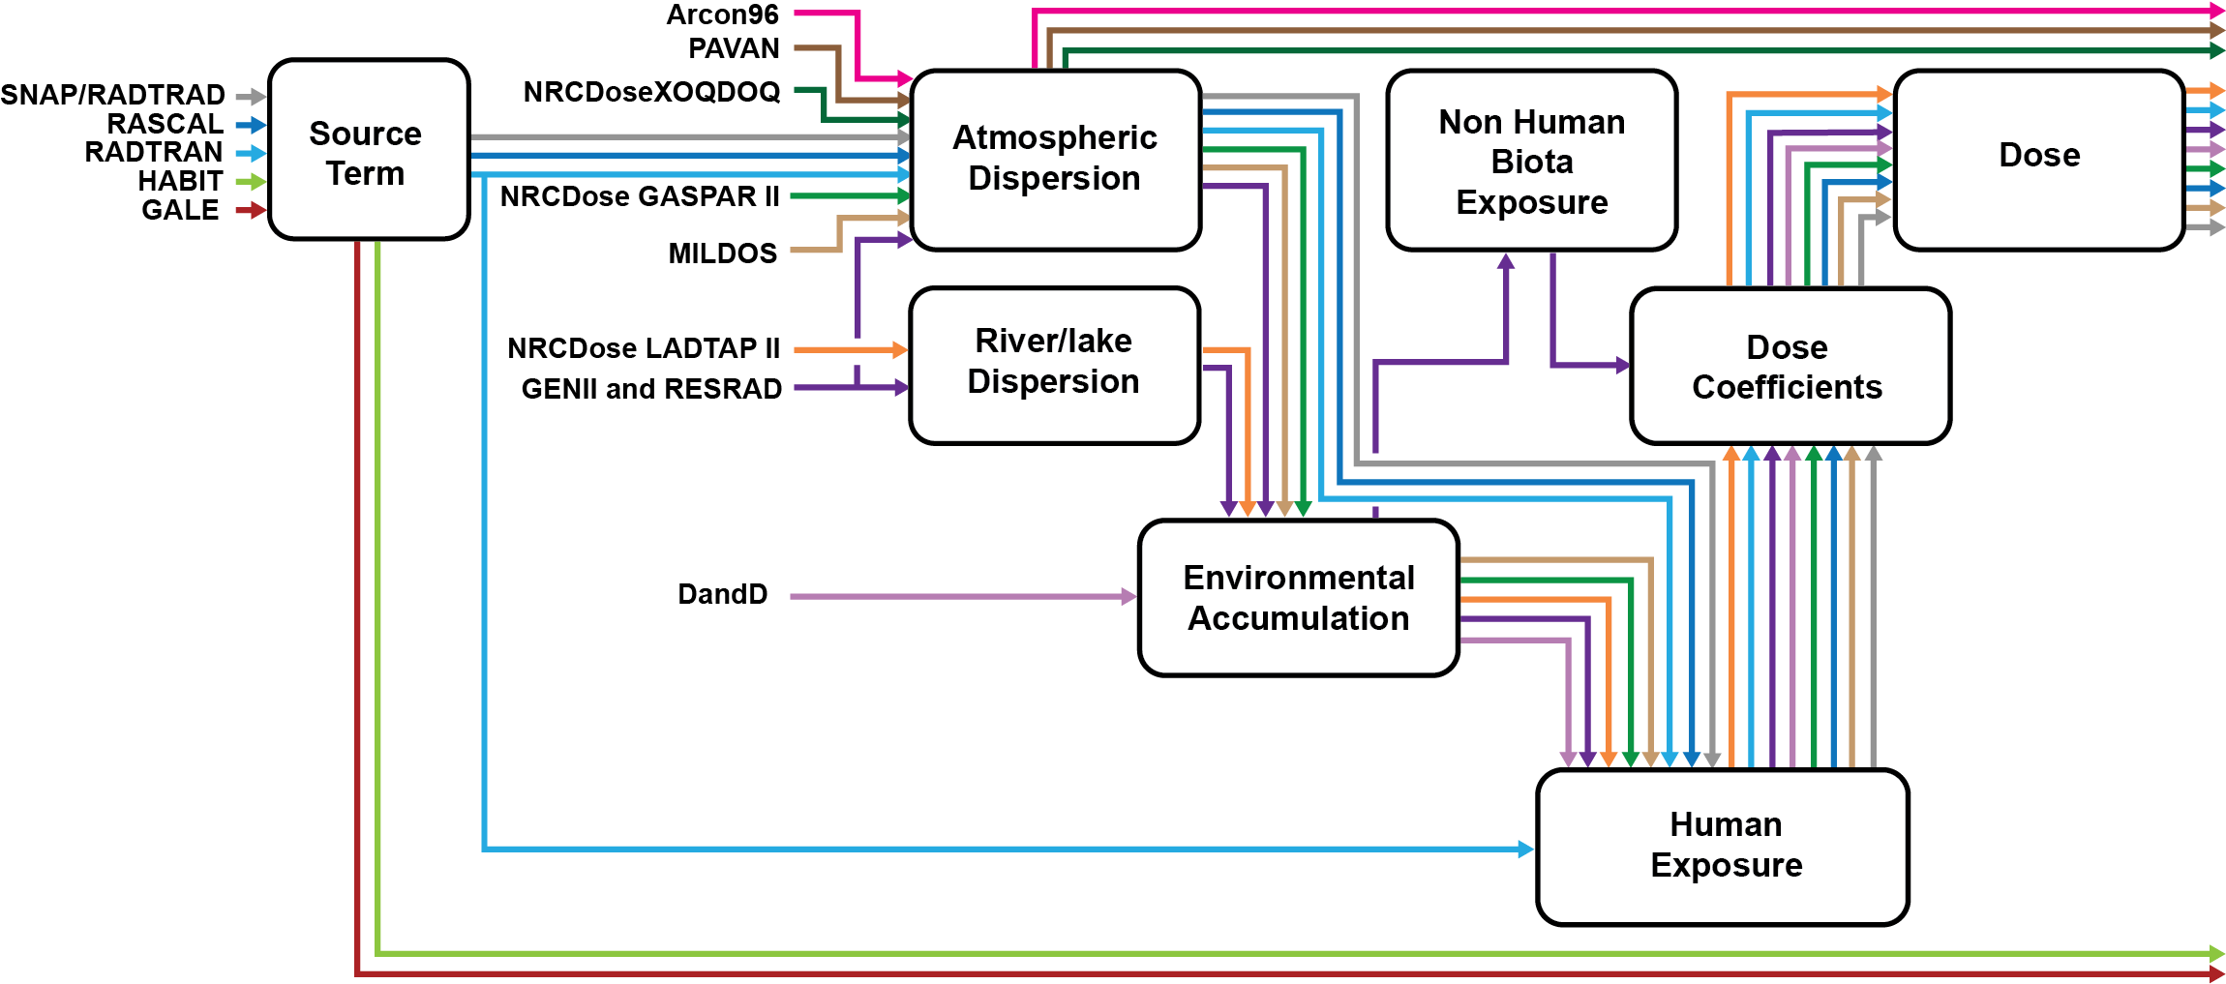
Consolidation and Modernization

Slide 25
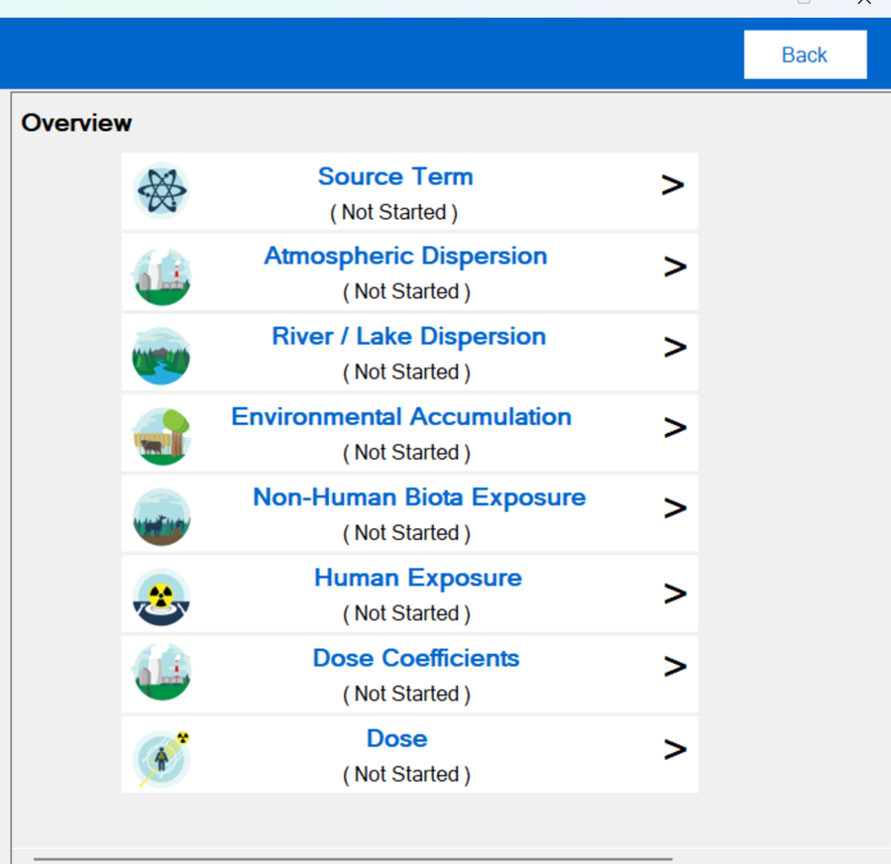
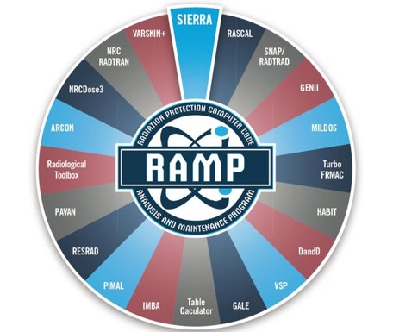
Introducing - SIERRA
Software Integration for Environmental Radiological Release Assessments

Slide 26
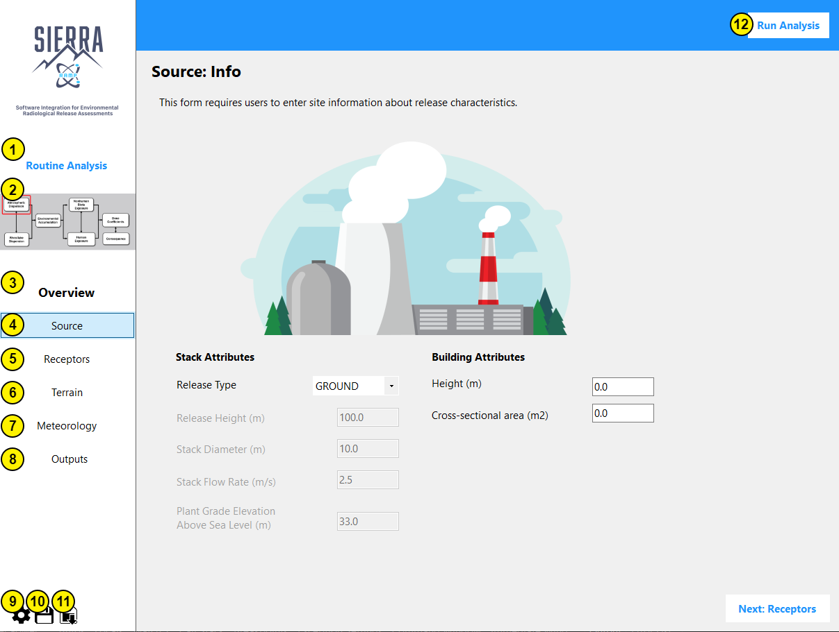

Overview/ Preview of SIERRA-ATD
Software under active development which aims to combine multiple RAMP codes into one easy to use package.
Currently have Three efforts underway for SIERRA.
  Atmospheric Dispersion Models
  SIERRA Source Term (Old GALE)
  Environmental (NRCDose3)
DRAFT

Slide 27
Tuesday’s Primer
RAMP Code Consolidation Project
SIERRA
Stephanie Bush-Goddard, Ph. D.
Senior RAMP Program Manager
2024 Fall RUG & MUG Meeting
October 21–25, 2024
Rockville, MD

