Slide 1
Preview of PiMAL 6.0
Jeffrey M. Luitjens, PhD
Director – Software Division, Partner
Corvallis, OR
jeff.luitjens@rcdsoftware.com

Slide 2
Outline
Purpose of PiMAL
Evolutionary history
Overview of upcoming changes
  Animal phantom editions
  Documentation
  MCNP execution and dose processing

Slide 3
What is PiMAL?
“PiMAL” is an acronym for: Phantom with Moving Arms and Legs
PiMAL is a phantom representation software tool for creating input decks for execution with MCNP.
PiMAL is not a radiation transport code.
The generated MCNP input deck describes arm and leg positioning of a phantom relative to a radiation source:
  External point source.
  Distributed source in one of the 11 internal human phantom organs.
Originally developed in 2007 by Oak Ridge National Lab for the NRC.

Slide 4
Why PiMAL?
Previous computational models of the human phantom have undergone progressive evolution since their initial development in the 1970s [1].
Computational phantoms employed were largely based on a model published in 1974, which did not account for select organs (e.g., neck, esophagus) and tissues.
These deficiencies were compounded by inaccurate organ placement within the body (e.g., thyroid).
All computational phantoms were previously assumed to be in the vertical-upright position
To assess the radiation dose in non-standard positions (e.g., occupational exposure or public exposure in a radiologically significant event), a mathematical phantom was devised to enable articulation of arms and legs.

Slide 5
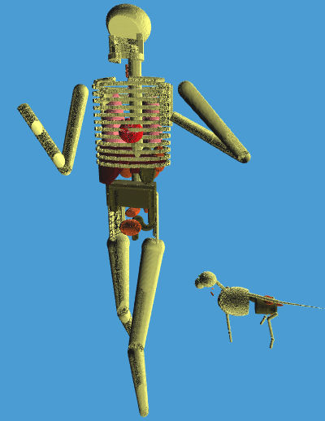
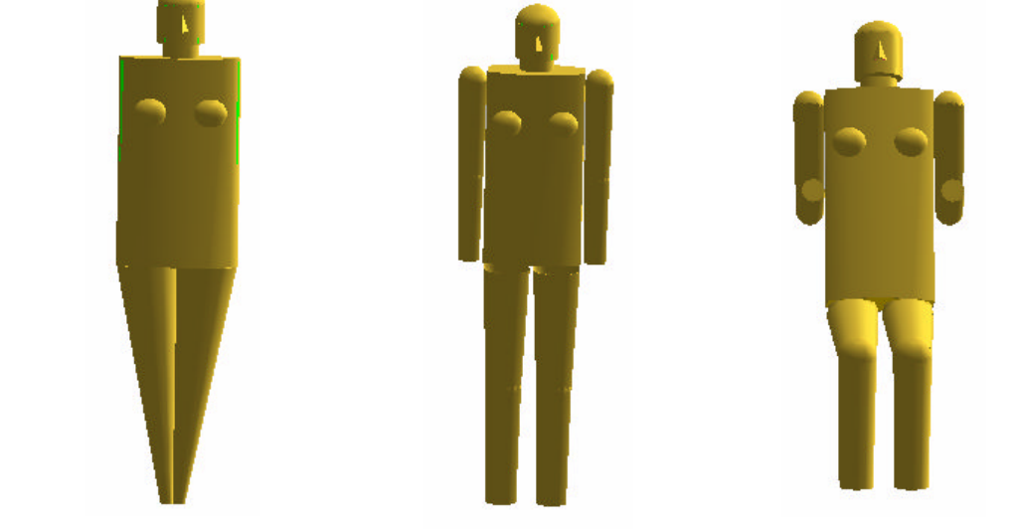
Evolutionary History
MIRD-5 → ORNL-UF → Sperate Arms and Legs → Addition of Joints (PiMAL)
Male and Female Phantoms
Development of PIMAL: Mathematical Phantom with Moving Arms and Legs; Akkurt H., Eckerman K.; Oak Ridge National Laboratory; ORNL/TM-2007/14, May 2007.

Slide 6
Software Changes (Upcoming)
The human phantom is unchanged with compositions based on ICRP-89.
Addition of animal phantoms to allow for the placement of radiopharmaceutical sources in domesticated pets:
  cats
  dogs, and
  horses.
Updated outdated library dependencies (graphics overall).

Slide 7
Documentation (Upcoming)
An effort is being made to enhance the documentation to provide clarity on the component definitions and their bases.
Typical information provided in terms of providing:
  Background information
  Installation
  User Interface Description
  Generation and Execution of MCNP Input Decks
  Reporting of Results
  Saving and Loading of Inputs and Outputs
An additional emphasis is being placed on:
  Linking instructions of MCNP to PiMAL to provide seamless executions along with importing of external MCNP outputs into PiMAL for processing as an alternative.
  Phantom descriptions
    MCNP Cell Number of components
    MCNP material number and material definitions
    Component volumes, densities, and masses
    MCNP tally number and cells / components that define the tally.
  Tutorials

Slide 8
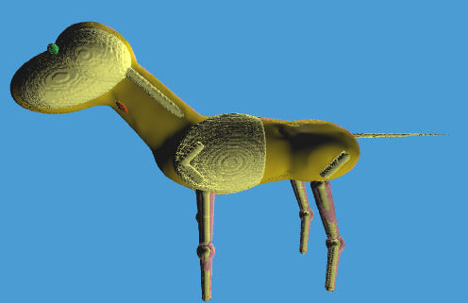
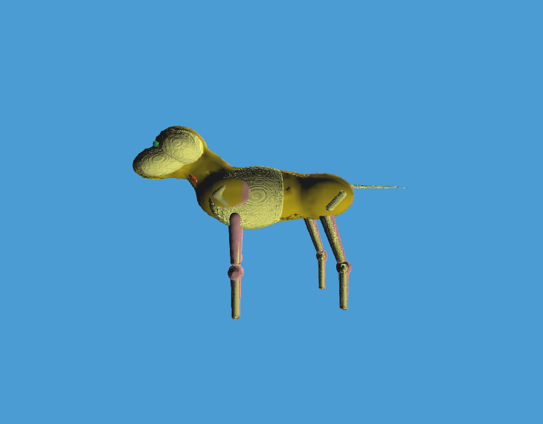
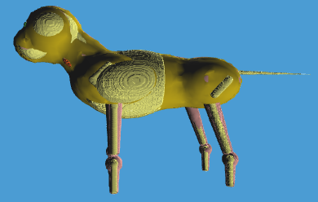
New Animal Phantoms
300 kg Horse
30 kg Dog
5 kg Cat

Slide 9
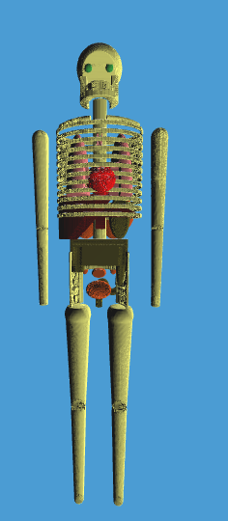
Source Definition and Interactions
Human and animal phantoms can be positioned in the same MCNP ‘universe’ / problem domain.
v6.0 now provides the user with the ability to estimate effective dose to human organs for scenarios involving exposure to pets.
Exposure path is always to the human whether the source is from:
  Internal distributed source.
  External point source.
  Pet.
x
*

Slide 10
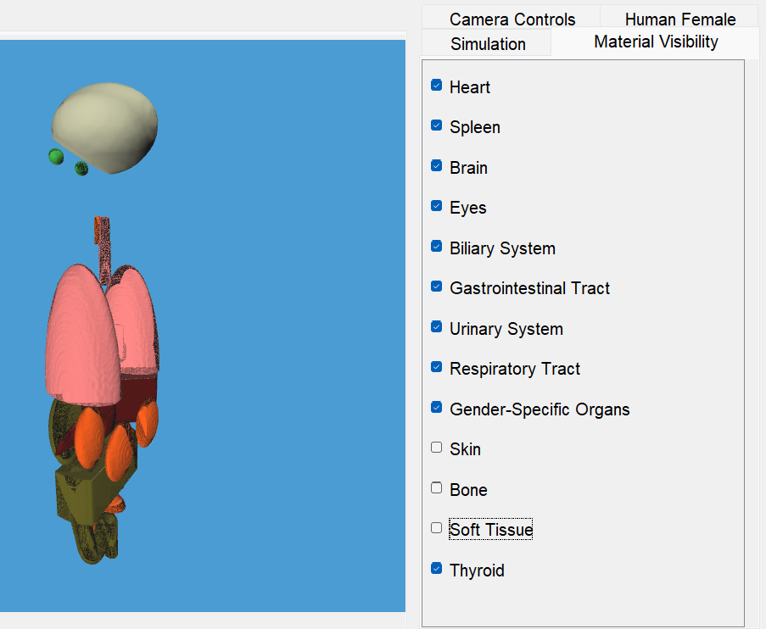
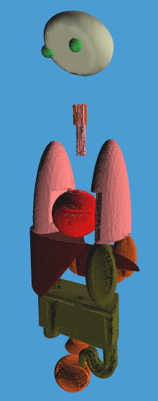
Phantom Layers and Visualization

Slide 11
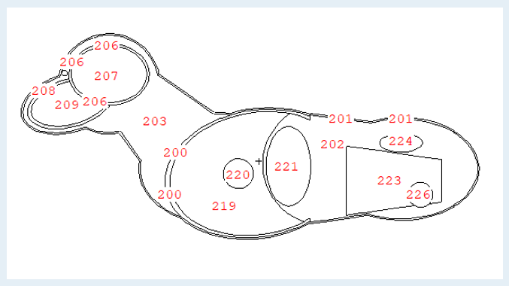
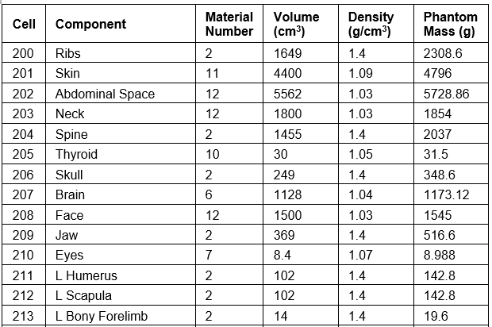
Phantom Definitions
Definitions and basis of human and animal phantom organs, volumes, materials, and geometry are provided within the user manual.

Slide 12
Animal Phantom Scaling
PiMAL allows the user to select the mass of the animal and outputs a scaled volume representing that mass.
As a general rule, the volume parameters (radius, for example) correspond mathematically with the computed volume in expected geometric ways that follow an approximate third power rule.
This is confirmed from aggregated data and fitting demonstrating that the relationship between mass and girth/length maintain a 1/3 exponential parameter.
Since there is some interspecies variation from a cat to dog to horse in neck length, face length and leg lengths, you can select the different animals, and the resulting phantom will reflect these variations.
All organ volumes, which will be the sources used for radiation dose calculations, are maintained from this 1/3 ratio.
The user manual further documents in detail specific considerations and exceptions for each animal phantom.

Slide 13
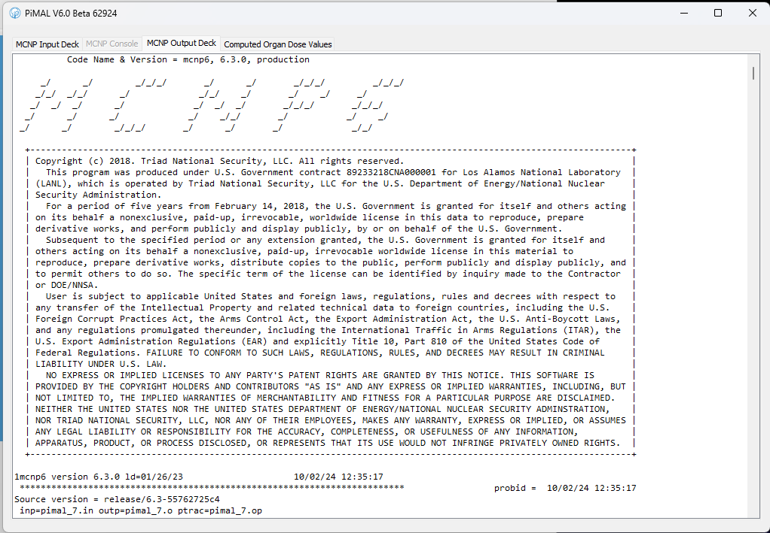
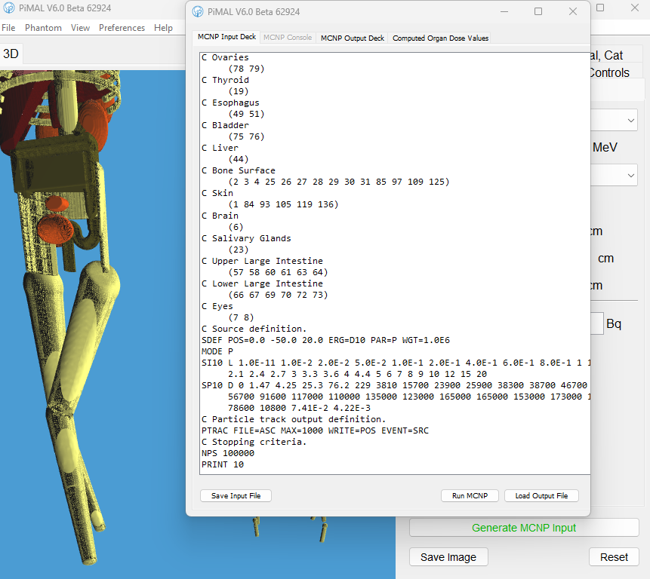
MCNP Execution and Dose Processing
PiMAL can be linked with MCNP for ease of analysis.
Phantom component doses are broken down with the use MCNP F6 tallies providing dose results in the form of dose per unit mass (MeV/g).
PiMAL extracts the tally information and converts doses to Gy (J/kg) .
Linkage tested with MCNP 6.2 and 6.3.

Slide 14
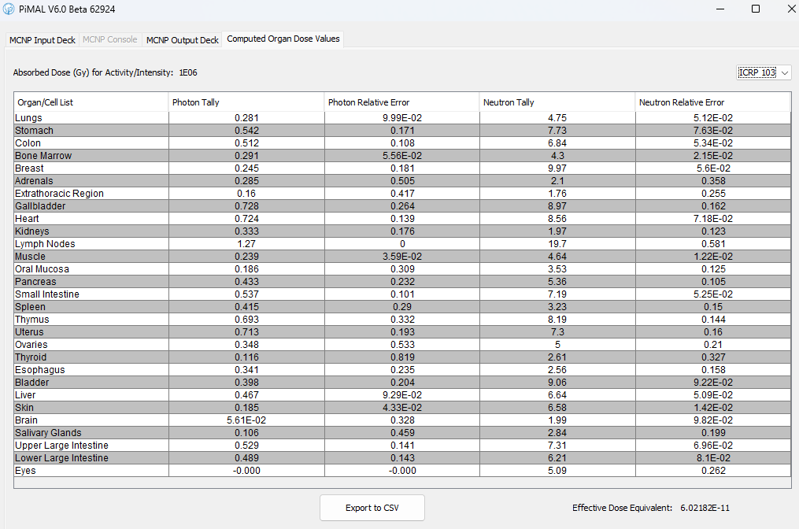
Example Dose Output
Source Definitions:
  Monoenergetic Photon
  Monoenergetic Neutron
  Ir-192
  I-131
  Lu-77
  Sn-117m
  X-Ray (60, 80, 100, 120 kVp)
  AmBe Neutron Source
  PuBe Neutron Source
Table Results
  Organ/Cell
  Photon Dose
  Photon Dose Relative Error
  Neutron Dose
  Neutron Dose Relative Error

Slide 15
Resources
Computer Analysis User Group (CAUG) training website provides beginner and intermediate level training on MCNP usage.
  https://ramp.nrc-gateway.gov/codes/pimal/training

Slide 16
Questions?
Jeffrey M. Luitjens, PhD
Director – Software Division, Partner
Corvallis, OR
jeff.luitjens@rcdsoftware.com

