Slide 1
2024 Fall International
RAMP & MACCS
Closing Ceremony
Marcos Vicente & AJ Nosek
RAMP and MACCS Program Managers

Slide 2
REMARKS
Insights from this meeting
  John Tomon, Chief Radiation Protection Branch
  Luis Betancourt, Chief Accident Analysis Branch
Thanks!
  AJ Nosek, MACCS Program Manager
  Marcos Vicente, RAMP Program Manager
Last Items
Group Pictures Slide Show

Slide 3
THANK YOU!
We were glad you were here!
We are grateful that you participated actively!
We are grateful that you shared your insights!
We are grateful that together, we are enhancing radiation protection and nuclear safety!
We hoped that you built networks!
We hoped that you strengthened collaborations!
We hoped you that enjoyed Washington/Maryland!

Slide 4
Last Items
Here tomorrow, Friday, October 25?
  Raise your hand!
Course Evaluation Form: 1 form for the entire week.
  Drop off on registration desk
ABHP Certified HP - Continuing Education Credits
  2024-10-24-462
  Up to 35 hours
PPTs and Videos from meeting
  Available on the RAMP website in ~2 weeks.
  https://ramp.nrc-gateway.gov

Slide 5
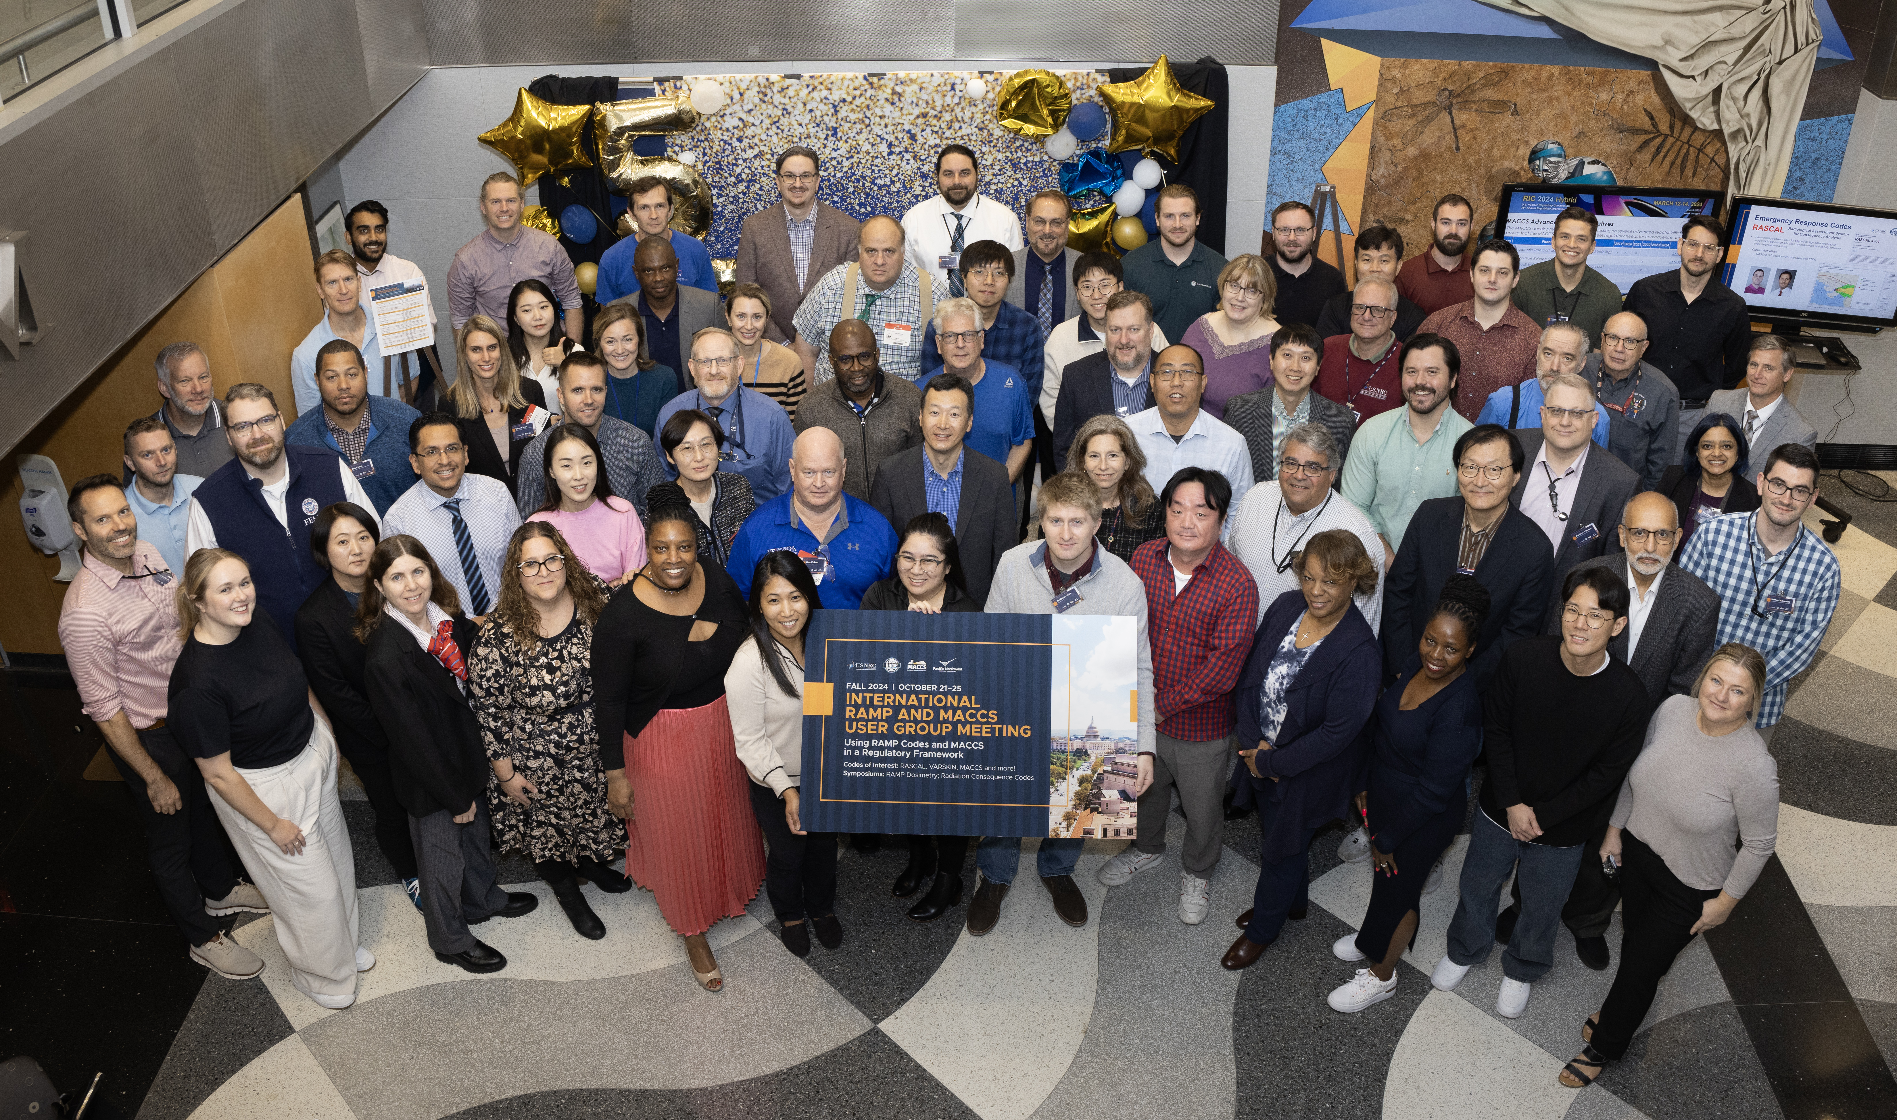
Photos from 2024 RAMP Meeting

Slide 6

RAMP Upcoming User Group Meeting

Slide 7
MACCS Upcoming User Group Meetings
European MELCOR and MACCS User Group (EMUG):
  The 16th Meeting of EMUG will be held in Brno, Czech Republic, in April 2025. The exact date will be provided at the end of 2024 (https://www.psi.ch/en/emug)
International MACCS User Group (IMUG):
  Next meeting to be determined. Stay tuned! (https://maccs.sandia.gov/events.aspx)

