Slide 1
Medical Activities and Codes
Brian Allen
Medical Health Physicist

Slide 2
Outline
Extravasation Dosimetry Model & Integration into V+
Introduce PiMAL 6.0: Animal Phantoms
Overview of our Activities involving Medical Uses of Nuclear Materials

Slide 3
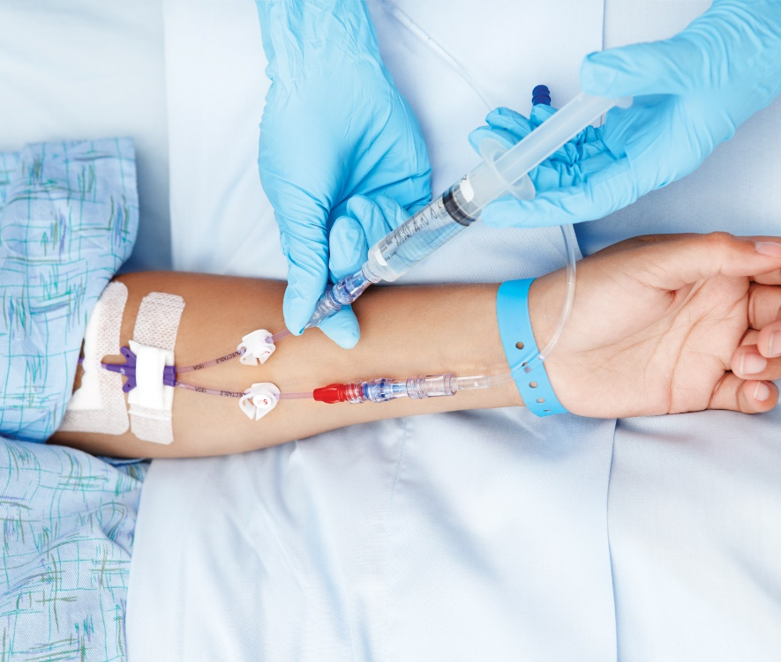
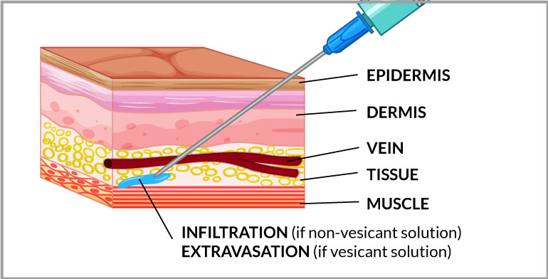

What are Extravasations:
Extravasation is the unintentional leakage of an injected drug out of the blood vessels, damaging the surrounding tissues.
Extravasation is not exclusive radiation diagnostic and therapy
Chemotherapy and other drug injections can be extravasated
Published studies indicate overall extravasation rates range from 0.10 to 16 percent for all injections
Notes:
A 2009 study indicated that factors that contribute to the probability of extravasation include the anatomy of the patient; training, experience, and technique of the medical personnel administering the injection; inadequate catheter size; and patient activity (Ref. 6).

Slide 4
Extravasation Rulemaking
1980 rulemaking to amend 10 CFR Part 35 excluded radiopharmaceutical extravasations from medical event reporting.
The Commission stated, in part, that, “Extravasation frequently occurs in otherwise normal intravenous or intra-arterial injections. It is virtually impossible to avoid. Therefore, the Commission does not consider extravasation to be a misadministration.”
Extravasations were not seen as a significant risk for patients from radiopharmaceutical injections
Radiation Safety Note:
  Significant extravasations are not currently required to be reported to the NRC
    even those that are severe enough to meet the NRC’s abnormal occurrence (AO) criteria for medical events
  Alarming
    Diagnostic and therapeutic radiopharmaceutical administrations involved large doses of high energy gammas, alphas, and betas
Notes:
Diagnostic and therapeutic radiopharmaceutical administrations today involved large doses of high energy gammas, alphas, and betas

Slide 5
Extravasation Today!
2020: NRC was petitioned to removed the exemption and treat extravasations as they would any other unanticipated irradiation
2022: NRC accepted the petition and began rulemaking
    As apart of the rulemaking efforts, NRC staff support was tasked to build a dosimetry model to characterize safety significant extravasations
    Incorporate this dosimetry model into the NRC's VARSKIN+ computer code
Notes:
Diagnostic and therapeutic radiopharmaceutical administrations today involved large doses of high energy gammas, alphas, and betas
As apart of the effort, the commission tasked the NRC staff to update guidance/regulations to account for extravasation events. Also, They directed the staff to conduct rulemaking to include extravasations that require medical attention for a suspected radiation injury in medical event reporting.

Slide 6
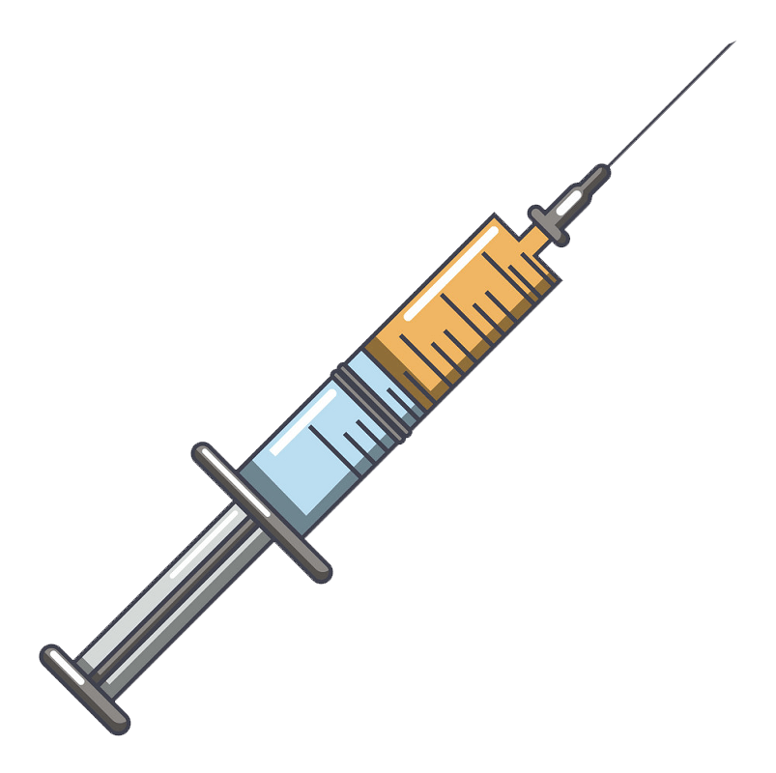
Extravasation Dosimetry Model
  Standardization:
    volume (range of particle)
    geometry/configuration
    biokinetics of patient
    radiopharmaceutical behavior
    dose delivery
  No standardized model or software to perform dose calculation
    Using simplistic ”worst-case” assumption will result in doses readily exceeding a 0.5 Sv threshold
Skin
α, β
ɣ
ɣ
Notes:
User Need Request (UNR) is required to implement the research required to
(1) develop an extravasation dosimetry model;
(2) integrate the new model into the NRC's VARSKIN+ computer code used for dosimetry analysis;
(3) support development of extravasation medical event reporting guidance concurrent with the rulemaking effort described above and the broader medical event reporting guidance required by the Commission; and
(4) provide training and knowledge management to staff and external stakeholders regarding the extravasation model and its integration into VARSKIN+.
29-year-old male was treated for non-Hodgkin’s Lymphoma with ZEVALIN® (32 mCi Yttrium-90 ibritumomab tiuxetan).
Estimated that 10 mCi had been extravasated into 5 cc of tissue (an estimate of the size of the black area, necrosis, in the image above)
the tissue would have received an extraordinary, absorbed dose of ~3,000 Gy.

Slide 7
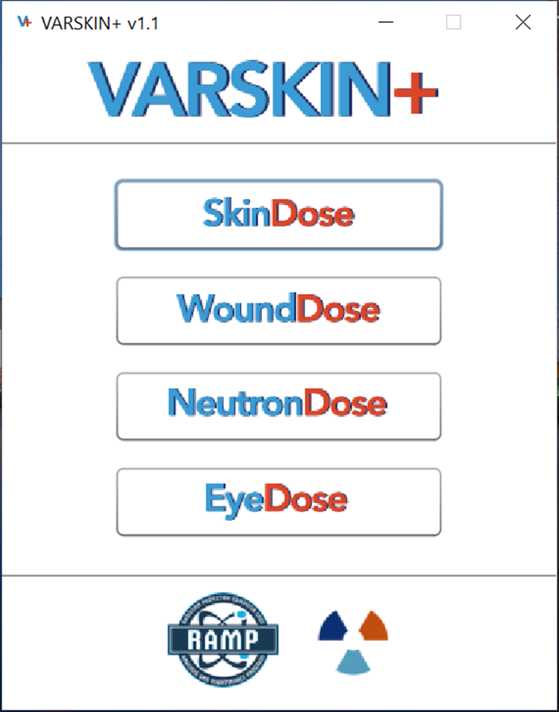
Extravasation Dosimetry Model
NMSS-2023-003 (ML22350A099)
Integration of extravasation dose model into VARSKIN+
Regulatory Guide Development Support
Training and Knowledge Management
Notes:
Diagnostic and therapeutic radiopharmaceutical administrations today involved large doses of high energy gammas, alphas, and betas

Slide 8
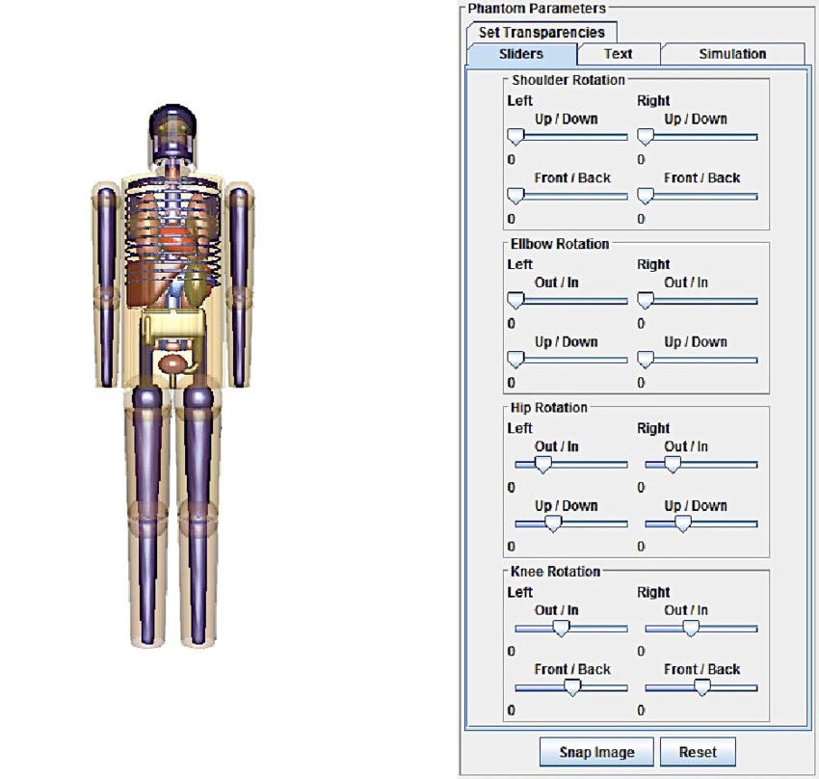
PiMAL
“Phantom with Moving Arms and Legs”
PIMAL is a tool for performing dosimetry calculations for radiation workers and exposed members of the public.
A graphical user interface with pre-processor and post-processor capabilities which assists users
in developing MCNP input decks and running the codes
Allows users to easily generate quantitative figures of merit regarding positioning arms and legs in difference geometries

Slide 9
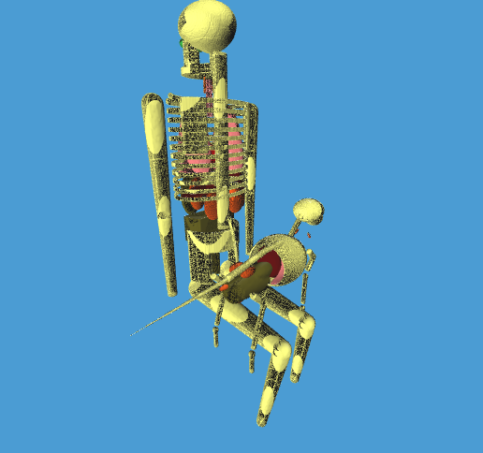
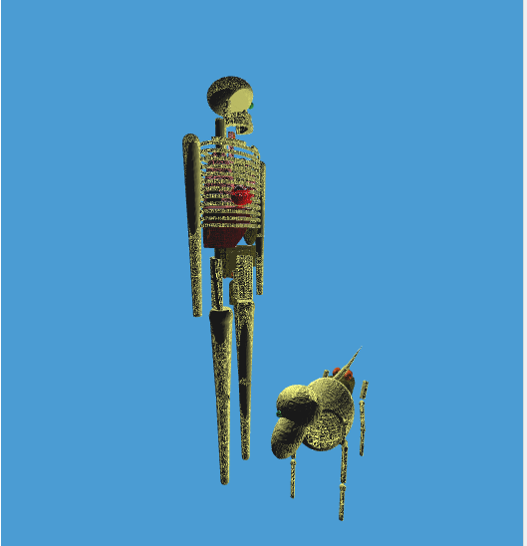
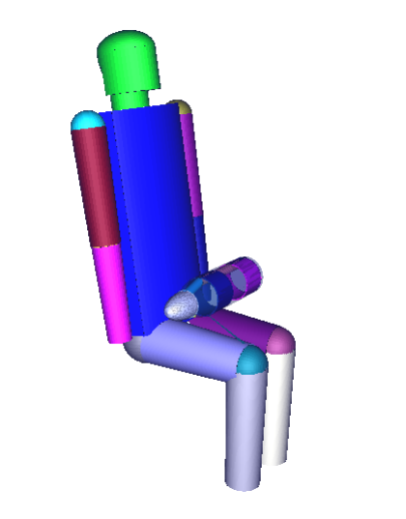
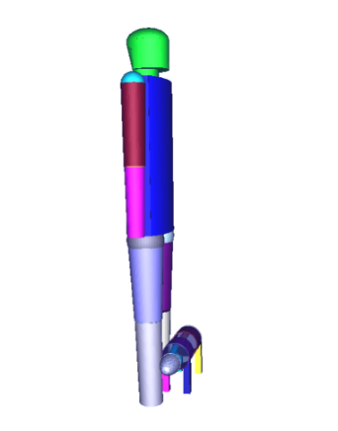
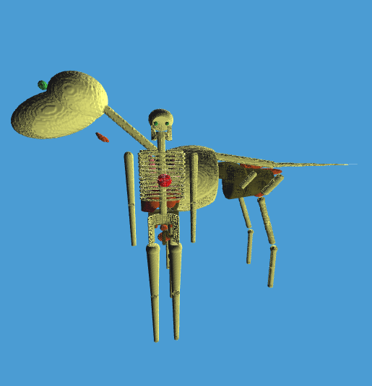
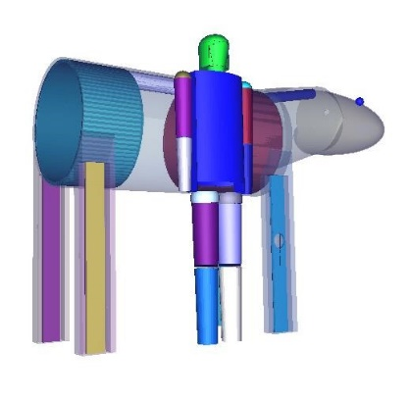
PiMAL Updates
Incorporation of veterinarian organs phantoms for a horse, cat, or dog
To examine internal and external animal to human dose assessments (dosimetry for individuals in contact with animals that had radiation therapy)
In The Lap
At The Feet
Standing At Shoulder

Slide 10



Purpose For Update
The NRC authorizes the release of animals to owners following veterinary procedures involving byproduct material when the exposure to members of the public from the animal is expected to be below the public dose limits in 10 CFR Part 20.
In recent years, new uses of byproduct material are emerging for use in veterinary medicine
Comprehensive guidance is needed to determine acceptable criteria and procedures for release of the animals following the procedures.
    Current veterinary procedures for cats, dogs, and horses are carried out using one of five primary radionuclides,
      131I,
      99mTc,
      117mSn,
      125I, and
      192Ir.
      Several additional emerging procedures are under consideration and have been studied in the clinical setting, namely,
        18F (canine imaging),
        90Y (canine skeletal treatments),
        153Sm (canine palliative care),
        166Ho (equine synovectomy), and
        alpha-particle emitters (none proposed).
Notes:
User Need Request (UNR) is required to implement the research required to
(1) develop an extravasation dosimetry model;
(2) integrate the new model into the NRC's VARSKIN+ computer code used for dosimetry analysis;
(3) support development of extravasation medical event reporting guidance concurrent with the rulemaking effort described above and the broader medical event reporting guidance required by the Commission; and
(4) provide training and knowledge management to staff and external stakeholders regarding the extravasation model and its integration into VARSKIN+.
29-year-old male was treated for non-Hodgkin’s Lymphoma with ZEVALIN® (32 mCi Yttrium-90 ibritumomab tiuxetan).
Estimated that 10 mCi had been extravasated into 5 cc of tissue (an estimate of the size of the black area, necrosis, in the image above)
the tissue would have received an extraordinary, absorbed dose of ~3,000 Gy.

Slide 11
Next Steps
Dosimetry Analysis
Technical Basis
Potential Veterinary Release Rule-Making & Regulatory Guide
Using the new animal phantoms to develop approach to support release criteria for known animal treatments
Develop technical basis (TB) document to support regulatory guidance development
Provide licensees with acceptable methodologies to development of animal release criteria.
Notes:
Develop technical basis (TB) document to support regulatory guidance development. This will include dosimetry analysis using the updated PIMAL code with veterinarian phantoms. This analysis will be used to develop recommended approach for dosimetry methodology to support release criteria for known animal treatments. The dosimetric analysis should utilize Agile Project Management to ensure appropriate cost benefits of the analysis conducted.
In conjunction with veterinary release rule-making, use the TB document (Task #2) to develop a RG to provide licensees with acceptable methodologies for development of animal release criteria.

Slide 12
Overview of Activities
Extravasation Module in V+
PiMAL 6.0
Radiological Toolbox integration in V+
Detector Geometry Model in SkinDose/V+
Distribution of IMBA Pro 5.0.1
Update the Patient Release Methodologies in RG 8.39
Regulatory Support of Licensees and Agreement States
Dosimetry Risk Analysis: Targeted Alpha Therapies

