Slide 1
Incident Response at the U.S. Nuclear Regulatory Commission
USNRC RAMP Users Meeting 2024
Jeff Kowalczik, CHP
Senior Emergency Response Coordinator
Office of Nuclear Security & Incident Response

Slide 2
History Timeline
1946 - Atomic Energy Commission
Production of nuclear weapons
Development AND the safety regulation of the civilian uses of nuclear materials
1974 – Energy Reorganization Act
Split AEC into Dept of Energy and NRC
1980 - Reorganization Plan No. 1 of 1980
Established emergency powers for NRC Chairman
Laid groundwork for NRC incident response program

Slide 3
NRC Response Program
National Response Framework
Nuclear / Radiological Incident Annex
“Lead Federal Agency” for Incidents Involving NRC Licensed Facilities and Materials
NRC Specific Plans and Procedures

Slide 4
NRC Response Roles
Ensure that licensee priorities and actions are in the interest of public health and safety
(Confirmed by independent assessments)
Coordinate with Federal, State, and local responders
Inform the public, media, and other stakeholders

Slide 5
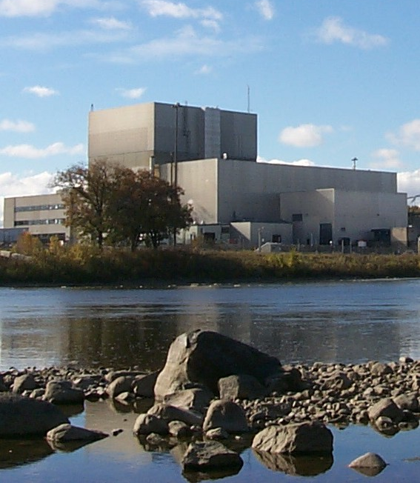
Licensee Emergency Classification
Notification of Unusual Event
Potential Degradation in the Level of Safety
Alert
Loss of a Vital System or Barrier
Site Area Emergency
Loss of a Vital Safety Function
General Emergency
Severe Core Damage Accident
Potential Offsite Consequences

Slide 6
Protective Actions Process
Initiating condition requiring classification of GE
Licensee required to make PAR within 15 minutes
State/Local receives PAR, may perform technical assessment
State/Local incorporate additional criteria, then make PAD

Slide 7
Event Reporting
State
EOC
EPA
DOE
DHS NOC
Federal
Partners
(DoD)
NRC
NRC
Licensee
HHS
Local Response
USDA
FEMA
15 minutes
1 hour
If required

Slide 8
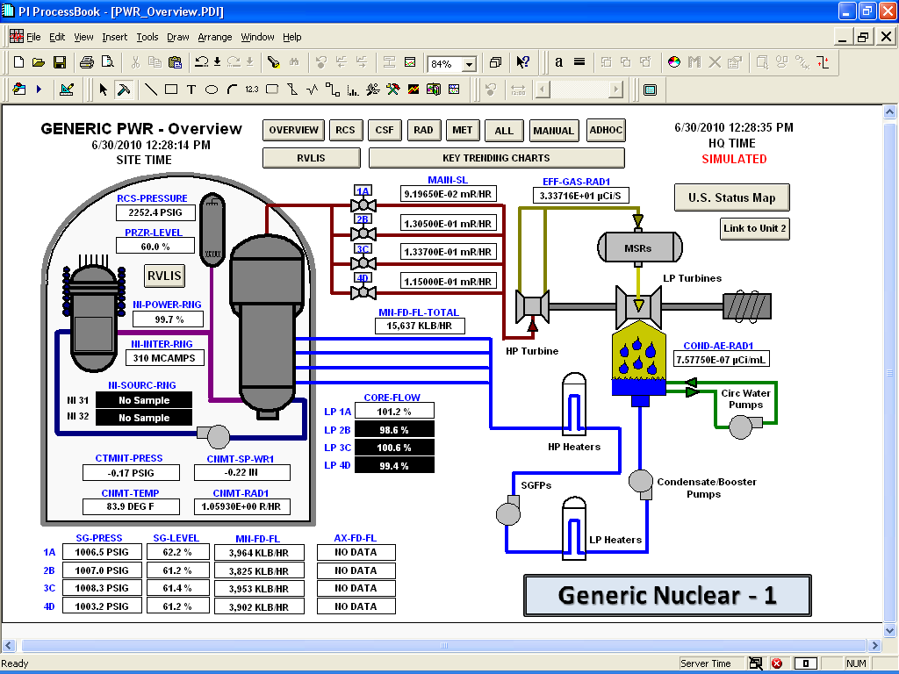
Emergency Response Data System (ERDS)

Slide 9
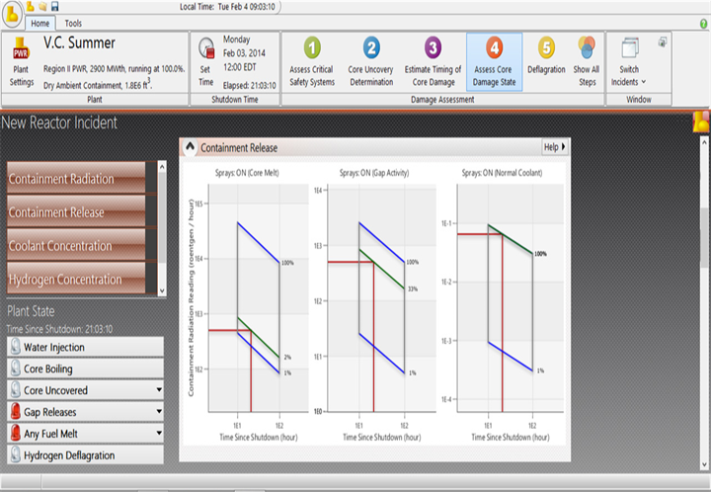
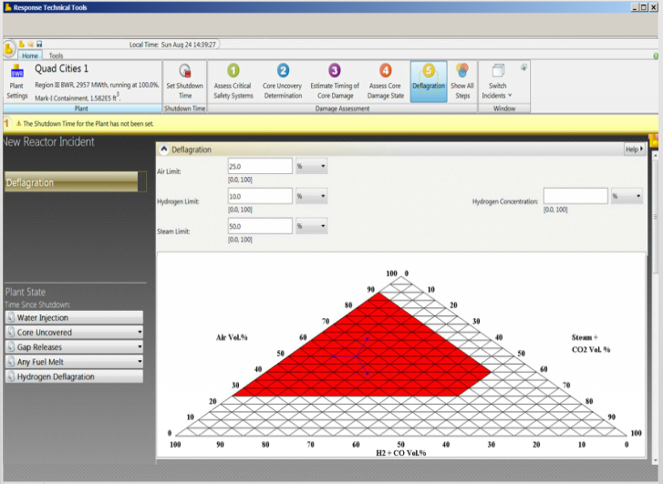
Response Technical Tools (RTT)

Slide 10
NRC Protective Measures Functions
Perform Dose Assessment
Reactor Information (RST and HPN Comm)
Meteorology
Compare vs PARs and PADs
Share source term/outputs externally
States/Local, International, IMAAC, FRMAC,

Slide 11
RASCAL
Used for NPPs, spent fuel, fuel cycle, other material
Generates estimated source term from set of conditions
Runs ATD models to calculate deposited material and doses
Runtime generally < minutes
Version 4.3.4 available on RAMP website

Slide 12
RASCAL
Source Term
Models or measurements; NPP unit-specific data
Atmospheric Transport
Weather (ERDS & NWS)
Close-in plume model & distance puff model
Outputs
Total dose (inhalation, cloud, ground)
Thyroid
Gamma/marker nuclide dose rates

Slide 13
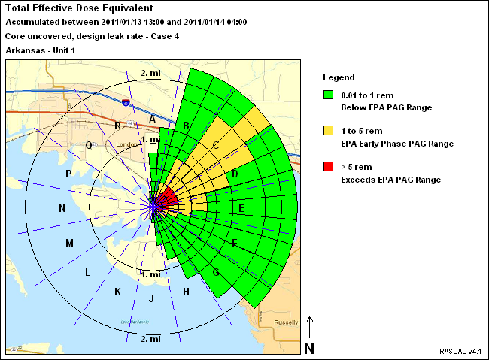
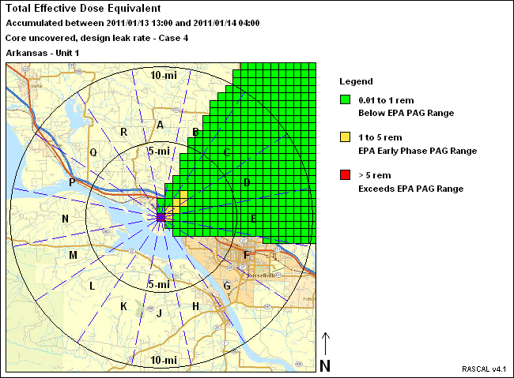
RASCAL

Slide 14
Interagency Coordination - IMAAC
Interagency Modeling & Atmospheric Assessment Center
Coordinates and disseminates Federal atmospheric dispersion modeling and hazard prediction products to aid in decision-making
Establishes Federal position during actual or potential incidents involving hazardous material releases
Frequently activated for chemical releases; infrequent for nuclear
IMAAC coordination occurs in 2 phases
For NPP events, NRC supplies source term to NARAC & DTRA for modeling
After models are generated, IMAAC coordination call will take place to agree upon product
Repeated as necessary

Slide 15
Interagency Coordination - FRMAC
Federal Radiological Modeling & Assessment Center
Coordinates, manages, and performs all federal radiological environmental monitoring and assessment activities during a nuclear or radiological incident
Primarily DOE assets with coordination from interagency
MOU with NRC for assistance to FRMAC
FRMAC will deploy and integrate with State
NRC liaison at FRMAC CMRT (State), DOE liaison at HQ PMT
NRC will assist if requested, but limited responsibilities

Slide 16
Interagency - A-Team
Advisory Team for Environment, Food and Health
Rad emergency response group that provides protective action recommendations to State and local governments
Primary members are EPA, FDA, CDC, and USDA
NRC is not primary member, but may be consulted

Slide 17
Questions?
Jeff Kowalczik
jeff.kowalczik@nrc.gov

