Slide 1
COMIDA food-chain model in MACCS: assumptions and limitations
Osvaldo Pensado
Staff Scientist at the Southwest Research Institute
October 23, 2024

Slide 2
Acknowledgments
Project sponsored by the US Nuclear Regulatory Commission (NRC)
Office of Nuclear Regulatory Research
Division of Systems Analysis
Accident Analysis Branch
This project is an independent product of the SwRI and it does not necessarily reflect the views of the NRC

Slide 3
Background
COMIDA is a food-chain model developed in the early 1990s
Computation of ingestion doses
Examination of the state-of-the art of the COMIDA model
Update input parameters with recent studies
Screening of tracked radionuclides
This talk is conceptual, focusing on assumptions and limitations of the model
Notes:
Only selective points are discussed, there is no time to fully cover the COMIDA model

Slide 4
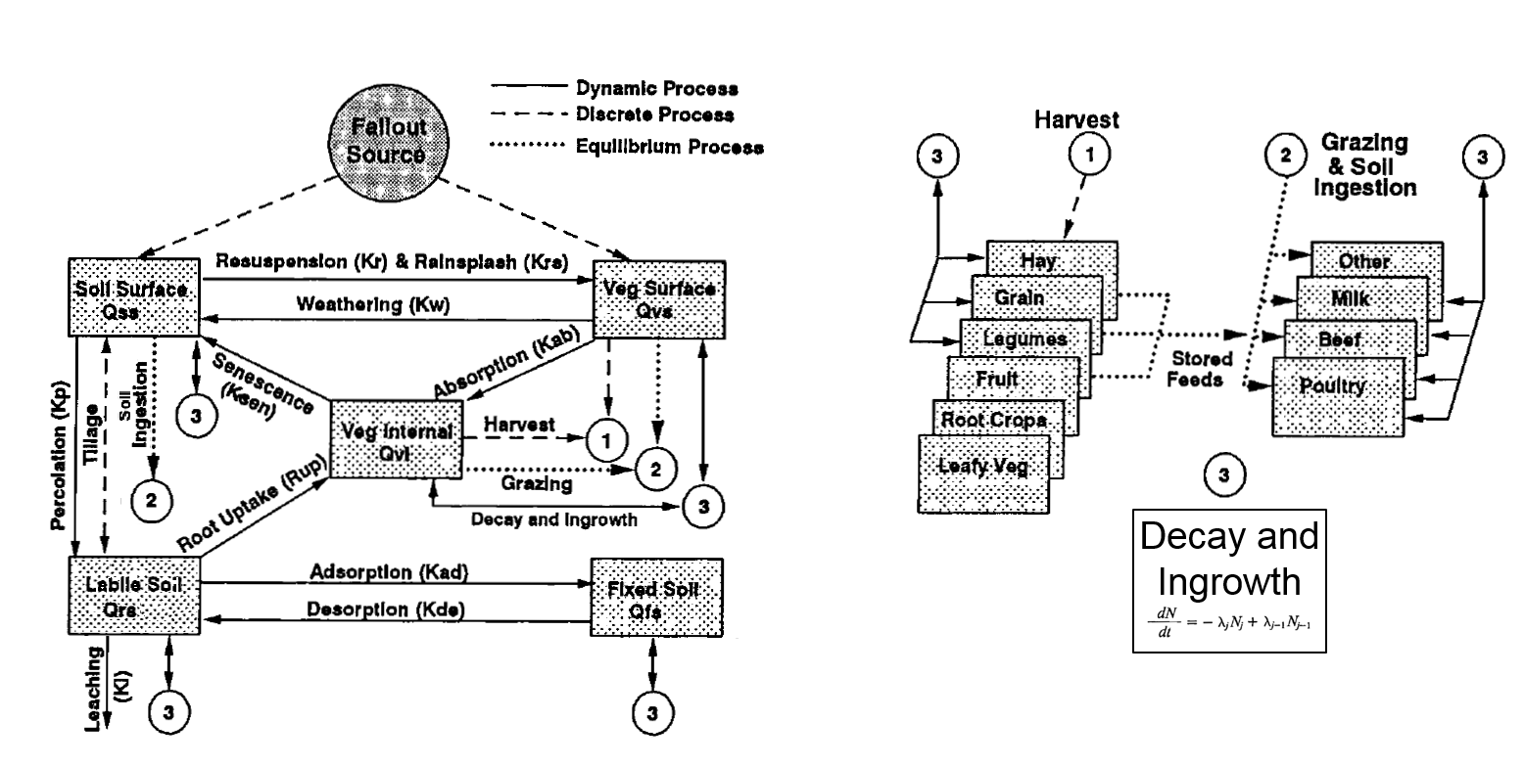
Background
Diagrams by Abbott and Rood, 1993
Notes:
COMIDA is a mass-balance model
Dynamic connections represent first order mass transfer between compartments
Equilibrium processes: animal products instantaneously equilibrate with the concentration in the feed
Harvests are precisely consumed in one year period
Processes that remove radioactivity from soil-plant compartments: harvesting and leaching to deep soil layers
Grazing is modeled as an equilibrium process, not removing radioactivity from the system

Slide 5
Products tracked in COMIDA
Seven plant products and four animal products
Plant products
Animal products
Leafy vegetables
Roots
Fruits
Grains
Legumes
Hay
Pasture for cattle and dairy cows
Beef
Poultry
Milk
Other (could be assigned to represent egg or pork)
Human crops
Animal feed

Slide 6
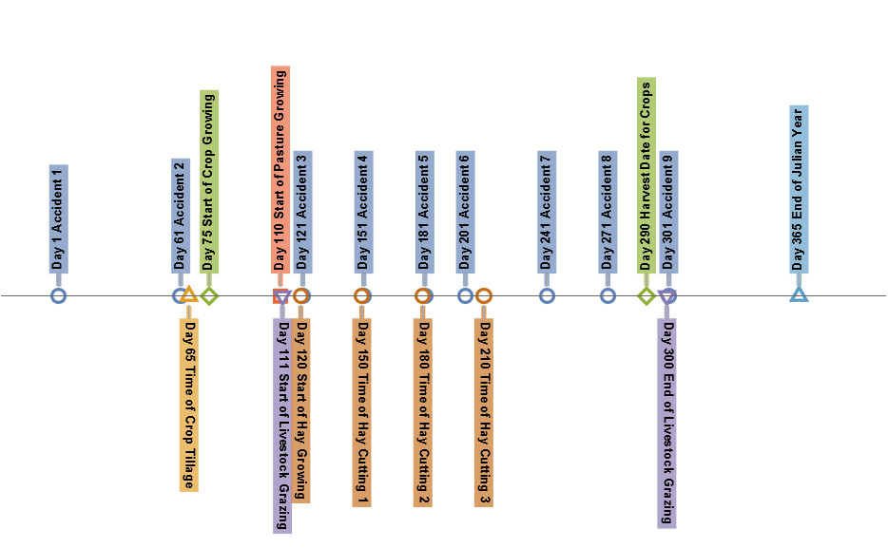
COMIDA tracks discrete events
One year
Crop season
Hay season
Grazing season
Notes:
Five crops with a single start and harvest date
Hay has three harvests: why did the authors have to consider more complexity for the hay model? No good reason known for the three hay cuts
Uncertainty in the date of the event is handled by postulating up to 9 accident dates, and computing consequence averages

Slide 7
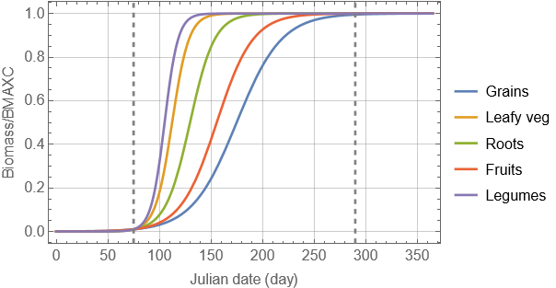
Plant growth model
Judgement applied to select representative crops and model parameters
Ground radioactivity is incorporated in the plant during the period of active growth
No radioactivity transfer to the plant during the plateaus
Harvest date
BMAXC = maximum yield (kg dry/m²)
Notes:
There is an implicit delay in the consumption, because all harvests are synchronized to the same date

Slide 8
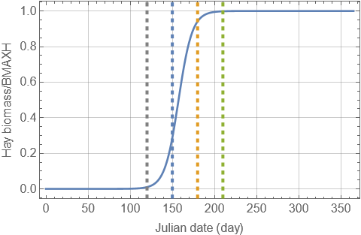
Hay model caveat
Three hay cuts
Concentration = average of 3 hay cuts, including decay correction up to hay cut 3
Hay feed starts on hay cut 1
Unintended double decay between hay cuts 1 and 3
Reason unclear of why model developers considered 3 hay harvests
On the other hand, 5 different crops for direct human consumption have a unique harvest date
Hay cut 1
Hay cut 3
Hay cut 2
Notes:
There is some lack of symmetry in the COMIDA model
Five crops have a single harvest, and those crops are directly consumed by humans causing doses
The hay has three harvests, and the dose to humans is indirect, through animal product consumption
Problem with double decay is easily eliminated by considering only one harvest date

Slide 9
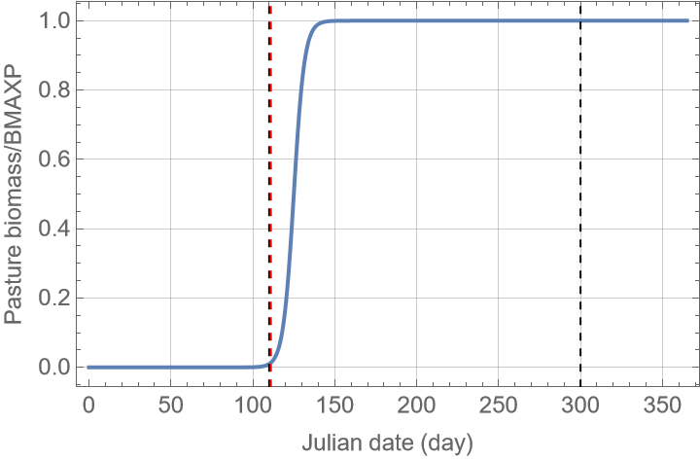
Caveat with pasture model
Grass typically grows in ~30 days
In the model, release events during the plateau do not incorporate radioactivity in the pasture
The time window to incorporate ground radioactivity in grass is very short, which is not realistic
Grass grows during the whole grazing season
The model needs adjustments to reflect continuously growing grass
End of grazing season

Slide 10
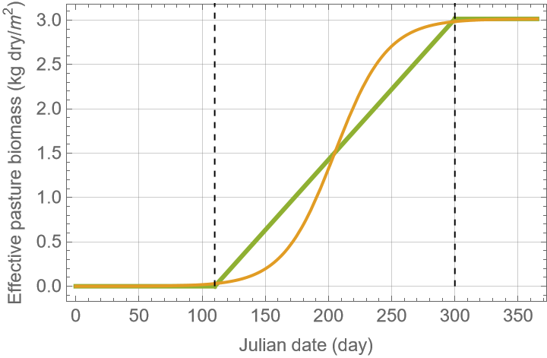
Proposed adjustment to the pasture model
Plateau increased by a factor proportional to the ratio of the grazing season to the grass maturity time (~30 days)
Effective pasture growth rate selected based on the duration of the grazing season
Adjustments intended to emulate pasture with a constant growth rate (= average single plant growth rate) throughout the grazing season (target green curve)
Target
Adjusted curve

Slide 11
Soil model features and approximations
Each plant type has independent soil compartments
Soil is not shared; no cross-contamination of plant products; no crop rotation
COMIDA soil layers (surface soil and root soil) have the same features for all plant products
Clearly a simplification: root volumes are different for different plant types
Resuspension process (from soil to plant) is the same for all plant products
Clearly a simplification: resuspension in a fruit tree differs from resuspension in close-to-ground plants like lettuce

Slide 12
Percolation and leaching
Percolation transfers radionuclides from surface soil to root soil
Simplification: all plant types are subjected to the same percolation rate, conservatively selected ignoring irrigation
Leaching: radionuclides lost to deep soil layers outside of plant influence
Input leach rate computed accounting for water balance (precipitation, evapotranspiration, irrigation, and surface runoff), and Kd retention (element dependent)
Why not conservatively selecting leach rate = 0?
Percolation and leaching recommended inputs inconsistently account for water balance
Two mechanisms remove radionuclides from the system: leaching and plant harvesting
Surface soil
Percolation
Root soil
Element dependent leaching
Notes:
Recommended values of infiltration rates for percolation rates ignore active irrigation
The water balance for leaching is approximated. The water balance is at a gross scale. There is no value in trying to be more precise.

Slide 13
Foliar absorption and weathering
Foliar absorption: transfer from plant surface to plant tissues
Dynamic process; no empirical information on transfer rates
Empirical information on equilibrium translocation factors, fa, for some plants and some elements
fa = radioactivity in plant / radioactivity on surface
Dynamic inputs selected so that foliar absorption rate in competition with weathering honors empirical fa
Translocation rates computed offline as function of weathering rate; fa is element-dependent and plant-dependent
Faster weathering expedites the translocation (non-intuitive result)
Empirical fa lacking for leafy vegetables, pasture, and hay; fa also lacking for many elements
This makes radionuclide screening analyses challenging

Slide 14
Root uptake and concentration ratios
Plants transfer radioactivity from soil by root uptake
Concentration ratio = CR = Bq/kg of plant / Bq/kg of soil
Long-term equilibrium concept
CR available in the literature for limited plant products and limited elements
Assumptions needed to select CR for broader plant types and elements
Root uptake is proportional to CR and plant growth rate
Harvesting removes radioactivity from the soil-plant compartment system
Notes:
Radionuclide screening analyses are challenging, given CR is lacking for many elements

Slide 15
General comments
COMIDA outputs
Concentration in plant products (Bq/kg dry) at the time of harvest
Concentration in pasture at any time during the year
Crops uniformly consumed over a one-year period by animals and humans
Additional decay and ingrowth occurs during the one-year consumption period
There is no fresh produce consumption model in COMIDA
Effect of short-lived radionuclides underestimated by the long consumption period
COMIDA considers delay from harvest to consumption (holdup time)
Holdup concept introduces non-intuitive results

Slide 16
Holdup concept
Consumption doses are computed at the accident year anniversaries
Holdup: delay from harvest to consumption
The 2nd year dose increases when the holdup time increases
This is a non-intuitive and non-desirable model feature
1st accident year
2nd accident year
Consumption year
Holdup
Next harvest
Release event
Consumption starts
Harvest
Fraction of consumption contributing to 1st year dose
Fraction of consumption contributing to 2nd year dose
Notes:
Disagreements with the implementation of the holdup time concept.
The holdup time should only be used to credit additional decay
There is no need to be strict about the holdup time
Implicit delays are already part of the model
The precise one-year consumption is an idealization (variable consumption periods should occur)

Slide 17
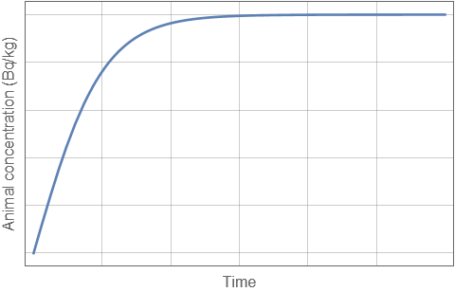
Animals in equilibrium with feed
Max concentration in animal product (Bq/kg)
TC = transfer coefficient (day/kg) = max conc / intake rate
In COMIDA, animal product concentration is conservatively assumed in instant equilibrium with the radioactivity intake
TC available for few elements
Limited empirical TC values available in the literature
Assumptions needed for a broader set of elements
Constant intake
Notes:
If high TC values are assumed for an isotope, that isotope can become important as a consequence of the assumption.
Objective radionuclide screening analyses are challenging (the importance of a radionuclide can be tied to input model assumptions)

Slide 18
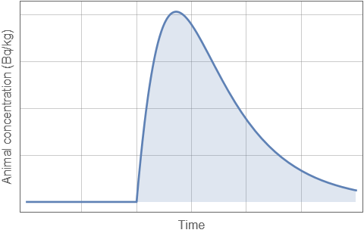
Average animal product concentrations
Instant animal product concentrations can be computed using the TC concept
Average concentration: integral average
Accounts for decay and ingrowth
Using constant average concentration throughout the year is reasonable: animal could be slaughtered any time of the year
Holdup considered to delay human consumption of the animal product
Additional decay credited only during the holdup time
Beef
Milk
Poultry
Other
Average animal product concentration
Release event
1 yr

Slide 19
Individual consumption annual dose
Consumption doses are computed at the accident year anniversaries
Not needed complexity: using the holdup time to change the proportion of consumption of crop and animal product yields in the 1st and 2nd year
COMIDA outputs
Concentration at harvest date per unit of fallout: Bq/kg / Bq/m²
Yearly average concentration in animal food products per unit of fallout: Bq/kg / Bq/m²
1st accident year
2nd accident year
Holdup
Consumption year of harvests
Harvest
Release event
Next harvest
Holdup
Consumption year of animal products

Slide 20
Individual consumption annual dose
Annual dose computed considering annual food intake (kg), dose conversion factors (Sv/Bq), COMIDA food concentrations per unit for fallout (m²/kg), and initial fallout (Bq/m²)
Important to balance the food consumption rates: ~ 400 kg/yr per person is reasonable
Protective actions are triggered when the individual dose exceeds certain limits
Crop and milk disposal
Farm decontamination and interdiction
MACCS adjusts the individual dose after protective actions, and outputs an annual societal dose-to-source ratio for each food product:
Dose after protective actions (Sv) / Annual food intake(kg) / Fallout (Bq/m²)

Slide 21
Population dose
COMIDA assumes that yearly food production is locally balanced by the food consumption
To establish food production rate inputs it is assumed, for example, that one person is fed by the agricultural outcome of 10⁴ m² of farmland
Population dose = COMIDA dose-to-source ratio (Sv/kg/Bq/m²) × annual production rate (kg/m²) × initial fallout (Bq/m²) × area of spatial element (m²)
Population doses are assigned to the original sector with farmland

Slide 22
Observations and remarks
COMIDA is an approximated model
Limited value in trying to refine inputs or make them “more precise”
There are no “right” inputs; instead, inputs should be consistent and justified
Many inputs of COMIDA are cross correlated and computed offline
Care must be exercised when trying to propagate uncertainty
Ample opportunity for contradiction
Site specificity could be considered in limited extent
Initial fallout intensity
Local diet and how much of the consumption is satisfied by local production
Information for many element-dependent inputs is not available

